Slide 1

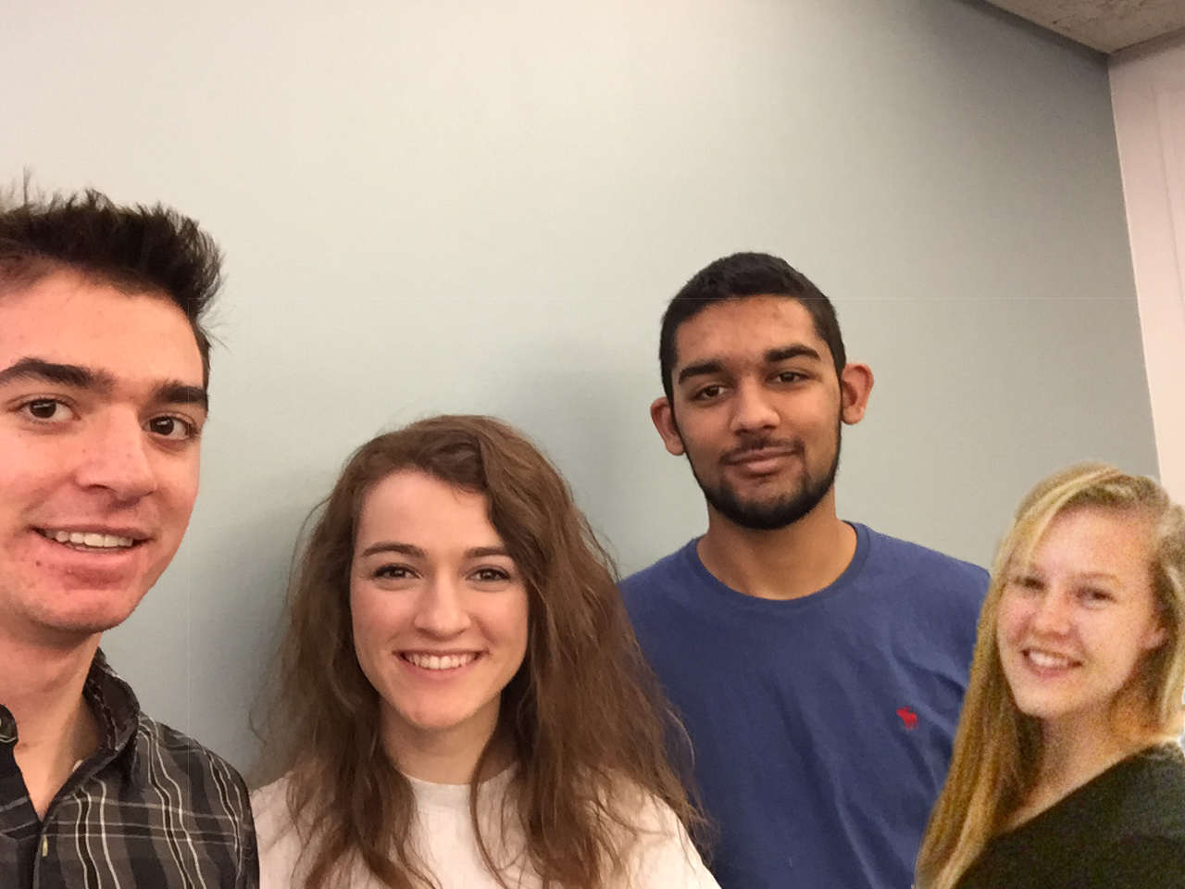
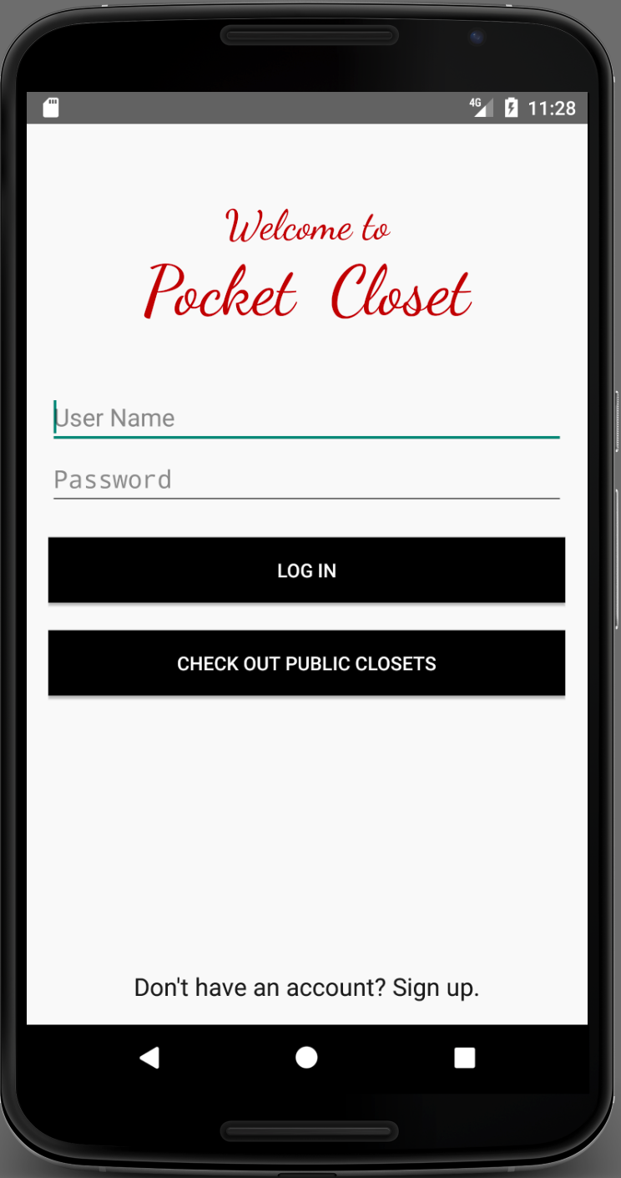
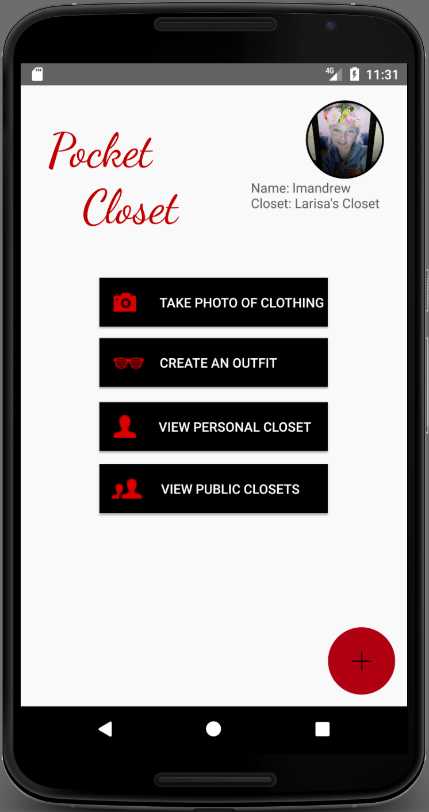
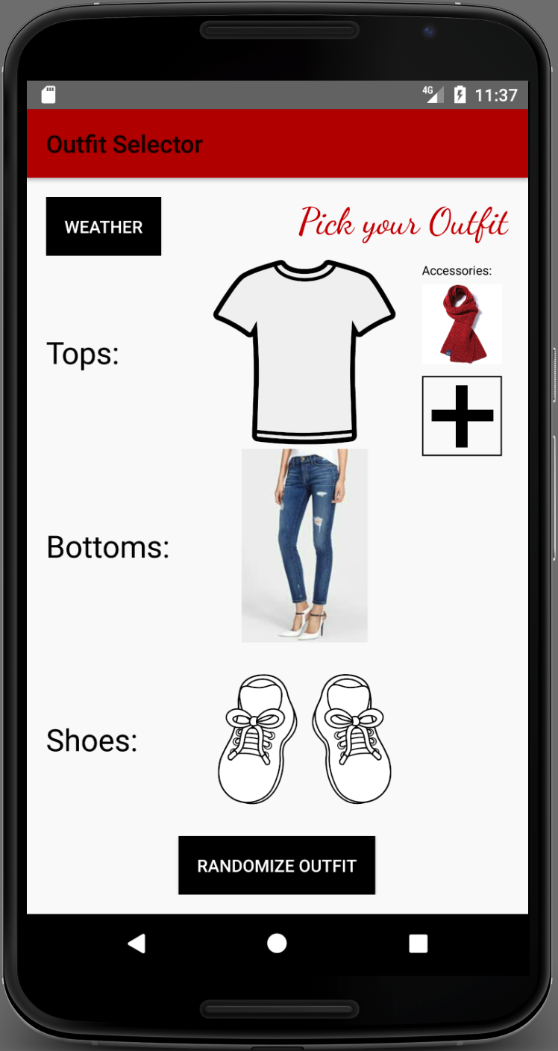
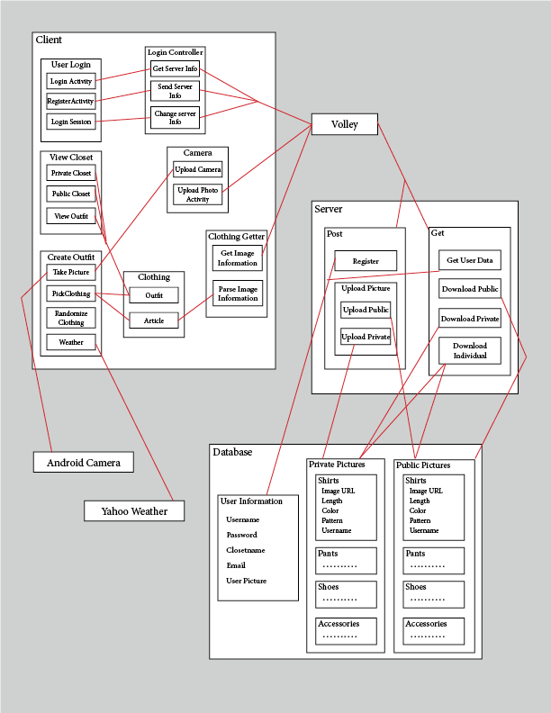
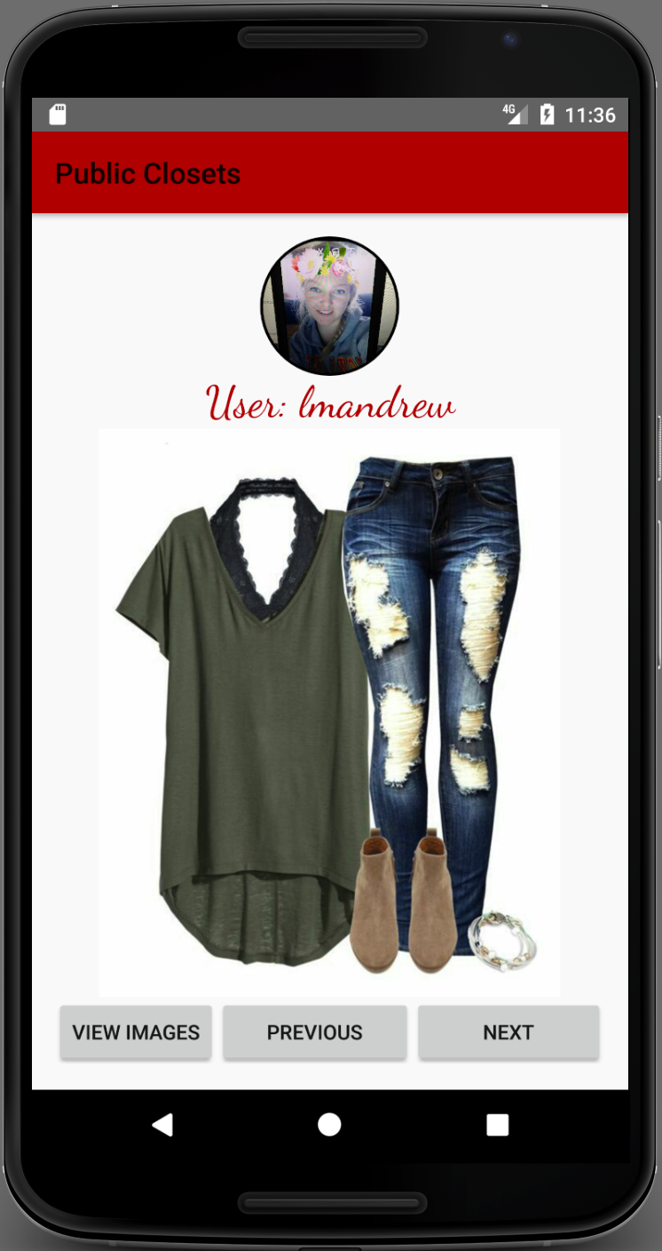
AJ Hanus (So)
Ammar Khan (So)
Larisa Andrews (So)
Morgan Anderson (So)
Project Description:
App designed to decrease time spent in the morning picking clothes while also improving style by using algorithms for matching clothes.
Users:
Private Users
Public Users
Administrators
Screenshots:
User Interfaces
Camera: Take pictures of clothes and upload them to server
Private Closet: View all of the clothes you have placed in your closet
Public Closet: View all of the clothes/outfits made public by other users
Outfit Selector: User can create outfits or can hit randomize and have the app automatically create an outfit
Lessons learned:
Don’t do everything at once
Push to GitHub
Communicate issues to team members
Document code frequently
Modules:
TakePicture
Accesses the phones camera to take a picture. Depending on the state of the toggle, may call function to remove background.
UploadPhoto
Uploads the photo to the server with characteristics of the article of clothing using Volley to correspond with PHP files.
DownloadPhoto
Retrieves a photo of a article of clothing with the characteristics as a JSON object.
PickClothing
Creates an outfit from the articles chosen by the user.
RandomizeOutfit
Randomizes the articles of clothing that were not chosen in PickClothing.
ViewOutfit
Views the outfit and allows you to save the outfit to your personal or public closet.
SaveOutfit
Saves the outfit to the server to your personal or public closet.
RegisterAccount
Creates a new account of the server to save clothing and outfit information.
DownloadAccount
Retrieves account information if username and password are correct.
What went wrong?
Code wasn’t well documented
Initial communication was lackluster
Layout designs across android devices
Passing data between activities
What went right?
Randomize clothing algorithm
All major design issues resolved
Successful working application

