Slide 1
SITEMESH
OPENSYMPHONY
“The best Open Source component you’ve never heard of…”
Written for The ServerSide Java Symposium - Las Vegas, USA - May 6-8

Slide 2
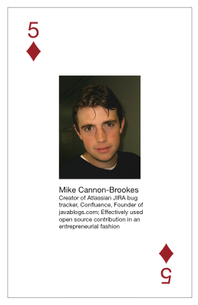

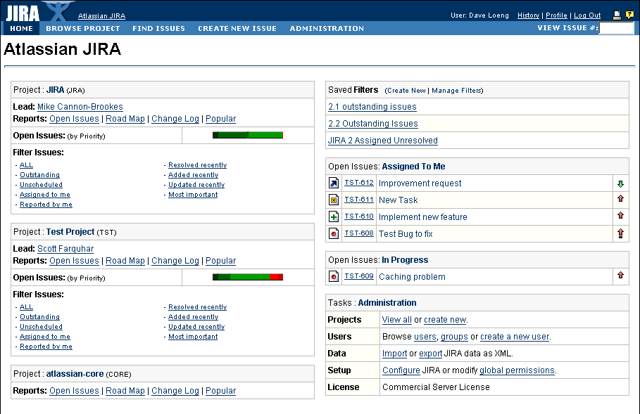
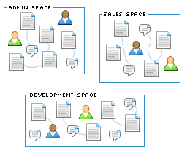
Who am I?
Mike Cannon-Brookes
OpenSymphony Project - www.opensymphony.com
Atlassian Software Systems - www.atlassian.com
JIRA
CONFLUENCE
Tracking knowledge projects.
Thought sharing for your team.
WebWork 2 / XWork
OSWorkflow
SiteMesh
OSCache

Slide 3
Agenda
The Problem
What is SiteMesh?
A Simple Example
How does it work?
Advanced techniques
  Decorator mappers
  Inline decorators
  Content blocks
  Tips & tricks
Q & A

Slide 4
THE PROBLEM
WEB-APP DECORATION
Notes:
4/53

Slide 5
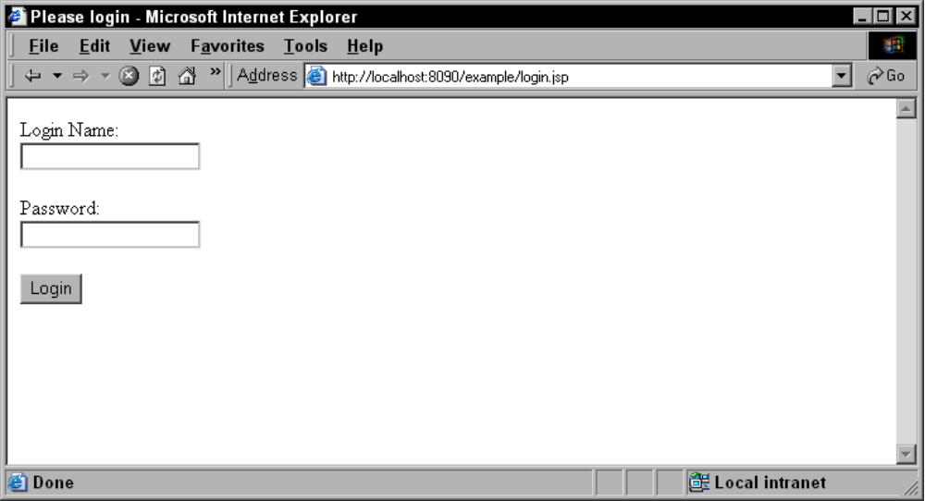
Your form looks like this…
20 lines of simple focused HTML
  Simple to maintain
  Developer can instantly see all form elements and their purpose

Slide 6
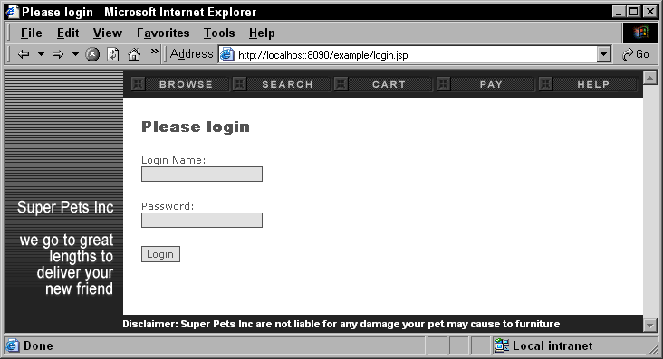
Your boss wants it to look like…
300 lines of complex HTML
  Developers must find 20 useful lines among decorative code
  Much less obvious to developer how the form works!

Slide 7
The Decoration Problem
Separating content & presentation is hard!
Every web application needs to do it.
Analogy: Swing look and feel changer
Decoration is more than just headers and footers:
  See if you can separate the content and presentation in this familiar example…

Slide 8
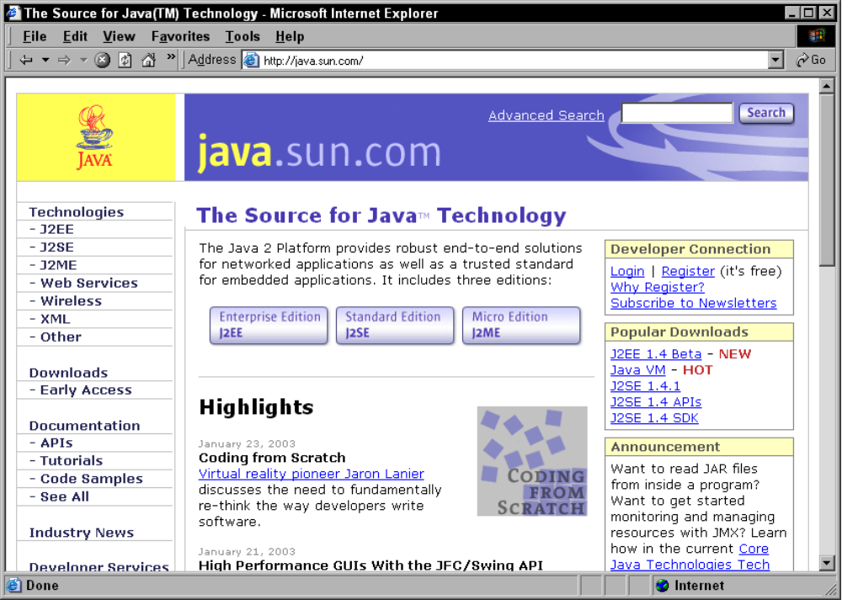
Decoration Example

Slide 9
Decoration Example
Header
Search
Navigation
Information
Login
Downloads
News

Slide 10
Decoration Examples
Typical decorations:
  Headers
  Footers
  Navigation elements
People forget:
  Panels within a single page
  Agent specific versions (eg cell phones)
  Printable versions

Slide 11
TYPICAL
SOLUTIONS
Notes:
11/53

Slide 12




Solutions
Copy & paste
  VERY BAD: Fire your developer.
JSP includes
  BAD: Fragile, strongly coupled and increasingly complex
XSLT
  OK: Flexible, but hard to debug, difficult to learn and you can’t view it without the ‘pipe’.
SiteMesh
  GOOD: Simple, decoupled, scalable, flexible.

Slide 13
WHAT IS
SITEMESH?
Notes:
13/53

Slide 14
SiteMesh is…
Open Source J2EE page layout and decoration engine
  www.opensymphony.com/sitemesh
Interpretation of GoF decorator pattern for web applications
  Analogy: Swing look & feel changer
Core values:
  Simplicity, Speed & Flexibility

Slide 15

Where does it fit?
Implemented as a Servlet 2.3 request filter
  Requires Servlet 2.3 compatible server
  Runs on all recent J2EE servers
Typical request (without SiteMesh):
Web Container
1. Incoming request
Web App
2. Generate
decorated page
(Servlet, JSP, Perl,
PHP, HTML etc)
Browser
3. Return result
Notes:
Supported on almost all modern servers - list them.

Slide 16
Where does it fit?
Request with SiteMesh filter deployed:
Web Container
SiteMesh
Filter
3. Get
Decorator
4. Decorate
page
Web App
2. Generate page
(Servlet, JSP, Perl,
PHP, HTML etc)
1. Incoming request
Browser
5. Return result

Slide 17
A SIMPLE
EXAMPLE
Notes:
17/53

Slide 18
Simple Example
Install SiteMesh
Write a simple JSP page
Write a JSP decorator
  Adds a heading
  Wraps the content in a basic box
Map decorator
View the result

Slide 19
Installation
Careful - it’s complicated…
Copy sitemesh-2.x.jar to the WEB-INF/lib/ directory of your web-app
Install and map the filter in WEB-INF/web.xml:
<filter>
<filter-name>sitemesh</filter-name>
<filter-class>com...sitemesh...PageFilter</filter-class>
</filter>
<filter-mapping>
<filter-name>sitemesh</filter-name>
<url-pattern>/*</url-pattern>
</filter-mapping>

Slide 20
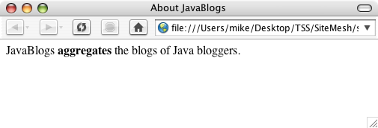
Write Simple Page
<html>
<head>
<title>About JavaBlogs</title>
<meta name="section" content="About">
</head>
<body bgcolor="#ffffff">
JavaBlogs <b>aggregates</b> the blogs of Java bloggers.
</body>
</html>

Slide 21
Write simple decorator
MyDecorator.jsp
<%@ taglib uri= "sitemesh-decorator" prefix="dec" %>
<html><head>
<title>java.blogs - <dec:title /></title>
<link rel="stylesheet" href="/styles/site.css">
</head>
<body bgcolor="<dec:getProperty property="body.bgcolor" />">
<h2><dec:title /></h2>
<dec:isPropertySet name="meta.section">
<p><b>Section:</b> <dec:getProperty property="meta.section"></p>
</dec:isPropertySet>
<div class="panel">
<dec:body />
</div>
</body></html>

Slide 22
Map decorator
Let’s simply map this to decorator to all URLs.
Basic URL mapping is done in /WEB-INF/decorators.xml
<decorators>
  <decorator name="main" page="/MyDecorator.jsp">
<url-pattern>/*</url-pattern>
</decorator>
</decorators>

Slide 23
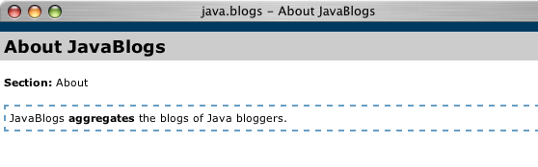
The Result
<html><head>
<title>java.blogs - About JavaBlogs</title>
<link rel="stylesheet" href="/styles/site.css">
</head>
<body bgcolor="#ffffff">
<h2>About JavaBlogs</h2>
<p><b>Section:</b> About</p>
<div class="panel">
JavaBlogs <b>aggregates</b> the blogs of Java bloggers.
</div>
</body></html>

Slide 24
I’M STILL
CONFUSED!
Notes:
24/53

Slide 25
4 ways to think about SiteMesh
Decoupling is a good thing
  SiteMesh decouples page decoration
Agile, not fragile, page decoration!
  Moving files doesn’t break anything
‘AOP for page decoration’
  Pages themselves need know nothing of their decoration
Separation of concerns
  Designers vs developers in large teams
    Naïve to think Model 2 solves this problem

Slide 26
SiteMesh is… clean.
Clean, logical separation of content vs presentation
  Content - JSP file
  Decorator - JSP file
Pages and decorators are valid HTML files
  Can be edited with any editor (ie Dreamweaver)
  Get rid of the ‘ugly half table’ problem
Pages are simpler
  Removing decoration makes for more simple, focused pages

Slide 27
SiteMesh is… friendly!
Decorators written in your favourite templating language
  Usually JSP but also Velocity, FreeMarker.
  Reuse all of your existing JSP tags etc in a decorator
  No more includes or XSLT!
Decorates any served content
  JSP, Velocity, PHP, Perl, basic HTML, other servers
Plays nicely with any MVC framework
  WebWork, Tapestry, Spring, Struts.
Doesn’t alter your URL structure
Notes:
Served content could even come from a different server altogether via some sort of proxy servlet - a neat pattern if you need to bring disparate web applications together

Slide 28
What is a decorator?
Decorator decides where the parsed fields are inserted into the final page
Decorators are HTML themselves, either:
  JSP pages using a SiteMesh tag library or JSP scriptlets
  Velocity or FreeMarker templates with pre-inserted context variables
Decorators can use includes themselves
  eg copyright information that is on all pages

Slide 29
Usage By Large App
ATLASSIAN JIRA is a large web app we build.
A good example of SiteMesh used in a large app:
  520 JSP files
  240 WebWork MVC actions
  and only 9 page decorators!
    Main - used by ~90% of pages
    Admin - administration layout & navigation
    Clean - main decorator with no borders
    No Title - main decorator with no title
    Front page - specifically for the front page
    Issue navigator - specifically for the navigator
    Popup - used by all popup windows, minimal decoration
    Printable - creates a printable version of any screen
    Insecure - for all insecure pages

Slide 30
HOW DOES
IT WORK?!
Notes:
30/53

Slide 31
How it works…
Content
Source
(JSP, Perl, PHP, HTML etc)
Content
(HTML
fragment)
Field Map
1.
2.
Server renders HTML.
SiteMesh parses HTML,
Selects decorator,
Merges content & decorator.
SiteMesh
3.
4.
Decorator
Mappers
Presentation
(Decorator -
JSP)
Result
(HTML)

Slide 32
1. Server renders HTML
Keep your HTML simple, without any decoration.
Example rendered HTML:
<html>
<head>
<title>About JavaBlogs</title>
<meta name="section" content="About">
</head>
<body bgcolor="#ffffff">
JavaBlogs <b>aggregates</b> the blogs of Java bloggers.
</body>
</html>

Slide 33
2. SiteMesh parses HTML
Turns your HTML into a map of fields
  Title and body extracted from HTML
  Name spaced fields for
    body attributes (body.),
    meta tags (meta.) and
    specified content blocks (content.).
Example fields map:
Key | Value
title | About JavaBlogs
meta.section | About
body | JavaBlogs <b>aggregates</b> the blogs of Java blogges
body.bgcolor | #ffffff

Slide 34
3. SiteMesh selects decorator
Effectively uses a sequence of rules (DecoratorMapper objects) to select a decorator for each request
~10 mappers built in, but you can easily write your own.
<%@ taglib uri= "sitemesh-decorator" prefix= ”dec" %>
<html><head>
<title>java.blogs - <dec:title /></title>
</head>
<body bgcolor="<dec:getProperty property= ”body.bgcolor" />">
<h2 class= "pagetitle"><dec:title /></h2>
<dec:isPropertySet name=“meta.section”>
<p><b>Section:</b> <dec:getProperty property=“meta.section”></p>
</dec:isPropertySet>
<div style=”border: 1px #000 solid; padding: 4px;">
<dec:body />
</div>
</body></html>

Slide 35
4. Merge content & decorator
Resulting code is plain HTML again
Example result:
<html><head>
<title>java.blogs - About JavaBlogs</title>
</head>
<body bgcolor="#ffffff">
<h2 class= "pagetitle">About JavaBlogs</h2>
<p><b>Section:</b> About</p>
<div style="border: 1px #000 solid; padding: 4px;">
JavaBlogs <b>aggregates</b> the blogs of Java bloggers.
</div>
</body></html>

Slide 36
ADVANCED
TECHNIQUES
Notes:
36/53

Slide 37
How is the decorator chosen?
A stack of DecoratorMappers are consulted in sequence to find a decorator
Mapper selects decorator for each request using:
  request meta data
  fields map
  application specific information
Mapping is decoupled from pages themselves
  No more fragile <jsp:include .. /> statements

Slide 38
Packaged Mappers
SiteMesh
Page
— Uses page specified meta tag
Frameset
— Handles framed sites
Printable
— For making printable versions
Language
— Select based on user language
Client OS
— Choose based on client operating system
User Agent
— Handles different browser types
Robot
— Serve web robots specific decorators
Parameter
— Select based on specific request parameters
Config
— DEFAULT: Config file and URL patterns…

Slide 39
ConfigDecoratorMapper
Most frequently used mapper, matches on URL patterns
Example of configuration (decorators.xml):
<decorators>
  <decorator name="main" page="/decorators/main.jsp">
<url-pattern>/*</url-pattern>
</decorator>
<decorator name="admin" page="/decorators/admin.jsp">
<url-pattern>/admin.jsp</url-pattern>
<url-pattern>/*/admin/*</url-pattern>
</decorator>
<decorator-mapping decorator="none">
<url-pattern>/styles/*.jsp</url-pattern>
</decorator-mapping>
</decorators>

Slide 40
Inline decorators
SiteMesh can also decorate ‘panels’ within a web page
  Called ‘inline decorators’
  Useful for componentising your view
Slightly different to page decorators
  Inline decorators generate fragments of HTML
Let’s look at an example…
Notes:
40/53

Slide 41
Example Inline decorator
MyPanelDecorator.jsp
<%@ taglib uri="sitemesh-decorator" prefix="decorator" %>
<div class="panel">
<div class="panel-title"><decorator:title /></div>
<decorator:body />
</div>
Note: looks just like a normal decorator
  Only no <html> etc
  Defined in decorators.xml as normal
Let’s see how we use it…

Slide 42
Inline Decorator Usage
<%@ taglib uri="sitemesh-page" prefix="page" %>
...
<td valign="top">
<page:applyDecorator name="panel" page="login.jsp" />
<page:applyDecorator name="panel" title="Disclaimer">
This site is not legally binding in any way.<br>
All rights reserved. Elvis has left the building.
</page:applyDecorator>
</td>
...
Note: uses a different SiteMesh tag library
Here we decorate:
  Another page - login.jsp
  An inline HTML fragment
Notes:
Also note that if you decorator uses some logic to decide whether or not to show the body, you can use inline decorators to make pieces of content appear/disappear for different users / requests. (Content blocks are a better way to do that though)

Slide 43
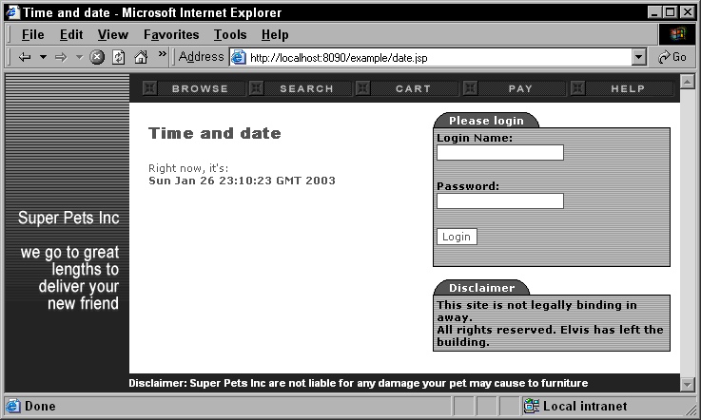
Inline Decorator Screenshot

Slide 44
Inline Components
Inline decorators can create complex ‘view components’
Useful for coarse-grained view components
  We use <webwork:component> for fine-grained
Example: all the forms within JIRA
  Only one decorator - jiraform.jsp!
  Renders:
    Form - including title, description and help
    Submit, cancel and any other buttons
    Form-level error messages
    JavaScript options (ie auto-select-first form element)

Slide 45
jiraform.jsp
PARAMETERS: (all are optional)
  action - the URI to submit this form too
  submitName - the name of the submit button
  cancelURI - the location to redirect to for the cancel button (no cancel button if this isn't present)
  buttons - any other buttons to put next to the submit button
  autoSelectFirst - unless this is present and "false", the first element of the form will be selected automatically using JavaScript
  title - a title for this form (HTML)
  notable - if this is specified, JIRA form will not output a border table (HTML)
  width - the width of the border table (HTML)
  multipart - if this parameter is present, the form will be a multipart form
  helpURL - the URL of a help link related to this form
  columns - the number of columns the underlying form will have
  method - the method of the form to submit (get or post)
  bgcolor - the background color of the table

Slide 46
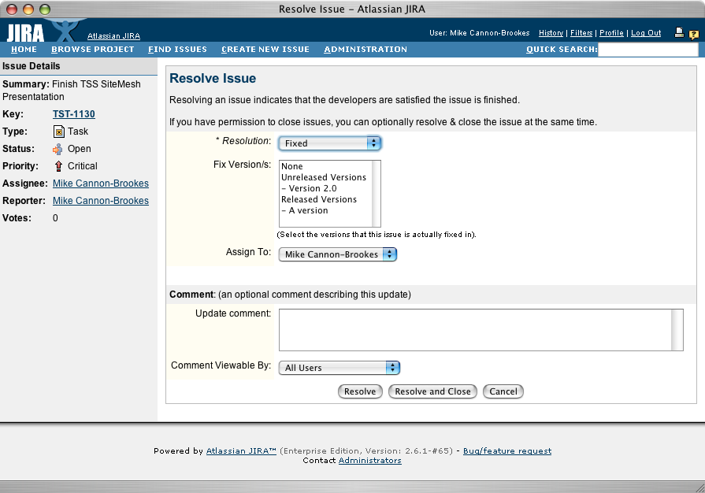
JIRA form screenshot

Slide 47
JIRA form decorator
jiraform.jsp
<decorator:usePage id="p" />
<% if (p.isPropertySet("action")) { %>
<form action="<decorator:getProperty property="action" />" method="<decorator:getProperty property="method" default="post" />" name="<decorator:getProperty property="formName" default="jiraform" />" <% if (p.isPropertySet("onsubmit")) { %>onsubmit="<decorator:getProperty property="onsubmit"/>" <% } %> <% if (p.isPropertySet("multipart")) { %> ENCTYPE="multipart/form-data"<% } %>>
<% } %>
<% if (!p.isPropertySet("notable")) { %>
. . . (draw table). . .
<% } %>
<% if (p.isPropertySet("title") && TextUtils.stringSet(p.getProperty("title"))) { %>
. . .
<% if (p.isPropertySet("helpURL")) { . . . %>
<webwork:component template="help.jsp" name="<%= helpUrl %>" >
<webwork:param name="'helpURLFragment'"><%= helpURLFragment %></webwork:param>
</webwork:component>
<% } %>
. . .
<% } %>
<decorator:body />
. . .

Slide 48
JIRA form usage
<page:applyDecorator name="jiraform">
<page:param name="title"><webwork:text name="'createissue.title'"></page:param>
<page:param name="description"><webwork:text name="'createissue.step1.desc'" /></page:param>
<page:param name="action">CreateIssue.jspa</page:param>
<page:param name="submitName"><webwork:text name="'common.forms.next'" />&gt;&gt;</page:param>
<ui:select label="text('issue.field.project')" name="'pid'”
list="allowedProjects" listKey="'long('id')'”
listValue="'string('name')'" >
<ui:param name="'mandatory'" value="true"/>
</ui:select>
<ui:select label="text('issue.field.issuetype')" name="'issuetype'" list="/constantsManager/issueTypes" />
</page:applyDecorator>

Slide 49
Content Blocks
For passing parameters and HTML directly to the decorator
  Warning: increases coupling!
Useful where some fragment of decoration HTML is more easily generated by page itself
Decorator can behave nicely if block doesn’t exist
Let’s look at an example…
Notes:
49/53

Slide 50
Content Block Example
mypage.vm
<body>
...
<content tag="breadcrumbs">
<a href="/dashboard.action">Dashboard</a> &gt;
<a href="/admin/console.action">Administration</a> &gt;
$action.getText("action.name")
</content>
...
Anything inside a <content tag="x"> tag is a content block.
SiteMesh will strip these blocks from the page body, putting them into the fields map.

Slide 51

Content Block Decorator
mydecorator.vmd
...
#if ($page.getProperty("page.breadcrumbs"))
<div width="100%" class="breadcrumbs">
Location:
  $page.getProperty("page.breadcrumbs")
</div>
#end
...
We display breadcrumb block only if it exists in the page being decorated.

Slide 52
Tips & Tricks
Group decorators into /decorators
  Helps developers differentiate presentation from content
Don’t be afraid to include
  If your decorators themselves duplicate code, use an include - in /decorators/includes!
CSS is your friend
  Easily share styles across page & decorator
Keep your view HTML simple
  Let’s the designers be complex, simple = less mistakes

Slide 53

More Info / Q&A
Where do I find out more?
http://www.opensymphony.com/sitemesh
  Docs, downloads mailing list, CVS etc.
My blog - http://blogs.atlassian.com/rebelutionary
Chapter of my recent book on real world development with Java OSS technologies </shameless-plug>
Buy Atlassian JIRA - comes with full source! :)
Email me - mike@atlassian.com
Thank you for listening - questions?
  Mike Cannon-Brookes
  ATLASSIAN - www.atlassian.com

