Slide 1
GSSRP 2026 | KEAN UNIVERSITY
Predicting Student
Academic Success
CENTRAL FINDING
Bagging Regressor
RMSE 3.7619
Interpretable machine learning with public educational data
SVM classifier
F1 0.8785
Yousef Nejatbakhsh | Final presentation
01

Slide 2
FINAL RESEARCH PRESENTATION
The question is not only whether prediction works
Research question
What the study evaluates
Which interpretable machine-learning models best predict student academic outcomes, and how can those predictions support timely assistance responsibly?
Regression for continuous outcomes
Classification for academic-success categories
Interpretability, leakage control, and responsible use
Prediction supports decisions; it does not prove causation or define a student.
Source: final_research_report.md
02

Slide 3
FINAL RESEARCH PRESENTATION
A reproducible comparison across two prediction tasks
01
02
03
PUBLIC DATA
CONSISTENT EVALUATION
LEAKAGE-AWARE TIMING
Repository-documented educational data with saved preprocessing and feature definitions.
Shared train-test partitions and pipelines support fair comparison across models.
Early-warning features exclude later grades such as G1 and G2 when unavailable at decision time.
12 regression models | 7 classification rows
Source: final report and saved leaderboards
03

Slide 4
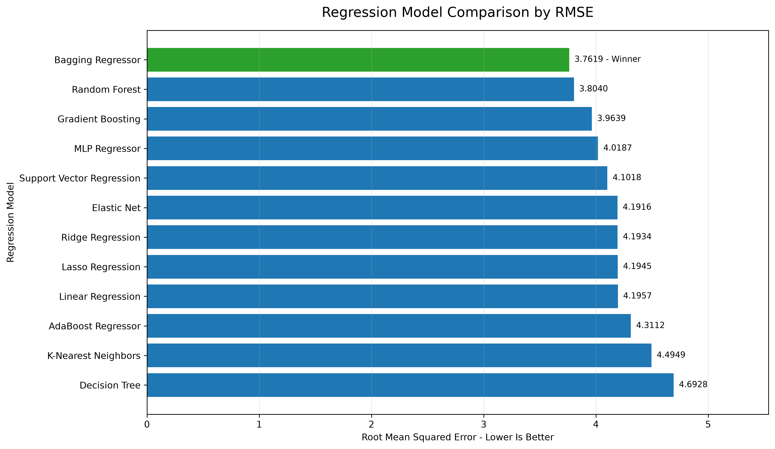
FINAL RESEARCH PRESENTATION
Bagging Regressor leads regression
BEST SAVED RESULT
Bagging Regressor
RMSE 3.7619
MAE 2.9887
R² 0.3098
Lower RMSE indicates lower typical prediction error.
Source: regression_leaderboard.csv and regression_rmse_comparison.png
04

Slide 5
FINAL RESEARCH PRESENTATION
SVM achieves the strongest saved F1 score
SVM TEST METRICS
Accuracy 0.835
Precision 0.792
Recall 0.904
F1 0.879
ROC AUC 0.939
Source: classification_leaderboard.csv; ranking uses F1
05

Slide 6
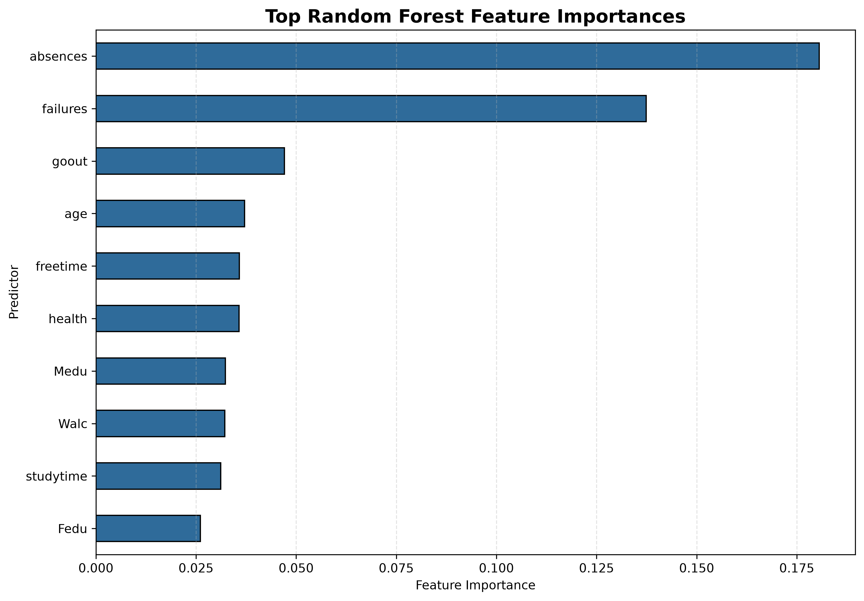
FINAL RESEARCH PRESENTATION
Absences and failures lead feature importance
Interpretation
The fitted model relied most strongly on absences and failures.
Importance measures association within this model, not causation.
Correlated predictors can divide or redistribute importance.
Source: feature_importance.png and model_card.md
06

Slide 7
FINAL RESEARCH PRESENTATION
Leakage-aware early warning is the responsible choice
FULL-FEATURE SETTING
EARLY-WARNING SETTING
May include later-grade information that improves apparent accuracy but is unavailable when early support decisions must be made.
Excludes G1 and G2 when they are not available at the intended decision time, reducing leakage and improving practical relevance.
Decision rule: prefer information that truly exists at the intervention point, even when peak accuracy is lower.
Source: final_research_report.md; no numerical full-vs-early gap is claimed
07

Slide 8
FINAL RESEARCH PRESENTATION
Accuracy is not permission to automate high-stakes decisions
LIMITATIONS
RESPONSIBLE USE
- One public dataset may not generalize to other schools or populations.
- Historical and measurement bias can reproduce inequities.
- Split variation, correlated predictors, and leakage affect rankings.
- Use predictions to offer voluntary academic support.
- Require qualified human review and student context.
- Never use the model for surveillance, punishment, exclusion, or permanent labeling.
Source: model_card.md and final_research_report.md
08

Slide 9
CONCLUSION
Model choice depends on the task, the metric, and the decision time
Bagging Regressor leads regression at RMSE 3.7619.
SVM leads classification by F1 at 0.8785.
Next steps
External validation
Subgroup fairness analysis
Calibration and monitoring
Support intervention. Preserve privacy. Keep humans accountable.
09

