Slide 1
How do Math and Stats fit into a World of Data Science?
Jo Hardin
Pomona College
4.7.2017

Slide 2
Recent Recommendations (statistics)
Curriculum Guidelines for Statistical Science (ASA)
Guidelines for Assessment and Instruction in Statistics Education (ASA)
Curriculum Guidelines for Undergraduate Programs in Data Science (PCMI & NSF)
INGenIOuS Project (ASA & MAA with AMS and SIAM)

Slide 3
Statistics & Data Science
The two pillars of computational and statistical thinking should not be taught separately.
Data scientists should understand both the computational and modeling challenges… when integrated with statistical thinking, computational thinking greatly amplifies the ability of data scientists.
PCMI Report, 2016
https://www.amstat.org/asa/files/pdfs/EDU-DataScienceGuidelines.pdf

Slide 4
Statistics Moving Forward (content – visualization & confounding)

Slide 5
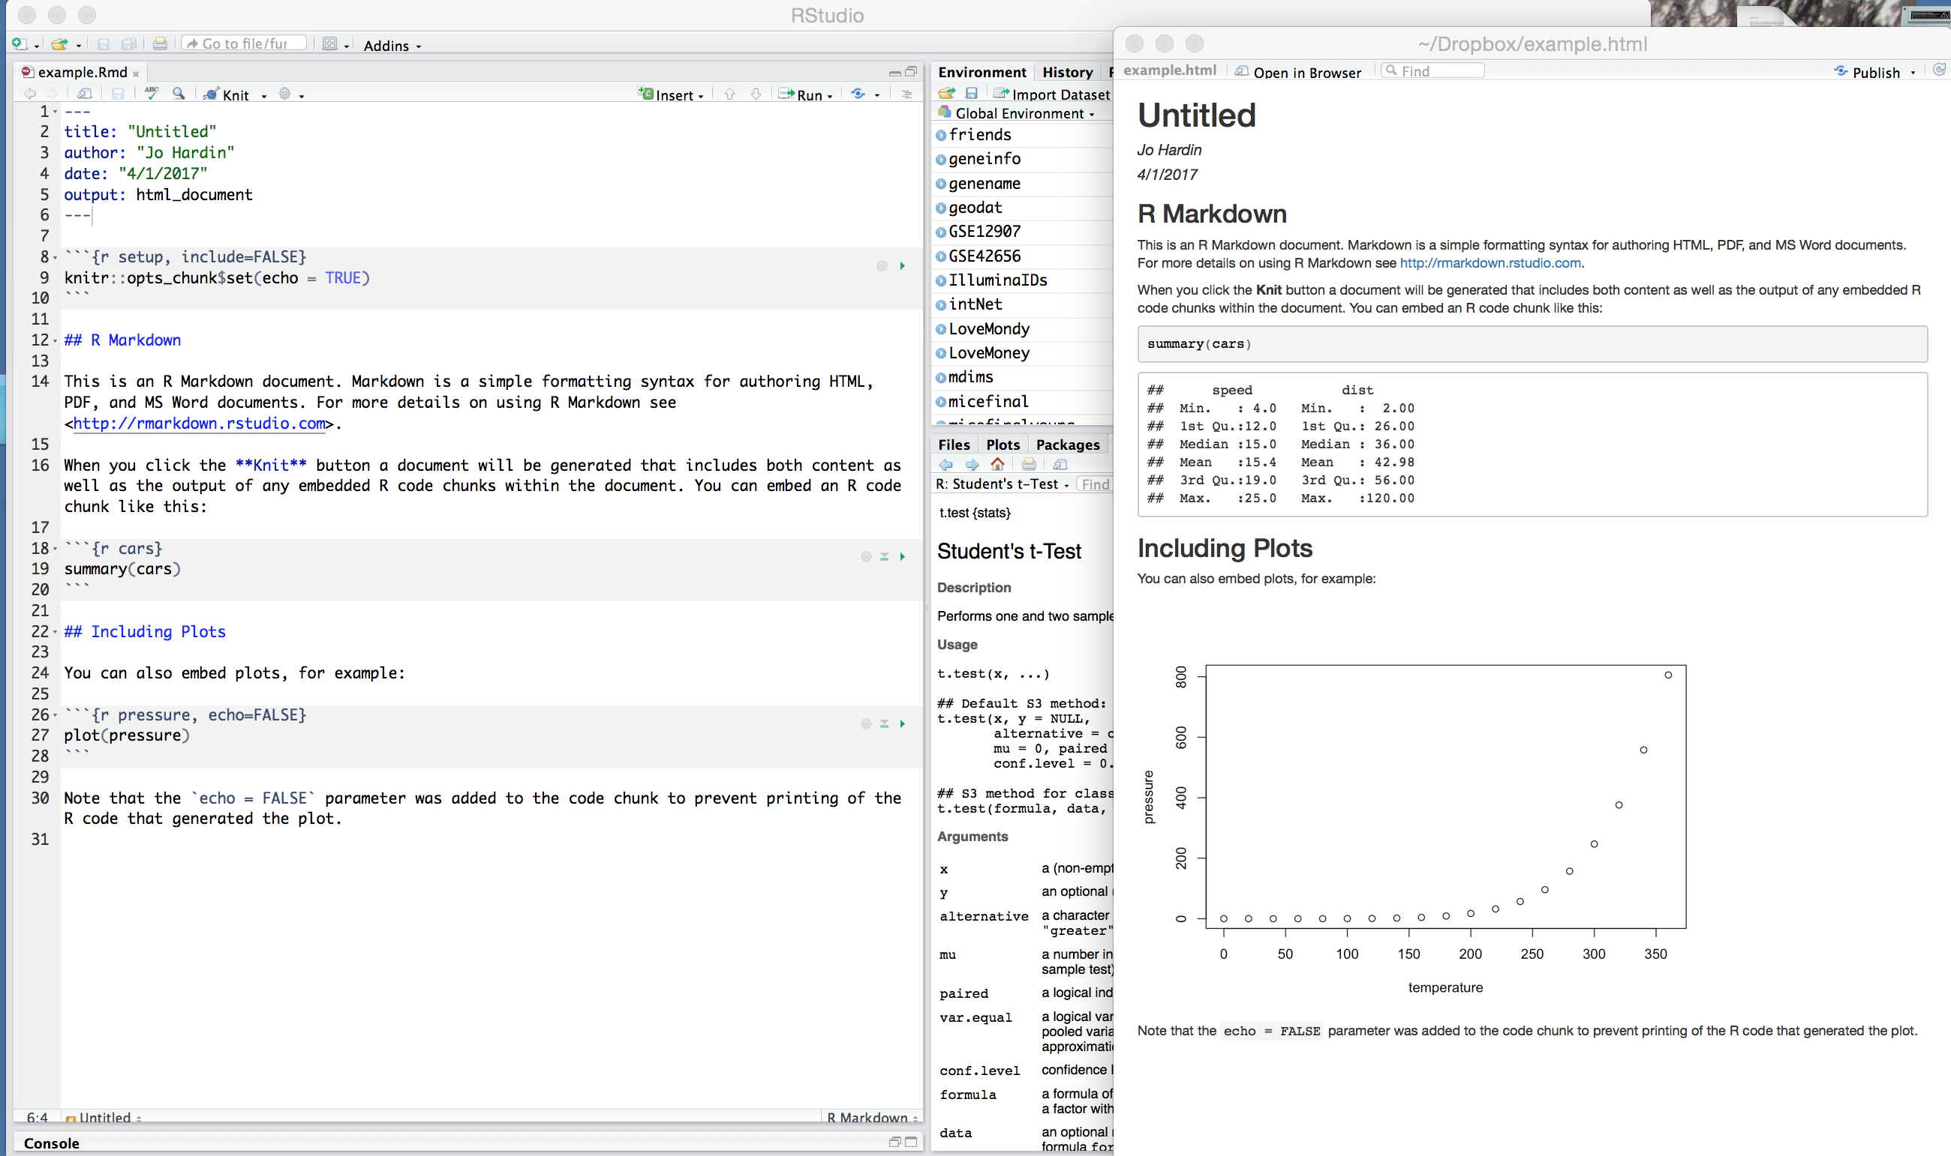
Statistics Moving Forward (tools - reproducible research)

Slide 6
Statistics Moving Forward (tools - reproducible research)

Slide 7
Recent Recommendations (math)
CUPM Curriculum Guide to Majors in the Mathematical Sciences (MAA)
INGenIOuS Project (ASA & MAA with AMS and SIAM)
Curriculum Guidelines for Undergraduate Programs in Data Science (PCMI & NSF)

Slide 8
Math & Data Science
Mathematical sciences major programs should include concepts and methods from data analysis, computing, and mathematical modeling.
Mathematical sciences major programs should teach students to use technology effectively, both as a tool for solving problems and as an aid to exploring mathematical ideas.
CUPM Curriculum Guide to Majors in the Mathematical Sciences (MAA)
http://www.maa.org/sites/default/files/pdf/CUPM/pdf/CUPMguide_print.pdf

Slide 9
Why Math in Data Science?
Data scientists employ models to understand the world and mathematics provides the language for these models, so a working data scientist requires a firm foundation in mathematics.
PCMI Report, 2016
https://www.amstat.org/asa/files/pdfs/EDU-DataScienceGuidelines.pdf

Slide 10
What math should DS know?
Calc I
Calc II
Calc II
Linear Algebra
Discrete Math
Probability Theory

Slide 11
What math should DS know?
Calc I
Calc II
Calc II
Linear Algebra
Discrete Math
Probability Theory
6 semesters of math !!
(not to mention needed CS, statistics, etc.)

Slide 12
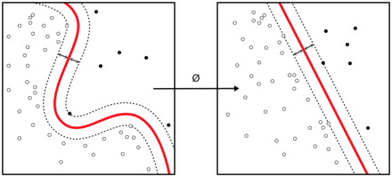
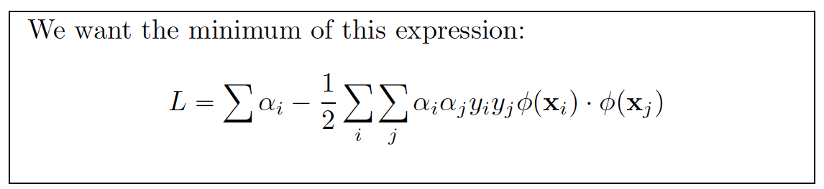
Do we need math? Case study: support vector machines
Transformations
Minima
Dot-products
Linear Algebra
Lagrange multipliers

Slide 13
Do we need math? Case study: support vector machines
or ONLY CALCULUS
No black box thinking

Slide 14
Math Moving Forward
Discrete Math
Continuous Math
Linear Algebra
Counting
Discrete Simulations
Graph theory
Functions & logic
Some calc (optimiz & partial deriv)
Taylor expansions
Probability
Multivariate thinking
Hardin & Horton “Ensuring that Mathematics is Relevant in a World of Data Science (forthcoming in AMS Notices)

Slide 15
Computing & Data Science (in math and stats)
Lack of computing in standard mathematical curricula.
Students can gain computing experience in their CS classes, but programming experience is quite different from the hands-on approach to computing with data and models.

Slide 16
Computing Moving Forward
The computation requirements that are sometimes part of mathematics and statistics majors … should be expanded …including more mathematical and statistical modeling, data analysis, visualization, and high performance computing.
MAA INGenIOuS Report (2013)
http://www.maa.org/sites/default/files/pdf/ingenious/INGenIOuS.pdf

Slide 17
Thank you!
Jo Hardin
Department of Mathematics
Pomona College
jo.hardin@pomona.edu

