Slide 1
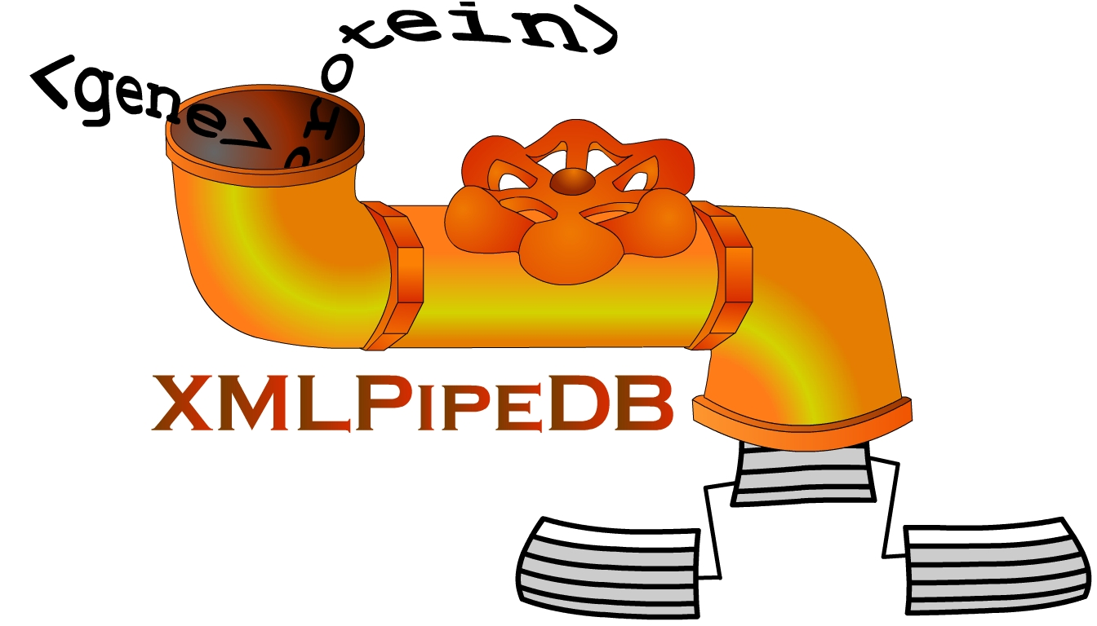
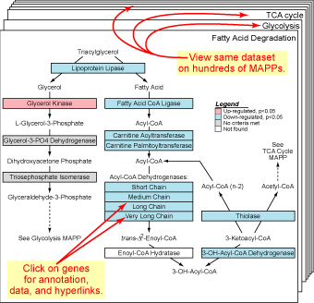
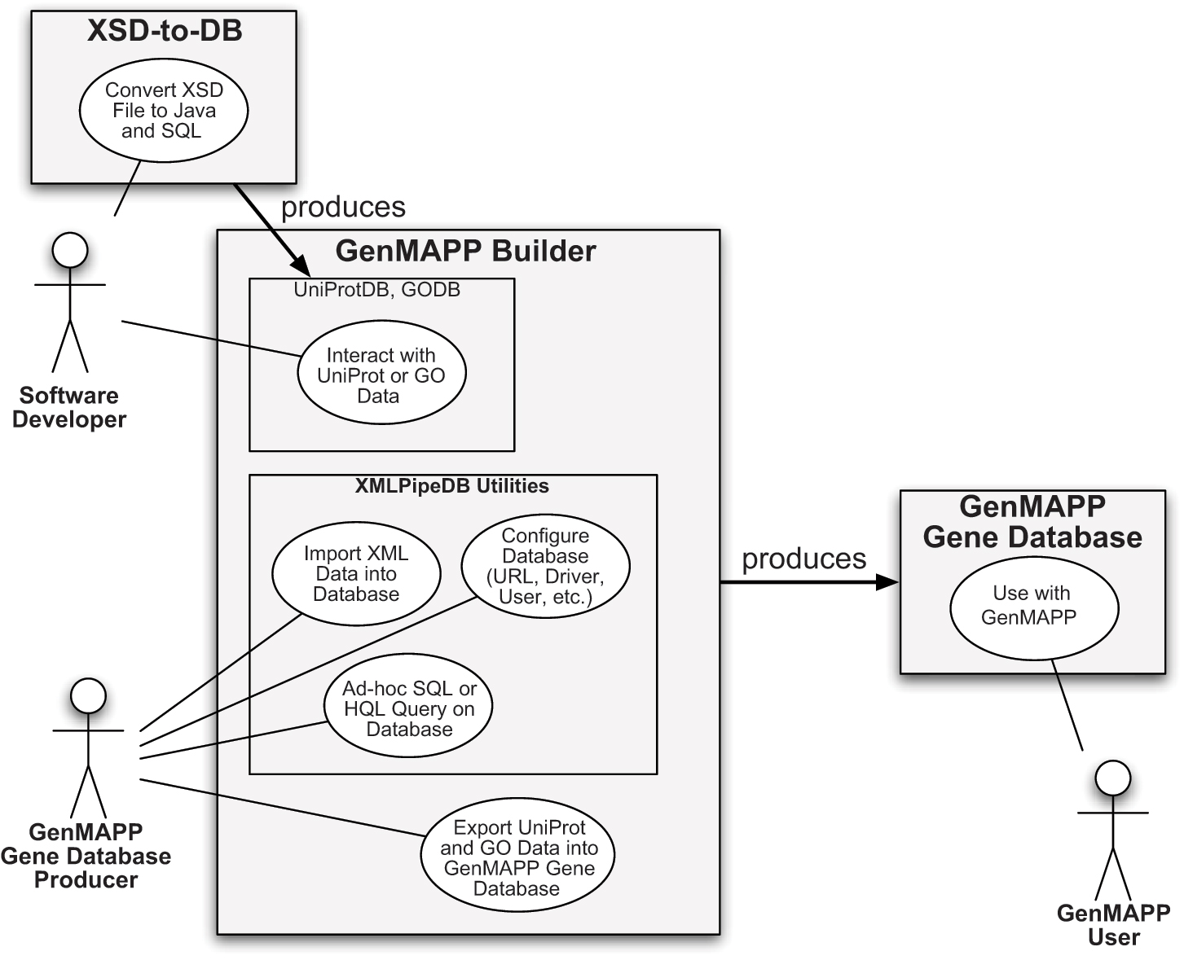
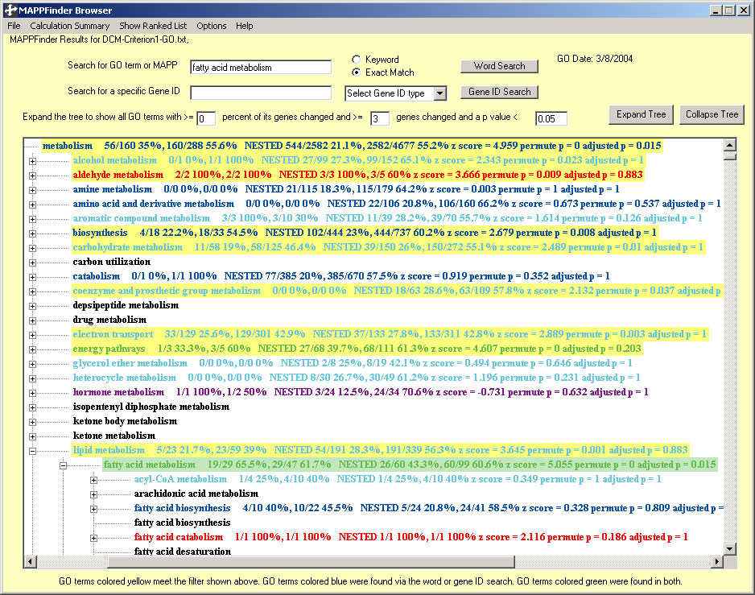
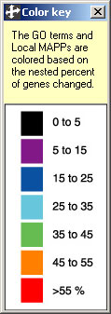
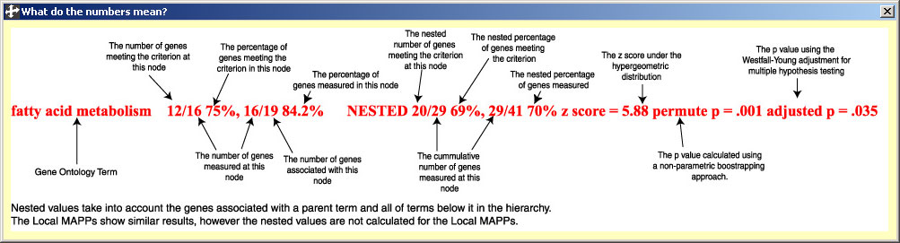
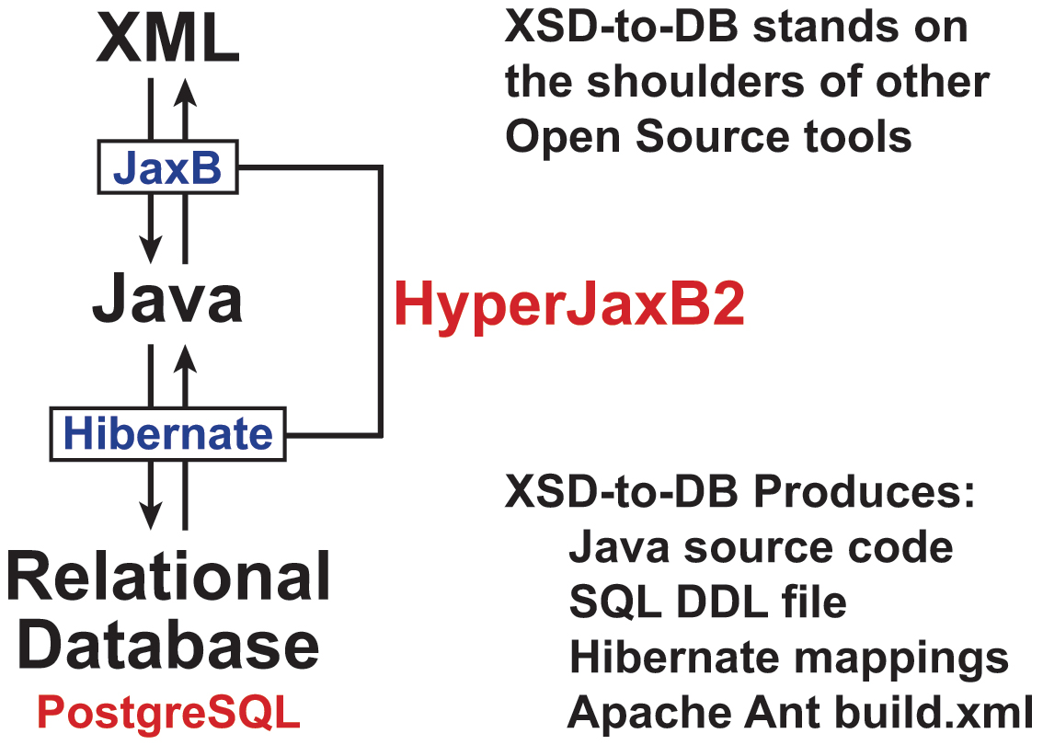
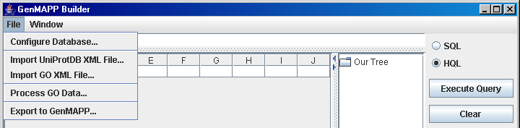
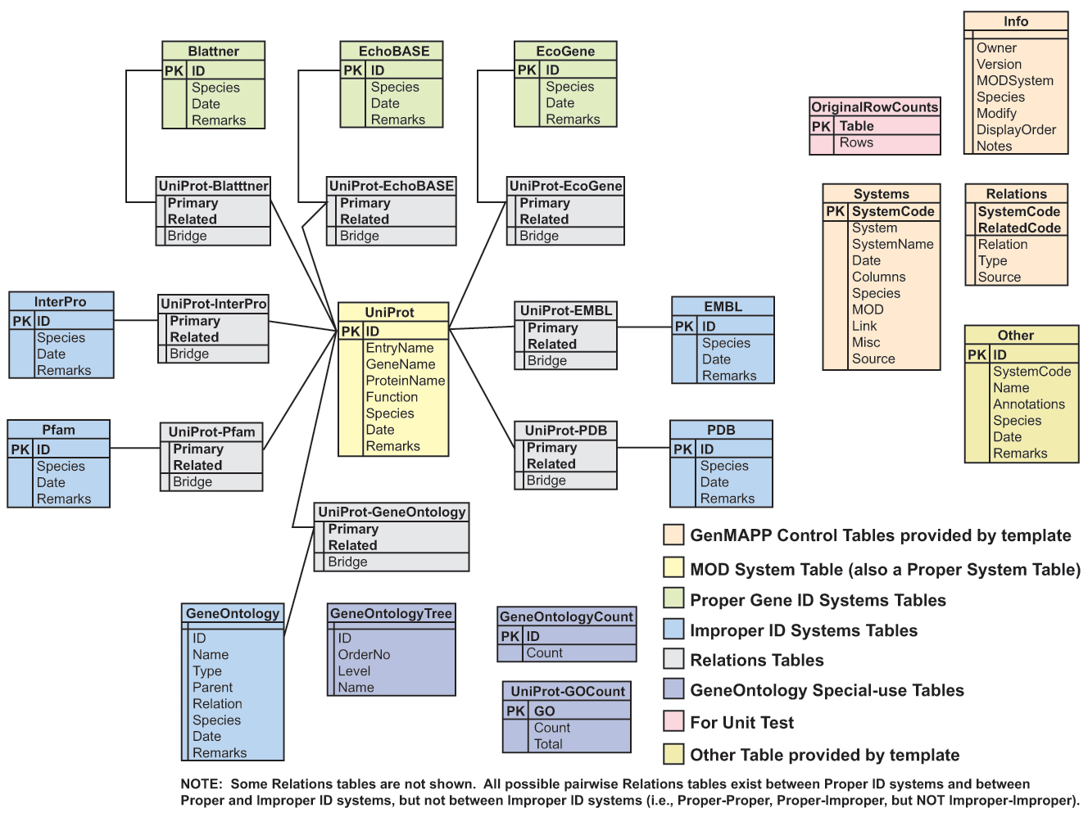

A Reusable, Open Source Tool Chain
for Building Relational Databases
from XML Sources
Kam D. Dahlquist¹, Joey Barrett², Joe Boyle², Adam Carasso², David Hoffman², Babak Naffas², Jeffrey Nicholas², Roberto Ruiz², Scott Spicer², John David N. Dionisio²
¹Department of Biology, ²Department of Electrical Engineering &
Computer Science, Loyola Marymount University
1 LMU Drive, Los Angeles, CA 90045 USA
http://cs.lmu.edu/~xmlpipedb
Background & Motivation
GenMAPP is a free program for viewing and
analyzing DNA microarray or other genomic
and proteomic data on biological pathways
Stand-along program implemented in Visual Basic
accessory files are Microsoft Access databases
Graphics tools for drawing MAPPs
MAPPs represent biological pathways and
other functional groups of genes
.mapp files store gene IDs and vector coordinates for all graphical objects
Underlying Gene Database
species-specific .gdb files store IDs, annotation, and hyperlinks to public
gene and protein databases
Import expression data and set criteria to automatically color the MAPPs
according to the data
separate Expression Dataset files (.gex) store data and color-coding instructions
XMLPipeDB Use Case Diagram
MAPPFinder finds
Gene Ontology terms
over-represented in a
GenMAPP Expression Dataset
and ranks them by p value
XMLPipeDB Implementation
UniProtDB and GODB
required some post-processing
Naming: XSD or DTD definitions
might use names that are SQL
reserved words and thus cannot
be used as table or attribute names,
for example:
--in UniProtDB, “end” was renamed
to “endPosition”
--in GO, “to” was renamed to “to_”
Datatypes: some XSD datatypes
are not easily supported in SQL,
for example:
--in UniProtDB, the definition for
citationType was changed
from month/year to string
--some definitions were changed from
SQL varchar(255) to
varchar(unspecified length)
Maintaining and Updating GenMAPP Gene Databases has been
a Bottleneck for Development
Microarrays use different gene ID systems for annotation;
users want as much information as possible.
We need to capture and reliably relate gene data from different sources
and keep the data updated.
Current GenMAPP Gene Databases are built from Ensembl as the main
data source.
limited to mostly animal species (human, dog, cow, mouse, rat, chicken, zebrafish,
fruit fly, worm, yeast)
sensitive to changes in flat file formats
Thus, the motivation for XMLPipeDB was:
to create GenMAPP Gene Databases for other species (bacteria/plants)
using UniProt as the main data source
to be robust to changes in source file formats
to use XML sources wherever possible
to take advantage of existing open source tools
to limit the manual manipulation of the data
GenMAPP Builder Uses the
XMLPipeDB Utilities Library
External to GenMAPP Builder, the
user must install the database server
and load the GenMAPP Builder schema
file generated by XSD-to-DB
Within GenMAPP Builder,
perform each function in
the order shown by the
File menu
Schema Diagram of Escherichia coli K12 Gene Database
Created by GenMAPP Builder
Availability
Gene Database for Escherichia coli K12
http://cs.lmu.edu/~xmlpipedb
XMLPipeDB Programs and Source Code
http://sourceforge.net/projects/xmlpipedb
Data Sources
XML UniProt Proteome Sets and GOA files from the Integr8 resource
http://www.ebi.ac.uk/integr8/
Gene Ontology OBO XML
http://www.godatabase.org/dev/database/
Contact Us
Kam D. Dahlquist John David N. Dionisio
http://myweb.lmu.edu/kdahqui http://myweb.lmu.edu/dondi
kdahlquist@lmu.edu dondi@lmu.edu
Acknowledgments
GenMAPP.org: especially, Bruce R. Conklin, Scott W. Doniger,
Kristina Hanspers, Steven C. Lawlor, and Alexander Pico
At LMU: Wesley T. Citti, Caskey L. Dickson, Ryan Nakamoto

