Slide 1


Visit us at www.osc.lmu.de
Follow lmu_osc on Bluesky, LinkedIn, Mastodon
Subscribe to our mailing list: lmu-osc@lists.lrz.de

Slide 2
Out in the open:
Open Access, preprints and postprints
FELIX SCHÖNBRODT & SARAH VON GREBMER ZU WOLFSTHURN
LMU OPEN SCIENCE CENTER (OSC)
Last update: 30.9.2026
Notes:
add menti

Slide 3
About these materials
These slides and materials were adapted from previous work by Prof. Dr. Felix Schönbrodt (https://orcid.org/0000-0002-8282-3910).They were subsequently modified by Dr. Sarah von Grebmer (https://orcid.org/0000-0002-6413-3895) and are licensed under CC-BY 4.0 (https://creativecommons.org/licenses/by/4.0/deed.en). You are free to share (copy and redistribute the material in any medium or format) and adapt (remix, transform, and build upon the material) for any purpose, even commercially, as long as you give appropriate credit to the original author(s), provide a link to the license, and indicate if changes were made.
Notes:
This work is licensed under a Creative Commons Attribution 4.0 International License (CC BY 4.0).
You are free to share (copy and redistribute the material in any medium or format) and adapt (remix, transform, and build upon the material) for any purpose, even commercially, as long as you give appropriate credit to the original author(s), provide a link to the license, and indicate if changes were made.

Slide 4

Sarah von Grebmer zu Wolfsthurn
Open Science Center at LMU Munich
Background in (clinical and neuro-) psychology (UK, NL)
PhD in cognitive psychology and neurolinguistics in H2020 project (NL)
Joined the OSC in January 2025 as Open Science Program Coordinator
  Coordinating, developing and delivering the “Train-the-trainer” program
  Facilitating interdisciplinary workshops, seminars, and networking events
  Supporting the adoption of open research practices
Notes:
Introductions

Slide 5
Today we will cover…
The academic publishing system (and our relationship with publishers)
The Why and types of Open Access
The life cycles of open research papers
A new vision of academic publishing
What you can do for more transparent research
Bonus content: Predatory publishing
Notes:
Today I want to give you an overview of Open Access, what it is, why it is important and also, how we do it.
Open access in this sense is a very interesting topic because I always found it to be a connecting topic between various fields – just in this audience, I can think of multiple participants and attendees who have mentioned open access, or the lack of, as the first contact point with open science and as a starting point for engaging in the topic in the first place.

Slide 6
What you are getting out of today…
Understanding the publishing system (and how publishers make $$$$)
Scrutinizing different Open Access policies and types, and assessing their implications for both authors and readers
Publishing your original manuscripts as preprints
(Re-)Evaluating the purpose of preprints and your own role in the academic publishing world
Notes:
Go through learning goals and refer back to them at the end of the session.

Slide 7
What do you expect of today’s session?

Slide 8
What do you connect with the term Open Access?

Slide 9
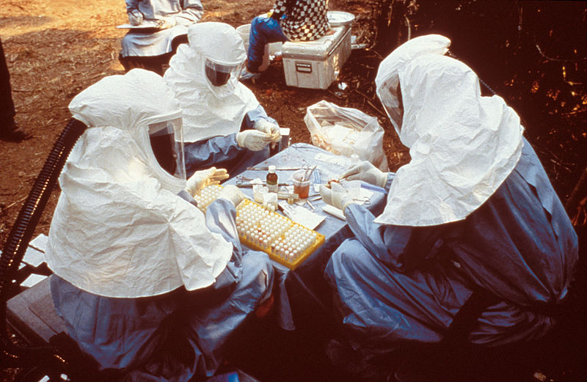

A closed access story
Ebola outbreak 2013-2016:
> 11,000 deaths, mainly in Liberia, Sierra Leone, and Guinea
Detection of the outbreak was delayed because doctors did not know it was present in the area
But: A 1982 scientific article (Ivanoff et al., 1982) had predicted the outbreak
Article was hidden behind a paywall (45$ = half week’s salary of a local physician)
In response to publicly raised criticism, Elsevier lifted the paywall
… only for Ebola-related papers …
… for 2 months
Masnik (2015), Capot (2014), Dahn et al. (2015), Ivanoff et al. (1982)
Picture from the Center for Disease Control PHIL Image ID 6136
Notes:
Ok, let’s get started.
First, let me tell you a story about closed access: Some of you might have followed the news about the latest ongoing Ebola outbreak from May 2026, with its epicenter in the Democratic Republic of Congo. As of two days ago, there have been almost 7000 confirmed cases and over 3000 related deaths.
This was not the first outbreak. The first documented outbreak was in 1976 in what today is the DRC. The largest and worst Ebola outbreak in West Africa to this date started end of 2013 in Guinea, spread across different countries in West Africa and reached its climax in August 2014. The epidemic led to more than 28000 infected people and 11,000 deaths, most of them in Liberia, Sierra Leone, and Guinea. The outbreak was declared over only two years later, in June 2016.
What most of you probably don’t know is that it took very long to detect the outbreak because the local doctors did not know that the virus was present in the area. This was not due to a global lack of knowledge, in fact, the authors of a scientific paper from 1982 had already discovered Ebola antibodies in 6% of a sample of 250 people in this region and had warned about a possible outbreak of the infection in the region.
However, this article was hidden behind a paywall and therefore almost inaccessible for local researchers. Specifically, the download fee was 45$, which was about a half week’s salary of a local physician. This would be comparable to roughly 1500$ for a general practitioner from the US in the same year. Nobody pays this much for an article whose content one does not know. Right now actually this article would cost 53 Euros for short term access from the platform where it is currently hosted at.
This put Elsevier, the publisher of the article, under a lot of public pressure. Was Elsevier responsible for the delay in the outbreak detection by keeping the relevant information from specialists who could help? How should they cope with the epidemic if they could not access up-to-date knowledge about the infectious disease and its prevention?
This led Elsevier to do something unique: They said well ok, let us lift the paywall. Great, BUT: They lifted the paywall only for Ebola-related papers, not for other global illnesses like malaria or AIDS. Additionally, they lifted they paywall for all Ebola-related papers in their selection for people from 15 West African nations for a period of two months. They used user’s IP addresses to track this. Of course, they put it back in action after this period, which way before the end of the epidemic in June 2016.
Why do we tell this story? Because it leads to a lot of questions:
Is this the reason why you want to become a researcher? To hide your insights, for the disadvantage of society? To hide your knowledge behind paywalls? Probably this is not what you want.

Slide 10
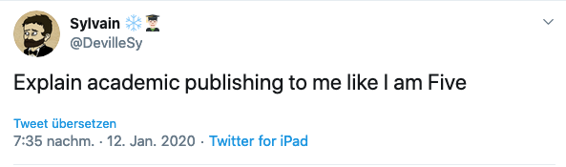
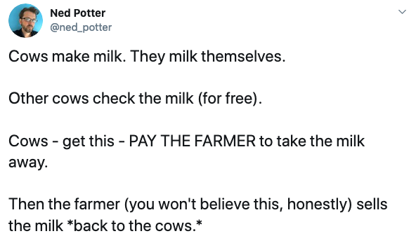
Notes:
So how does the academic publishing system work? To understand the different variants of Open Access publishing models, you need a basic understanding of publishers’ business models.
Fortunately, this can be explained in a single tweet — and in a way that even a five-year-old can understand. There were many good answers, this was the best one.
Imagine cows. Cows make milk, and they MILK themselves. And other cows CHECK the milk for free.

Slide 11
At this point, the product is fully there.
Notes:
So this is what we do. We write papers, ourselves, other researchers check our papers for free. As a reviewer, you don't get money. And at this point, the product is fully there. The research is done.

Slide 12
At this point, the product is fully there.
Notes:
But then what happens? The cows - get this - PAY the farmer to take the milk away.

Slide 13
At this point, the product is fully there.
Notes:
And then the farmer - you won't believe this, honestly - SELLS the milk back to the cows.
So it could happen that you publish a paper, and if your university does not have the subscription of that journal, then you yourself are unable to download your own paper, unless you pay for it out of your own pocket. That can happen. So it's a really absurd system.
I remember once explaining my Italian mum this system, and as I was talking, I realized how absurd I was sounding. In fact, I sounded so absurd, that my mum said something in classic Italian fashion that I cannot repeat on camera and way accompanied by this hand gesture.

Slide 14
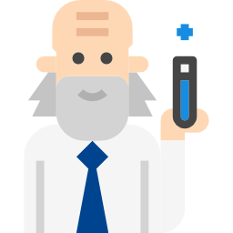



Status quo:
How publishers make $$$$$
$ final editing
$ server costs
$ administration
$ advertising
$ running a paywall
$ issuing take-down notices to researchers who share their papers
$ Suing Sci-Hub
$ Lobbyism
free content
free reviews
(mostly) free editorial service
researchers
$ private publishing money
publishers
$ publication fees
$ subscription fees
$$$ profit margin
university
$ subscription fees
$ Single paper payments
$ tax money
general public & industry
Icon from flaticon.com by turkkub and Flaticon
Notes:
Let’s talk about money. What are the money flows in the publishing system?
So researchers provide free content, free reviews, mostly free editorial service. So the editors in chief or senior editors that you send your papers to, the ones deciding whether it fits the scope of the journal, manage reviewers etc., most of them work for free. Some of them get like a tiny amount of money, like 500 euros a year, or maybe a thousand euros a year, but only a few of them. And it's a lot of work, to be an editor. The reviewers for a journal of course do it for free.
But there are more money flows. So the universities pay publication fees and subscription fees to the publishers.
Additionally, if someone who is not a member of academia (an industry expert or just an interested individual) wants to access an article which a researcher wrote whom they paid with their own tax money, they also have to pay subscription fees to the publishers. I'm sure you've seen that. If you want to read a paper behind the paywall, it's just $50 or 50 euros. And then you can read it. So there's a lot of money and work flowing to the publishers. For example, the paper I mentioned before from 1982 predicting the Ebola outbreak in the region can currently be purchased for 53 euros.
And I know that many researchers pay private money for publishing their papers. I don't know how much you already published. So maybe I can ask here, did somebody already do that?

Slide 15
Have you ever paid private money to publish your manuscript?

Slide 16
Status quo:
How publishers make $$$$$
$ final editing
$ server costs
$ administration
$ advertising
$ running a paywall
$ issuing take-down notices to researchers who share their papers
$ Suing Sci-Hub
$ Lobbyism
free content
free reviews
(mostly) free editorial service
researchers
$ private publishing money
publishers
$ publication fees
$ subscription fees
$$$ profit margin
university
$ subscription fees
$ Single paper payments
$ tax money
general public & industry
Icon from flaticon.com by turkkub and Flaticon
Notes:
Of course, the publishers have costs as well. So we need to take that into account. The final editing costs something. So you send, for example, a Word manuscript, and they make a nice PDF out of it. So they send it to India, and they do it for very cheap money to get a nice PDF. Elsevier, for example, historically has had a large production team for typesetting, figure handling, proofreading in Chennai in India, where the labor costs are much lower.
Publishers have server costs. They run servers. Well, they have administration. They pay a lot for advertisement. Running a paywall is quite expensive. So actually, they pay money to get more money. Issuing takedown notices to researchers who share their papers on platforms without the permission of the publisher to sue the researchers. That costs money. That needs to be paid. And they spend a lot on lobbyists. But given all of these red costs, the profit margin of publishers is amazing.
------------------------------------------------------------------------------
This is a very sketchy overview of the cashflows in academic publishing. Most scholars and universities are paid tax money which assures that they can do their research. They pay fees to academic publishers – publication fees (so that they can publish their research results as a paper in a journal) as well as subscription fees (so that they get access to academic journals). They also provide their content (the papers they write) for free and act as reviewers for free. Additionally, if someone who is not a member of academia (an industry expert or just an interested individual) wants to access an article which a researcher wrote whom they paid with their own tax money, they also have to pay subscription fees to the publishers.
On the other hand, the costs which accrue for publishers are minimal. They invest in some final editing, they pay for hosting the content on their servers, and they have some administrative costs (after all, they are large companies which need to be run).
Do you think this system is fair?

Slide 17
Publishing costs
We (society, researchers) pay on average between 3.800 € and 5.000 € for publishing a paper (all subscription fees + APCs + payments divided by published papers;
not counting free labor such as reviewing, editing, etc.)
„Billion dollar donation“: In 2020, 130 million hours of unpaid reviewing time were done by scientific community overall; translated to money value with average wages:
  $1,510,810,944 (US)
  $391,036,638 (UK)
Actual costs for publishing one paper (online only, no print): ~ 400 €
(estimates range between 200 € and 1000 €, see Grossmann et al., 2021)
Schimmer, R., Geschuhn, K. K., & Vogler, A. (2015). Disrupting the subscription journals’ business model for the necessary large-scale transformation to open access. doi:10.17617/1.3.
Van Noorden, R. (2013). Open access: The true cost of science publishing. Nature News, 495(7442), 426. https://doi.org/10.1038/495426a
Grossmann, A., & Brembs, B. (2021). Current market rates for scholarly publishing services [version 2; peer review: 2 approved]. F1000Research, 10(20). https://doi.org/10.12688/f1000research.27468.2
Aczel, B., Szaszi, B., & Holcombe, A. O. (2021). A billion-dollar donation: Estimating the cost of researchers’ time spent on peer review. Research Integrity and Peer Review, 6(1), 14. https://doi.org/10.1186/s41073-021-00118-2
Notes:
What are the publishing costs? How much does it cost to publish a paper? If you take together all of the costs?
You probably have no idea. I didn't have any idea. So but there are, there's research about it. So we, as society, as researchers pay on average, between 4000 - 5000 euro for publishing a paper. So this does not include like doing the research, of course not. It's just really the act of publishing it. This includes all subscription fees, APCs. So these are article processing charges, where you pay for publishing your paper; not counting free labor, such as reviewing, editing, and so on. We will soon see what the actual costs are for publishing a paper.
There was a nice paper which was called a billion dollar donation. The authors estimated that in 2020, 130 million hours of unpaid reviewing time was done by the scientific community. And if you multiply that with average hourly rates and wages, they came to the number of 1.5 billion US dollar only in the US. So the reviewing time that was like done in the US or 400 million dollars in the UK. So, lots of money in the system.
But what does it cost to actually publish a paper? So the red costs on the previous slide. So the estimate is around 400 euro. That's the real cost of publishing a paper. Now you can imagine, so the real costs are 400 euro. What the publishers get are 4000 Euros.

Slide 18
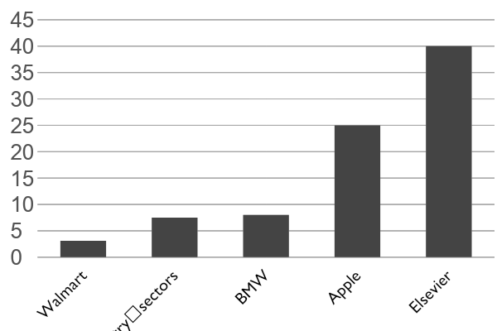
Profit margins
40%
Profit margin
https://www.theguardian.com/science/2012/apr/24/harvard-university-journal-publishers-prices
Notes:
If my goal were to make a lot of money, I would probably not be a researcher, but I would start a scientific journal. Let us take the example of a big publisher, Elsevier.
The heart of Elsevier’s business model is subscription-based access. Universities, research institutes, hospitals, and corporations pay large annual fees, often through so-called “big deal” contracts, for bundled access to thousands of journals and articles via platforms like ScienceDirect. These subscriptions account for the majority of Elsevier’s revenue and are highly recurring, typically locked in through multi-year agreements. Because institutions depend on access to journals for teaching and research, switching away from Elsevier is costly and disruptive, which gives the company strong pricing power.
Another source for revenue is the purchase of access to individual articles, although this revenue is comparatively low.
In addition to subscriptions, Elsevier increasingly earns revenue from open-access publishing fees (ACPs), known as article processing charges. In this model, authors, or more often their funders or institutions, pay a fee to make the research freely available to readers. While open access was initially seen as a threat to subscription publishing, Elsevier has integrated it into its business model and now treats it as a growing revenue stream rather than a replacement.
A key reason Elsevier is so profitable is its cost structure. Academic authors and peer reviewers are typically unpaid, even though their work is essential to the product. Much of the underlying research is publicly funded, yet access to the final published output is sold back to the same institutions that funded it. Combined with digital distribution, this results in relatively low marginal costs and very high operating leverage.
What about profit margins then for Elsevier? So after covering all expenses, what remains at the end of the year? Walmart in the US has a profit margin of about 4%. BMW here in Bavaria has a profit margin of about 8%. Apple, as one of the most profitable companies hits 25% profit margins. What do you think is the profit per year for a publisher like Elsevier?

Slide 19
Profit margins
40%
Profit margin
https://www.theguardian.com/science/2012/apr/24/harvard-university-journal-publishers-prices
Notes:
If your goal in life is to make money, you should probably open a scientific publishing house. Elsevier generates roughly 3.5 billion euros in annual revenue. Of that, operating profit is around 1.1 to 1.2 billion euros, which translates into an operating profit margin of approximately 37 to 38 percent. This is exceptionally high for a publishing or information services business and rivals profit margins seen in large technology companies. Let this sink in for a moment.

Slide 20
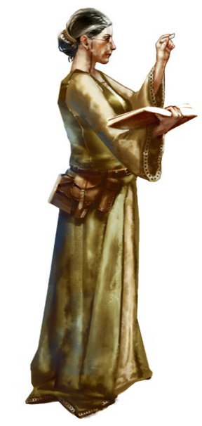

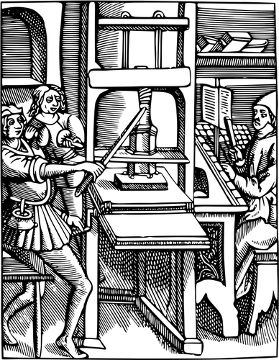
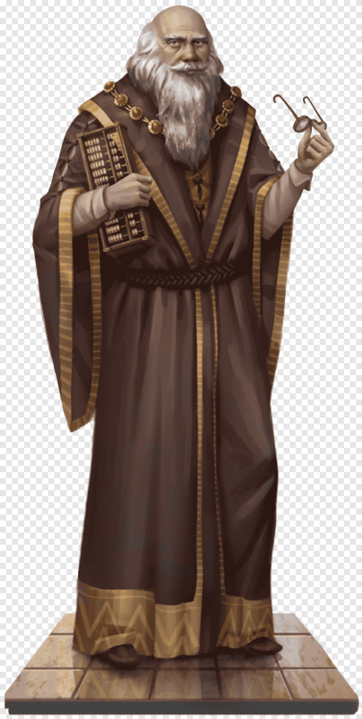
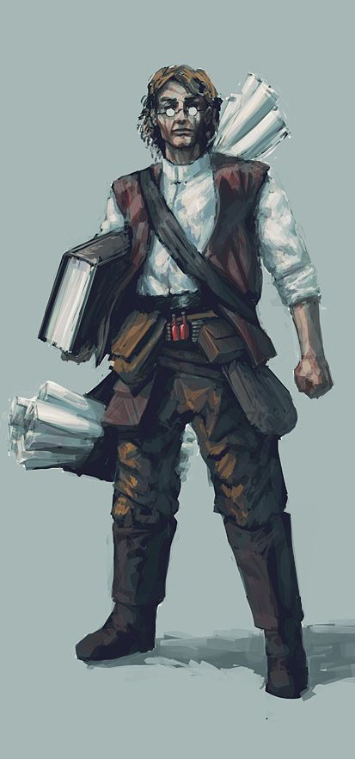
Trade
„article processing charges“
against
„prestige points“
Scholars
Publishers
 | Price | Prestige points („JIF“)
BMC Psychology | €1625 | 4.6 🎖
Nature Communications | €6,150 | 18.1 🎖
Nature Human Behavior | €10850 | 20.5 🎖
 | Price
MIT Press „Data intelligence“ | €0
Nature Scientific Data | €2390
Buy the „Nature“ branding
https://www.springernature.com/gp/open-research/journals-books/journals; Prices in €
Notes:
So the question is: why does this work? How is the business model from Elsevier working? Why do we pay such immense money and such ridiculous profit margins to the scientific publishers? Because we are playing a game with coins.
We trade our work and journal articles for prestige points. But not trade in the conventional sense, we give publishers the journal articles AND give them coins in the form of article processing charges to get the prestige points in return.
So if you want to publish in, say, psychology, you could go to BMC psychology. BMC Psychology is a peer-reviewed, open access journal publishing on a broad range of topics in psychology. You pay 1625 coins, and you get 4.6 prestige points as of June 2026.
Another example, you can spend over 6,000 coins at Nature Communications, and you get around 18 prestige points. Pay close to 11,000 coins at Nature Human Behaviour, and you get about 20 prestige points. Same activity, but different price tags for more prestige.
What is it that we are paying for exactly? What are those prestige points? The prestige points here stand for the impact factor for a journal. The impact factor is the metric based on how often a journal’s articles are cited. A higher impact factor signals influence, readership, and prestige. And because careers, grants, and university rankings very often depend on those signals, publishers can charge more in APCs. The extra money for APCs doesn’t buy better science, it buys reputation. It’s like a designer label: the product may be similar, but the name makes it expensive.
That’s the key: we’re not paying for real differences in service. The APC prices don’t reflect higher costs these journals have, better review workflows from those journals, or better science. Journals with a high impact factor don’t re-run your analyses or fundamentally improve quality of your work compared to journals with lower impact factors. The process is largely the same. If you think about it too hard, this is actually a crazy. Or sad. Or both. Ironically, if you hide your article behind a paywall with these publishers, it’s free. No charges, because you’re not paying for access, you’re paying for visibility and status.

Slide 21

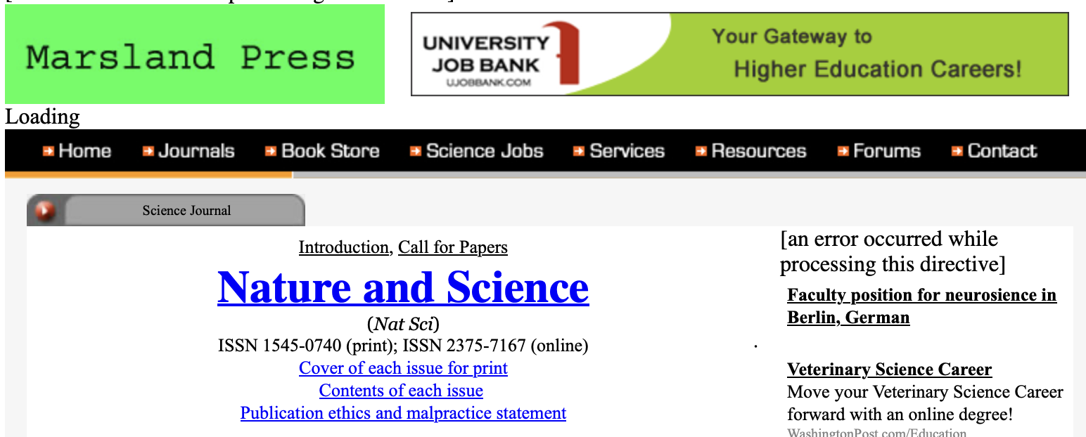
„I published in Nature AND Science!“
APC: Just 150 $
Notes:
As a small sidenote, it might actually be much easier to publish in nature and science than you think. There is a journal called nature and science, with an article processing charge of 150 USD.
https://www.statnews.com/2015/11/19/fraudsters-academics-journals/
So then, where does Open Access come in?

Slide 22
What is Open Access?
The Budapest Open Access Initiative (BOAI) Declaration:
“free availability [of scholarly literature] on the public internet permitting any users to read, download, copy, distribute, print, search, or link to the full texts of these articles, crawl them for indexing, pass them as data to software, or use them for any other lawful purpose, without financial, legal, or technical barriers […]“
„The only constraint on reproduction and distribution, and the only role for copyright in this domain, should be to give authors control over the integrity of their work and the right to be properly acknowledged and cited."
It is simply: Freely sharing the results of your tax-paid research. Open Access does not imply…
… high costs
… lower quality
Suber (2015), Vilnius University Library (2018); https://open-access.net/en/information-on-open-access/what-is-open-access
Notes:
Now, what actually is Open Access? There's a definition from the Budapest Open Access Initiative Declaration. And it says, Open Access is the free availability of scholarly literature on the public internet permitting any users to read articles. But it's not only to read articles.
Open Access includes to download, copy, distribute, print, search, or link to the full text, crawl them for indexing, pass them as data to software. A lot of meta science research takes PDFs or articles as data and does research on those data. To use them for any other lawful purpose without financial, legal, or technical barriers. The only constraint on reproduction and distribution and the only role for copyright in this domain should be to give authors control over the integrity of their work and the right to be properly acknowledged and cited.
So Open Access is a very broad permission to do stuff. So it's simply freely sharing the results of your tax paid research. Very importantly, Open Access does not imply high costs. So nowadays, we think, oh, Open Access is expensive because you have to pay article processing charges. But no, Open Access simply means to read freely what you produced. It does not imply high costs. And it does not imply lower quality, which has also been dominating the thinking of researchers in the last 10 years or so.

Slide 23
What is Open Access?
The Budapest Open Access Initiative (BOAI) Declaration:
“free availability [of scholarly literature] on the public internet permitting any users to read, download, copy, distribute, print, search, or link to the full texts of these articles, crawl them for indexing, pass them as data to software, or use them for any other lawful purpose, without financial, legal, or technical barriers […]“
„The only constraint on reproduction and distribution, and the only role for copyright in this domain, should be to give authors control over the integrity of their work and the right to be properly acknowledged and cited."
It is simply: Freely sharing the results of your tax-paid research. Open Access does not imply…
… high costs
… lower quality
Suber (2015), Vilnius University Library (2018); https://open-access.net/en/information-on-open-access/what-is-open-access

Slide 24
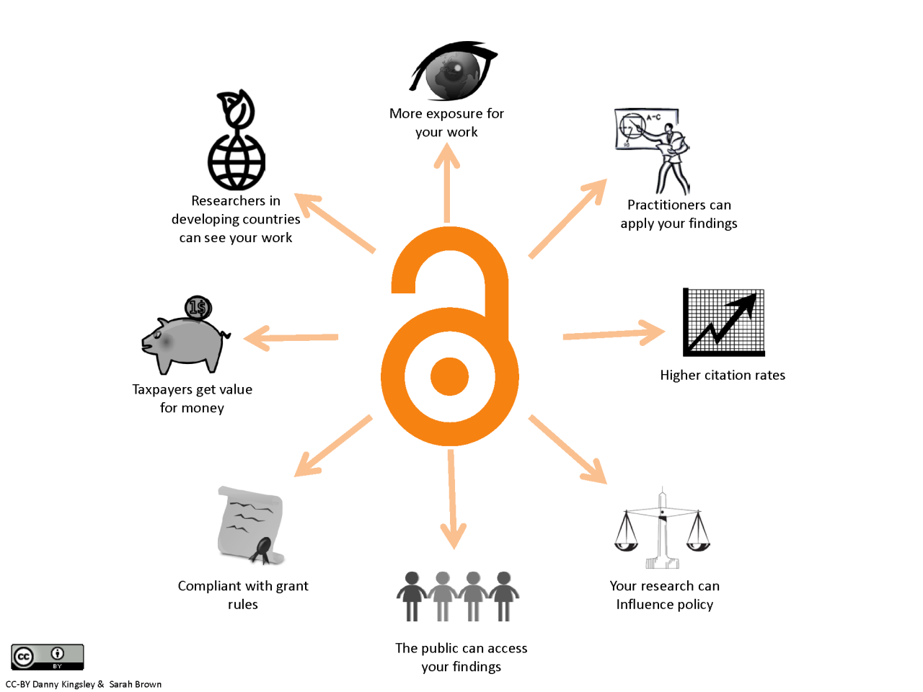
Why Open Access?
http://www.oaacademy.org/why-open-access.html
https://annaclemens.com/blog/benefits-publishing-preprint-scientific-paper/
Notes:
The figure illustrates the broader benefits of Open Access. By making research freely available, it can reach a wider audience, including researchers, practitioners, policymakers, and the public. This greater accessibility can increase the visibility and use of research, support knowledge sharing, and potentially lead to higher citation rates and greater societal impact.
Studies looking at the impact of preprints, which we will discuss ina second but for now you can imagine as freely available manuscripts before they were peer reviewed, e.g., the findings of Fu and Hughey (2019), provide supporting evidence that making research openly available, particularly through preprints, is associated with greater attention and citations. Specifically, they found that articles with a preprint had, on average 36% more citations than articles without a preprint. These associations were independent of several other article- and author-level variables, such as scientific subfield and number of authors, and were unrelated to journal-level variables such as access model and Impact Factor.
So, with your open access article, you give something back to the taxpayers who funded your research in the first place, you give the public access to your work, and practitioners reliant on the most recent scientific findings, such as doctors or psychotherapists, you get more exposure for your work and you get higher citation rates. Importantly, open access is now increasingly wanted by funders, so you are increasing your chances of obtaining a grant by complying to the grant regulations.

Slide 25
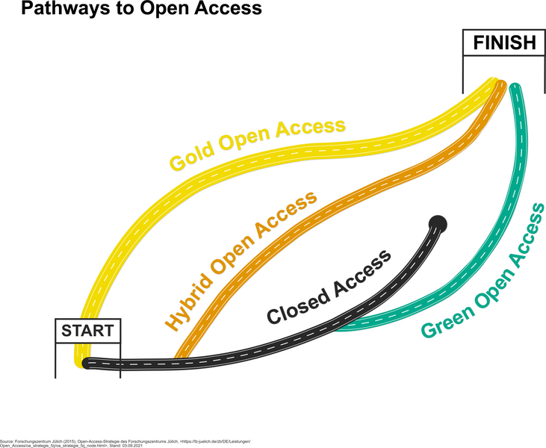
Types of Open Access
Source: Open Access Network (2021), Pathways of Open Access (CC BY 4.0 International)
Notes:
When we talk about Open Access, there are many types. Here is a visual overview from the Open Access network, which shows different ways in which research can become openly available, here represented by the FINISH line.
Hybrid open access I actually will not discuss much further, that is essentially when a journal makes some articles available under an open licence, for a fee of course, and some articles are paywalled. Closed access I will not discuss for obvious reasons, because from here on out I just want to talk about open access.
The Open Access Network is an organization integrated within the University of Konstanz. It provides a lot of information on Open Access as well as training and materials around this topic, so if anyone wants to know more, this is a good address.
Overview: https://open-access.network/en/information/open-access-primers/green-and-gold
Discussion readings: https://scholarlykitchen.sspnet.org/2024/11/12/green-open-access-free-for-authors-but-at-a-cost-for-readers/

Slide 26
Types of Open Access
 | Description | Costs for author | Other/hidden costs | Where is the PDF? | Look of PDF | Example (prices from 08/2026)
Bronze | Journals make articles free to read on their website, but without open license, and without right to download or share | 0 € | (depends - usually subscription fees) | Journal’s website | Formatted journal’s layout | Nature ReadCube
Gold | Journals that are entirely open access; authors pay article processing charges (APCs) | typically 600 € - 5000 € | 0 € | Journal’s website | Formatted journal’s layout | PLOS ONE (APC 1800 Euros)
Green | Self-archiving of the pre- or postprint in repositories or private websites | 0 € | (depends - usually subscription fees) | Open Repository | Author’s version (Word, Latex, etc) | Science
Diamond / Platinum | Open access journals without APCs | 0 € | Institutions pay for journal maintenance costs | Journal’s website | Formatted journal’s layout | Social Psychological Bulletin (on PsychOpen platform) Open Journals LMU
https://open-access.network/en/information/open-access-primers/green-and-gold
Notes:
When we talk about Open Access, there are many types.
Bronze open access is the most curious case of Open Access. It is when the reader does not pay to submit an article to a journal, but the long-term availability is not guaranteed. For Bronze Open Access, it means that after you submit your article to a journal under Bronze Open Access, not you yourself make your article free to read, but the journals does it on the website, but without an open license. So you can read it on the website, but you're not allowed to download it. You're not allowed to use the text for anything else than reading it. Sometimes you're not even allowed to print it. So according to the Budapest declaration, this is actually not Open Access, but they call it bronze Open Access. It doesn't cost you anything. The PDF is at the journal's website and it's formatted in the journal's layout. The problem is also that access can be temporary: the journal can your article take down anytime and then you can't read it anymore.
Gold open access is what most people think of when they hear “open access.” In this model, you submit to a journal and the final published version of the paper is freely available to everyone immediately. However, it usually involves paying an article processing charge, or APC, just to publish in that journal which can be covered by the author, their institution, or funder in the submission process. The costs are typically somewhere between 600 and 5000 Euros. Remember that the publisher cost to publish your article is around 400 Euros, so publishers overcharge by a lot in many cases.. Often APCs are covered by your organization. And then the PDF is available on the website of the journal in the layout of the journal, free for download. Many well-known journals like PLOS ONE or Nature Communications operate this way. For PLOS ONE, for example, you pay an article processing fee of around 1800 Euros depending on the USD exchange rate, and after publication, your articles is freely accessible under an open license to readers and yourself.
Green open access might be a type of open access that is a little bit less known, but is one key open access type that I wanted you to be familiar with.
Green open access is when an author deposits a copy of the paper, usually the accepted manuscript, in a repository or on their personal or institutional website and then additionally go the traditional publication route and publish their work with a journal. Green OA is also sometimes referred to as “self archiving”. So you have a copy of your work on a separate repository, that you uploaded there yourself and is free for anyone to read. In the repository, you have your manuscript, as a pdf, for example, in your own formatting version and not in a journal template. The costs for you as the authors in this case are zero. We will go through the process in a minute. Depending on which journal you chose to publish your article after in addition to making it available yourself, could mean that you still pay processing charges or that your university pays subscription fees for accessing the journal article. Accessing your own repository, however, would be free for everyone.
Finally, there is platinum or diamond open access. These are Open Access journals without APCs. In this is model, publishing and reading articles is free for authors and free for readers. How do these publishers pay for their costs? Usually, the costs are covered by scientific societies, or funded by universities or a grant, or crowdfunding. These journals often reply on volunteer work. And often these journals try to lower the costs, for example, by not paying someone to take care of the layout but instead by providing a Word or Latex template. And then the authors should just use the template. And if the papers don't look exactly identical in the layout, they don't really care. They care about the content and not about the cover. So here are examples for diamond Open Access journals. In fact, UNESCO initiated the Global Diamond Open Access alliance in 2024, stating that diamond open access should be promoted wherever possible.
Discussion readings: https://scholarlykitchen.sspnet.org/2024/11/12/green-open-access-free-for-authors-but-at-a-cost-for-readers/

Slide 27
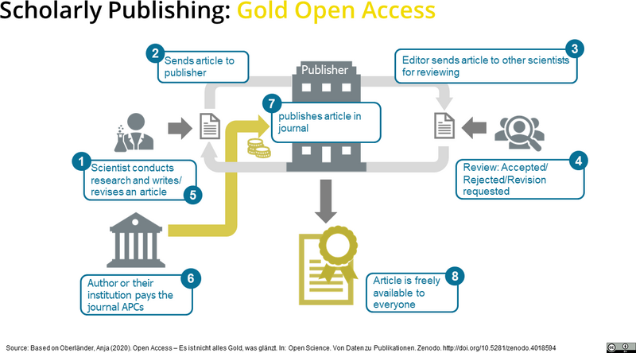
Source: Based on Oberländer, A. (2020). Open Access – Es ist nicht alles Gold, was glänzt. In: Open Science. Von Daten zu Publikationen. Zenodo.
https://zenodo.org/records/4018594 (CC BY 4.0 International)
Notes:
Here a more graphic overview of the publication process of a paper published with Gold Open Access. The key here is that to publish Gold OA, publishers charge Article Processing Charges. These APCs, by the way, are also widespread in closed access publishing. Often APCs are covered by institutions, who have publishing deals with the publishers. So it can be that institutions will partially or fully cover the fees, sometimes there is a quota.

Slide 28
Free your research!
At the end, every OA publication (gold, green, diamond) can be read freely by everybody → the main difference is in financing
If green OA is possible - why pay at all? Make your research free for no extra costs (and without throwing more money at publishers)
  But: Funding agencies might have regulations (e.g., embargo periods)
Moral obligation to release your research as green OA wherever possible
  = Self-archiving pre- and/or postprint
Notes:
Thinking back to the Ebola example from the beginning, the goal from an open science perspective would be to free your research so that others can read it, that other researchers can build upon it, and that society can profit from it. At the end, every open access publication, regardless of the color is free to read by everybody. So the main difference is the financing.
So the question is maybe: which one is for me? If green open access is possible, well, why should you pay at all? Self-archive your work for no extra cost and make it available to everyone, while you still follow the more traditional publishing route. So green open access, again, means you publish at a classical journal, it is paywalled, but you can publish the final version as green open access. So the only difference is the only difference is that whatever you self-archived and made available, it will not have the layout of the of the journal. But also, if it's possible to make your research free without paying, I would suggest don't pay.
I would say we have a moral obligation to release our research as green open access wherever possible.
How would you do that? By self-archiving a pre- or postprint, for example.
So let us have a look at how we would go about publishing a paper the Green Open Access way.
---------------------------------------------------------------
Discussion: pros and cons of green open access
https://blogs.ch.cam.ac.uk/pmr/2011/07/20/the-benefits-and-limitations-of-green-open-access/
Embargo Periods: Publishers often impose embargoes, restricting access to the article for 6 to 48 months after publication.
Version Restrictions: Usually only the accepted manuscript (post-print) can be shared, not the final publisher-formatted Version of Record (VOR).
Administrative Burden: Authors must manage the self-archiving process, including tracking publisher policies and managing file versions.
Lower Discoverability: Articles in repositories may be less discoverable than those on publisher websites.

Slide 29
The Green OA publishing route
Preprint
submitted manuscript
reviews come in
revised version
final version = Postprint
copy-editing (minor linguistic changes) + journal’s layout
Publisher’s version
Notes:
Here would be a visualisation of the lifecycle of an open paper that you publish as green open access.
I think what you are familiar with is that usually, you have a manuscript, you submit to a journal, they review it, you integrate the feedback, then you send back the final version, the publisher adds some formatting and publishes the final version. In the Green Open Access publishing route, we have some additional elements: preprints and postprints

Slide 30
The Green OA publishing route
Preprint
Preprint = manuscript before peer review
a.k.a. „the author’s original manuscript (AOM)
Before finalizing manuscript:
  Check if journal allows preprints: https://openpolicyfinder.jisc.ac.uk/
  Upload to preprint server
  Get a doi to cite the preprint
  Clearly mark the PDF as preprint, e.g.: DRAFT - not peer-reviewed
Optionally: Ask for feedback on social media (external review)
submitted manuscript
reviews come in
revised version
final version = Postprint
copy-editing (minor linguistic changes) + journal’s layout
Publisher’s version
Notes:
You start with a preprint, which is a manuscript before it has been sent out for review at a journal. In other words, this is the author’s original manuscript. Once you have this, you need to check if the journal you would like to submit to allows preprints. Most journal these days allow preprints, but it is nevertheless good to check. The journal typically has this info on the website, or you can use this website to find journals in your field who accept preprints. If a journal allows preprints, it means they permit you to publicly share a draft of your research manuscript on a preprint server (like arXiv, bioRxiv) before it has undergone formal peer review.
If you discover that your chosen journal accepts preprints, you can go ahead and upload your preprint to your personal website or, even better, a preprint server. I will give concrete examples in a moment. When you upload your preprint there, you get a digital object identifier (DOI) that makes your preprint citable. In this process, clearly mark your pdf as a preprint. Others need to be aware that this is your original manuscript version and that it has not been peer-reviewed yet. Large letters usually work well, in red font on the title page. The readers need to be aware.
Once you have uploaded it to the preprint server, you can tell your online community on social media that you have new exciting work and that you are asking for feedback. This way, you would not need to rely on journal reviewers, but you would get feedback from a larger community. Note also that peer review does not need to come from reviewers from a journal, if your colleague reviews it, it is also peer reviewed.
Sometimes papers stay preprints forever – then drop the „draft“ and just mention that it has not formally been peer-reviewed in a editorial process.
-------------------------------------------
ADDITIONAL INFORMATION
Under German copyright law, authors are allowed under certain conditions to make post-prints available to the public, irrespective of whether the publisher agrees to this. This is known as the Zweitveröffentlichungsrecht. If you’re a researcher in Germany who published a publicly funded journal article, you can typically upload your post-print to a repository after 12 months, as long as it’s non-commercial and properly cites the original publication, even if your publisher objects.

Slide 31

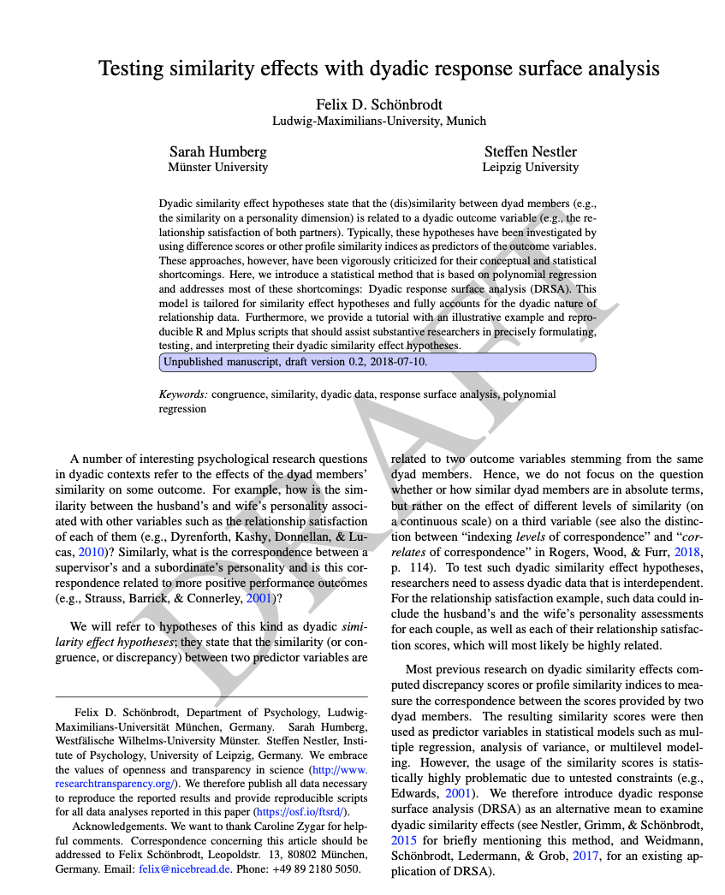
Example: Preprint
Even better:
"Unpublished manuscript,
version 0.2 (2020-05-07), NOT peer-reviewed.
Cite at your own risk.“
Notes:
This is an example for how to clearly mark a preprint. Citation is possible, but at your own risk since errors might only get detected during the review process. When you start citing preprints, it can be good to check for updated versions.

Slide 32
The Green OA publishing route
Preprint
Optionally: Update preprint on preprint server with revised version
  Make a note on the front page that this is a revised version
  (technically, a revised version is somewhere between pre- and postprint)
submitted manuscript
reviews come in
revised version
final version = Postprint
copy-editing (minor linguistic changes) + journal’s layout
Publisher’s version
Notes:
When you get your peer reviews in, you have what you know as the revised version of your manuscript. You could now update the preprint on the preprint server with the revised version and state that this is a revised version. Note that revised manuscripts are also manuscripts before the official acceptance by the journal.

Slide 33
The Green OA publishing route
Preprint
Post-print = accepted version after review, but before layouting. a.k.a. the accepted manuscript (AM)
Before final submission to journal for copyediting
Check if journal allows post-prints: https://openpolicyfinder.jisc.ac.uk/
Update PDF on preprint server with the post-print
Clearly mark the PDF as postprint.
Distribute the link to the open access version to colleagues etc. Put OA link on your website.
submitted manuscript
reviews come in
revised version
final version = Postprint
copy-editing (minor linguistic changes) + journal’s layout
Publisher’s version
Notes:
When you get reviews back from the journal and your article gets accepted, you have what is called a postprint, aka the accepted version of your manuscript after reviews, but still before any standardized layout according to journal standards has been applied. So this is your original manuscript, in the layout you had it initially, including revisions.
Next, you should check if your journal allows postprints. If they do, then you would do what you did before with the preprint, you upload the postprint to a postprint server, share it on social media if you like and keep it openly accessible for everyone.
If you had a preprint, you can simply update the preprint on the preprint server with the revised and accepted version. Most preprint servers have versioning, meaning that the first version is not replaced, but readers can see that you first had a preprint version, that was later updated once the revisions had come I and updated again once it was accepted. This way, readers can compare versions and see what has changed.
Now you can re-mark the version as postprint and say hey, this version has been revised by peers and I have integrated the feedback. Readers should know that this is now a new version that is peer reviewed. For your postprint, you will once again get a DOI that you can share with colleagues or the online community.
Once your article was published with the journal, you can distribute the link to your postprint and this accepted version to your colleagues. Also put the link to this onto your website if you have one. Make it easy for your readers to find your work and to cite it. Ideally, there is just one click for the reader to go from an article title to the pdf version.

Slide 34

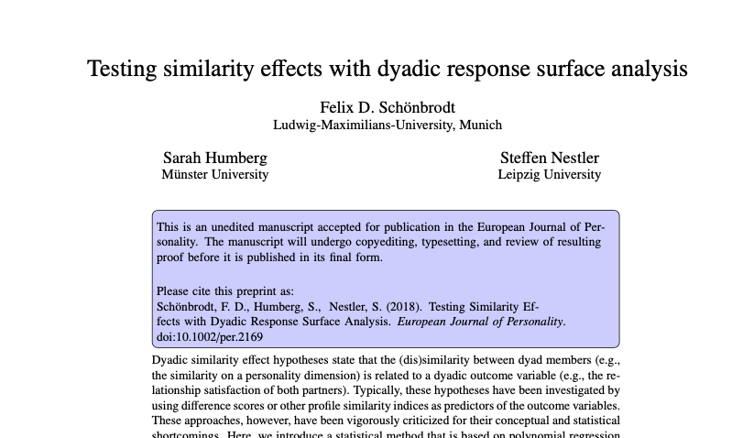
Example: Postprint
Please cite as:
Notes:
This is an example for how to mark a postprint. It is a clear note that this is a postprint, namely that it has undergone revisions and was accepted but it is not the publisher version with a specific layout etc. It is nice to have a date and a note that this is an unpublished, but reviewed manuscript. Citation is possible.

Slide 35

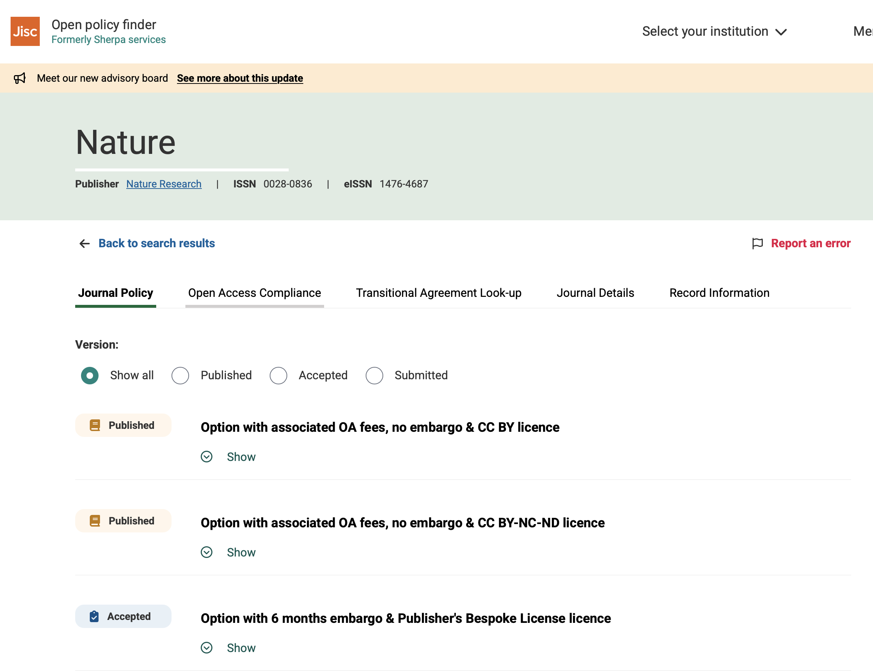
https://openpolicyfinder.jisc.ac.uk
Notes:
Open Policy Finder is a free tool that helps researchers and institutions understand Open Access publishing policies. It brings together information about journals, publishers, and funders in one place.
For example, researchers can use it to check:
- Whether a journal allows Open Access or self-archiving
- Which version of an article can be deposited in a repository
- Whether there is an embargo period before a paper can be made openly available
- Whether a journal meets the Open Access requirements of a particular funder, note that this is limited to UK funders.

Slide 36
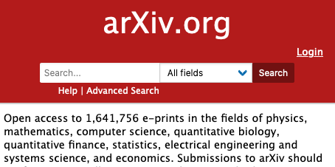
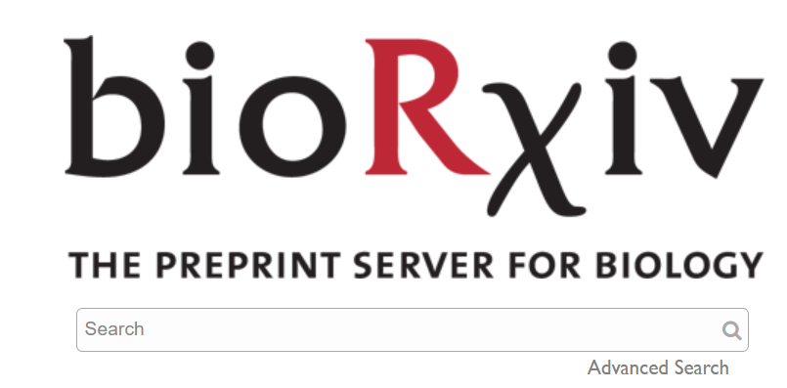
Pre- and postprint servers
https://www.biorxiv.org/
https://arxiv.org/
Notes:
The mother of all preprint servers is archive.org. It is focused in math, physics, computer science etc. Bioarchive is what neuroscience would use for example.
Technically speaking, preprint servers are a mix of preprints and postprints and revised original manuscripts. This is because you first upload a preprint, then the revised version, and then also the postprint, so the so-called preprint servers are actually also postprint servers, for example.

Slide 37

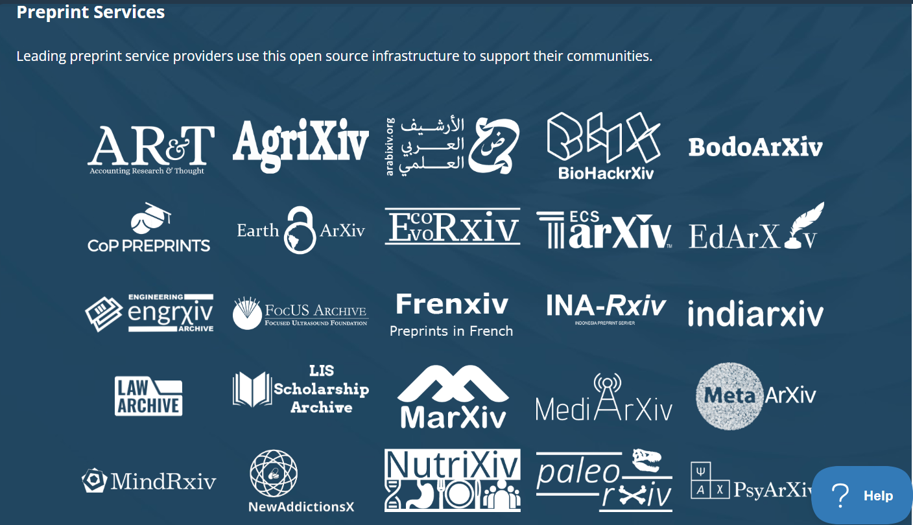
Pre- and postprint servers: OSF
Hettne et al. 2021. A Practical Guide to Preprints: Accelerating Scholarly Communication (1.0). Zenodo. https://doi.org/10.5281/zenodo.5600535
In contrast to ResearchGate and academia.edu these are non-commercial services!
https://osf.io/preprints/discover
Notes:
There are new preprint servers coming out, many of them integrated into the Open Science Framework, OSF. There are also many that are tailored to specific disciplines, or geographic regions, for example Arica archive, Earth archive etc.
Maybe some of you are thinking: Ah, I published my paper in a journal but I also have my paper on academic.edu or ResearchGate. Perhaps good to know those are commercial websites, they make money by selling ads and selling your data. OSF preprint servers are not commercial and they keep your data and metadata safe.
OSF has been a great platform historically because it combined many different services into one: archiving, preprints, project collaboration, file storage, data repository, file sharing etc. In August 2026, OSF announced that it will move away from being a general purpose repository and instead be the connecting platform between preprints and materials in other repositories. While this has quite large implications for research projects being hosted on OSF, the preprint service will remain unaffected. You will still be able to submit preprints, access existing preprints, update your preprints and create DOIs for them, but there are implications if you want to store your research materials along with your preprints.
Right now, if you have a preprint together with your materials in a public OSF repository, from late 2026 you will still be able to access everything, but you can no longer make changes. So if you have data, supplementary files etc. that you know will need updating after that moment, you need to store it elsewhere. OSF has also announced that they are planning to remove private projects for storage reasons and recommend to move to a different repository.
If you are planning to submit a preprint to OSF at the end of the year or after, that will still be possible. However, you will be unable to create a new public OSF folder for the supplementary materials and the data.
More information here:
https://help.osf.io/article/727-osf-projects-transition

Slide 38
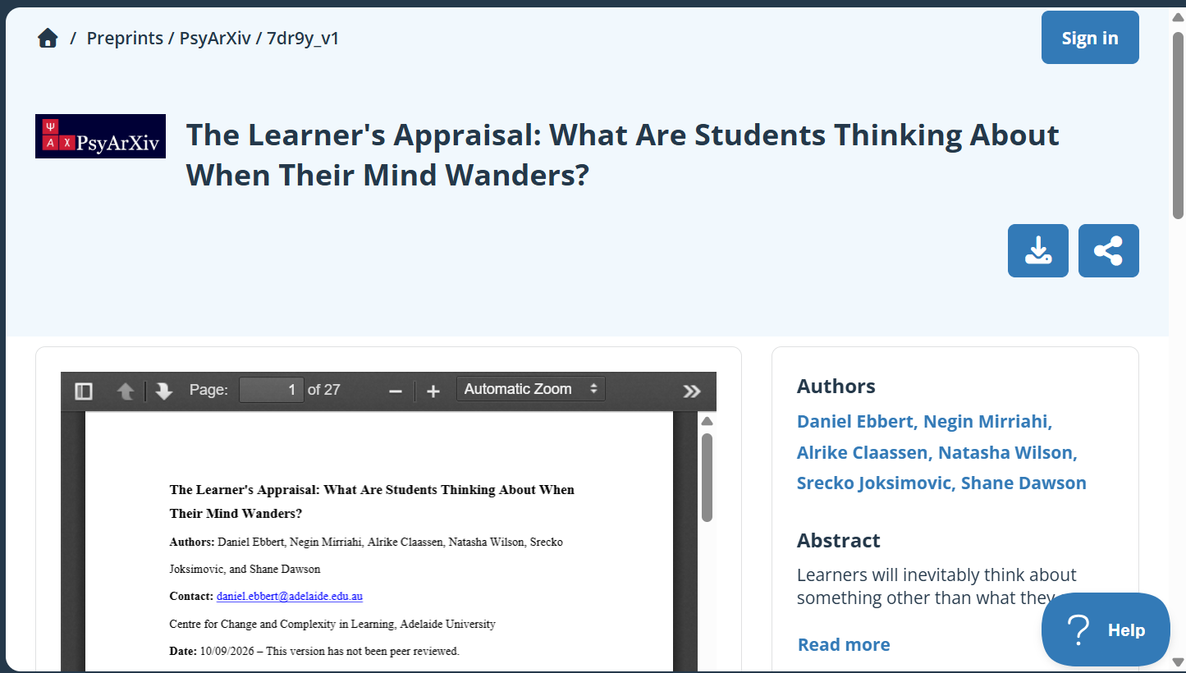
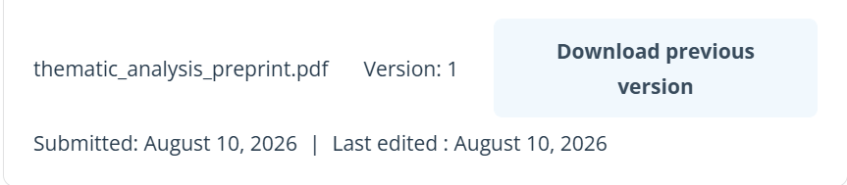
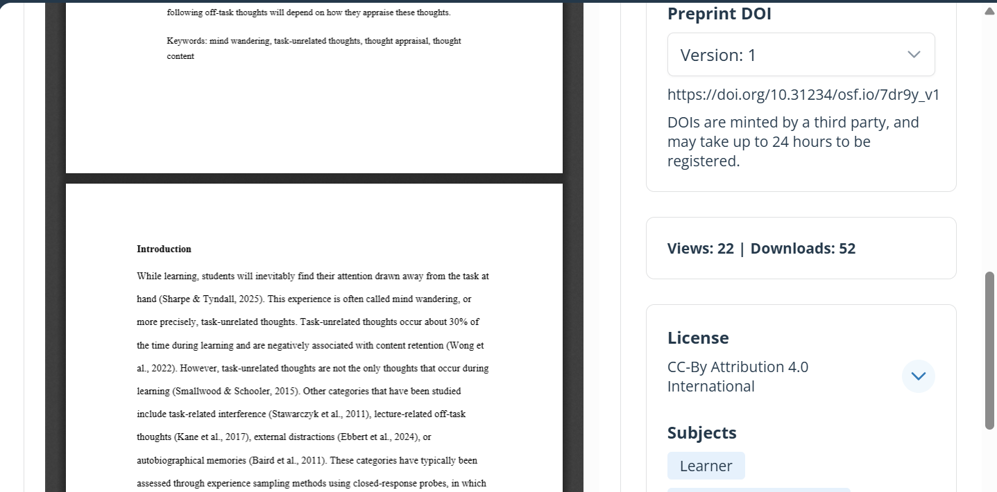
Pre- and postprint servers: OSF
https://osf.io/preprints/psyarxiv/7dr9y_v1
https://osf.io/preprints/discover
Notes:
Here is an example for a recent preprint on the Open Science Framework. You can see that it has a digital object identifier attached to it, a version and a license.
Example for recent preprint:
https://osf.io/preprints/psyarxiv/7dr9y_v1

Slide 39

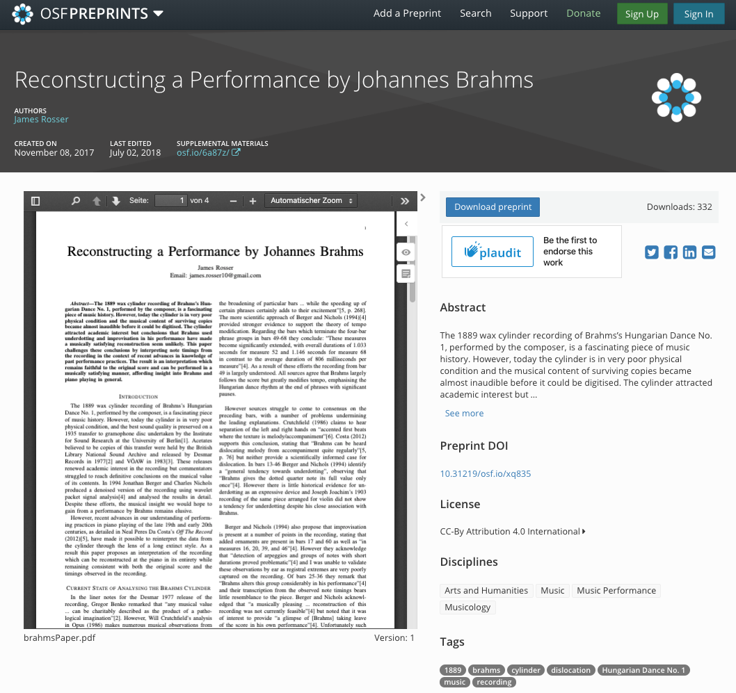
Pre- and postprint servers: OSF
https://osf.io/preprints/discover
Notes:
There are new preprint servers coming out, many of them on the Open Science Framework, OSF. There are also many that are tailored to specific disciplines, or geographic regions, for example Arica archive, Earth archive etc.
Maybe some of you are thinking: Ah, I published my paper in a journal but I also have my paper on academic.edu or ResearchGate. Perhaps good to know those are commercial websites, they make money by selling ads and selling your data. OSF preprint servers are not commercial and they keep your data and metadata safe.

Slide 40
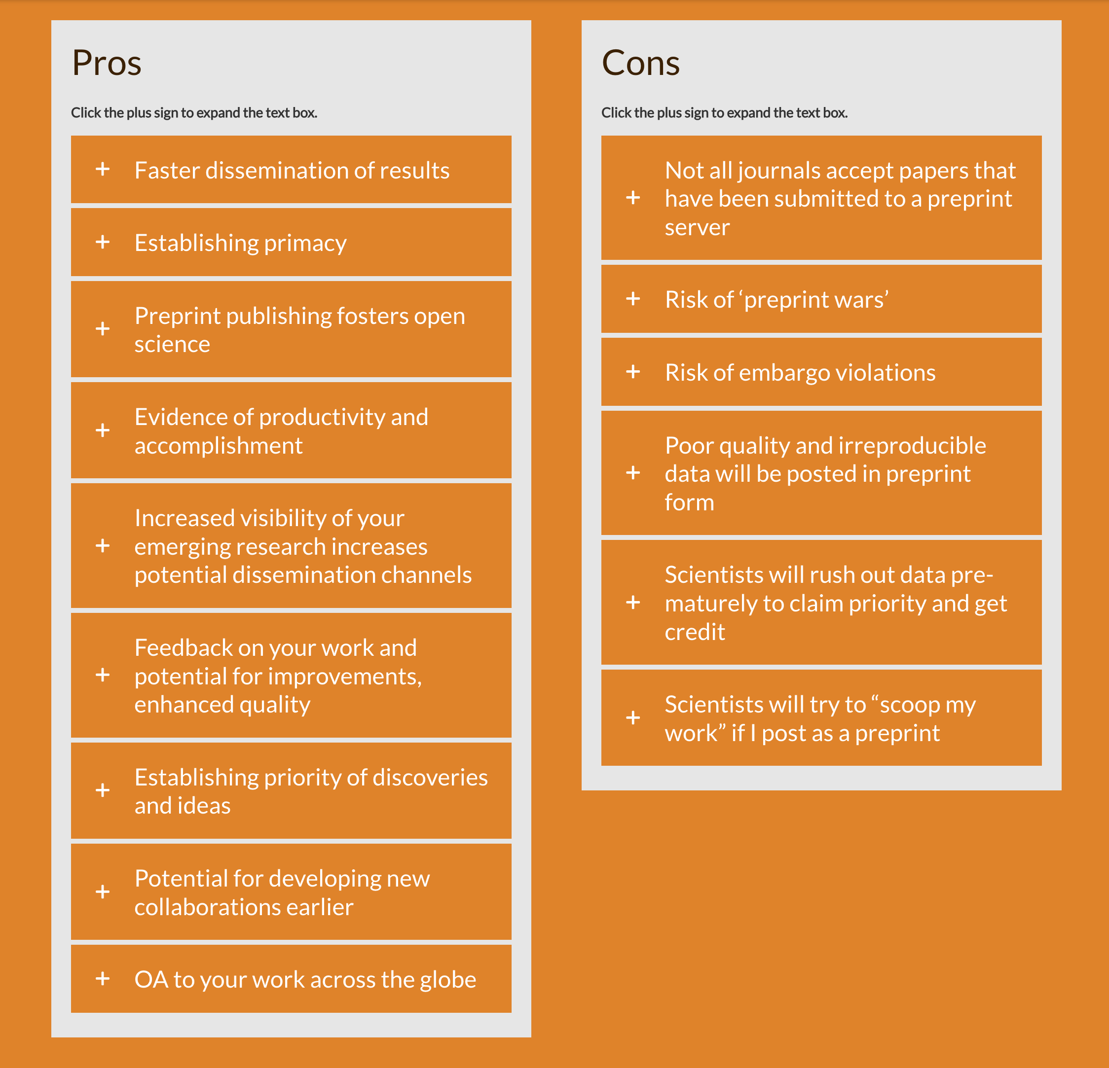
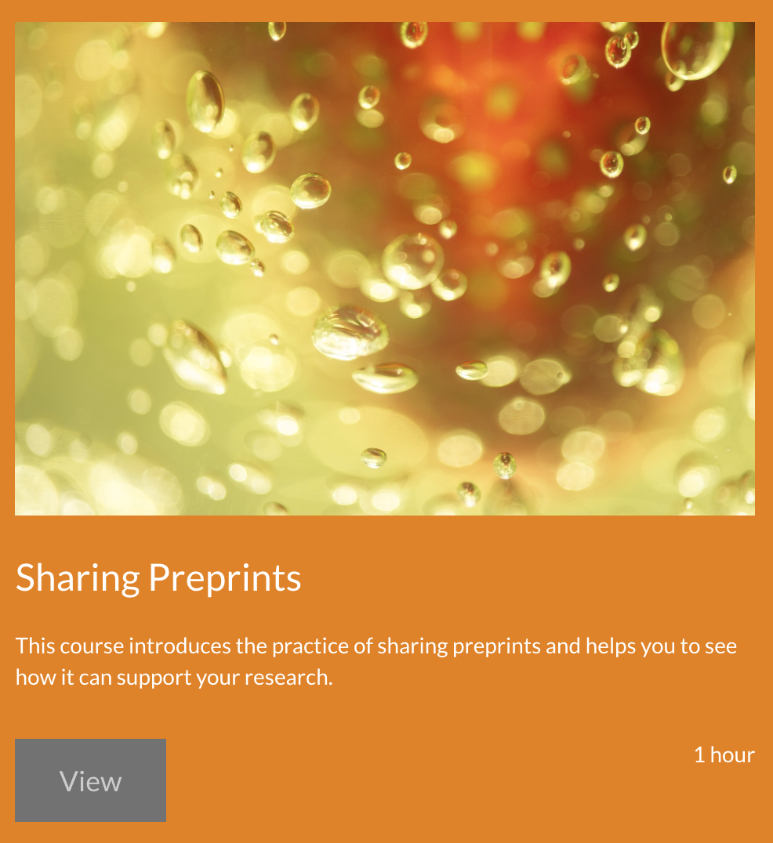
Pros and cons
/concerns
FOSTER course ‘Sharing Preprints’
Notes:
https://www.fosteropenscience.eu/learning/sharing-preprints/#/
Main pros are the faster dissemination and sollicating of feedback, the fostering of open science, increasing visibility of the research.
It is good to be aware of the cons, although some of these are not as severe. For example more and more journals are now accepting articles that have been made available as preprint, or even support this. The poor quality issue is probably countered by the fear of loss of reputation, while the scooping of results is actually countered by preprints, as they already count as a date-stamped output.

Slide 41
I have a preprint
(or a postprint).
So what..?

Slide 42
Contributing to a new way of academic publishing
Preprints and postprints (marked as such) are free to be used by anyone
  Content is not locked behind paywalls
  There is a record of versions
  Higher visibility → more citations
  …with licenses to ensure that you get credit
Not only articles to be deposited on preprint servers! Also images, analysis scripts, plots and figures … → for reproducibility
Notes:
Publishing pre- and postprints matters: it is a step towards a new way of academic publishing. What I am trying to get across here is perhaps a different way of academic publishing compared to what you know and are used to and a different way for each one of you to contribute to this new vision of publishing.
Instead of paying journals to publish our content Open Access OR not pay but then have your research hidden behind a paywall, we could store all our research output, not just manuscripts, but also data, figures etc. in non-profit and publicly funded services or repository, like archives.
Preprints and postprints could be in those archives, and they could be freely used by anyone. The content is not behind a paywall, there is a record of how many versions of this document exist and what has changed, because it is open you are more visible and you get more citations and you have licences that protect you and your work and ensure that you get credit for what you did.
Also, this would not only go for articles, but also everything else that is produced alongside your manuscript, like images, code, figures etc.

Slide 43
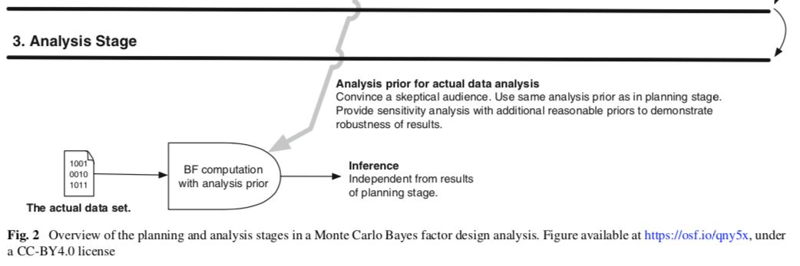
Researcher life hack: Free your images!
Publish your figures under a free license (prior to submission), and then you give the license to the journal (not the other way round).
For more details, see: https://medium.com/@malte.elson/retaining-copyright-for-figures-in-academic-publications-to-allow-easy-citation-and-reuse-77c6e2b511fe
Notes:
Let us talk about images and figures. When you present data or findings in a visual form, you are most likely generating a figure, image, graph etc. However, when you publish your article in a journal with your figures in it, the copyrights for this figure may transfer to the journal. As a result, you as the original creator of this image, may later need to ask permission from the journal where it was published to reuse your own figure. This is the case even if you recreate the figure with your own hands or draw it with your own pencil.- you may not be allowed to use that figure because you signed over the rights to the figure.
If we later want to reuse a figure from our own publication, the official approach may be to ask the publisher for permission. In many cases, permission will be granted, but technically we may no longer have the right to reuse the figure without that permission. This can create unnecessary administrative work.
One way to avoid this problem is to release the figure under an open license before publishing the paper. For example, the figure can be uploaded to a repository such as the Open Science Framework or Figshare under a Creative Commons Attribution (CC BY) license. This makes the figure available for reuse by others, including the original authors, as long as the license conditions are respected.
Instead of publishing the figure first and later asking the publisher for permission to reuse it, the figure is made openly available from the beginning. The figure can then be included in the paper or book chapter with a citation to the openly licensed version. In this way, the publisher is using a figure that has already been made available for reuse, rather than the author having to ask the publisher for permission later.
A CC BY (Creative Commons Attribution) license allows others to copy, share, adapt, and reuse your work, including for commercial purposes, as long as they give appropriate credit to the original creator. It is one of the most permissive Creative Commons licenses and is widely used to support the open sharing and reuse of academic content.

Slide 44
A vision for the future of academic publishing
Brembs, B., Huneman, P., Schönbrodt, F., Nilsonne, G., Susi, T., Siems, R., Perakakis, P., Trachana, V., Ma, L., & Rodriguez-Cuadrado, S. (2023). Replacing academic journals. Royal Society Open Science, 10(7), 230206. https://doi.org/10.1098/rsos.230206

Slide 45
A flood of preprints?
Recommender algorithms
Review:
Community, e.g. on PubPeer
Make PDF available:
Preprint server (publicly funded), OSF
An open market:
Services that compete with each other, operating on the open content.
(often there are public alternatives, possibly better commercial offers?)
Version of Record:
➙ Record of versions!
(e.g., Papers can be updated)
Make PDF beautiful:
Layout service
Organise review administratively (editorial system):
Open Source (Open Journal Systems)
Commercial providers
Persistency:
Libraries
Reproducibility checks:
Team Red Service,
AEA data editor
Content is stored in a public backbone, has an open license and is based on interoperable, open standards (defined by the scientific community).
CC0 / CC-BY
Plots & Figures
Reproducible computational environments
Data
Software, analysis scripts
Text (versioned)
Material
Notes:
So what if we were not only talking about preprints, postprints and figures stored in public repository? What if it was all research output? Data, software, analysis code, the manuscript, plots, figures and materials?
So we imagine that all of this content is stored in a public backbone, in a public repository. It has an open license and is based on interoperable open standards. So that means that the file formats are set up in a way that services and people can interact with these files.
And now comes the fun part. Based on that content, we can have different services. And these services could compete in an open market. So these could be free public services.
But I could also imagine there to be commercial services if they have an added value. So for example, if I upload my text version of my paper, I did it in Word. And now I want to make the PDF available. Well, this can be done on a preprint server. Then we need to organize the review. This has been done by journals traditionally. But we could organize it differently. So we could use, for example, open source software. There's the open journal systems, which provides well, the administrative system to organize a peer review. Maybe you've seen Manuscript Central. That's one of the commercial things. So whenever you submit a paper, the software, the website that you use can be replaced by an open source software. And we want to have not the version of record, but a record of versions. So that means that papers can be updated. We need a service to create persistency. Well, that's the traditional job of libraries, to create persistency. Then we need to do the review. This can be done by community, for example, on PubPeer. There's a very nice new journal-like system. It's called PeerCommunityIn. That's a community-driven platform to organize peer review. So we don't need the journals for that. If you want to make a beautiful PDF, well, you can ask a layout service to do that. You could ask other people for reproducibility checks. As you remember, 50% of all papers have objective numerical errors. You could avoid that if somebody else checks your paper, and you could pay for that if you want to. And if you are concerned about the flood of preprints, well, we could have recommender algorithms, which are tailored to your research interest, to your research area, based on your votes. I mean, these are problems that have been solved already. If you go to Amazon, you get very good recommendations. The same can be done for papers. So all of these services that you see here traditionally have been bundled at the journal. So the journal organizes all of these aspects, but we could separate them and get the same overall service for much cheaper and probably much better. Yeah. Also, the idea is that publishing should be scholarly-led and scholarly-owned. So it's not about commercial publishers, but the scholarly communities define how the publishing works and should be non-profit. The content is free to use and designed in a way that prevents vendor log in by using open standards and licenses.

Slide 46
Scholarly-led and scholarly-owned publishing
The content backbone is run scholarly-led and scholarly-owned by non-profit and publicly financed stakeholders.
The content is free to use by anyone, …
designed in a way that prevents vendor lock-in by using open standards and licenses, allowing portability between service providers.
These modular components are not necessarily located at a single service provider but can be distributed across distinct but interoperable services.

Slide 47
I get it, but if I want a career in academia, I have to play the game!
* ,,, and when I am tenured myself, I have to play the game for my PhD students.
Thrive in the current academic system
Build a better future
Notes:
Maybe some of you are now thinking, this kind of all makes sense and I see all the issues with the publishing systems and how it is not sustainable and I want for my work to be open access, but also I have to care about which journal I publish in and I have to care about the impact factor because I want to advance my career and currently this is the game to play. It is a tricky balance, the balance between trying to create better and fairer publishing systems and managing the current status quo.
You might think: well I am a PhD student with no power, I am a victim of the system. But: there are actually things you can do without hindering your career advancement.
https://www.unesco.org/en/diamond-open-access

Slide 48
What could everybody* do?
* without hampering your career.
Don’t play the game of glamour magz
(e.g., when you introduce external speakers, don’t mention the outlet)
Allocate your reviewing time to open platforms
(e.g., in diamond open access journals)
Always publish your post-prints as Green OA.
(unless impossible). Don’t pay unnecessary Gold OA fees!
When you apply for a grant or a position: Make your publishing strategy explicit:
  „For the following reasons I decided to submit my scientific work mostly to diamond open access journals with quality assurance: … I ask the committee to evaluate the quality of my work based on its intrinsic merits, and not based on where it is published.“
Notes:
Now, coming to perhaps the most important part of today: How can you make your research more transparent and accessible? So what is it concretely that you could do at this point without losing sight of this balance?
Do not play the game of glamour magazines: when you have external speakers, avoid mentioning in which journals they published
If you can, allocate time for reviewing for diamond open access journals
Perhaps the most important point of today: always publish your postprints somewhere on a repository as Green Open Access, so that it is freely accessible even when it is published in a journal.
Talk about what you do for science through your publishing strategy and raise awareness, for example with the following statement in your grant application or PostDoc or other job application.
These are steps you can take without harming your career, since we know that this is a big concern in the current academic system.

Slide 49
What could PIs/supervisors* do?
Mentor for responsibility, not for survival
  Gopalakrishna et al. (2022): Survey of 6,813 researchers in the Netherlands:
  “mentoring for survival“ predicts QRPs (positively), „mentoring for responsibility“ predicts QRPs negatively
Publish (some of) your best work in Diamond OA journals
Devote your service (editorial work) to open journals/platforms
As PhD supervisors (or “Doktorvater/mutter“):
  What kind of academic environment do you want to create and leave for your “offspring“?
*Hey, you are in a position to actually change the system!
Notes:
What could Pis or supervisors do to support the implementation of open access publishing? Important thing to consider is that as mentors, we shape what younger researchers understand as normal and acceptable academic behavior.
Gopalakrishna and colleagues' 2022 National Survey on Research Integrity provides an important illustration. The study surveyed 6,813 academic researchers across the Netherlands and examined factors associated with questionable research practices, or QRPs. The researchers distinguished between two forms of mentoring: “survival mentoring,” which focuses on navigating the competitive academic system and getting ahead, and “responsible mentoring,” which emphasizes responsible research conduct and good scientific practice.
The results are particularly relevant for us as supervisors. Survival mentoring was associated with more frequent engagement in QRPs, whereas responsible mentoring showed an association in the opposite direction.
So, we should not teach our students how to survive in academia, but to be responsible in academia.
This also includes being a role model. We should consider publishing some of our best work in Diamond Open Access journals and platforms, where neither readers nor authors are charged fees. And we can devote some of our editorial and reviewing work to open journals and platforms. This sends a signal to junior researchers that academic quality does not have to be equated with prestige, subscription barriers, or the ability to pay an article processing charge.

Slide 50
What could institutions do?
Change evaluation practice in hiring and promotion: Don’t use the journal impact factor (JIF). See DGPs initiative / DORA / CoARA
  In job ad: „The Department of Psychology values transparent, robust, and replicable research.[…] Please do not report journal impact factors, the committee does not use them in evaluation.“
  Do not use JIF in agreements/goals for habilitations/dissertations.
Remove JIF entirely from performance-based money allocation.
Retrospectively make all publications of the department available as Green OA (can be done by student assistant + help from library).
Notes:
Institutions also have the power to change the research culture. For example, they could change the hiring practices to no longer include “What is the impact factor of the journal this person has published in”. Impact factors are a journals property, and we know that a higher JIF does not necessarily mean higher quality of research. There are initiatives like DORA and CoARA that are calling for abandoning publication-based metrics such as JIF and focus more on quality and replicability. So, institutions could highlight this in their hiring ads, for instance with statements as shown here. So, for example, saying: "This researcher has published five papers in journals with an impact factor above 10“ does not tell a hiring committee whether those five papers are excellent, rigorous, innovative, reproducible, or important.
The same principle should apply for promotions, not just at the point of hiring. We should not use JIFs in agreements or formal goals for habilitations or dissertations. If a doctoral student is told that success means publishing in journals above a particular impact-factor threshold, we are effectively teaching them that the journal is the target rather than the quality of the research.
Next, institutional funding should not be tied to JIF in any sort of way, for similar reasons as above: they are an incredibly poor predictor of research quality. If a department receives more money because its researchers publish in high-JIF journals, then we are recreating exactly the incentive structure that we say we want to overcome.
Finally, we could make our existing research available by going back through the department’s publications and make them available through Green Open Access, as a postprint whenever the publisher copyrights allows it. This would perhaps also not take a large amount of resources: Much of the work could be done systematically by a student assistant, in cooperation with our library: identify the publications, check the publisher's self-archiving conditions, retrieve the appropriate manuscript version, and deposit it in the institutional or subject repository.
-----------------------------------------------
ADDITIONAL INFORMATION
DORA: Declaration on Research Assessment. Worldwide initiative with its roots in 2018. The key message is that JIF should not be used in hiring, promotions or funding decisions, instead the focus should be on the scientific content and the quality of the work itself.
https://sfdora.org/
CoARA = Coalistion for Advancing Research Assessment, from 2022. Key message: research assessment should be based on qualitative judgements and peer review. Calls for the recognition of the following during hiring:
Research quality, open and transparent research, peer review, collaboration, teaching, supervision and mentoring, leadership, technical contributions, science communication etc. So instead of asking “How many papers did you publish and where” it is more about: “What contributions have you made, how good were they and what impact did they have?”

Slide 51
How to … Diamond OA!
Find Diamond OA journal
  https://pub.uni-bielefeld.de/record/2963331#details
  https://doaj.org/
    Check “No fees” and double-check author rights!
Free for authors to and readers to publish and access articles
  No subscription fees
  No article processing fees
Aligns with the UNESCO 2021 Recommendation on Open Science regarding open scientific knowledge and scientific publications
Notes:
If you say that preprints for the moment are a step too far or the journal you want to publish with does not accept them, although this is rare, you could change your tactics and go straight for Diamond Open Access. There are journal findes for diamond OA and remember that the key here is that it is free for authors to publish papers and for readers to access articles. There are no subscription fees and no APC article processing charges.
In fact, UNESCO has written about Open Science and provided recommendations about the topic, and diamond OA is aligned with these recommendations, I put the link here.
https://www.unesco.org/en/diamond-open-access

Slide 52
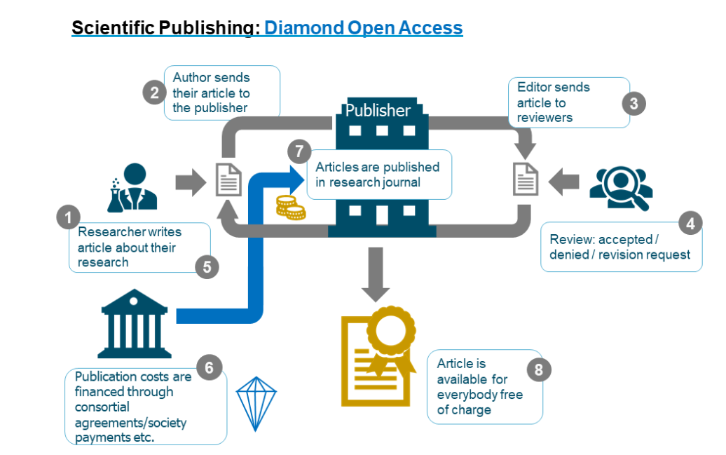
Source: Based on Oberländer, A. (2020). Open Access – Es ist nicht alles Gold, was glänzt. In: Open Science. Von Daten zu Publikationen. Zenodo.
https://zenodo.org/records/4018594 (CC BY 4.0 International)
Notes:
Here a more graphic overview of the publication process of a paper published with Diamond Open Access. The financing behind is through the way the journals are run: volunteer work, reliant on public funding etc. to then make articles completely free to publish and to read for everyone.

Slide 53
Questions / comments / concerns?
Notes:
And with this, I would like to open up the room for questions. What are your questions?

Slide 54

Thanks so much!
Reach out if you have any comments or questions!
LMU OSC: https://www.osc.lmu.de/
Developing your Open Research teaching skills:
https://lmu-osc.github.io/train-the-trainer-open-research/
Self-paced tutorials on Open Research skills:
https://www.osc.lmu.de/training/self-learning.html

Slide 55
Bonus slides
Notes:
And with this, I would like to open up the room for questions. What are your questions?

Slide 56
Open Policy Finder - Example
https://openpolicyfinder.jisc.ac.uk/publication contains information about:
  Open-access policy
  Whether the publisher allows self-archiving
  Embargo periods
  Licence requirements
  …
Notes:
If you say that preprints for the moment are a step too far or the journal you want to publish with does not accept them, although this is rare, you could change your tactics and go straight for Diamond Open Access. There are journal findes for diamond OA and remember that the key here is that it is free for authors to publish papers and for readers to access articles. There are no subscription fees and no APC article processing charges.
In fact, UNESCO has written about Open Science and provided recommendations about the topic, and diamond OA is aligned with these recommendations, I put the link here.
https://www.unesco.org/en/diamond-open-access

Slide 57
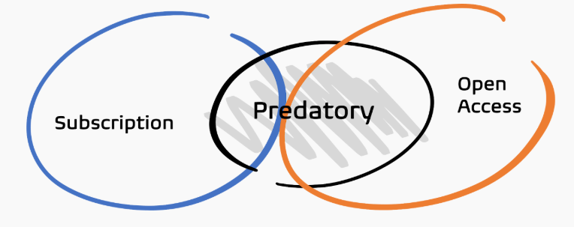
Predatory publishing
- Predatory publishing = “an exploitative business model that involves charging publication fees to authors without checking articles for quality and legitimacy”
  Compromises the credibility and integrity of scientific research
  (Shen et al., 2023)
https://www.predatoryjournals.org/
Notes:
Predatory journals are journals that prioritize collecting publication fees over providing genuine scholarly publishing services. They may accept papers without proper peer review, editorial oversight, or quality control. In essence, these journals set up fake websites where articles are published and often actively recruit researchers to submit to their journal. They often fail to mention that there are fees for publishing.
The term predatory publishing was coined by Jeffrey Beall, an academic librarian of the University of Colorado. He is credited with bringing the concept to the attention of academics, and maintained a website until 2017 that listed predatory publishers and journals. It is not without controversy, as there have been discussions around the criteria for what is a predatory journal.
In simple terms, you could say that predatory publishing is an elaborate con scheme, with researchers as their victims. However, there are also researchers that will willingly submit to these fake journals, especially in a system where research performance is about quantity rather than quality
There are some common predatory practices that authors should be aware of:
Badly designed journal websites, although this is not as common anymore with the help of GenAI
Promising short review and publication times
Predatory journals will also republish or plagiarize articles from legitimate journals and pass them off as original work
They will clone legitimate journal websites to collect author charges when authors believe they are submitting on the correct website
Emails to invite authors to conferences. Authors are invited to present at conferences and fees are collected in advance in return for publishing their work afterwards.
Common Warning Signs:
-Very rapid acceptance with little or no meaningful peer review.
-Pressure to submit papers or join editorial boards, sometimes solicited via email
-Publication fees are not clearly disclosed upfront.
-Researchers may be listed on editorial boards without their knowledge or permission.
-Journals may use fake editors, reviewers, or editorial board members.
-Editors may publish excessively in their own journals.
-The journal imitates the name or website of a reputable journal.
-It may provide a misleading address or location.
Think. Check. Submit. Org https://thinkchecksubmit.org/ is a great initiative to identify which publisher you can trust with your research.. For example, they offer a checklist to assess a specific journal or publisher.

Slide 58
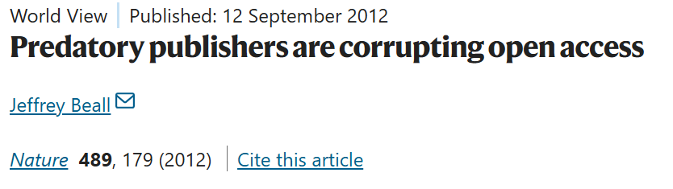
Predatory publishing
- Predatory publishing increases the amount of freely available low-quality research outputs
  Does not only affect open access publishing, but also the rise of “paper mills”
Beall, J. Predatory publishers are corrupting open access. Nature 489, 179 (2012). https://doi.org/10.1038/489179a
Notes:
People have long been misled into believing that predatory publishing is unique to OA journals, while predatory behaviours could be seen among traditional commercial publishers as well. Predatory journals are also known as dubious, deceptive, or fake journals. However, concerns about academic fraud are not limited to predatory practice committed by publishers through predation on researchers but also include individual research misconduct engaged by a researcher or researchers which can take various forms, namely, falsification, fabrication and plagiarism. Recently, a rising threat posed by the activities of ‘paper mills’, where organizations offer scholarly papers, authorship or other deceptive academic products for sale, has worsened the situation.

Slide 59

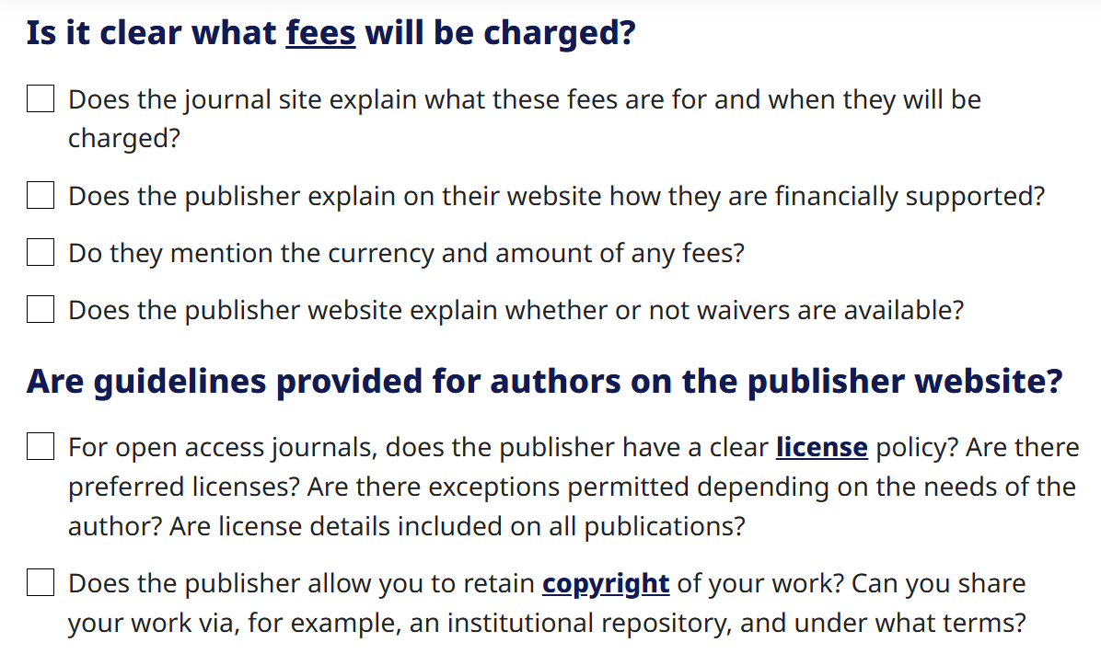
Diamond access and predatory publishing
see
Diamond OA cannot be predatory!
(Because no profit is made)
https://thinkchecksubmit.org/
Notes:
EDIT
What about predatory publishing? Sometimes the boundary between predatory publishing and legit publishers is not so clear. There was a very nice blog post comparing MDPI, which is alwayslike in the gray area. So some people think it's predatory, others think it is not. There's a bigdiscussion. And this blog post compares MDPI, I think with Elsevier, along systematic dimensions. Andthe conclusion was, we cannot find systematic differences between these publishers. So it'ssometimes really hard to tell what is the predatory publisher. There's this website, think, check, submit, which gives you some hints how to spot predatory publishers. One good thing is diamond open access cannot be predatory because no profit is made. So predatory is about profit. And if there'sno profit, then it's not predatory.

Slide 60
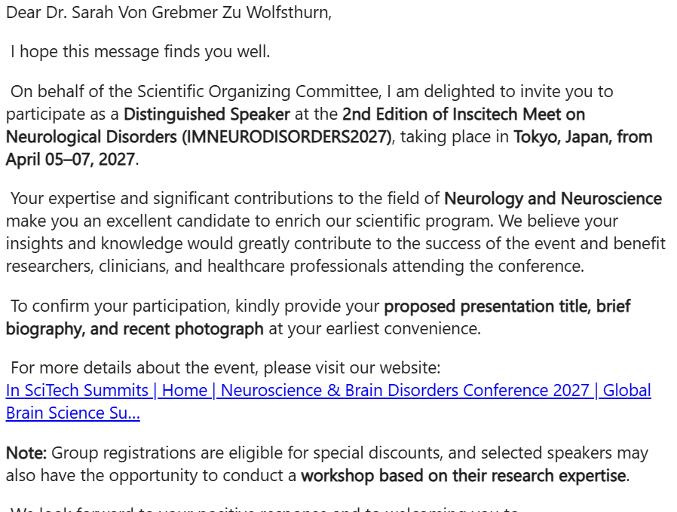
Predatory invites to “conferences”
Notes:
Mid August 2026 I coincidentally received this email. It was an invite to participate as a distinguished speaker at the second edition of the conference on neurological disorders in Tokyo in April 2027. They invited me because of my expertise in neurology and neuroscience, which, of course, I do not have. Since I was just preparing this current slide deck, I decided to do a little detective work and see what I can find out about this conference and the company who organizes it as a potential example how academia has also attracted con artists.

Slide 61
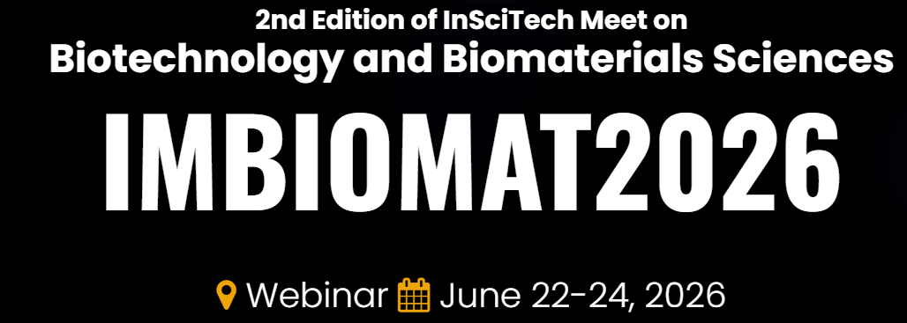


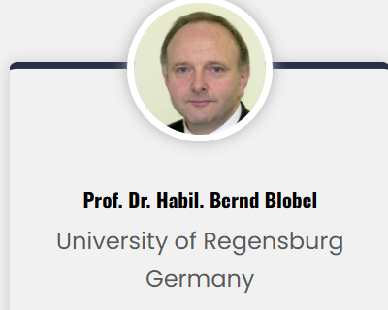
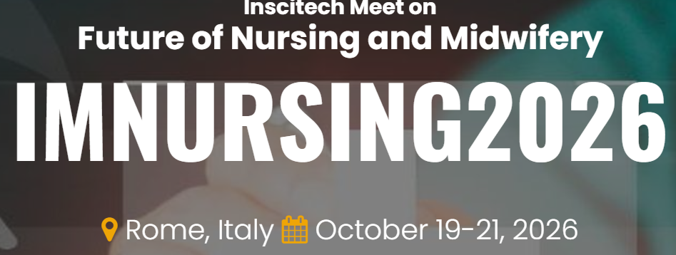
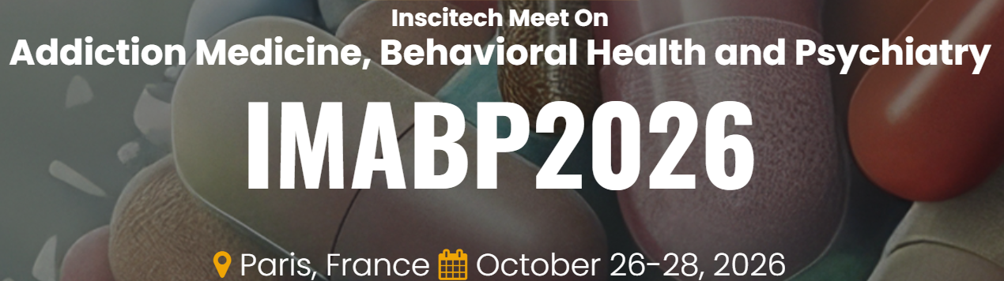
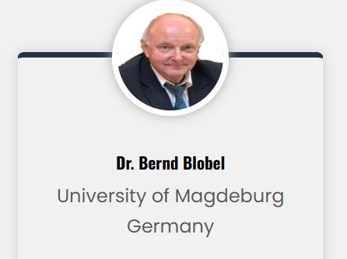
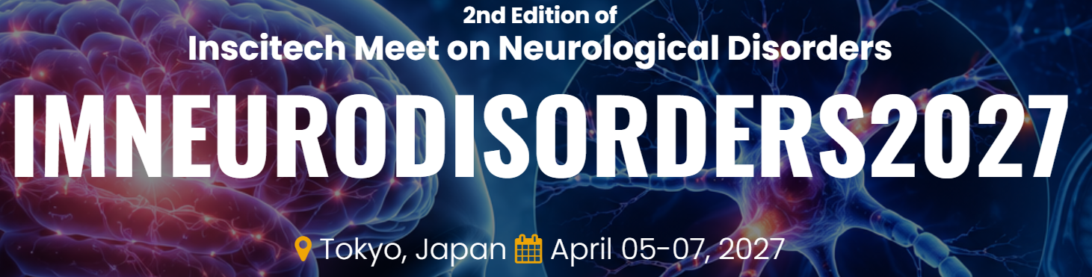
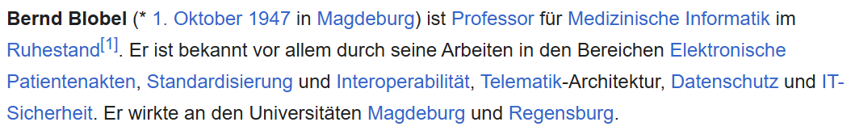
Notes:
So I looked into this conference organizer, INSCITECH. On their website, they state that their address is in Las Vegas. When you look up the company, you find out they are actually a registered event management company in Hyderabad in India, about one year old. Maybe a little odd, but ok, perhaps just a mistake on the conference website and sometimes companies have mailboxes somewhere else.
It becomes more interesting when you look at their website in more detail. So they organize large amounts of conferences, or meetings or summits as they call them, across all fields: dental science, nanotechnology, engineering, astronomy, applied sciences, you name it, often happening at the same time. If they are a large event management company, perhaps that is also nothing unusual. They have fees to participate in these congresses, specified in Indian Rupees, you get an early bird fee if you are super early etc. These fees are not nothing, but around 400 dollars for students, for conferences usually lasting about three days. So you registered and want to attend. Problem is that none of their websites specifies the actual location beyond the city. No conference venue. Hmm. A little more fishy.
The most interesting part however is when you look at the invited speakers, the keynote and plenary speakers. For example, you will find a certain Prof. Dr. Bernd Blobel as a keynote speaker or plenary speaker for all these conferences listed here. According to his Wikipedia page and publishing record, his background is in medical informatics. So then perhaps his keynote at the conference for biotechnology was not that strange. Just in August 2026 he allegedly appeared at the neurological disorders conference. My favorite is this conference he will take part in next month on Nursing and midwifery in Rome. At the same time, he is of course also speaking at the public health conference in Rome, but perhaps they managed it so that he speaks at one conference on the one day and at the other the next day. For those two conferences, his keynote title is actually not known yet, but will be updated soon I am sure. Just a week later, he has another keynote in Paris for addiction medicine and psychiatry. To top it off, he has already secured another keynote at the meeting for neurological disorders in Tokyo, for which his keynote title is already known.
I decided to email him and another few alleged keynote speakers from these conferences to verify if they were aware of their conference participations. This far, I have not gotten a response, but my guess at this point is they will not know what I am talking about.
The point here is that these are mostly real people, real researchers at real research institutions, that are likely used in these fraudulent websites to attract other researchers and interested parties to these conferences and to scam them for registration money. In case you thought I had prepared this slide specifically: these are screenshots of the actual conference websites. They look the same, the structure on the website is the same, and even the keynote speakers are the same, as we just saw.

Slide 62
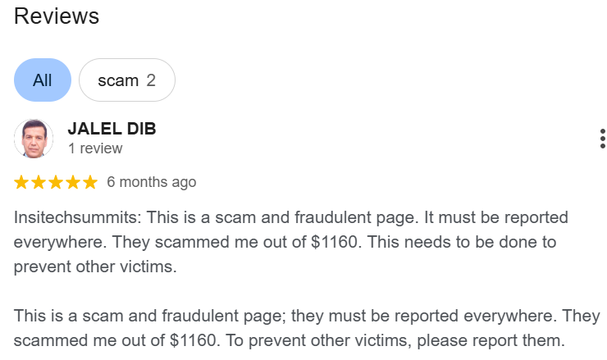
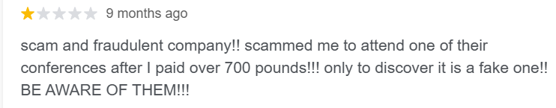
Notes:
There are two Google reviews about this so-called company, that denounce this company as being fake because they had payed the registration money just to find out that the conference of course does not exist.
Already before AI, it was increasingly easy to scrape the internet for whatever information you wanted. If you have a little tech background, now helped by AI for structure and grammar, you can generate thousands of these fake websites in no time. And people have caught onto the fact that researchers do in fact go to conferences and pay conference fees, and want to publish their work in a journal. So what best than to pretend that you are a journal and request that you submit a paper (for a fee)? Or that you are invited as a speaker to a conference, for which you unfortunately also have to pay.
The key message here is: it is no longer a secret that there is big money in publishing and people are trying to get into this business – as researchers we need to beware and always check the sources, never click links and verify the identity of the journal or conference.

Slide 63
References
Björk, B.-C., Welling, P., Laakso, M., Majlender, P., Hedlund, T., & Gudnason, G. (2010). Open access to the scientific journal literature: Situation 2009. PLoS ONE, 5(6), e11273. https://doi.org/10.1371/journal.pone.0011273
Capot, C. (2014). Free access to medical information for African countries battling Ebola: New initiative gives healthcare professionals access to Elsevier’s medical content online and via mobile. Elsevier Connect (blog). elsevier.com/connect/free-access-to-medical-information-for-african-countries-battling-ebola
Cisarella, J. (2013). Open access: Which side are you on [Slides]. de.slideshare.net/cirasella/open-access-which-side-are-you-on-oa-week-2013
Dahn, B., Mussah, V., & Nutt, C. (2015, April 8). Yes, we were warned about Ebola. The New York Times. nytimes.com/2015/04/08/opinion/yes-we-were-warned-about-ebola.html?_r=0
Masnik, M. (2015). Don’t think open access is important? It might have prevented much of the Ebola outbreak. Techdirt (blog). tdrt.io/eEp
Matthias, L., & Tennant, J. (2018). How to make your research open access? For free and legally (Version 3) [Figure]. https://doi.org/10.6084/m9.figshare.5285512.v3
Research Information Network. (2008). Activities, costs and funding flows in the scholarly communications system in the UK (Report). rin.ac.uk/system/files/attachments/Activites-costs-flows-report.pdf
Suber, P. (2015). Open access overview. bit.ly/oa-overview
Travis, J. (2016). In survey, most give thumbs-up to pirated papers. Science. https://doi.org/10.1126/science.aaf5704
Vilnius University Library. (2018). Open access databases. www.vgtu.lt/library/e-resources/databases/open-access/287178

Slide 64
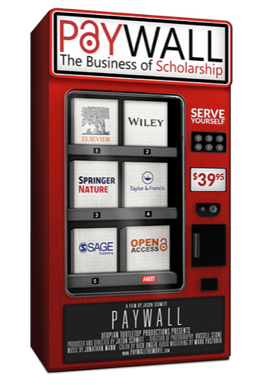
Watch the movie (1h):
“Paywall: The Business of Scholarship“
https://paywallthemovie.com/

Slide 65
Visit us at www.osc.lmu.de
Follow lmu_osc on Bluesky, LinkedIn, Mastodon
Subscribe to our mailing list: lmu-osc@lists.lrz.de

Slide 66
OSF Transition
https://help.osf.io/article/727-osf-projects-transition

Slide 67
What could you do?
For students/PhDs:
Always publish your post-prints as Green OA
(unless impossible). Don’t pay unnecessary Gold OA fees!
Don’t play the game of glamour magz
(e.g., when you introduce external speakers, don’t mention the outlet)
When you apply for a grant or a position, make publishing strategy explicit:
“For the following reasons I decided to submit my scientific work mostly to diamond open access journals with quality assurance: …”
For PIs/Supervisors:
Publish (some of) your best work in Diamond OA journals; devote your service (editorial work) to open journals/platforms
Notes:
So what is it concretely that you could do at this point without losing sight of this balance?
First, always publish your pre- and/or postprints as Green OA. Dont’t pay the Gold OA fees!
Second, don’t play the game of the glamour magazines. Do not introduce speakers at talks you organise as “Here is X, she published in Nature”. Talk about what they published. Move away from impact factor as much as is in your power.
Third, when you apply for a grant or for
a position, you could make your publishing strategy explicit. So you could say, for example, for the following reasons, I decided to submit my scientific work mostly to diamond open access journals with quality assurance, blah, blah, blah. I asked the committee to evaluate the quality of my work based on its intrinsic merits and not based on where it is published. The last sentence, I think nearly nobody would object to that. The reality looks very different. In reality, hiring committees have no time and they use the shortcuts of looking at the journal names. But if you ask them and remind them of their own values, which would be to look at the quality and not on the label, I think that's a good strategy.
Lastly, perhaps geared a little more towards supervisors and PIs: pick in which journals you publish. There is a website that launched about 15 years ago where you can pledge that you will not publish in Elsevier journals. Instead, you could donate your time time review for Open Access journals.
When you eventually move up the academic ladder, think about what kind of academic environment you would like to create for the researchers that will inevitably follow you. Fight against impact factor - we know that it is an invalid and bad indicator of quality of your work.

