Slide 1


Visit us at www.osc.lmu.de
Follow lmu_osc on Bluesky, LinkedIn, Mastodon
Subscribe to our mailing list: lmu-osc@lists.lrz.de

Slide 2
Where to next?
SARAH VON GREBMER ZU WOLFSTHURN
Last edited: 13.10.2026
Notes:
Welcome to this session! It is meant to integrate the different content and skills and provide you with somewhat of a roadmap on where to go from here. There is an inherent interactive element to this session, but self-learners can also use these slides to reflect on their own journey.

Slide 3
About these materials
These slides are a derivative of “What’s Next?” by Verena Heise used under the CC BY 4.0 License. The current slides “Where to next?” by Sarah von Grebmer zu Wolfsthurn are also licensed under a CC BY 4.0 license.
Notes:
This work is licensed under a Creative Commons Attribution 4.0 International License (CC BY 4.0).
You are free to share (copy and redistribute the material in any medium or format) and adapt (remix, transform, and build upon the material) for any purpose, even commercially, as long as you give appropriate credit to the original author(s), provide a link to the license, and indicate if changes were made.

Slide 4
Preparatory reading
To read before starting:
Heise, V., Holman, C., Lo, H., Lyras, E. M., Adkins, M. C., Aquino, M. R. J., ... & Weissgerber, T. L. (2023). Ten simple rules for implementing open and reproducible research practices after attending a training course. PLOS Computational Biology, 19(1), e1010750. https://journals.plos.org/ploscompbiol/article?id=10.1371/journal.pcbi.1010750

Slide 5
What to expect in this session
You have practiced so many different skills…
But now..
Let’s brainstorm on what
your own next steps are!
Notes:
In this session, we will specifically focus on what your own next steps could be and which skills, pieces of knowledge and new techniques are actually implementable and applicable in your own contexts.
For instructors: Use interactive whiteboards (e.g., scrumblr: http://scrumblr.ca/) to encourage your audience to collect their thoughts. Give enough time for your audience to reflect on their own journey, and discuss individual contributions and common themes in the big group.

Slide 6
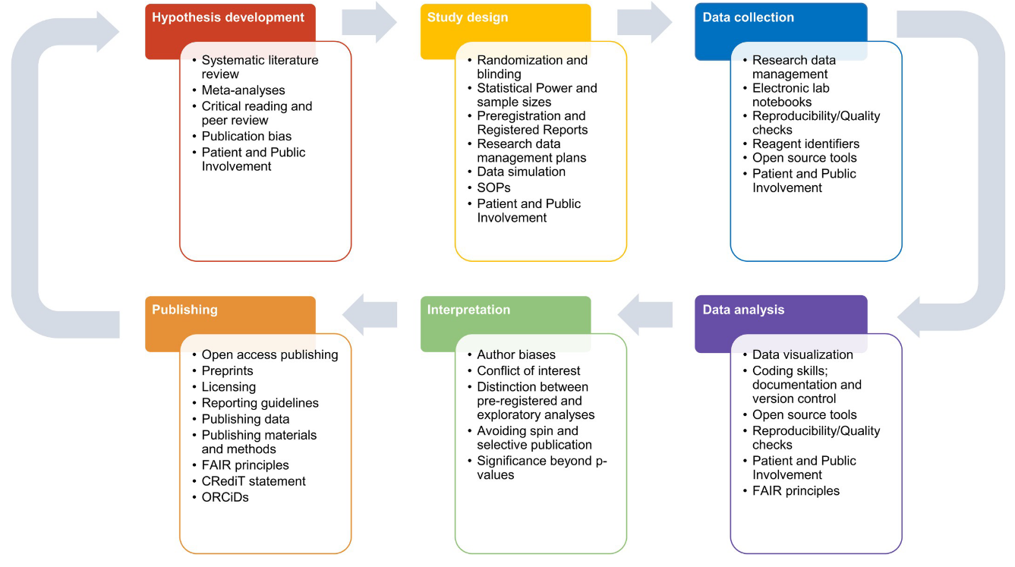
Open and reproducible research practices
https://journals.plos.org/ploscompbiol/article?id=10.1371/journal.pcbi.1010750#sec004
Notes:
If you have followed all the previous sessions, you now have a very broad overview and skills set in relation to open research practices.

Slide 7
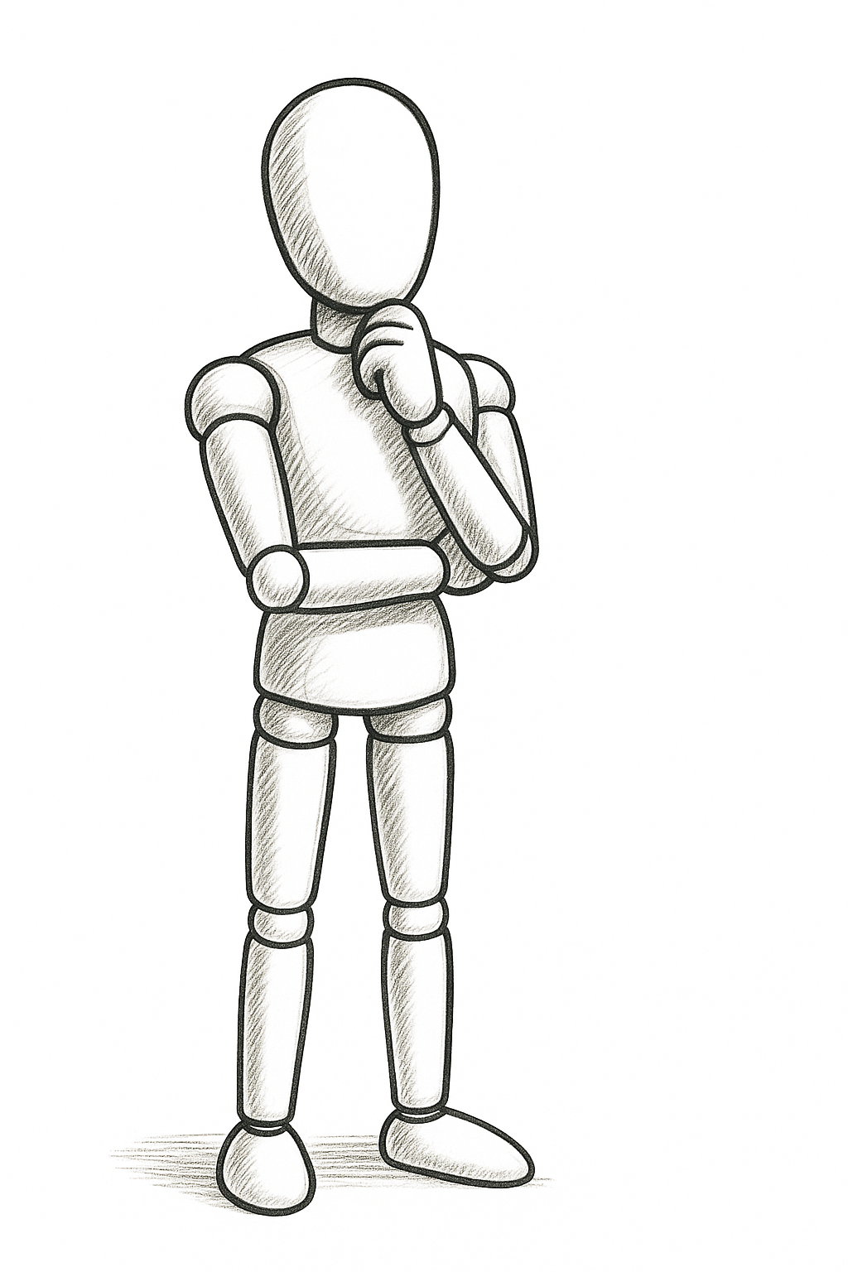
Today
R
FAIR data
Version control
Preregistration
GitHub
Quarto
Notes:
We were hoping to bring you closer to different research practices, and either introduce you to some of these practices or develop your skills over the course of the past sessions. Visualizing your current state of mind, this is what I currently imagine is happening inside your minds: your mind is full with ideas on how implement these new skills, inspiration and motivation to get going on the next part. There are probably also many more questions. Perhaps you are slightly confused about something, perhaps there was something you did not get to work etc.
Taking all of this motivation, inspiration and new skills together, the question that is at the center of today’s discussion is: Where to go from here?
Let me share a little anecdote that I think will be useful to visualize where we are currently at. Perhaps you can think of it as swimming in an indoor pool versus swimming in the open sea. In the pool, aka here in this setting, you have a safe, controlled environment, you have support around you, other swimmers, it is perhaps even indoor, so the weather is always constant and predictable.

Slide 8
Monday
Meeting
Preparing for teaching
Reviewer Two
Reviewer Two
Grant application
Grant application
Supervisor
Coffee
Abstract deadline
Notes:
Compared to right this second, next week however can look quite different.
Next week Monday can mean that your motivation, inspiration and new skills will have to wait, because there is Reviewer 2 who is giving you a headache, there is a grant application you wanted to finish as well as an abstract for a conference, plus you have teaching and multiple meetings to prepare for. And, not to forget, you have a meeting with your supervisor, where you need to negotiate an extension of your contract or the funding of a research stay you had applied for months ago.
If we continue the analogy from the indoor pool vs the open sea from before, the open sea is different, there might be less support around you, the context is different, there are challenges you did not have to deal with in the indoor pool, like waves, rain and wind, currents etc.
Implementing new practices can be difficult, because it can mean:
Facing challenges with integration into own work, think about next Monday.
Facing challenges with convincing others of change
Facing challenges with deciding WHAT to implement
Facing challenges with obtaining resources for implementation

Slide 9
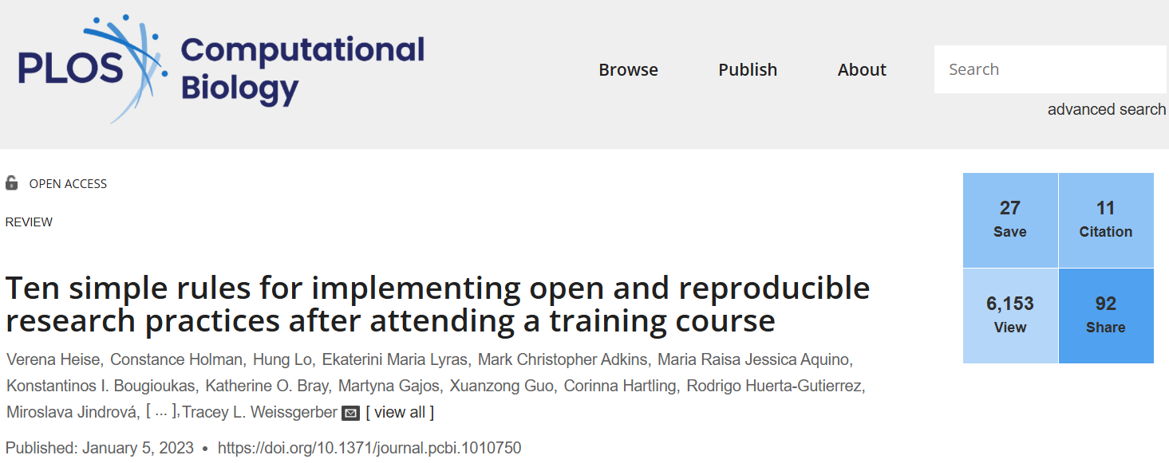
https://journals.plos.org/ploscompbiol/article?id=10.1371/journal.pcbi.1010750
Notes:
What we will focus on for the rest of this session is based on this paper by Verena Heise and colleagues, who conducted a virtual brainstorming event in September 2021 with participants of multiday research courses similar to this current one. They explored which and how research practices were maintained longer term after the courses had ended. The result was this paper outlining ten rules guiding participants of training courses, like all of you, through implementing research practices in their own projects once they return to their respective research environments.

Slide 10
Roadmap: Stages of implementation
Phase 1: Plan = prioritizing and planning of implementation
Phase 2: Implement = implementing and managing problems during implementation
Phase 3: Looking to the future = making reproducible research practices an intrinsic part of the research / research career
Notes:
The paper essentially provides a roadmap for implementing open research practices that you have acquired and/or developed during this summer school. The roadmap consists of three phases:
Phase 1: Plan = prioritizing and planning of implementation
Phase 2: Implement = managing problems during implementation
Phase 3: Look to the future = making reproducible research practices an intrinsic part of the research / research career

Slide 11
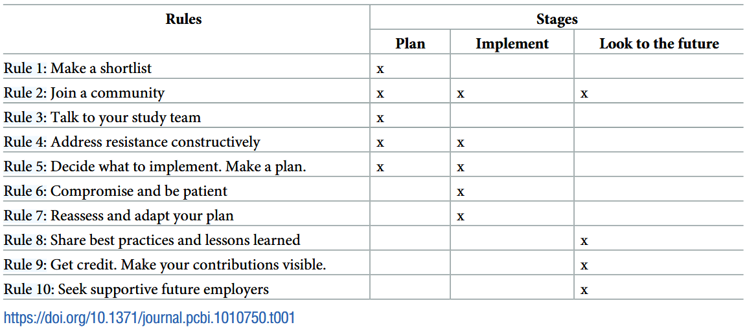
Ten Simple Rules
Notes:
Each of the rules outlined in the paper provide a step-by-step guide for implementation of open research practices across the three different phases. As you can see here, the rules are somewhat divided across the three different phases, and some rules are relevant to more than one phase. We will not go into each of these ten rules in detail, but rather we will focus on the overarching three phases of planning, implementing and looking to the future, in combination with interactive group activities.

Slide 12
Ten Simple Rules
Notes:
Looking at these rules, they are actually not that simple and depend heavily on your individual contexts.

Slide 13
Phase 1: Plan
Focus on rules 1-5
Questions to ask:
  What is relevant to your project/field?
  What is relevant to your project at this stage?
  What are relevant institutional/ funder policies?
  Which resources are available?
  What are my own interests and skills?
  Where can I get support from? (research group, institution, national/ international organization)
Notes:
Starting off your roadmap to implementation, for this discussion round we will focus on rules 1 – 5. As a reminder, rule 1 was concerned with shortlisting practices to implement in your current project. Some questions that can assist you making this list can be for example:
What are the practices that are relevant to my project or field in the first place?
What would be relevant at this moment in time for my project?
What are possible constraints by funders?
What resources would I need for implementation and what is available?
Last but not least: Who could support me in this planning stage and in answering all of these questions?
This last question directly ties into Rule 2 about talking to your research team about what to implement. Find a micro- or a macro-community in your direct research environment or broader scale support who can assist you in implementing practices in your own research project. At the micro-level, this could be your colleagues, supervisors but also libraries, IT-services or Open Science officers. In terms of macro-communities, you could look for journal clubs or you can join the international Reproducibility Network. Keep looking for other courses or seminars to further develop your skills.
This brings us to Rule 3 . Once you determined who could support you, speak to them how they would feel about you implementing those practices and how exactly they could support you. Discuss with your supervisors or team members what you have learned, what you took from courses such as this one and which practice you want to keep moving forward and why. Explain why you find certain practice useful, and discuss concerns your colleagues may have. Use success stories as a tool to obtain more support.

Slide 14
Your turn! (10 mins)
Which practice(s) (up to three) would you like to implement first?
Who can support you with implementation?
Notes:
This brings us to our first interactive activity. Here it is critical that you think about these questions in concrete terms, e.g., when you think about who can support you, you may want to be more specific than “my department”. Brainstorm your ideas.
When shortlisting robust research practices to implement, focus on practices that are relevant to your field or project and that you can address at your current project stage. Find out whether there are institutional or funder policies that apply to your current project, such as open access or open data policies, or policies related to scientific rigor and integrity. Be mindful of ethical guidelines that may affect the implementation of specific practices, such as open data.
This links to the second question: Who can support you here?

Slide 15

Tips for planning and support
Colleagues in your department
Institutional support services (IT, library, Open Science Center,…)
Interest groups (institutional/ national/ international)
Scientific societies (incl. German Reproducibility Network)
Funders
Publishers
…

Slide 16
Phase 2: Implement
Focus on rules 4 - 7
You will run into obstacles 🡪 be flexible and adapt,
it’s a marathon, not a sprint
  Technical obstacles (skills, infrastructure, resources, …)
  Social obstacles (team, supervisor, collaborators, …)
  Personal obstacles (life happens!)
Notes:
Phase 2 is, as we know, the implementation phase. A critical aspect of this phase are the obstacles you will encounter. These obstacles can come in many different shapes and forms. There can be technical or logistical obstacles, social obstacles, or personal obstacles.

Slide 17
Your turn! (10 mins)
Which obstacles (technical or social) do you foresee?
How can you deal with those obstacles?
Notes:
Now, I would like for you to think about your own situations and contexts, and think about which concrete technical or social obstacles you foresee. I also want you to think about what you can concretely do about overcoming these obstacles.

Slide 18
Tips for implementation
Anticipate (social) resistance
  Assume positive intent
  Be constructive and ready to compromise
  Different arguments work for different people
  Focus on easy wins (especially in environments with high resistance)
  Be patient and reassess your goals regularly
  Look after yourself

Slide 19
Phase 3: Looking to the future
Focus on rules 8, 9, & 10
Make changes sustainable in your group/ department/ institution
Teach others
Get credit
Seek out (new) job opportunities where your skills and ideas are valued
Notes:
Moving from Phase 2 to Phase 3, this last phase is all about preparing yourself for your own future the best way you can and putting yourself in optimal conditions. It is about sustainable changes, but also about sharing your knowledge, get recognized and valued for your work and expanding on your skills.

Slide 20
Your turn! (10 mins)
How can you make changes sustainable?
How can you teach others?
How can you get credit for your work?
How can you find job opportunities where your skills are valued?
Notes:
Onto the final interactive activity. Similar to the two activities before, be concrete and specific in terms of your answers – really tailor it to your own context.

Slide 21
Tips for the future
Sustainability: write documentation, support others, join/ start a movement
Teaching: formal and informal learning-by-doing – ideas see here: https://doi.org/10.7554/eLife.89736 and https://www.osc.uni-muenchen.de/news/11strategies/index.html
Credit: document your progress, apply for awards, add info to your CV
New opportunities: define your values and what you expect from your next job, might be in research support roles or with other stakeholders
Notes:
While you are developing new strategies and are implementing new research practices at your local level, for example, document what you can to support future researchers at your department. Not only will you cement your reputation and your legacy, you will have also helped change and raise the standards at your respective department. This is strongly connected to the general rule of sharing knowledge and to teach others when you can and have opportunities. Passing on knowledge does not mean you are doing all the work for others to enjoy – all written documentations, lab manuals, presentations, teaching materials etc. will bear your name and you will be credited for your work.
Define your values and reflect on what matters to you. This could be about the type of work you want to be doing in the future, but also about the working environment you want to be in. Also think about transferrable skills, and the skills you have been practicing while focusing on actively changing research policies in light of resistance. Be strategic in what you need the companies or organizations you want to work for to know about you in terms of your efforts and your skills. Showcase your work on platforms such as OSF and Zenodo. Consider your opportunities and combine them with your values and skills.

Slide 22

Some inspiration from the paper …
When discussing research practices in your team:
  “It is important to approach others with a positive attitude. Your goal is not to criticize, but to suggest future improvements.”
  “It is OK if you cannot convince everyone.”
Implementing new research practices more generally:
  “Research improvement is a marathon, not a sprint.”
  “Priorities shift (..). That is OK.”
Looking after yourself:
  “Balance what you want to do with what you can do; do not commit to more than you can achieve.”
  “Do not be afraid to say no (..) if you feel overwhelmed”
Notes:
Here are some quotes directly taken from the paper, that I believe can be helpful tips to continue your open research journey.

Slide 23
“Open Science is a buffet”
- Christina Bergmann
Unrealistic to implement every open research practice at once (and it’s not as if every practice suits every research design anyway)
Tailor the suggested solutions to their specific research projects
(Nuijten, 2019)
Start with something practical and low effort
  Tidy up one of your folders
  Make one preprint available
  Preregister one study
Come back for more

Slide 24

Questions or comments?

Slide 25

Thanks so much!
Reach out if you have any comments or questions!
https://www.osc.lmu.de/
OSC Website with more educational resources for teaching novices: https://github.com/lmu-osc/teaching-material-for-novices

Slide 26
References
Heise, V., Holman, C., Lo, H., Lyras, E. M., Adkins, M. C., Aquino, M. R. J., ... & Weissgerber, T. L. (2023). Ten simple rules for implementing open and reproducible research practices after attending a training course. PLOS Computational Biology, 19(1), e1010750.
Kohrs, F. E., Auer, S., Bannach-Brown, A., Fiedler, S., Haven, T. L., Heise, V., ... & Weissgerber, T. L. (2023). Eleven strategies for making reproducible research and open science training the norm at research institutions. Elife, 12, e89736.
Nuijten, M. B. (2019). Practical tools and strategies for researchers to increase replicability. Developmental Medicine & Child Neurology, 61(5), 535-539.

