Slide 1

2026-09
Introduction to
Open Research Data
Why should we share data?
(And do I get a co-authorship?)
Reema Gupta, Ludwig-Maximilians-Universität München using material from
Prof. Dr. Felix Schönbrodt
www.osc.uni-muenchen.de
Notes:
Good morning, everyone. This talk is an introduction to open research data, and it builds on Felix Schönbrodt's material from last year, which he generously shared and allowed to adapt and reuse.
We will tackle two questions: why should I share my data at all, and, something you might be thinking, do I get a co-authorship for it or not?
—
One thing to know upfront: many examples come from psychology. Partly that is because the Open Science Center sits in the psychology department, but mainly it is because psychology went through the replication crisis early and painfully, so it is the field with the most concrete numbers, worked-out policies and community debates. I will use it as the worked example throughout; keep asking yourself what the equivalent is in your field.

Slide 2
Why open data?
Notes:
So the first question: why should we even have open data? I will give five reasons to convenience to as to why open data is a good idea.

Slide 3

Why open data?
1. Nullius in verba -
take nobody's word for it
  Motto of the oldest scientific society (Royal Society, founded 1660)
  Science is not built upon blind trust, but on verifiability.
  „Organized skepticism“
  (Merton, 1942)
Only when raw data (and other research material) are shared organized skepticism can be enacted, and science can really be self-correcting. Open data is one part of good scientific practice.
Notes:
Reason number one, Nullius in verba, take nobody's word for it. That is the motto of the Royal Society, the oldest continually existing scientific society, and it echoes that science is not built on blind trust but on verifiability.
Robert K. Merton, an American sociologist of science, described a set of norms that characterize how science works. One of them is 'organized skepticism', that is, scientific claims are not accepted on authority or trust, the community systematically scrutinizes them before they count as knowledge. This is one of the foundations of science and one of the things that distinguishes the scientific method from other ways of gaining knowledge.
And only when the raw data and other research materials are shared can this principle be enacted, and only then can science really be self-correcting. We always claim that science is self-correcting, but to be self-correcting we need access to the data. So put simply, open data is just one part of good scientific practice.

Slide 4

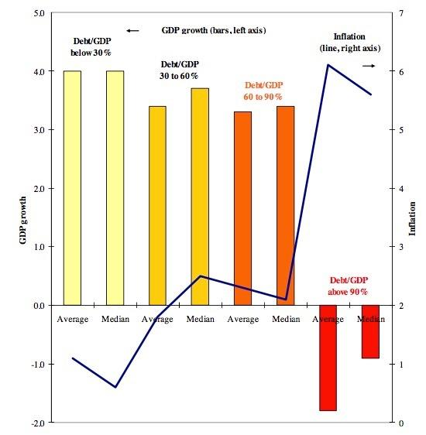

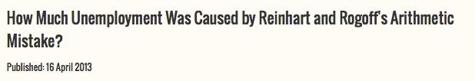

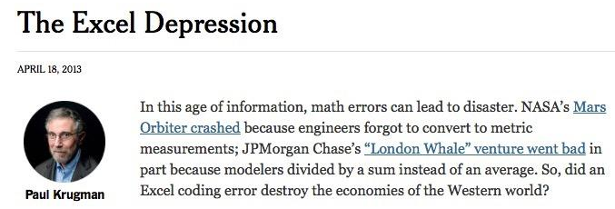
90%-Excel-Gate
The most important point of the story: The original authors shared their raw data, which made it possible to correct the honest mistake!
http://economix.blogs.nytimes.com/2013/04/16/flaws-are-cited-in-a-landmark-study-on-debt-and-growth/?smid=tw-share&_r=0
https://www.aeaweb.org/articles.php?doi=10.1257/aer.100.2.573
Notes:
The 90 percent excel gate from the 2010s is an example of self-correction made possible by sharing data. There was a famous study published, titled, 'Growth in a Time of Debt', with the headline finding that when a country's public debt exceeds 90 percent of GDP, economic growth drops off sharply. The red bars you see on the plot here. That number became hugely influential; politicians cited it to justify austerity policies after the financial crisis.
Later in 2013, a graduate student was trying to reproduce the analysis for a course assignment and could not get the same numbers. He asked the authors, and they sent him their actual Excel spreadsheet. In it, amongst three prominent issues, he found, a spreadsheet error, that the formula skipped several countries. With the errors corrected, the dramatic growth cliff at 90 percent largely disappeared.
This story became a talking point but take away of the story should not be the mistake; honest mistakes happen everywhere. The point is that the original authors shared their raw spreadsheet, and only because of that could the error be found and corrected. That is science working as it should: we make mistakes, we correct them, and advance scientific knowledge.
—
In 2010, the Harvard economists Carmen Reinhart and Kenneth Rogoff published a famous study, 'Growth in a Time of Debt'.In 2013, Thomas Herndon, a graduate student, tried to reproduce the analysis for a course assignment and The
Correcting all three problems (a spreadsheet coding error that dropped five countries, selective exclusion of years, and unconventional weighting) raised average growth above 90% from -0.1% to 2.2%. The famous Excel error was real but was the least important of the three.
—
Hardwicke et al. 2018 (Cognition) Data-available statements rose from 104/417 (25%) pre-policy to 136/174 (78%) post-policy; reusable data 22% to 62%.
For 35 articles with reusable data they attempted to reproduce 1,324 target values; 64 values (5%, CI 4-6) could not be reproduced even after author assistance.
22 articles fully reproduced (11 required author assistance); 13 articles had at least one non-reproducible value despite assistance.
there were no clear indications that original conclusions were seriously impacted
Fišar et al. 2024, Management Science 70(3):1343-1356, DOI 10.1287/mnsc.2023.03556 — ">95% reproduced when data accessible, 68% across all articles," 2019 policy
Verbatim: "the results of more than 95% of articles under the new disclosure policy could be fully or largely computationally reproduced. However, for 29% of articles, at least part of the data set was not accessible... Considering all articles in our sample reduces the share of reproduced articles to 68%." INFORMS Nearly 500 articles; 700+ reviewers; Data and Code Disclosure policy introduced 2019.

Slide 5
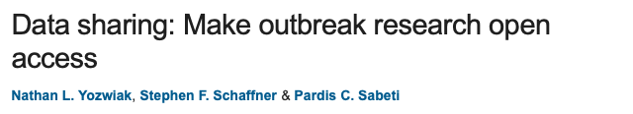
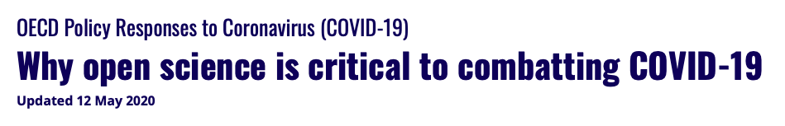
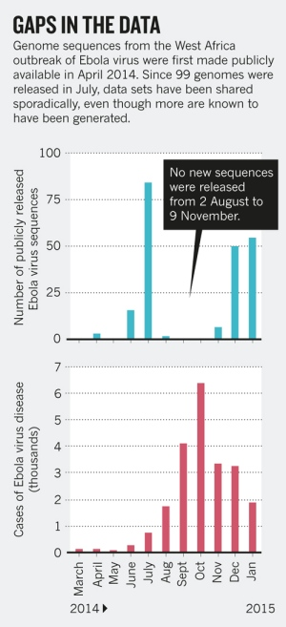
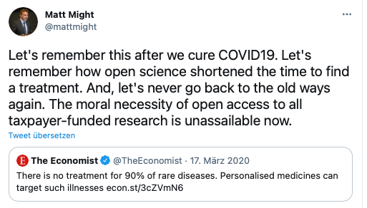
Why open data?
2. Efficiency and Inclusiveness
  Speedy responses in outbreaks; share rare and hard-to-collect data
https://www.nature.com/news/data-sharing-make-outbreak-research-open-access-1.16966
The covid-19 pandemic has shown how fast scientific progress can be when we share our data and knowledge freely, and that free knowledge is a moral imperative.
Notes:
If this wasn’t reason enough, the second is efficiency and inclusiveness. The COVID outbreak showed how important open data is. We can have really speedy responses to outbreaks if we share the data, especially hard-to-collect data, which is even more valuable to share.
There were headlines at the highest political level, for example the OECD policy response on why open science is critical to combating COVID-19. And there is this nice tweet: let's remember how open science shortened the time to find the treatment, and let's never go back to the old ways again. The moral necessity of open access and open data to all taxpayer-funded research is unassailable.
The Ebola example on the right: the red bars show continuous outbreaks, the blue bars show released genomic sequences. You can see gaps where no genomic data was released even though we know from the case numbers that there were outbreaks, hinting that there is still a long way to go for even data of such high importance.

Slide 6
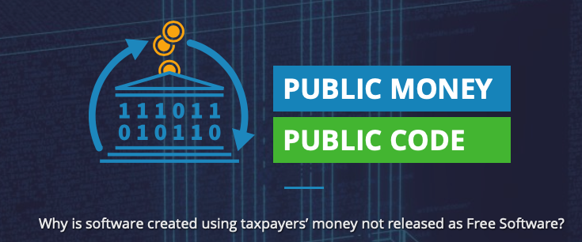
Why open data?
3. Public money = public good
and data!
https://publiccode.eu
Publicly funded research data does not belong to the researcher who collected it.
They have the right of primary usage, but after that the data should be considered a public good (of course respecting privacy rights and applicable copyrights).
Notes:
Another reason is public money means it is a public good. There is a big initiative called Public Money, Public Code, and we should extend that: public money, public data.
Publicly funded research data does not belong to the researcher who collected it. Many researchers have the gut feeling that after years of work in the lab the data somehow belongs to them. I would not say that is correct. Researchers who put in the effort of data collection have the right of primary usage: you should be the first to publish with the data and be able to exploit it for a while. But at the end of the day the data should be public, of course always respecting privacy rights and copyright.

Slide 7
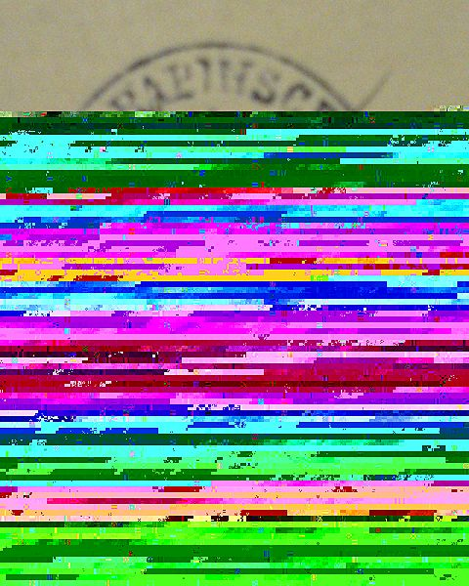
Why open data?
4. Data persistence
  never lose data due to a crashed hard disk drive
  Open data allows independent copies at multiple places (e.g. even in decentralized bittorrent swarms) – create resilience against autocratic regimes that delete „inconvenient“ research data
A publicly funded repository is the right place for long term storage of research data – not your private USB stick, your personal university website (that vanishes after you change affiliation), or the journal’s online supplemental material that hides the data behind a paywall. Prefer repositories in countries that value academic freedom.
Notes:
Now, Reason number 4, a very practical one: data persistence. Once your data is on a proper repository with a proper backup strategy, you will never lose it to a crashed hard drive. It happens so often that someone wants to check or reuse existing research and the original authors say: sorry, the hard drive broke, the dog ate the data.
Open data also allows independent copies in multiple places. There recently was a data rescue hackathon with the Safeguarding Research project: in the US, politically inconvenient research data (climate change, transgender research, research on minorities) is being systematically deleted from repositories, and initiatives around the globe are making copies to save it. Only because this data was made openly accessible data, it can be copied like that. This creates resilience and sustenance of scientific knowledge.
So the right place for your data is a publicly funded repository, ideally in a country that values academic freedom. What is not appropriate is your USB stick, or any website that is not persistent, for example, your personal university website. If you try clicking a data link in a paper from before 2010, chances are high it is dead. Also not the journal's online supplemental material: it often sits behind a paywall, and you can never be sure the journal will not take it down someday.

Slide 8
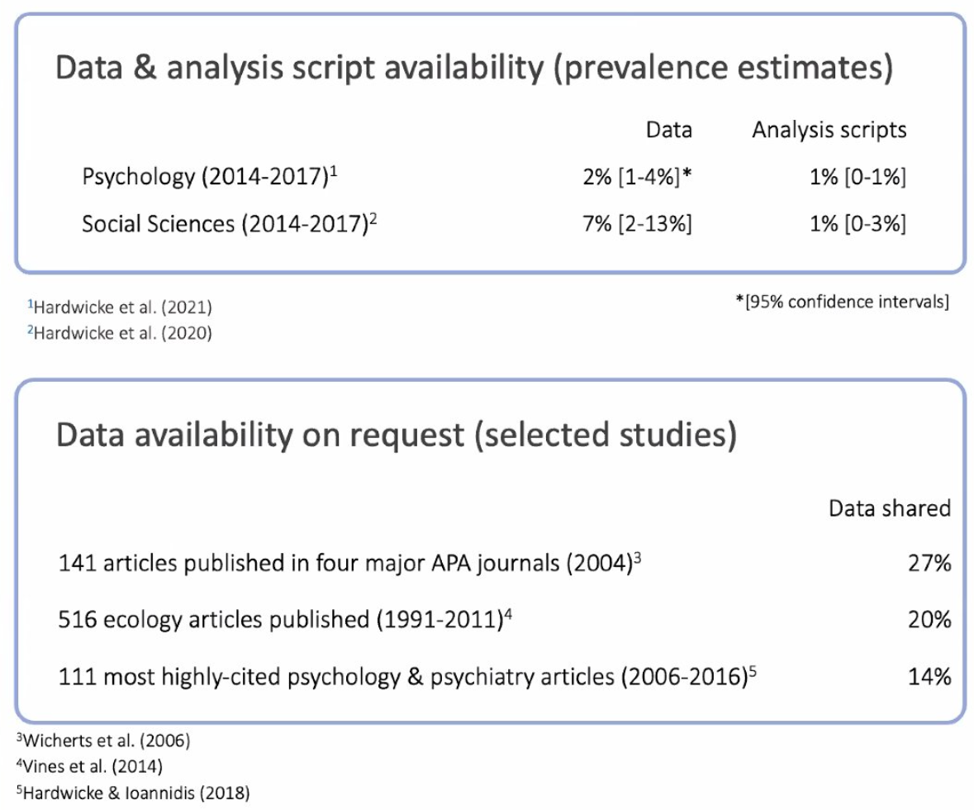
Availability Prevalence
Hardwicke et al. (2024): random samples of psychology articles
Data availability 2% → 14%; code availability 1% → 8.5%
Hardwicke et al. (2022), Perspectives on Psychological Science 17(1): 239–251; Hardwicke et al. (2024), Advances in Methods and Practices in Psychological Science 7(4).
Notes:
Here is the analysis by Tom Hardwicke and colleagues. They first looked at whether data and analysis scripts are available in the first place. Back then, up to 2017, in psychology and the social sciences data was available for only 2 to 7 percent of papers, and analysis scripts for only 1 percent. The updated study found a positive trend, with data availability rising from 2 percent to 14 percent and code from 1 to 8.5 percent (articles from 2022). Better, but still rare.
—
Hardwicke et al. (2024), "Prevalence of Transparent Research Practices in Psychology: A Cross-Sectional Study of Empirical Articles Published in 2022", Advances in Methods and Practices in Psychological Science 7(4), DOI 10.1177/25152459241283477: Raw data 14% [7%, 21%]; analysis scripts 8.5% [4.5%, 13%]; preregistration 7%; materials 16%.

Slide 9
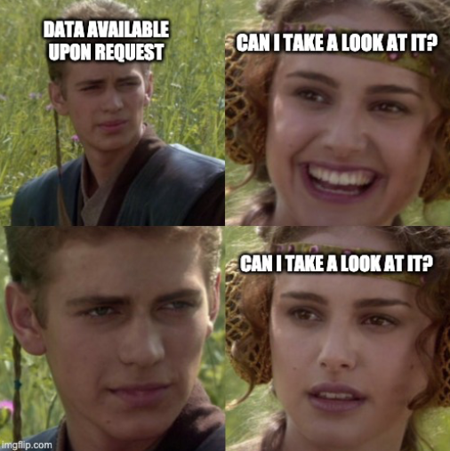
https://twitter.com/JohnBorghi/status/1405227318876905472?s=20
Notes:
Now, due to any legitimate reasons, if a paper said something like “Data available upon request”, or even better, 'upon reasonable request'. then who decides what is reasonable? The original authors, of course. So if you doubt my analysis, I would say that is not a reasonable request.
But let us be hopeful and assume that the data, WILL be made available.. upon request…right?

Slide 10
„Available upon request“
Gabelica et al. (2022): wrote to authors of 1,792 articles whose data availability statement promised sharing on request
93% never responded or declined. 6.8% shared data enabling reanalysis
Medicine (Hamilton et al. 2023): ~8% of articles declare data availability, ~2% actually share it
Tedersoo et al. (2021), 875 Nature & Science papers, nine disciplines: „upon request“ delivered 42.3%, no statement at all 38.3%.
Gabelica, Bojčić & Puljak (2022), Journal of Clinical Epidemiology 150: 33–41; Tedersoo et al. (2021), Scientific Data 8: 192.
Notes:
Hardwicke and other a meta-scientific studies, went ahead and actually requested the data for such papers. This should be at 100 percent. In fact, only about 20 percent of requests actually got the data.
Another similar meta study with a larger sample size found that only 6.8 percent of researchers shared usable data (Gabelica et al. 2022).
The trend holds in other fields such as medicine, where, about 8% of articles declare open data and about 2% actually share it (Hamilton et al. 2023, BMJ 382: e075767, 700,054 articles).
Furthermore, it was reported that in fact the availability statement did not have too much of a difference about its real availability to begin with.

Slide 11
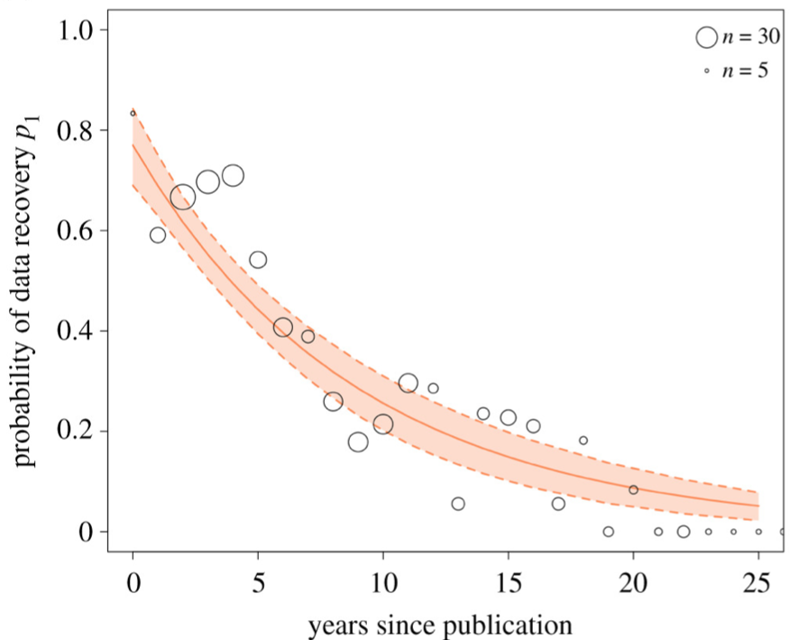
Data decay in social learning research
„probability of finding material for any publication halves every 5.7 years“
„probability of recovering data for studies > 20 years ago is close to zero“
Across all fields: the odds a dataset still exists fall ~17% per year (Vines et al. 2014)
Minocher, R., Atmaca, S., Bavero, C., McElreath, R., & Beheim, B. (2021). Estimating the reproducibility of social learning research published between 1955 and 2018. Royal Society Open Science, 8(9), 210450. https://doi.org/10.1098/rsos.210450 | Vines, T. H., et al. (2014). The availability of research data declines rapidly with article age. Current Biology, 24(1), 94-97.
Notes:
The chances of getting hold of the data also depends on the age of the paper.
In social learning research, they looked at the probability of data recovery depending on the age of the paper, and you see this declining curve. They concluded that the probability of finding material for any publication halves every six years, and for papers older than 20 years it is close to zero.
Vines et al. (2014, Current Biology) generalizes decay beyond psychology: (516 articles aged 2 to 22 years;) odds of the dataset still existing fell 17% per year, odds of a working author email fell 7% per year. Authors of old papers responded just as often; the data was simply lost or on dead media.
That research was done before public repositories and the open science movement really took hold. My hope is that this has gotten much better. At least we now have the technical infrastructure with repositories and persistent resources to make it better. It is now a matter of adoption.

Slide 12
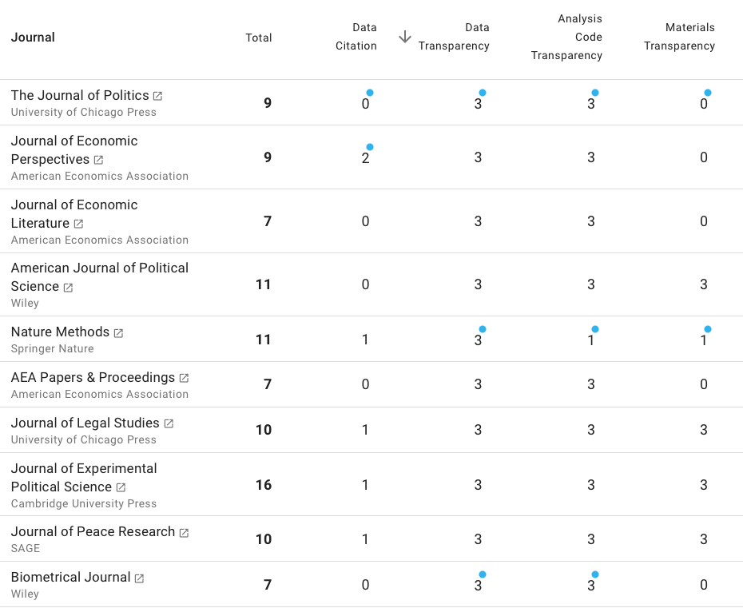

Why open data?
5. More and more funders and journals demand it.
https://www.topfactor.org
TOP level 3: Data must be posted to a trusted repository, and reported analyses will be reproduced independently prior to publication.
Notes:
Finally, Reason 5, also very practical: more and more funders and journals demand it. The TOP guidelines (Transparency and Openness Promotion) are a kind of rating system for journals. The data transparency level goes from 0 to 3. Zero: the journal says nothing. One: open data is encouraged but not checked and not mandatory, so more of a lip service. Level 3 is the highest: the data must be posted to a trusted repository, and the reported analyses are independently reproduced before publication. That is a really high transparency level, and quite a few journals already have it. If you want to publish in the Journal of Politics, for example, you simply must post the data, unless you have very good justified reasons not to.

Slide 13
Why open data?
5. More and more funders, journals and policies demand it.
DFG Code of Conduct (2019): data availability is part of good scientific practice, binding for German universities; DFG (2022): requires statement on research data handling and allows to request the associated costs
Horizon Europe (2021): data management plan + trusted repository are mandatory, „as open as possible, as closed as necessary“
NIH (2023): a data management & sharing plan for every grant, at the world's largest public research funder
Not a values debate anymore. A funding requirement.
DFG (2019) Guidelines for Safeguarding Good Research Practice; Horizon Europe AGA; NIH Data Management & Sharing Policy (2023).
Notes:
This is reflected in the policies themselves in 2026. The DFG Code of Conduct (2019, Guideline 13) makes data availability part of good scientific practice, and it is binding for every German university that takes DFG money, which is all of them. Since 2022 the DFG also requires a statement on research data handling in every proposal, and costs for data curation can be requested in the proposal itself.
Horizon Europe (since 2021) made data management plans plus deposit in a trusted repository mandatory for funded projects with the guiding principle, 'as open as possible, as closed as necessary'.
Since January 2023, every grant funded by NIH, largest public research funder needs a data management and sharing plan.
The takeaway for you as an early-career researcher: this is no longer a values debate you have to win with your PI. Increasingly it is simply a compliance requirement of the funders and the journals.

Slide 14
What is open data?
Notes:
Those were, in my view, five good reasons for open data. But now comes the question: what actually is open data?

Slide 15
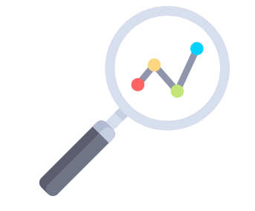
What is Data?
“The recorded factual material commonly retained by and accepted in the scientific community as necessary to validate research findings.”
(EPSRC, 2018)
Anything and everything produced in the course of research.
Lynch (2014)
Icon from flaticon.com by freepic
Notes:
What is data? Two definitions. The formal one: 'the recorded factual material commonly retained by and accepted in the scientific community as necessary to validate research findings'. That is a bit complicated, so here is a simpler one: anything and everything produced in the course of research. A very broad definition.

Slide 16

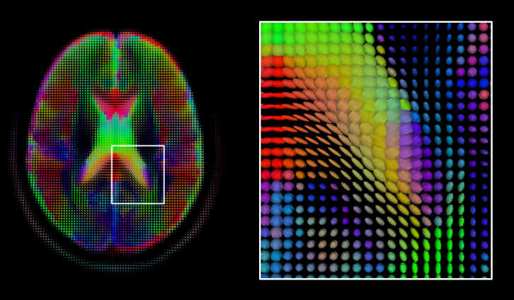
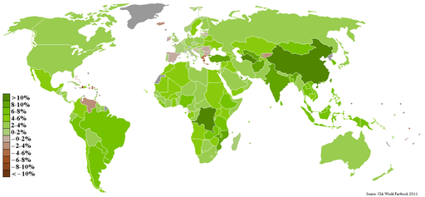
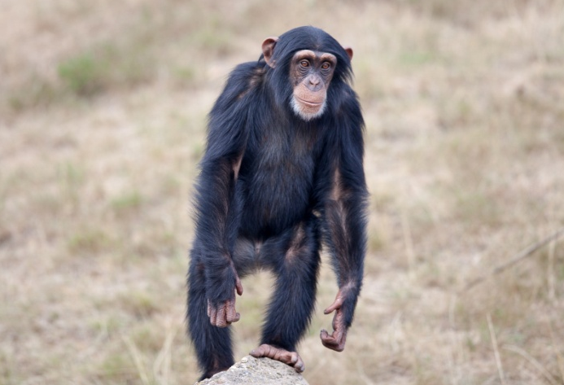
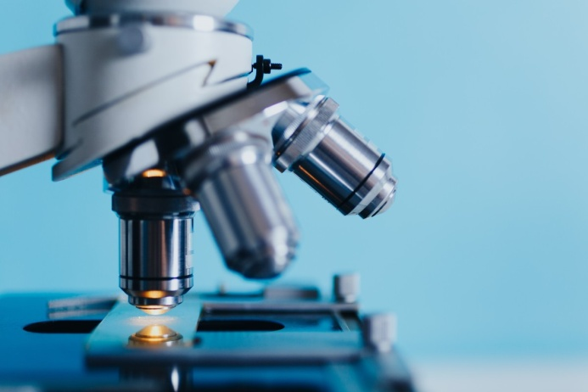

What is Data?
➙ we need field-specific definitions: What constitutes „research data“?
Pictures from en.wikipedia.org/w/index.php?curid=36808161; pixabay.com; pxhere.com/en/photo/1192476; pxhere.com/en/photo/914805; pxhere.com/en/photo/595225; commons.wikimedia.org/wiki/File:Gdp_real_growth_rate_2007_CIA_Factbook.PNG
Notes:
That means it really depends on the discipline what counts as data, and as raw data. We need field-specific definitions: what is research data, and on what level of granularity?
This could be MRI scans, geographical information, data from technical devices like smartphones, videos of animal behavior, microscope images, audio recordings.
[depending on time, engage people?]

Slide 17
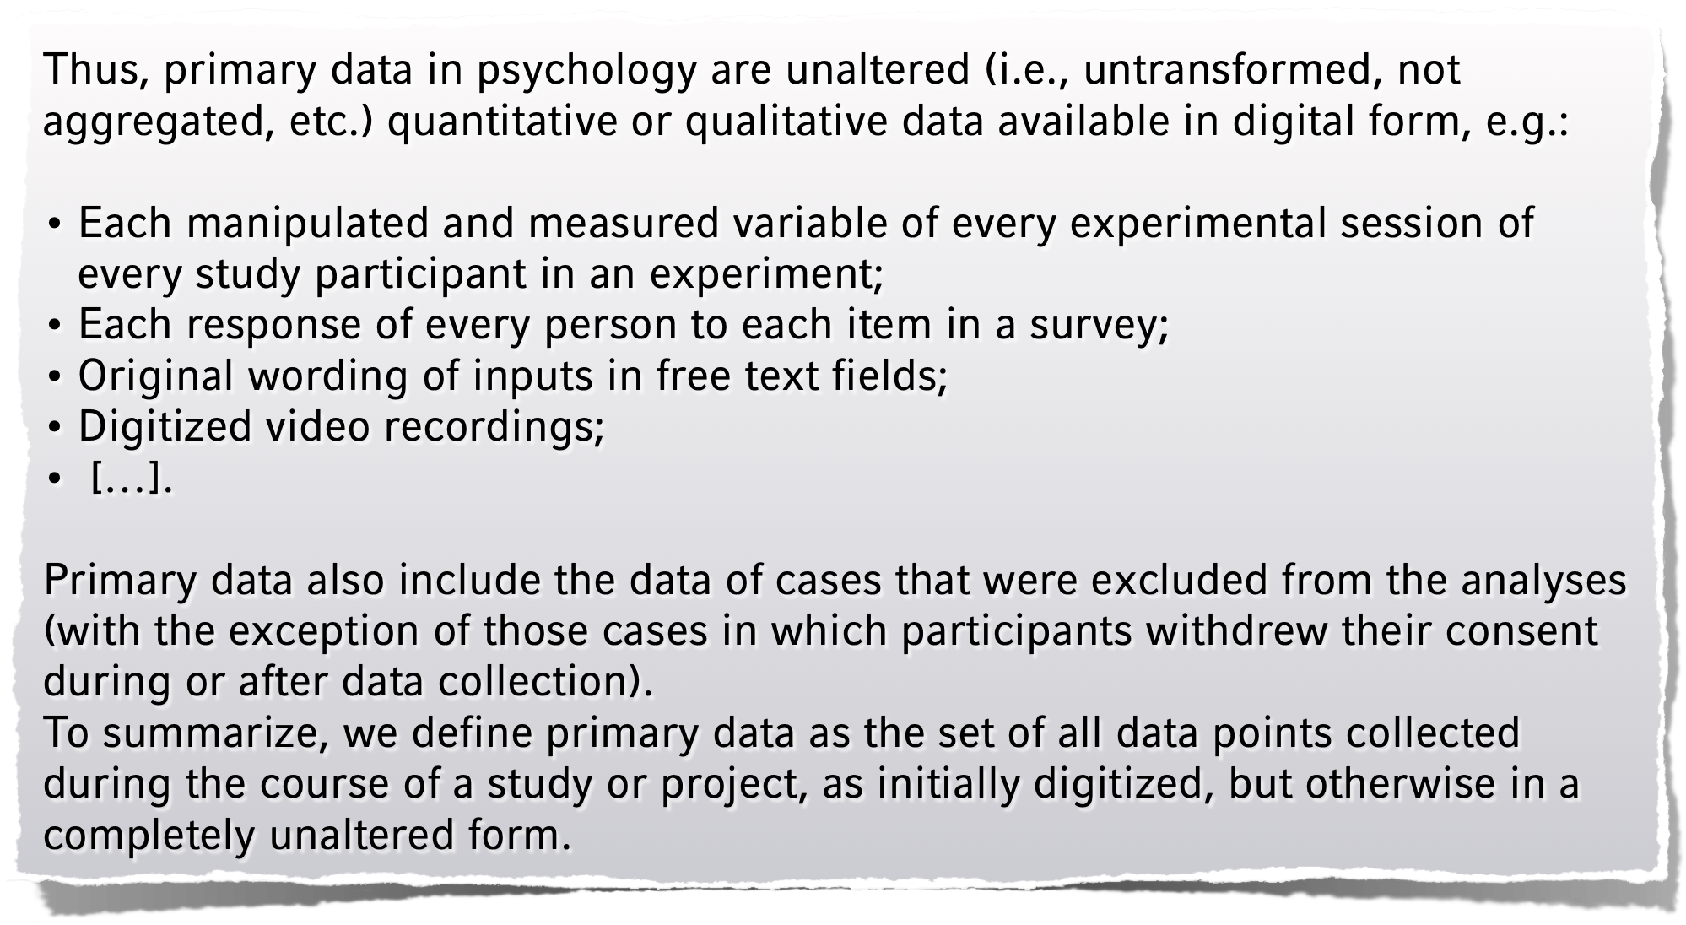
Example: Psychology
Recommendations of the German Psychological Society, https://psyarxiv.com/24ncs/
Notes:
In psychology, 10 to 15 years ago there was a big discussion in the community about what research data actually is. Some people said: I published the means and standard deviations in the article, that is all the data you need, you could recompute the t-test from that. Most people said: no, sorry, that is a summary statistic, aggregated data, not enough.
But beyond that it is genuinely not easy. If participants fill in a questionnaire on paper, what is the primary data: the paper sheet you would have to conserve in an archive, or the first digitized version?
Out of these discussions, a committee of the German Psychological Society wrote a white paper defining data for the field: primary data are the unaltered (untransformed, not aggregated) quantitative or qualitative data in digital form. Every manipulated and measured variable of every experimental session. Importantly, primary data also include cases excluded from the analyses, so outliers stay in, except where participants withdrew their consent.
In short: primary data is the set of all data points collected during a study, as initially digitized but otherwise completely unaltered. Now it is defined, the community knows what data is, and the paper questionnaire sheets can be thrown away. That was not clear before.
This is one the first questions worth asking, what would count as data, raw data, primary data, secondary data, etc or its equivalents in your fields in your field?

Slide 18
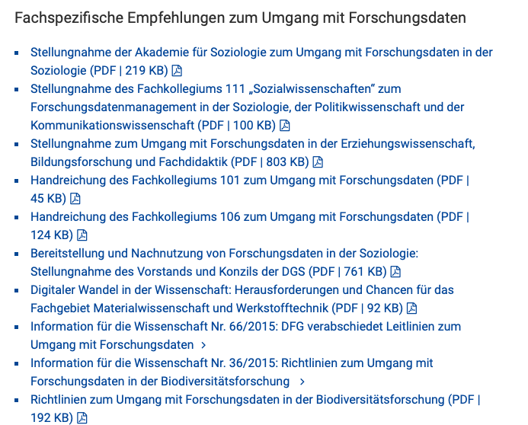
DFG Subject Specific Recommendations
https://www.dfg.de/foerderung/antrag_gutachter_gremien/antragstellende/nachnutzung_forschungsdaten/index.html
https://psyarxiv.com/vhx89
Notes:
The German Research Foundation (DFG) encouraged all disciplines to develop such data guidelines, and multiple fields have them by now. This could be worth checking to decide on how you manage and share your data.

Slide 19
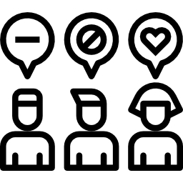

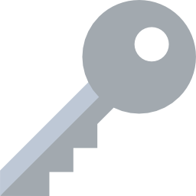
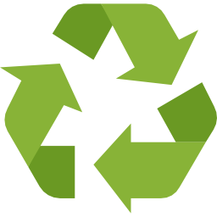
Not only open, but FAIR
The FAIR principles
Findable
Accessible
Interoperable
Reusable
Good research data management
➙ attend workshop on
„FAIR research data management“
Icon from flaticon.com by freepic, mynamepong, monkik
Notes:
The discussion in the scientific community has moved a bit from 'open data' to ' open and FAIR data', because 'open' is a broad term and does not characterize the usefulness of the data for all the reasons and more that we looked at before. The FAIR principles give a more fine-grained definition of characteristics of the data, the how of data sharing: findable, accessible, interoperable, reusable. What these four terms mean in practice is exactly what we will cover in a workshop later on. A well managed research data qualifies a lot of criterias of FAIR and can be made open with minimal effort.

Slide 20
FAIR enough
aka. FAIR for dummies
Findable:
(1) Put your data in a professional repository that provides a globally unique, citable and persistent identifier (e.g., DOI, PURL, ARK) and requires essential metadata such as a standardized codebook (e.g., PsychArchives, NFDI, see also https://www.re3data.org/)
Accessible:
This is automatically achieved with (1)
Inter-
operable:
Most interoperability is automatically achieved with (1)
(2) Link to other related data sets (optionally, if applicable). This is a feature of the repository.
(3) Explicitly assign a license, as open as possible (e.g. CC0; see OSC tutorial on licenses)
(4) Describe (in the metadata) people, entities, and processes involved in the creation, management and longer-term curation of the data set: (a) Data collection date; (b) Contributors involved in data creation and their roles (DataCRediT); (c) Data versioning information (if applicable)
(5) Write a structured codebook (following the standards of your field)
(6) Use a structured, open, non-proprietary format for the data (e.g., .csv, .tab, .json, .xlsx; not .sav or .pdf)
Reusable:
Icon from flaticon.com by freepic, mynamepong, monkik
Notes:
For those not attending the workshop, let us try to go over the FAIR principles following the Pareto principle, with some effort you quickly get 80 percent of the output; getting to 100 percent is complicated, but we should grab the easy 80 percent, with what is FAIR enough.
Findable: the data needs an persistent identifier, links that do not break like a DOI and should be findable reliably. You get this simply by putting your data into a professional repository.
Accessible and Interoperable: the technical accessibility and interoperability of your dataset as a web resource is taken care of by the choice of a repository. In the workshop, we will extend these principles to the contents of your research data itself.
Reusable: here you have some work. Assign a license, preferably an open one like CC0 (public domain). Describe who was involved in the creation, management and curation of the data set. Just like CRediT contributor roles for papers, there are roles for data sets: who did what. Record the data collection date, and use data versioning. Sometimes we correct errors in data sets, and then we need to know exactly which version a paper refers to.
Cautionary tale: the European Social Survey, a large cross-national survey run across Europe with very professional data management, once corrected an error but forgot to create a new official version. Two data sets had the same version number but different data, and existing analyses could not be reproduced. So: every data set needs a version number.
Finally, write a codebook, otherwise nobody understands your variables, and use a structured, open, non-proprietary format. Please do not store your data as a PDF.
That is it. It is doable, and with that you fulfill most of the FAIR criteria.
We will go into the specific during the workshop where I will also invite you to think about these domain agnostic FAIR principles and how it applies to your research context.

Slide 21
Balancing values:
Three fields of tension with data
Notes:
But before that, a bit more social side of open data sharing. When we talk about open data in the community of scientists, we typically see three fields of tension that need to be balanced. These tensions surfaced most explicitly when the psychology community discussed its data sharing recommendations, but they apply to research data in every field.

Slide 22
Balancing values I
Open Data, public interest/entitlement to publicly funded data
Privacy rights of research subjects
Privacy rights > openness; but GDPR also mentions a „legitimate interest“ of research
Ask participants for a broad consent of open reuse
Use tiered access levels (e.g., „scientific use files“)
Publish aggregated data (e.g., ratings of videos) without the primary data (videos)
Sharing something > sharing nothing
It’s not either „open“ or „closed“ - it’s a continuum:
As open as possible, as restricted as necessary
Notes:
To begin, the tension between open data and privacy rights of subjects. As a general heuristic: privacy rights beat openness. But the GDPR, the EU's General Data Protection Regulation, also mentions a legitimate interest of research, which could overrule its restrictions. The problem is legal decisions draw on existing rulings for concrete advice, but to date there have been essentially no court rulings on the GDPR in the research context as far as I am aware, so nobody can delineate the gray area precisely yet.
Still, we can do things. First, ask participants for broad consent to open reuse. We sometimes assume participants want to lock their data away; often it is the other way around. In one case, a sample of people with a rare disease said: please reuse my data for any research, we want a cure for this disease, for our kids and for others affected. But we have to ask them.
Second, tiered access levels. Putting data plainly on the internet where Google and Meta can download it is not the only way to share. Scientific use files sit on a repository under restricted conditions: typically only people with a university affiliation can apply, they write a one-paragraph proposal stating their research question, and they sign a contract promising not to re-identify anyone and to delete the data after the analysis. If they misbehave, they are liable, not you. This is a very good way to integrate privacy rights with openness, and scientific use files still count as open data. From the scientific point of view it is good enough.
Third, publish aggregated data. Video recordings of mothers interacting with their children are hard to publish, and I would not. But typically we analyze such videos, counting how often the mother smiles, how the child reacts, and those ratings are perfectly anonymous. Publish the ratings and your paper is reproducible without the problematic videos.
In general, sharing something is always better than sharing nothing. It is not binary, open or closed. It is a continuum: as open as possible, as restricted as necessary.

Slide 23
Balancing values II
Right of first usage,
incentives to collect data in the first place
Optimal and efficient gain of knowledge by data reuse
Incentivize data sharing
Right of first usage, possibility of embargo
At the end of the day (resp., the embargo), all data are as open as possible
Notes:
The second tension: on one hand the right of first usage, since collecting data must be incentivized, rewarded and valued. On the other hand we want optimal, efficient gain of knowledge through data reuse.

Slide 24

I do important and good research by reanalyzing existing data sets, such as SOEP or GESIS panels. Don’t devalue my research!
I spent three years in the lab collecting my data! No research parasite will profit from my data!
Notes:
This is a scene from Game of Thrones, chosen because there was a lot of fighting. When two researchers fight, one says: I spent three years in the lab collecting my data, no research parasite will profit from it. And that term is real: in 2016 the editors of the New England Journal of Medicine, one of the most prestigious medical journals, wrote an editorial warning about 'research parasites', meaning people who reuse others' data without investing the hard work of collection.
And one can understand the feeling: you spend three years in the lab, then some random person takes your data and publishes more papers than you do.
On the other hand, people who reuse data have a legitimate position too: I do important and good research by reanalyzing existing data sets, for example the big longitudinal studies that need data collected through years from different people. That data is enormously valuable, of course it should be reanalyzed. Please do not devalue my style of research.
SOEP and the GESIS Panel are two of Germany's most prominent long-term social science research infrastructures that collect large-scale survey data on the population. [1, 2]
SOEP (Socio-Economic Panel)
What it is: A massive, long-running longitudinal household survey tracking individuals and families in Germany.
Run by: The German Institute for Economic Research (DIW Berlin).
Started: 1984 (making it one of the oldest and largest of its kind globally).
Scope: Surveys roughly 30,000 people across 20,000 households annually.
Focus: Gathers data on income, employment, education, health, and family dynamics to study long-term life trajectories and societal changes. [1, 2, 3]
GESIS Panel
What it is: A mixed-mode probability-based omnibus panel (a survey carrying multiple topics from different researchers) designed for social science research. [1, 2]
Run by: GESIS – Leibniz Institute for the Social Sciences.
Started: 2014. [1]
Scope: Surveys the German-speaking adult population regularly (e.g., every three months) via web or mail. [1, 2]
Focus: Acts as a shared infrastructure that allows external academic researchers to submit and collect their own survey questions free of charge, while also providing rich open data for secondary analysis. [1, 2]

Slide 25
I do important and good research by reanalyzing existing data sets, such as SOEP or GESIS panels. Don’t devalue my research!
I spent three years in the lab collecting my data! No research parasite will profit from my data!
A proposed answer:
Collecting primary data is a sine qua non for empirical research, so this should be valued.
But: No type of research is inherently „better“, there is a place for researchers purely focusing on re-analysis.
Job committees should define what kind of research expertise they are looking for - some might prefer persons with data collection experience, some might look for data re-analysts.
Notes:
The resolution psychology proposed, and I think it is the balanced one: yes, collecting primary data is a sine qua non for empirical research.
If everybody only reanalyzed existing data, research would soon stop. So data collection must be valued.
But no type of research is inherently better, and there is a place for researchers who purely focus on reanalysis. Job committees should simply define what research expertise they are looking for: experience collecting data, or experience reanalyzing existing data. Both are skill sets.
Sine qua non is a Latin phrase that means an essential condition or a necessary requirement without which something is impossible

Slide 26

I just compute some effect sizes from your data to plan my study – a co-authorship is ridiculous! And by the way: the data do not belong to you, but to the public!
You want to reuse my Data??
OK - but I get a co-authorship in every paper that you publish for the rest of your life.
HARRR - my h-index is the largest of all!!!
Notes:
Another discussion: you want to reuse my data? Fine, but only if I get a co-authorship, and not just on this paper, on every paper you publish for the rest of your life. And the poor person on the other side says: I just compute some effect sizes from your data to plan my study, a co-authorship is ridiculous. And by the way, the data does not belong to you but to the public.

Slide 27
I just compute some effect sizes from your data to plan my study – a co-authorship is ridiculous! And by the way: the data do not belong to you, but to the public!
You want to reuse my Data??
OK - but I get a co-authorship in every paper that you publish for the rest of your life.
HARRR - my h-index is the largest of all!!!
A proposed answer:
Co-authorship can already difficult in single-lab papers - cannot be solved in an abstract way, rather single case decisions
„Simple reuse“ does not imply co-authorship, but there are cases where an offering is warranted
Co-authorship requires something more than only providing already existing data
Move from „authorship“ to „contributorship“ (CRediT)
Notes:
The answer from the psychology recommendations, and I find it convincing even though it is a bit unsatisfying: co-authorship decisions are already difficult in single-lab papers without any data sharing. What qualifies for co-authorship cannot be solved in the abstract; these are single-case decisions. But: simple reuse does not imply co-authorship. If it did, every meta-analysis would have to list all authors of all primary studies as co-authors, because a meta-analysis reuses their effect sizes. Co-authorship requires something more than providing already existing data; the absolute minimum is reading and commenting on the new paper.
In general, the suggestion is to move away from authorship toward contributorship. There is a concrete system for that: the CRediT taxonomy, defining the different roles involved in creating a scientific article. Each role is graded: lead / equal / supporting. Some journals have also adopted it already.

Slide 28
Balancing values III
Reproducibility and verifiability of published analyses
Protect original authors against inadequate burden and potential attacks
Primary focus: openness and transparency. Correcting errors is painful, but a necessary condition for doing science
Data providers should be informed if their data are going to be reused or reanalyzed ➙ allows to prepare a reaction
Notes:
The third and final tension: we want reproducibility and verifiability of published analyses, which open data enables. But we also want to protect original authors against inadequate burden and potential attacks. This concern is voiced a lot: bad-faith actors can use open data as a weapon to damage research or researchers.
What can we do? The primary focus should remain on openness and transparency. Correcting errors is painful, nobody enjoys someone else finding an error in their paper, but it is a necessary condition for doing science.
But data providers should be informed when their data is going to be reused or reanalyzed, so they can at least prepare a reaction. There have been cases where reanalyzers found errors, wrote a really harsh blog post, put it on social media, and a storm broke loose. The original authors happened not to be on Twitter, did not even know it was happening, and had no chance to react. It is only fair to inform them. Before you write the blog post and the tweet, contact the original authors: I reanalyzed the data and I think I found an error, though the error could also be mine, let's talk. We share the common goal of gaining true knowledge, and errors are bad for that goal, so we all want errors fixed. Get into the conversation before you go public.
We have seen this in climate research and in tobacco research, and it now operates at the level of federal governments. the executive order 'Restoring Gold Standard Science' (EO 14303, May 2025) adopts the vocabulary of open science, reproducibility, transparency, skepticism, while revoking scientific integrity policies, and the Center for Open Science and others warn that it can be used to selectively dismiss inconvenient research as 'not gold standard'. All federal agencies filed implementation plans in 2025. That is a bad-faith usage of the good ideas of open science. (Sources: whitehouse.gov presidential actions, 23 May 2025; cos.io statement on the executive order.)

Slide 29
Balancing values III
Reproducibility and verifiability of published analyses
Protect original authors against inadequate burden and potential attacks
Problematic asymmetry:
  Data provided ➙ often errors get detected
  No data provided ➙ no errors are detected (because not possible). Default assumption: „Everything is OK. Perfect paper, because no errors are spotted!“
Making oneself vulnerable is good for science, and should also be good for reputation!
Change default assumption?
„No data ➙ Probably erroneous analysis.“
Nuijten et al. (2016), Behavior Research Methods 48: ~50% of psychology articles contain at least one inconsistently reported statistic.
Notes:
There is a problematic asymmetry. If you provide your data, errors often get detected. And errors are common: meta-research that automatically rechecked the statistics in published psychology papers found that about half contain at least one reporting inconsistency (the statcheck studies by Nuijten and colleagues; similar findings exist for economics). So chances are your paper has an error too. Providing data makes you vulnerable. If you do not provide the data, no errors will ever be detected, and the paper looks perfect, because the default assumption is that everything is fine as long as nobody spots an error. So strategically, for your personal career, it would make sense not to publish the data. That is the problem.
Making oneself vulnerable is good for science, and therefore it should also be good for your reputation. We need to change the incentives so this behavior is valued. And maybe we should flip the default assumption: when a paper is published without data and without justification, assume there are probably errors, and let your skepticism rise. Just the act of publishing data should earn credit.

Slide 30


Incentivizing Open Data Sharing
State of Open Data 2025 (4,700+ researchers, 151 countries): 81% support open data as common scholarly practice
Familiarity with FAIR principles: 15% (2018) → 41% (2025)
But 69% say researchers get too little credit for sharing data (2020: 78%)
„6. Review and develop research assessment criteria, tools and processes:
[…] The changes should increase the ability to assess quality by enabling recognition of all contributions to quality research by research units and institutions. Such recognition includes that of early sharing of data and results, open collaboration, teamwork […]“
„Performance assessment based on content-related qualitative criteria also explicitly includes ensuring that the entire spectrum of academic publication types are equally displayed and acknowledged in funding proposals and CVs“
„including articles on preprint servers, data sets or software packages, for example“
https://doi.org/10.6084/m9.figshare.30823079; https://coara.eu/agreement/the-commitments/; DFG Information für die Wissenschaft Nr. 61 (2022): Maßnahmenpaket zum Wandel der wissenschaftlichen Bewertungskultur
Notes:
The State of Open Data survey has run for ten years; the 2025 edition collected answers from more than 4,700 researchers in 151 countries.
The headline: researchers are already convinced. 81 percent support open data. Awareness of the FAIR principles has nearly tripled since 2018, from 15 to 41 percent.
But 69 percent say researchers get too little credit for sharing data. That number was 78 percent in 2020, so it is improving, slowly.
So the bottleneck is not conviction, and mostly not technology either. It is credit and recognition. Which is exactly what the next slides are about.
There are first steps toward incentivizing open data sharing. CoARA, the Coalition for Advancing Research Assessment, explicitly says that recognition includes early sharing of data, for example when you apply for a position or funding. And the DFG says performance assessment explicitly includes the entire spectrum of publication types in CVs: preprints, data sets, software packages. Data sets are now valued by the DFG if you publish them.
—
If asked what actually changes behaviour, the evidence: journal mandates reliably work (Cognition data statements 25% to 78%, Hardwicke et al. 2018; PLOS Computational Biology code 53% to 87%, Cadwallader et al. 2022). Badges are mixed: open data at Psychological Science rose from under 3% to 23% after badges (Kidwell et al. 2016), but that is observational, and a randomized trial of badges at BMJ Open found no effect (Rowhani-Farid et al. 2020). Strongest package: mandatory deposit plus verification, as at Management Science or AJPS with the Odum Institute. Kidwell figure available at images/kidwell-2016-fig2-badges.png (CC BY) if a slide is ever wanted.

Slide 31
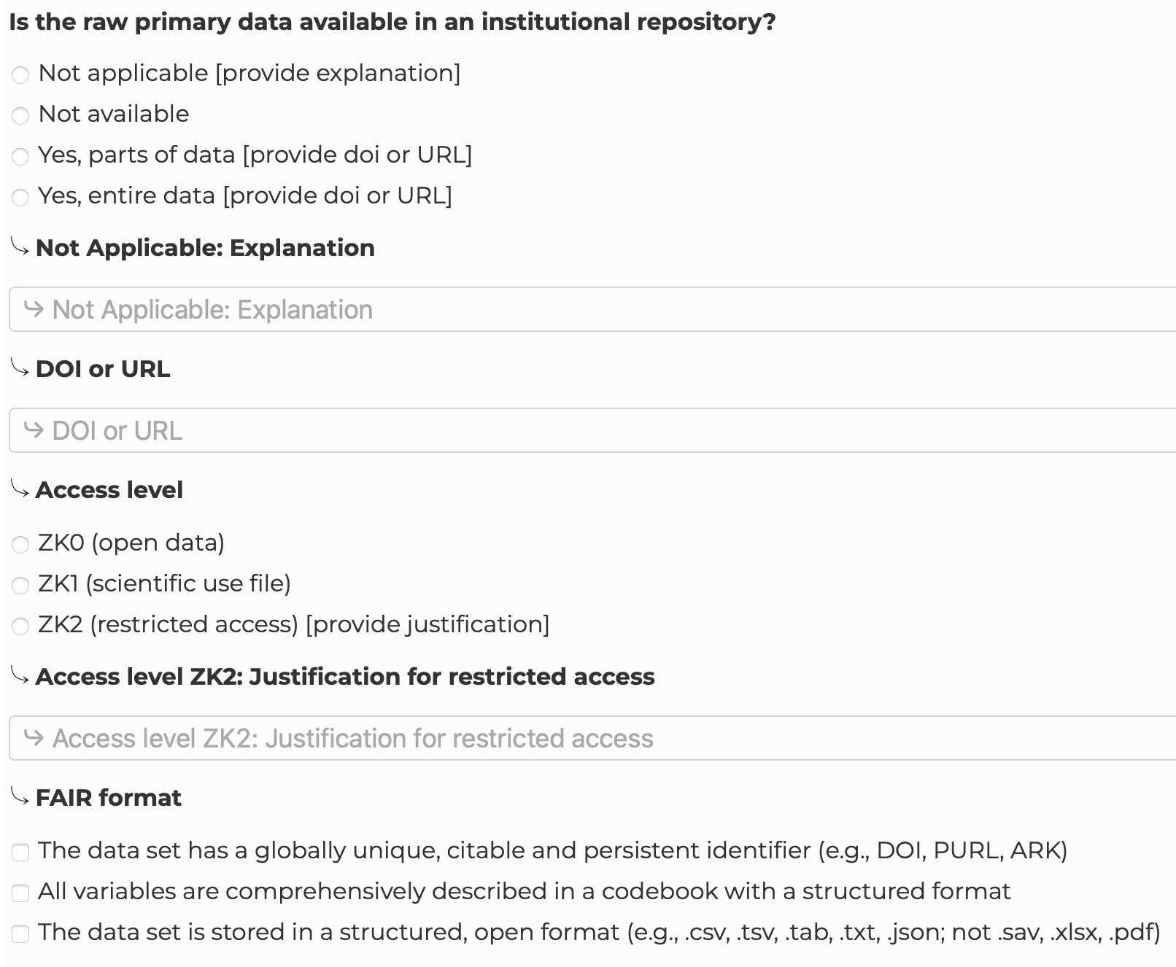
Incentivizing Open Data Sharing
RESQUE (Research Quality Evaluation Framework)
Principle 1: Academic contributions are multifaceted. Regarding research contributions, do not only value (a) journal articles, but also (b) data sets and (c) research software development.
Schönbrodt et al. (2024), Responsible Research Assessment I: Implementing DORA and CoARA for hiring and promotion in psychology
(Working commissioned by the German Psychological Society)
https://www.resque.info/
Notes:
Within psychology, our colleagues developed RESQUE, the Research Quality Evaluation framework. It also says explicitly: data sets are a valid research output next to journal articles, on the same level.

Slide 32
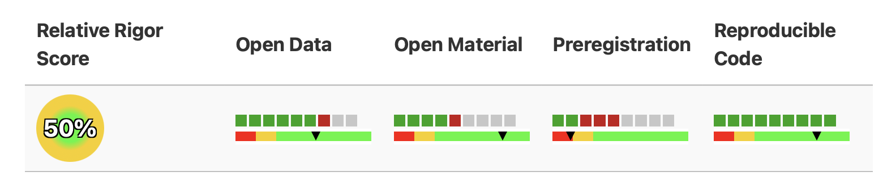
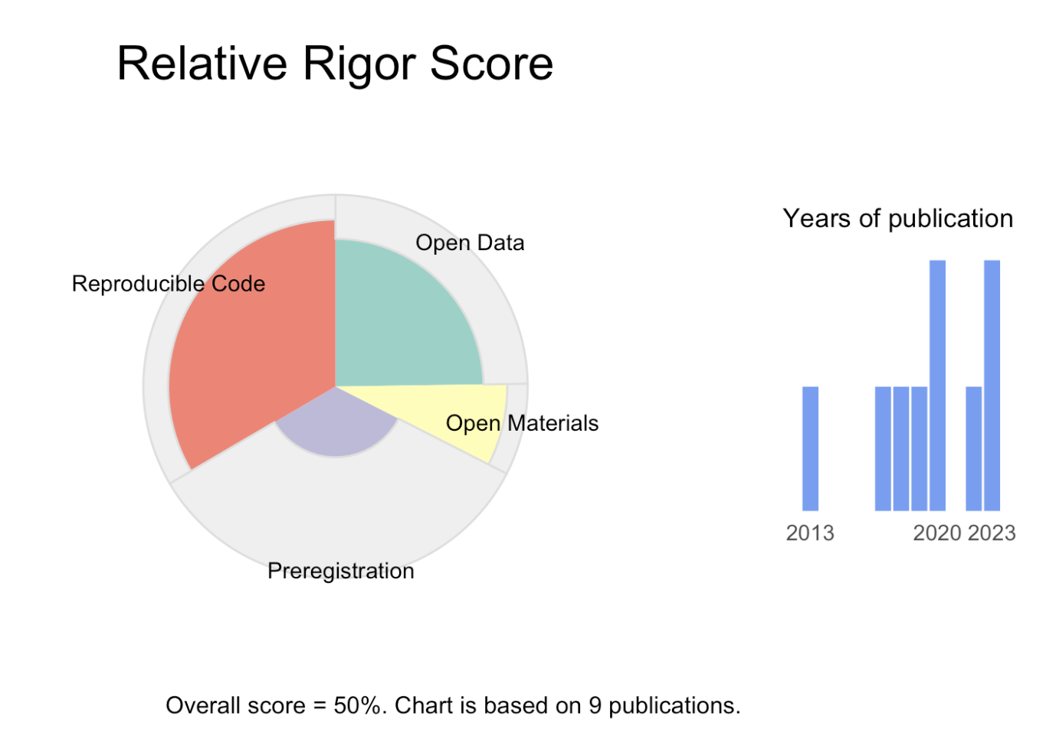
Incentivizing Open Data Sharing
RESQUE Profile for job candidates:
https://www.resque.info/includes/demo_profile.html
Notes:
In RESQUE you get a so-called relative rigor score. In this example profile, the applicant submitted nine of their best papers. For open data, the graph shows: six papers had open data (green), one did not although it could have (red), and for two open data was not applicable (gray), for instance a simulation study without data. The framework also looks at the quality of the open data: is there a good codebook, is it on a proper repository? Then you get quality points.
This RESQUE profile is starting to be used by hiring committees for professorships. Again, it is about transparency: it simply shows what you have done in your research and publishing activity.

Slide 33
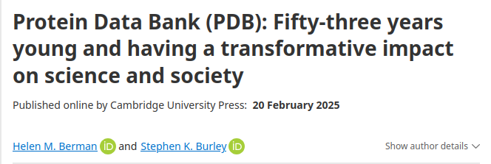
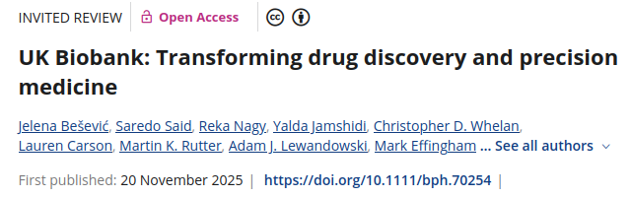
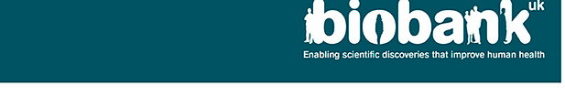
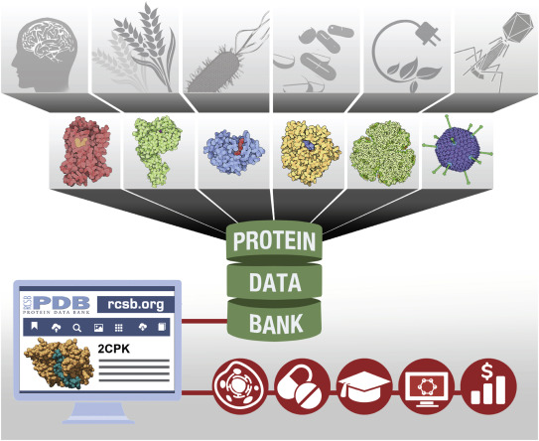
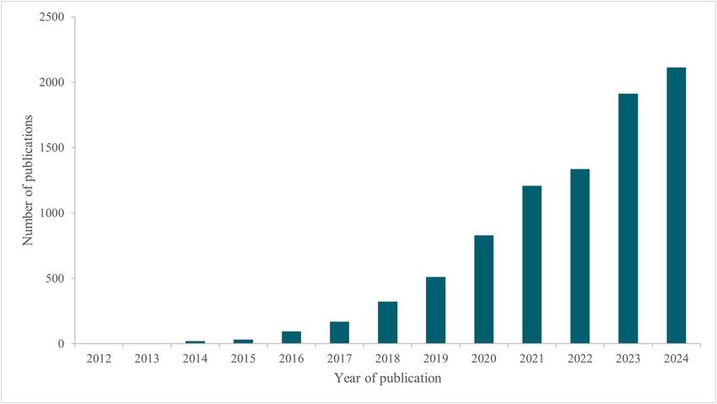
Independent Reuse
“Protein Data Bank archive helps…knowledge, benefiting basic and applied research and education.”
Burley S Impact of structural biologists and the Protein Data Bank on small-molecule drug discovery and development Journal of Biological Chemistry, 2021; 296
Bešević, J., Said, S., Nagy, R., Jamshidi, Y., Whelan, C. D., Carson, L., Rutter, M. K., Lewandowski, A. J., Effingham, M., Collins, R., Lacey, B., & Allen, N. E. (2026). UK Biobank: Transforming drug discovery and precision medicine. British Journal of Pharmacology, 183(2), 234–248. https://doi.org/10.1111/bph.70254
Notes:
In addition to the COVID story from before, another big success story comes from structural biology: the Protein Data Bank. Structural biologists have deposited their experimentally determined protein structures openly since 1971, over two hundred thousands of them. That fifty-year-old open data set is what AlphaFold was trained on. AlphaFold has now predicted more than 200 million protein structures, shared them freely, has been used by over two million researchers in 190 countries, and in 2024 the Nobel Prize in Chemistry.
Another is the UK Biobank: half a million participants, whose data has produced over 18,000 peer-reviewed papers. The people who built that cohort could never have written those papers alone.
This is where we see collective benefits to science with independent reuse of data. None of these outcomes was foreseeable when the data was shared. In addition to transparency, this is what excites me. With more and more data collection with sophisticated technologies, you cannot predict what your data enables.

Slide 34
Thank you for your attention.
Notes:
Thank you for your attention.

Slide 35
Sharing pays: the citation advantage
Colavizza et al. (2020): 531,889 articles. Papers linking to data in a repository received up to 25% more citations.
Colavizza et al. (2024): conservative causal estimate +4.3%. Direction consistently positive.
No study finds a citation penalty for sharing.
And sharing is becoming normal: PLOS articles with data in a repository rose 23% → 28% (2018–2023).
Colavizza et al. (2020), PLOS ONE 15(4): e0230416; Colavizza et al. (2024), PLOS ONE 19(10): e0311493; PLOS Open Science Indicators, figshare.com/articles/dataset/21687686.
Notes:
Before you conclude that data sharing is pure altruism, there is decent evidence of private benefits, and I want to give you the honest version with both numbers.
The largest study, Colavizza and colleagues 2020, looked at over half a million articles and found that papers linking to data in a repository received up to 25 percent more citations. Their 2024 follow-up, using more conservative causal methods, finds about 4 percent. So the honest range is somewhere between four and twenty-five percent. The direction is consistently positive across studies, and importantly, no study finds a citation penalty for sharing.
And sharing itself is becoming normal: in PLOS journals, articles with data in a repository rose from 23 to 28 percent between 2018 and 2023.
So the pitch to your career-self: this is not a lottery ticket, it is a small but consistent positive effect, on top of everything else in this lecture.
Sources: Colavizza et al. 2020, PLOS ONE 15(4) e0230416; Colavizza et al. 2024, PLOS ONE 19(10) e0311493; PLOS Open Science Indicators dataset on Figshare.

