Slide 1


Navigating leadership in Open Science: challenges
Dr Sara Lil Middleton (she/her)
Notes:
Session 2 is all about challenges

Slide 2
Prerequisites
A foundational understanding of Open Science practices such as open access, preregistration, where training materials can be found here: https://www.osc.lmu.de/training/
Leadership in Open Science: Skills, values and culture (access here)
Access to the Open Research Workshop Design Workbook: https://lmu-osc.github.io/train-the-trainer-open-research/workshop-design-workbook/
Note:
These training materials form part of three sessions on leadership in Open Science:
Skills, values and culture (access here)
Challenges (current session)
Strategies (access here)
Notes:
Speaker notes:
These are the speaker notes. You will find a script for the presenter for every slide. In presentation mode, your audience will not be able to see these speaker notes, they are only visible to the presenter.
This session assumes a basic familiarity with common Open Science concepts and practices. Examples include: replication crisis, R for data analysis and reproducible workflows; Quarto for reproducible documents; Git and GitHub for version control and collaboration, preregistration to document hypotheses and analysis plans in advance, Open Access publishing and broader transparency practices
You will need access to the workbook which can be downloaded as a Google Doc template.
Completion of session 1: Leadership in Open Science: Skills, values and culture
Today forms the 2nd part of 3 sessions on leadership in Open Science.
Instructor notes:
Learners do not need to be an expert, but you should have at least seen or used some of these concepts before. If some of these terms are new, you are encouraged to review the introductory Open Science materials linked on the slide before continuing. The goal is simply to ensure everyone shares a common base vocabulary so the workshop can focus on learning how to teach about Open Science rather than Open Science itself.

Slide 3
Survey
1. What is a particular challenge you have when it comes to adopting Open Science practices?
How confident are you in your ability to:
0 = not confident at all, 1 = mostly not confident, 2 = somewhat confident, 3 = very confident
2. identify which Open Science challenges are within my sphere of influence/control to address?
Notes:
Speaker notes:
Let’s start with a survey!
Instructor notes:
These questions can be shared in an online survey format like https://www.particify.de/en/

Slide 4
Session goals
Identify challenges in adopting Open Science practices and examine reasons behind them to raise awareness of possible barriers you and others may encounter.
To distinguish between challenges according to whether they occur at individual, interpersonal, institutional or systemic levels to practice a key problem-solving leadership skill.
Notes:
Speaker notes:
Identify challenges in adopting Open Science practices and examine reasons behind them to raise awareness of possible barriers you and others may encounter.
To distinguish between challenges according to whether they occur at individual, interpersonal, institutional or systemic levels to practice a key problem-solving leadership skill.

Slide 5
Working through the 5A framework for navigating challenges
This session
Next session
See resources
Awareness
Acknowledge
Agency
Action (address, advocate, approach others)
Assess
Noticing challenges in non-judgmental way
Naming challenges, recognizing context, multiple perspectives can co-exist
Identifying where you have influence to act
Reflecting on actions taken: were they effective? Has my sphere of influence changed?
Taking concrete steps towards addressing challenges, connecting with others
Notes:
Speaker notes:
We are going to be working through this framework over the two sessions.
The framework outlines 5 key steps for navigating challenges in Open Science
1 awareness: noticing challenges or that something may not quite right and approaching with curiosity and in a non-judgmental way
2 acknowledgement: identify and name issues, recognizing the context of the challenge and that multiple perspectives in a situation exist
3 agency: this is about recognizing each of us have agency to act and we have a sphere of influence in which we can act
4 action: taking steps towards addressing challenges and approaching others. – a problem shared is a problem halved.

Slide 6
Working through the 5A framework for navigating challenges
Framework allows you to practice key leadership skills and qualities: self-awareness, empathy, knowledgeable, problem solvers, collaborative, flexibility
Steps shown linearly but in practice things are often not straightforward!
Awareness
Acknowledge
Agency
Action (address, advocate, approach others)
Assess
Noticing challenges in non-judgmental way
Naming challenges, recognizing context, multiple perspectives can co-exist
Identifying where you have influence to act
Reflecting on actions taken: were they effective? Has my sphere of influence changed?
Taking concrete steps towards addressing challenges, connecting with others
Notes:
Speaker notes:
Engaging in these steps allows us to practice self-awareness, being knowledgeable, and a problem solver.
Importantly, as we know our work is almost never plain sailing and linear. I designed this framework as a starting place for us to use and that can be adapted to our contexts.
You’ll see the steps in the top right as we go through the two sessions.

Slide 7
What challenges do you experience in implementing
Open Science?
1. Self reflect
2. Write down short phrases
or sentences
3. Group discussion
Awareness
~10 minutes
Notes:
Speaker notes:
Let’s start with step 1 awareness: I would like us to think and then write down issues, barriers and challenges you have in implementing open science practices. We will spend about 10 minutes reflecting, sharing our thoughts and then having a group discussion.
Instructor notes:
This exercise can be done on a shared whiteboard (e.g. http://scrumblr.ca/) to gather everyone’s thoughts on the question and then have a short group discussion

Slide 8
Challenges in Open Science: Time
Time
e.g. Time constraints in a project to carry out a preregistration
Notes:
Speaker notes:
We will go through some specific examples.
Time is a big issue people report with adopting open science practices. It can be linked to things like short time to complete assignments or projects. I would argue quite a few practices like preregistration is a re-allocation of time where it is front loaded.

Slide 9
Challenges in Open Science: Overwhelm
Time
Overwhelm
e.g. Competing demands
Notes:
Speaker notes:
Overwhelm is another commonly reported feeling – as there are so many resources, standards some general some discipline specific – which to chose?. Increasingly in academia researchers have many responsibilities to juggle and it can be hard to keep on top of what’s going on in open science as well as discipline specific research.

Slide 10
Challenges in Open Science: Incentive structures
Incentive
structures
Time
e.g. Narrow research evaluation metrics like H-index
Overwhelm
Notes:
Speaker notes:
Some of us may feel there is a mis-alignment between trying to do open science and the larger narrow evaluation metrics like H-index in a publish or perish culture.

Slide 11
Challenges in Open Science: Lack of training/skills
Incentive
structures
Time
Lack of
training/
skills
Overwhelm
e.g. Training on how to make reproducible code
Notes:
Speaker notes:
Lack of training and skills is another barrier to be aware and then to develop competency in open science practices.

Slide 12
Challenges in Open Science: Norms and culture
Incentive
structures
Norms and
culture
Time
e.g. Different disciplinary norms and approaches to research
Lack of
training/
skills
Overwhelm
Notes:
Speaker notes:
A big challenge is the diversity of norms and approaches to research that can make is challenging to develop a common understanding of what open science is and standards.

Slide 13
Challenges in Open Science: Lack of support
Incentive
structures
Norms and
culture
Time
Lack of
training/
skills
Lack of support
Overwhelm
e.g. Supervisor not supportive of making dataset open access
Notes:
Speaker notes:
A lack of support from others to adopt open science practices - sometimes it can be discouragement or ambivalence from PIs.

Slide 14
Challenges in Open Science: Restrictions/inflexibility
Incentive
structures
Norms and
culture
Restrictions/
inflexibility
Time
e.g. Data protections for human data or protected species
Lack of
training/
skills
Lack of support
Overwhelm
Notes:
Speaker notes:
Challenges in how to navigate situations where being open is not possible for example when dealing with human data in medicine or with in conservation with the geographical location of protected species, dual use research

Slide 15
Challenges in Open Science: Limited resources
Incentive
structures
Norms and
culture
Restrictions/
inflexibility
Time
Lack of
training/
skills
Lack of support
Limited
resources
Overwhelm
e.g. Funding for article processing charges (APCs) to make research open access
Notes:
Speaker notes:
Resources are another big limitation to adoption of open science practices, for example paying article processing charges to make outputs open access.

Slide 16
Challenges in Open Science: Additional workload
Incentive
structures
Norms and
culture
Restrictions/
inflexibility
Additional workload
Time
e.g. Large administrative workload in Big Team Science projects
Lack of
training/
skills
Lack of support
Limited
resources
Overwhelm
Notes:
Speaker notes:
It can sometimes feel there is a lot of extra things to do in order to comply with open science practices like with making research FAIR. Or when working in a large-scale collaboration the admin associated with coordinating a large group of people.

Slide 17
Challenges in Open Science: Career impact
Incentive
structures
Norms and
culture
Restrictions/
inflexibility
Additional workload
Time
Lack of
training/
skills
Lack of support
Limited
resources
Career
impact
Overwhelm
e.g. Contributions to open source infrastructure is undervalued
Notes:
Speaker notes:
Mirroring the incentive structure sometimes there isn’t always established methods to appropriately credit contributions to open science infrastructure (people who make software packages)

Slide 18
Challenges in Open Science: Equity issues
Incentive
structures
Norms and
culture
Restrictions/
inflexibility
Additional workload
Time
Equity issues
e.g. Data sovereignty (CARE principles: Collective benefit, Authority to control, Responsibility and Ethics)
Lack of
training/
skills
Lack of support
Limited
resources
Career
impact
Overwhelm
Notes:
Speaker notes:
Equity and ethical challenges we can be faced with such as thinking about CARE principles.

Slide 19
Challenges in Open Science: AI technologies
Incentive
structures
Norms and
culture
Restrictions/
inflexibility
Additional workload
Time
Equity issues
Lack of
training/
skills
Lack of support
Limited
resources
Career
impact
Overwhelm
AI technologies
e.g. Hallucinated references
Notes:
Speaker notes:
Increasingly AI technologies are cause issues in the research landscape from publications with hallucinated references or AI slop papers.

Slide 20
Challenges in Open Science
Incentive
structures
Norms and
culture
Restrictions/
inflexibility
Additional workload
Time
Equity issues
Lack of
training/
skills
Lack of support
Limited
resources
Career
impact
Overwhelm
AI technologies
See more: Gownaris et al. 2022
Notes:
Speaker notes:
I recommend taking a look at this paper by Gownaris and colleagues which focuses on barriers to Full Participation in the Open Science Life Cycle among Early Career Researchers

Slide 21
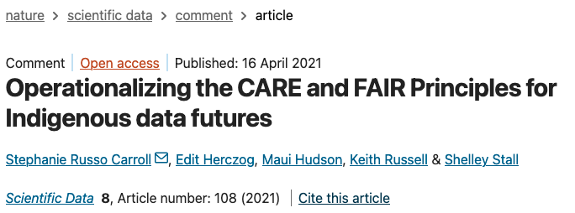
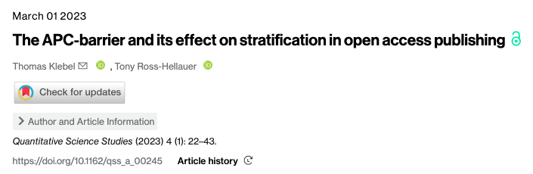
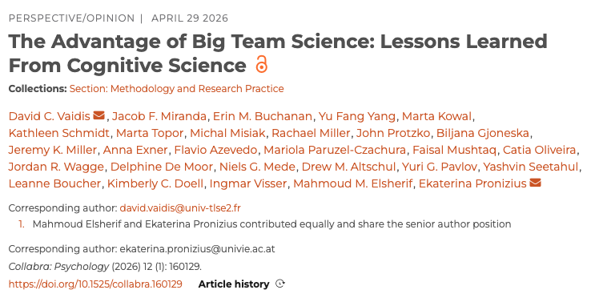
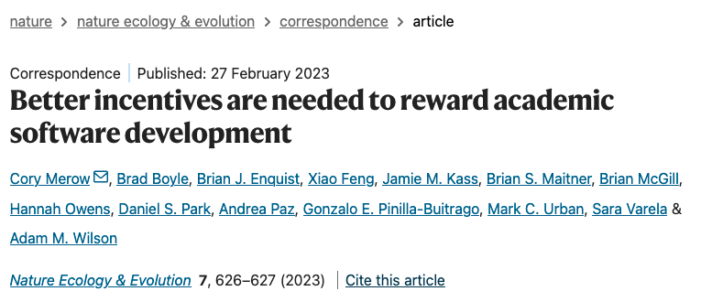
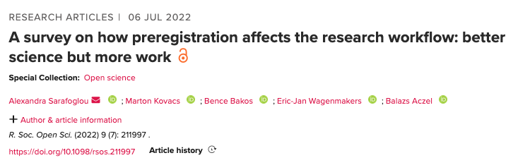
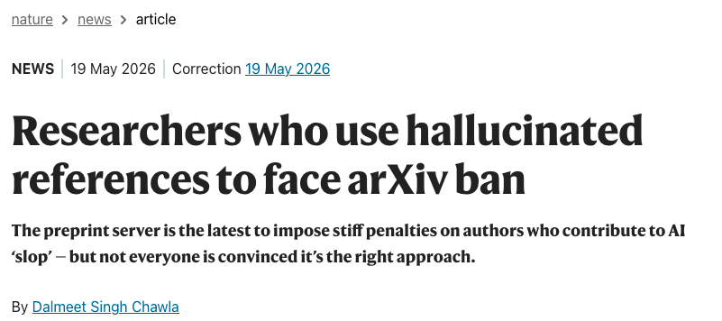
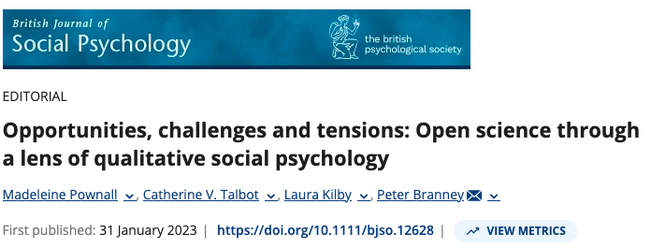
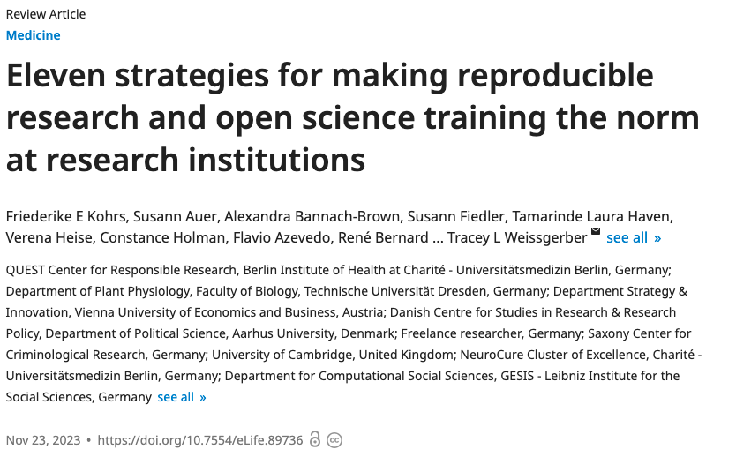
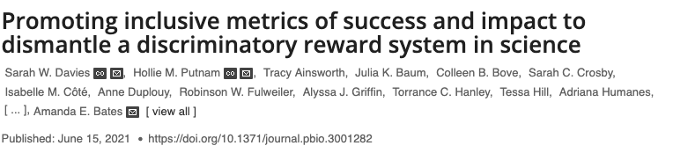
Challenges in Open Science
Notes:
Speaker notes:
Here are a selection of papers published on some of the challenges we have discussed.
Ok now we have some awareness of these different challenges, let’s dissect the challenges? What type of challenges are they?

Slide 22
Open Science is happening across scales
The diversity of pathways to Open Science (e.g. research, education, policy, infrastructure) bring about different conceptual, practical and equity challenges.
Acknowledgement
Individual
Teams
Institutional
Regional
Global
Notes:
Speaker notes:
Our pathways to open science varies, which brings about conceptual, practical and equity challenges.
Instructor notes:
This slide is designed to set the scene to help learners dig a bit deeper into the why of the challenges. (step 2 of framework – acknowledgment)

Slide 23

Open Science is happening across scales
The diversity of pathways to Open Science (e.g. research, education, policy, infrastructure) bring about different conceptual, practical and equity challenges.
You
Individual
Teams
Institutional
Regional
Global
Notes:
Speaker notes:
Let’s imagine you as a student, post doc, PI compared to policy sphere such as UNESCO.

Slide 24
Open Science is happening across scales
The diversity of pathways to Open Science (e.g. research, education, policy, infrastructure) bring about different conceptual, practical and equity challenges.
The values, goals and standards
You
How Open Science is
understood and practiced
Individual
Teams
Institutional
Regional
Global
Notes:
Speaker notes:
There will be different ideological and practical circumstances influence how we value open science and the goals and priorities we set and the standards
This influences how we understand what open science means and is practiced

Slide 25





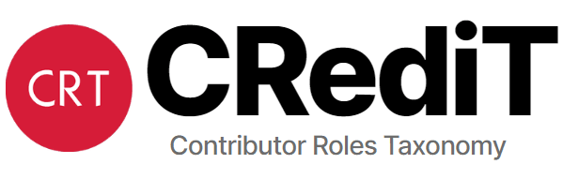
Challenges in Open Science: diversity of domains
Research &
Scholarly communication
Notes:
Speaker notes:
Now we will explore the diversity of domains where Open Science is happening.
A large domain is academic research and journals:
includes examples such as zenodo: an open repository launched in 2023 that accepts a wide range of outputs
Another example Morphs project (the logo in black) Materialising Open Research Practices in the Humanities and Social Sciences which looks at open research from the humanities and social science perspective

Slide 26





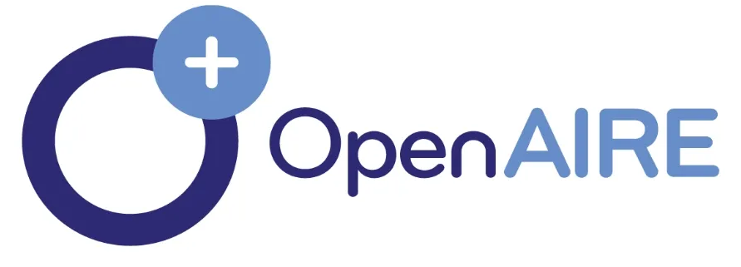
Challenges in Open Science: diversity of domains
Research &
Scholarly communication
Education &
training
Education
institutions
Notes:
Speaker notes:
Within the domain of education and training – the LMU Open Science Center falls within this sphere.
Training is happening at the lab team or department level in educational institutions too.

Slide 27









Challenges in Open Science: diversity of domains
Research &
Scholarly communication
Education &
training
Education
institutions
Policy &
infrastructure
Notes:
Speaker notes:
In the policy and infrastructure sphere we have examples like open-source software like R which you used last week, Zotero – citation manger software to policy groups like COARA that focus on systematic reform of research assessment mostly at the European level

Slide 28




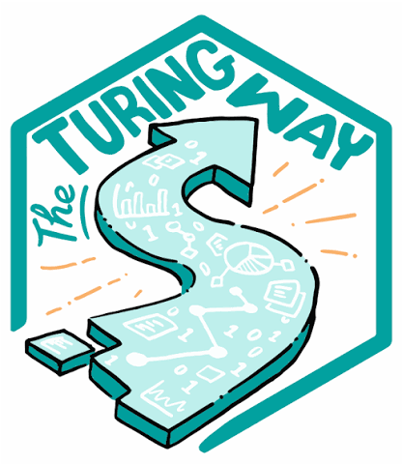





Challenges in Open Science: diversity of domains
Non-exhaustive list!
Research &
Scholarly communication
Education &
training
Education
institutions
Community &
networks
Policy &
infrastructure
Business &
Industry
See more here:
https://amcm.shinyapps.io/openit/
Notes:
Speaker notes:
Community and networks sphere have many local to global networks sometimes focussing on a particular open science practice (Quala lab qualitative methods) or research area (SORTEE – ecology and evolution)
Make you aware of another sphere, which we won't explore is business and industry: Open UK - the UK body for the business of Open Technology is an example.
The take away – is the diversity of initiative and how they fit across domains

Slide 29
A conceptual challenge in Open Science: terminology
‘Open Science’ means different things to people
5 Open Science schools of thought (Fecher & Friesike, 2014)
Democratic: Making knowledge freely available for everyone (e.g. open data, licensing)
Notes:
Speaker notes:
Let’s walk through some of the conceptual challenges: terminology
The term open science means different things to people and this paper by Fescher and Frieske captures this well
One way to view open science is through the democratic lens: focus is on making knowledge freely available widely – e.g. with open workflows and data

Slide 30
A conceptual challenge in Open Science: terminology
‘Open Science’ means different things to people
5 Open Science schools of thought (Fecher & Friesike, 2014)
Democratic: Making knowledge freely available for everyone (e.g. open data, licensing)
Pragmatic: Opening up the process of knowledge creation (e.g. Big Team Science, open code)
Notes:
Speaker notes:
Those who subscribe to the pragmatic school focus more on the process of knowledge creation – e.g. big team science and open code

Slide 31
A conceptual challenge in Open Science: terminology
‘Open Science’ means different things to people
5 Open Science schools of thought (Fecher & Friesike, 2014)
Democratic: Making knowledge freely available for everyone (e.g. open data, licensing)
Pragmatic: Opening up the process of knowledge creation (e.g. Big Team Science, open code)
Infrastructure: Creating open technical architecture for scientists (e.g. tools, platforms, services)
Notes:
Speaker notes:
Infrastructure lens focuses on the developing the tools, platforms and services that are open-source researchers use in their work and to collaborate.

Slide 32
A conceptual challenge in Open Science: terminology
‘Open Science’ means different things to people
5 Open Science schools of thought (Fecher & Friesike, 2014)
Democratic: Making knowledge freely available for everyone (e.g. open data, licensing)
Pragmatic: Opening up the process of knowledge creation (e.g. Big Team Science, open code)
Infrastructure: Creating open technical architecture for scientists (e.g. tools, platforms, services)
Public: Making knowledge creation accessible to non-academics (e.g. Science communication, public participation)
Notes:
Speaker notes:
Public school is about opening up the knowledge creation process to non-academics (for example science communication and outreach and community/citizen science)

Slide 33
A conceptual challenge in Open Science: terminology
‘Open Science’ means different things to people
5 Open Science schools of thought (Fecher & Friesike, 2014)
Democratic: Making knowledge freely available for everyone (e.g. open data, licensing)
Pragmatic: Opening up the process of knowledge creation (e.g. Big Team Science, open code)
Infrastructure: Creating open technical architecture for scientists (e.g. tools, platforms, services)
Public: Making knowledge creation accessible to non-academics (e.g. Science communication, public participation)
Measurement: Developing alternative metrics for success and impact (e.g. altmetrics, authorship)
Notes:
Speaker notes:
The 5th school of thought is measurement: this focusses on success metrics and impact and developing wider metrics (altmetrics in journal publications, authorship criteria)
Having heard all five you may gravitate to one or two.
Instructor notes:
Pause here and ask learners if they relate to a particular school.

Slide 34
A conceptual challenge in Open Science: terminology
Confusion and lack of shared context of terminology can create barriers for non-native speakers, knowledge transfer and interdisciplinary collaborations (Parsons et al. 2022).
Notes:
Speaker notes:
Thinking about terminology within open science, there can be some confusion which can create barriers for non-native speakers, knowledge transfer and interdisciplinary collaborations
Next, we will go over some concrete examples

Slide 35
A conceptual challenge in Open Science: terminology
Confusion and lack of shared context of terminology can create barriers for non-native speakers, knowledge transfer and interdisciplinary collaborations (Parsons et al. 2022).
Acronyms
Metaphors
e.g. Orcid iD (Open Researcher and Contributor ID)
e.g. Garden of forking paths,
salami slicing
Notes:
Speaker notes:
Acronyms! Orcid is not a flower but stands for Open Researcher and Contributor ID
Metaphors – lots of terms use metaphors like salami slicing which is the questionable research practice that increases the number of publications from slicing up the data from a single study.
Or garden of forking paths – which is relevant to preregistration – is the many alternative paths researchers can take when analysing data

Slide 36
A conceptual challenge in Open Science: terminology
Confusion and lack of shared context of terminology can create barriers for non-native speakers, knowledge transfer and interdisciplinary collaborations (Parsons et al. 2022).
Acronyms
Metaphors
e.g. Orcid iD (Open Researcher and Contributor ID)
e.g. Garden of forking paths,
salami slicing
Usage
differences
Creating
new terms
Additional meanings
e.g. Paper mills
Factories manufacturing paper
Organizations involved in science misconduct producing papers with falsified or fabricated data
e.g. Preregistration as a process and output
(Mayo-Wilson et al. 2025), replication-reproducibility confusion
e.g. #Bropenscience
(Whitaker & Guest, 2020)
Notes:
Speaker notes:
Some terms have additional meanings like paper mills – it means a factory that makes paper but also to describe organizations involved in science misconduct producing papers with falsified or fabricated data
Some terms can have different usage: preregistration – as a process of project planning and and output – uploading onto a repository.
Creating new terms like “Bropenscience” a lighthearted way to describe issues around lack of diversity in science

Slide 37
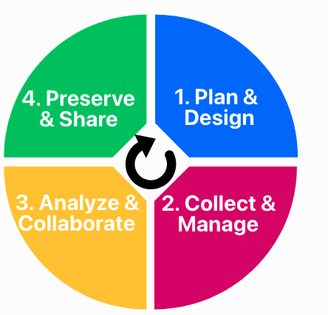
A practical challenge in Open Science: building accessible and sustainable infrastructure
There are technical and organizational infrastructure challenges in supporting researchers adopt Open Science practices across the research life cycle.
Research life cycle
Ihle et al. 2026
Notes:
Speaker notes:
Links to infrastructure school we discussed earlier. This practical challenge relates to how to operationalize things across the research cycle

Slide 38
A practical challenge in Open Science: building accessible and sustainable infrastructure
There are technical and organizational infrastructure challenges in supporting researchers adopt Open Science practices across the research life cycle.
Research life cycle
Stepping into the infrastructure school (Fecher & Friesike, 2014), practical issues:
Funding for development
Monitoring and maintenance
Governance
FAIR (Findability, Accessibility, Interoperability, and Reuse)
Global forces (e.g. geopolitics)
Ihle et al. 2026
Notes:
Speaker notes:
How to operationalize things
Platforms for collaboration
The funding to develop the tool or software
FAIR particularly Interoperability (ability to integrate and work across workflows)
How does geopolitics affect the maintenance of infrastructure?

Slide 39
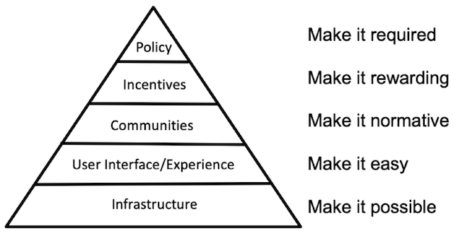
A practical challenge in Open Science: building accessible and sustainable infrastructure
There are technical and organizational infrastructure challenges in supporting researchers adopt Open Science practices across the research life cycle.
Stepping into the infrastructure school (Fecher & Friesike, 2014), practical issues:
Funding for development
Monitoring and maintenance
Governance
FAIR (Findability, Accessibility, Interoperability, and Reuse)
Global forces (e.g. geopolitics)
Culture change pyramid
Adapted from Nosek (2019)
Notes:
Speaker notes:
Illustrated nicely here with Brian Nosek’s culture change pyramid which shows the steps towards an open research culture.
Infrastructure forms the basis and makes things possible then you move up the levels towards policy.

Slide 40
A practical challenge in Open Science: building accessible and sustainable infrastructure
There are technical and organizational infrastructure challenges in supporting researchers adopt Open Science practices across the research life cycle.
Stepping into the infrastructure school (Fecher & Friesike, 2014), practical issues:
Funding for development
Monitoring and maintenance
Governance
FAIR (Findability, Accessibility, Interoperability, and Reuse)
Global forces (e.g. geopolitics)
Culture change pyramid
Note: Culture change pyramid has been critiqued due to overemphasis of infrastructure as a technical issue issue in Open Science.
Adapted from Nosek (2019)
See Principles of Open Scholarly Infrastructure (POSI) https://openscholarlyinfrastructure.org/
Notes:
Speaker notes:
Some critiques say it overemphasis open science as a technical issue. Non the less it is an important part of the fabric of research.

Slide 41
A practical challenge in Open Science:
Building organizational infrastructure
Building organizational infrastructure (e.g. workflows, team structure, fora, etc.) to foster communication and collaboration between domains and scales.
Culture change pyramid
Adapted from Nosek (2019)
Notes:
Speaker notes:
Thinking about organizational infrastructure – that is the workflows, team structure symposiums, fora etc.
Connecting along this pyramid

Slide 42
A practical challenge in Open Science:
Building organizational infrastructure
Building organizational infrastructure (e.g. workflows, team structure, fora, etc.) to foster communication and collaboration between domains and scales.
Practical issues:
Navigating tensions
Recognition
Avoiding duplicated efforts
Regulations
Digital divide
Usefulness and effectiveness
Culture change pyramid
Think about all the technical tools or services you use on a daily basis in your work!
Adapted from Nosek (2019)
Notes:
Speaker notes:
Practical issues:
grassroot initiatives and top-down policy actions.
bridging differences in agendas, attitudes and adoption
Instructor notes:
Optional: a small discussion listing all the technical tools or services the group uses on a regular basis. This can raise awareness of the tools we use regularly and how much we rely on them to research, learn and teach.

Slide 43
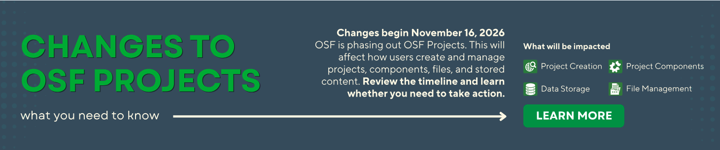
Importance of sustainable infrastructure:
The case of the Open Science Framework (OSF)
The Open Science Framework (OSF) publicly launched in 2012 and as of 2026, has 1 million registered users!
A centralized repository and research workflow platform to support sharing of data and materials in collaborative teams
From November 2026, OSF projects are to be phased out due to increased maintenance costs ($4-5 million USD per year), decreased long term funding and scope creep (Nosek, 2026).
Read more about the changes: https://www.cos.io/blog/osf-changes-a-note-to-users
Notes:
Speaker notes:
A very topical example is the winding down of OSF projects.
A bit of background: has been going for 14 years and has 1 million registered users
A centralized repository and research workflow platform – indeed the track 2 slide decks are currently hosted there
From November this year they are to be phased out. The cost is 4-5 million us dollars!
This will cause a change to workflows

Slide 44
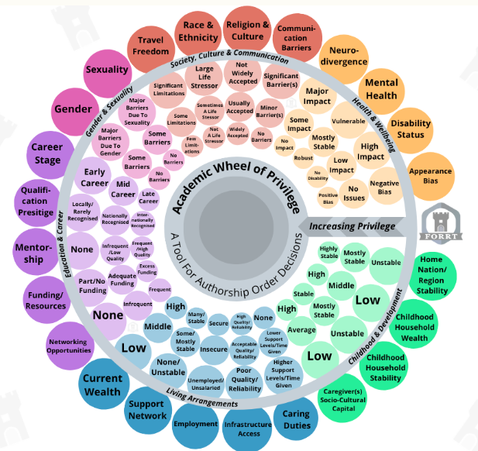
Open Science challenges around equity: contributions, credit and capacity building
Not considering equity and (social) justice, risks replicating the status quo and perpetuating harm to under-represented communities.
Equity = Fairness based on need
Justice = Transformation of the system by
removing cause of inequity to ensure fairness for all
Adapted from Middleton et al. 2026 (CC BY NC SA)
Notes:
Speaker notes:
Now moving on to thinking about equity in open science Which links well to what we discussed in session 1 and also will be relevant to some of the case studies that are part of session 3 strategies.
In short by equity, we mean fairness based on need and justice – removing cause of the inequity

Slide 45
Open Science challenges around equity: contributions, credit and capacity building
Not considering equity and (social) justice, risks replicating the status quo and perpetuating harm to under-represented communities.
Equity issues:
Biases
Who decides the standards?
Whose knowledge do we value and acknowledge?
How are people from under-represented communities impacted?
Equity = Fairness based on need
Justice = Transformation of the system by
removing cause of inequity to ensure fairness for all
Adapted from Middleton et al. 2026 (CC BY NC SA)
Notes:
Speaker notes:
Personal biases -
Who sets the standards?
Whose knowledge do we value – thinking about authorship, and credit. How are contributions recognized
How does our ways of working and research impact communities that are under-represented in academia?

Slide 46
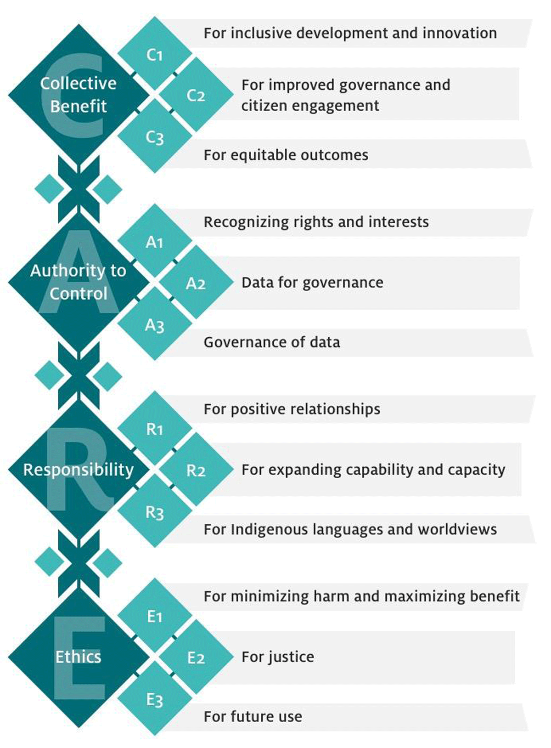
FAIR data management also needs CARE
FAIR asks: Are people able to access and reuse these data?
Technical infrastructure focus
CARE asks: Should these data be accessible and to whom? Who decides?
Equity and ethics focus
Consider CARE Principles when working with:
Indigenous communities
Vulnerable or marginalized communities
FAIR = Findable, Accessible, Interoperable and Reusable
CARE = Collective Benefit, Authority to Control, Responsibility, and Ethics
Image from Carroll et al. (2020)
Notes:
Speaker notes:
On the last point about impact on communities is the CARE principles developed for research involving Indigenous communities which stands for Collective Benefit, Authority to Control, Responsibility, and Ethics
FAIR focuses on technical infrastructure and asks questions like: Are people able to access and reuse these data?
With an equity, ethics and social justice lens: CARE asks: Should these data be accessible and to whom? Who decides?
The CARE principles are good to consider when working with indigenous communities and vulnerable or marginalized groups to minimize harm.
Just because you can, does not always mean you should!

Slide 47
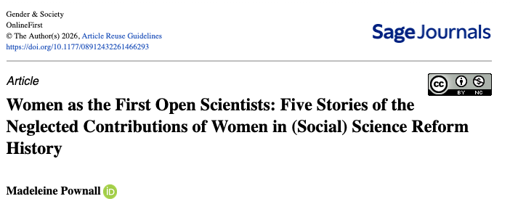
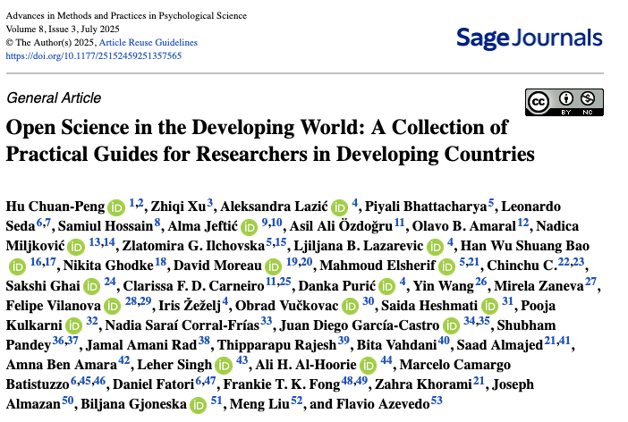
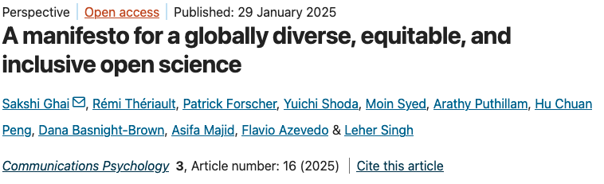
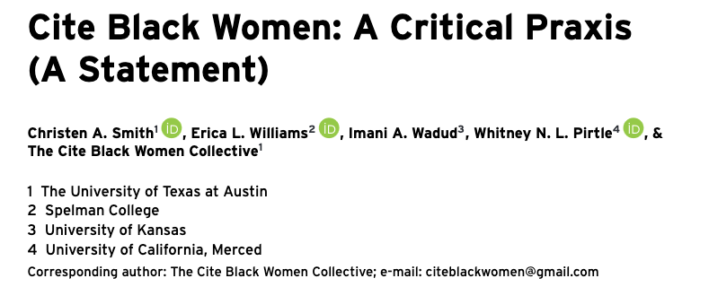
Open Science challenges around equity and (social) justice
See OSC training module on citation politics:
https://lmu-osc.github.io/train-the-trainer-student-track-pedagogy/materials/PMM-M4/PMM-M4-S3-Citation-Politics/PMM-M4-S3-Citation-Politics.html
Notes:
Speaker notes:
Here are a selection of papers that discuss equity and social justice challenges in an open science context.

Slide 48
Challenges in Open Science: AI technologies
Rapid usage of artificial intelligence (AI) technologies throughout the research life cycle presents conceptual, practical and equity challenges
Ambiguity around AI terminology (e.g. large language models vs chatbots).
Implications for scientific understanding?
Large volume of AI- generated work affecting the evaluation of research outputs.
Implications for preprint servers, peer review, funding panels?
AI reduces engagement (e.g. outsourcing questions to AI chatbot vs talking with an expert).
Implications for value of human expertise, team dynamics?
Guest et al. 2026, Hao et al. 2026
Notes:
Speaker notes:
It is important to briefly mention a challenge of AI technologies and how this connects the three types of challenges (conceptual, practical and equitable)
Conceptually there is confusion about the different types of AI technologies
e.g. what is a Chatbot:
An engineered system that appears to converse with
the user using text or voice.
Then practically how does use of AI affect how we evaluate research outputs (and educational assessments)?
and the equity perspective, how does AI impact team dynamics?
Instructor notes:
This slide is designed to prompt reflection and can be extended to a group discussion activity or short essay writing exercise.

Slide 49
Recap on Open Science challenges
We’ve Identified challenges in adopting Open Science practices
and examined some reasons behind them
Conceptual, practical and equity challenges
Diversity of domains
Notes:
Speaker notes:
A quick recap before we pivot
We dissected the challenges? What type of challenges are they?
We’ve looked at the big picture – let’s relate to our challenges

Slide 50
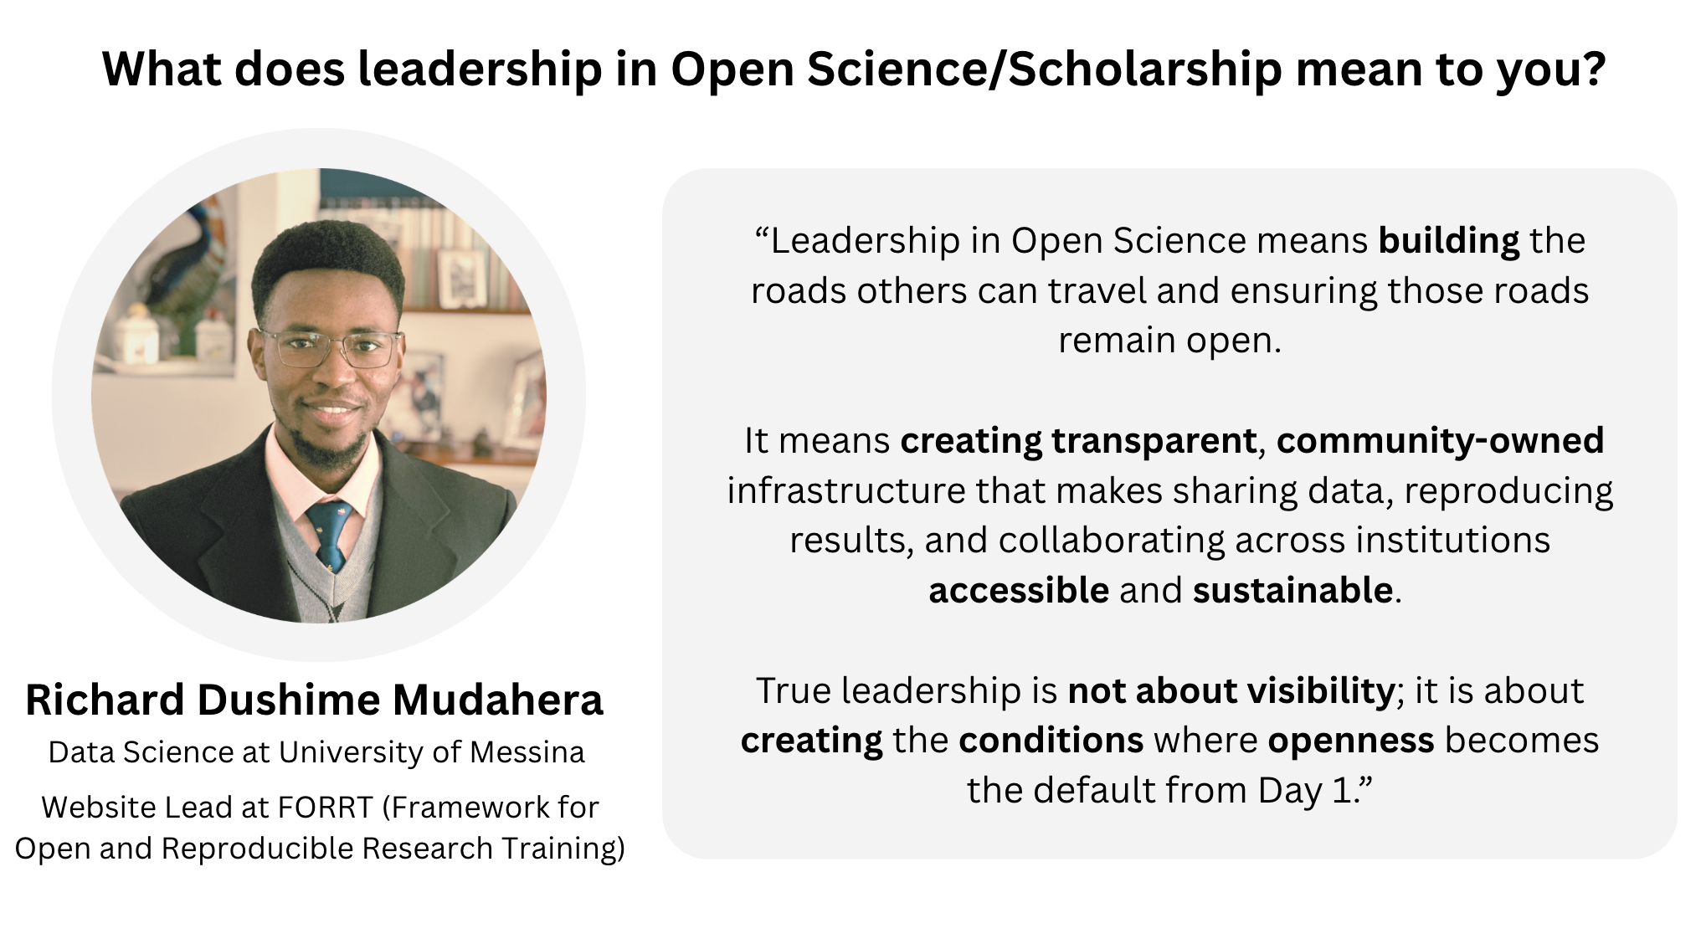
Notes:
Speaker notes:
Another perspective on leadership in open science by a Richard Dushime who is a data scientist and website leader at FORRT.
“Leadership in Open Science means building the roads others can travel and ensuring those roads remain open.
It means creating transparent, community-owned infrastructure that makes sharing data, reproducing results, and collaborating across institutions accessible and sustainable.
True leadership is not about visibility; it is about creating the conditions where openness becomes the default from Day 1.”

Slide 51
The scale of the challenges
Whole systems (e.g. academic ecosystem)
Systemic
Embedded policies/practices that provide scaffolding of systems
Note:
Identifying which scale the challenge is -> addressing it
Institutional
Interactions and behaviors between people and teams
Inter-personal
Personal behaviors
Individual
Notes:
Speaker notes:
Let’s talk about scale!
We can map these challenges based on where they occur:
Starting from large scale: whole systems – like academia
Then institutional or organizational (mezzo scale) is where embedded policies/practices that provide scaffolding of systems
Then on smaller scale of teams – this covers interactions and behaviors between people and teams
Finally at the individual scale it is about personal behaviors

Slide 52
The scale of the challenges
Systemic
Incentive
structures
Note:
Challenges don’t always fit neatly onto the scale!
Institutional
Lack of support
Time
Inter-personal
Lack of
training/
skills
Individual
Notes:
Speaker notes:
Some of the challenges we saw earlier can be mapped on like this.
Incentive structures are dictated at the academic system at national or regional policy decisions
Lack of support is a challenge at the scale of institutions and teams
There may be an aspect of a challenges that is within your sphere of influence

Slide 53
Sphere of influence
Which challenges are in our control or influence to address?
Agency
Reflection question:
For a given challenge, am I able to address it by myself or can I partly influence (via my actions and behavior) how the challenge impacts me?
Notes:
Speaker notes:
Now we are thinking about step 3 – agency, now that we have acknowledged the challenges we can begin to think about which ones we have control or influence over to address

Slide 54
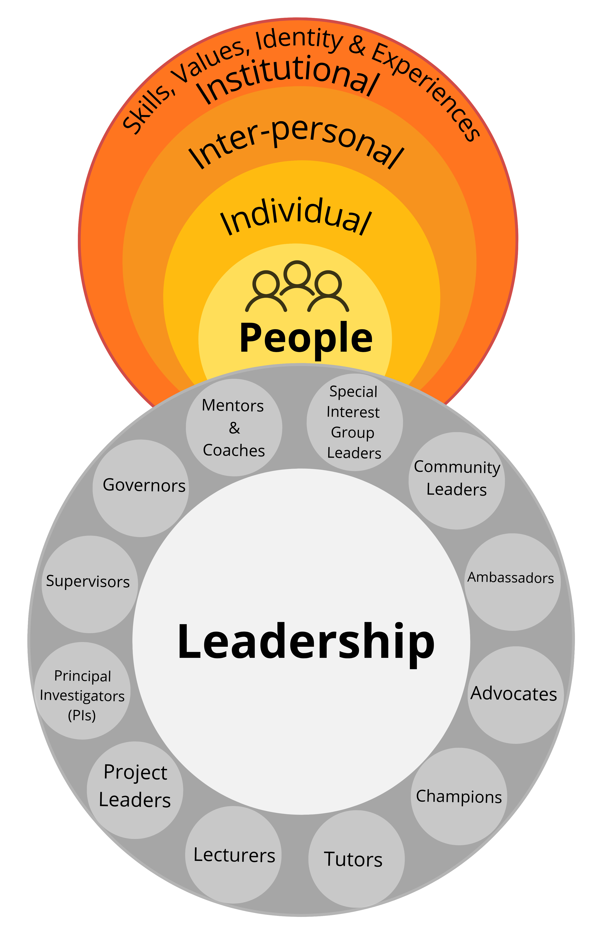
Where is our sphere of influence?
Systemic
Institutional
Inter-personal
We generally have more control and influence for challenges at this scale
Individual
Notes:
Speaker notes:
We generally have more control and influence for challenges at the inter-personal and individual level)
Links back to slide on open science happening on different scales (practical issues), each of us has different sphere of influence

Slide 55
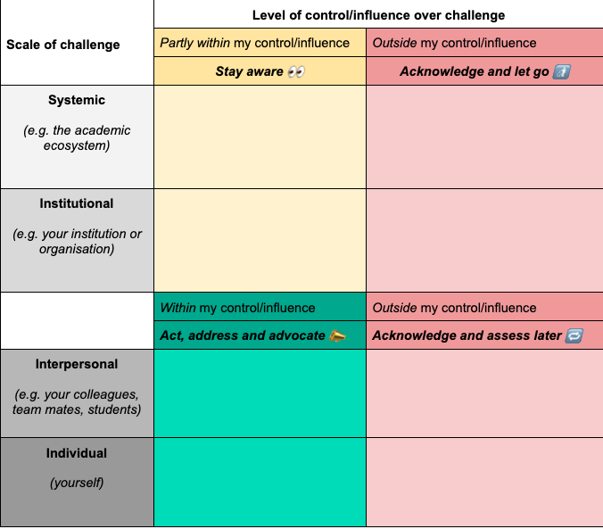
To act or not to act?
Categorizing the list of challenges can help us with decision making and reduce overwhelm!
Notes:
Speaker notes:
How do we go from brain dump of challenges to deciding which challenges to address?
This table can help us. We have the scale of the challenge on the left-hand side in grey and then 4 boxes with varying level of control or influence over the challenge.
Top left we have challenges that are partly within in our control and we can stay aware
Top right are challenges outside our control – we acknowledge them and then try and let go to reduce the mental space they are occupying in our brain
Then bottom left we have the green zone of challenges that are within our control/influence and we can then look at how to act to address them
Lastly in the bottom right we have outside our control which we will accept for now but can assess at a later date if our sphere of influence has shifted or not.
Our sphere of influence is dynamic and as we accumulate more lived and work experience and make more connections our capacity to address challenges changes. Barriers that are currently outside our control/influence to address may be possible to act upon in a few months time.

Slide 56
Exercise in mapping our challenges
Write down a couple Open Science challenges in section 8.1 of the workbook: https://lmu-osc.github.io/train-the-trainer-open-research/workshop-design-workbook/
For each challenge, categorize them into the grid (use the reflection question to help you in section 8.2)
Extension: For one challenge in the green zone set out a next step to address the challenge
Reflection question:
For a given challenge, am I able to address it by myself or can I partly influence (via my actions and behavior) how the challenge impacts me?
~8 minutes
Notes:
Speaker notes:
Now is time for you to write down your challenges and begin to categorize them in your workbooks
Fell free to use challenges we’ve crowd sourced earlier in the session.

Slide 57
Final summary
Mapping challenges and identifying sphere of influence is a step towards addressing barriers
How Open Science is understood and practiced differs across the domains
(e.g. a student vs policymaker)
Conceptual, practical and equity challenges remain in Open science (e.g. terminology, infrastructure and credit)
Notes:
Speaker notes:
There are many actors in the open science space, in education, research, policy, infrastructure and this brings about a number of challenges. We discussed some conceptual, practical and equity challenges.
We examined what our challenges are and went into depth in 3 key challenge areas (conceptual, practical and equity challenges)
Here is what I want you to remember
There are multiple entry points into Open Science activities and things are happening across scale and we have agency to address issues!

Slide 58
Leadership qualities we practiced
Using the 5A framework we worked on increasing our self-awareness and knowledge
Self-awareness
Knowledgeable
Awareness
Acknowledge
Agency
Action
Assess
Notes:
Speaker notes:
A reminder of the leadership qualities we practiced: self awareness and gaining knowledge about open science challenges

Slide 59
Leadership qualities we practiced
Using the 5A framework we worked on increasing our self-awareness and knowledge
Self-awareness
Knowledgeable
In the next session we will work on:
Awareness
Acknowledge
Agency
Action
Assess
Next session:
Strategies in leadership: access here
Problem solving
Collaboration
Notes:
Speaker notes:
Next, we will work on problem solving and collaboration.

Slide 60
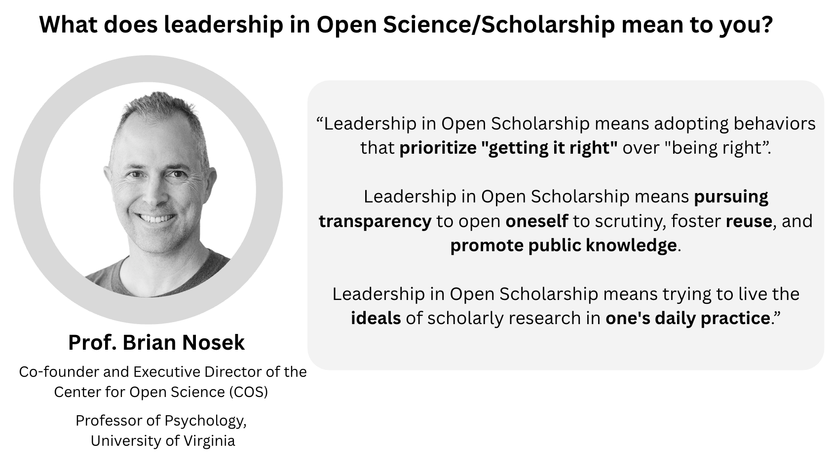
Notes:
Speaker notes:
Here we have Brian Nosek’s, cofounder of center for open science perspective on leadership:
“Leadership in Open Scholarship means adopting behaviors that prioritize "getting it right" over "being right.
Leadership in Open Scholarship means pursuing transparency to open oneself to scrutiny, foster reuse, and promote public knowledge.
Leadership in Open Scholarship means trying to live the ideals of scholarly research in one's daily practice.”

Slide 61
Survey
1. What is a particular challenge you have when it comes to adopting Open Science practices?
How confident are you in your ability to:
0 = not confident at all, 1 = mostly not confident, 2 = somewhat confident, 3 = very confident
2. identify which Open Science challenges are within my sphere of influence/control to address?
Notes:
Speaker notes:
Now to revisit the survey we began with

Slide 62
Questions
Notes:
Speaker notes:
We now have time for questions, thoughts and comments from the session.

Slide 63
Contribution statement
Creator: Middleton, Sara Lil ( 0000-0001-5307-8029)
Reviewer: Verheyen, Steven ( 0000-0002-6778-6744),
von Grebmer zu Wolfsthurn, Sarah ( 0000-0002-6413-3895)
Acknowledgements:
Sharing leadership expertise:
Richard Dushime Mudahera, Brian Nosek

Slide 64

License and citation statement
This current work by Sara Lil Middleton, Steven Verheyen and Sarah von Grebmer zu Wolfsthurn is licensed under a CC-BY-SA 4.0 Creative Commons Attribution 4.0 International SA License (unless otherwise stated). It permits unrestricted re-use, distribution, and reproduction in any medium, provided the original work is properly cited. If you remix, transform, or build upon the material, you must distribute your contributions under the same license as the original.
Please cite these materials as: Middleton, S., Verheyen, S., & Von Grebmer Zu Wolfsthurn, S., (2026). Challenges in leadership [Quarto slides]. LMU Open Science Center and FORRT. https://lmu-osc.github.io/train-the-trainer-open-research/leadership-open-research/challenges-leadership/

Slide 65
References
Carroll, S. R., Garba, I., Figueroa-Rodríguez, O. L., Holbrook, J., Lovett, R., Materechera, S., Parsons, M., Raseroka, K., Rodriguez-Lonebear, D., Rowe, R., Sara, R., Walker, J. D., Anderson, J., & Hudson, M. (2020). The CARE Principles for Indigenous Data Governance. Data Science Journal, 19, 43. https://doi.org/10.5334/dsj-2020-043
Fecher, B., & Friesike, S. (2014). Open Science: One Term, Five Schools of Thought. In S. Bartling & S. Friesike (Eds), Opening Science (pp. 17–47). Springer International Publishing. https://doi.org/10.1007/978-3-319-00026-8_2
Gownaris, N. J., Vermeir, K., Bittner, M.-I., Gunawardena, L., Kaur-Ghumaan, S., Lepenies, R., Ntsefong, G. N., & Zakari, I. S. (2022). Barriers to Full Participation in the Open Science Life Cycle among Early Career Researchers. Data Science Journal, 21, 2. https://doi.org/10.5334/dsj-2022-002
Guest, O., Suarez, M., Müller, B., van Meerkerk, E., Oude Groote Beverborg, A., de Haan, R., Reyes Elizondo, A., Blokpoel, M., Scharfenberg, N., Kleinherenbrink, A., Camerino, I., Woensdregt, M., Monett, D., Brown, J., Avraamidou, L., Alenda-Demoutiez, J., Hermans, F., & van Rooij, I. (2026). Against the Uncritical Adoption of ‘AI’ Technologies in Academia. https://doi.org/10.5281/ZENODO.17065098to-open-science/
Hao, Q., Xu, F., Li, Y., & Evans, J. (2026). Artificial intelligence tools expand scientists’ impact but contract science’s focus. Nature, 649(8099), 1237–1243. https://doi.org/10.1038/s41586-025-09922-y
Ihle Malika, Gupta Reema, Schönbrodt Felix, April 2026, Open Research Cycle Handbook https://lmu-osc.github.io/training/research-cycle-handbook.html CC-BY-SA 4.0 LMU Open Science Center
Mayo-Wilson, E., Grant, S., Corker, K. S., & Moher, D. (2025). Consistent and Precise Description of Research Outputs Could Improve Implementation of Open Science. Advances in Methods and Practices in Psychological Science, 8(4), 25152459251375445. https://doi.org/10.1177/25152459251375445
Middleton, S. L., Sulik, J., Iley, B. J., Elsherif, M. M., & Azevedo, F. (2026). The Academic Wheel of Privilege: An equity-based tool for authorship order. MetaArXiv. https://doi.org/10.31222/osf.io/af4nk_v2
Nosek, B. (2019). Strategy for Culture Change. Center for Open Science. https://www.cos.io/blog/strategy-for-culture-change
Nosek, B. (2026). OSF Changes: A Note to Users. Center for Open Science. https://www.cos.io/blog/osf-changes-a-note-to-users
Parsons, S., Azevedo, F., Elsherif, M. M., Guay, S., Shahim, O. N., Govaart, G. H., Norris, E., O’Mahony, A., Parker, A. J., Todorovic, A., Pennington, C. R., Garcia-Pelegrin, E., Lazić, A., Robertson, O., Middleton, S. L., Valentini, B., McCuaig, J., Baker, B. J., Collins, E., … Aczel, B. (2022). A community-sourced glossary of open scholarship terms. Nature Human Behaviour, 6(3), 312–318. https://doi.org/10.1038/s41562-021-01269-4
Whitaker, K., & Guest, O. (2020). #bropenscience is broken science. The Psychologist, 33, 34–37. https://thepsychologist.bps.org.uk/volume-33/november-2020/bropenscience-broken-science

