Slide 1


Leadership in Open Science: Skills, values and culture
Dr Sara Lil Middleton (she/her)
Dr Flavio Azevedo (he/him)

Slide 2
Prerequisites
A foundational understanding of Open Science practices such as open access, preregistration, where training materials can be found here: https://www.osc.lmu.de/training/
Access to the Open Research Workshop Design Workbook: https://lmu-osc.github.io/train-the-trainer-open-research/workshop-design-workbook/
Access to FORRT leadership case study: https://osf.io/ay8qk/files/cmeuy
Note:
These training materials form part of three sessions on leadership in Open Science:
Skills, values and culture (current session)
Challenges (access here)
Strategies (access here)
Notes:
Speaker notes:
These are the speaker notes. You will find a script for the presenter for every slide. In presentation mode, your audience will not be able to see these speaker notes, they are only visible to the presenter.
This session assumes a basic familiarity with common Open Science concepts and practices. Examples include: replication crisis, R for data analysis and reproducible workflows; Quarto for reproducible documents; Git and GitHub for version control and collaboration, preregistration to document hypotheses and analysis plans in advance, Open Access publishing and broader transparency practices
You will need access to the workbook which can be downloaded as a Google Doc template.
The FORRT leadership case study provides a real world example of Open Science leadership.
Today forms part 1 of 3 session on leadership in Open Science.
Instructor notes:
Learners do not need to be an expert, but you should have at least seen or used some of these concepts before. If some of these terms are new, you are encouraged to review the introductory Open Science materials linked on the slide before continuing. The goal is simply to ensure everyone shares a common base vocabulary so the workshop can focus on learning how to teach about Open Science rather than Open Science itself.

Slide 3
Survey
1. Have you ever had an advocacy role?
How confident are you in your ability to:
0 = not confident at all, 1 = mostly not confident, 2 = somewhat confident, 3 = very confident
2. identify my own leadership values?
3. recognize how different elements of the working environment influences how you lead?
Notes:
Speaker notes:
Let’s start with a survey!
Instructor notes:
These questions can be shared in an online survey format like https://www.particify.de/en/

Slide 4
Session goals
Identify and describe key effective leadership qualities to build on existing knowledge and experiences
Identify own leadership values which you can adopt in your leadership contexts
Recognize where values of effective leadership and Open Science overlap to strengthen your capacity as leaders in Open Science
Examine how social context influences leadership and open research culture
Notes:
Speaker notes:
Four main goals
Identify and describe key effective leadership qualities to build on existing knowledge and experiences
Identify own leadership values which you can adopt in your leadership contexts
Recognize where values of effective leadership and Open Science overlap to strengthen your capacity as leaders in Open Science
Examine how social context influences leadership and open research culture

Slide 5
Leadership in Open Science journey:
From:
“I am not sure what the key aspects of effective leadership are or how to incorporate them into my context”
to…
“I feel I can critically evaluate my own leadership values and skills and feel empowered to adopt effective leadership practices in my context”
Notes:
Speaker notes:
So the journey we will go on today is one where we start out with being unsure of what effective leadership is and how to embed those skills into our contexts to hopefully by the end being able to critically evaluate the values and skills of leadership and feel empowered to apply to your own contexts

Slide 6
Zooming out
Thinking about the wider context of leadership in Open Science workshop in industry and policy.
Notes:
Speaker notes:
Let’s take a step back and think about the wider context leadership beyond open science in industry and policy.

Slide 7
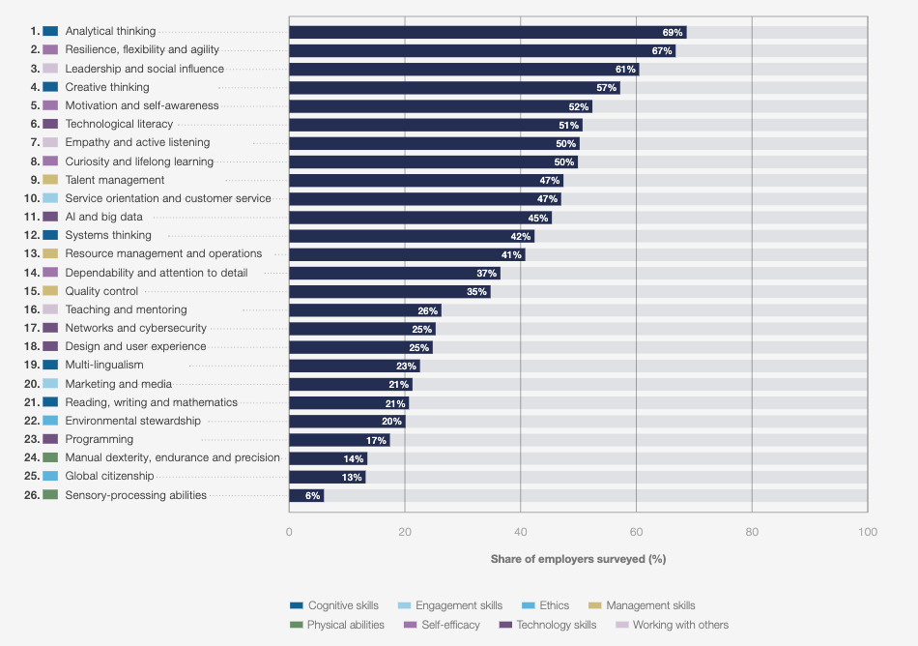
Leadership is a core skill
Share of employers who consider the stated skills to be core skills for their workforce
Adapted from Leopold et al. (2025)
Notes:
Speaker notes:
This chart shows 1,000 employers – representing more than 14 million workers across 22 industry clusters and 55 economies providing insights into the emerging jobs landscape for the 2025-2030 period
Leadership is regarded as a core skill!
Instructor notes:
Make a general point
Context for work the content you will engage with today is relevant for wherever your next role or project will be, inside or outside academia.

Slide 8
Skills in working with others and self-efficacy
Share of employers who consider the stated skills to be core skills for their workforce
Adapted from Leopold et al. (2025)
Notes:
Speaker notes:
In addition to leadership, Some of the core skills that support leadership relate to working with others and self-efficacy – belief in oneself and we will practice some of these skills today.

Slide 9
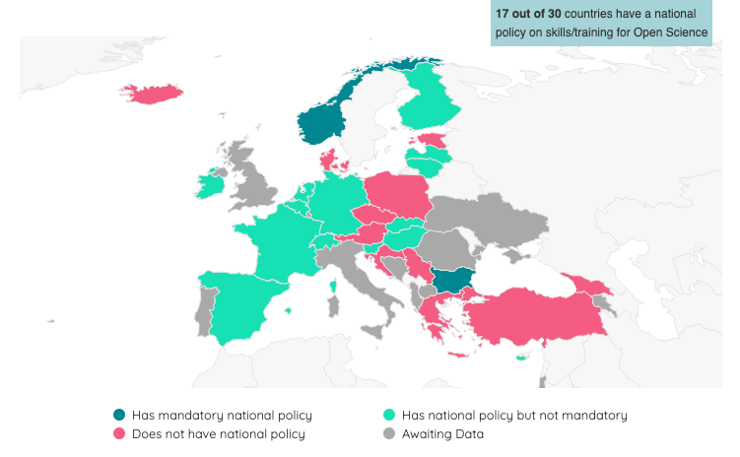
European Policy on skills/training in Open Science
~55% of countries have an Open Science skills/training policy
Adapted from EOSC Open Science Observatory (2024)
Notes:
Speaker notes:
Switching to policy in the European context, this map shows just over half of nations have a policy on skills/training on open science.
Policy and other top-down practices can be slow to implement, which highlights the importance of skills and training at individual, team, departmental and institutional levels

Slide 10
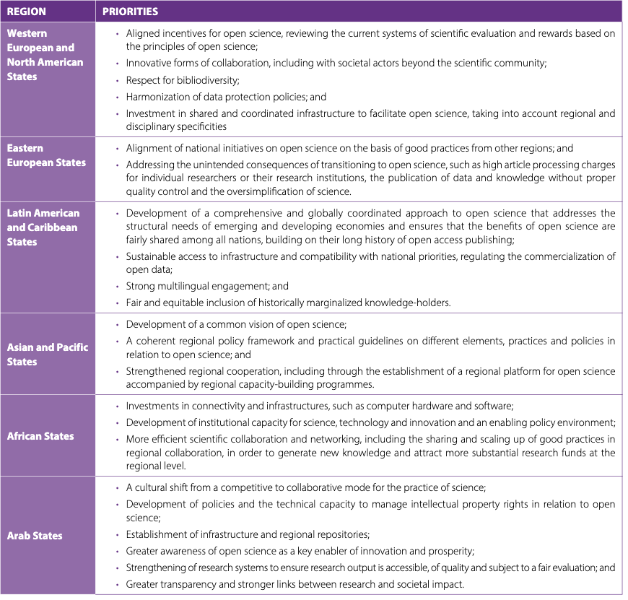
Regional differences in Open Science priorities
Working towards
these priorities
requires effective leadership!
Adapted from UNESCO (2023)
Notes:
Speaker notes:
Important to recognize open science adoption and priorities differ around the world. This table focusing on non-European regions highlights some key priorities that we will discuss in more detail over the course of the day.
Instructor notes:
Sign post to learners to check out the UNESCO open science report for more in-depth information.

Slide 11
What does good leadership look and feel like?
1. Self reflect
2. Write down words, short phrases
or sentences
3. Group discussion
~10 minutes
Tip
Think back to a time you had a role model within or outside academia that left a positive impression on you.
Notes:
Speaker notes:
This exercise aims to get you thinking about what "good" leadership looks and feels like. We will spend about 10 minutes reflecting, sharing our thoughts and then having a group discussion.
Instructor notes:
This exercise can be done on a shared whiteboard (e.g. http://scrumblr.ca/) to gather everyone’s thoughts on the question and then have a short group discussion

Slide 12
Some key leadership skills and qualities
Non-exhaustive list!
Active listening
Clear communicators
Knowledgeable
Empathy
Problem solvers
Active learning
Self-awareness
Collaborative
Flexibility
Notes:
Speaker notes:
Some key qualities that come up repeatedly in the literature and previous workshops are qualities such as:
active listening, clear communication, subject knowledge, empathy, problem solving, active learning, self awareness, being collaborative and flexible.

Slide 13
Some key leadership skills and qualities
Focus on five leadership qualities over the three sessions:
Active listening
Clear communicators
Knowledgeable
Empathy
Problem solvers
Active learning
Self-awareness
Collaborative
Flexibility
Notes:
Speaker notes:
We will focus on these 5 skills and qualities: empathy, problem solving, self awareness, collaboration and knowledge

Slide 14
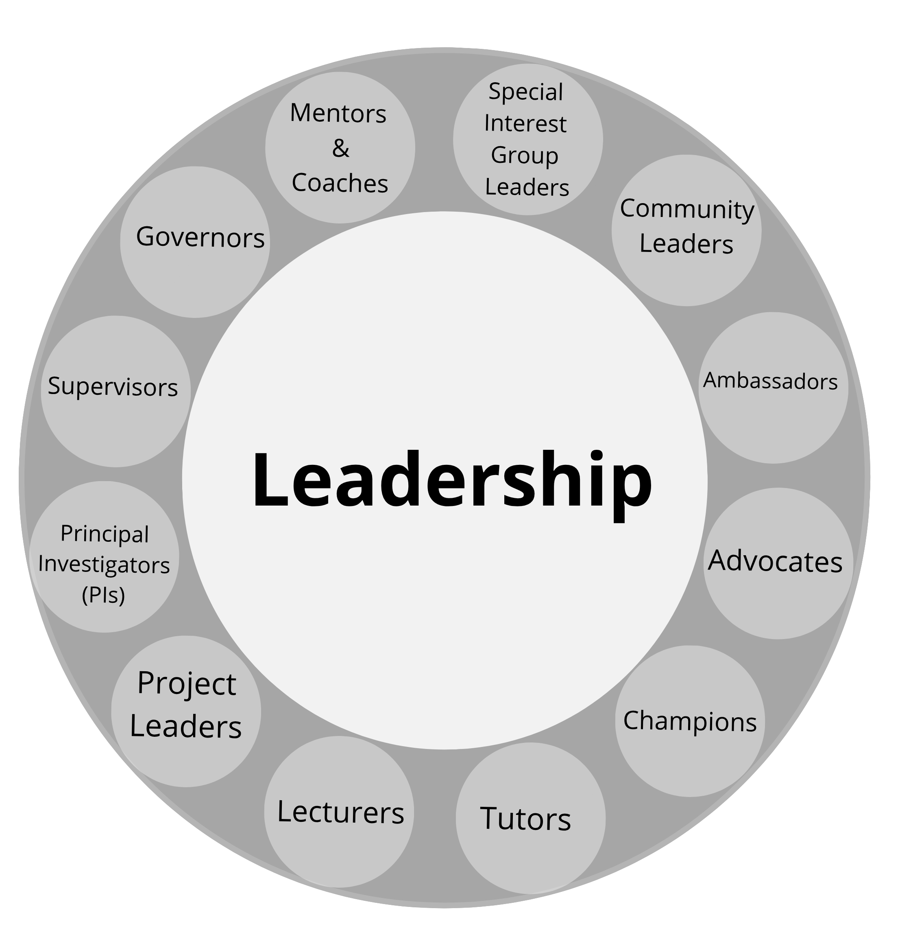
Diversity of leadership roles
Notes:
Speaker notes:
Leadership is not one thing and is highly context dependent
although often we picture PIs or supervisors
This leadership ring shows different leadership roles like: community leaders, lecturers, mentors.

Slide 15
Diversity of leadership roles: formal
Have responsibility and authority over others to achieve goals
Officially recognized with position/title often appointed or elected
Usually some training
Feature of more hierarchal organizations
Formal
Notes:
Speaker notes:
Picture a leader typically we think about formal leaders
Examples outside of academia: Heads of state, CEOs, manager.
In academic contexts: PIs, supervisors
Characteristics of formal leaders: officially recognized , there is a hiring process and a feature of hierarchical organizations

Slide 16
Diversity of leadership roles: informal
Informal
Have responsibility and authority over others to achieve goals
Officially recognized with position/title often appointed or elected
Usually some training
Feature of more hierarchal organizations
Takes initiative, influence and inspire others towards achieving shared goals
Doesn’t have formal leadership position/title
Not usually trained
Emerges organically in times of change
Formal
Notes:
Speaker notes:
Informal leaders
Emerge in growing movements such as Open Science, often grassroots and advocacy roles
Shared skills, and qualities.

Slide 17
Diversity of leadership contexts
Special Interest Groups (SIGs)
Committees
Departments
Lab groups
Degree courses
Authorship teams
Tutorials/workshops
Project teams
Notes:
Speaker notes:
There are a mix of formal and informal leadership roles found in different contexts such as committees, university departments, project teams.
Leadership roles ary in size, timeframe and level of responsibility
Instructor notes:
It can be a good way for learners to relate to instructors if you share a short personal anecdote about your leadership experience.

Slide 18
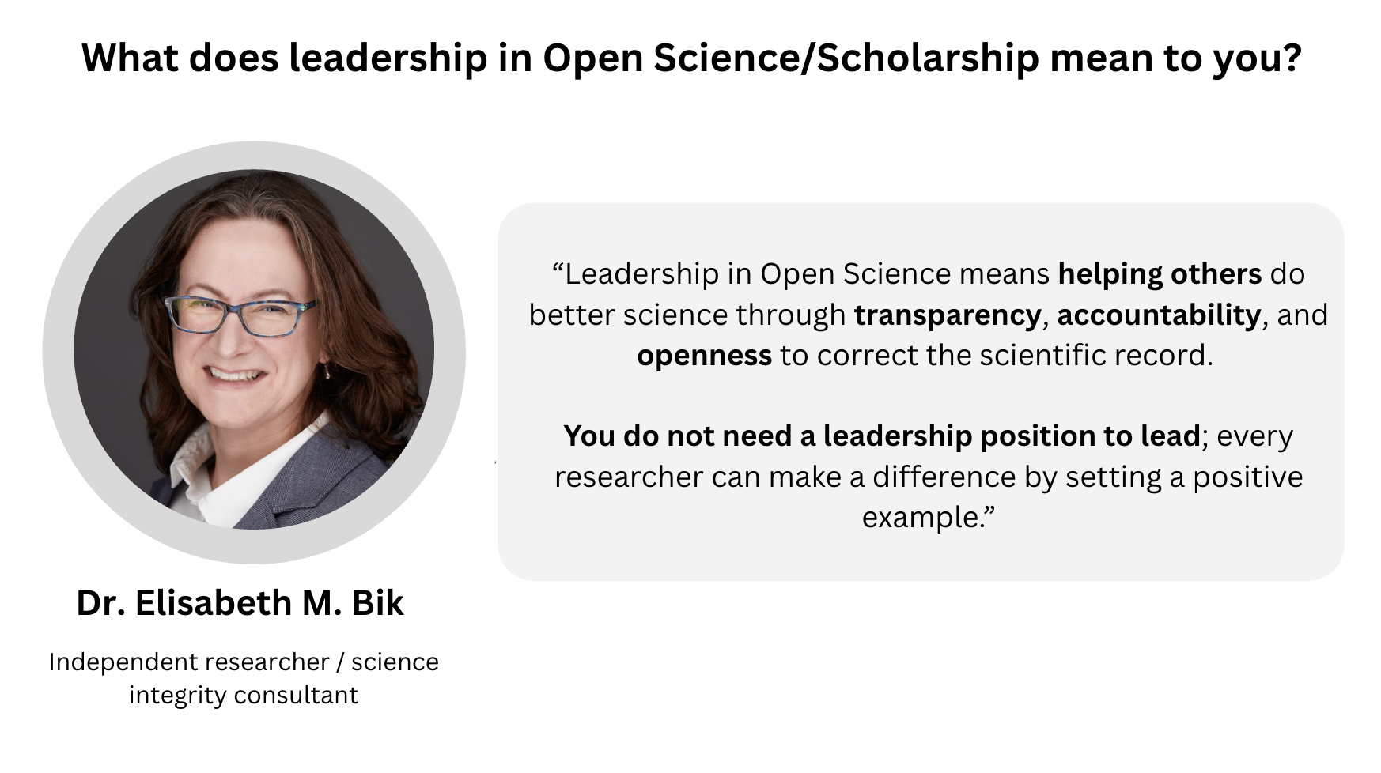
Notes:
Speaker notes:
A perspective of leadership in open science by Dr Elisabeth Bik who trained as a microbiologist and pivoted into working on research integrity matters (photo manipulation) after she found her paper was plagiarized back in 2023.
She says: Leadership in Open Science means helping others do better science through transparency, accountability, and openness to correct the scientific record.
You do not need a leadership position to lead; every researcher can make a difference by setting a positive example.

Slide 19
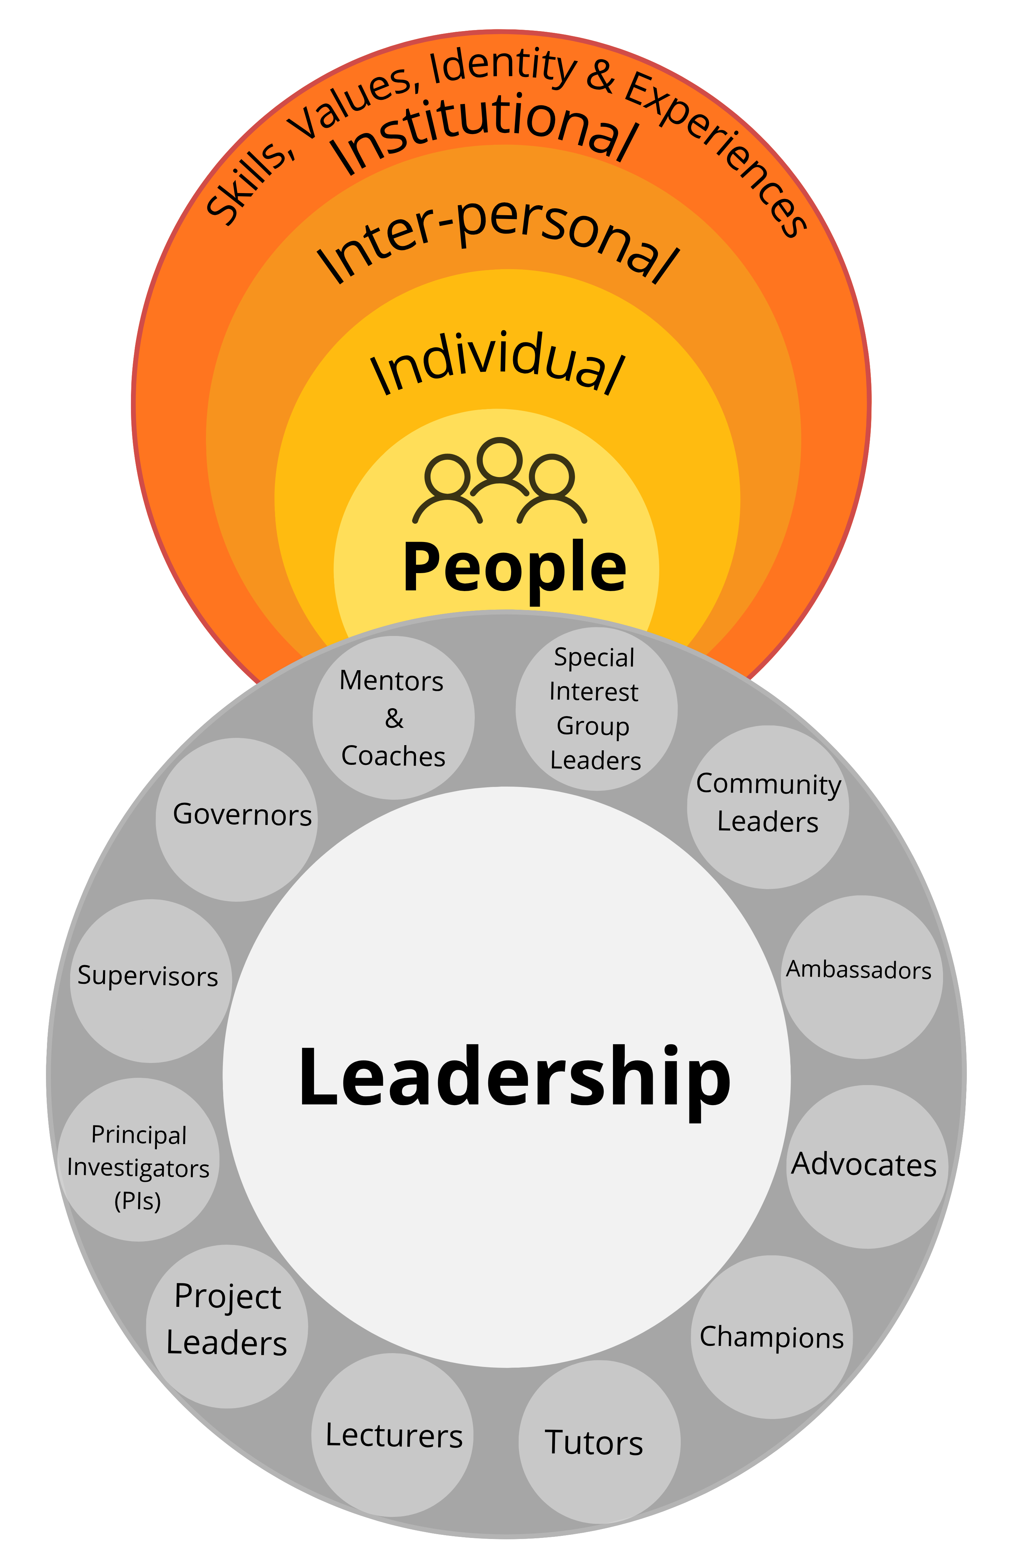
Leadership is about people!
Leadership doesn’t exist in a vacuum as the social context of leaders and followers matters.
Followers (e.g. learners, graduate students, employees, etc.) play an active role in co-constructing leadership.
(DeRue and Ashford, 2010)
Notes:
Speaker notes:
In all the contexts we just discussed, leadership is about people, a dance between leaders and followers
It is about relationships at the level of the individuals > teams to the institutional or organizational level
In an instructor context more than instructor at the front transmitting knowledge – learners play a role

Slide 20
Leadership styles
Coaching
Democratic
“Try this”
“What do you think?”
Develops others via mentorship and support
Involves others in shared decision-making
Visionary
Transformational
“Come with me”
“Let’s work towards…”
Mobilizes others toward a clear vision
Inspires and empowers others to reach their potential
Adapted from Goleman (2000)
Notes:
Speaker notes:
Goleman an economist developed some leadership archetypes in the Harvard Business Review and here are some of them.
A coaching style focuses on mentorship and support to develop others – so in an open science context this might be having an academic mentor or paired peer review where an experienced peer reviewer can coach a first time peer reviewer in the process.
Democratic involves shared decision making and people within the team have a voice
Visionary – when change is needed and leaders with their vision move people towards a clear goal
Transformational – more co-creative more of a focus on values of others – an example I can give in open science is with FORRT, which you will hear more about later with Flavio.

Slide 21
A relational view of leadership
Leadership is:
Relational
Social process between
leaders and followers
Uhl-Bien (2006)
Notes:
Speaker notes:
So leadership is about people and the relationships cultivated between leaders and followers.
It links back to the opening question about what good leadership feels like
Even if more formal role granted – important to consider the relational view
If nobody follows your ideas, leadership does not exist

Slide 22
A relational view of leadership
Leadership is:
Relational
Social process between
leaders and followers
Dynamic
Evolving process, adapting
Uhl-Bien (2006)
Notes:
Speaker notes:
Leadership is dynamic, Leadership is about attuning and adapting to the needs of people in your team or group as you are
engaging with different people who have different skill sets, values, socio-cultural identities and experiences against the backdrop of dynamic environment

Slide 23
A relational view of leadership
Leadership is:
Relational
Social process between
leaders and followers
Dynamic
Evolving process, adapting
Multi-directional
Beyond formal roles and organizational hierarchy
Uhl-Bien (2006)
Notes:
Speaker notes:
Leadership is multidirectional! It is more than top-down supervisor – student and we’ll explore the multidirectional aspect next in more detail

Slide 24
Multi-directional leadership: downwards
Beyond downward dominance in organizational hierarchy
Attuning and adapting to the needs of people in your team
Leading
downwards
Notes:
Speaker notes:
The more classic view of leadership of formal leaders we saw earlier. It is important for leaders to attune and adapt to the needs of people in their team

Slide 25
Multi-directional leadership: sideways
Leading
downwards
Influencing your peers during discussions in meetings
Leading
sideways
Notes:
Speaker notes:
Leading sideways is about sharing knowledge and influencing your peers for example during discussions and meetings

Slide 26
Multi-directional leadership: outwards
Leading
downwards
Leading
sideways
Representing the team/organization
Building connections with others (e.g. policymakers, funders, community groups)
Leading
outwards
Notes:
Speaker notes:
Leadership does not occur in a vacuum, often times we lead outwards and represent our teams at conferences or other events and also we build connections with aligned groups.

Slide 27
Multi-directional leadership: upwards
Leading
downwards
Leading
sideways
Sharing own knowledge and expertise with your own leaders and managers
Leading
upwards
Leading
outwards
Notes:
Speaker notes:
Leading upwards – contribute knowledge with your own leaders

Slide 28
Multi-directional leadership: inwards
Leading
downwards
Self-aware of skills, values, identity and power
Self-management (time, priorities, etc.)
Leading
yourself
Leading
sideways
Leading
upwards
Leading
outwards
Notes:
Speaker notes:
Keep in mind the 5 leadership directions, especially when we come to challenges and strategies sessions that follow this one.
We will focus quite a bit of our time here on leading yourself.

Slide 29
Self-leadership as a crucial part of leading others
What values matter to me?
Where are my knowledge gaps?
How do my experiences shape how I lead?
Leading
yourself
Notes:
Speaker notes:
Self-leadership considers values, identifying own skills and knowledge gaps and understanding how your experiences shape how you lead
Let’s unpack this!

Slide 30
Start inwards: What matters to me?
Agency
Integrity
Openness
Efficiency
Reflexivity
Competence
Values
Teamwork
Critical thinking
Creativity
Diversity
Flexibility
Independence
Rigor
Notes:
Speaker notes:
Values are like your compass
Here are some values that may be more or less important to you: Agency, rigor, reflexivity.

Slide 31
Start inwards: What matters to me?
Agency
Integrity
Showcasing ethical and responsible research
Openness
Efficiency
Reflexivity
Competence
Values
Teamwork
Critical thinking
Creativity
Diversity
Flexibility
Independence
Rigor
Notes:
Speaker notes:
Let’s say integrity is a core value of yours
This value is about show casing ethical and responsible research

Slide 32
Values shape actions
Goals
&
Culture
Outcomes
&
Impact
Values
Adapted from Centre for Teaching Support and Innovation (2026)
Notes:
Speaker notes:
Values are our compass and they shape how we behave and our actions
Influence ways of working, the goals we set
research culture provides the ecosystem of norms, policies, incentives, and leadership that facilitate
or hinder research integrity with wider outcomes and impacts.
Let’s go through an example next.

Slide 33
Values shape actions
Value: Integrity. Showcasing ethical and responsible research.
Values
Goals
& Culture
Outcomes
& Impact
Notes:
Speaker notes:
Let’s work with the example of integrity as a core value in the context of leading a class

Slide 34
Values shape goals and culture
Value: Integrity. Showcasing ethical and responsible research.
Values
Goal: Learners engage deeply on the topic of AI usage in the research cycle.
Goals
& Culture
Culture: Set expectations that integrity matters for high-quality credible research and for public trust in science.
Outcomes
& Impact
Notes:
Speaker notes:
Having integrity as a core value shapes the type of learning goal you may set for example: Learners engage deeply on the topic of AI usage in the research cycle.
The culture this sets at your event: Set expectations that integrity matters for high-quality credible research and for public trust in science

Slide 35
Values shape outcomes and impact
Value: Integrity. Showcasing ethical and responsible research.
Values
Goal: Learners engage deeply on the topic of AI usage in the research cycle.
Goals
& Culture
Culture: Set expectations that integrity matters for high-quality credible research and for public trust in science.
Outcomes: Learners critically examine a case study on AI usage for data analysis from an ethical perspective.
Outcomes
& Impact
Impact: Learners have increased ethical awareness of AI usage in their research and beyond.
Notes:
Speaker notes:
An outcome of this would be Learners critically examine a case study on AI usage for data analysis from an ethical perspective
The wider impact of this could be that learners have increased ethical awareness of AI usage in their research and beyond.

Slide 36
Start inwards: What matters to me?
Tip
Take a look at the values table and guiding questions to help you.
Access workbook here: https://lmu-osc.github.io/train-the-trainer-open-research/workshop-design-workbook/
1. Scan through values table in workbook section 7.1
2. Self reflect which leadership values resonate with you
3. Write down three values in the workbook
~5 mins
Notes:
Speaker notes:
Now it is time to start thinking about what matters to you. In your workbooks in section 7.1 write down 3 values
I will give you 5 minutes.
Instructor notes:
This exercise practices a key skill in emotional intelligence
It can be nice to share your own values with the group too (e.g. mine are joy creativity and integrity)
Trouble shooting:
Learners might feel stuck to pick only 3, as many values resonate with them.
Encourage them to think of it as an iterative process: They can make a start during workshop and revisit after the workshop
Learners can start with a longer list and then reduce them. For example, if they selected the values flexibility and openness, these might be grouped together as they both have something to do with change. One of the 2 values could then be selected.
It is a very personal exercise and it is only important that the groupings make sense for them.

Slide 37
Interim summary
Leadership is a co-constructive process between leaders and followers
Leadership can be formal (e.g. supervisor) or informal (e.g. community champion)
Leadership is multi-directional
Values shape actions
Notes:
Speaker notes:
To summarize this part of the session:
Leadership can be formal or informal
Leadership is a co-constructive process and is multidirectional (downwards, sideways, outwards, upwards and self-leadership)
Values shape our actions as we saw with the example of integrity.

Slide 38
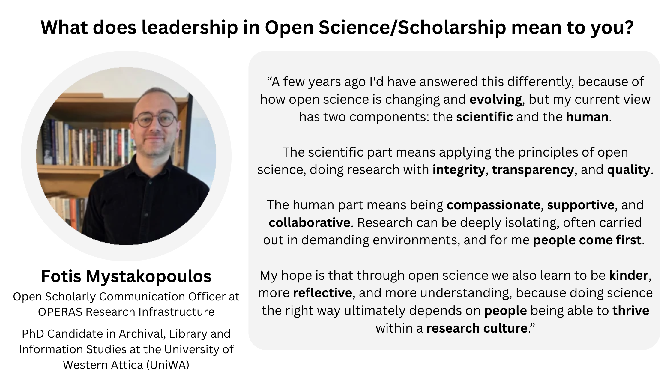
Notes:
Speaker notes:
Before we move onto the next part, here is another perspective on leadership by Fotis Mystakopoulos who is a PhD candidate and open scholarly communications officer.
His perspective speaks to what we discussed about leadership being about people
“A few years ago I'd have answered this differently, because of how open science is changing and evolving, but my current view has two components: the scientific and the human.
The scientific part means applying the principles of open science, doing research with integrity, transparency, and quality.
The human part means being compassionate, supportive, and collaborative. Research can be deeply isolating, often carried out in demanding environments, and for me people come first.
My hope is that through open science we also learn to be kinder, more reflective, and more understanding, because doing science the right way ultimately depends on people being able to thrive within a research culture.”

Slide 39
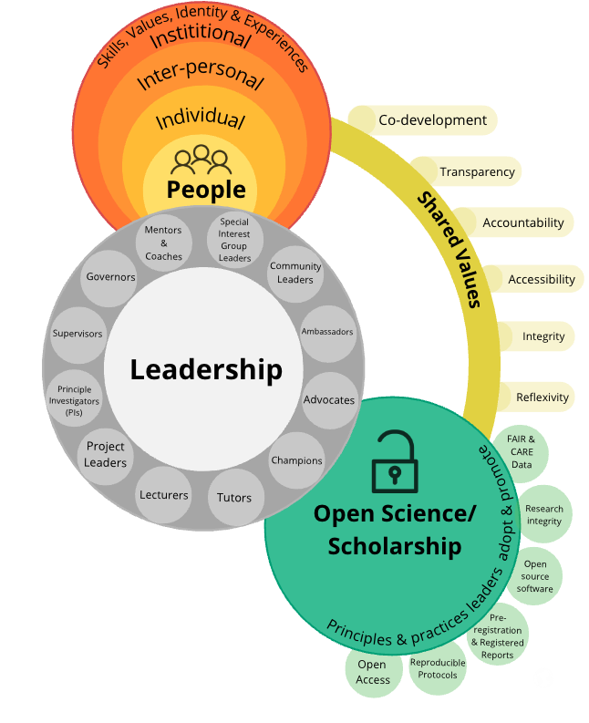
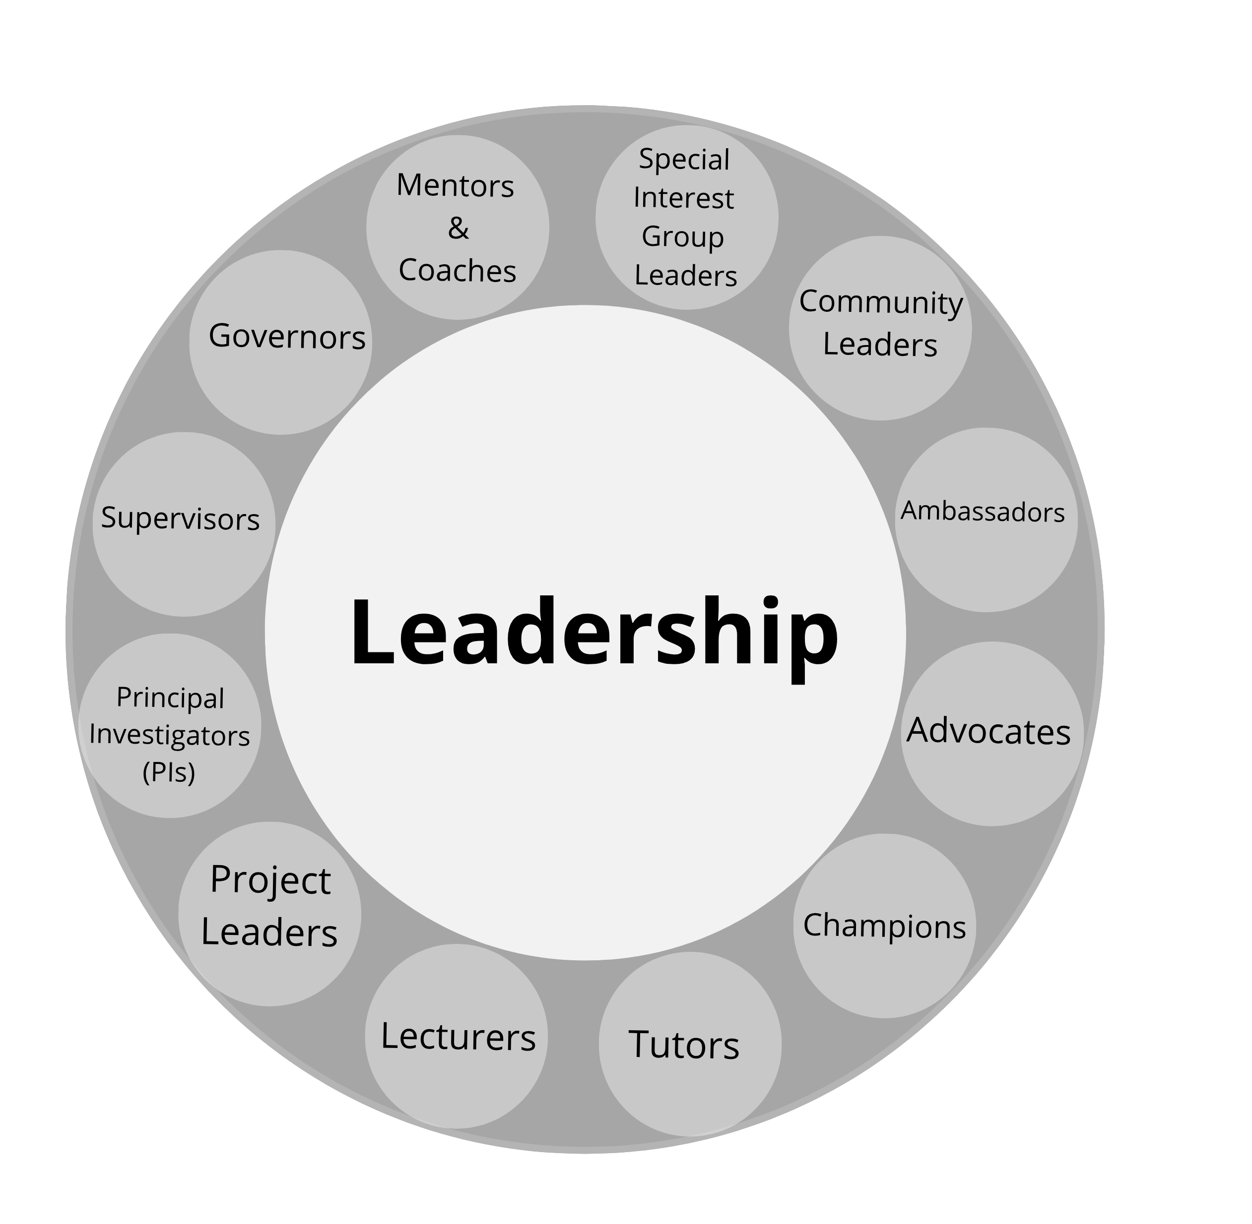
Shared values of effective leadership and Open Science
There are lots of values of effective leadership that overlap with values we strive for in Open Science!
Leadership
Open Science
Notes:
Speaker notes:
A lot of values we looked at earlier have overlap with values we strive for with open science!
Such as co-development, transparency, accountability, accessibility, integrity and reflexivity
Let’s dive in!

Slide 40
Example of shared values: transparency and integrity
Leadership
Open Science
Openness of decision-making processes and clear communication helps build trust within a group.
Transparency
and integrity
Values
Context
Notes:
Speaker notes:
In this table we have the values on the left-hand side and the context: leadership column and open science column
Let’s take the example of transparency and integrity. In the leadership context this can look like: Openness of decision-making processes and clear communication helps build trust within a group.

Slide 41
Example of shared values: transparency and integrity
Leadership
Open Science
Thoughtful planning and transparently documenting study design, data collection and analysis in a preregistration improves credibility of research.
Openness of decision-making processes and clear communication helps build trust within a group.
Transparency
and integrity
Values
Context
Notes:
Speaker notes:
In an open science context this value might show up as: Thoughtful planning and transparently documenting study design, data collection and analysis in a preregistration improves credibility of research.

Slide 42
Example of shared values: co-development
Leadership
Open Science
Thoughtful planning and transparently documenting study design, data collection and analysis in a preregistration improves credibility of research.
Openness of decision-making processes and clear communication helps build trust within a group.
Transparency
and integrity
Values
Relational leadership, collective role in decision-making process, empowering everyone to contribute, ability to balance multiple (sometimes conflicting) ideas.
Co-development
Context
Notes:
Speaker notes:
Another example is co-development.
In the leadership context this may look like: Relational leadership, collective role in decision-making process, empowering everyone to contribute, ability to balance multiple (sometimes conflicting) ideas.

Slide 43
Example of shared values: co-development
Leadership
Open Science
Thoughtful planning and transparently documenting study design, data collection and analysis in a preregistration improves credibility of research.
Openness of decision-making processes and clear communication helps build trust within a group.
Transparency
and integrity
Values
Relational leadership, collective role in decision-making process, empowering everyone to contribute, ability to balance multiple (sometimes conflicting) ideas.
Embedding CARE principles into research, co-producing data governance policies with communities, minimizing harm and improving quality of research (Carroll et al. 2021).
Co-development
Context
Notes:
Speaker notes:
In open science, co-development can look like: Embedding CARE principles into research, co-producing data governance policies with communities, minimizing harm and improving quality of research
Care principles stand for Collective Benefit, Authority to Control, Responsibility, Ethics.

Slide 44
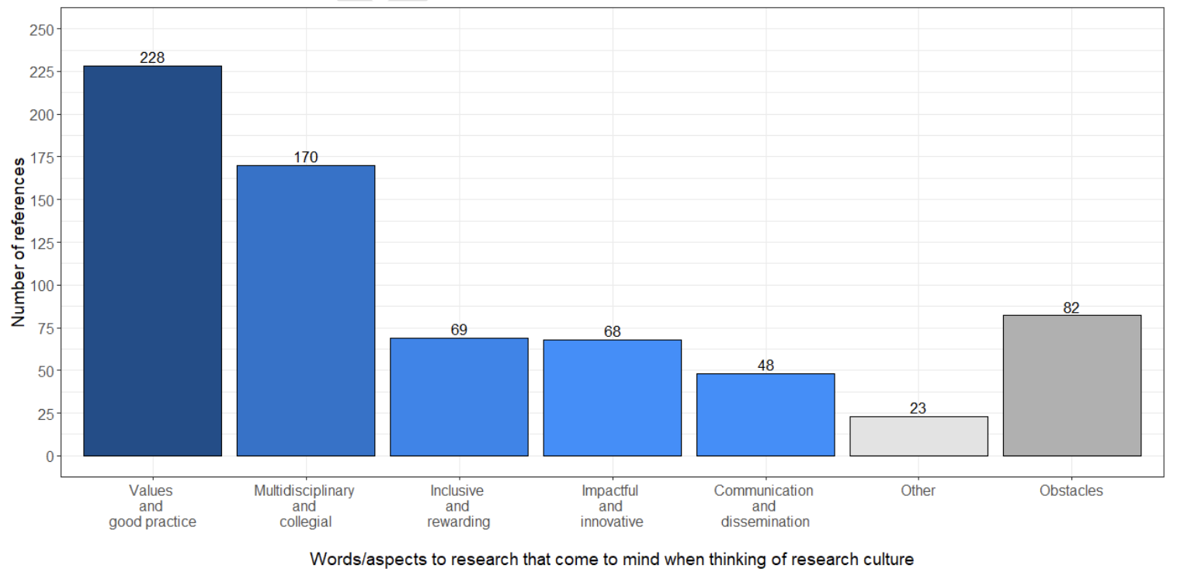
Shared values towards an open research culture
“What words or aspects to research come to mind when you think of research culture?”
Adapted from Lacey et al. (2026)
Notes:
Speaker notes:
In a case study on leadership influences on research culture at the Munster technological university in Ireland.
Lacey and colleagues surveyed >600 people and the largest category of responses related to values and good practice.

Slide 45
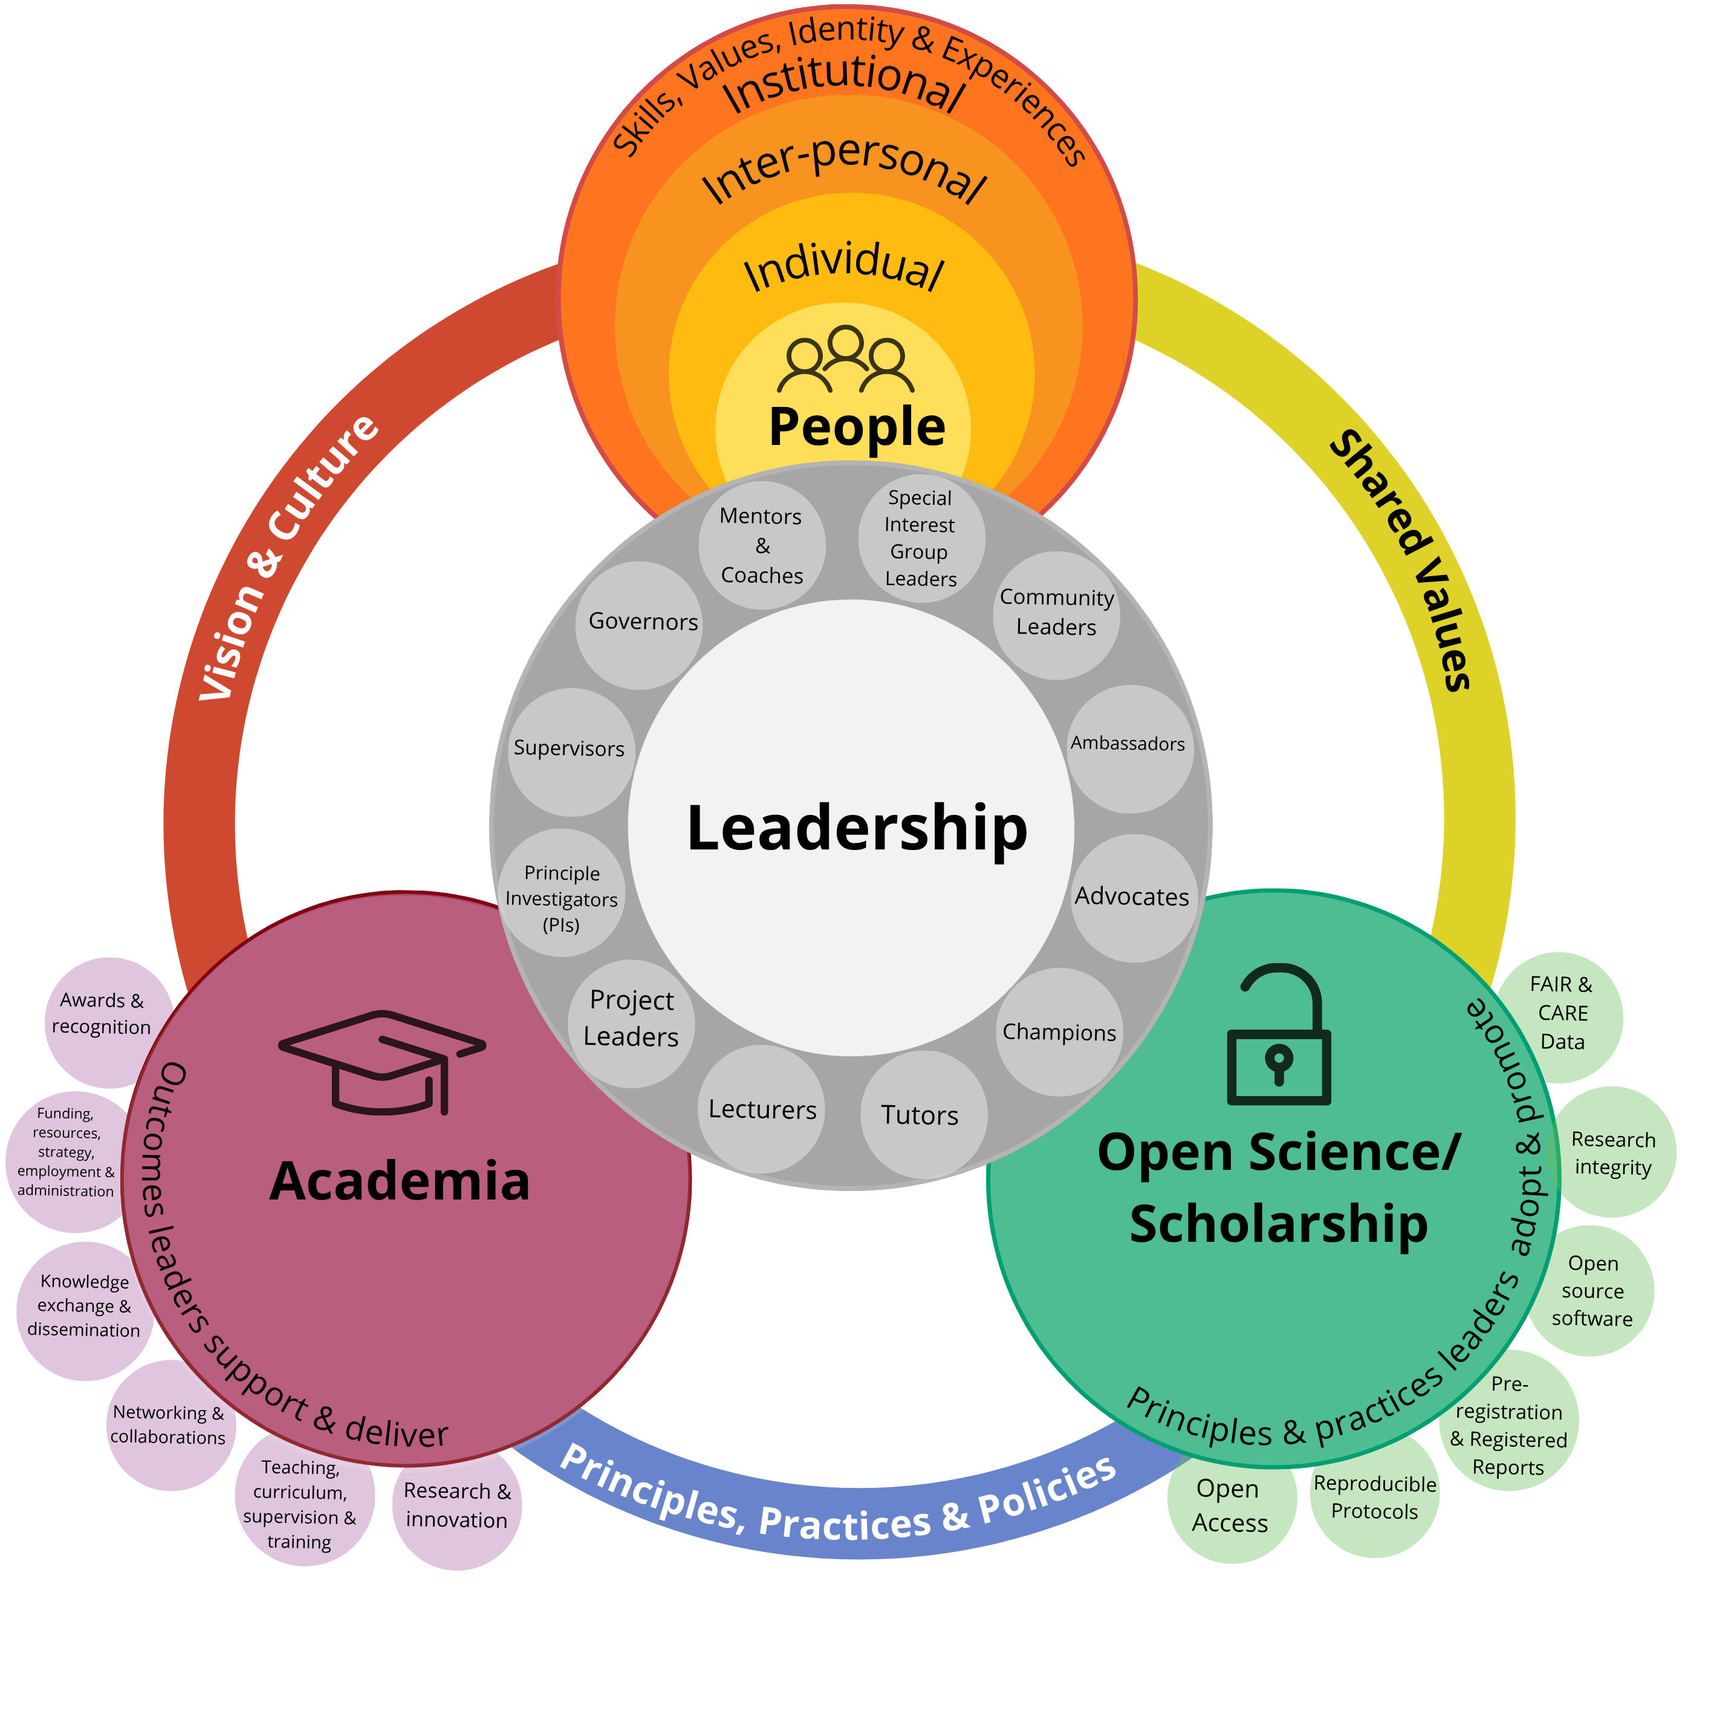
Current context shapes research culture
The environment in which research happens is not a neutral backdrop.
Notes:
Speaker notes:
So far, we have been thinking about how values shape our actions, culture and the environment we work in, but the reverse is also true!
The environment shapes leadership values.
In the academic context, academia is not a neutral backdrop

Slide 46
Current context shapes research culture
Social, cultural, educational background, economic factors influences how we lead and respond to challenges.
The environment in which research happens is not a neutral backdrop.
Notes:
Speaker notes:
Social, cultural, educational background, economic factors influences how we lead and respond to challenges

Slide 47
Current context shapes research culture
Leadership is a critical mediating factor in fostering a research culture that is open, equitable and collaborative.
Social, cultural, educational background, economic factors influences how we lead and respond to challenges.
The environment in which research happens is not a neutral backdrop.
Notes:
Speaker notes:
Leadership is a critical mediating factor in fostering a research culture that is open, equitable and collaborative.
Next, we are going to talk about research culture, norms and social-cultural identities

Slide 48
Adoption of Open Science practices varies
Adoption of Open Science practices varies across teams, career stage, departments, disciplines and regions.
Notes:
Speaker notes:
Adoption of open science practices varies within this group today and also thinking in your own contexts.

Slide 49
Culture change curve
The diffusion of innovation model is a helpful guide to think about types of adopters and how to communicate/
advocate across the adoption spectrum.
Adoption of Open Science practices varies across teams, career stage, departments, disciplines and regions.
Adoption of an Open Science practice
Time
Adaptation of diffusion of innovation model by Rogers (1983)
Notes:
Speaker notes:
A way to map on variation in adoption rates is using the diffusion of innovation model developed between the 60s and 80s by Rogers (who borrowed concepts from many different fields)
Today this model is used in marketing, conservation biology and sociology.
It is a helpful guide to think about types of adopters and how to communicate/
advocate across the adoption spectrum.
You have time along the bottom and on the left-hand side, number of people adopting open science practices. Now we will go through the 5 adopter types

Slide 50
Culture change curve: innovators
Adoption of an Open Science practice
“Ooh this new
thing is exciting!”
Innovators
2.5%
Time
Adaptation of diffusion of innovation model by Rogers (1983)
Notes:
Speaker notes:
Innovators tend to go “ooo” and are excited about trying or developing new things and make up 2.5 % of the population.

Slide 51
Culture change curve: early adopters
“This looks great to use for my study.”
Adoption of an Open Science practice
Early
adopters
“Ooh this new
thing is exciting!”
Innovators
2.5%
13.5%
Time
Adaptation of diffusion of innovation model by Rogers (1983)
Notes:
Speaker notes:
Early adopters come next and they say things like “this looks great to use for my study”.

Slide 52
Culture change curve: early majority
“I heard about it,
might give it a go.”
Early
majority
“This looks great to use for my study.”
Adoption of an Open Science practice
Early
adopters
“Ooh this new
thing is exciting!”
Innovators
2.5%
13.5%
34%
Time
Adaptation of diffusion of innovation model by Rogers (1983)
Notes:
Speaker notes:
Early majority next

Slide 53
Culture change curve: late majority
“I heard about it,
might give it a go.”
Early
majority
Late
majority
“Most of my colleagues use it, I’ll give it a go.”
“This looks great to use for my study.”
Adoption of an Open Science practice
Early
adopters
“Ooh this new
thing is exciting!”
Innovators
2.5%
13.5%
34%
34%
Time
Adaptation of diffusion of innovation model by Rogers (1983)
Notes:
Speaker notes:
late majority next and they might say: “I’ll give it a go as most of my colleagues use it”

Slide 54
Culture change curve: laggards
“I heard about it,
might give it a go.”
Early
majority
Late
majority
“Most of my colleagues use it, I’ll give it a go.”
“This looks great to use for my study.”
Adoption of an Open Science practice
Early
adopters
“Ooh this new
thing is exciting!”
“Do I have to
use this?”
Laggards
Innovators
2.5%
13.5%
34%
34%
16%
Time
Adaptation of diffusion of innovation model by Rogers (1983)
Notes:
Speaker notes:
Lastly the laggards who are quite resistant and say things like “do I have to use this?”

Slide 55
Culture change curve: time to adoption
More cautious and critical before adopting practice
Early
majority
Late
majority
Adopt when practice is already mainstream
Curious to see benefits before adopting practice
Adoption of an Open Science practice
Early
adopters
First ones to try out prototype/practice
Adopt practice when a policy requires change
Laggards
Innovators
2.5%
13.5%
34%
34%
16%
Time
Adaptation of diffusion of innovation model by Rogers (1983)
Notes:
Speaker notes:
Thinking about time to adoption, let’s say with open access as an example: innovators are the first to try out, early adopters are curious, early majority are cautious, late majority adopt when mainstream and laggards when policy requires them to change.
It can be helpful to think where you are on this curve, perhaps for some things you are an early adopter but maybe in situations you are late majority.
Useful to think about how we evaluate progress in research culture reform and for strategic planning
We will revisit in strategies sections

Slide 56
Communicating with different adopter types
How to tailor messaging depending on adopter type based on the effort adopters expect.
Did you know 25% of researchers already use this Open Science tool/practice? Join in future of X by trying out this tool/practice!
Late
majority
65% of researcher are using this Open Science tool/practice. There is a policy coming soon that you’ll have to comply with. Learn about the tool/practice now ahead of the policy.
Early
majority
This Open Science tool/practice has X benefits, have you tried it out?
Adoption of an Open Science practice
Early
adopters
Sign up to be the first cohort to try out this new Open Science tool/practice!
There is a policy in place now which requires X.
Laggards
Innovators
Time
Effort
expected:
Willing to put in extra effort
Some effort
Not much
effort expected
Minimal effort
Expect assistance
Adaptation of diffusion of innovation model by Rogers (1983); Skelly & Rusu (2023)
Notes:
Speaker notes:
Based on where on the adoption curve people are on you can adapt your messaging.
The bottom of the graph also shows how much effort each adopter type expects to put in when trying out a new practice.

Slide 57
Varying norms and awareness of Open Science practices
1. Which Open Science practice do you think is the most used? And the least?
Open Science practices
Open Data
Open Code
Open Materials
Open Research
Open Peer Review
Preprints
Preregistration
Registered Reports
Replication
Open Access Publications
Research Co-production
Notes:
Speaker notes:
Let’s look at norms and awareness of open science practices.
Out of the options in the box, which open science practice is most used and the least?
Instructor notes:
This short exercise can involve guesses from learners via hands up/unmuting for online participants or via a poll on Particify https://www.particify.de/en/

Slide 58
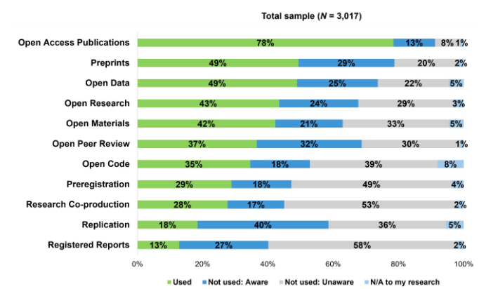
Open Access is now the norm
Adapted from Pennington et al. 2026
Notes:
Speaker notes:
This figure shows that open access is now the norm with over 78% of people surveyed in Pennington and colleagues study have adopted open access practices with the least being registered reports.

Slide 59
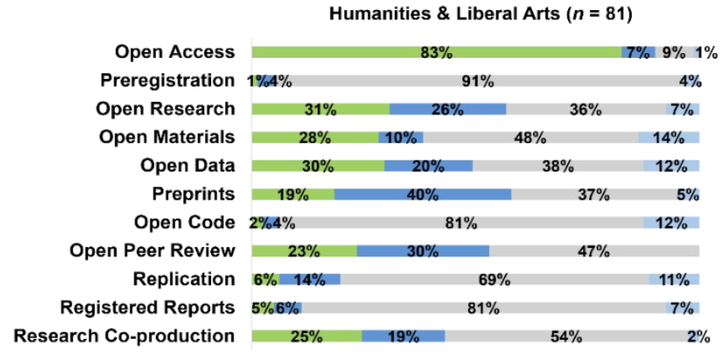
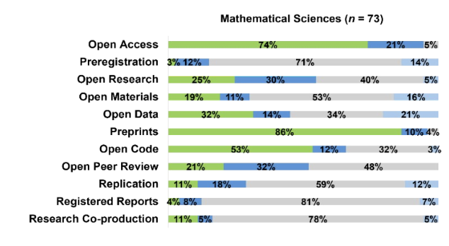
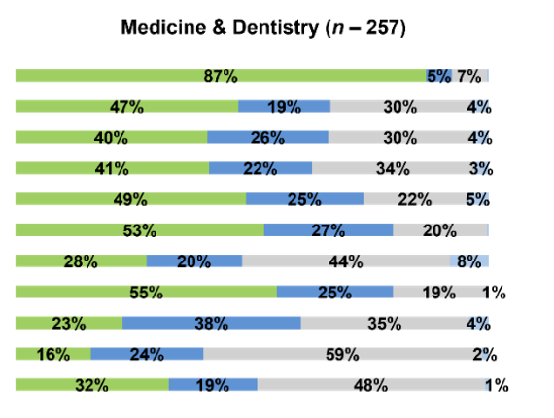
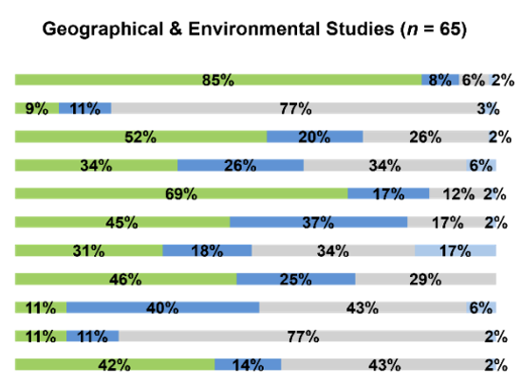
Varying norms and awareness across disciplines
Adapted from Pennington et al. 2026
59
Notes:
Speaker notes:
Looking at adoption rates across disciplines we can see that
Low adoption rates for preregistration and registered reports humanities and physical sciences
High use of preprints (physical sciences)
Research co-production adoption is quite high in geography and environmental sciences

Slide 60
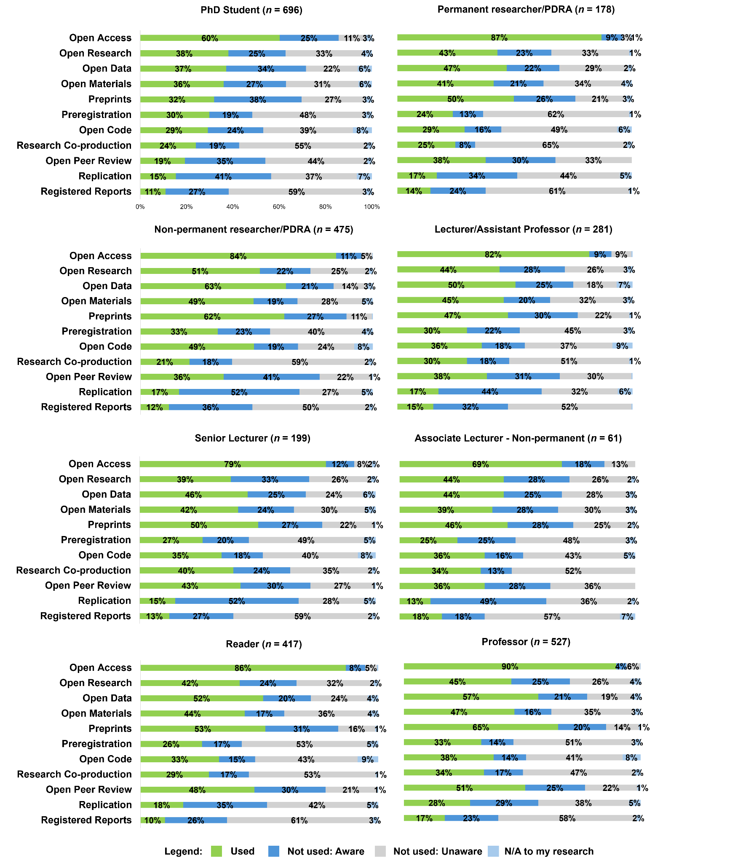
Varying norms and awareness: career stage
Adapted from Pennington et al. 2026
Notes:
Speaker notes:
Professors using open access publications the most and PhD students the least, potentially owing to the allocation of resources and access (e.g., funding for OA from grants or institutional publishing partnerships)
as well as simply PhD students having had less opportunity to have published their work.
open peer review difference could be to do with precarity, fear of backlash from signing your name on peer review - set you up for potential criticism

Slide 61
Social location influences leadership and research culture
Social and cultural factors such as gender, ethnicity, employment status, travel freedoms, etc. influence how you do research.
Notes:
Speaker notes:
Ok now let's consider how how social and cultural identity influences leadership and research culture
Factors such as gender, ethnicity, employment status and travel freedoms influence how you show up and research and learn.

Slide 62
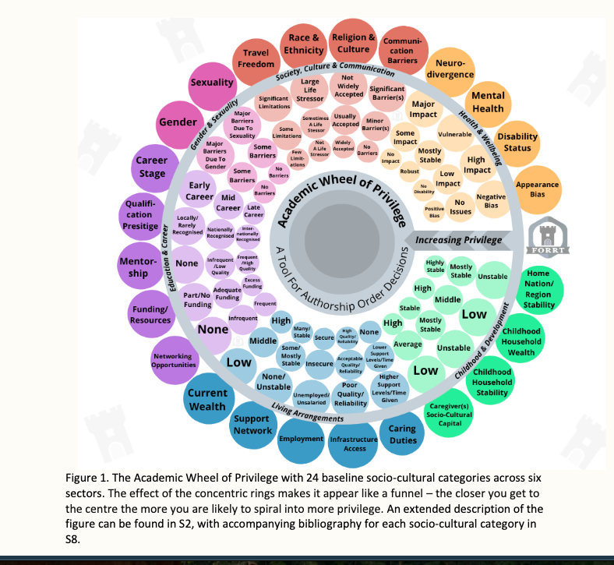
Social location influences leadership and research culture
Social and cultural factors such as gender, ethnicity, employment status, travel freedoms, etc. influence how you do research.
The Academic Wheel of Privilege is a framework to reflect on how social location influences academic activities (e.g. authorship decisions, building collaborations, study design, and leadership).
Adapted from Middleton et al. 2026
(CC BY NC SA)
Notes:
Speaker notes:
The Academic Wheel of Privilege is a framework to reflect on how social location influences academic activities (e.g. authorship decisions, building collaborations, study design, and leadership).
There are 24 baseline categories relating to health and wellbeing, society, culture and communication, gender and sexuality, education and career, living arrangements, childhood and developmental experiences
as you go towards the center ring you have increasing privilege.

Slide 63
Social location influences leadership style
Each of us map onto a different social location, which can change over time.
Our social location influences our values, actions and the research culture we foster as leaders.
Adapted from Middleton et al. 2026
(CC BY NC SA)
Notes:
Speaker notes:
Our social location influences our values, actions and research culture we foster as leaders

Slide 64
Social location influences leadership style
Each of us map onto a different social location, which can change over time.
Our social location influences our values, actions and the research culture we foster as leaders.
Example: teaching a reproducible coding workshop
The workshop is likely to be led differently if the instructor is a tenured male professor, disabled post-doctoral researcher or a female international PhD student.
See Gershenson et al. (2015) for more on this topic.
Adapted from Middleton et al. 2026
(CC BY NC SA)
Notes:
Speaker notes:
Social location influences our leadership style, as shown in the example here about teaching a reproducible coding workshop
There may be biases or blind spots in how the teacher teaches and the expectations of learners. They may be more mindful of certain things from lived experience than others,
Hence why training and raising awareness is a step towards improving learning and research culture.
You can also think about other contexts like leading a large replication study Chair of an Open Science community initiative

Slide 65
Social location and adoption of Open Science practices
Funding/resources
Ability to pay for Article Processing Charges (APCs) for Open Access publications
Adapted from Middleton et al. 2026
(CC BY NC SA)
Notes:
Speaker notes:
I am now going to walk you through some examples of how your social location can influence adoption of open science practices
The access to funding and resources affects your ability to pay for open access publications, not everyone can afford $10, 000 USD for an open access article in Nature for example

Slide 66
Social location and adoption of Open Science practices
Culture and language
Study design, language accessibility of Open Educational Resources. Utility of open peer review perceived differently across cultures
Funding/resources
Ability to pay for Article Processing Charges (APCs) for Open Access publications
Adapted from Middleton et al. 2026
(CC BY NC SA)
Notes:
Speaker notes:
Culture and language shape how we design studies and the types of research questions we ask, also accessibility of open educational resources (many are in English)
Open peer review might be seen differently depending on cultures (some might prefer anonymity or call in rather than call out issues with a paper)

Slide 67
Social location and adoption of Open Science practices
Culture and language
Disability status
Study design, language accessibility of Open Educational Resources. Utility of open peer review perceived differently across cultures
Accessibility of digital platforms and time to implement Open Science practices
Funding/resources
Ability to pay for Article Processing Charges (APCs) for Open Access publications
Adapted from Middleton et al. 2026
(CC BY NC SA)
Notes:
Speaker notes:
Disability status – accessibility of digital platforms and time to implement open science practices

Slide 68
Social location and adoption of Open Science practices
Culture and language
Disability status
Study design, language accessibility of Open Educational Resources. Utility of open peer review perceived differently across cultures
Accessibility of digital platforms and time to implement Open Science practices
Home nation stability
Ability to make and sustain collaborations or engage in Big Team Science projects
Funding/resources
Ability to pay for Article Processing Charges (APCs) for Open Access publications
Adapted from Middleton et al. 2026
(CC BY NC SA)
Notes:
Speaker notes:
Home nation stability is very topical now as we see many cuts to the higher education sector and geopolitical instability. This influences ability to build and sustain collaborations.

Slide 69
Social location and adoption of Open Science practices
Culture and language
Disability status
Study design, language accessibility of Open Educational Resources. Utility of open peer review perceived differently across cultures
Accessibility of digital platforms and time to implement Open Science practices
Home nation stability
Ability to make and sustain collaborations or engage in Big Team Science projects
Funding/resources
Ability to pay for Article Processing Charges (APCs) for Open Access publications
Employment status
Insecure or short-term employment influences capacity to do a preregistration
or registered report
Adapted from Middleton et al. 2026
(CC BY NC SA)
Notes:
Speaker notes:
Employment status – many of us are on fixed term contracts which can influence how we plan our studies – can impact our capacity to do things like preregistration

Slide 70
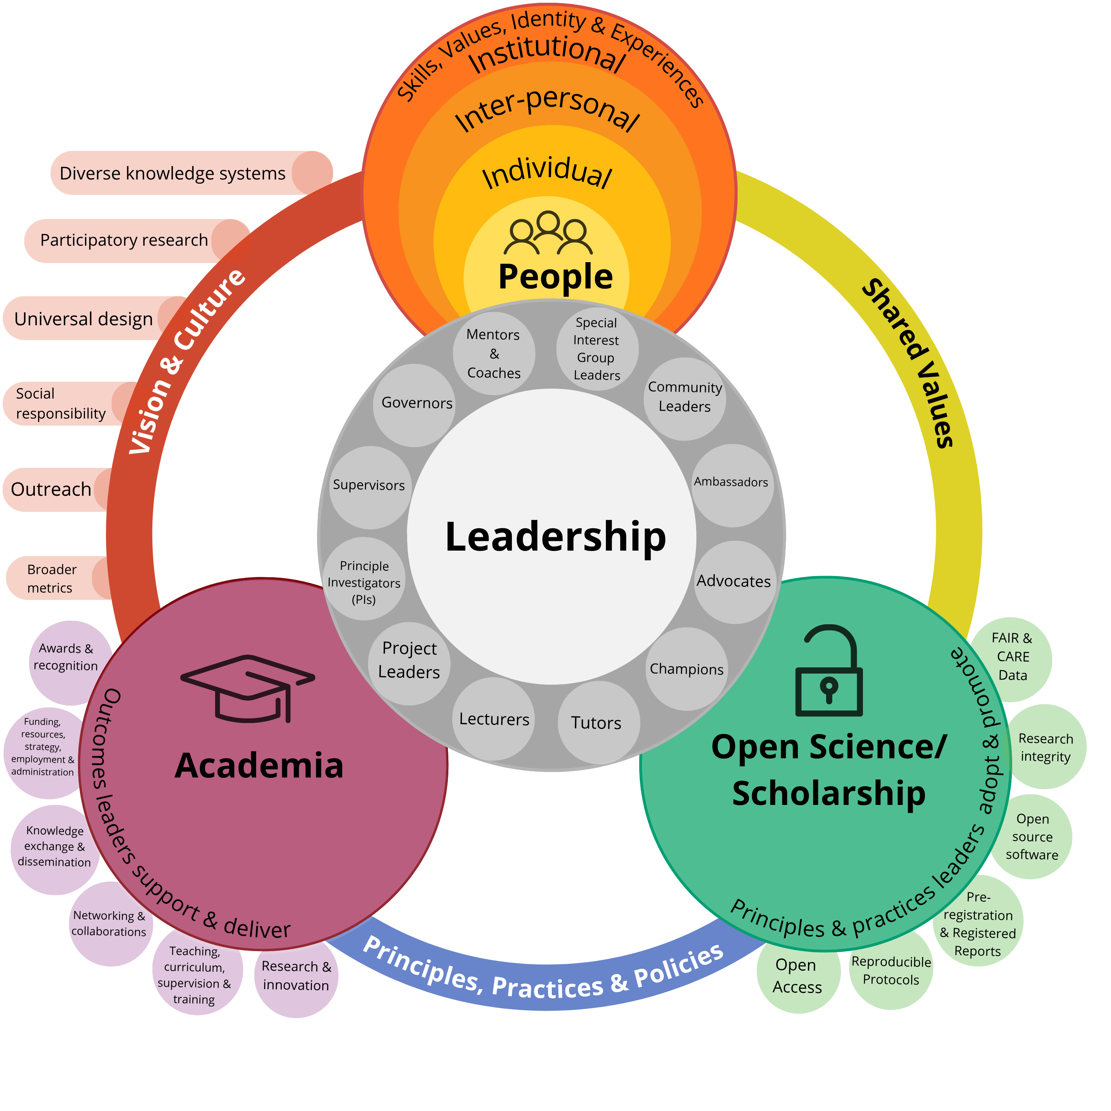
Towards an open, equitable
and diverse research culture
A healthy research culture enables high quality research (which also safeguards research integrity)
Notes:
Speaker notes:
So now to close the loop: we have looked at values, the research culture context and now thinking about moving towards and open, equitable and diverse research culture
A vision where diverse knowledge systems are embraced, as is participatory research, broader metrics
A healthy research culture enables high-quality research (which also safeguards research integrity)

Slide 71
Towards an open, equitable
and diverse research culture
A healthy research culture enables high quality research (which also safeguards research integrity)
Identify what is working well and what is not
Notes:
Speaker notes:
It requires leaders to identify what is working well and what is not
taking stock or an audit if you will of how things work in your group, team, or class.

Slide 72
Towards an open, equitable
and diverse research culture
A healthy research culture enables high quality research (which also safeguards research integrity)
Identify what is working well and what is not
Recognize how your actions shape the research culture
Notes:
Speaker notes:
Recognize how actions shape the research culture

Slide 73
Towards an open, equitable
and diverse research culture
A healthy research culture enables high quality research (which also safeguards research integrity)
Identify what is working well and what is not
Recognize how your actions shape the research culture
Try out new ways of thinking and working
Notes:
Speaker notes:
It is important to try out new ways of thinking and working

Slide 74
Towards an open, equitable
and diverse research culture
A healthy research culture enables high quality research (which also safeguards research integrity)
Identify what is working well and what is not
Recognize how your actions shape the research culture
Try out new ways of thinking and working
Increase opportunities for engagement in the learning and research process (e.g. via Universal Design, participatory research)
Check the workbook for additional resources!
Notes:
Speaker notes:
Increase opportunities for engagement in the learning and research process (e.g. via Universal Design, participatory research)
Instructor notes:
The workbook has more on universal design in the additional resources section (end of the workbook)

Slide 75
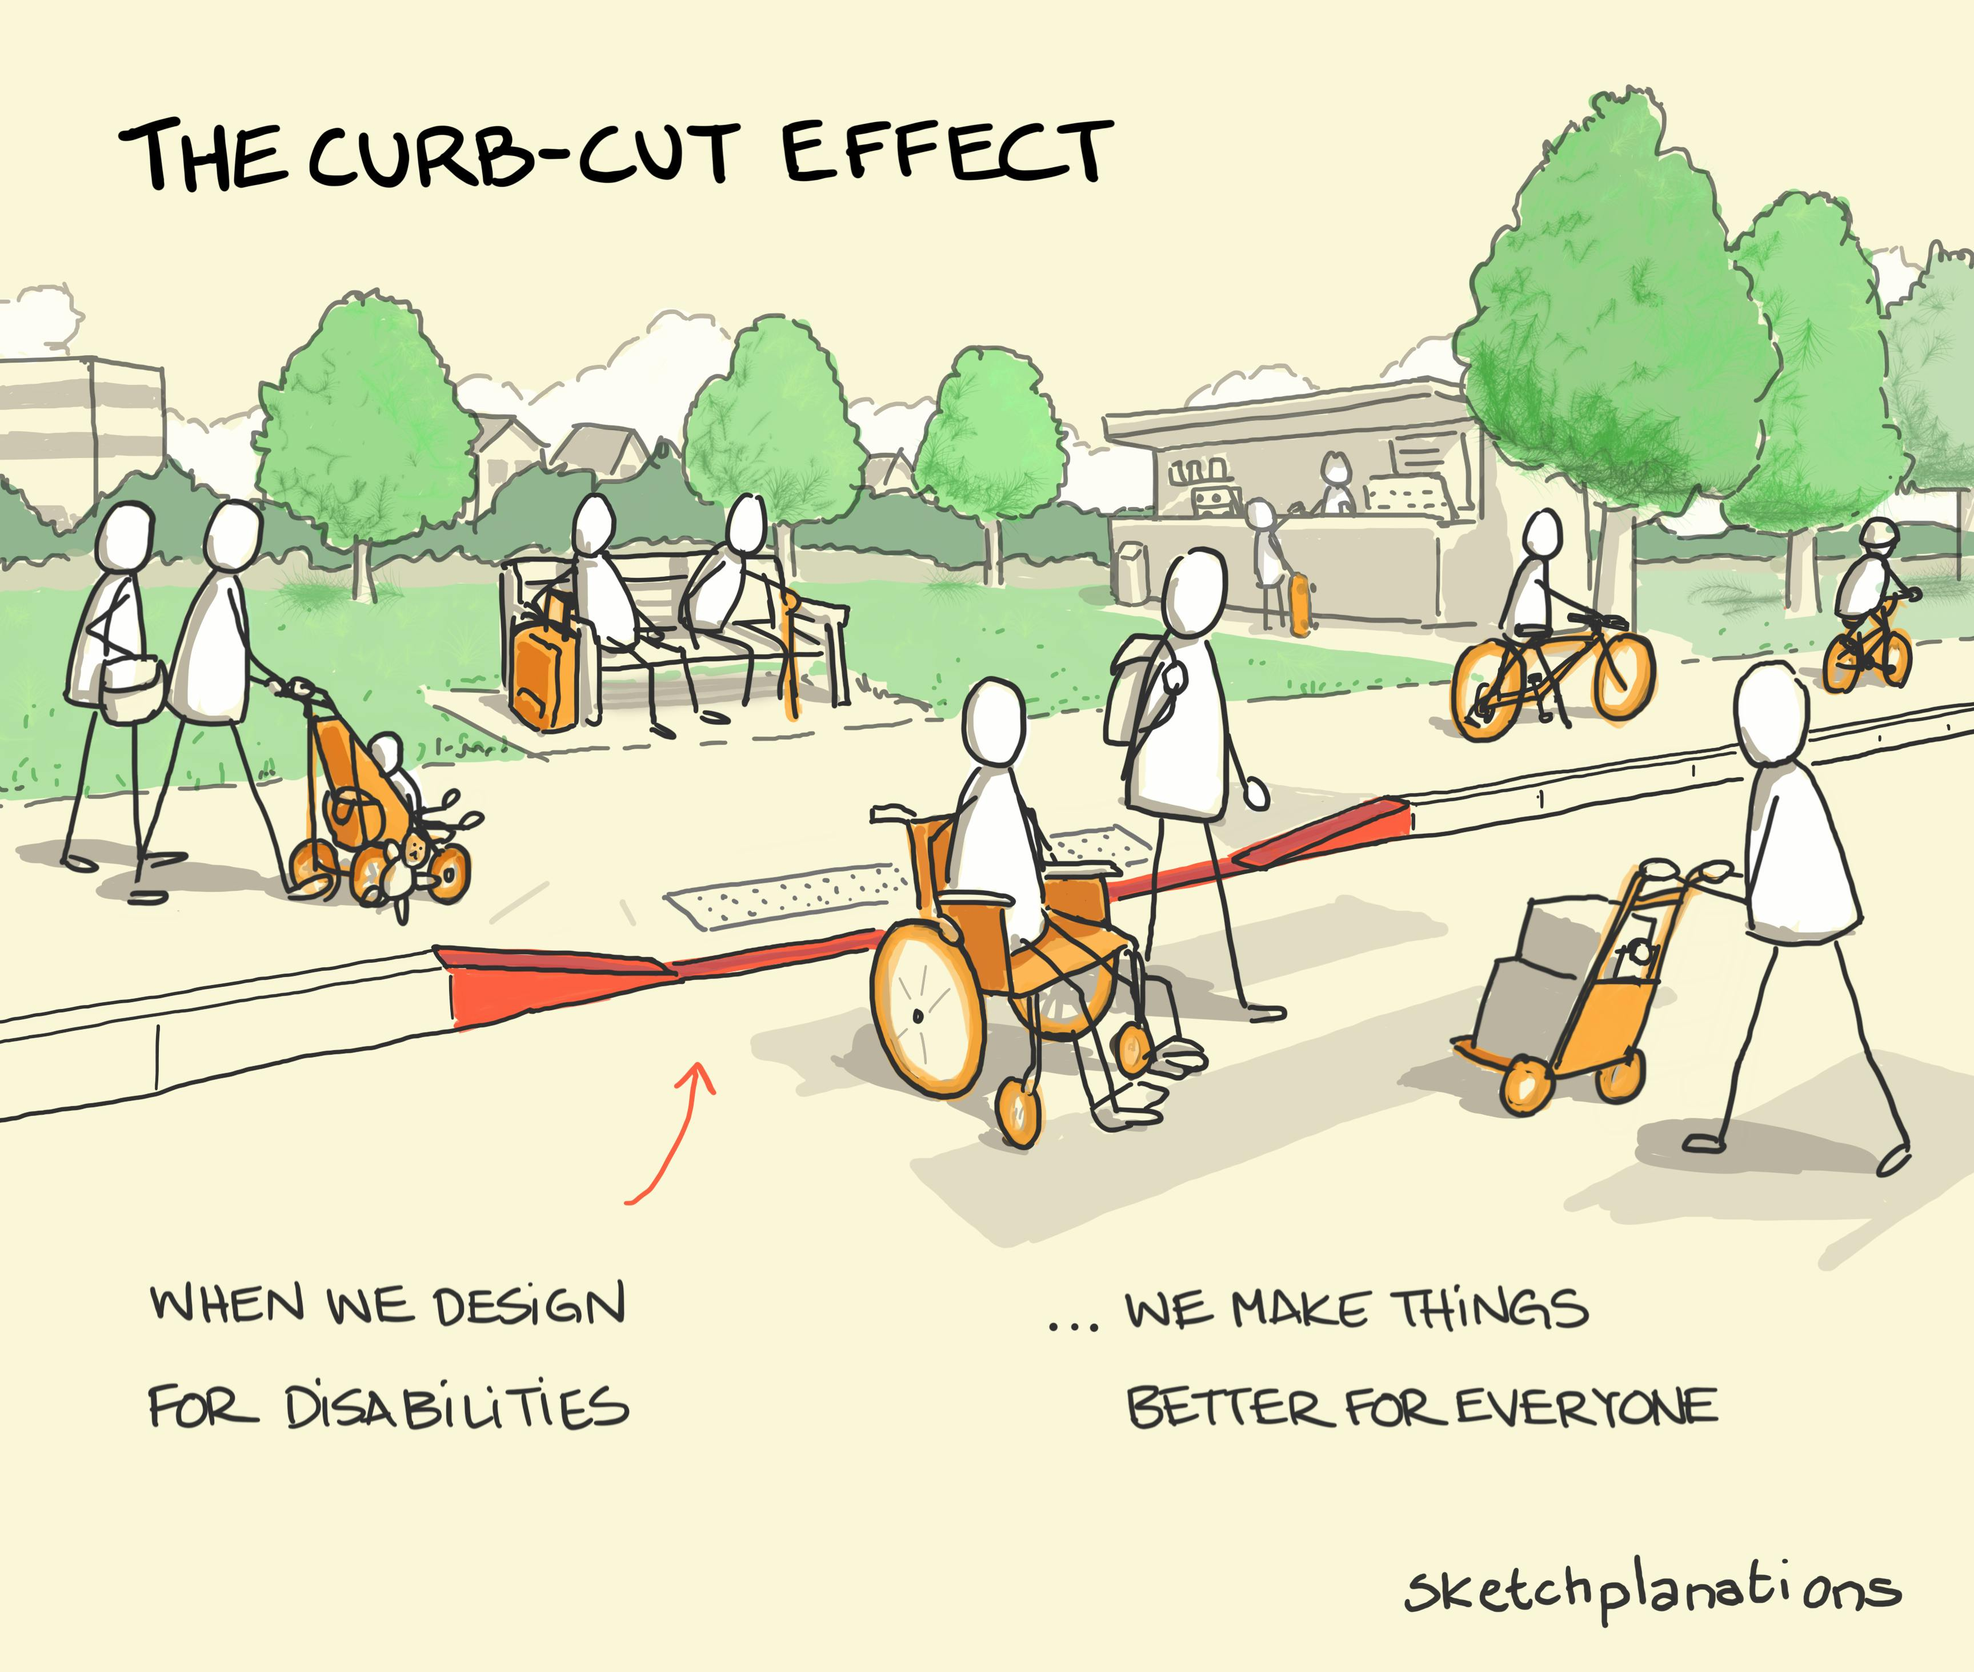
Towards an open, equitable
and diverse research culture: Universal Design (UD)
The proactive creation of spaces designed with human variability in mind.
Aims to minimize barriers and be usable by the widest range of people.
Increase opportunities for engagement in the learning and research process (e.g. via Universal Design, participatory research)
Image source: https://sketchplanations.com/the-curb-cut-effect
Notes:
Speaker notes:
Spend a bit of time now talking about universal design and add to yesterday’s session on creating a positive learning environment
Universal design is the The proactive creation of spaces designed with human variability in mind. Aims to minimize barriers and be usable by the widest range of people.
I like this illustration whereby making the street accessible it widens access to other users

Slide 76
Towards an open, equitable
and diverse research culture: Universal Design (UD)
Example: Extend FAIR principles to include Universal Design to information sharing.
Include plain language summaries, captioned video or audio format summaries to research outputs/educational materials (Phan et al. 2025).
Many people benefit (e.g. neurodivergent, disabled, non-native speakers, those with caring duties)!
Image source: https://sketchplanations.com/the-curb-cut-effect
Notes:
Speaker notes:
An open science example is with extending the FAIR principles
Include plain language summaries, captioned video or audio format summaries to research outputs/educational materials.
Many people benefit (e.g. neurodivergent, disabled, non-native speakers, those with caring duties)!

Slide 77
Interim summary
There are 5 adopter types of Open Science practices: innovators, early adopters, early majority, late majority and laggards
Effective leadership and Open Science have many shared values
Social and cultural identities influences how we navigate research spaces, leadership and engagement with Open Science practices
Adoption of Open Science practices varies across teams, career stage, departments, disciplines and nations.
Notes:
Speaker notes:
Time for a summary! We covered in this part the shared values between effective leadership and open science (using the examples of integrity and co-development)
We looked at the 5 adopter types using the diffusion of innovation model. The innovators, early adopters, early majority, late majority and laggards
We covered how adoption of open science practices varies from career stage to disciplines
And lastly, we thought about how our social and cultural identities influence how we lead and engage with open science practices.

Slide 78
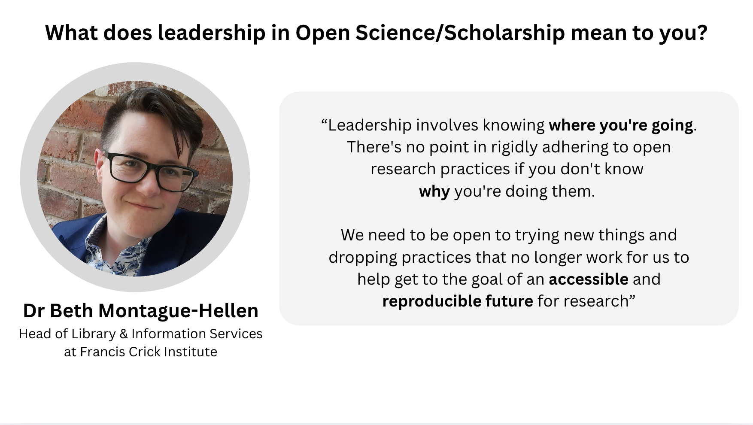
Notes:
Speaker notes:
A perspective on leadership in open science by Dr Beth Montague-Hellen who is head of library and information services at the Frances Crick Institute
“Leadership involves knowing where you're going. There's no point in rigidly adhering to open research practices if you don't know
why you're doing them. We need to be open to trying new things and dropping practices that no longer work for us to help get to the goal of an accessible and reproducible future for research”

Slide 79
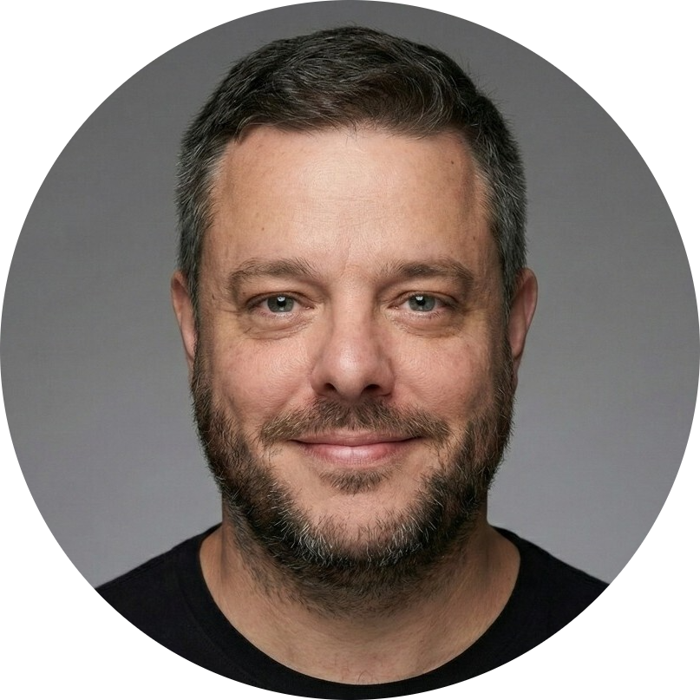

Case study on leadership in Open Science: FORRT
Dr Flavio Azevedo (he/him)
Access to slides: https://osf.io/ay8qk/files/cmeuy
Asst. Prof Interdisciplinary Social Sciences (Utrecht) and FORRT Director
Notes:
Speaker notes:
Putting together all the things we’ve discussed in this session into a real-world example of leadership in open science in action with Flavio Azevedo who is going to discuss more his perspectives and highlight the work at FORRT.
Instructor notes:
This FORRT case study can be explored as an asynchronous activity/resource after the session if time is short.

Slide 80
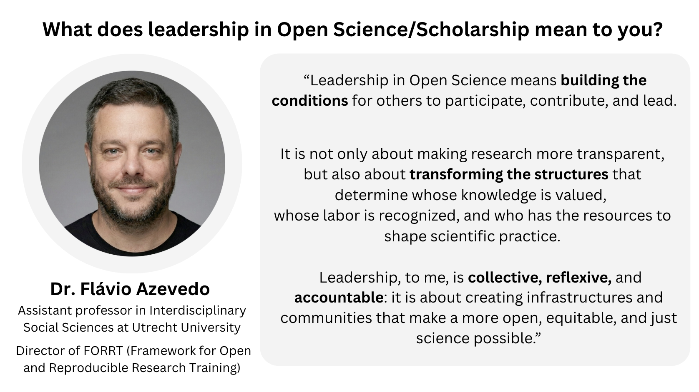
Notes:
Speaker notes:
Before we move onto the final summary, this perspective from Flavio encapsulates well the themes we discussed in this session.
“Leadership in Open Science means building the conditions for others to participate, contribute, and lead. It is not only about making research more transparent, but also about transforming the structures that determine whose knowledge is valued,
whose labor is recognized, and who has the resources to shape scientific practice. Leadership, to me, is collective, reflexive, and accountable: it is about creating infrastructures and communities that make a more open, equitable, and just science possible.”

Slide 81
Final summary
Leadership is about people!
Self-leadership is critical step towards leading others
Values shape actions
Effective leadership and Open Science share many values
Awareness and
adoption of Open Science practices varies
Research/learning culture shaped by our values, social location and work context
Culture curve can be used to identify types of Open Science adopters
Notes:
Speaker notes:
To tie it all together and summarize:
Leadership is about people! Self leadership is very important and a critical step towards leading others
Values shape our actions via our goals and the culture we cultivate
There is overlap in the values between effective leadership and open science such as transparency, integrity, co-development
Out social location influences how we work and lead and adopt open science practices
The culture curve can be helpful to identify adopter types
Awareness of open science practices varies

Slide 82
Leadership qualities we practiced
We’ve worked our emotional intelligence muscles in this session!
Empathy
Self-awareness
Notes:
Speaker notes:
In this session we practiced empathy and self-awareness in the values exercise

Slide 83
Leadership qualities we practiced
We’ve worked our emotional intelligence muscles in this session!
Empathy
Self-awareness
In the next two sessions we will work on:
Next two sessions:
Challenges in leadership: access here
Strategies in leadership: access here
Knowledge
Problem solving
Collaboration
Notes:
Speaker notes:
Next we are going to work on increasing knowledge, problem solving and collaboration

Slide 84
Survey
1. Have you ever had an advocacy role?
How confident are you in your ability to:
0 = not confident at all, 1 = mostly not confident, 2 = somewhat confident, 3 = very confident
2. identify my own leadership values?
3. recognize how different elements of the working environment influences how you lead?
Notes:
Speaker notes:
Now to revisit the survey we began with

Slide 85
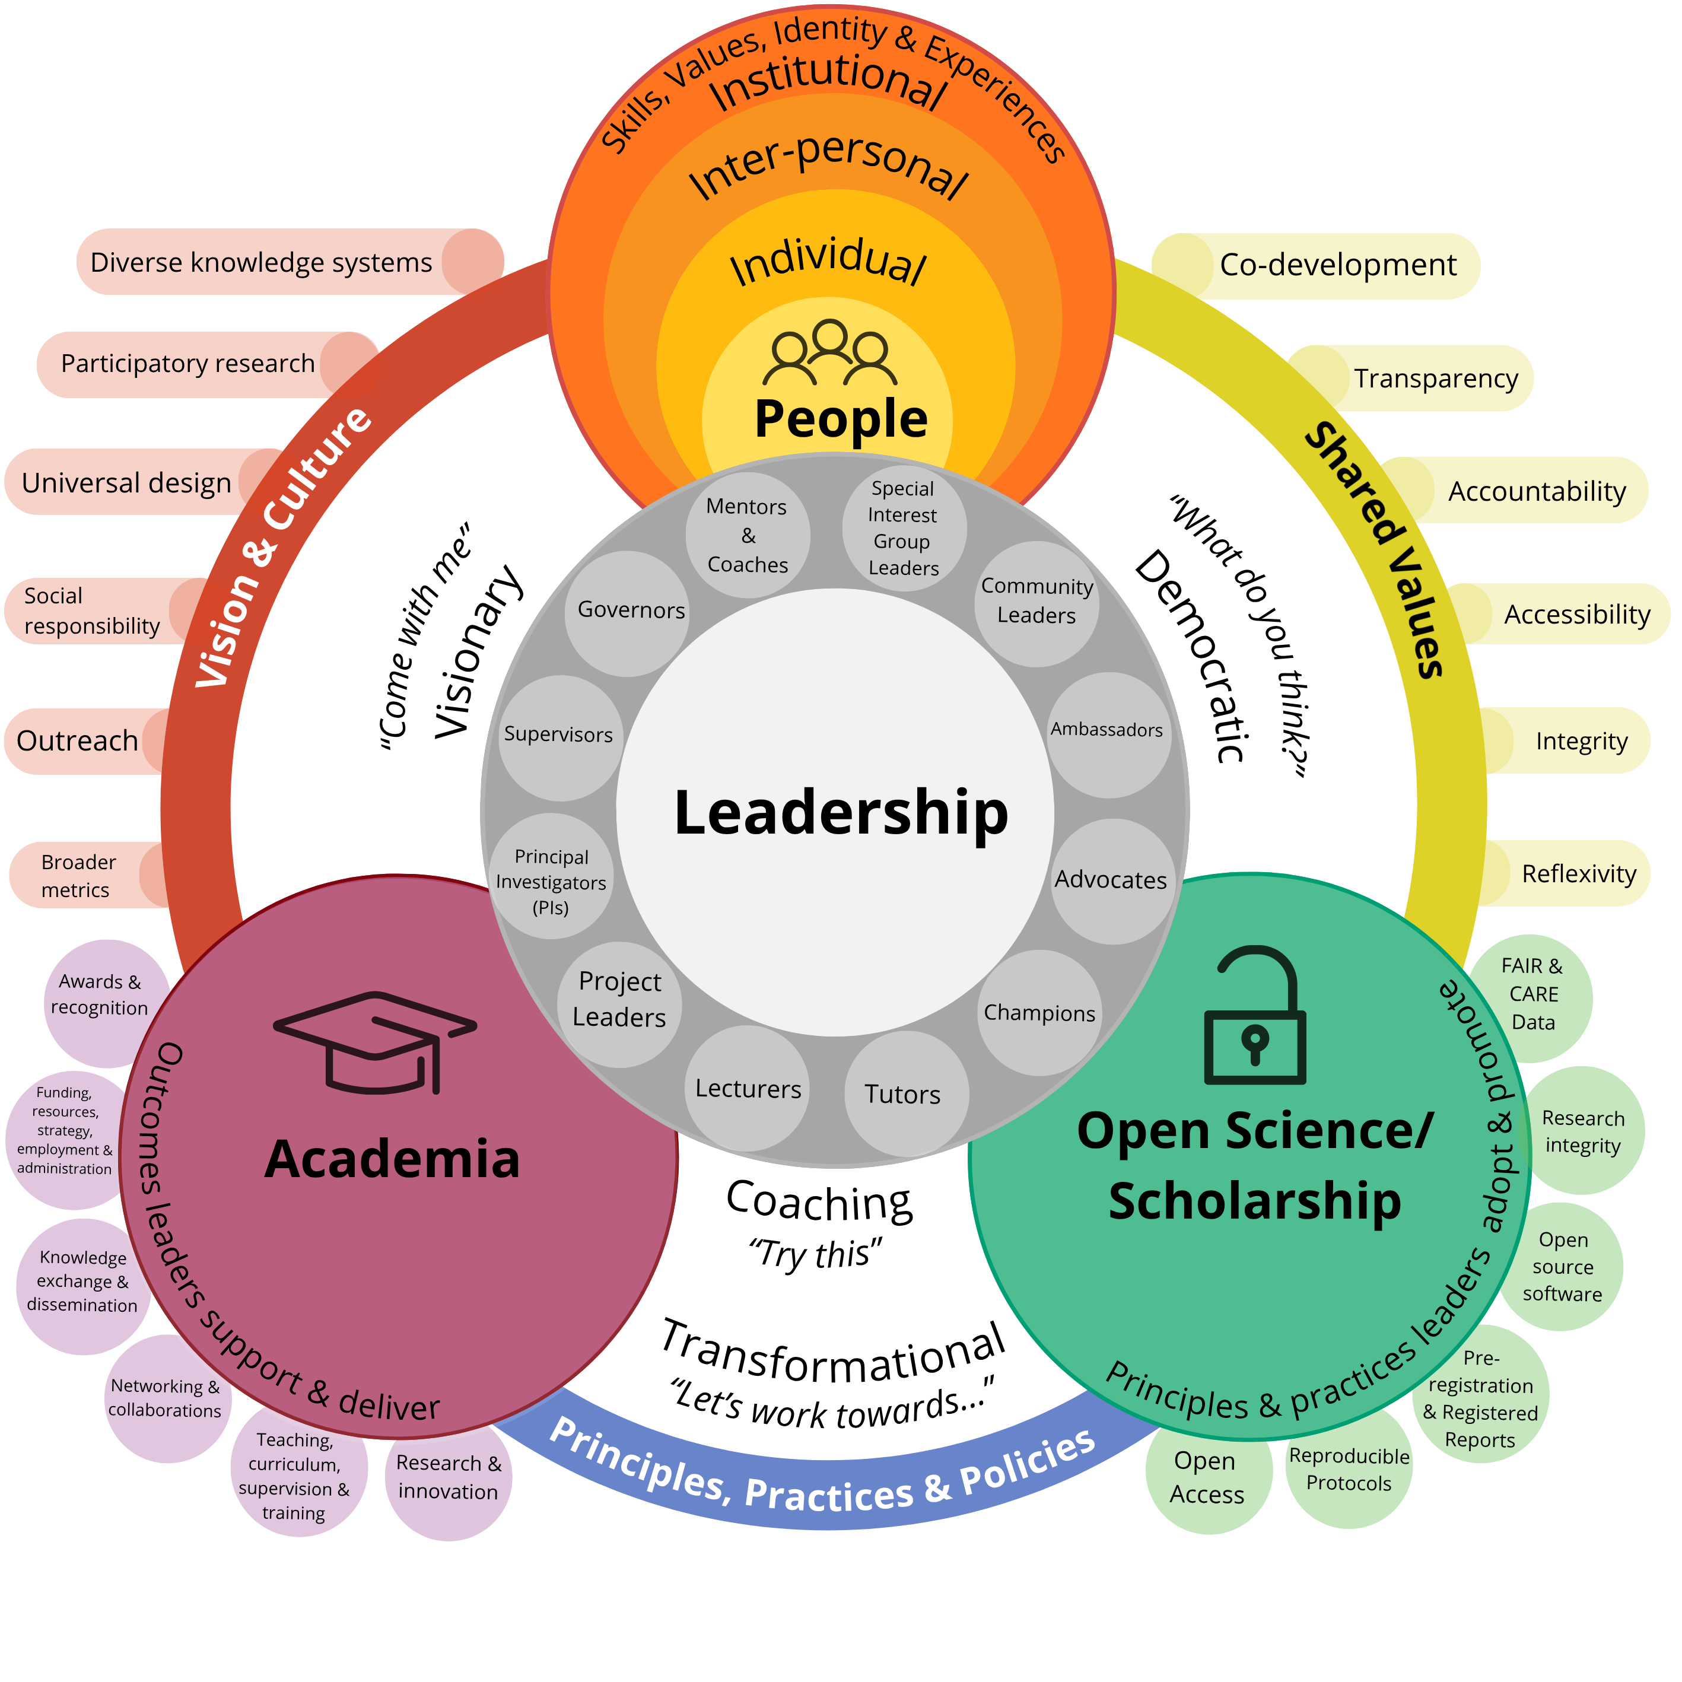
Questions
Notes:
Speaker notes:
We now have time for questions, thoughts and comments from the session.

Slide 86
References
Carroll, S. R., Herczog, E., Hudson, M., Russell, K., & Stall, S. (2021). Operationalizing the CARE and FAIR Principles for Indigenous data futures. Scientific Data, 8(1), 108. https://doi.org/10.1038/s41597-021-00892-0
Centre for Teaching, Support and Innovation. (2026). 1.3 Values, Goals, and Outcomes. Universal Design for Learning Foundations. https://q.utoronto.ca/courses/386447/pages/1-dot-3-values-goals-and-outcomes?module_item_id=7180870
DeRue, D. S., & Ashford, S. J. (2010). Who will lead and who will follow? A social process of leadership identity construction and organizations. The Academy of Management Review, 35(4), 627–647. JSTOR. http://www.jstor.org/stable/29765008
EOSC Open Science Observatory (2024). Open Science by Area / Training for Open Science. https://www.eoscobservatory.eu/explore/open-science-by-area/training
Gershenson, S., Holt, S. B., & Papageorge, N. W. (2015). Who Believes in Me? The Effect of Student-Teacher Demographic Match on Teacher Expectations. W.E. Upjohn Institute. https://doi.org/10.17848/wp15-231
Goleman, D. (2000). Emotional Intelligence: Leadership That Gets Results. Harvard Business Review.
https://hbr.org/2000/03/leadership-that-gets-results
Lacey, S., Ricken, J., & Cassidy, S. (2026). Leadership to Strengthen Research Culture and Foster Responsible Conduct of Research: A Case Study. EdArXiv. https://doi.org/10.35542/osf.io/ws2cv_v1
Leopold, T., Di Battista, A., Jativa, X., Sharma, S., Li, R., & Grayling, S. (2025). Future of jobs report 2025. In World Economic Forum. https://www.weforum.org/publications/the-future-of-jobs-report-2025/
Middleton, S. L., Sulik, J., Iley, B. J., Elsherif, M. M., & Azevedo, F. (2026). The Academic Wheel of Privilege: An equity-based tool for authorship order. MetaArXiv. https://doi.org/10.31222/osf.io/af4nk_v2
Pennington, C. R., Norris, E., Skubera, M., Ba, Y., Moffat, R., Amaral, O. B., Adamkovic, M., Adıgüzel, A., Almeida, R. A., Baldwin, J., Ballou, N., Behrens, L. M. P., Bertram, M., Bjerke, I. E., Blackwell, S. E., Bochynska, A., De Boer, M., Buljan, I., Canales-Aguirre, C. B., … Clark, K. (2026). Awareness and Use of Open Research Practices: An International Survey of Researchers Across Disciplines. PsyArXiv. https://doi.org/10.31234/osf.io/edzxf_v1
Phan, J. M., Middleton, S. L., Azevedo, F., Iley, B. J., Grose‐Hodge, M., Tyler, S. L., Kapp, S. K., Yeung, S. K., Shaw, J. J., Hartmann, H., & FORRT. (2025). Bridging Neurodiversity and Open Scholarship: How Shared Values Can Guide Best Practices for Research Integrity, Social Justice, and Principled Education. Journal of Social Issues, 81(4), e70035. https://doi.org/10.1111/josi.70035
Rogers, E. M. (1983). Elements of Diffusion. In Diffusion of innovations (3rd edn). The Free Press. (Original work published 1962)
Skelly, L. & Rusu, C. (2023). Crafting Open Research advocacy message using the Diffusion of Innovation theory. Edinburgh Open Research Conference.
Uhl-Bien, M. (2006). Relational Leadership Theory: Exploring the social processes of leadership and organizing. The Leadership Quarterly, 17(6), 654–676. https://doi.org/10.1016/j.leaqua.2006.10.007
UNESCO (2023) Open Science Outlook 1: status and trends around the world. https://unesdoc.unesco.org/ark:/48223/pf0000387324

Slide 87
Contribution statement
Creator: Middleton, Sara Lil ( 0000-0001-5307-8029),
Azevedo, Flavio ( 0000-0001-9000-8513)
Reviewer: Verheyen, Steven ( 0000-0002-6778-6744),
von Grebmer zu Wolfsthurn, Sarah ( 0000-0002-6413-3895)
Acknowledgements:
Sharing leadership expertise:
Elisabeth Bik, Fotis Mystakopoulos, Beth Montague-Hellen

Slide 88

License and citation statement
This current work by Sara Lil Middleton, Flavio Azevedo, Steven Verheyen and Sarah von Grebmer zu Wolfsthurn is licensed under a CC-BY-SA 4.0 Creative Commons Attribution 4.0 International SA License (unless otherwise stated). It permits unrestricted re-use, distribution, and reproduction in any medium, provided the original work is properly cited. If you remix, transform, or build upon the material, you must distribute your contributions under the same license as the original.
Please cite these materials as: Middleton, S., Azevedo, F., Verheyen, S., & Von Grebmer Zu Wolfsthurn, S. (2026). Leadership in Open Research: Skills, values and culture [Quarto slides]. LMU Open Science Center and FORRT. https://lmu-osc.github.io/train-the-trainer-open-research/leadership-open-research/leadership-skills-culture/

