Slide 1


Navigating leadership in Open Science: strategies
Dr Sara Lil Middleton (she/her)

Slide 2
Prerequisites
A foundational understanding of Open Science practices such as open access, preregistration, where training materials can be found here: https://www.osc.lmu.de/training/
Leadership in Open Science: Skills, values and culture (access here)
Navigating leadership in Open Science: Challenges (access here)
Access to the Open Research Workshop Design Workbook https://lmu-osc.github.io/train-the-trainer-open-research/workshop-design-workbook/
Access to Leadership in Open Science case studies
Note:
These training materials form part of three sessions on leadership in Open Science:
Skills, values and culture (access here)
Challenges (access here)
Strategies (current session)
Notes:
Speaker notes:
These are the speaker notes. You will find a script for the presenter for every slide. In presentation mode, your audience will not be able to see these speaker notes, they are only visible to the presenter.
This session assumes a basic familiarity with common Open Science concepts and practices. Examples include: replication crisis, R for data analysis and reproducible workflows; Quarto for reproducible documents; Git and GitHub for version control and collaboration, preregistration to document hypotheses and analysis plans in advance, Open Access publishing and broader transparency practices
You will need access to the workbook which can be downloaded as a Google Doc template and case studies which are linked in the slides and also on the landing page of these training materials.
Completion of session 1: Leadership in Open Science: Skills, values and culture
Completion of session 2: Leadership in Open Science: Challenges
Today forms the final part of 3 sessions on leadership in Open Science.
Instructor notes:
Learners do not need to be an expert, but you should have at least seen or used some of these concepts before. If some of these terms are new, you are encouraged to review the introductory Open Science materials linked on the slide before continuing. The goal is simply to ensure everyone shares a common base vocabulary so the workshop can focus on learning how to teach about Open Science rather than Open Science itself.

Slide 3
Survey
How confident are you in your ability to:
0 = not confident at all, 1 = mostly not confident, 2 = somewhat confident, 3 = very confident
1. use effective strategies to address challenges within Open Science?
Notes:
Speaker notes:
Let’s start with a survey!
Instructor notes:
These questions can be shared in an online survey format like https://www.particify.de/en/

Slide 4
Session goals
Examine approaches to addressing challenges in Open Science from multiple perspectives to increase breadth of knowledge.
Discuss and propose actionable and equitable strategies to address challenges in Open Science as a way to relate to own leadership contexts and build up collective problem-solving skills.
Notes:
Speaker notes:
2 main goals for this session:
Examine approaches to addressing challenges in Open Science from multiple perspectives to increase breadth of knowledge.
Discuss and propose actionable and equitable strategies to address challenges in Open Science as a way to relate to own leadership contexts and build up collective problem-solving skills.
We will work in groups later looking at case studies

Slide 5
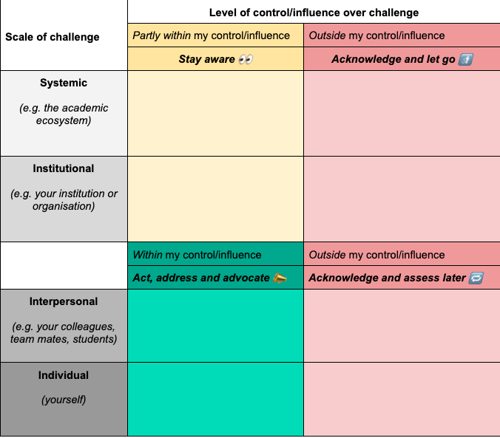
Quick recap
Following the 5A framework for addressing challenges: awareness, acknowledge, agency, action and assess
Looked at what and why of some challenges in Open Science
Identifying sphere of influence to address challenges
We’re at the action stage now
Notes:
Speaker notes:
In the previous session we looked at the what and why of open science challenges and we started to map out our challenges in the sphere of influence exercise.
Switch our attention to what we can do about it – stage 4 action.

Slide 6
Ways to approach challenges
Action
First start by thinking about general approaches before we apply to the group case study activity
You can keep in mind the challenges you have written down from sphere of influence activity
You
Notes:
Speaker notes:
First start by thinking about general approaches before we apply to the group case study activity
You can keep in mind the challenges you have written down from sphere of influence activity

Slide 7
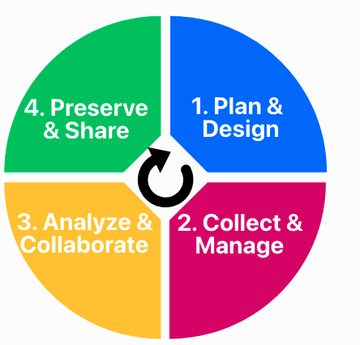
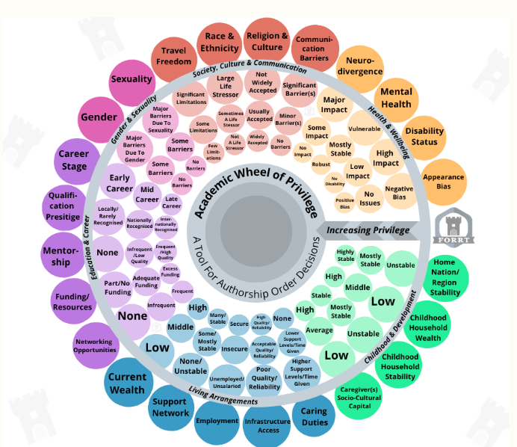
Ways to approach challenges: location
Consider the context you are in. Locate the scale, domain and your social position.
Which scale?
Which domain(s)?
Where in the research life cycle?
What is my positionality?
Adopter type?
Ihle et al. 2026; Rogers, 1983; Middleton et al. 2026
Notes:
Speaker notes:
Consider the context you are in. Locate the scale, domain and your social position
Reflecting on these things helps provide a sense of direction and orientation with regards to the challenges. We are revisiting the concepts we saw in session 1 and 2 through a problem solving lens.
Scale – what scale is the challenge is it a system issue? Is it an interpersonal one?
Domain: Is the challenge related to infrastructure? Is the challenge within the domain of training? There may be overlap
If within the research domain then where is the challenge happening in the research cycle?
Adopter type: for issues that are interpersonal, which adopter types do the challenges related to? Is it mostly late majority and laggards?
Finally, looking inwards, what is your positionality, what is the social location that you approach these challenges – it can give you an idea of your capacity and sphere of influence.

Slide 8
Ways to approach challenges: connect, communicate and collaborate
Spend some time to connect with yourself and others.
Connect with your values
Collaborate with peers and find or form community
Clear communication and build a shared vocabulary
e.g. what is important to you?
e.g. in your department, learned society, early career network
e.g. Co-create a group charter or glossary for a project
Notes:
Speaker notes:
Connecting with others and ourselves is important
What are our values?
Where can we join with others to make change? There will be resources linked of OS communities to join listed at the end
Build up a shared vocabulary that makes expectations and project goals explicit and keeps in mind accessibility, cultural differences.

Slide 9
Ways to approach challenges: small steps
Take small actions within sphere of influence, capacity, resources and time constraints
“Open Science Buffet” approach within your capacity and resources
Take action in your sphere of influence/impact
Identify what can be done now and what can wait
e.g. What things can I influence/control in a situation?
Bergmann (2023)
e.g. can I send that email today?
Notes:
Speaker notes:
Small steps start somewhere, in your sphere of influence, try out a practice at your own pace and context.
Taking a small action can help you build momentum.
Consider your capacity and resources adopting the open science buffet approach
Identify actions that can be done today and ones that can wait. This helps with overwhelm!

Slide 10
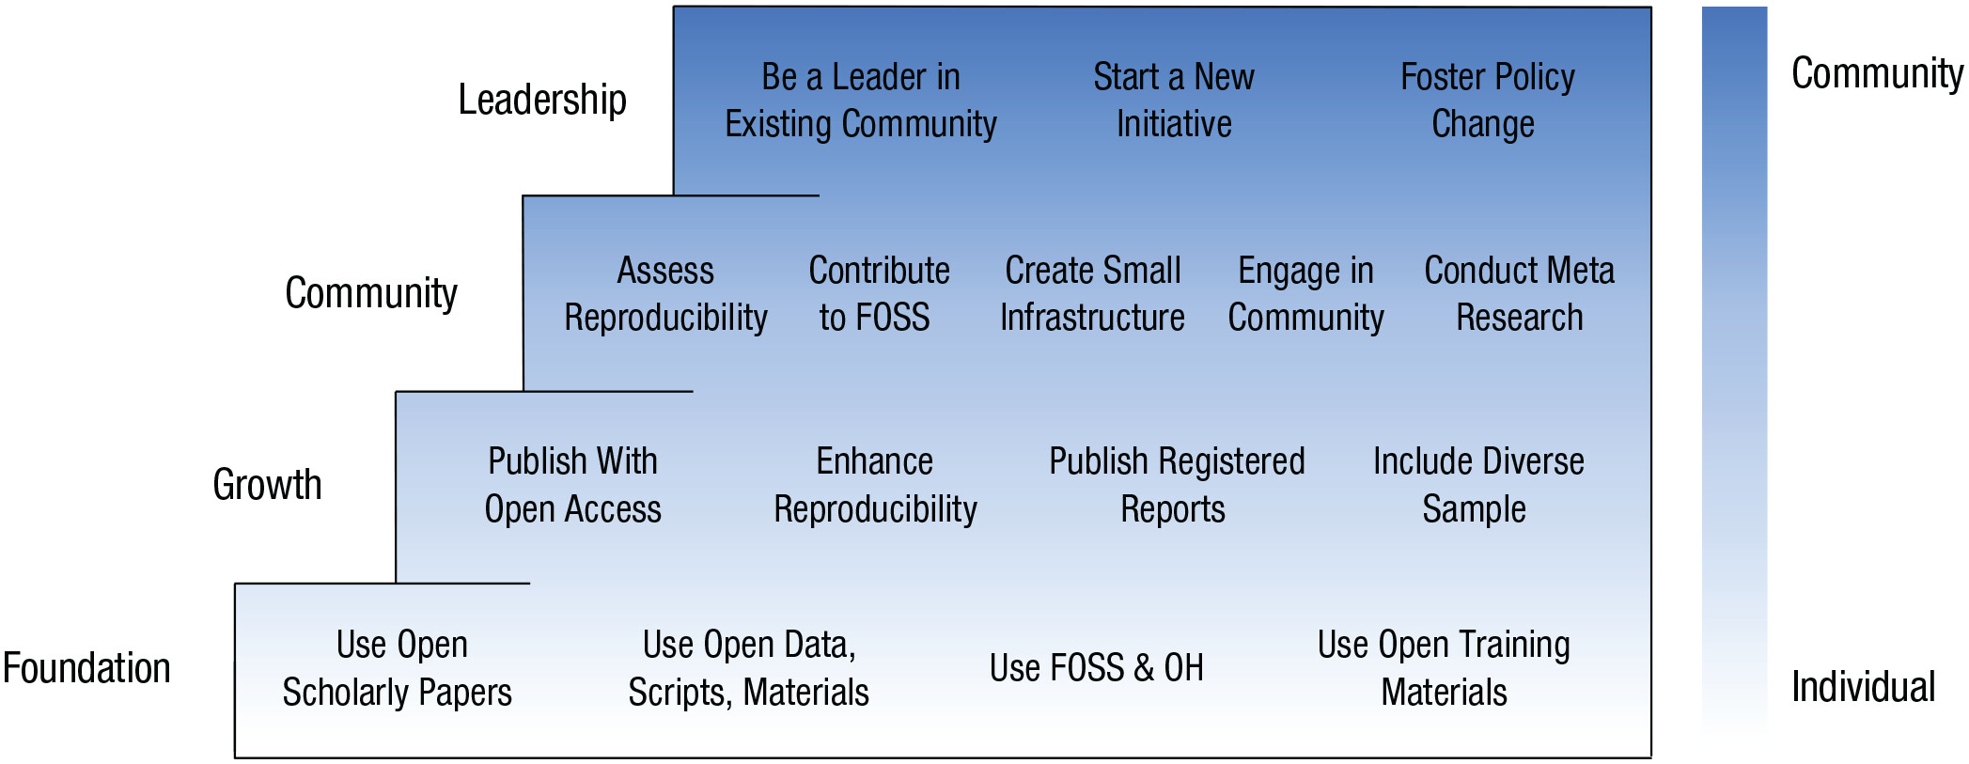
Small steps: from individual actions to community efforts
A practical guide for engaging in Open Science by Chuan-peng et al. (2025), with a focus on researchers from developing countries.
FOSS = Free and open-source software, OH = Open hardware
Notes:
Speaker notes:
A nice overview of small steps, we were discussing in the previous slide.
Steps on the left-hand side from foundation, growth, community and leadership showing actions with increasing resources needed
Some actions are more resource intensive
Going at your own pace and context.

Slide 11
Equity embedded not as an add-on in Open Science
Consider how your
actions impact those
from under-represented communities
Recognize the diversity of capacities, knowledge systems and values of researchers
Advocate for broader metrics for evaluating impact
e.g. Openness and flexibility to different ways of working, establish multiple ways to contribute
e.g. More than H-index. What
counts as rigorous research?
e.g. Using inclusive language
One-size-doesn’t-fit-all
Read more about equity in Open Science in the Munich Manifesto for Equitable Open Research (PHIL_OS, 2026): https://zenodo.org/records/20700870
e.g. Challenge binary ways of thinking, adopt and adapt recommended practices to context
Notes:
Speaker notes:
Equity should be integrated into strategies and not seen as separate.
Recognize the diversity of capacities, knowledge systems and values of researchers
Consider how your actions impact those from under-represented communities
Advocate for broader metrics for evaluating impact- think about is this metric serving us or are we serving it?
With diversity and one size doesn’t fit all it links to what we saw yesterday and earlier this morning about universal design for learning
There is more information about equity in Open Science in this Munich Manifesto.

Slide 12
Interim summary
Ways to take action: locate scale and domain of challenges, connect inwards and with others, start with small steps, embed equity.
Location
Connect
Small steps
Equity
Map out where the challenges are and your relationship to them
Check-in with yourself and connect with others
Consider equity as central part of practice and not as an optional addition
Breakdown challenges into manageable steps
Notes:
Speaker notes:
To summarize before we move onto the next session
Ways to take action: locate scale and domain of challenges, connect inwards and with others, start with small steps, embed equity.

Slide 13
Using case studies to apply the 5A framework
Case studies are a great reflective exercise (Toogood, 2023).
Allows you to combine learned theory and personal experiences to problem-solve scenarios that resemble real-world examples!
Can be done individually, small groups or larger groups.
Helps relate to own leadership contexts and build up (collective) problem-solving skills.
Next: Example case study as a larger group -> case study in small groups
Notes:
Speaker notes:
Case studies are a great reflective exercise that allows you to combine learned theory and personal experiences
Allows you to combine learned theory and personal experiences to problem-solve scenarios that resemble real-world examples!
Can be done individually, small groups or larger groups.
Helps relate to own leadership contexts and build up (collective) problem-solving skills.

Slide 14
Case study: building a cross-functional team
Awareness
Cameron and Gloria are two biologists starting a new collaboration on a project on modelling large mammal migrations.
They are both excited about the project and want to make it a success. They are not sure how best to leverage their expertise and align their ways of working.
Cameron has a computational background working with big data and adopts Open Science practices like reproducible workflows, version control and data archiving. He has some knowledge of the study species.
Gloria has extensive fieldwork experience with large mammals and keeping detailed field notebooks. She is aware of some Open Science practices, but her workflows are not yet reproducible (e.g. she uses point and click software for data analysis).
What could Cameron and Gloria do next? What potential challenges could they experience?
Notes:
Speaker notes:
Let’s apply the awareness of challenges, acknowledging the context identifying where we have agency (sphere of influence)
Work through one together: building a cross-functional team
Words in bold are areas to be aware
Instructor notes:
Read out loud the case study
Open up the floor and ask learners if they have thoughts on potential challenges.

Slide 15
Case study: building a cross-functional team
Acknowledge
Cameron and Gloria are two biologists starting a new collaboration on a project on modelling large mammal migrations.
They are both excited about the project and want to make it a success. They are not sure how best to leverage their expertise and align their ways of working.
Challenges
Conceptual
Practical
Equity
Cameron has a computational background working with big data and adopts Open Science practices like reproducible workflows, version control and data archiving. He has some knowledge of the study species.
Gloria has extensive fieldwork experience with large mammals and keeping detailed field notebooks. She is aware of some Open Science practices, but her workflows are not yet reproducible (e.g. she uses point and click software for data analysis).
Conceptual challenges: Same discipline but different norms, possible confusion over Open Science concepts and study species.
Notes:
Speaker notes:
Onto acknowledging the challenges
A conceptual challenge might be that they are both biologist with different research approaches and norms. They might run into confusion of ways of working in an open science way.

Slide 16
Case study: building a cross-functional team
Acknowledge
Cameron and Gloria are two biologists starting a new collaboration on a project on modelling large mammal migrations.
They are both excited about the project and want to make it a success. They are not sure how best to leverage their expertise and align their ways of working.
Challenges
Conceptual
Practical
Equity
Cameron has a computational background working with big data and adopts Open Science practices like reproducible workflows, version control and data archiving. He has some knowledge of the study species.
Gloria has extensive fieldwork experience with large mammals and keeping detailed field notebooks. She is aware of some Open Science practices, but her workflows are not yet reproducible (e.g. she uses point and click software for data analysis).
Practical challenge: Developing an organizational infrastructure that accounts for varying Open Science skills
Notes:
Speaker notes:
A practical challenge may be setting up an organizational infrastructure that accounts for current skills and knowledge of open science.

Slide 17
Case study: building a cross-functional team
Acknowledge
Cameron and Gloria are two biologists starting a new collaboration on a project on modelling large mammal migrations.
They are both excited about the project and want to make it a success. They are not sure how best to leverage their expertise and align their ways of working.
Challenges
Conceptual
Practical
Equity
Cameron has a computational background working with big data and adopts Open Science practices like reproducible workflows, version control and data archiving. He has some knowledge of the study species.
Gloria has extensive fieldwork experience with large mammals and keeping detailed field notebooks. She is aware of some Open Science practices, but her workflows are not yet reproducible (e.g. she uses point and click software for data analysis).
Equity challenge: Valuing diverse expertise and experiences. What does a successful collaboration look like?
Notes:
Speaker notes:
An equity challenge is defining what mutual success would be like to ensure their diverse and complimentary skills sets are valued.

Slide 18
Case study: building a cross-functional team
Agency
Cameron and Gloria are two biologists starting a new collaboration on a project on modelling large mammal migrations.
They are both excited about the project and want to make it a success. They are not sure how best to leverage their expertise and align their ways of working.
Sphere of influence
Inter-personal
Individual
Cameron has a computational background working with big data and adopts Open Science practices like reproducible workflows, version control and data archiving. He has some knowledge of the study species.
Gloria has extensive fieldwork experience with large mammals and keeping detailed field notebooks. She is aware of some Open Science practices, but her workflows are not yet reproducible (e.g. she uses point and click software for data analysis).
Agency: The challenges are mostly at the team and individual level
Notes:
Speaker notes:
Thinking about what they can do - a lot of the challenges mentioned previously are at the interpersonal and individual level.
Instructor notes:
Open up the floor and ask learners if they have thoughts on potential strategies.

Slide 19
Case study: building a cross-functional team
Action
Cameron and Gloria are two biologists starting a new collaboration on a project on modelling large mammal migrations.
They are both excited about the project and want to make it a success. They are not sure how best to leverage their expertise and align their ways of working.
Research domain
Research cycle
Clear communication
Cameron has a computational background working with big data and adopts Open Science practices like reproducible workflows, version control and data archiving. He has some knowledge of the study species.
Gloria has extensive fieldwork experience with large mammals and keeping detailed field notebooks. She is aware of some Open Science practices, but her workflows are not yet reproducible (e.g. she uses point and click software for data analysis).
Actions: Create a shared code of collaboration. Helps ensure joint agreement of expectations for project workflow, roles, outputs and ways of communicating
What could Cameron and Gloria do next? What potential challenges could they experience?
Notes:
Speaker notes:
An action they could take early on in their collaboration is create a shared code of collaboration.

Slide 20
Collective problem-solving with case studies
Find your case study group
Nominate 1 person to be a notetaker and 1 spokesperson
Read the case study scenario and guiding questions
In your groups note down some challenges, strategies
Compare your group’s suggested strategies with those in the case study and reflect
Whole group discussion and reflections
~20 mins
Notes:
Speaker notes:
Ok now it is your turn in groups to take a look at a case study. These case studies have been developed by experts within the FORRT community covering a range of dilemmas in open science.
At the end we will have a group discussion where each group will share one sentence can you share a reflection.
Instructor notes:
You can pre group learners based on interests shared prior to the session.
Creating a shared Google Doc for learners is a helpful way to collect thoughts from each group that the whole group can read.

Slide 21
Case study series on leadership in Open Science
Columbus, A., & Middleton, S. L. (2026, September 3). Leading an equitable Big Team Science consortium, a case study series on leadership in Open Science (LMU Open Science Center and FORRT). Zenodo. https://doi.org/10.5281/zenodo.22282068
Daniel, A., & Middleton, S. L. (2026, September 4). Finn's struggle to choose a method(ology), a case study series on leadership in Open Science (LMU Open Science Center and FORRT). Zenodo. https://doi.org/10.5281/zenodo.22308007
Daniel, A., Verheyen, S., & Middleton, S. L. (2026, September 4). Listening beyond protocol: Roya's experience with cultural ways of knowing, a case study series on leadership in Open Science (LMU Open Science Center and FORRT). Zenodo. https://doi.org/10.5281/zenodo.22308238
Mathy, A., & Middleton, S. L. (2026, September 4). Contributorship under tension, a case study series on leadership in Open Science (LMU Open Science Center and FORRT). Zenodo. https://doi.org/10.5281/zenodo.22307117
Middleton, S. L., & Ihle, M. (2026, September 4). Paulo's preregistration problem, a case study series on leadership in Open Science (LMU Open Science Center and FORRT). Zenodo. https://doi.org/10.5281/zenodo.22307709
Plank, I. S., & Middleton, S. L. (2026, September 4). Alex's open code dilemma, a case study series on leadership in Open Science (LMU Open Science Center and FORRT). Zenodo. https://doi.org/10.5281/zenodo.22306455

Slide 22
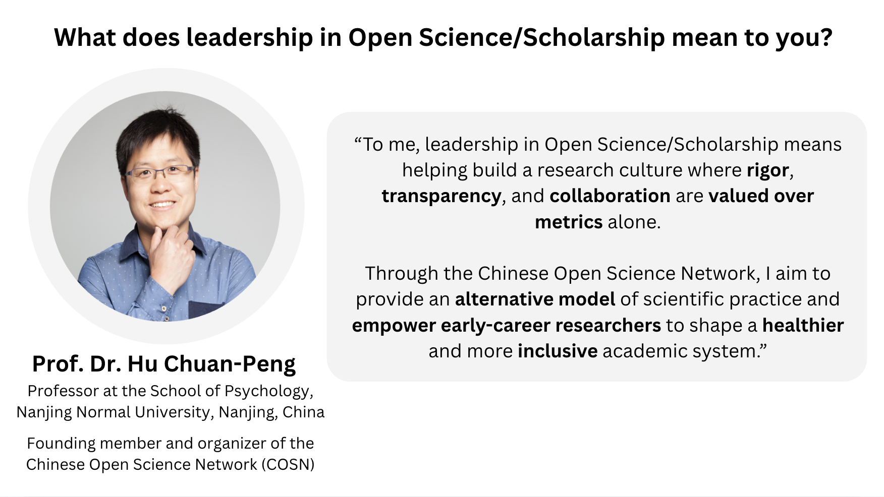
Notes:
Speaker notes:
Professor Hu Chuan-Peng shares this perspective on leadership in open science:
“To me, leadership in Open Science/Scholarship means helping build a research culture where rigor, transparency, and collaboration are valued over metrics alone.
Through the Chinese Open Science Network, I aim to provide an alternative model of scientific practice and empower early-career researchers to shape a healthier and more inclusive academic system.”

Slide 23
Leadership qualities we practiced
Using the 5A framework we worked on our collaborative problem-solving skills!
Awareness
Acknowledge
Agency
Action
Assess
See workbook for resources!
Problem
solving
Collaboration
Notes:
Speaker notes:
We worked a lot on our collective problem-solving skills.
We don’t have time to go into assess during this session, so please take a look at the workbooks for resources!

Slide 24
Final summary and questions
There is no one way to take action to address challenges.
Approaches consider:
Context (scale and domain of challenges, types of values, motivations of self and others)
Starting somewhere small and then building up
Capacity, resources and equity
Case studies are a useful active exercise by:
Combining theory and practice
Having a flexible approach (individual or group discussions)
Building up problem-solving skills on a realistic scenario
As you take action, keep in mind: What would be successful outcome?
Notes:
Speaker notes:
There is no one way to take action to address challenges.
Approaches consider:
Context (scale and domain of challenges, types of values, motivations of self and others)
Starting somewhere small and then building up
Capacity, resources and equity
Case studies are a useful active exercise by:
Combining theory and practice
Having a flexible approach (individual or group discussions)
Building up problem-solving skills on a realistic scenario

Slide 25
Take homes and wrap up
Notes:
Speaker notes:
Now it is time to wrap up!

Slide 26
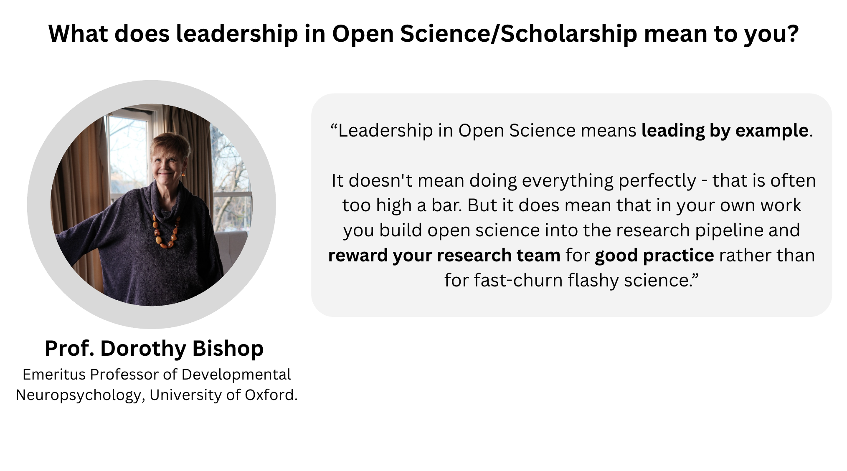
Notes:
Speaker notes:
Professor Dorothy Bishop’s take on leadership in open science: “Leadership in Open Science means leading by example.
It doesn't mean doing everything perfectly - that is often too high a bar. But it does mean that in your own work you build open science into the research pipeline and reward your research team for good practice rather than for fast-churn flashy science.”

Slide 27

Leadership in Open Science take home messages
Self-leadership and sideways leadership
5A framework for navigating challenges
Built up your leadership toolbox!
Empathy
Problem-solving
Leadership
Toolbox
Self-awareness
Collaboration
Knowledge
Notes:
Speaker notes:
Over the 3 sessions you have built up your leadership toolbox working on self-leadership using the 5A framework. You’ve practiced empathy, self-awareness, knowledge, problem solving and collaborative skills, which are all important for effective leadership.

Slide 28
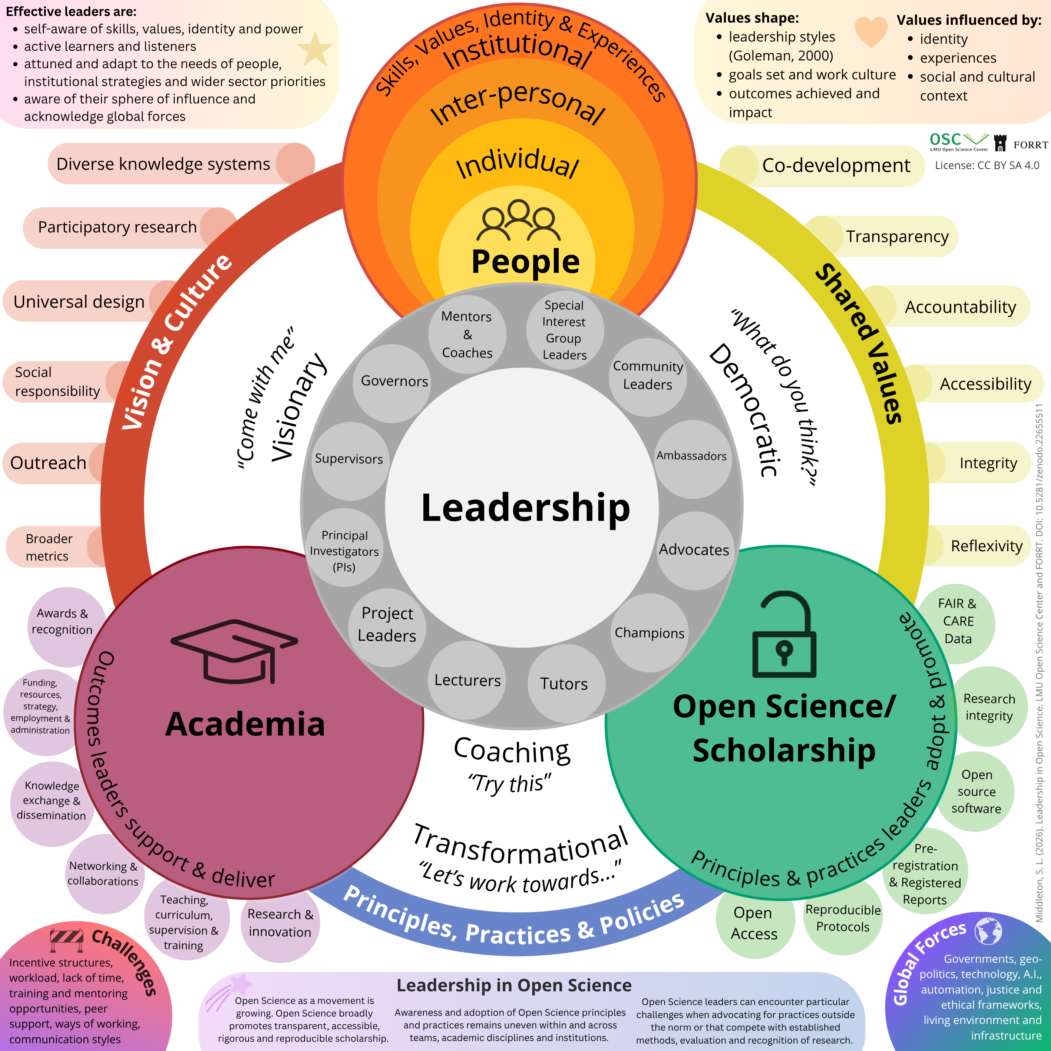
Leadership in Open Science summary sheet
https://zenodo.org/records/22655511
Notes:
Speaker notes:
This summary sheet collects many of the points that have been covered across the 3 sessions.

Slide 29
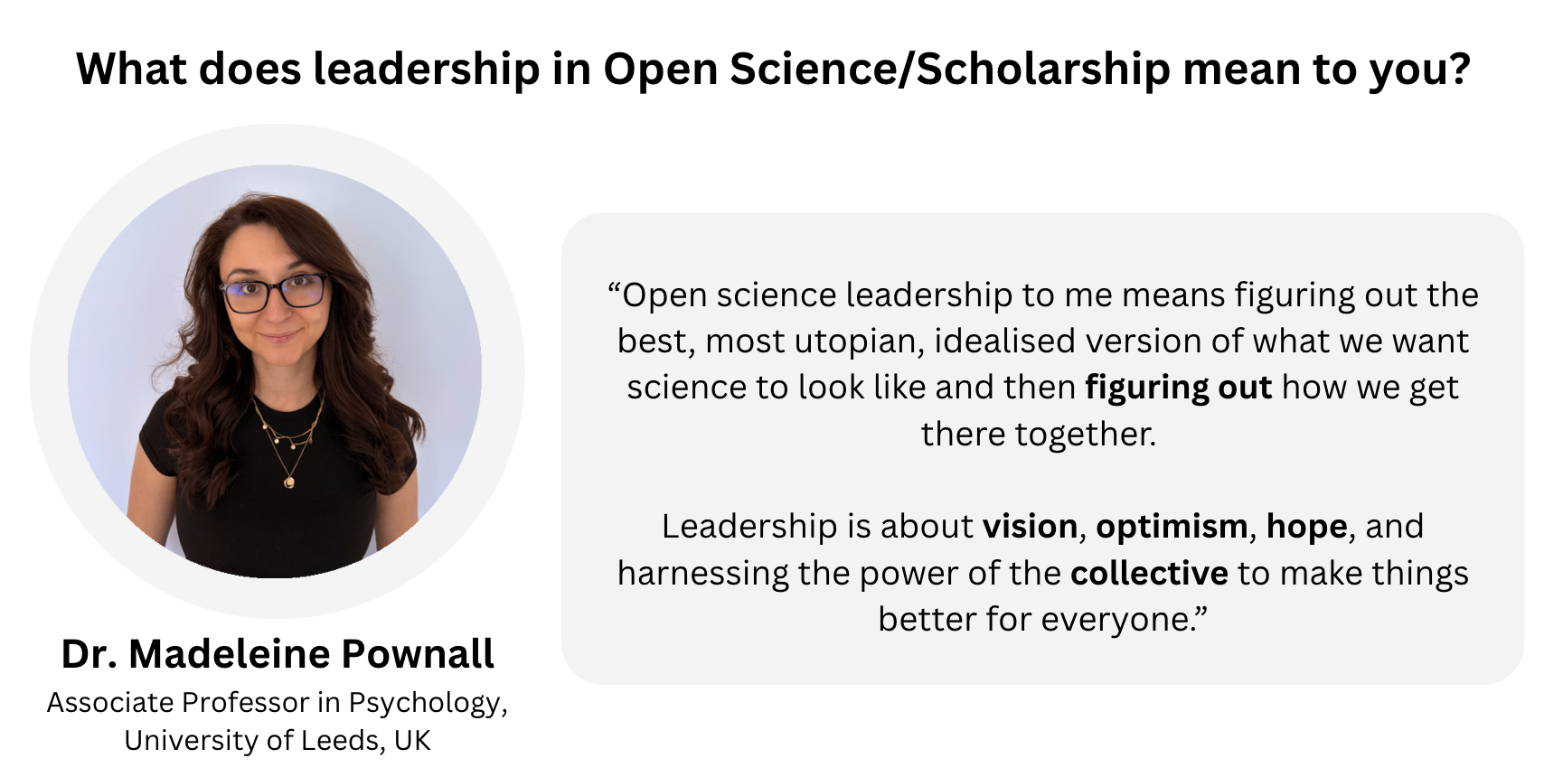
Notes:
Speaker notes:
Dr Madeleine Pownall’s perspective on open science leadership: “Open science leadership to me means figuring out the best, most utopian, idealised version of what we want science to look like and then figuring out how we get there together.
Leadership is about vision, optimism, hope, and harnessing the power of the collective to make things better for everyone.”

Slide 30
Survey
How confident are you in your ability to:
0 = not confident at all, 1 = mostly not confident, 2 = somewhat confident, 3 = very confident
1. use effective strategies to address challenges within Open Science?
Notes:
Speaker notes:
Now to revisit the survey we began with

Slide 31
Questions
Notes:
Speaker notes:
We now have time for questions, thoughts and comments from the session.

Slide 32

License and citation statement
This current work by Sara Lil Middleton, Steven Verheyen and Sarah von Grebmer zu Wolfsthurn is licensed under a CC-BY-SA 4.0 Creative Commons Attribution 4.0 International SA License (unless otherwise stated). It permits unrestricted re-use, distribution, and reproduction in any medium, provided the original work is properly cited. If you remix, transform, or build upon the material, you must distribute your contributions under the same license as the original.
Please cite these materials as: Middleton, S., Verheyen, S., & Von Grebmer Zu Wolfsthurn, S., (2026). Strategies in leadership [Quarto slides]. LMU Open Science Center and FORRT. https://lmu-osc.github.io/train-the-trainer-open-research/leadership-open-research/strategies-leadership/

Slide 33
Contribution statement
Creator: Middleton, Sara Lil ( 0000-0001-5307-8029)
Reviewer: Verheyen, Steven ( 0000-0002-6778-6744),
von Grebmer zu Wolfsthurn, Sarah ( 0000-0002-6413-3895)
Acknowledgements:
Case study developers:
Adira Daniel, Adrien Mathy, Alyssa Columbus, Irene Sophia Plank
Case study reviewers:
Steven Verheyen, Flavio, Azevedo, Malika Ihle, Max Wan, Sarah Sauve
Sharing leadership and Open Science expertise:
Hu Chuan-Peng, Richard Telford, Dorothy Bishop, Madeleine Pownall

Slide 34
References
Bergmann, C. (2023). The Buffet Approach to Open Science. https://cogtales.wordpress.com/2023/04/16/the-buffet-approach-
Chuan-Peng, H., Xu, Z., Lazić, A., Bhattacharya, P., Seda, L., Hossain, S., Jeftić, A., Özdoğru, A. A., Amaral, O. B., Miljković, N., Ilchovska, Z. G., Lazarevic, L. B., Bao, H. W. S., Ghodke, N., Moreau, D., Elsherif, M., C., C., Ghai, S., Carneiro, C. F. D., … Azevedo, F. (2025). Open Science in the Developing World: A Collection of Practical Guides for Researchers in Developing Countries. Advances in Methods and Practices in Psychological Science, 8(3), 25152459251357565. https://doi.org/10.1177/25152459251357565
Ihle Malika, Gupta Reema, Schönbrodt Felix, April 2026, Open Research Cycle Handbook https://lmu-osc.github.io/training/research-cycle-handbook.html CC-BY-SA 4.0 LMU Open Science Center
Middleton, S. L., Sulik, J., Iley, B. J., Elsherif, M. M., & Azevedo, F. (2026). The Academic Wheel of Privilege: An equity-based tool for authorship order. MetaArXiv. https://doi.org/10.31222/osf.io/af4nk_v2
PHIL_OS. (2026). Munich Manifesto for Equitable Open Research. Zenodo. https://doi.org/10.5281/zenodo.20700870
Rogers, E. M. (1983). Elements of Diffusion. In Diffusion of innovations (3rd edn). The Free Press. (Original work published 1962)
Toogood, C. (2025). Supporting students to engage with case studies: A model of engagement principles. Educational Review, 77(4), 1125–1139. https://doi.org/10.1080/00131911.2023.2281227

Slide 35



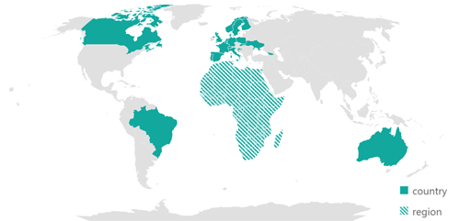


Some Open Science communities and networks
LMU, Munich Open Science Center: https://www.osc.lmu.de/about/join-us.html
SORTEE (Society for Open, Reliable, and Transparent Ecology and Evolutionary Biology): https://sortee.org/join/
FORRT (Framework for Open and Reproducible Research Training):https://forrt.org/about/get-involved/
Quala Lab:
https://qualalab.org/contact-us/
Global reproducibility networks (e.g. German Reproducibility Network):
https://www.ukrn.org/global-networks/
ReproducibiliTea:
https://reproducibilitea.org/
R Ladies: https://rladies.org/about-us/involved/

Slide 36
Some alternatives to OSF projects
Non exhaustive list!
Data repository:
Dataverse: https://dataverse.harvard.edu/
Dryad: https://datadryad.org/
Code repository:
GitHub: https://github.com/
Figshare: https://figshare.com/
Methods repository:
Protocols.io: https://www.protocols.io/
Research outputs:
Zenodo: https://zenodo.org/
If you are at LMU, Zenodo community:
https://zenodo.org/communities/lmu/about
Blogs to read more:
https://www.osc.lmu.de/news/news/2026-09-29-osf-project-functionality.html
https://help.osf.io/article/735-choosing-a-repository
https://daniellakens.blogspot.com/2026/08/which-data-repository-should-you-use.html

