Slide 1


BEYOND THE LECTURE
ACTIVATING LEARNERS IN ACADEMIC TEACHING
SOPHIE
RENARD

Slide 2

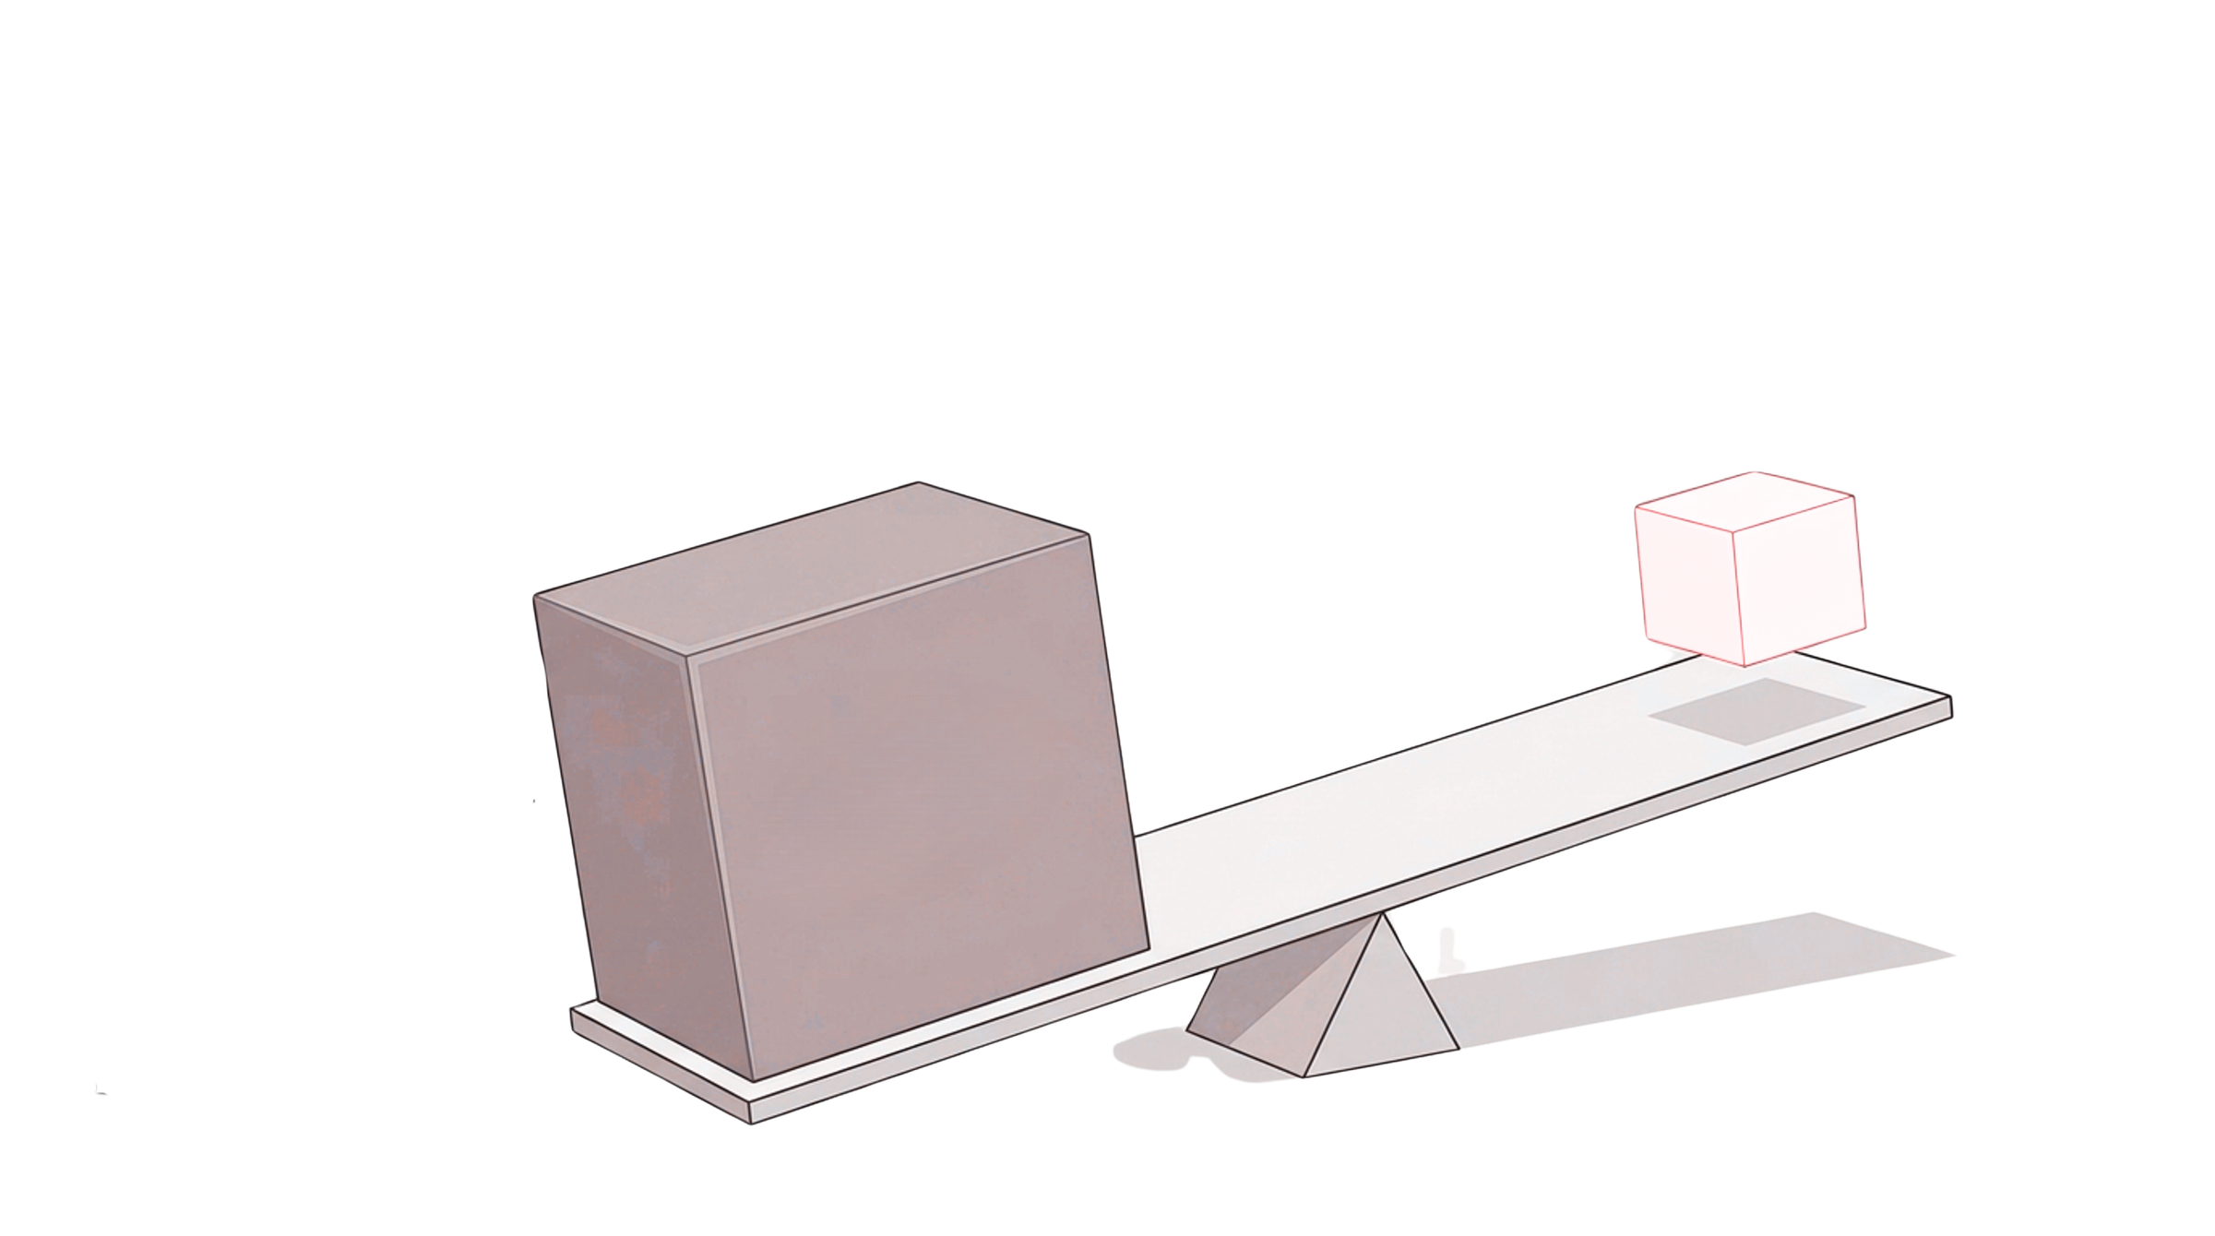
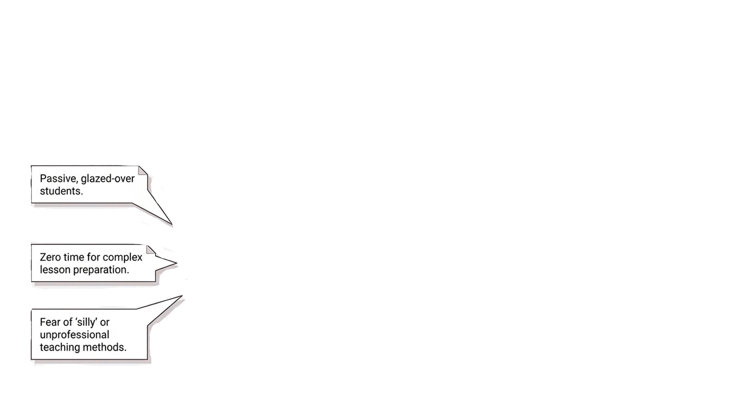

DESIGNING TEACHING SESSIONS THAT SUPPORT LEARNING
Pushing massive amounts of content against tight deadlines
Supporting the learning, reflection, retrieval, attention & engagement
Limited time for preparation / delivery
Cognitive
Processing
& Reflection
Information
Delivery
Passive learners
Fear of “silly” or unprofessional teaching methods
1

Slide 3
A
  Theoretical Basis
GEN
  2. ICAP-Framework
  3. Methods, Methods, Methods
DA
{
  4. Summary
Beyond
Lecture
the
2

Slide 4




What do
we mean
[...] pedagogical activities that can serve different purposes: they can help learners relax, counteract fatigue, stimulate discussion or support concentration.
by activation?
- Apacki, 1991
METHOD
TIME & PREP
SCALE
FOCUS
Micro-Interventions
are easily implentable
low preparation and implementation time
makes learning a socioable experience rather than an isolated moment
supports attention and energy
Beyond
Lecture
the
3

Slide 5


10-FINGERS-METHOD
1. How familiar are you with (activation) methods in teaching?
2. How active or involved are your learners currently?
3. How active would you like your learners to be - ideally?
Beyond
Lecture
the
4

Slide 6
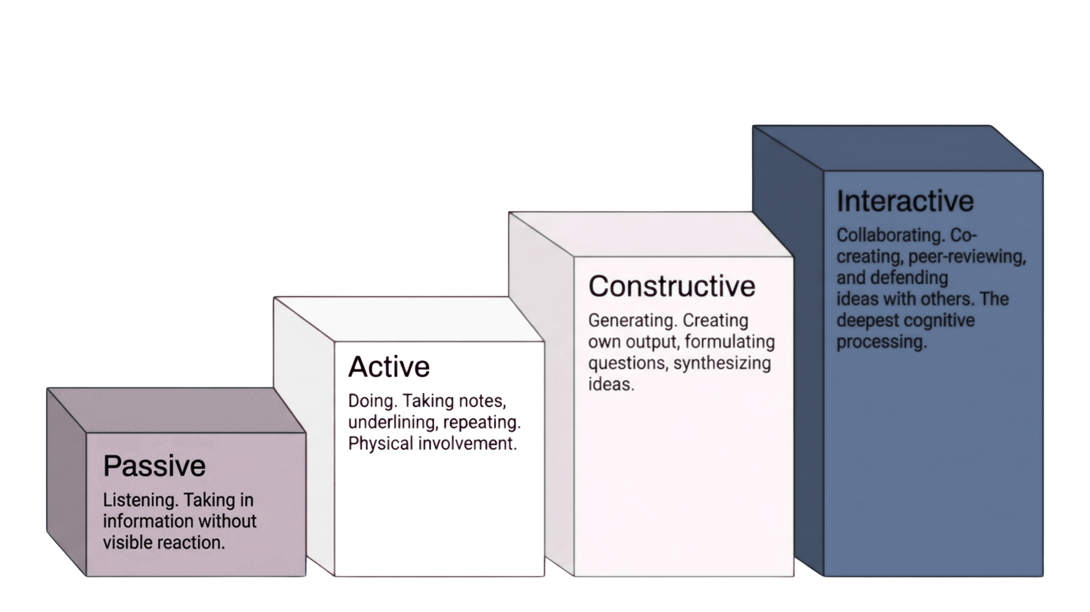
The ICAP
Framework
- Chi, 2009
THE DEGREE OF ENGAGEMENT
AFFECTS THE QUALITY OF LEARNING
Interactive
Collaborating;
co-creating and construction of knowledge, peer-reviewing & defending ideas with others
Constructive
Generating; formulating questions, synthesizing ideas, output
Active
Doing;
taking notes, underlining, repeating, observable action
Passive
Listening;
taking in information
5

Slide 7

Supporting retention
  Activation and retrieval of existing knowledge / repetition
  (Anderson, 2000)
  Situated learning (Greeno et al., 1996)
Enhancing
learning motivation
  Motivation and attitudes towards the subject (Wecker & Fischer, 2014)
  Social connectedness / sense of belonging (Deci & Ryan, 2008)
Creating productive learning pauses
Distributed learning / spaced learning
(Donovan & Radosevich, 1999)
Incidental / unintentional learning (Antosch-Bardohn, 2019)
Focusing attention and concentration
  Reduces cognitive load (Sweller et al., 2011)
  Helps process learning effectively (de Jong, 2010)
WHY WE ACTIVATE
The Enginge of Learning
6

Slide 8

The Learning objective determines the method
NEVER THE OTHER WAY AROUND
7

Slide 9



A
rrive
Zoom
Mentimeter
Mood
check
Survey /
Poll
Buzz Groups
Break-Outs
“Floor”
Arrangement
Tscheck.in
Flinga.fi
Spotlight
wheelofnames.de
Beyond
Lecture
the
8

Slide 10
R
eactivate
Call-In List/
Chat Queue
Pre-
Questions
Chain of Associations
Lucky
Dip
MindMap
Etherpad
Flinga.fi
Particify
Beyond
Lecture
the
9

Slide 11
I
nform
Visual
Presentation
Develop a model together
Sandwich
mini-ARIPE
Cercuit /
Vernissage
Reading
Research
Beyond
Lecture
the
10

Slide 12
P
rocess
Crossword
Puzzle
Coffeehouse
+ / -
Questions
Think
Pair
Share
Fish-Bowl
Discussion
Beyond
Lecture
the
11

Slide 13
E
valuate
Quiz
Letter to my future self
Who
wants to be a Millinaire?
Daring
Thesis/
6-Hats
Pre-
Questions
mailnudge.de
One Minute
Paper
PINGO
Socrative
Kahoot
Particify
Etherpad
Flinga.fi
Mentimeter
Beyond
Lecture
the
12

Slide 14


YOUR TURN: GET ACTIVE
15
mins.
Choose a small piece of an Open Science topic that you could imagine teaching:
1. What is your Learning Objective?
2. Where are you in the ARIPE process?
3. What kind of cognitive engagement does the objective require?
4. Design a 5-minute learning activity!
Beyond
Lecture
the
13

Slide 15
SU
Break up longer input phases with activation.
MMA
Short activation methods can redirect attention and create opportunities for learners to process, retrieve and connect content.
RY
{
The quality of engagement matters.
ICAP: Different levels of cognitive activation support different kinds of learning processes.
Activation serves different purposes.
It can support retention, learning motivation, productive learning pauses, attention and concentration.
Choose your methods purposefully.
The Münchner Methodenkasten provides a useful orientation for selecting methods according to the learning phase, social form and intended learning activity.
Start with the learning objective - not the method!
Beyond
Lecture
the
14

Slide 16

TAKE-HOME-MESSAGE
What is your key take-home-message of this input;
or: What is something you definitely will try out?
Follow the instructions in class!
Beyond
Lecture
the
15

Slide 17
Anderson, J. R. (2000). Learning and memory: An integrated approach. John Wiley & Sons Inc.
Antosch-Bardohn, J. (2018). Nicht-intentionale Lernprozesse im Alltag von Studierenden: Einflussfaktoren auf nicht-intentionale Lernprozesse in Zusammenhang mit studentischem Wissenserwerb. Logos Verlag Berlin GmbH
Beege, B.; Antosch-Bardohn, J. (2018). Kurze Aktivierungsmethoden für Lehrveranstaltungen. Interdisziplinäres Symposium. München: Ludwig-Maximilians-Universität (LMU) & Münchner Dozierenden Netzwerk (MDN), 12.10.2018. Vortrag.
Chi, M.-T. H. (2009). Active-constructive-interactive: A conceptual framework for differentiating learning activities. Topics in Cognitive Science, 1, 73-105.
Chi, M.-T. H. & Wylie, R. (2014). The ICAP Framework: Linking Cognitive Engagement to Active Learning Outcomes. Educational Psychologist, 2014,49:4, 219–243.
Deci, E. L., & Ryan, R. M. (2008). Facilitating optimal motivation and psychological well-being across life's domains. Canadian Psychology/Psychologie canadienne, 49(1), 14–23. https://doi.org/10.1037/0708-5591.49.1.14
Donovan, J. J., & Radosevich, D. J. (1999). A Meta-Analytic Review of the Distribution of Practice Effect: Now You See It, Now You Don't. Journal of Applied Psychology, 84(5), 795–805.
Greeno, J. G., Collins, A. M., & Resnick, L. B. (1996). Cognition and learning. Handbook of educational psychology, 77, 15-46.
Jong, T. de. (2010). Cognitive load theory, educational research, and instructional design: Some food for thought. Instructional Science, 38(2), 105–134. https://doi.org/10.1007/s11251-009-9110-0
Sweller, J., Ayres, P. L., & Kalyuga, S. (2011). Cognitive load theory. Explorations in the learning sciences, instructional systems and performance technologies. New York: Springer.
16

Slide 18
BEYOND THE LECTURE
ACTIVATING LEARNERS IN ACADEMIC TEACHING
SOPHIE
RENARD
You turn!
Stay activated!

