Slide 1

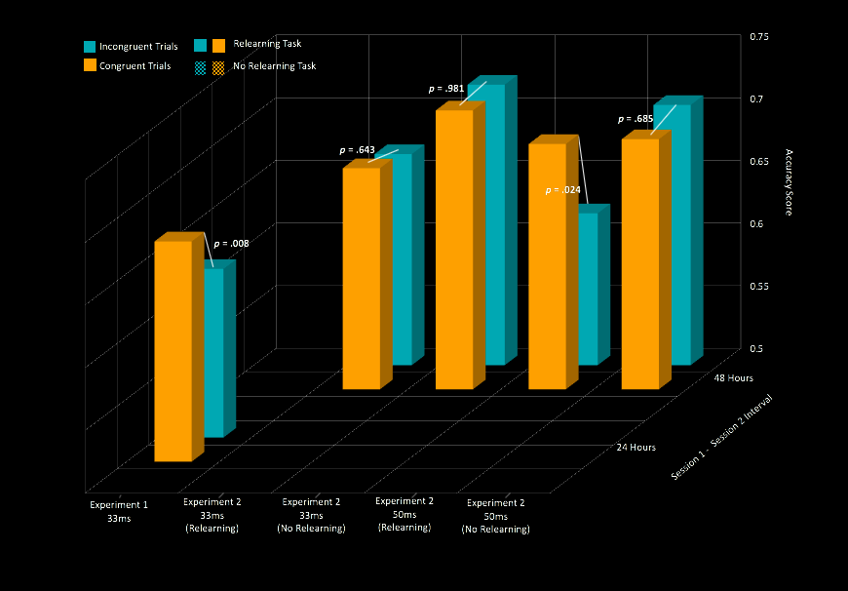


Rapid and Durable Recruitment of Novel Words Into Unconscious Processing
Ariel Pruyser, Demarko Flanagan, Samantha Aniceto, Reed Morgan, Richard L. Abrams, Ph.D.
Psychology Department, Loyola Marymount University
Introduction
Unconscious visual processing is a phenomenon in which a briefly flashed, consciously imperceptible word influences the categorization of a different target word that participants are instructed to attend to.
Studies conducted on unconscious visual processing typically use everyday, “overlearned” words as both primes and targets. Earlier findings indicate overlearned words yield robust priming only after an interval of relearning (Greenwald & Abrams, 2000; Damian, 2001).
Some research reports that after extensive learning, novel words successfully acted as semantic primes (Dagenbach, Horst, and Carr, 1990; Tamien and Gaskell, 2013).
Our studies extended these findings by investigating the recruitment of newly acquired words into language processing systems that involve solely unconscious processing.
Over the course of two experiments, the acquisition of rare and presumed-to-be unfamiliar exemplars of two common categories, fish and flower, was examined. We manipulated (a) the duration between practice and priming task sessions, (b) whether or not participants received a brief second round of practice, and (c) prime duration. Our objective of this study is to evaluate the process by which newly-acquired vocabulary is recruited in to the unconscious systems and to examine the role of relearning/reactivation.
Method
All experiments began with a session of extensive learning (30-45 minutes) in which participants were introduced to the novel exemplars first by pairing the words with pictures of the corresponding fish or flower, then practiced categorizing the words alone
After a time-varied interval, participants performed a priming task with the newly-acquired (NA) exemplars as the masked primes, and common fish and flower names as the visible targets
The presence of a relearning session with the newly-acquired exemplars just before the priming task was present amongst all participants in experiment 1 but varied in experiments 2. Priming tasks were followed by a test of prime visibility, in which participants categorized the briefly-flashed, visually masked primes.
Results
Experiment 1 (relearning after a 24-hour interval with 33 ms primes)
Priming task yielded significant priming, p = .008 or the difference in accuracy between congruent and incongruent trials for the NA exemplars from 33 ms primes (N = 19)
Experiment 2 (relearning vs. no relearning after a 48-hour interval with 33 ms and 50 ms primes)
Significant priming from the NA exemplars for relearning group (N = 20) in the 50 ms group, p = .024, but not for 33 ms relearning group, p = .643.
No evidence of significant priming from the NA exemplars for the no relearning group (N = 20) in both the 33 ms prime group, p = .918, or the 50 ms group, p = .685.
Visibility task indicated that the NA exemplars were consciously imperceptible in all conditions: R+ with 33 ms primes (M = 0.50, SD = 0.05; t(19) = -0.22, p = .825), R- with 33 ms primes (M = 0.48, SD = 0.05; t(19) = -1.59, p = .128), R+ with 50 ms primes, (M = 0.50, SD = 0.04; t(19) = -0.47, p = .641), and R- with 50 ms primes (M = 0.49, SD = 0.05; t(19) = -0.84, p = .414).
Discussion
These experiments demonstrate that novel category exemplars are rapidly recruited into systems that handle unconscious processing of visual language.
Similar to overlearned words ,these NA category exemplars function as unconscious primes only after a session of practice/relearning.
The novel category exemplars ability to function as unconscious primes lasts for at least 48 hours and is dependent on prime duration.
Successful priming after 48 hours suggests that rapid recruitment may depend upon a prolonged opportunity to consolidate the newly learned verbal material, such as the intensive consolidation that occurs during overnight sleep (e.g. Saletin & Walker, 2012). This opens up the intriguing possibility that that overnight sleep is necessary for the recruitment of novel words in to unconscious processing systems.
Trial sequence in priming and visibility tasks
(Same sequence in both tasks; in priming, instruction was to categorize the target; in visibility, instruction was to categorize the masked word)
response window, 133 ms, to encourage responding when the unconsciously-perceived prime is still present in memory
target (common name), 333 ms
lavender
!
prime (NA category exemplar) 33 or 50 ms
MANDUBA
backward mask, 33 ms
forward mask, 333 ms
Acknowledgements:
This research would not be possible without the support of the Monica Lester Endowment to the Department of Psychology at Loyola Marymount University for funding undergraduate student research. We would also like to acknowledge the Bellarmine College of Liberal Arts at LMU for their support in conference funding.

