Slide 1

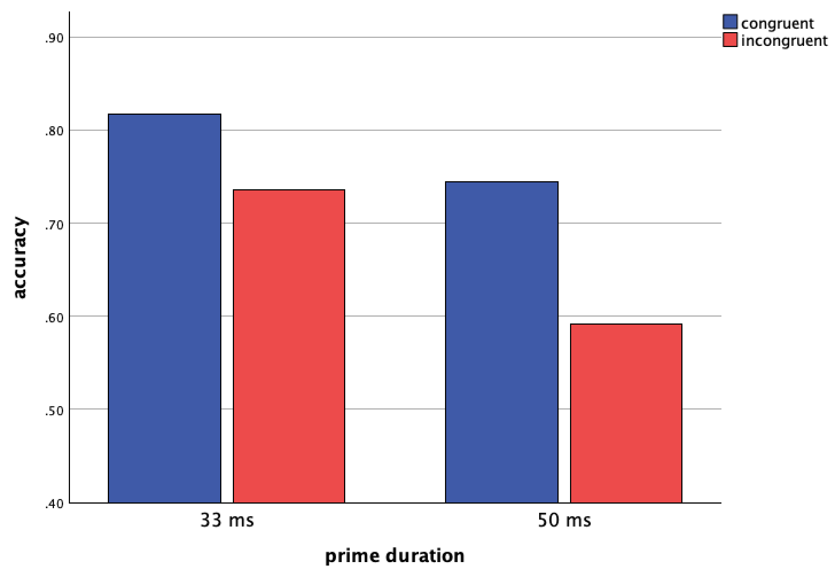
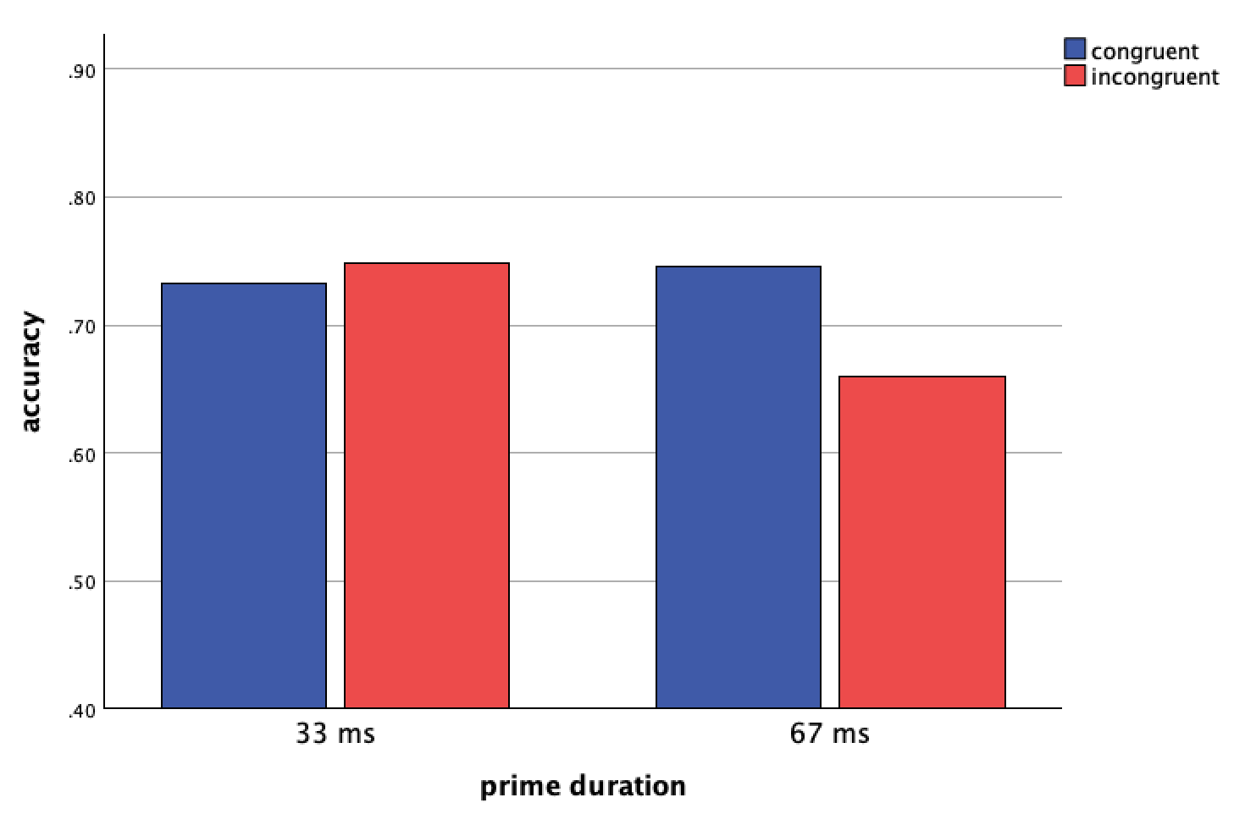
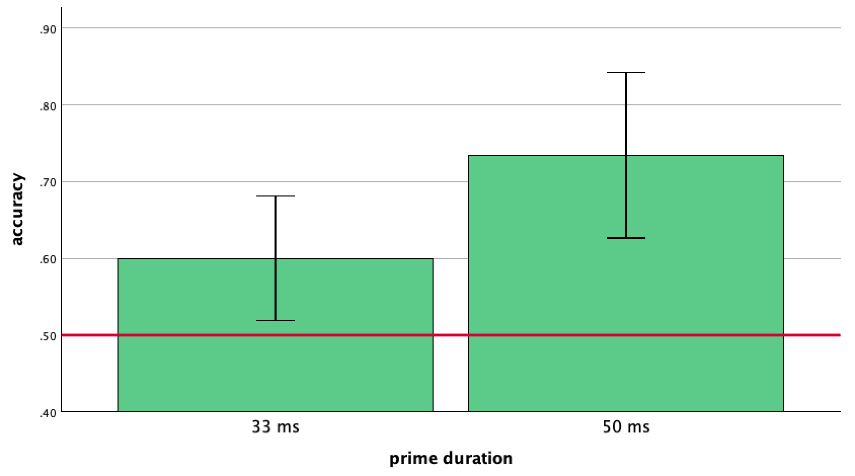
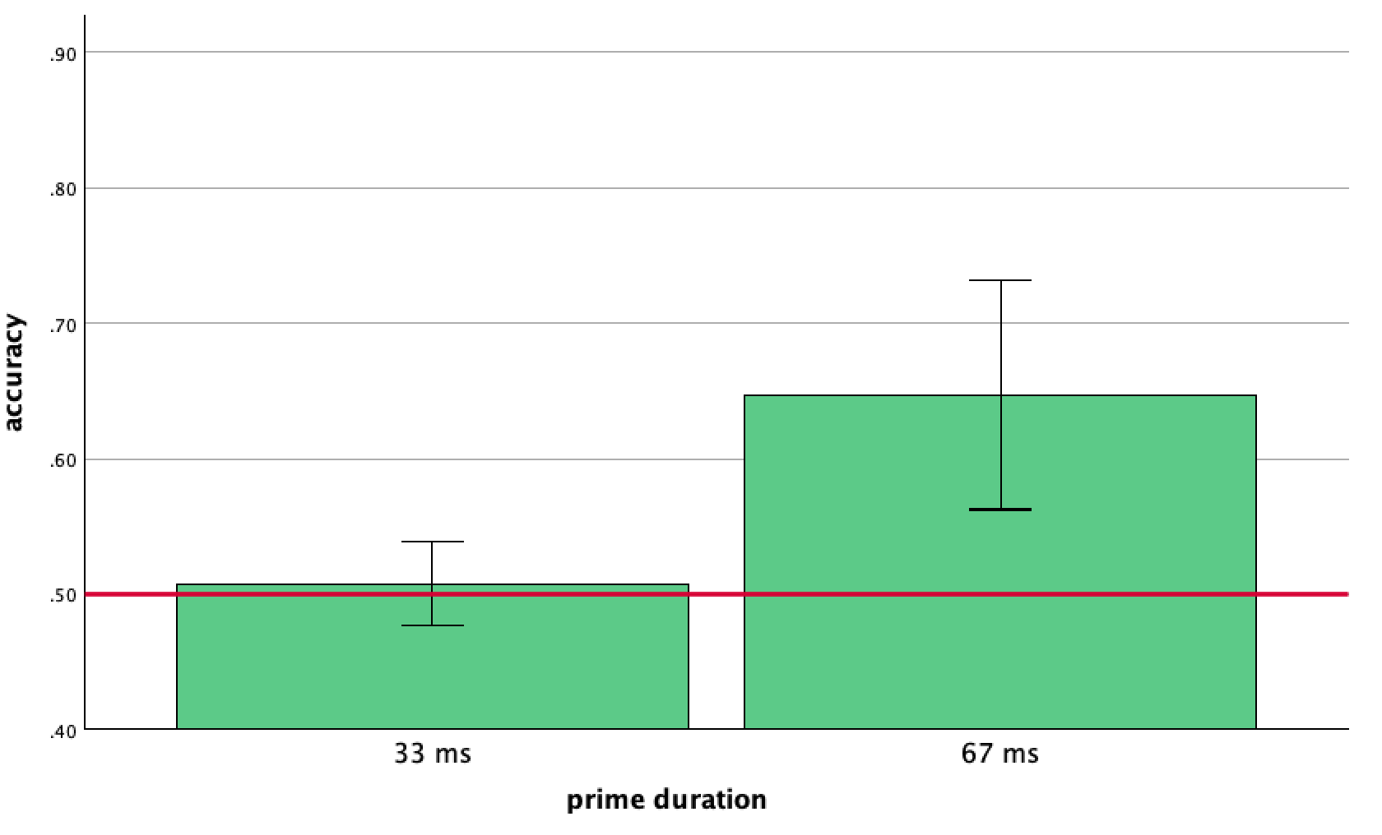

Essential Role of Consciousness in Cross-Language Masked Priming
Megan Chen, Samantha Cheng, Ela Nordfors, Abigail Mora, Richard L. Abrams, Ph.D.
Department of Psychological Science, Loyola Marymount University
Introduction
Experiment 1
Experiment 3
Cross-language priming occurs when exposure to a word (the prime) in one language influences processing of a corresponding target word in another language; for example, the Spanish prime "amigo" followed by the English target "friend."
Nakayama & Lupker (2018) reported evidence for cross-language priming under display conditions (masking, short prime duration) which they claimed rendered primes consciously imperceptible.
This intriguing finding implies the possibility that cross-language priming occurs at an unconscious level.
The finding is intriguing in part because most research in unconscious priming has found that nonconsciously-perceptible primes are processed only after recent conscious (i.e. visible) practice with the words that subsequently appear as masked primes; Nakayama & Lupker's primes had not been practiced.
We took an approach similar to Nakayama & Lupker but with the addition of an explicit test of prime visibility (Nakayama & Lupker did not use an explicit test of prime visibility).
Objective
This experiment tested Nakayama and Lupker’s (2018) claim that cross-language processing occurs unconsciously. Specifically, we investigated whether priming effects could be observed for Chinese and English primes and their cross-language targets, even when participants had not previously practiced the primes.
Testing Chinese-English bilinguals allows us to evaluate cross-language processing between two distinct writing systems, providing a critical context for understanding unconscious bilingual word recognition.
Objective:
This experiment further investigates our conclusion from Experiment 1 that priming effects for never-before practiced cross-language primes may depend on visibility levels. Building on Experiment 2, we tested Spanish-English cross-language pairs in conditions with presumed low visibility (233 forward mask, 33 ms primes) and high visibility (233 forward mask, 67 ms primes).
Method: Prime durations were 33 and 50 ms, with 300 ms forward masks. The language of the primes and targets was counterbalanced (See “Examples” table).
Methods: Primes and forward mask durations were based on Conditions 2 and 8 from Experiment 2. The language of the targets and primes, as well as presentation order of visibility, were counterbalanced (See “Examples” table.)
Priming Effect (accuracy)
A 2x2 ANOVA on accuracy for within subjects congruence (congruent, incongruent) and between subjects duration (33, 50 ms) revealed significant main effects of congruence (p = .013) and duration (p = .036).
No significant interaction was observed.
Contrasts revealed a significant priming effect for both prime durations: 33 ms (p = .025) and 50 ms (p = .022).
Priming Effect (accuracy)
A 2x2 repeated measures ANOVA on accuracy for congruence (congruent, incongruent) and duration (33 ms, 67 ms) on accuracy showed a significant main effect of duration (p = .049) but not of congruence (p = .059).
A significant interaction (p = .013) indicated that accuracy differences for congruence depend on prime duration.
Contrasts revealed significant congruence effects in the 67 ms condition (p = .011), but not the 33 ms condition (p = .402).
*
*
*
General Method
Participants first gained practice categorizing targets not preceded by primes as “pleasant” or “unpleasant.”
They then did a priming task, in which the same target words they have been practicing were now preceded just before by primes. These primes were briefly flashed, visually masked words in a different language (Experiments 1 & 3) or set (Experiment 2) from the target words. Semantic similarity was controlled for. Primes were not shown to participants prior to their appearance as primes.
The categorization task was speeded by use of a response window which, as in earlier work (Draine & Greenwald), obliges participants to respond quickly to maximize responding during the fleeting activation elicited by the masked primes.
Primes were either congruent (same category) with the following target or incongruent (different category). In analyzing data, we calculated priming effect as the difference in accuracy between congruent and incongruent trials. A significant priming effect indicates that the category of the primes affects accuracy in target categorization.
After the priming task, participants completed a visibility task. These trials were structured the same way as the priming task, but participants were asked to categorize the primes instead of the targets. In analyzing data, accuracy significantly above M = .50 indicates that participants were able to categorize the primes more accurately than if they were merely guessing, which points to visibility.
Visibility
A one-sample t-test revealed that performance in accuracy when categorizing primes was significantly above the chance level in both conditions: 33 ms primes (p = .021) and 50 ms primes (p = .0.0007).
*
*
*
Visibility
A one-sample t-test revealed that categorization accuracy was significantly above chance accuracy for 67 ms primes (p = .002) but not for 33 ms primes (p = .595).
Conclusion: Like Nakayama and Lupker (2018), we demonstrated that cross-language priming across distinct language systems occur in bilinguals. However, unlike Nakayama and Lupker, we measured visibility and found that participants were able to categorize primes with above-chance accuracy, even at brief durations of 33 ms and 50 ms. This suggests that the primes in our study were not processed below the level of conscious awareness. Therefore, we did not find support for Nakayama and Lupker’s claim regarding the absence of visibility.
Conclusion: In this experiment, only 67 ms primes produced priming effects on their cross-language targets, while 33 ms primes did not. These results suggest that priming effects for cross-language word pairs require above-chance visibility, which aligns with previous findings.
Experiment 2
Discussion
Objective
Building on Experiment 1, we wish to further investigate cross-language priming effects in the absence of visibility.
Due to Chinese-English bilingual recruitment limitations, we decided to test Spanish-English bilingual participants. This experiment allows us to identify display conditions that produce below-chance and above-chance visibility, for the English alphabet. This approach is necessary to establish conditions that can distinguish priming effects based on visibility levels, which were not fully addressed in Experiment 1.
Collectively, our results cast doubt on the claim in Nakayama & Lupker that cross-language priming occurs under conditions of conscious imperceptibility. In our two cross-language experiments, priming effects were obtained only when performance was above chance in an explicit test of priming visibility. Priming was absent when the visibility test indicated conscious non-perceptibility.
These findings align with others from our group and elsewhere which imply narrow limits on unconscious prime processing including, in particular, the inability to unconsciously process primes that haven't first been practiced consciously as visible words.
Our ongoing research is aimed at furthering our understanding of what aspects of language processing can be handled solely by unconscious systems in the brain and which require coordination between conscious and unconscious systems.
Trial sequence in priming tasks
Response window
!
Methods: Assessed nine possible conditions, with primes of 33, 50, and 67 ms and forward masks of 133, 233, and 333 ms. Primes were never-before practiced English words.
Target (example of an incongruent trial from Expt 3), 400 ms
basura
Backward mask, 33 ms
FRIEND
Priming Effect (accuracy): Priming effect was marginally significant for Condition 8. See table for all priming effect results.
Condition | Mask/Prime Duration (ms) | Priming effect | Visibility
1 | 333 / 33 ms | p = .713 | p = .965
2 | 233 / 33 ms | p = .516 | p = .859
3 | 133 / 33 ms | p = .930 | p = .361
4 | 333 / 50 ms | p = .770 | p = .079
5 | 233 / 50 ms | p = .129 | p = .305
6 | 133 / 50 ms | p = .093 | p = .058
7 | 333 / 67 ms | p = .138 | p = .290
8 | 233 / 67 ms | p = .065 | p =.056
9 | 133 / 67 ms | p = .005 | p = .140
Prime, 33, 50, or 67 ms
Forward mask, 300 ms (Expt 1) 233 ms (Expt 3)
Visibility: Prime categorization accuracy was above chance for Condition 8. See table for all visibility results.
References
Examples of Cross-language Pairs in Experiments 1 and 3
Draine, S. C., & Greenwald, A. G. (1998). Replicable unconscious semantic priming. Journal of Experimental Psychology: General, 127(3), 286.
Nakayama, Mariko, and Stephen J. Lupker. “Is there lexical competition in the recognition of L2 words for different-script bilinguals? an examination using masked priming with Japanese-English bilinguals.” Journal of Experimental Psychology: Human Perception and Performance, vol. 44, no. 8, Aug. 2018, pp. 1168–1185, https://doi.org/10.1037/xhp0000525.
Expt 1 unpleasant
Expt 1 pleasant
Expt 3 unpleasant
Expt 3 pleasant
Conclusion: We chose Condition 8 to represent above chance visibility. In order to keep the forward mask duration consistent, we chose Condition 2 for below chance visibility. Using these conditions would allow us to achieve our goal of comparing priming effects from primes with below and above chance visibility.
English | Chinese
failure | 失敗
selfish | 自私
death | 死亡
English | Chinese
friend | 朋友
rainbow | 彩虹
warm | 溫暖
English | Spanish
trash | basura
danger | peligro
death | muerte
English | Spanish
friend | amigo
rainbow | arcoíris
warm | cálido
*
*

