Slide 1
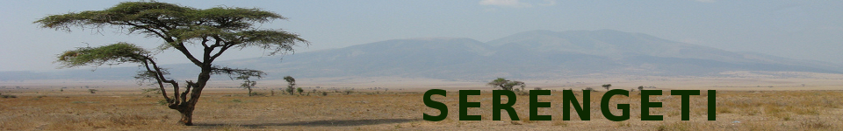
Loren (Durnew) Abrams
James (Paris) Coleman
Lita (Aerialist) Gratrix
Edgardo (Malevolent Man) Ineguez
Mark (Chick Magnet) Miscavage
Chris (Anquan) Mueller
Don (Scythe) Murphy
Loyola Marymount University
December 2009

Slide 2
Problem
Current location-aware social networking applications are centered on the individual.
We need a focus on teams --- and compe-tition.

Slide 3
Serengeti is...
An augmented reality, social networking application and game where teams compete for "ownership" of locations by recording their visits to local establishments.
  Visits and team status can be tracked on the web or on mobile apps.
  Can be used for discounts, friendly competitions, fund raising for charity, or just to find out where your friends and enemies might be.
  A basis for next-generation community-driven local portals, with revenue ($$$) potential.

Slide 4
Playing Serengeti
Sign up, log in, log out
Manage your profile
Create and manage teams
Create and manage locations
Invite people to be friends or teammates
Check in from a location
See the status of players, teams

Slide 5
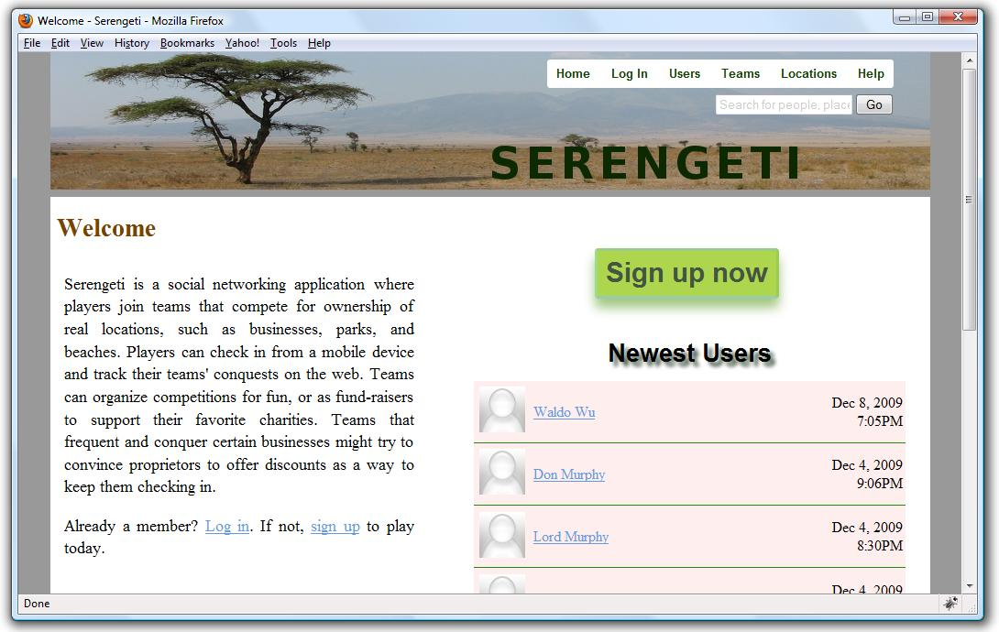
Hello Serengeti

Slide 6
Player Profiles

Slide 7
Team Profiles

Slide 8
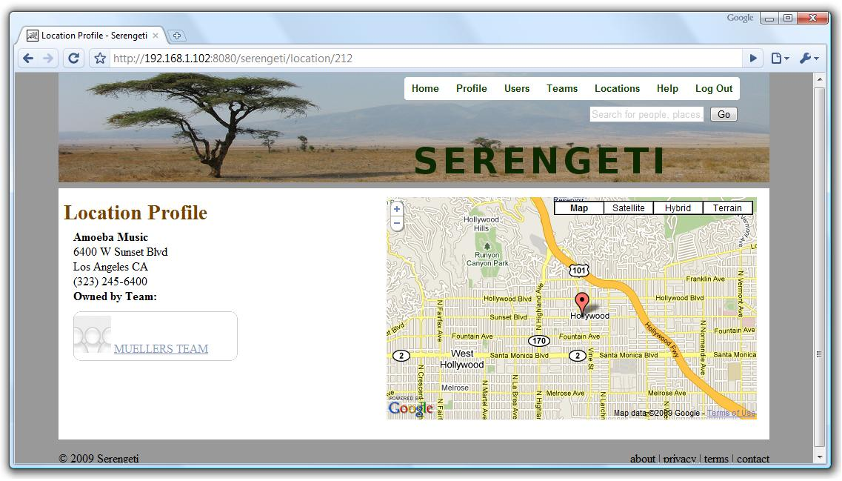
Location Profiles

Slide 9
Checking In

Slide 10
Project Environment
Serengeti was developed in the CMSI 401 capstone course, which provides students
  Classroom training in software engineering (methodologies, requirements, analysis, construction, testing, deployment)
  Visits from industry reps (Citysearch, KP)
  Introductions to, and practice with, many new technologies
  A fairly intensive group development experience --- an important resume item

Slide 11
Technologies Used
Java, JavaEE, Spring, iBATIS, Log4j, JSP, JSTL, Tiles, UrlRewrite
JavaScript, JQuery
CSS, HTML, XML, JSON
Google APIs for mapping and geocoding
Maven
Tomcat
PostgreSQL
ObjectiveC, Cocoa (for the iPhone)

Slide 12
CMSI 401 vs. Real World
CMSI 401 tries to simulate a real-world industry experience; however, we
  Have a fixed team (no hirings and firings)
  Don't have a dedicated QA team
  Aren't together 40 hours per week
  Don't have to worry about subcontractors
  Aren't senior engineers or architects
  Aren't delivering a bunch of projects at the same time (except, well, we have other classes...)

Slide 13
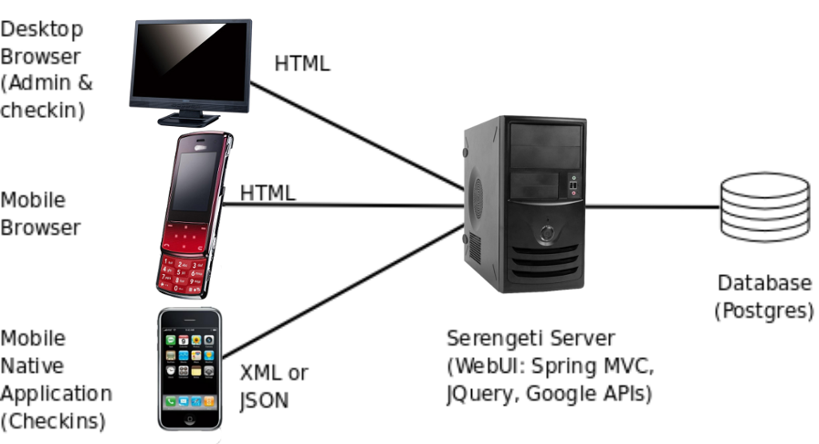
Serengeti Architecture

Slide 14
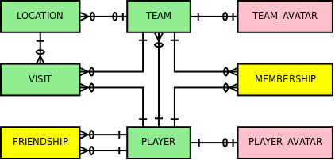
Database Schema
We have only four main concepts, two linkage concepts, and store some image content

Slide 15
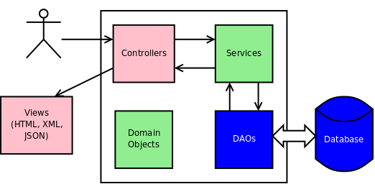
Server
Server is a typical layered Java webapp

Slide 16
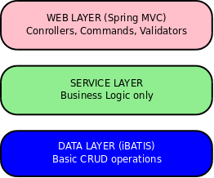
Webapp Layers

Slide 17
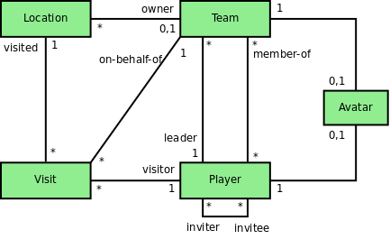
Domain Objects
Represents the data within the Java code (objects), not the database world (relations)

Slide 18
Rendering
Output (views) for web browsers constructed with
  JSP
  JSTL (for programmatic rendering)
  The Apache Tiles framework, for consistent layout with common headers, footers, and other common content
Output also provided in
  JSON
  XML

Slide 19
Styles
Separation of content, presentation, and interaction – no inline styles
Accessibility and usability guidelines
Used some CSS3, though
One stylesheet for desktop web
One stylesheet for mobile web
One third party stylesheet – 960 (for gridding)

Slide 20
Scripts
Separation of content, presentation, and interaction – no inline scripts
Accessibility and usability guidelines
Wrote plenty of our own JavaScript (quite a bit of Ajax and DHTML)
Used some third party scripts
  JQuery
  JSON (for parsing)
  Google APIs for maps and geocoding

Slide 21
Mapping

Slide 22
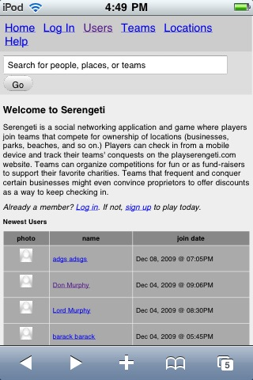
Mobile Website
Version for small-screen, but fully-featured browsers on mobile devices
Done exclusively with alternate style sheets!
  Images suppressed
  Text sizes / margins varied

Slide 23
iPhone App
Native app (runs dir-ectly on iPhone OS)
Objective C / Cocoa
Calls server via HTTP gets and posts
Decodes JSON responses from server to render

Slide 24
Demos
We'll see desktop web, mobile web, and iPhone
  “Launching” the app
  Browsing the site without logging in (home, help, search, map, location profiles)
  Registering for a new account
  Logging in
  Browsing some more
  Checking in
  Viewing the resulting map and profiles

Slide 25
We're on the Web
Hosted at Google Code
  http://playserengeti.googlecode.com/
  Open-source: SVN source code repository
  Wiki holds the requirements, architecture and design docs, sketches, etc.
Discussions (R-Rated for language) at Google Groups
  http://groups.google.com/group/playserengeti
And of course http://playserengeti.com

Slide 26
Summary
Fun project
Useful domains covered (mobile, social, web)
Valuable practice and experience in software design, architecture, and development – important for resumes
Group size (7) not atypical (e.g., Citysearch scrums have size 6-8)
Maven, SVN, Java, Web UI were not new, but many other things were

Slide 27
Questions?

