Slide 1
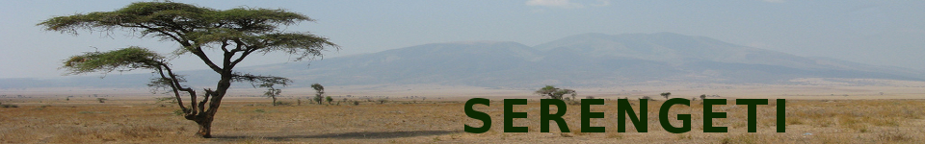
Loren (Durnew) Abrams
James (Paris) Coleman
Lita (Aerialist) Gratrix
Edgardo (Malevolent Man) Ineguez
Mark (Chick Magnet) Miscavage
Chris (Anquan) Mueller
Don (Scythe) Murphy
Loyola Marymount University
December 2009

Slide 2
Problem
Current location-aware social networking applications are centered on the individual.
How about being able to control a city in a group?

Slide 3
Serengeti is...
A augmented reality, social networking application and game where teams compete for "ownership" of locations by recording their visits to the local establishments.
  Visits and team status can be tracked on the web or on mobile apps.
  Can be used for advertising ($$$), discounts, friendly competitions, fund raising for charity, or even to find out where your friends might be.

Slide 4
Goals and Objectives
The CMSI 401 capstone course provides students
  A class setting to discuss software engineering (methodologies, requirements, analysis, construction, testing, deployment)
  Visits from industry reps (Citysearch, KP)
  Practice with many new technologies
  A fairly intensive group development experience --- an important resume item

Slide 5
Technologies Used
Java, JavaEE, Spring, iBATIS, Log4j, JSP, JSTL, Tiles, UrlRewrite
JavaScript, JQuery
CSS, HTML, XML, JSON
Google APIs for mapping and geocoding
Maven
Tomcat
PostgreSQL
ObjectiveC, Cocoa (for the iPhone)

Slide 6
CMSI 401 vs. Real World
CMSI 401 tries to simulate a real-world industry experience; however, we
  Have a fixed team (no hirings and firings)
  No dedicated QA
  Aren't together 40 hours per week
  Don't have to worry about subcontractors
  Do informal risk management
  Aren't delivering a bunch of projects at the same time

Slide 7
More CMSI vs. Real World
We also
  TODO

Slide 8
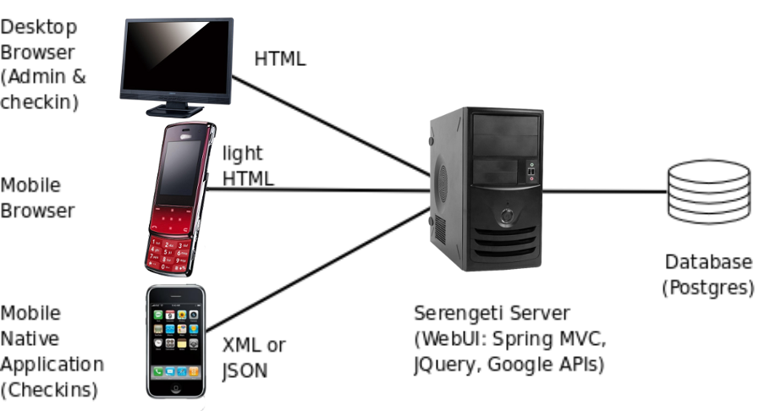
Architecture

Slide 9
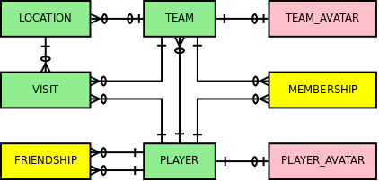
Database Schema

Slide 10
Web Application
Configuration
  web.xml
  spring-servlet.xml (MVC)
  application-context.xml (data source, txs)
  IBATIS sql maps, Tiles defs, UrlRewrite rules
Domain Objects – just POJOs (thx Spring)!
Controllers, commands, validators
Services and Daos
UI – JSP, JSTL, Tiles, CSS, Scripts

Slide 11
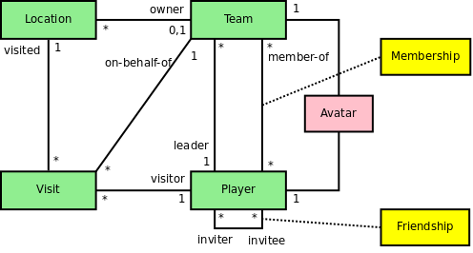
Domain Objects
Package com.playserengeti.domain

Slide 12
Services
Business logic (not web-specific, not database-specific)
Package com.playserengeti.service
  LocationService
  TeamService
  UserService
  VisitService

Slide 13
Daos
Data access objects
Package com.playserengeti.dao
  XxxDao , XxxDaoMockImpl, XxxDaoIbatisImpl for Xxx in
    Location
    User
    Team
    Visit
    Friendship
    Membership

Slide 14
Tiles
In src/main/webapp/WEB-INF
  serengeti-tiles.xml
In src/main/webapp/WEB-INF/tiles
  *.jsp
  *.jspx
In src/main/webapp/WEB-INF/tiles/layout
  main.jsp, header.jsp, footer.jsp

Slide 15
Styles
Separation of content, presentation, and interaction – no inline styles
Accessibility and usability guidelines
Used some CSS3, though
In src/main/webapp/WEB-INF/styles
  serengeti.css
  text.css
  reset.css
  960.css – third party stylesheet for gridding

Slide 16
Scripts
Separation of content, presentation, and interaction – no inline scripts
Accessibility and usability guidelines
In src/main/webapp/WEB-INF/scripts
  serengeti.js
  jquery-1.3.2.min.js – JQuery
  json2.js – For JSON.parse
Remote calls made to Google APIs

Slide 17
Maps Example
TODO SCREENSHOT

Slide 18
Mobile
Version for small-screen, but fully-featured browsers on mobile devices
playserengeti.com/m/...
Requests “light” HTML from server
  Most pages are nothing more than forms and labels (minimal graphics)

Slide 19
iPhone App (1 of 2)
TODO

Slide 20
Iphone App (2 of 2)

Slide 21
Demos
“Launching” the webapp
Browsing the site without logging in (home, help, search, map, location profiles)
Registering for a new account
Logging in
Browsing some more
Checking in
Viewing the resulting map and profiles
Comparing the web and mobile sites

Slide 22
We're on the Web
Hosted at Google Code
  http://playserengeti.googlecode.com/
  Contains wiki and source code (SVN)
  Requirements, architecture and design docs, sketches on wiki
Discussions (R-Rated at times) at Google Groups
  http://groups.google.com/group/playserengeti
And of course http://playserengeti.com

Slide 23
Summary
Fun project
Useful domains covered (mobile, social, web)
Valuable practice and experience in software design, architecture, and development – nice for resumes
Group size (7) not atypical (e.g., Citysearch scrums have size 6-8)
Maven, SVN, Java, Web UI was not new, but tons of other things were

Slide 24
Questions?

