Slide 1
Minimization of Timing Failures in Pipelined Designs via Path Shaping and Operand Truncation
Ioannis Tsiokanos,
Lev Mukhanov, Dimitrios S. Nikolopoulos, Georgios Karakonstantis
ECIT Institute, Queen’s University Belfast
© The content of this presentation is confidential.

Slide 2
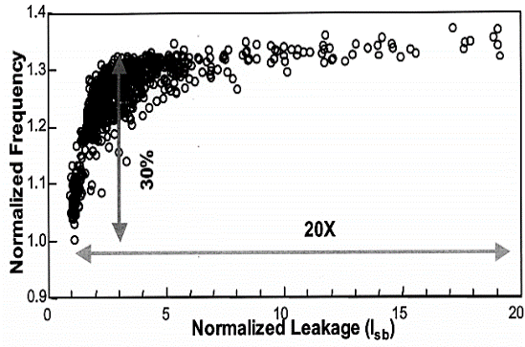
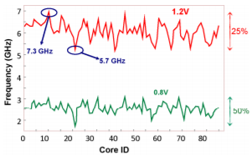


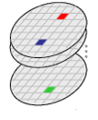
Challenge: Process Variations in Nanoscale Era
Transistor shrinking has made circuits more prone to static and dynamic variations
Up-to 50% delay variations
Such delay variations threaten correct functionality and ultimately yield
#of chips
F_{req1}
F_{req2}
F_{reqk}
< <
Frequency
Notes:
The impact of such variations is on making circuits prone to timing failures and difficult
to meet the power and performance specifications.

Slide 3
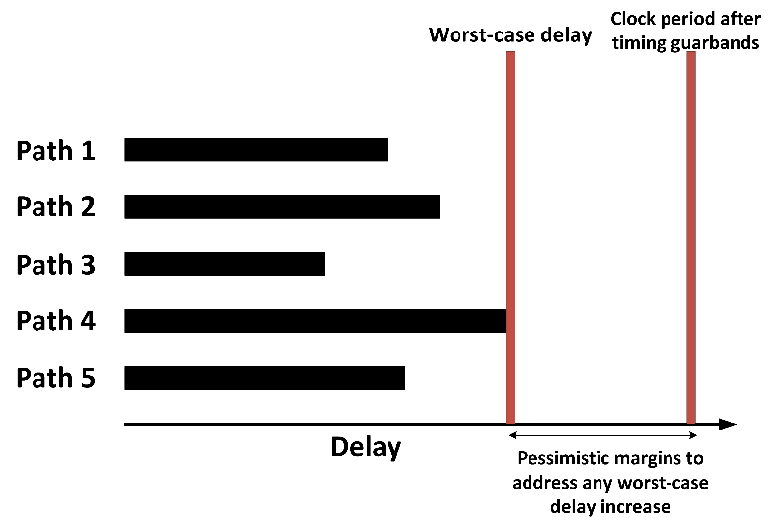
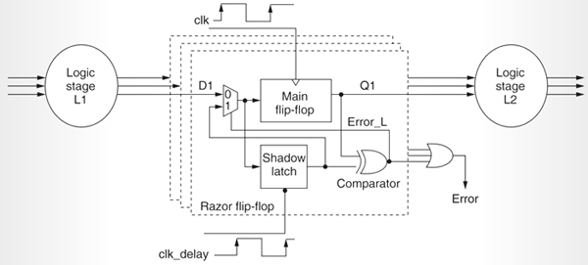

Variation-Aware Designs
Designers address variations/failures by:
Using pessimistic timing guardbands
Based on STA or SSTA
Adopting dynamic error detection/correction circuits
Exploiting different precisions, allowing trade off between quality and energy/reliability
Prevent circuits to run as fast as they could
Complex designs and large overheads in case of many failures
Application to few custom designs.
Agnostic of the underlying circuits
Can we avoid any guardband and large overheads in pipelined designs at low cost?
Notes:
Adopting timing margins that provide sufficient timing margins to mitigate timing failures. However,
Another variation- aware technique focus on integrating extra circuits to dynamically detect and correct errors. Although effective, such techniques…
Recently schemes that reduce the precision of the operands, allowing trade offs between quality and energy have also been proposed for minimizing the traditional overheads. applied mainly to few custom designs and simple units and neglects the dynamic timing dependence. Furthermore they are agnostic of
So, the question that arises is:

Slide 4
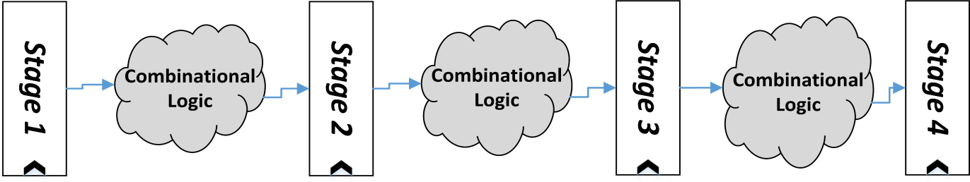
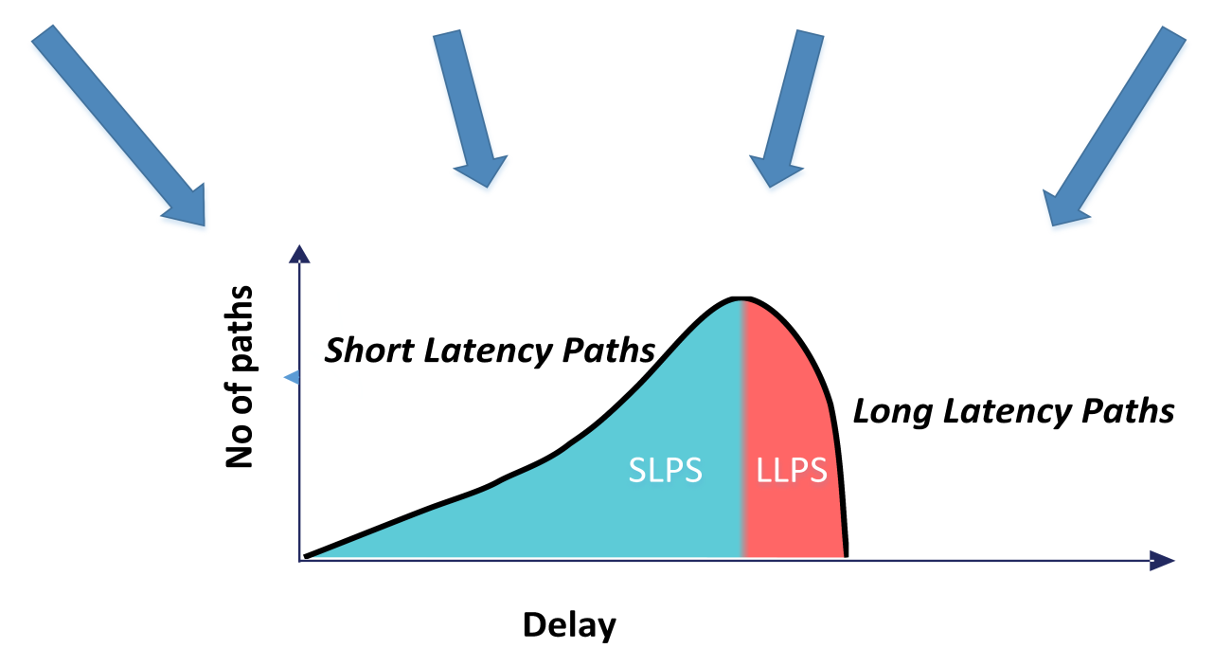
Conventional Paradigm - Motivation
Focus on pipelined designs
Each instruction activate different paths in each stage based on the operands
Performance-centric ASIC flow
Primary objective: improvement of performance
The inherently fast paths are allowed to become slow
Many long paths from every stage are close to the target clock frequency
Timing wall
Increased probability of failures across all the stages
Source of large overheads in design-centric techniques
Use of any error correction scheme in many places
Timing Wall
Clock period
There is a need to move away from such a path distribution
Notes:
In order to answer this question we need to have a more thorough look in pipelined designs.

Slide 5
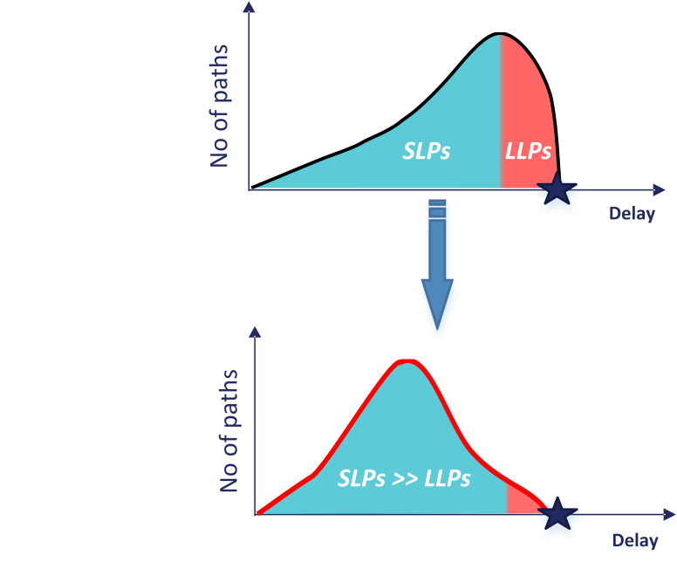
Proposed Approach
Target
Minimization of timing failures at minor overheads
Avoid the use of any pessimistic guardband
Exploit the data dependent path excitation
Main ideas
Path Shaping
Redesign the target circuit, obtaining a path distribution with less LLPs
Operand Truncation
Truncating the bit-width only of the instructions and operands that activate the LLPs
(i.e. by setting a number of LSBs to zero) for obtaining a timing slack
Clock period
Clock period
Operand : 01010101010011101010101010111011
Operand after 10 LSBs truncation : 01010101010011101010100000000000
Notes:
After the path shaping, in order to further reduce the excitation probability of the LLPs, we truncating the bit-width only of the instructions and operands
that activate these paths. This can be achieved by setting to 0 a number of the LSBs of specific operands, as we can see in this example. This will allow us to
obtain timing slack for addresing delay variations, as I will explain later.

Slide 6
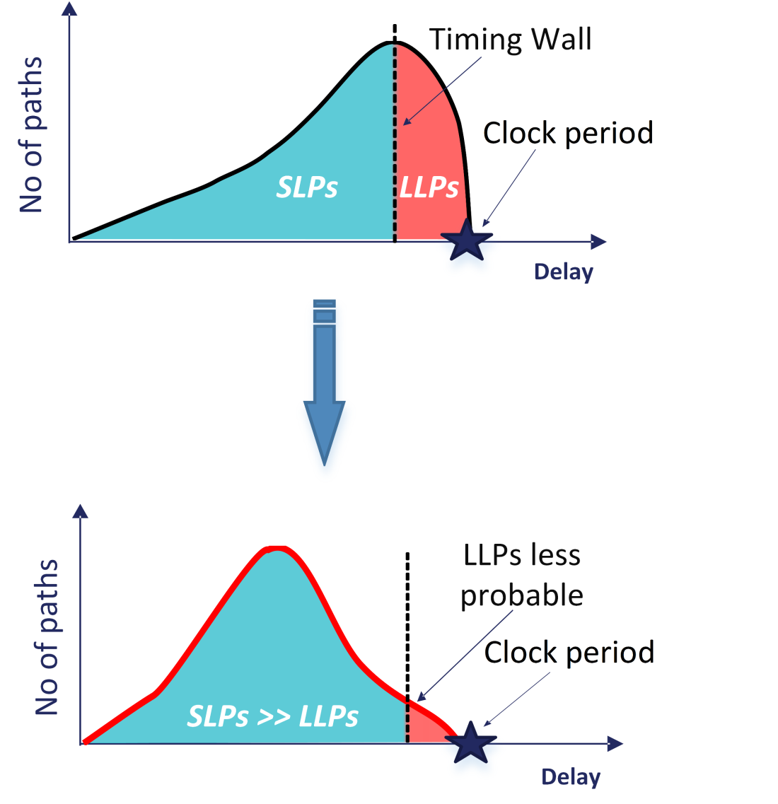
Proposed Approach: Methods (I) – Path Shaping
Eliminate the timing wall
Enforce a path distribution with gradual slope, where |SLPs| >> |LLPs|
Render the LLPs less probable
Restrict the LLPs to as few stages as possible, accessed by specific instructions
Further control the operands that activate the LLPs

Slide 7
Proposed Approach: Method (II) – Operand Truncation
Setting to 0 only the LSBs of the operands of the specific instruction(s) that activate the LLPs
Reduce computational delay Further reduce the LLPs excitation probability
Addition of two 8 bits operands
A: 00000001 and B: 01111111
00000001
+ 01111111
10000000
Addition of two operands after 4 LSBs truncation
A: 00000000 and B: 01110000
00000000
+ 01110000
01110000
No truncation
4 LSBs truncation
Carry propagation,
Activation of LLPs
No carry propagation,
Activation of SLPs
Any quality loss can be controlled by selecting the right number of truncated bits

Slide 8
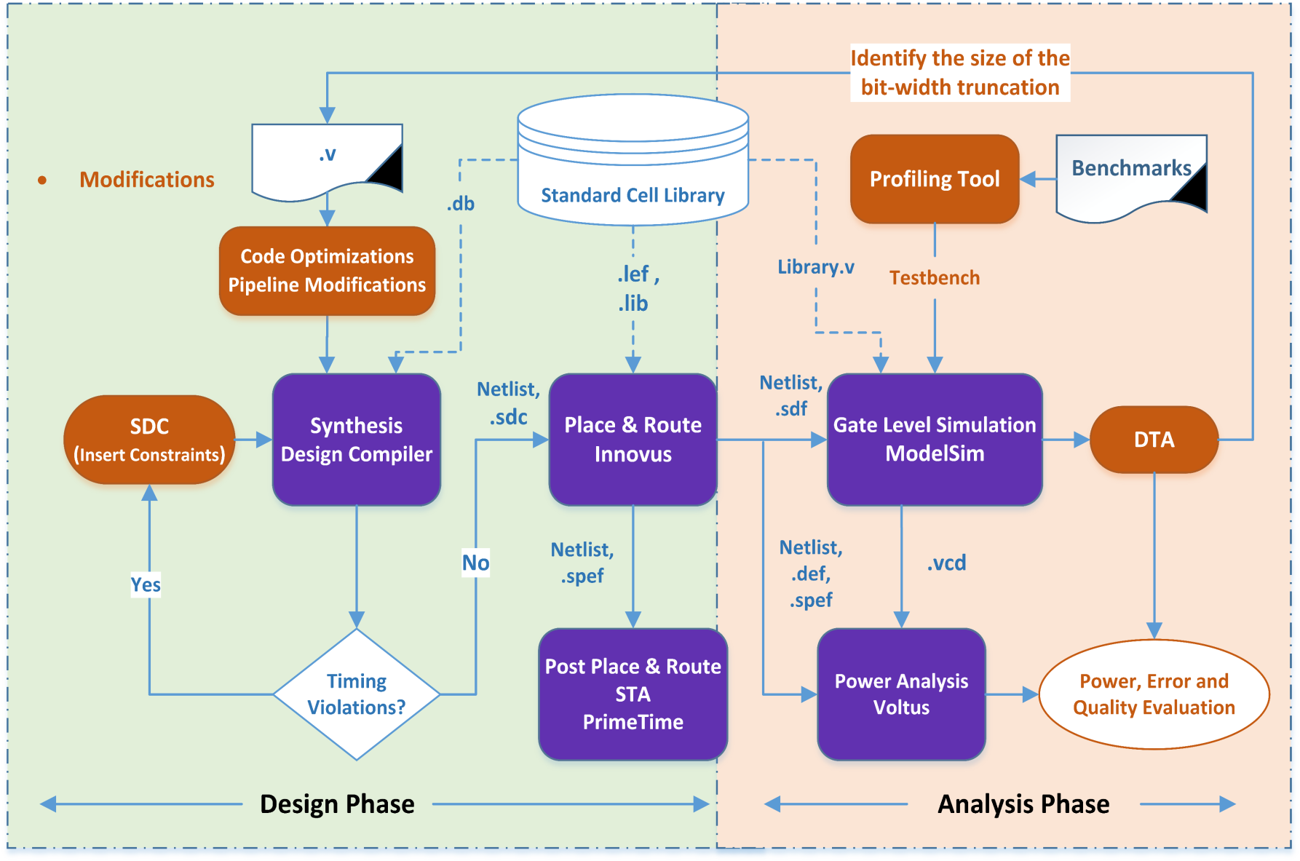
Proposed Design and Analysis Flow
Microarchitectural and Code optimizations
Changes in the combinational logic of pipeline stages
Re-implement parts of the Verilog code
A profiling tool for extracting instruction traces and operands as are being executed on real processors
Target of these 2 modifications is to mitigate the “timing wall”, proposing a preferred path distribution
Aims to uncover the unused timing margins
Simulate the design under potential timing variations (scale down the clock period)
We compare the output data with a ‘golden’ model to calculate timing failures
Quality, error and dynamic power measurements
Introduction of path-group constraints
Make long paths smaller in number
Not allow the tool to make the naturally fast paths slower
Notes:
enable characterization of the data-dependent path excitation

Slide 9
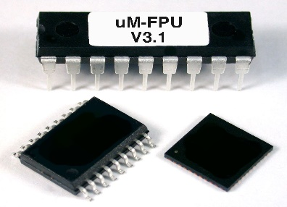
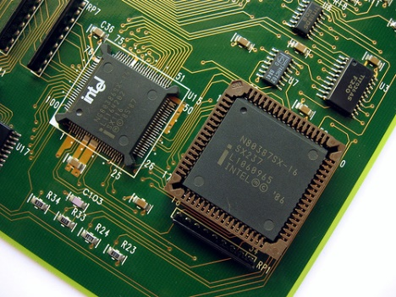
Case study: Application to an FPU
Application to the Out-of-Order mor1kx marocchino pipeline FPU based on OpenRISC Instruction Set Architecture
Excellent representatives of complex pipelined designs
Impact on overall performance, area and power dissipation
Floating point operations are dominant in various cutting-edge applications
A limited number of works provides a variation-aware FPU
Instruction distribution of a Face Detection app

Slide 10
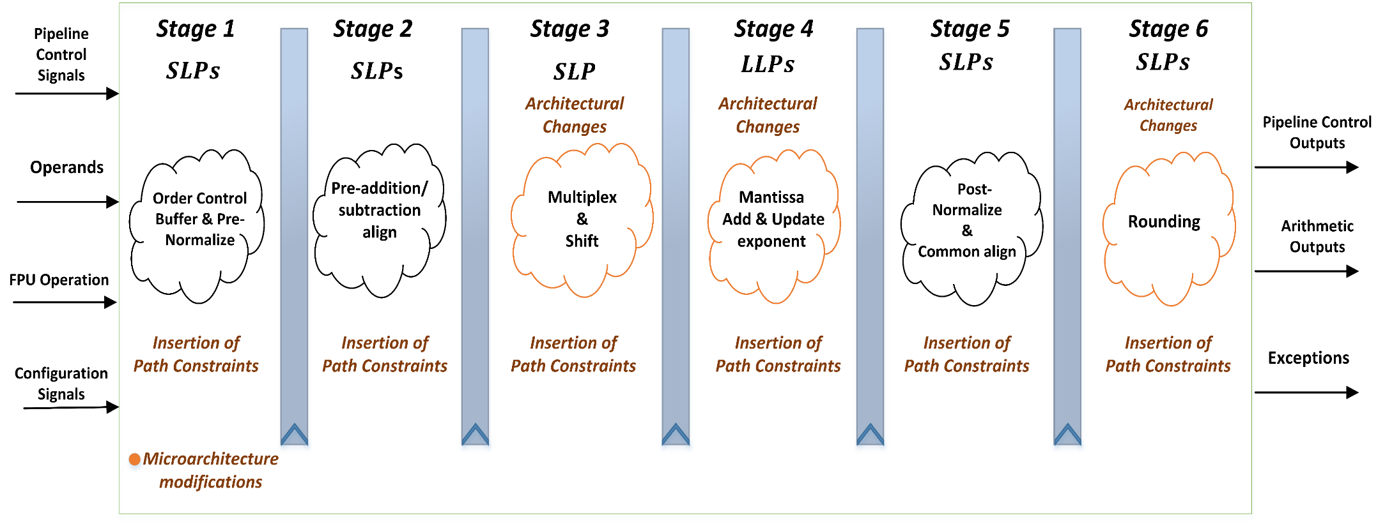
Re-implemented FPU
We apply the steps of our design flow making the following main modifications in the original FPU:
Micro-architectural changes
We moved combinational logic from Stage 4 into Stage3
We optimized part of the RTL code in Stage 6
Group path constraints
Grouping paths based on how fast they could run
Isolate the LLPs only to Stage 4 of the FP addition/subtraction instructions
Notes:
In order to apply our design flow in the targeted FPU, we redesigned this unit and Here we can observe the micro-architecture of the redesigned FPU, highlighting the FP addition/subtraction related stages. Our modifications are highlighted in orange
Apart from the micro-architectural changes, as I mentioned we imposed timing constraints, grouping paths based on how fast they could run.
These constraints and micro-architecture changes have as results the isolation of the LLPs only to Stage 4 of the FP add/sub instructions.

Slide 11
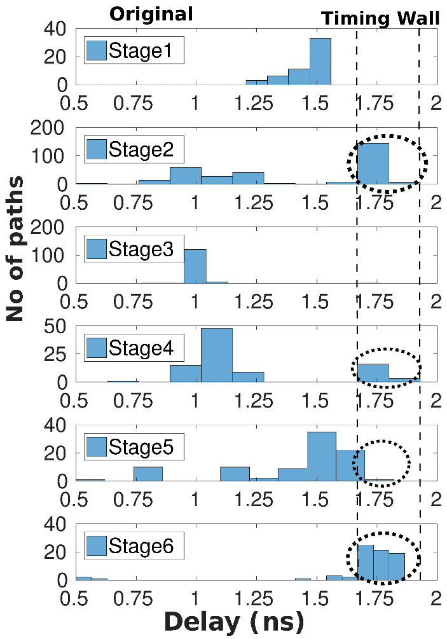
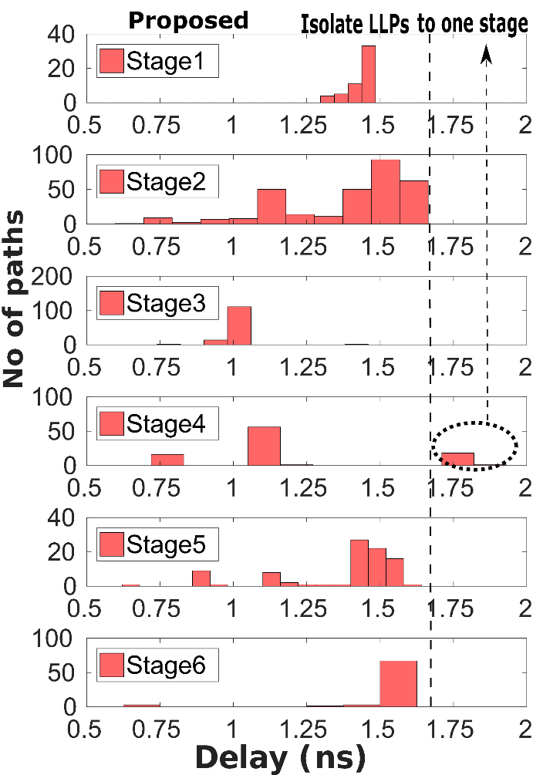
Path Distribution of the Re-designed FPU
Original design
Timing wall
LLPs exist in 4 out 6 stages
Increased possibility of massive timing failures under even small delay variations
Proposed design
The number and the excitation probability of the LLPs have been reduced
LLPs are restricted only to Stage 4
All the other paths are fast enough to address delay variations
Original path distribution among the stages
Proposed path distribution among the stages
Notes:
Now I will compare the path distrubution of the redesigned FPU with the one from the original unmodified FPU.
For the original design, the obtained distribution implies that the performance-centric flow incurs a large number of LLPs close to the clock period.
Such a path distribution creates the timing wall. This figure reveals that the timing wall exists in 4 out of the 6 stages.

Slide 12
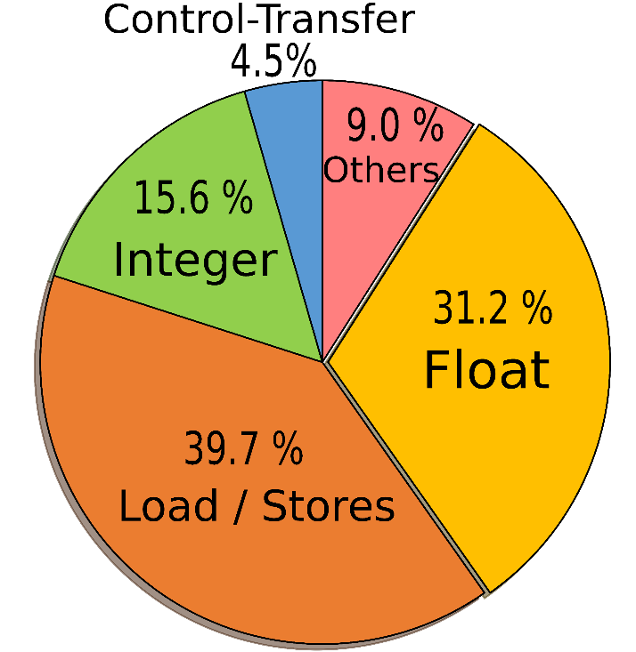
Evaluation Results (I)
Application profiling
Use of a developed profiling tool to extract floating-point operands from application running on an ARM A7 based system
Profiled applications:
Kmeans, CFD from Rodinia Suite,
Raytrace from Parsec Suite
31.2% FP instructions
Simulation under potential worst-case delay increase
Different clock period reductions levels (from 0% up-to 16%)
Operand bit-width truncation
32, 44 and 48 LSBs truncation are applied to FP add/sub operands
Average instruction distribution
Notes:
Finally, in our experiments, we selected to evaluate the truncation of the 32, 44 and 48 LSBs of the mantissa part of the FP addition/subtraction operands
Note that LLPs are isolated in that way that only FP add/sun instructions can activate them.

Slide 13
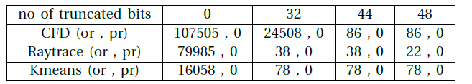
Evaluation Results - Timing failures
DTA tool
Timing failures estimation
Comparison of the simulation output with an error-free golden model
Simulation under different clock reduction and truncation levels
Results:
Original
Massive failures even under small variations
Proposed
Under 8% delay increase and 32, 44 and 48 LSBs truncation failures are reduced by 6.24x, 146.48x and 263.28x, respectively
Timing failures under various clock reduction and operand truncation levels across 3 benchmarks (caption shows the number of the truncated bits)
TABLE III: Timing failures under 3% clock period reduction and various truncation level
Notes:
As shown in Figure 5, under the nominal clock period no failures are manifested. In the same figure we can see that under small delay variation
For example 3% in the original design are manifested up-to 100000 failures.
We can also observe that the proposed design with path shaping and operand bit-width
truncation significantly minimizes there errors up to 8%. Specifiacally, under 8% delay variation and truncating
the 32, 44 and 48 LSBs timing failures are reduced by

Slide 14
Evaluation Results - Quality Evaluation
SNR under various clock reduction and operand bit-width truncation levels across 3 benchmarks (caption shows the number of the truncated bits)
Truncation may incur quality loss, but this can be controlled by carefully selecting the number of truncated bits.
Truncation of 32, 44 and 48 LSBs of FP operands to the original FPU as well to the pr(oposed) one.
Up-to 8% worst-case delay increase the proposed design presents in any case considerably less or equal quality loss that may be incurred by random timing failures.
Notes:
For fair comparison

Slide 15
Area and Power Estimation
Area overhead: 0.25%
Power consumption:
Path shaping
5.7% power overhead
Path shaping & operand truncation
Power gains (reduced switching activity)
From 19.1% up-to 44.7% power savings
32 LSBs truncation provides a balanced option
Notes:
For the considered benchmarks the 32 LSBs truncation provides a balanced option between accuracy loss and power gains

Slide 16
Conclusion
Framework for minimizing timing failures in pipelined cores by:
Redesigning the target circuit in a way that limits the long latency paths
Exploiting the dynamic excitation of the LLPs by few operands
Truncating the bit-width only of the operands that activate the error-prone LLPs (reducing the LLPs excitation probability)
Up-to 44.7% power gains at a 0.25% area overhead and minimal quality loss
IEEE IOLTS - 2 – 4 July 2018
Notes:
To sum up, we proposed a framework for minimizing the timing failures in pipelined designs by redesigning the target circuit
in a way that eliminates the excitation of the LLP. After this, we exploit the dynamic activation of such paths by
few operands by settting to “0 a fixed number of LSBs of the operands that trigger these paths.
Results shows that the proposed design can result in up-to …. At a

Slide 17



Questions? The presented work is partially supported by the European Community Horizon 2020 programme under grant no. 688540 (UniServer) and grant no. 732631 (OPRECOMP).
http://www.uniserver2020.eu/
http://oprecomp.eu/

Slide 18
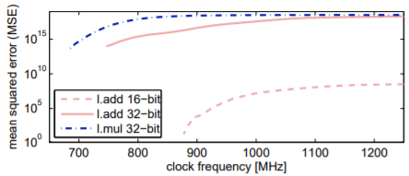
Timing Failures
Apart from PVT variations, timing failures depend on:
Type of instruction
Different instructions activate different paths
Instructions that activate long paths tend to fail more frequently
Input operands
Different input operands (even from the same instruction) activate different paths and affect the failure distribution.
Addition of two 4 bits operands
A: 0001 and B: 0111
0001
+ 0111
1000
Addition of two 4 bits operands
A: 0000 and B: 0100
0000
+ 0100
0100
Carry propagation,
Activation of the critical paths.
High probability of errors
No Carry propagation,
Activation of the non-critical paths.
Low probability of errors

Slide 19
Instruction Sequence & Timing Failures
Sequence of instructions have a significant impact on timing error rate
Instruction | Operand A (hex) | Operand B (hex)
1) FP mul | 41d2309ce5400000 | 3e80000000000000
2) FP mul | 42aecf56fd821a00 | 3e80000001000000
3) FP mul | 47509ce540000000 | 41becf5600000000
4) FP sub | 429ffe93049dac00 | 3e80000040000000
5) FP add | 41509ce540000000 | 41401ac000000000
6) FP mul | 41509ce541021578 | 7acbd5780001a987
Instruction | Operand A (hex) | Operand B (hex)
1) FP mul | 41d2309ce5400000 | 3e80000000000000
2) FP mul | 42aecf56fd821a00 | 3e80000001000000
3) FP sub | 429ffe93049dac00 | 3e80000040000000
4) FP add | 41509ce540000000 | 41401ac000000000
5) FP mul | 41509ce541021578 | 7acbd5780001a987
6) FP mul | 47509ce540000000 | 41becf5600000000
Re-ordering
Error rate = # faulty instr. / # total instr. = ~ 0.17
Error rate = 0

Slide 20
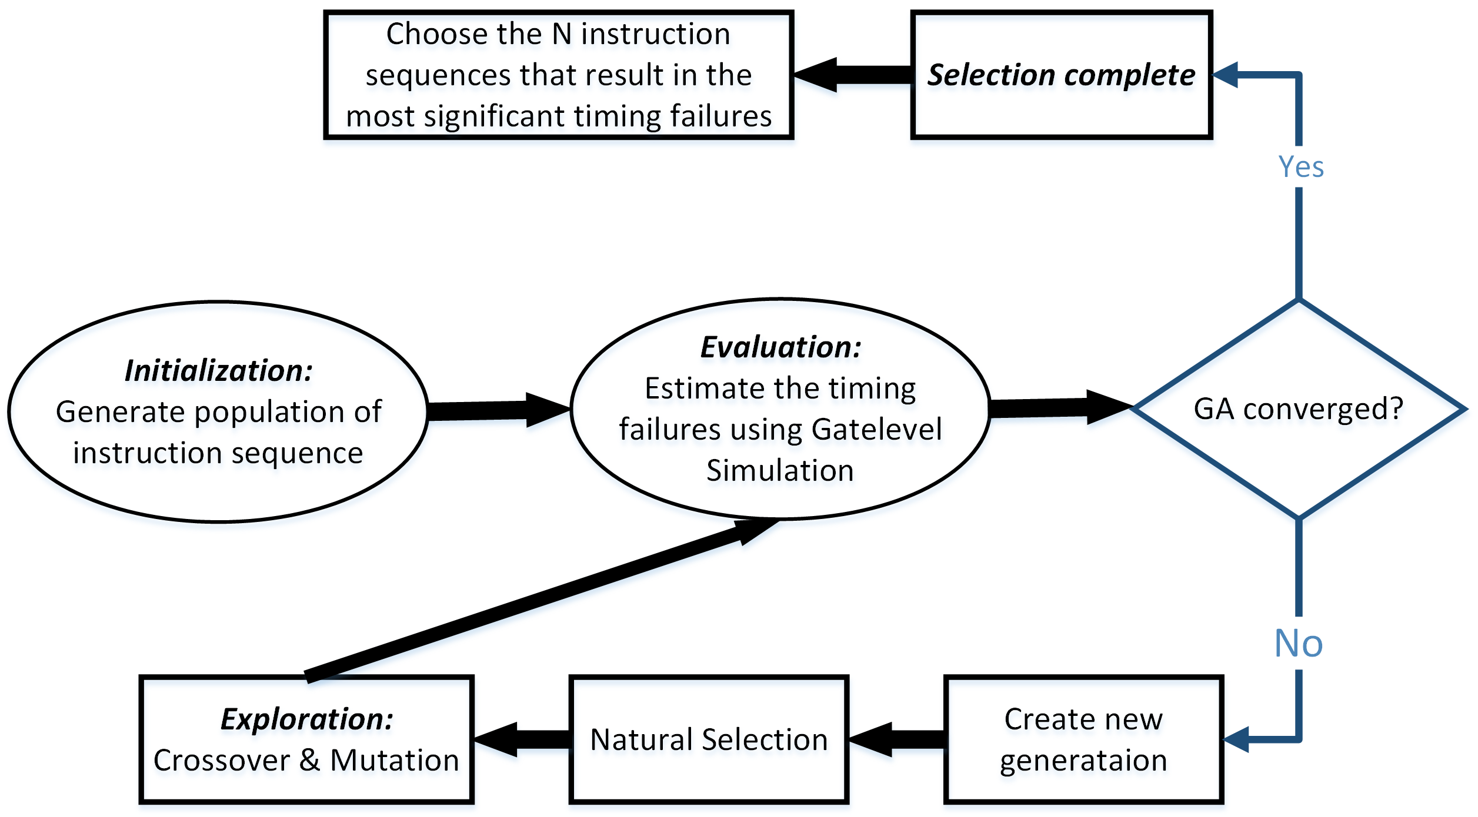
Genetic algorithm & Timing failures
Development of an error-prone code region identification framework using Genetic Algorithm (GA)

