Slide 1
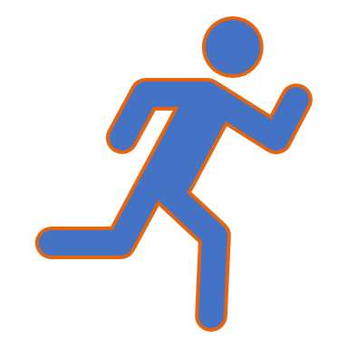
Health and Fitness monitoring system
CS 2043 Project 1

Slide 2
Why This system?
The possibility to predict diseases or to warn individuals of their progressions before it's a serious problem would help reduce strain on the health care system. To personalize a menu, measure amount of activity with better accuracy, and finally, monitor and advice on current health status would greatly impact the quality of life for those individuals with elevated care requirements.

Slide 3

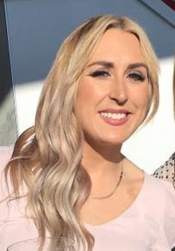

Our TEAM
Mohamed Mesbahi El Aouame
Third year student at UNBSJ.
C++ Programmer and AI enthusiast. Interested in embedded systems development in the domain of IoT, as well as neural networking and deep learning techniques.
Michael Guo
UNB BscCs student
Lindsay Mullett
UNBSJ BscCs student
Educated in data management and object orientated programming. Motivated to improve implementation and efficiency of systems relating to precision medicine.

Slide 4
Overview of the System
Client
System
Client – Upon purchasing a wearable device (eg.smart watch) user will upload personal data to be monitored and measured for self-improvement, health monitoring and medical analysis. User will be identified through a unique identification number and password to create account and assess own data. The wearable device will measure vitals and record physical data. There will be different options for users to subscribe to. High risk individuals such as diabetics or those with genetic disorders will be able to have their data closely monitored by their health care provider and have automatic alerts if vitals reports are concerning. In the event of a medical emergency, a health care professional will be able to access data off of the users device such as vitals, medical history, medications, allergies and blood type. Those wishing to have guidance for self improvement will subscribe to coaches for fitness and nutrition. Through that they will submit reports to have analyzed then receive feedback and modifications from their coaches.
System – Website and app connected to user's wearable device. Device will measure physical data and store it with the client’s profile accessible through a website. User friendly interface for client to upload and monitor data. Interface for healthcare professionals to connect to in the event of urgent medical care. Available connection for fitness and nutrition coaches to check progress and submit changes to recommendations. System will notify health care professionals of changes that may be concerning. Alerts will be issued to user if blood sugars or heart rates are at dangerous levels. It is required to keep medical information and personal information separate. The system will include a specialized database that allows storage of dynamic information of clients.

Slide 5
Stakeholders System can be used by anyone, Specifically Targeted at:
Fitness motivated individuals
Diabetics
Individuals with genetic disorders
Personal Trainers
High risk individuals
Nutritionists
Health care professionals

Slide 6
Functional system requirements
 | Description | Priority
REQ-1 | The system should allow the user to create his own profile and modify it | 5
REQ-2 | The system should be able to store the personal health data uploaded by users from any machine(computer/mobile) into a database | 5
REQ-3 | The system should provide 4 types of accounts: one for health professionals, one for personal coaches and nutritionists, one for regular users and one for users at risk (people with diabetes, genetic conditions, chronic diseases...) | 3
REQ-4 | For the regular users account, the system should have these features: | 2
REQ-5 | Connecting actors to the user. Allowing the different types of professionals to modify plans and provide recommendations to users. Produce output of experts’ conclusions, recommendations on treatment, prevention, rehabilitation, volumes and intensity of a training process, nutrition, and diet limitations.
REQ-6 | System will allow for user’s vital information to be accessed by health care professional in the event of a medical emergency

Slide 7
Functional system requirements Continued
 | Description | Priority
REQ-7 | System will monitor vitals of user and send alert when there is a dramatic change in blood sugars or heart rate | 2
REQ-8 | Access personal data about the client health presented as formalized electronic medical records that enable displaying the current integral evaluation of the health state
REQ-9 | The system will include a specialized database that allows storage of dynamic information of clients.
REQ-10 | System will connect to other companies' technologies that monitor heart rate, blood pressure and blood sugar | 2
REQ-11 | Encapsulation to ensure only authorized individuals access sensitive information

Slide 8
Use Case Scenarios
Use Case | Description | Requirement satisfied
Client creating profile | Allows user to create his/her personal profile and modify its access/information | REQ-1
Health care professional | Allow health care professionals to monitor high risk patients, or patients with different disorders to make necessary changes to optimize health of patient. | REQ-5
Healthcare professional (In Emergency situation) | Access vitals of patient for emergency treatment | REQ-6
Fitness/ nutrition coach | Access client's reports then provide feedback | REQ-8
User | Connecting to database to review and submit changes

Slide 9
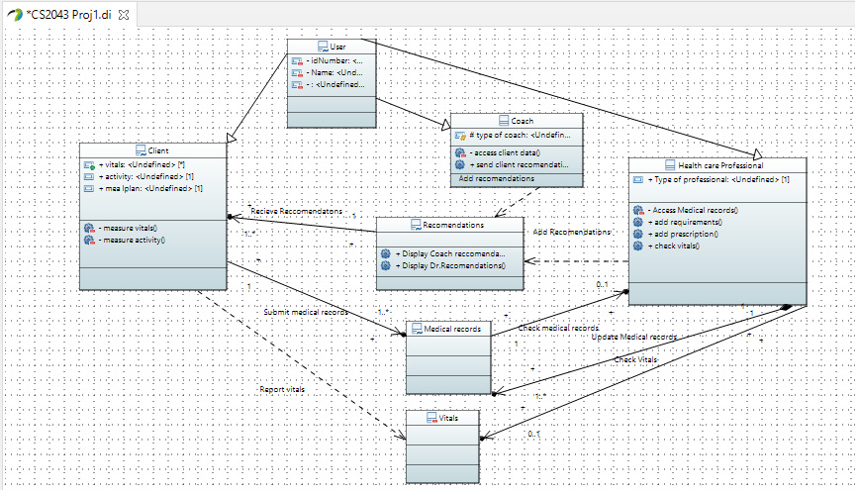
Class Diagram

Slide 10
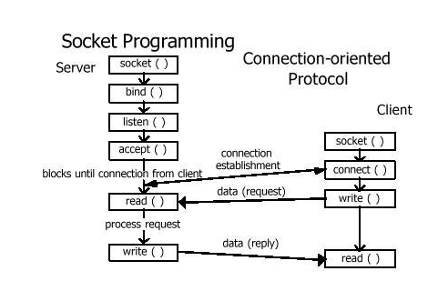
Communication between users
A socket represents a connection for communication between two users . Multiple individuals in client/server or distributed systems can simultaneously communicate with a single Web server. Multiple sockets are required to do this. The socket's flow of events starts with a connection-oriented client-to-server model, the socket on the server process waits for requests from a client. To do this, the server first establishes (binds) an address that clients can use to find the server. When the address is established, the server waits for clients to request a service. The client-to-server data exchange takes place when a client connects to the server through a socket. The server performs the client's request and sends the reply back to the client.
Image: https://world4java.wordpress.com/2014/02/28/socket-programming/

Slide 11
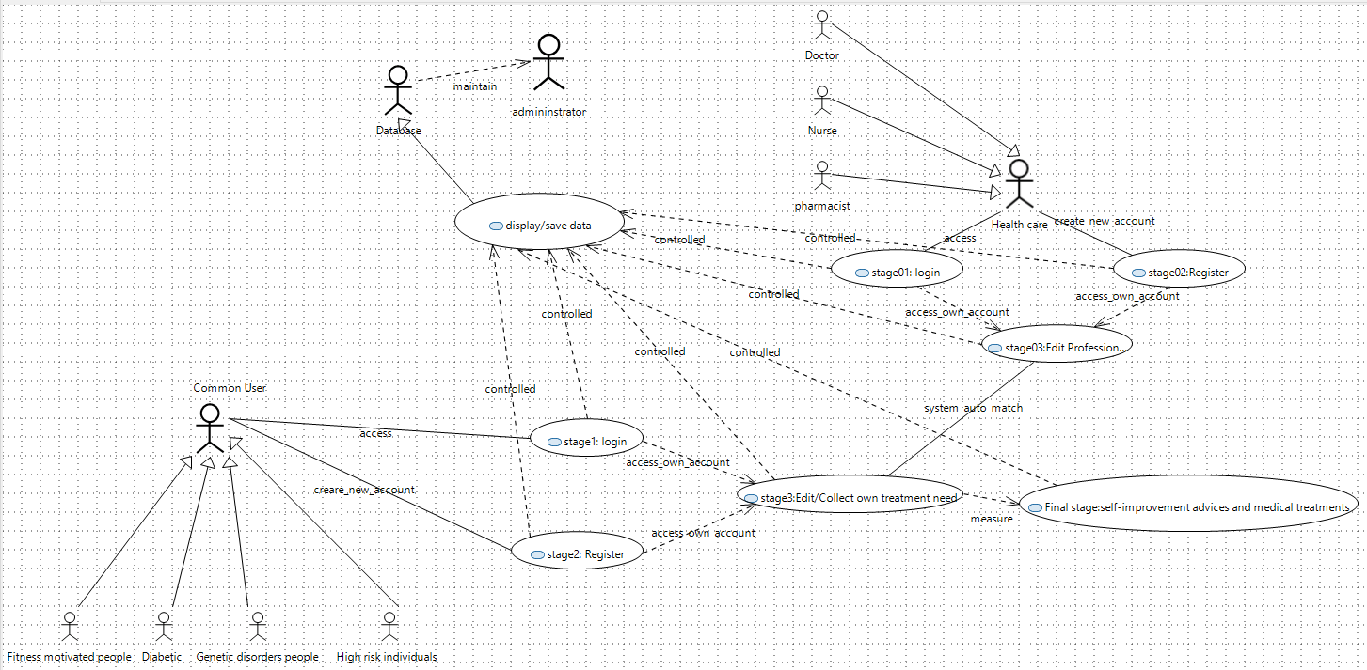
General Use Case Diagram

Slide 12
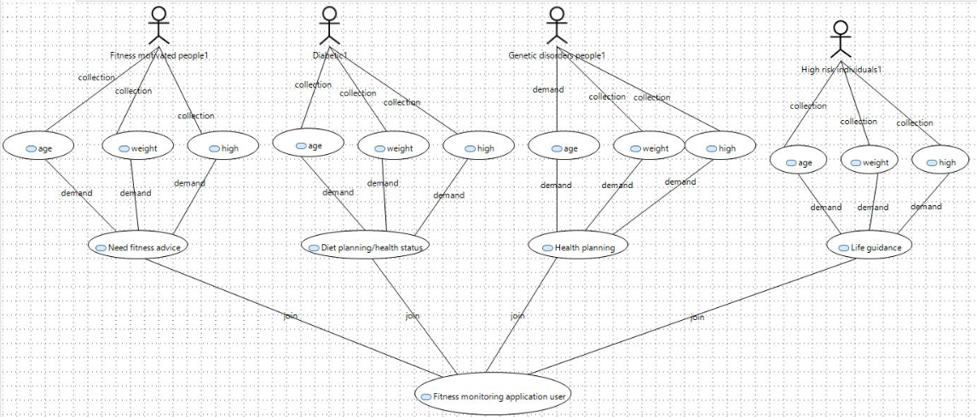
User Use Case Diagram

Slide 13
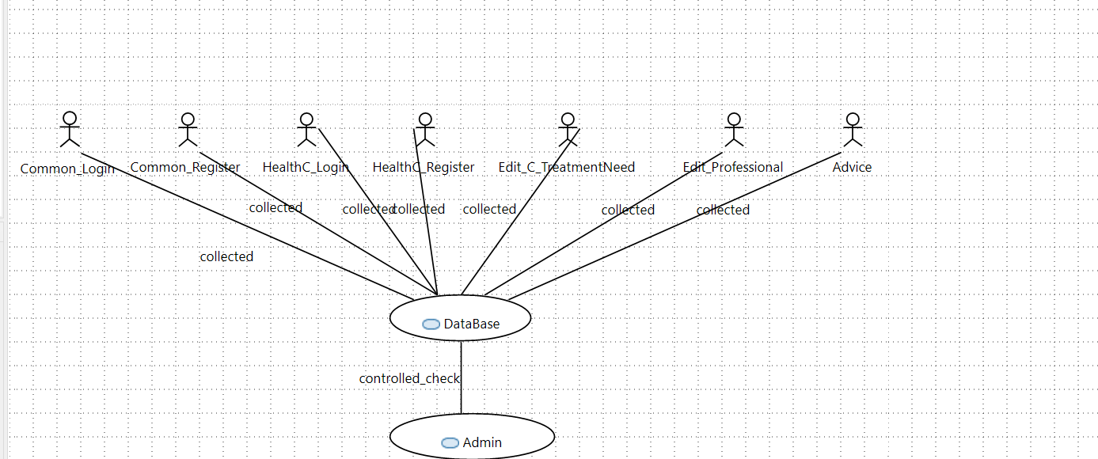
DATABASE USE CASE DIAGRAM

Slide 14
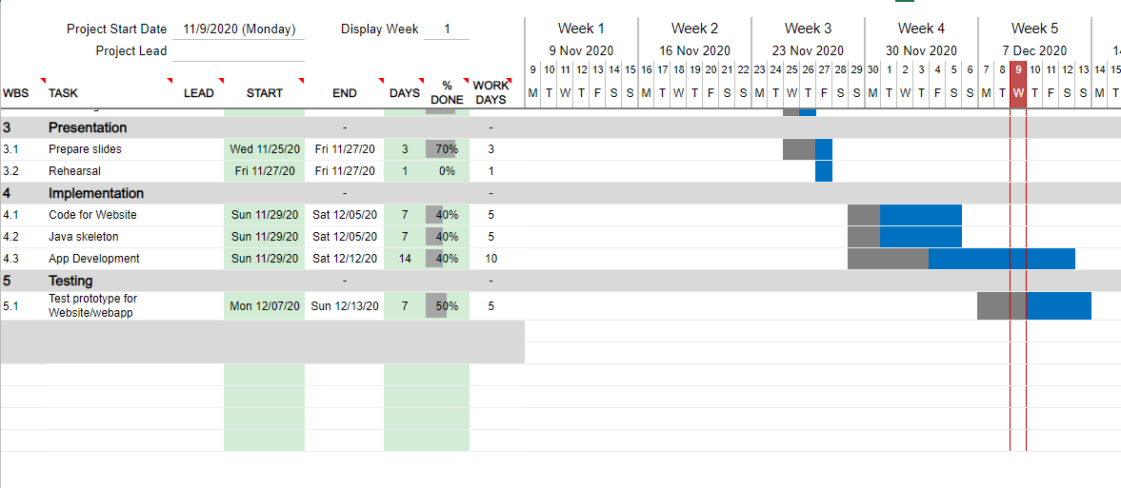
Gantt Chart to illustrate project schedule

Slide 15
Testing scenarios
Test connectivity and functionally of each use case
Check encapsulation by attempting to access medical information from coach perspective
Ensure client is able to access multiple recommendations and requirements at the same time
Input altered data from external monitors to verify the systems displays changes in real time
Monitor healthy client with a duplicate account to ensure there are no discrepancies between accounts

Slide 16

Risks
Bugs providing inaccurate results
Security breach affecting client privacy
Trainability of health care professionals required to operate the system
Relying on other technology (wearable device, Dexcom) to connect properly to our software

Slide 17
Evolution of Health and Fitness monitoring system
Enlisting guidance from professionals to determine estimated development costs
01
Expanding classes to include various types of health care professionals with different requirements
02
Consulting with health care professionals and coaches to determine the most affective user interface for their applications
04
Implementing a functioning system to subject to rigorous testing
05
Meeting with representatives who have developed physical monitoring devices
03

Slide 18
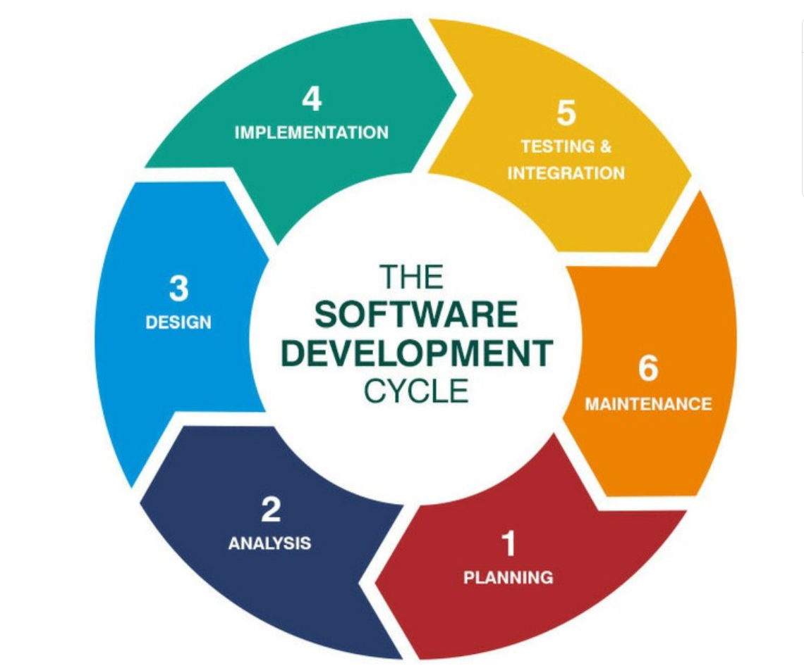
"As the design progressed, it was interesting to learn new programming ideas." -Lindsay
"Defining the scope of the project at early stage is very important, organization between team members is very crucial to the continual development of the project, finding adaptive solutions to the problems encountered is the key" -Mohamed
Image: https://medium.com/@jilvanpinheiro/software-development-life-cycle-sdlc-phases-40d46afbe384

Slide 19
Thank you

