Slide 1

Health and Fitness monitoring system
CS 2043 Project 1

Slide 2

Our TEAM
Mohamed Mesbahi El Aouame
Third year student at UNBSJ.
C++ Programmer and AI enthusiast. Interested in embedded systems development in the domain of IoT, as well as neural networking and deep learning techniques.
Michael Guo
Title
Lindsay Mullett
UNBSJ BscCs student
Educated in data management and object orientated programming. Motivated to improve implementation and efficiency of systems relating to precision medicine.

Slide 3
Overview of the System
Client
System
Client – Upon purchasing a wearable device (eg.smart watch) user will upload personal data to be monitored and measured for self-improvement, health monitoring and medical analysis. User will be identified through a unique identification number and password to create account and assess own data. The wearable device will measure vitals and record physical data. There will be different options for users to subscribe to. High risk individuals such as diabetics or those with genetic disorders will be able to have their data closely monitored by their health care provider and have automatic alerts if vitals reports are concerning. In the event of a medical emergency, a health care professional will be able to access data off of the users device such as vitals, medical history, medications, allergies and blood type. Those wishing to have guidance for self improvement will subscribe to coaches for fitness and nutrition. Through that they will submit reports to have analyzed then receive feedback and modifications from their coaches.
System – Website and app connected to user's wearable device. Device will measure physical data and store it with the client’s profile accessible through a website. User friendly interface for client to upload and monitor data. Interface for healthcare professionals to connect to in the event of urgent medical care. Available connection for fitness and nutrition coaches to check progress and submit changes to recommendations. System will notify health care professionals of changes that may be concerning. Alerts will be issued to user if blood sugars or heart rates are at dangerous levels. It is required to keep medical information and personal information separate.

Slide 4
Stakeholders System can be used by anyone, Specifically Targeted at:
Fitness motivated individuals
Diabetics
Individuals with genetic disorders
Personal Trainers
High risk individuals
Nutritionists
Health care professionals

Slide 5
Functional system requirements
 | Description | Priority
REQ-1 | The system should allow the user to create his own profile and modify it | 5
REQ-2 | The system should be able to store the personal health data uploaded by users from any machine(computer/mobile) into a database | 5
REQ-3 | The system should provide 4 types of accounts: one for health professionals, one for personal coaches and nutritionists, one for regular users and one for users at risk (people with diabetes, genetic conditions, chronic diseases...) | 3
REQ-4 | For the regular users account, the system should have these features: | 2
REQ-5 | Connecting actors to the user. Allowing the different types of professionals to modify plans and provide recommendations to users.
REQ-6 | System will allow for user’s vital information to be accessed by health care professional in the event of a medical emergency

Slide 6
Functional system requirements Continued
 | Description | Priority
REQ-7 | System will monitor vitals of user and send alert when there is a dramatic change in blood sugars or heart rate | 2
REQ-8
REQ-9
REQ-10 |  | 2
REQ-11

Slide 7
Use Case Scenarios
Use Case | Description | Requirement satisfied
userProfile | Allows user to create his/her personal profile and modify its access/information | REQ-1
Health care professional | Allow health care professionals to monitor high risk patients, or patients with different disorders to make necessary changes to optimize health of patient. | REQ-5
Healthcare professional | Access vitals of patient for emergency treatment | REQ-6

Slide 8
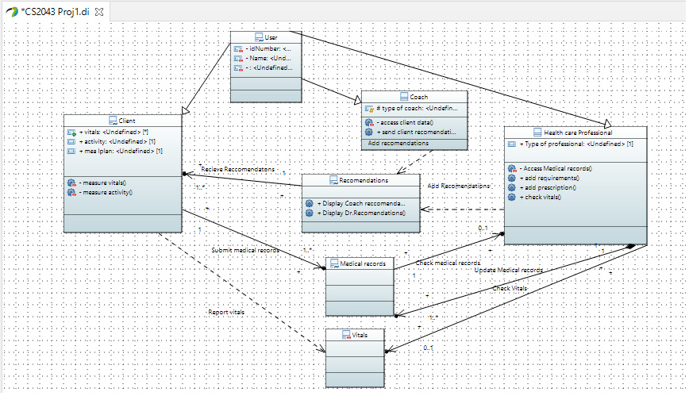
Class Diagram

Slide 9
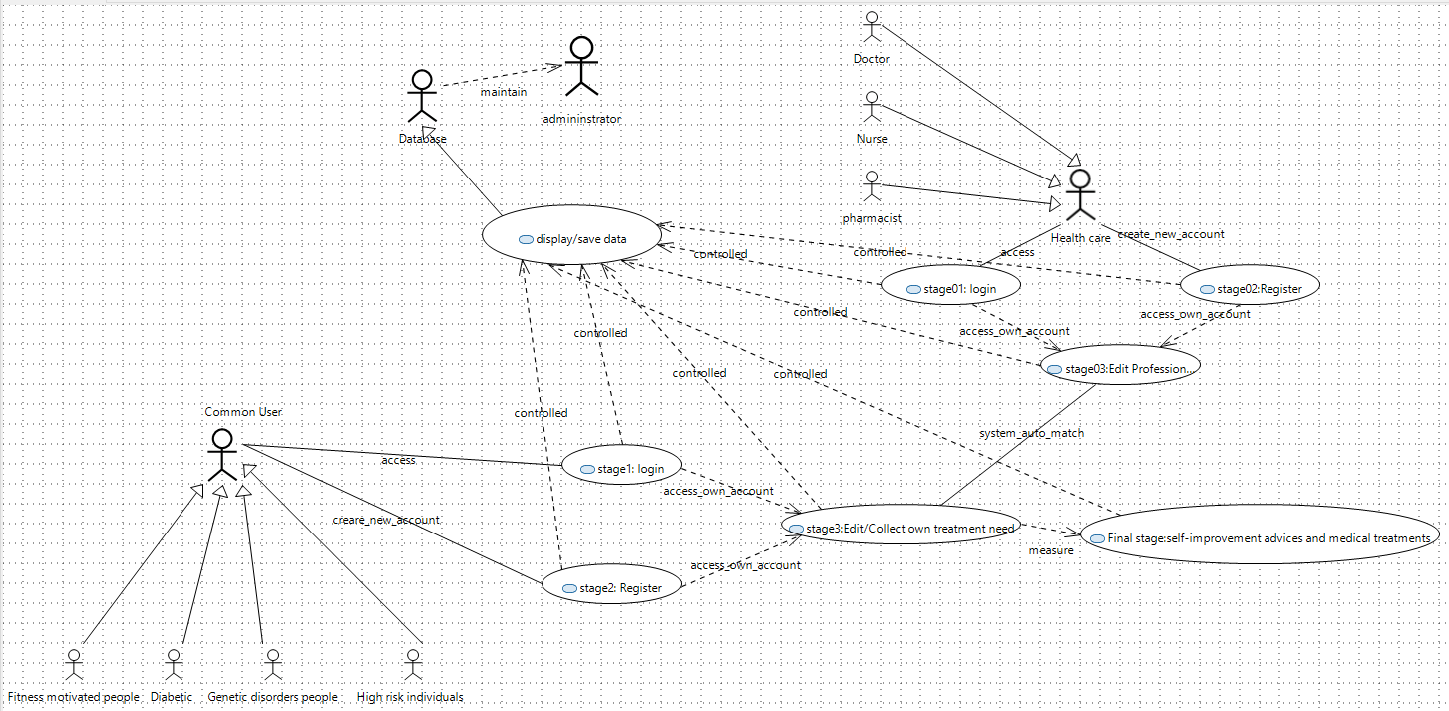
General Use Case Diagram

Slide 10
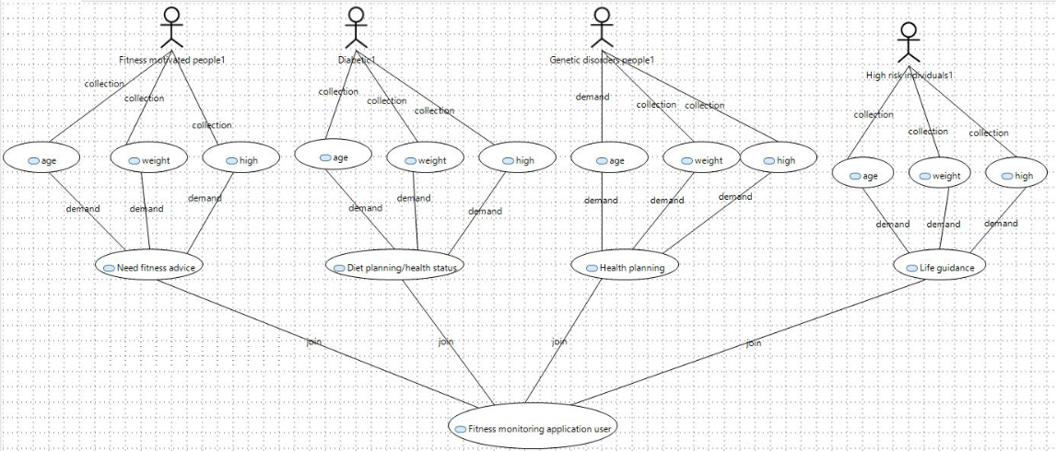
User Use Case Diagram

Slide 11



Thank you
Presenter name
Email address
Website

