Slide 1

Health and Fitness monitoring system
CS 2043 Project 1

Slide 2

Our TEAM
Mohamed Mesbahi El Aouame
Third year student at UNBSJ.
C++ Programmer and AI enthusiast. Interested in embedded systems development in the domain of IoT, as well as neural networking and deep learning techniques.
Michael Guo
Title
Lindsay Mullett
UNBSJ BscCs student
Educated in data management and object orientated programming. Motivated to improve implementation and efficiency of systems relating to precision medicine.

Slide 3
Overview of the System
Client
System
Person who would purchase device and upload personal data to be monitored and measured to be used for self-improvement and medical treatments. User can create account to assess own data. Client would need to own a smart watch for measuring vitals and recording physical data
Website and app connected personal device. Device will measure physical data and store it with the client’s profile accessible through a website. User friendly interface for client to upload and monitor data. Interface for healthcare professionals to connect to in the evet of urgent medical care. It is required to keep medical information and personal information separate.

Slide 4
Stakeholders System can be used by anyone, Specifically Targeted at:
Fitness motivated individuals
Diabetics
Individuals with genetic disorders
Expectant mothers
Personal Trainers
High risk individuals
Nutritionists

Slide 5
Functional system requirements
 | Description | Priority
REQ-1 | The system should allow the user to create his own profile and modify it | 5
REQ-2 | The system should be able to store the personal health data uploaded by users from any machine(computer/mobile) into a database | 5
REQ-3 | The system should provide 4 types of accounts: one for health professionals, one for personal coaches and nutritionists, one for regular users and one for users at risk (people with diabetes, genetic conditions, chronic diseases...) | 3
REQ-4 | For the regular users account, the system should have these features: | 2
REQ-5 | Connecting actors to the user. Allowing the different types of professionals to modify plans and provide recommendations to users.
REQ-6 | System will allow for user’s vital information to be accessed by health care professional in the event of a medical emergency

Slide 6
Functional system requirements Continued
 | Description | Priority
REQ-7 | System will monitor vitals of user and send alert when there is a dramatic change in blood sugars or heart rate | 2
REQ-8
REQ-9
REQ-10 |  | 2
REQ-11

Slide 7
Use Case Scenarios
Use Case | Description | Requirement satisfied
userProfile | Allows user to create his/her personal profile and modify its access/information | REQ-1
Health care professional | Allow health care professionals to monitor high risk patients, or patients with different disorders to make necessary changes to optimize health of patient. | REQ-5
Healthcare professional | Access vitals of patient for emergency treatment | REQ-6

Slide 8
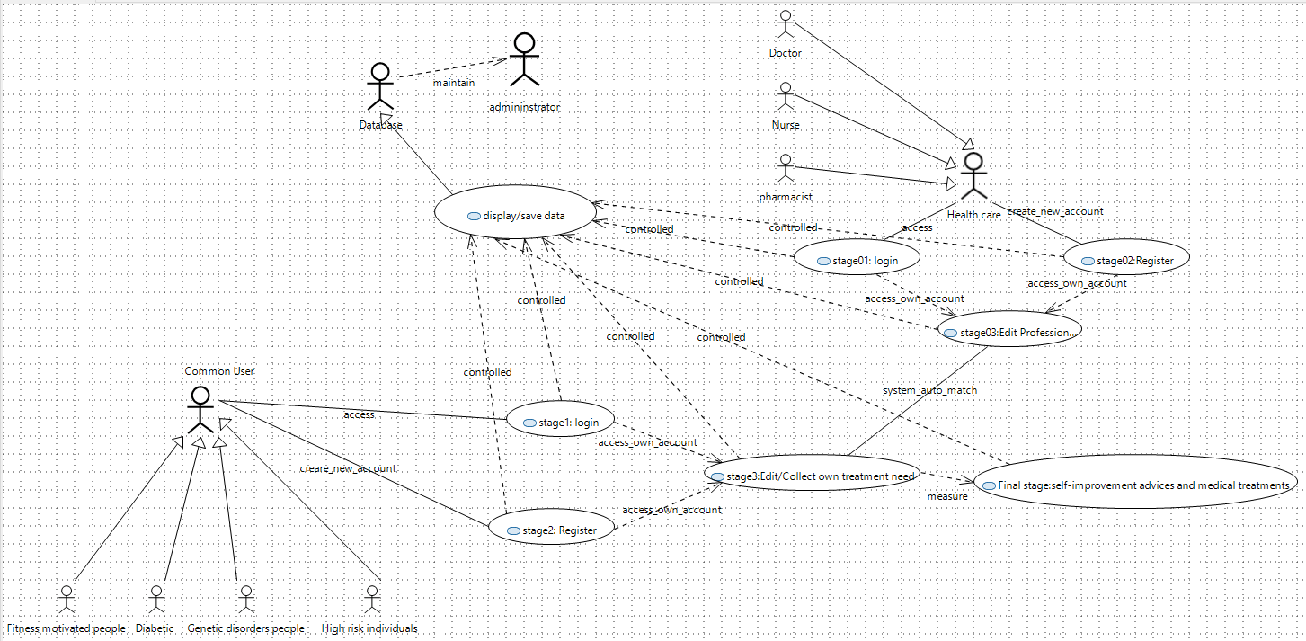
General Use Case Diagram

Slide 9
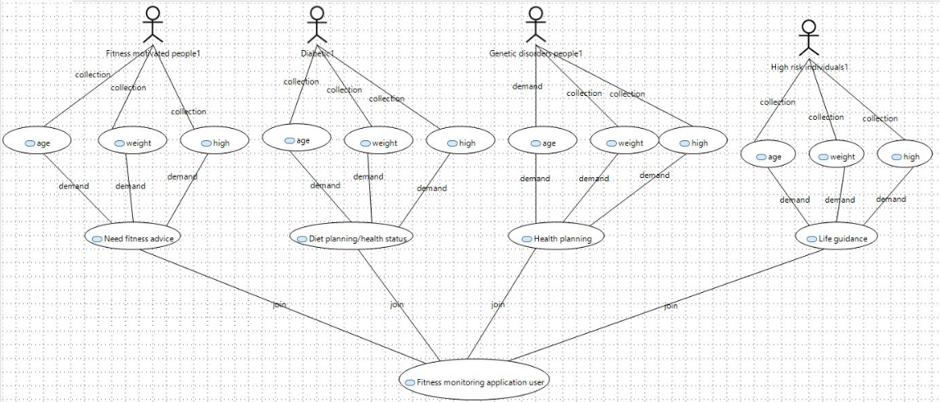
User Use Case Diagram

Slide 10



Thank you
Presenter name
Email address
Website

