Slide 1
Examining Salaries, Crime, & Bias in Montgomery County
Lucy Murray
DATA205
Notes:
This project aims to examine three datasets from dataMontgomery, which is the open data portal for Montgomery County, Maryland. I am interested in examining the Salaries, Crime, and MCPD Bias Incidents datasets. My goal was to compare the salaries dataset--focusing specifically on the police department--with the crime dataset and to further explore the relatively new MCPD Bias Incidents dataset.

Slide 2
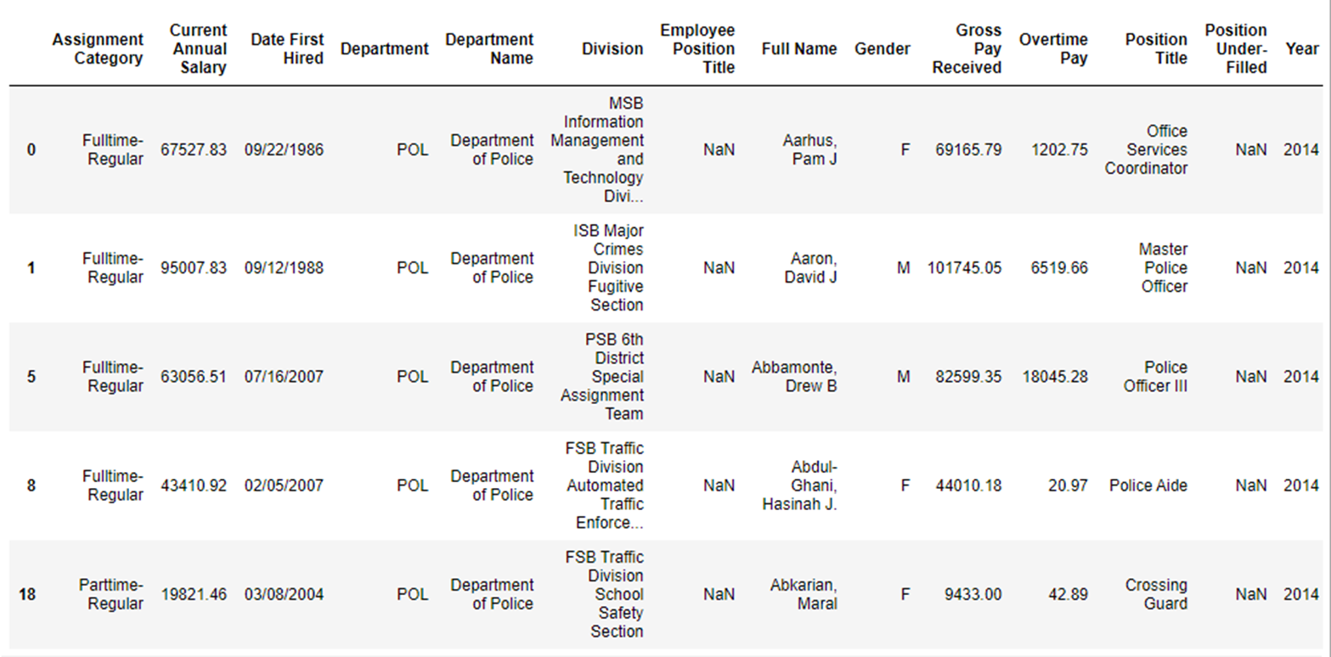
Dataset 1: Employee Salaries
Employee Salaries datasets 2014, 2015, 2016, 2017, and 2018 from dataMontgomery
Provides pertinent information about Montgomery County employees' salaries such as current annual salary, gross pay received, overtime pay, department, division, assignment category (part or fulltime), date first hired, etc.
Relatively clean and consistent data, with the same column names
Many NA values for Employee Position Title, Position Under-Filed, and Gender

Slide 3
Montgomery County Salaries (2014-2018)
Data Wrangling:
Created “mcsalaries” dataframe:
Added year column corresponding to the year of each dataset
Removed year in columns: “[Year] Gross Pay Received” and “[Year] Overtime Pay”
Created a new dataframe concatenating all datasets on the matching columns
Created “mcpolice” dataframe:
Filtered by the Department Name == “Department of Police”
Exploratory Questions:
How did annual salary of MC employees change by gender from 2014 to 2018?
How did annual salary of MC police change by gender from 2014 to 2018?

Slide 4

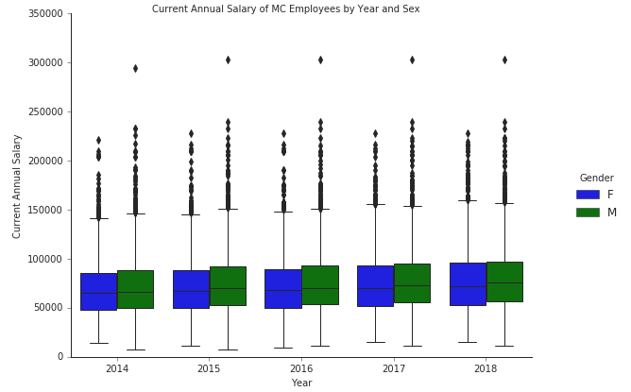
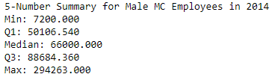
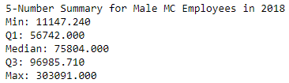
How did annual salary of MC employees change by gender from 2014 to 2018?
Notes:
I approached this question by utilizing boxplots, violin plots, and the 5-number statistics summary. With the Seaborn package, I created two boxplots indicating the Current Annual Salary for employees each year with differing colors representing gender. With the Seaborn package, I created two boxplots indicating the Current Annual Salary for employees each year with differing colors representing gender. The 5-number statistics summary provides the, maximum, medium, lower and upper quartiles. These values are represented by the lines on the box plots as well as by the dashed line in the violin plots.

Slide 5
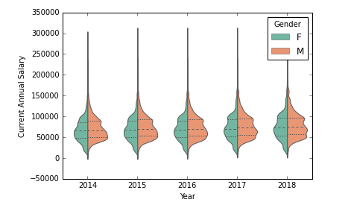
How did annual salary of MC employees change by gender from 2014 to 2018?
Notes:
I created violin plots which show the same data in a very similar way. However, wider sections of the curves represent a higher probability.
Conclusion: overall, the annual salary of MC employees did not change very much. It slightly increased, as we might assume would naturally occur due to inflation. Further, it is consistent in every year that males had a slightly higher current annual salary.

Slide 6
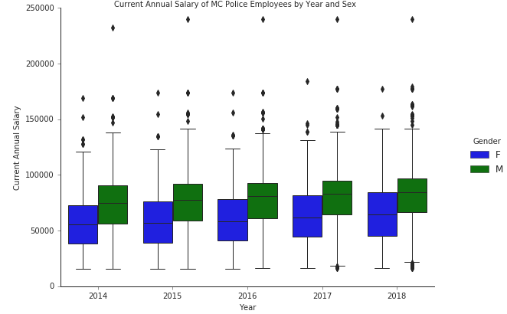
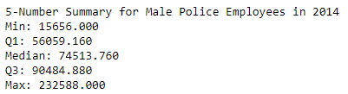
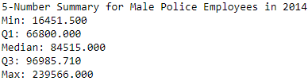
How did annual salary of MC police change by gender from 2014 to 2018?
Notes:
I approached this question identically to how I examined MC employees, utilizing the "mcpolice" dataframe that I created by wrangling the original "mcsalaries" dataframe.

Slide 7
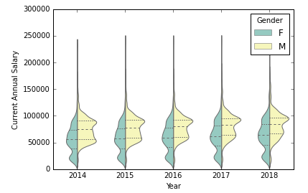
How did annual salary of MC police change by gender from 2014 to 2018?
Notes:
Conclusion: overall, the annual salary of MC employees in the police department specifically did not increase much over this five-year period. However, it is consistent in every year there was a greater disparity of males having a higher current annual salary.

Slide 8
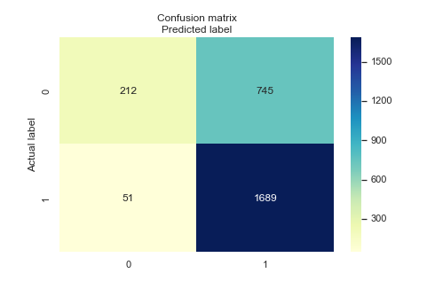
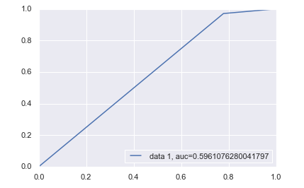
Can we accurately predict police employees that are male with a ML model?
Notes:
Logistic regression models are utilized to predict binary classes. In this case, we are computing the probability that Montgomery County police employees are male. In order to create this model, I needed to create the "police_new" dataframe. To run the logistic regression, I needed to recode categorical variables such as Assignment Category and Gender as binary numbers. I also created the new variable, "Years Total", to represent the number of years the employee worked at the Montgomery County police department. I utilized the Gender, Assignment Category, Current Annual Salary, Over Time Pay, and Years Total as parameters. I split the data into train and test data, trained the model, and checked the accuracy of the model for predictions.
Conclusion: The accuracy of the model was 72%, which is relatively high. Precision was 72%, which indicates a low false positive rate; in other words, of all employees classified as male, 72% are male. The recall value indicates that the model can identify employees that are male in the test set 94% of time. However, observing the Receiver Operating Characteristic (ROC) Curve, it showed an AUC score of 0.596 indicating the model is a relatively worthless classifier.

Slide 9
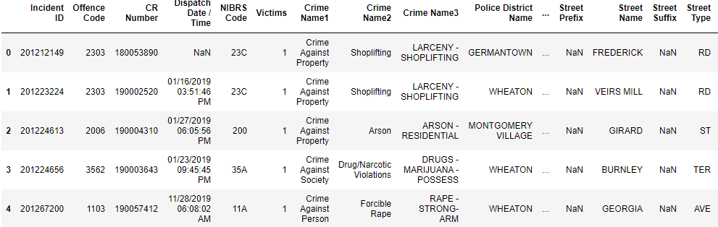
Dataset 2: Crime
“Crime” dataset from dataMontgomery
Data spans from 2016-2020 and is being updated presently
Repetitive column names
Classified according to the National Incident-Based Reporting System (NIBRS) of the Criminal Justice Information Services (CJIS) Division Uniform Crime Reporting (UCR) Program

Slide 10
Crime
Data Wrangling:
Parsing date time:
Converted to datetime
Added year, time, and weekday columns
Created “crime_look” daaframe
Removed 2016 and 2020 years, as the data was incomplete
Exploratory Questions:
Did the distribution of crime in different districts change from 2017 to 2019?
What days of the week had the highest amount of crime?

Slide 11
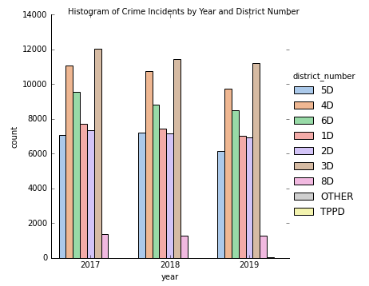
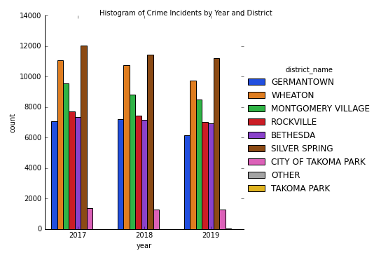
Did the distribution of crime in different districts change from 2017 to 2019?
Notes:
Because this data is categorical in nature, it makes sense to ask about the distribution of crime incidents. I used the seaborn package and represented this data by both district number and district name.
Conclusion: district 3D or Silver Spring had the highest number of crime incidents all three years, while 8D or the city of Takoma Park had the lowest number of crime incidents.

Slide 12
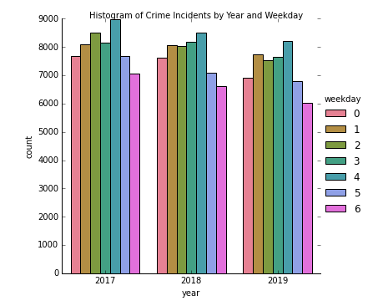
What days of the week had the highest amount of crime?
Where 0 = Monday and 6 = Sunday
Notes:
By parsing datetime, I could extract the day of the week from the date the crime incident occurred. I visually represented this with another histogram to examine the distribution.
Conclusion: every year, Friday had the highest incidents of crime, while Sunday consistently had the lowest incidents.

Slide 13
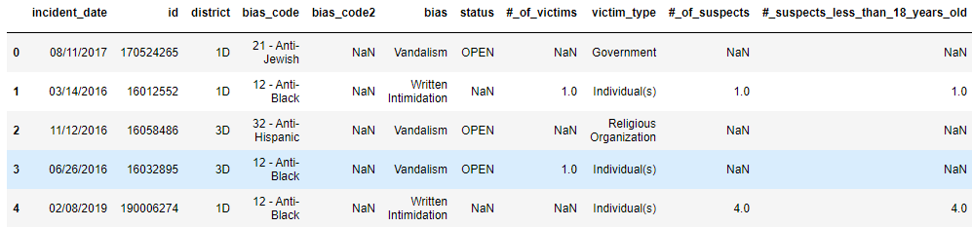
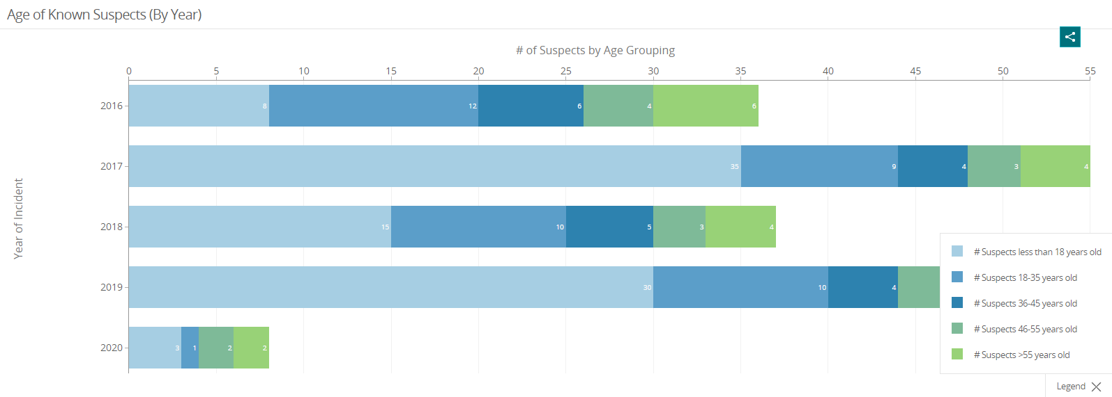
Datasets 3: MCPD Bias Incidents
"MCPD Bias Incidents" from dataMontgomery
Data spans from 2016-2020 and is presently being updated on a monthly basis
Many NA values for each column
It captures incidents and criminal offenses that may be motivated by an offender's bias
I am interested in variables such as bias code, bias, victim type, # of suspects, and the variables describing suspects' age ranges

Slide 14
MCPD Bias Incidents
Data Wrangling:
Cleaned column names
Converted to datetime to add the year column
Parsed new “bias_type” column
Exploratory Questions:
Did the distribution of crime in different districts change from 2017 to 2019?
What days of the week had the highest amount of crime?

Slide 15
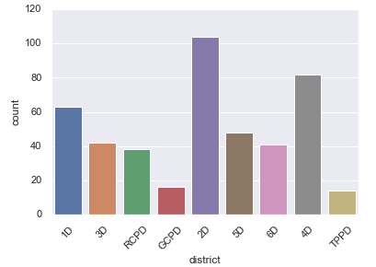
What police districts had the highest incidents of biased crime?
Notes:
This dataset is like the crime dataset in that it is full of mostly categorical variables, however, it has even less data to work with. Thus, I approached this question with a histogram.
Conclusion: district 2D, or Bethesda had the highest incidents of biased crime, while TPPD or Takoma Park had the lowest. This is very different from the distribution of biased incidents we saw in the overall crime dataset. While Takoma Park had the lowest incidents of crimes in both, Silver Spring had the highest incidents in the overall crime dataset. In the biased crime dataset, Silver Spring seems to be more average.

Slide 16
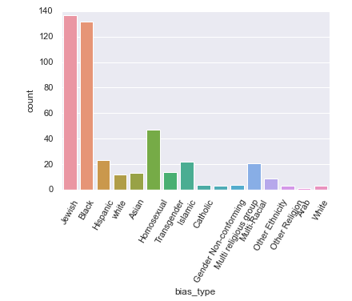
Which biased type crime occurred most often?
Notes:
The dataset has the variable "bias_code" which represents the type of bias of the crime. To approach this quqestion, I plotted this variable on a histogram. I utilized the "bias_type" variable I created by parsing the data, so that the messy code number and the word "Anti" would not be present. Not only did this look cleaner, but it made the graph more legible.
Conclusion: Anti-Jewish bias incidents occurred most frequently, with Anti-Black trailing right behind it. Additionally, Arab had the lowest accounted for type of biased crime in Montgomery county.

Slide 17
Final Recommendations
Montgomery County Salaries (2014-2018):
Additional Columns: education level, years worked in Montgomery County, and whether the person worked in a different position in the county
Dataset of only the Montgomery County employees that worked all 5, 10, or X interval
Could compare with private sector data
Crime:
Live dashboard, plotting incidents by their coordinates – scrub through incidents over time
MCPD Bias Incidents:
Additional Columns: age of suspects, bias type, district name
Compare with data about biased incidents in other counties
More documentation about how incidents were coded
**Due to the time constraints of this presentation, there are several additional topics addressed in the full report:
https://github.com/lmurra38/DATA205

Slide 18
Acknowledgements
Hamman, John F
Mohamed, Abdirisak
Saidi, Rachel

