Slide 1
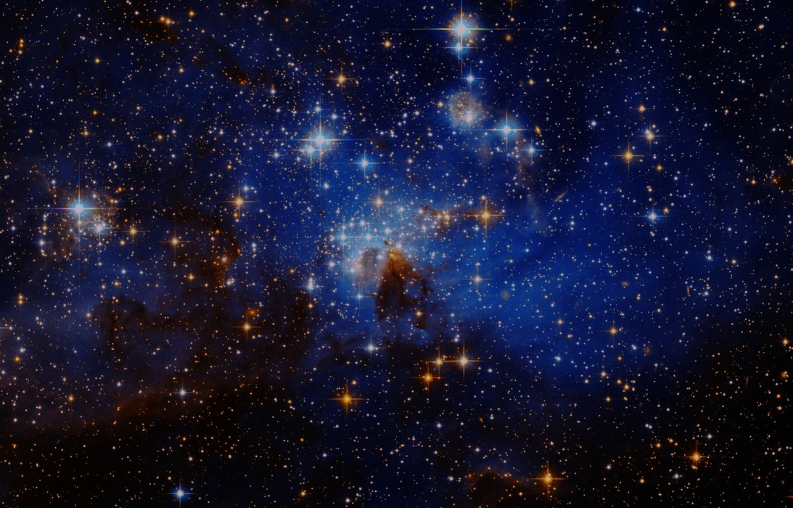
Cheetah: Modeling Starspots from Kepler Lightcurves
Michael Thomas ‘15
advised by
Adam Finkelstein
Lucianne Walkowicz

Slide 2
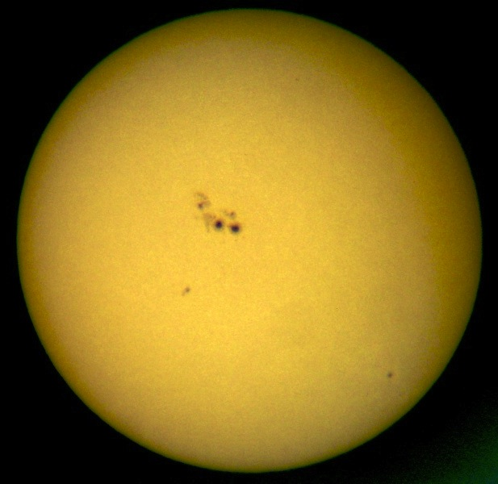
What are starspots?
Cooler areas on the “surface” (photosphere) of a star
Caused by internal magnetic field penetrating surface
On Sun, vary over an 11-year cycle
Solar activity (e.g. flares) tends to occur at or near spots
SiriusB, Wikimedia Commons licensed CC BY-SA 3.0

Slide 3
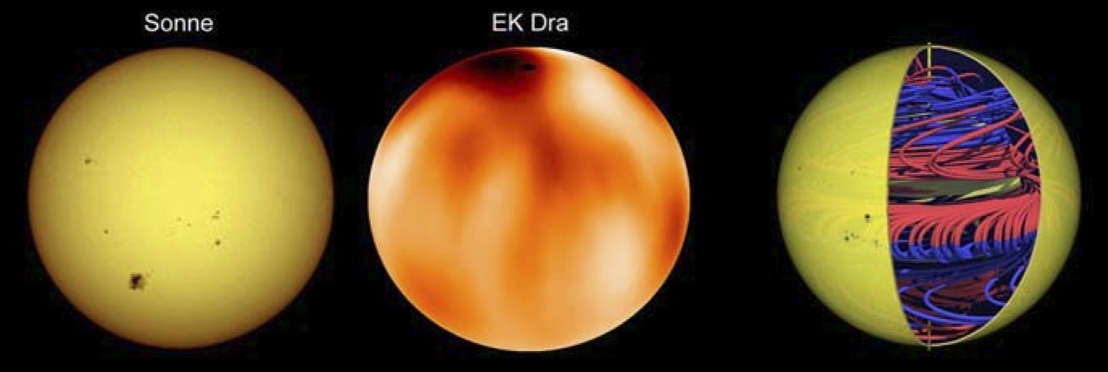
Why do we care about starspots?
Internal magnetic fields of stars not fully understood
In general, most stellar data comes from the Sun
Starspots could provide info about MF of other stars
Also give clear indication of rotation rate
Strassmeier 2009, “Starspots,” Astron Astrophys Rev

Slide 4
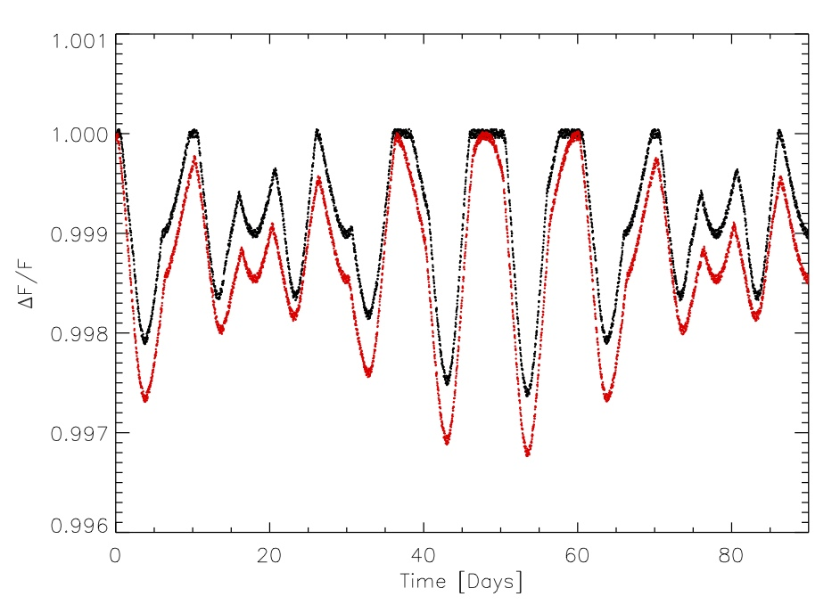
What is our data & How can we use it to find starspots?
Stars (except Sun) too far to see spots
Kepler measures light intensity of many stars
Brief periodic dimming used to infer planet revolution
Gradual variation (lightcurve) used to infer spots
Walkowicz 2012 (see References)

Slide 5
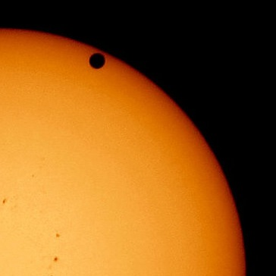
Model Parameters
stellar inclination
  semi-degenerate with latitude
limb-darkening coefficients (taken as fixed)
number of spots
spot radius & position (latitude & longitude)
spot contrast (taken as fixed)
  degenerate with radius
Image © Brocken Inaglory, Wikimedia Commons, licensed CC-BY 2.5

Slide 6
Ancient History
Ismael Boulliau first (incorrectly) proposed starspot hypothesis (1667)
Gerald Kron first modern data of light variability (1947)
Kron proposed starspots (correctly) but largely ignored until 1960s-70s
Several other methods used for detecting spots (Doppler, eclipse mapping, LDR)

Slide 7
Mathematics: Generating lightcurve from spot parameters
Integrate specific intensity over visible area
Several analytic formulations assuming circular spots – we use Eker 1994
Numerical models also used, but problematic for fitting

Slide 8
Fitting: Estimating spot parameters from lightcurve
Ribarik et al. 2002 – SpotModeL
  Levenberg-Marquardt algorithm
Croll 2006 – Starspotz
  Added MCMC algorithm
We want more suitable treatment for large Kepler dataset
Walkowicz et al. 2012 – Examination of degeneracies between parameters

Slide 9
Goals & Plan I
Implement Eker equations for lightcurve generation in Python [done]
Start by implementing L-M nonlinear least squares
Try to improve performance with gradient methods
Such methods only give local optima; try MCMC for more thorough traversal of parameter space

Slide 10
Goals & Plan II
Provide method of determining “appropriate” number of spots
Reevaluate how multispot fitting is done
Start modeling stars with some known parameters (e.g. inclination) from other sources
Ultimately, apply to large set of Kepler lightcurves, aiming to draw general conclusions

Slide 11
References
Eker 1994, “Modeling light curves of spotted stars,” ApJ
Ribárik et al. 2002, “A new computer code for time-series photometric spot modelling,” 1st Potsdam Thinkshop
Croll 2006, “Markov Chain Monte Carlo methods applied to photometric spot modeling,” Pub. Ast. Soc. of the Pacific
Walkowicz et al. 2012, “The information content in analytic spot models of broadband precision lightcurves,” ApJ Supplement Series

