Slide 1
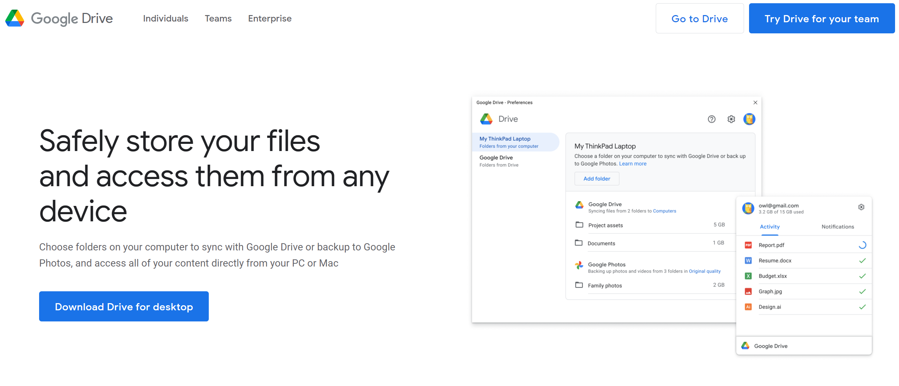
Step 1: Get Google Drive Set up on Computer
Start here: https://www.google.com/drive/download/
Click Here
Note: this is not the old google “back up and sync” but a newer system – update to this.

Slide 2
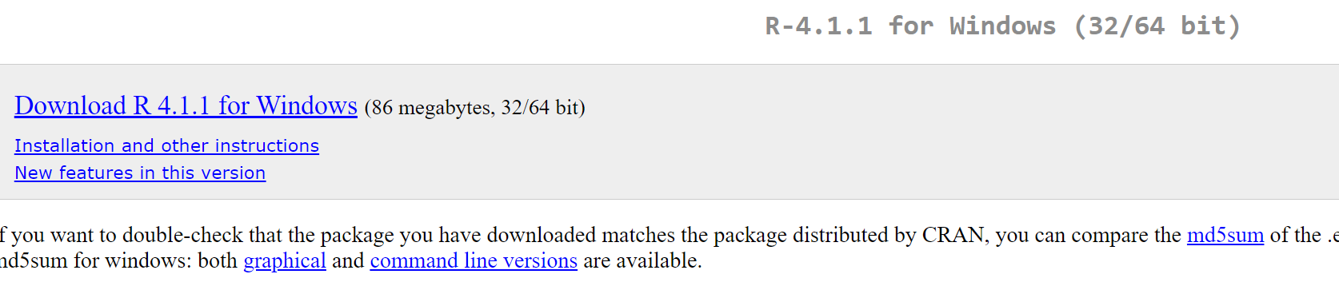
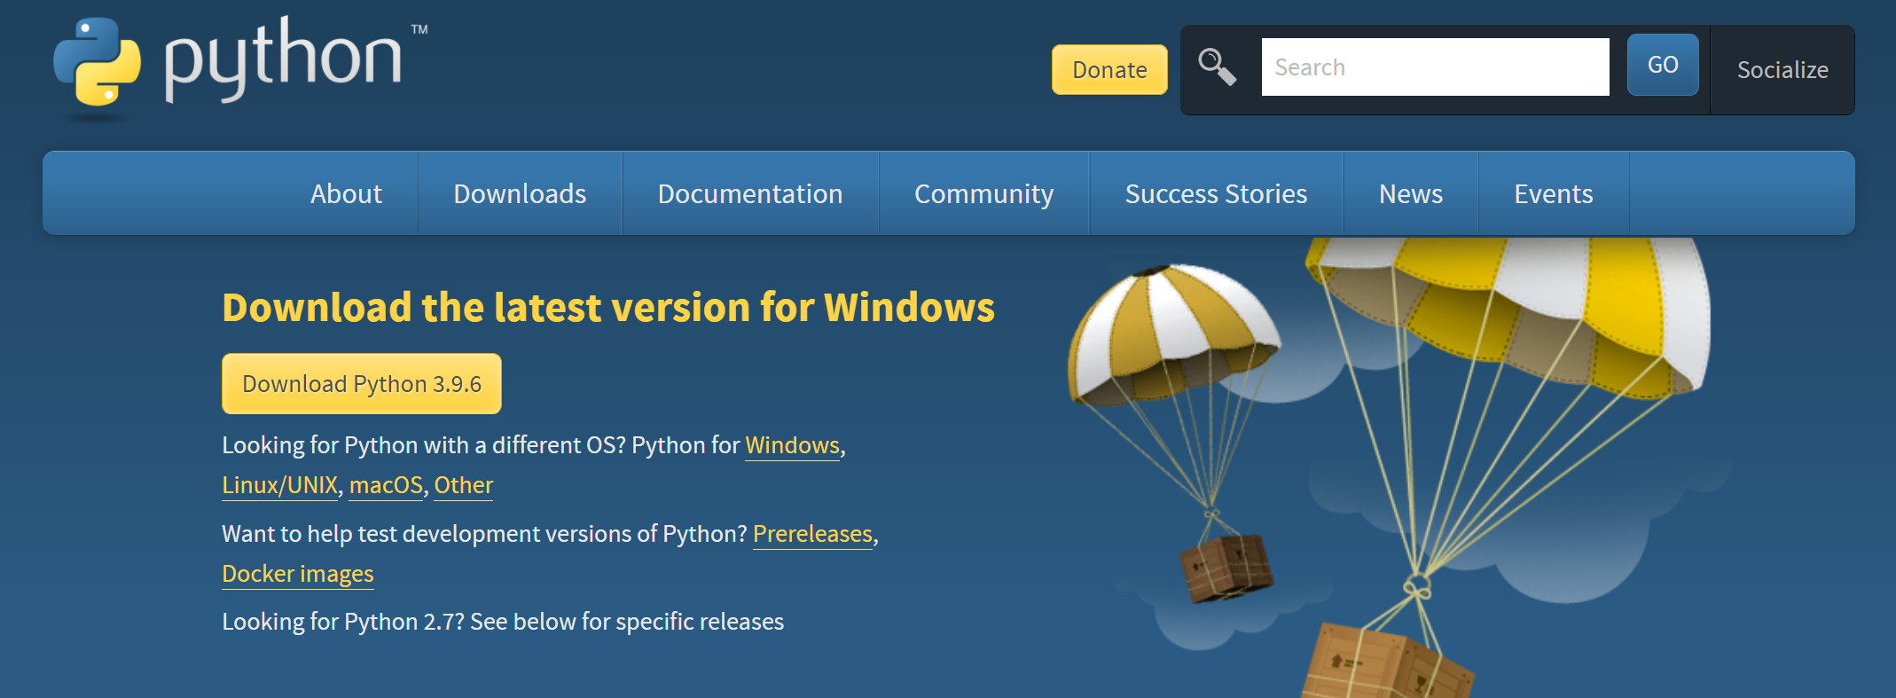
Step 2: Do you have R or Python?
If you need R, go to: https://cran.r-project.org/bin/windows/base/
If you need Python, go to: https://www.python.org/downloads/
Click Here
Click Here

Slide 3
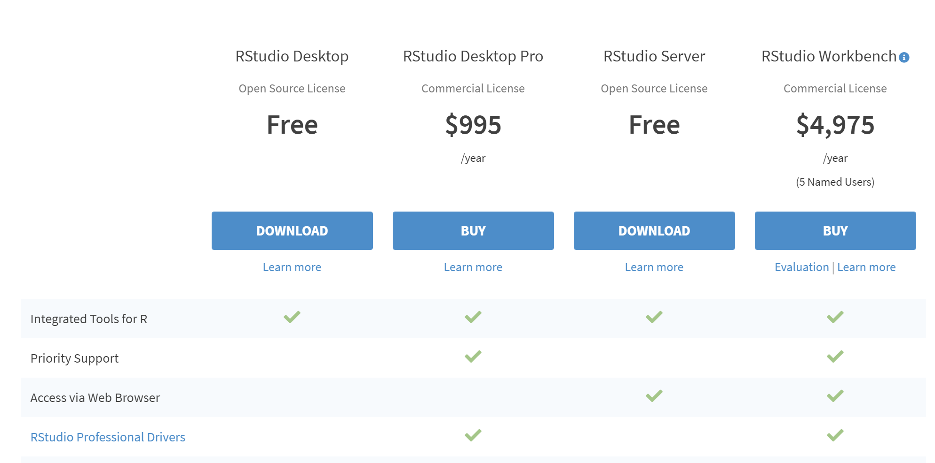
Step 3: Do you have a good workspace for R and Python?
RStudio can read and write BOTH languages:
https://www.rstudio.com/products/rstudio/download/
Click Here

Slide 4
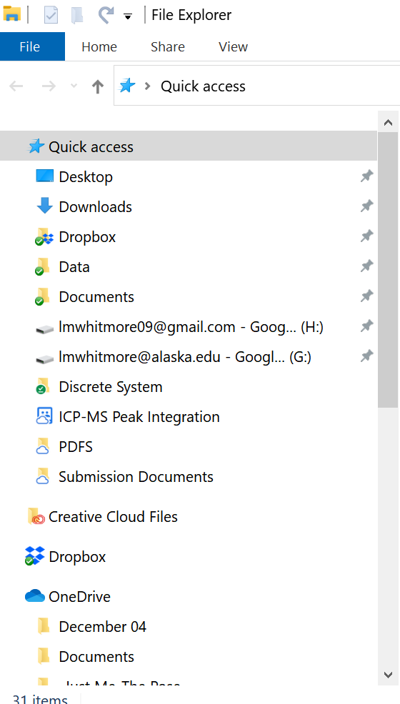
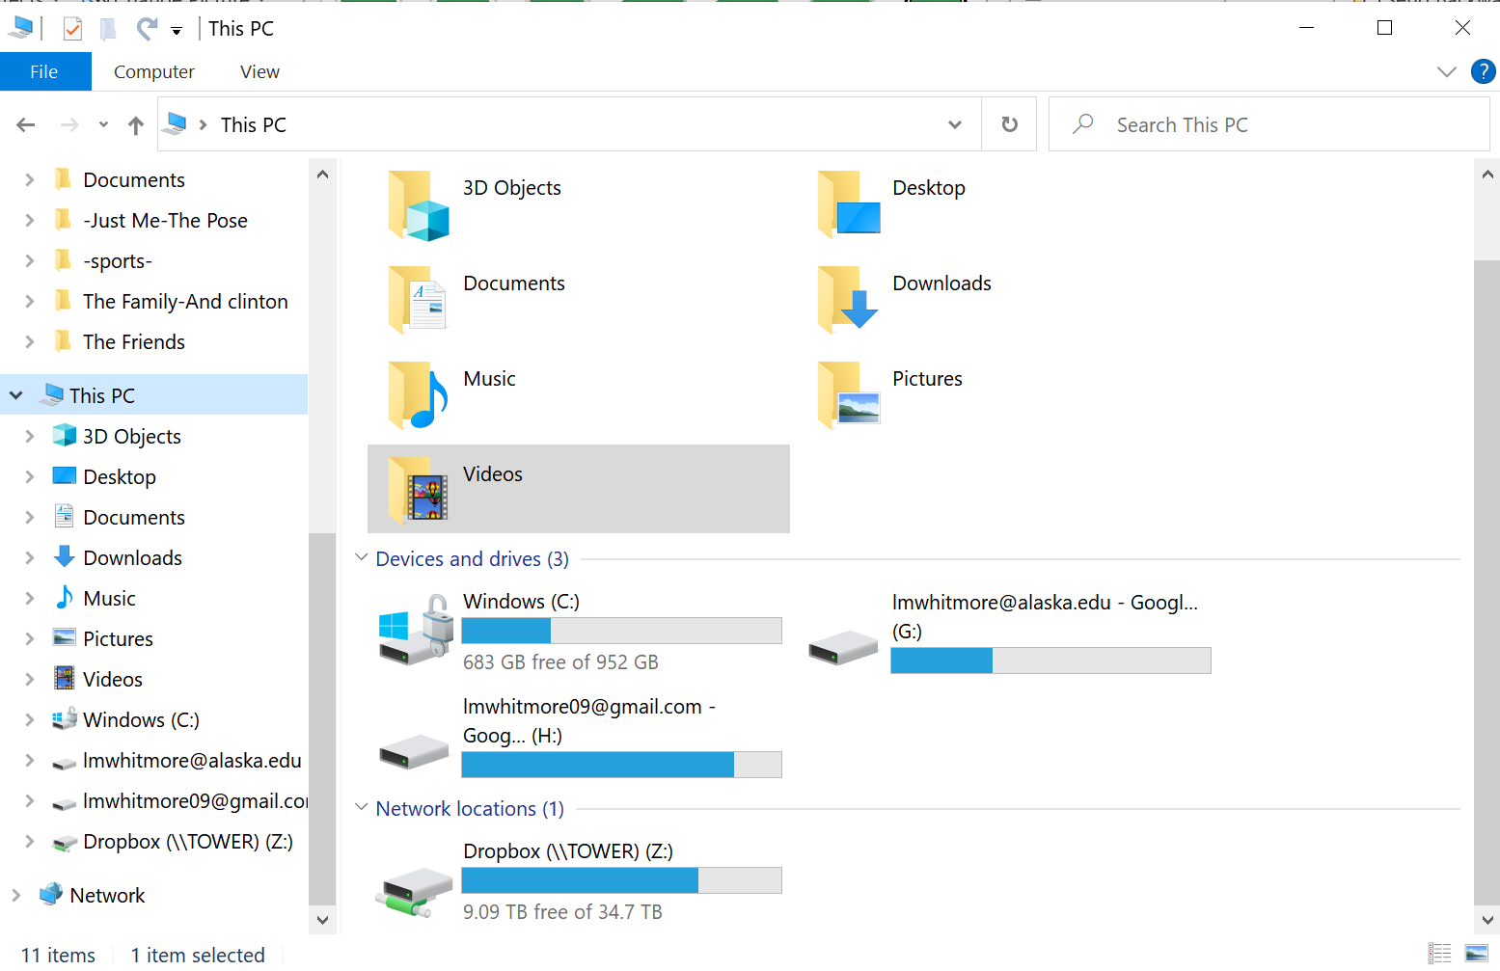
Let’s Explore Google Drive
I have two drives set up, one for my personal account and one for my work account.

Slide 5
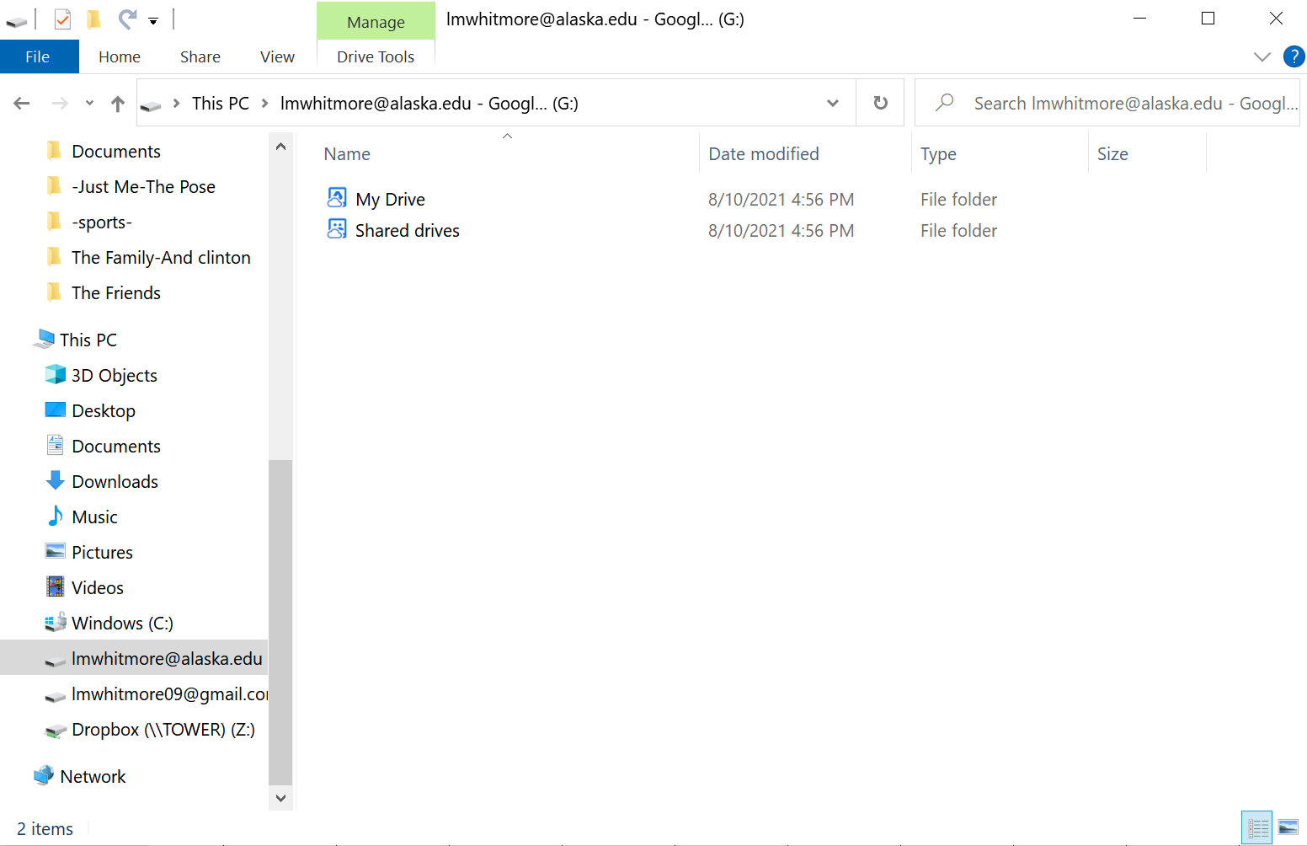
Your google drive has two options: “My Drive” and “Shared Drives”

Slide 6
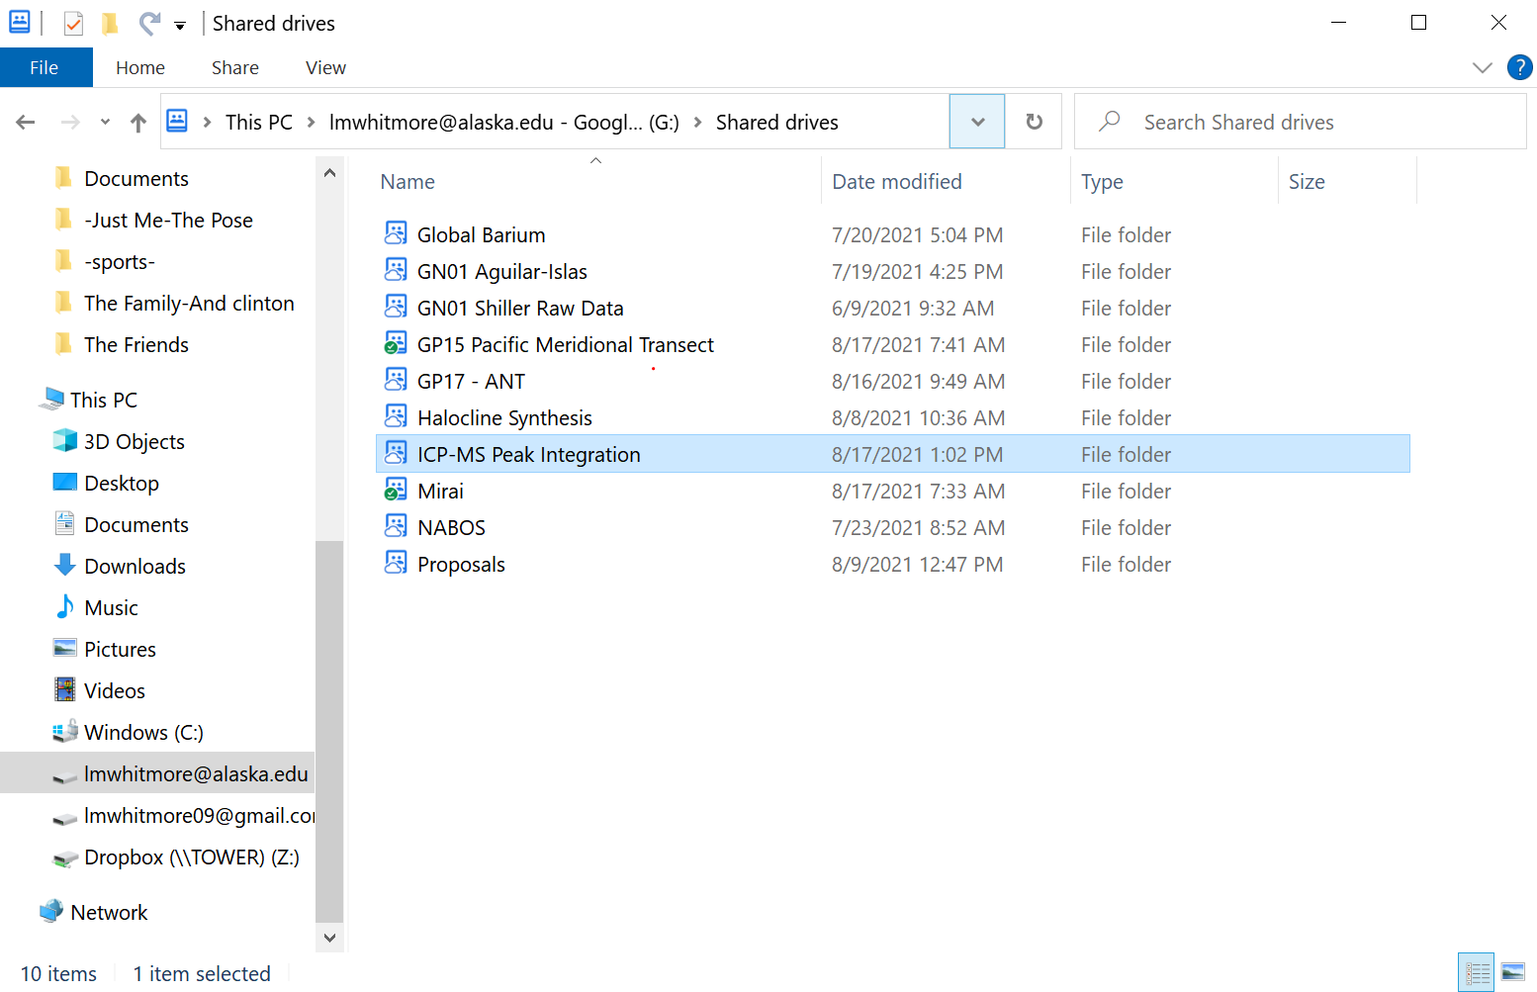
ICP-MS Peak Integration can be accessed through your shared drive.

Slide 7
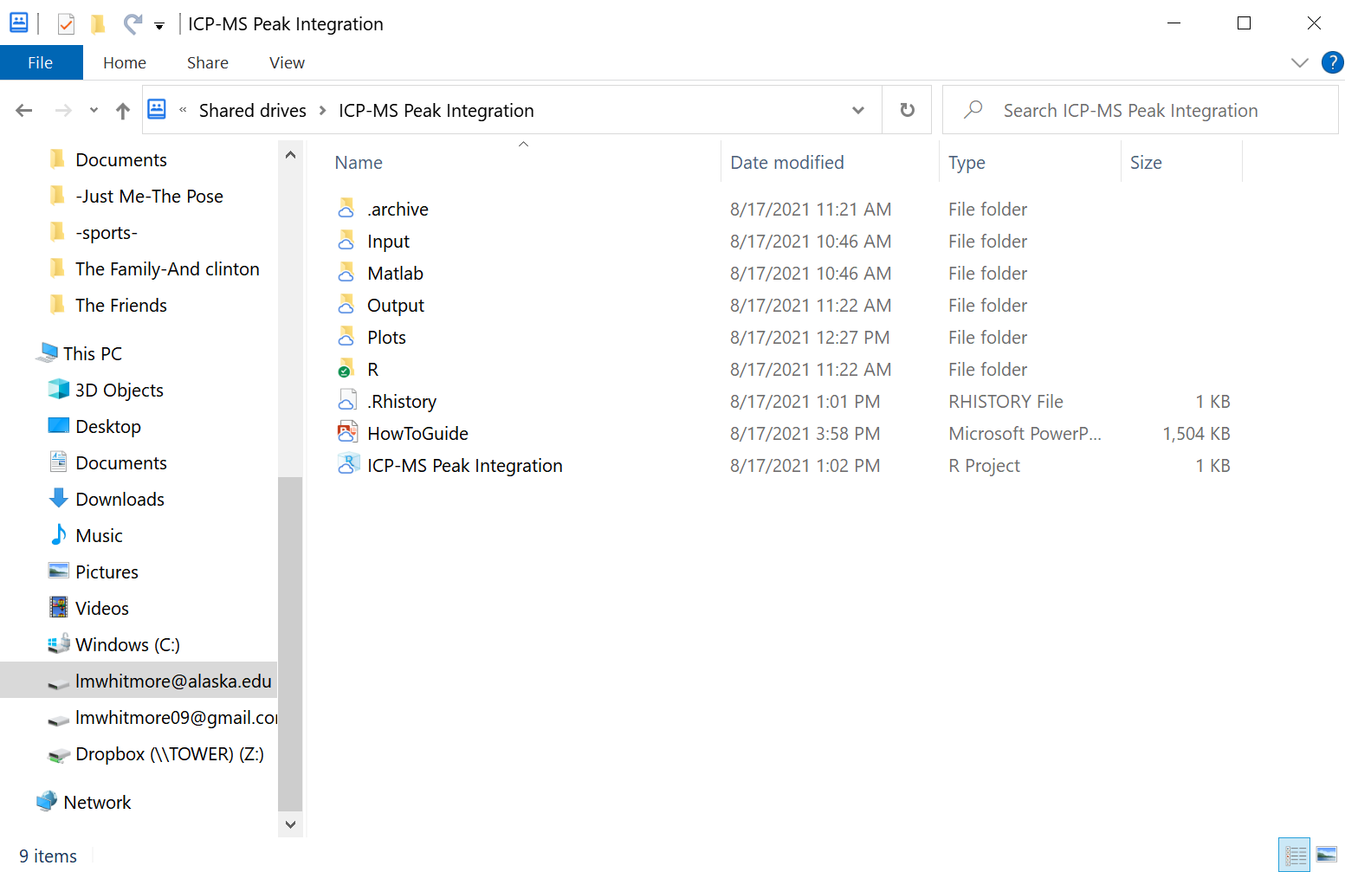
To Use R/Python
Open this “ICP-MS Peak Integration” project in Rstudio
Double Click or
Open Rstudio > File > Open Project…

Slide 8
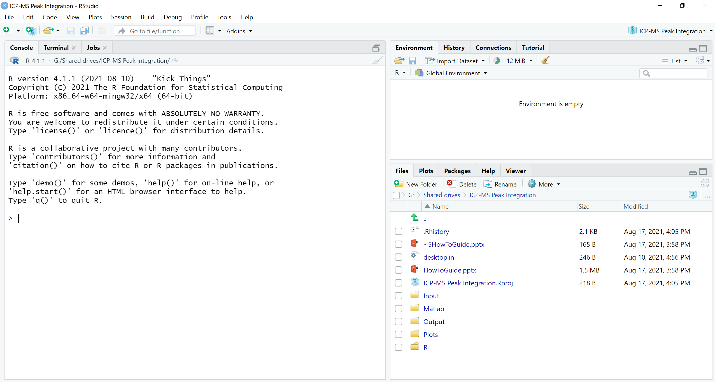
This is what RStudio looks like
data loads over here
type lines of code here (not editable)

Slide 9
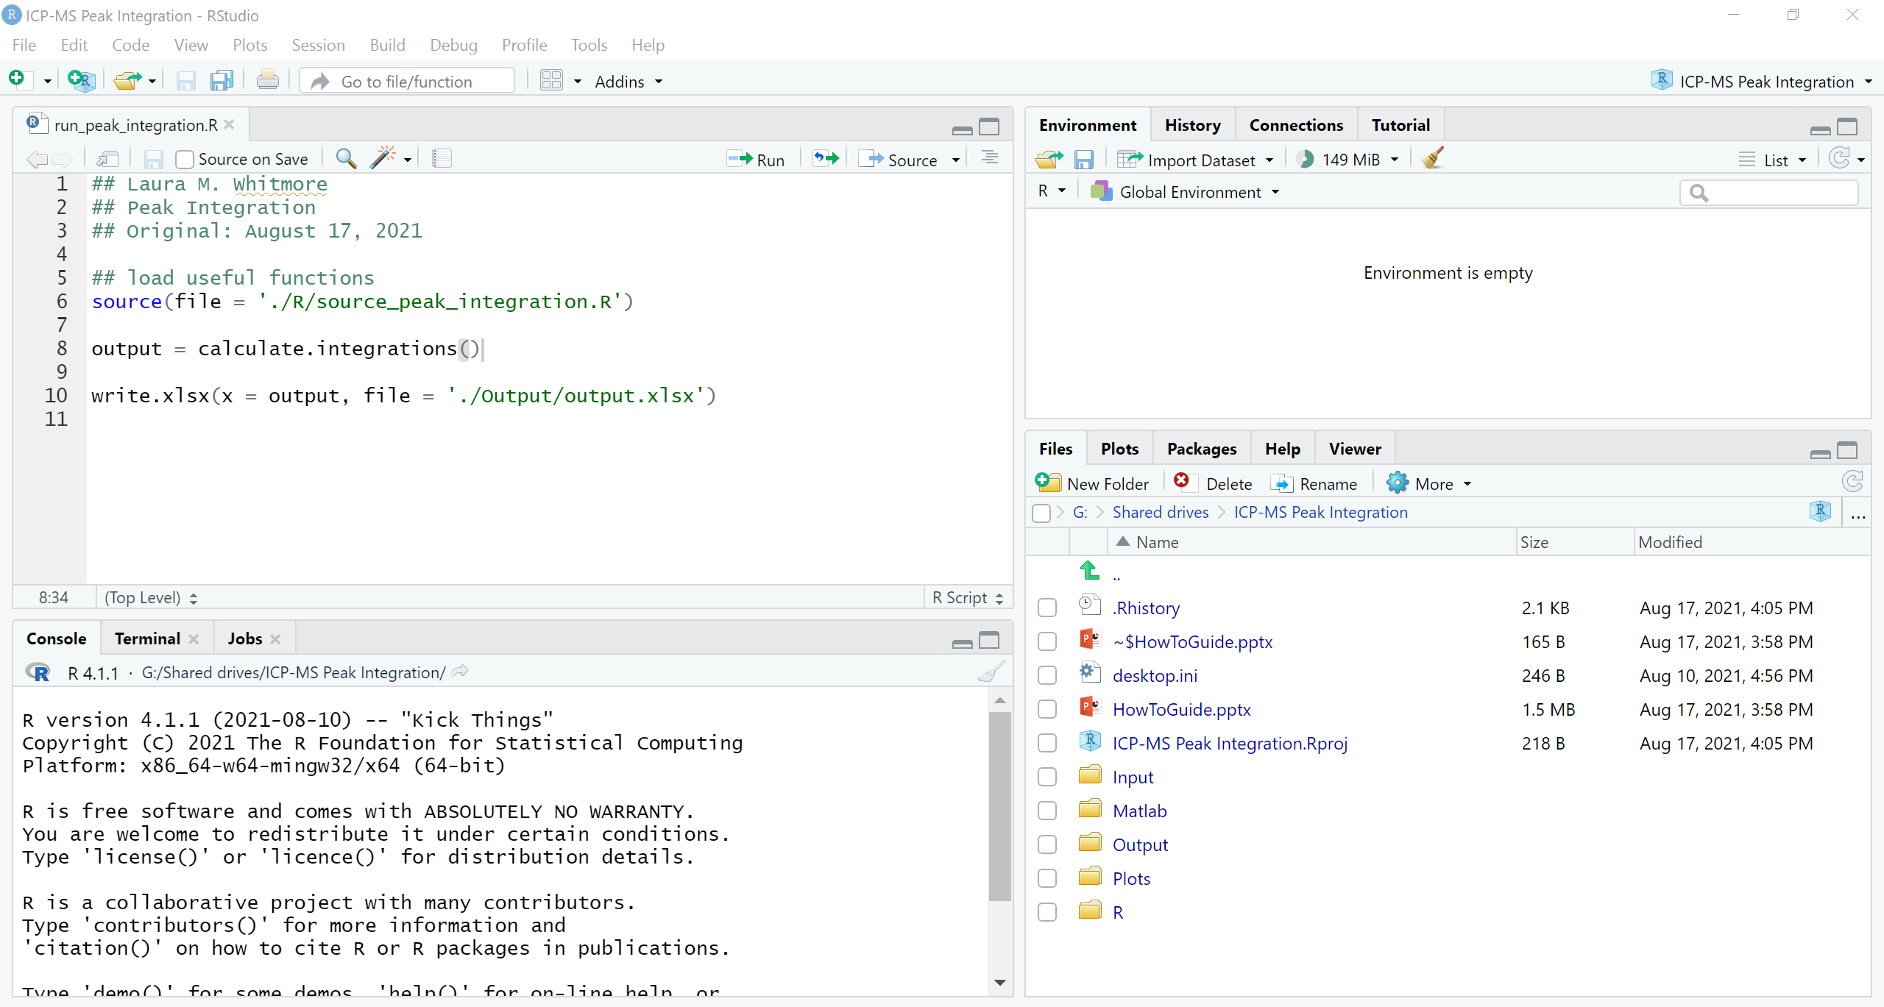
When you open the script (File > Open File > R > run_peak_integration.R):
Toggle between R or Python here
Edit your script and run it here
type lines of code here (not editable)

Slide 10
How to run this script
Line 8 is the only one that you need to edit.

Slide 11
calculate.integrations() is a function
You need to run line 6 first to be able to use the function (this line loads the function into the workspace).
To run line 6, place the cursor at the start of the line and click ctrl+enter.
output = calculate.integrations()
within this function there are several items to specify, if your cursor is within the parentheses following the function you can click tab to see what those options are:
input.files
time_start
time_end
dt
verbose

Slide 12
output = calculate.integrations() has DEFAULT settings.
input.files = makes a list out of all .txt files in the Input folder
time_start = starts integration at 27 seconds
time_end = ends integration at 70 seconds
dt = 1e-4
verbose = TRUE
You may not need to make any changes to the default settings.
input.files: move all the files you want integrated to the shared drive “ICP-MS Peak Integration > Input” as .txt files.
time_start: adjust to be near the start of the peak
time_end: adjust to be near the end of the peak
dt: only needs to be changed if you want coarser (or finer) resolution on the peak integration
Verbose: if “TRUE” prints messages on the status of the script

