Slide 1
Visualization with d3.js
Leslie Myint

Slide 2
What is D3?
Data-driven documents
Javascript library developed by Michael Bostock
Goal: efficient manipulation of documents based on data

Slide 3
To use or not to use?
Pros
Cons
Portable (web browser + text editor)
Efficient way to explore data in multiple ways
Information-rich data displays
http://www.nytimes.com/interactive/2013/03/29/sports/baseball/Strikeouts-Are-Still-Soaring.html?ref=baseball
http://www.nytimes.com/interactive/2012/08/11/sunday-review/drought-history.html
http://www.nytimes.com/interactive/2012/02/13/us/politics/2013-budget-proposal-graphic.html?_r=0
Not ideal for performing (complex) calculations on data on the fly
Lends itself to being overkill
http://bl.ocks.org/mbostock/1136236
http://examples.oreilly.com/0636920026938/chapter_11/04_force.html

Slide 4
How does it work?

Slide 5
Overview of language essentials
HTML
SVG
CSS
Javascript

Slide 6
HTML
In general:
<tagname attributeName1=attr1, attributeName2=attr2>
Content
</tagname>
Examples:
<p>I am a paragraph.</p>
<p class="introtext">Welcome to the D3 tutorial!</p>
<div id="update">The current temperature is 55 degrees.</div>

Slide 7
DOM: Document Object Model
HTML has an inherent tree structure
“DOM” refers to this representation
<body>
<div id="leftpanel">
<p>Paragraph 1</p>
<p>Paragraph 2</p>
</div>
<div id="rightpanel">
<p>Item 1</p>
<p>Item 2</p>
<p>Item 3</p>
</div>
</body>
body
div
#leftpanel
div
#rightpanel
p
p
p
p
p
Important for understanding how to select the elements that I want

Slide 8
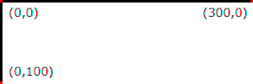
SVG: Scalable Vector Graphics
Tag-based way of creating graphics
<svg width="500" height="400">
<rect x="11" y="200" width="28" height="50"
fill="rgb(0, 0, 50)"></rect>
<circle cx="195" cy="233" r="2"></circle>
<text x="576" y="14">25</text>
</svg>
Coordinate system:
D3 has its own line functionality for line graphs
For additional properties (e.g. aesthetics): http://www.w3schools.com/svg/svg_reference.asp

Slide 9
CSS: Cascading Style Sheets
In general:
<style type="text/css">
selector {
property1: value1;
property2: value2;
}
</style>
Example:
<style type="text/css">
p {
font-size: 12px;
font-family: sans-serif;
}
</style>

Slide 10
CSS Selectors
Type selectors
p
div
svg
Descendant selectors Syntax: parent child
div p
Class selectors Syntax: .classname
.axis
.axis.x
ID selectors Syntax: #idname
#leftpanel
http://chimera.labs.oreilly.com/books/1230000000345/ch03.html#_selectors

Slide 11
Javascript: Variables and objects
Variables
var num = 2.3;
var color = "red";
var ra = [1, 1, 2, 3]; // Access with ra[0], ra[1]
var ra2d = [ [1, 3], [2, 4] ];
Objects
var subject = {
id: "S1",
height: 62,
weight: 189
};
subject.id
subject.height
subject.weight

Slide 12
What is D3 doing?
Data: 8, 6, 7, 5, 3, 0, 9
Web text:
Web bar chart:
<p>8</p>
<p>6</p>
<p>7</p>
<p>5</p>
<p>3</p>
<p>0</p>
<p>9</p>
<svg width="600" height="300">
<rect height="8"></rect>
<rect height="6"></rect>
<rect height="7"></rect>
<rect height="5"></rect>
<rect height="3"></rect>
<rect height="0"></rect>
<rect height="9"></rect>
</svg>
D3 provides us with a library of functions that can bind data to DOM elements to dynamically create HTML and SVG elements

Slide 13
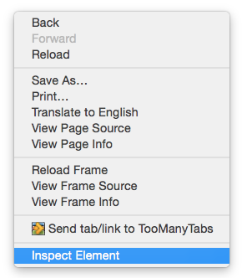
Interactive debugging
In Chrome and Safari, click Inspect Element to open up the Developer pane

Slide 14
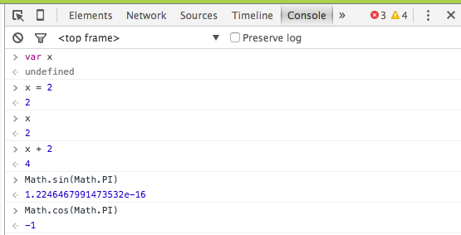
Interactive debugging
The Javascript console works a lot like an R session:
Run code interactively
View variables in the global namespace

Slide 15
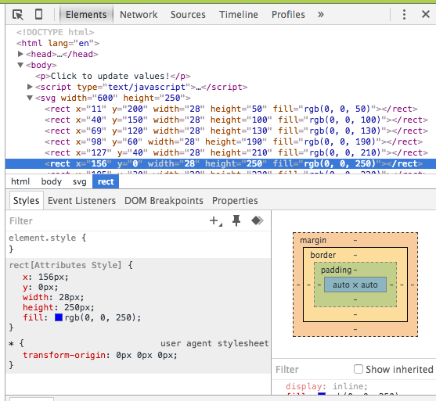
Interactive debugging
The Elements pane allows you to explore the DOM

Slide 16
Let’s make a D3 app!

Slide 17
Prepare your data
If preparing your data in R:
write.csv(df, file = yourFileName, row.names = FALSE, quote = FALSE)
D3 also has methods for reading in
JSON
HTML
XML
Text files

Slide 18
Load data into a Javascript object
d3.csv("data.csv", function(error, data) {
if (error) {
console.log(error);
} else {
// All of the code for our app!
// ...
// ...
}
})
At this point, data holds a Javascript object array of our data

Slide 19
Creating DOM elements
Create an svg container for our plots
var w = 500;
var h = 400;
var svg = d3.select("body").append("svg") .attr("width", w)
.attr("height", h);
Note: Most D3 methods return DOM selections. Useful in making sense of the frequent method chaining in D3.

Slide 20
Creating data-bound DOM elements
In general:
svg.selectAll(shape)
.data(dataset)
.enter()
.append(shape)
.attr(...)
Example:
svg.selectAll("circle")
.data(data)
.enter()
.append("circle")
.attr({
cx: function(d) { return xScale(d.meanDenom); },
cy: function(d) { return yScale(d.tstat); },
r: 2
});
Notes:
selectAll selects the nonexistent circles
data binds our data to these nonexistent circles and returns the update selection: this represents the selected DOM elements that were successfully bound to the specified data elements. The update selection also contains a reference to the enter and exit selections, for adding and removing nodes in correspondence with data.
enter: Returns the enter selection: placeholder nodes for each data element for which no corresponding existing DOM element was found in the current selection. This method is only defined on the update selection, which is returned by the data operator. In addition, the enter selection only defines the append, insert, select and call operators; you must use these operators to instantiate the entering elements before modifying any content. Enter selections also support empty and size.

Slide 21
Creating data-bound DOM elements
Example:
svg.selectAll("circle")
.data(data)
.enter()
.append("circle")
.attr({
cx: function(d) { return xScale(d.meanDenom); },
cy: function(d) { return yScale(d.tstat); },
r: 2
});
R translation: Say .append("circle") returns circleObjectVector where each element is a named list. Then .attr() is essentially doing:
cx <- lapply(circleObjectVector, function(circle) {
xScale(circle$meanDenom)
})
Notes:
selectAll selects the nonexistent circles
data binds our data to these nonexistent circles and returns the update selection: this represents the selected DOM elements that were successfully bound to the specified data elements. The update selection also contains a reference to the enter and exit selections, for adding and removing nodes in correspondence with data.
enter: Returns the enter selection: placeholder nodes for each data element for which no corresponding existing DOM element was found in the current selection. This method is only defined on the update selection, which is returned by the data operator. In addition, the enter selection only defines the append, insert, select and call operators; you must use these operators to instantiate the entering elements before modifying any content. Enter selections also support empty and size.

Slide 22
Functions as arguments in D3
When setting attributes or adding text via a method, D3 gives you functional access to the data bound to the selection:
.attr("cx", function(d, i) {
return xScale(d.meanDenom);
});
We have access to both the data d and its index i within the selection array.
R translation: Imagine being able to provide a two-function argument in lapply.
cx <- lapply(circleObjectVector, function(circle, i) {
xScale(circle$meanDenom)
})
Notes:
selectAll selects the nonexistent circles
data binds our data to these nonexistent circles and returns the update selection: this represents the selected DOM elements that were successfully bound to the specified data elements. The update selection also contains a reference to the enter and exit selections, for adding and removing nodes in correspondence with data.
enter: Returns the enter selection: placeholder nodes for each data element for which no corresponding existing DOM element was found in the current selection. This method is only defined on the update selection, which is returned by the data operator. In addition, the enter selection only defines the append, insert, select and call operators; you must use these operators to instantiate the entering elements before modifying any content. Enter selections also support empty and size.

Slide 23
Functions as arguments in D3
.attr("cx", function(d, i) {
return xScale(d.meanDenom);
});
Another way to think about d and i is that d refers to the entire row of the data table and i is the (0-based) row number:
p variables
d
row i+1
n
observations
Notes:
selectAll selects the nonexistent circles
data binds our data to these nonexistent circles and returns the update selection: this represents the selected DOM elements that were successfully bound to the specified data elements. The update selection also contains a reference to the enter and exit selections, for adding and removing nodes in correspondence with data.
enter: Returns the enter selection: placeholder nodes for each data element for which no corresponding existing DOM element was found in the current selection. This method is only defined on the update selection, which is returned by the data operator. In addition, the enter selection only defines the append, insert, select and call operators; you must use these operators to instantiate the entering elements before modifying any content. Enter selections also support empty and size.

Slide 24
D3 Scales: where/how big do I draw?
Need to map data values to plotting region
d3.scale.linear()
Data range
.domain(...)
-10
10
.range(...)
Plotting range
0px
300px
var xScale = d3.scale.linear()
.domain(d3.extent(data, function(d) { return d.meanDenom; }))
.range([padding, w - padding*2]);
R translation:
range(sapply(data, function(d) {
d$meanDenom
}))
Notes:
selectAll selects the nonexistent circles
data binds our data to these nonexistent circles and returns the update selection: this represents the selected DOM elements that were successfully bound to the specified data elements. The update selection also contains a reference to the enter and exit selections, for adding and removing nodes in correspondence with data.
enter: Returns the enter selection: placeholder nodes for each data element for which no corresponding existing DOM element was found in the current selection. This method is only defined on the update selection, which is returned by the data operator. In addition, the enter selection only defines the append, insert, select and call operators; you must use these operators to instantiate the entering elements before modifying any content. Enter selections also support empty and size.

Slide 25
Interactivity
Apply the mouseover and mouseout event listeners to each selected circle
svg.selectAll("circle")
.on("mouseover", function(d) {
d3.select(this).attr({
fill: "red",
r: 5
});
})
.on("mouseout", function(d) {
d3.select(this).attr({
fill: "black",
r: 2
});
});
Restore initial display.

Slide 26
References
Interactive Data Visualization for the Web Scott Murray http://chimera.labs.oreilly.com/books/1230000000345/index.html
Mike Bostock’s documentation: https://github.com/mbostock/d3/wiki

