Slide 1
MINIJ-PAS-PDR201912
60 filters (gSDSS,iSDSS,J0378,J0390-J0910,J1007,rSDSS,uJAVA,uJPAS)
covering a total area of ~ 1 deg².
RA = 214.2825, DEC = 52.5143
based on images collected by the JST/T250 telescope and the Pathfinder instrument.

Slide 2
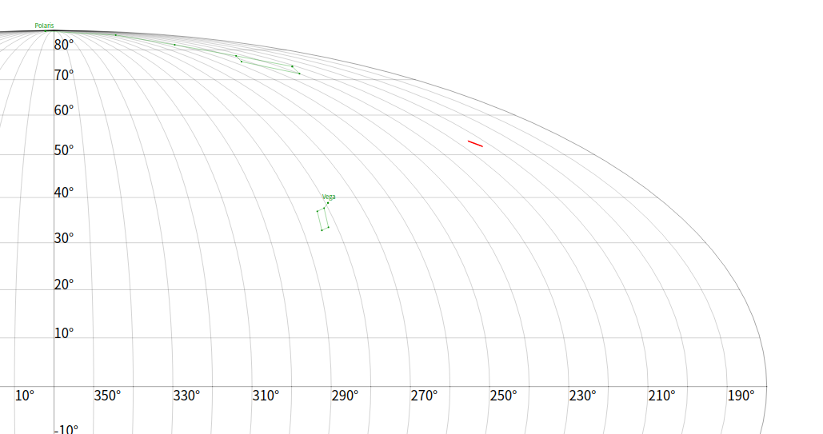
Coverage Map (ICRS frame)

Slide 3
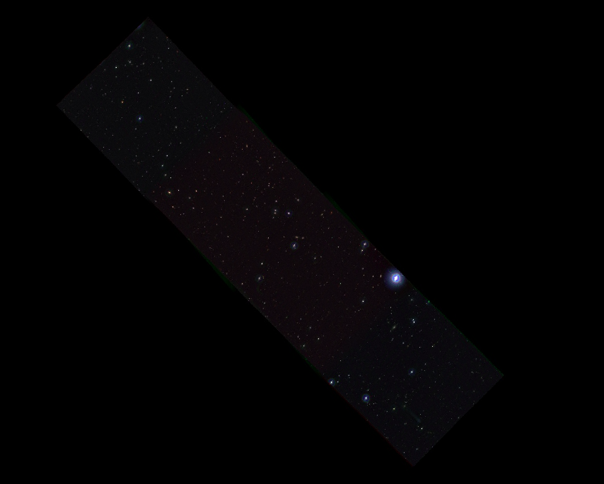

Slide 4
AEGIS001-v201912_J0400_swp info(ID = 2235)
FWHM = 1.61
Depth（2FWHHM5s）= 23.7
Depth（3Arc5s）= 23.7
Depth（Arcsec2）= 24.8
Zero Point = 22.60
sigma（zero point）= 0.04
ZPT Procedure ：SL
TExposed = 1080.00
Efectime = 1052.16
NCombined = 9
Datasum = 3865438706

Slide 5
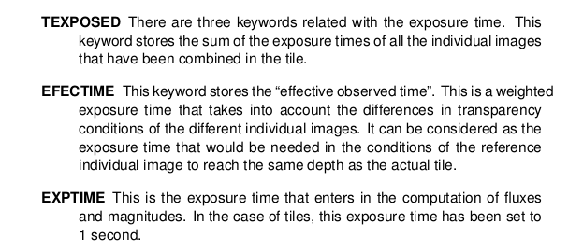
Manual

Slide 6
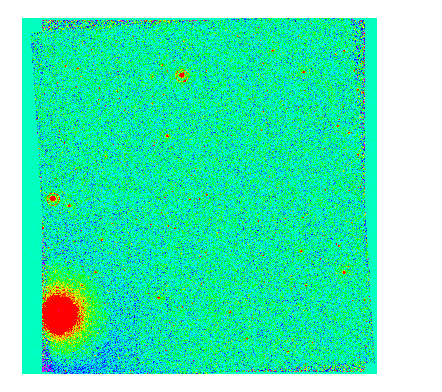
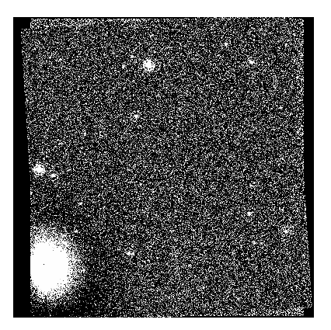
DS9(边缘有噪点)

Slide 7
J0400 header

Slide 8
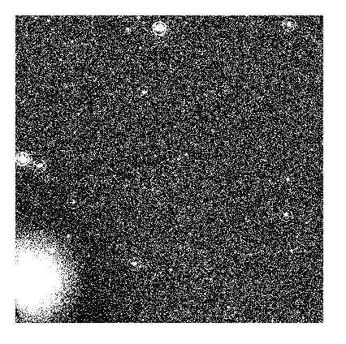
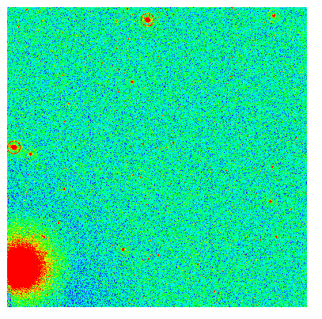
iraf: [600:7600,500:7500]

Slide 9
Source extrator (all default)
得到了以下文件：
J0400.cat
orig.fits
prof.fits
subprof.fits

Slide 10
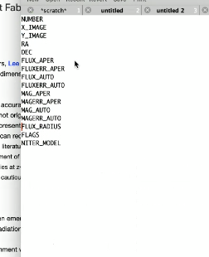

To do list
unzip fz
cut image keep WCS
加RA DEC key words
2 小

Slide 11
SExtractor-Input:the Configuration File
Image Information
Background Estimation
Finding and Separating Objects
Detetion,Thresholds
Filtering
Deblending
Cleaning

Slide 12
SExtractor-Output parameters
Photometric param
Astrometric param
Geometric param
Radii
Object classification
ASSOC output
Flags
Fitted param

Slide 13
To do list
mag zeropoint
AB sloan mag
! aper photometry
sloan color transformation:sloan catlog , cross-match
how to get s/n
s/n formulae
iraf/pyraf

Slide 14
Astro magnitude
general defination：
traditional mags are defined form the near-UV to the mid-IR with reference to the AO star α Lyrae ---Vega, which by definition has mag = 0 in all passbands.(primary standard)
AB magnitude
flux density------energy, per area, per time, in unit frequency
1 Jy = 10²⁶ J/(s·m²·Hz)=10²³ ergs/(s·cm²·Hz)
flux density in units of ergs/(s·cm²·Hz)

Slide 15
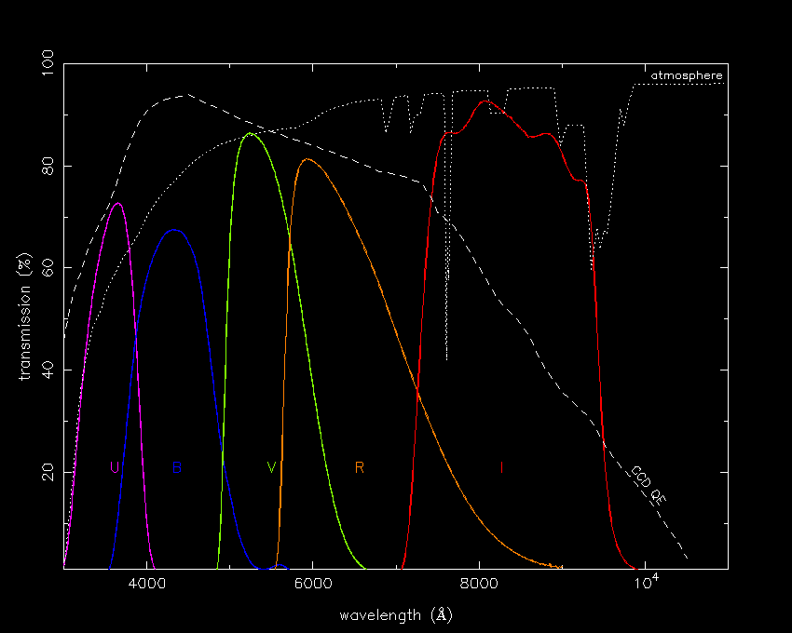
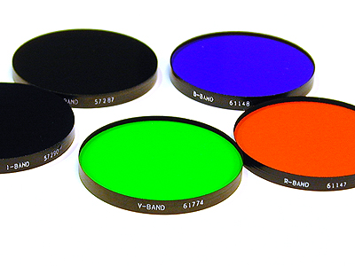
UBVRI system/Johnson-Morgan-Cousins system
the transmission of the atmosphere (dotted line)
the quantum efficiency of a typical CCD (dashed line).
Notes:
http://www.vikdhillon.staff.shef.ac.uk/teaching/phy217/instruments/phy217_inst_photsys.html

Slide 16
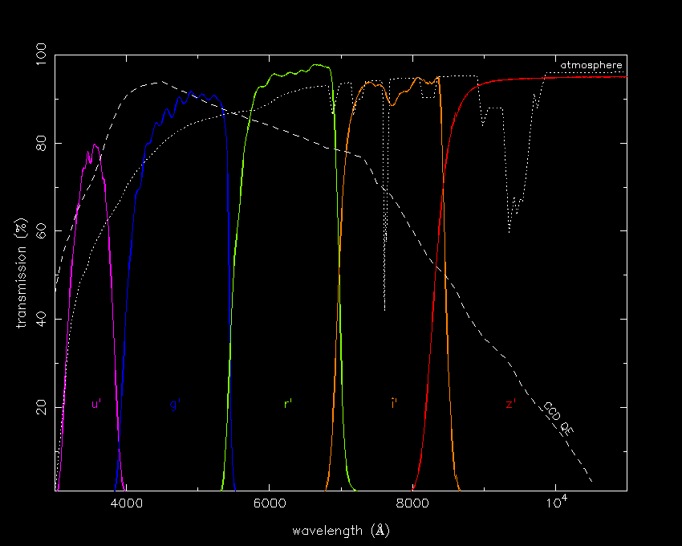
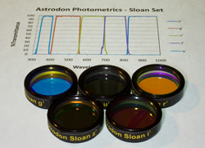
Sloan Digital Sky Survey (SDSS) u'g'r'i'z' system
the transmission of the atmosphere (dotted line)
the quantum efficiency of a typical CCD (dashed line).

Slide 17
From counts to calibrated magnitde
Divide the number of counts by the exposure time, to get a measure of flux in counts per second.
Calculate the instrumental magnitude, from the counts per second
Determine the extinction coefficient, and correct the instrumental magnitude to the above-atmosphere value.
Repeat the above steps for a standard star and use the resulting above-atmosphere instrumental magnitude of the standard star to calculate the zero point./catlogue cross-match with required system
Use the zero point to transform the above-atmosphere instrumental magnitude of the target star to the required photometric system.
Notes:
http://slittlefair.staff.shef.ac.uk/teaching/phy217/lectures/principles/L04/index.html#instmags
http://classic.sdss.org/dr7/algorithms/sdssUBVRITransform.html

Slide 18
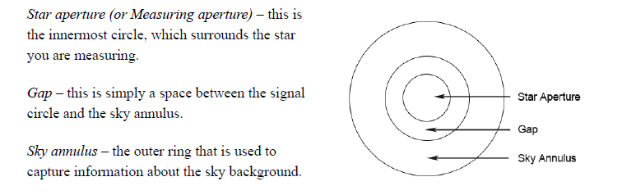
Aperture photometry
Diameter of star aperture: 3-4 average FWHM
Diameter of inner sky annulus: 5 average FWHM

Slide 19
Signal to Noise Rate (S/N)
the CCD S/N equation:
√S_{source} , shot-noise in the detected photo-electrons from the source;
√S_{sky} , shot-noise in the detected photo-electrons from the sky background;
√S_{dark} , shot-noise in the thermally excited electrons, i.e the dark current;
R, time-independent readout noise. Note there is no square root here. The readout noise is the standard deviation in the number of electrons measure - it is not a Poissonian counting process.
Notes:
http://slittlefair.staff.shef.ac.uk/teaching/phy217/lectures/instruments/L14/index.html

Slide 20
Signal to Noise Rate (S/N)
CCD equation in units of counts (ADU)
Generally, we have:
S_{source} : photon-counts per second
S_{sky} : photon-counts per second, per pixel
S_{dark} : electrons per second, per pixel
R : electrons per pixel
So, all use electrons, we get:
G,Gain,in units of e-/ADU
exposure time
# of pixels in the measure aperture

Slide 21
To do list
example
find LAE cat
find some point source ,do the FWHM measurement

Slide 22
Calculate
J-PLUS-01488-iSDSS
pixscale = 0.5556
imexam.a:
4596.78 4641.58 4596.78 4641.58
6.19 19.79 121. 0.01206 17.3 0.23 -37 14.8 1.99 2.11 2.06
seeing = pixscale * FWHM = 1.1445 arcsec2

Slide 23
J-PLUS Lya Nebula
example：1000001-JPLUS-00525-v2

Slide 24
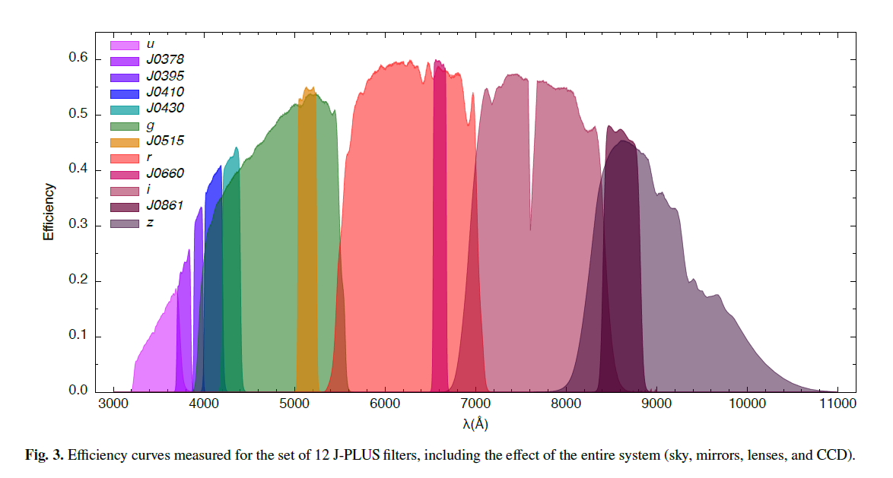
Filters

Slide 25
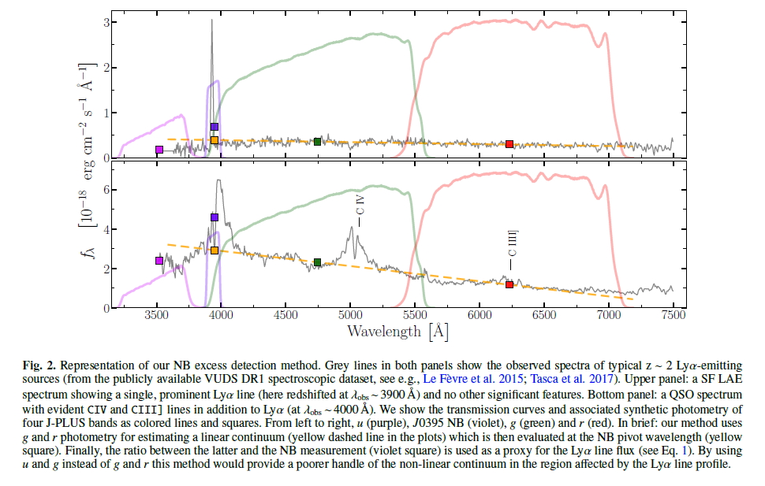
3-filters method

Slide 26
