Slide 2


Exp 2: Elasticity
Test Phases (1000 msg/s Burst)
Baseline
Burst
10 msg/s
1000 msg/s
Medium Load
Scale Down
100 msg/s
Recovery
Notes:
In this experiment, we wanted to see how quickly our system can react when traffic suddenly increases.
We tested four phases: a baseline at 10 messages per second, a medium load at 100, a burst of 1000 messages per second, and finally the recovery period where traffic drops again.

Slide 3
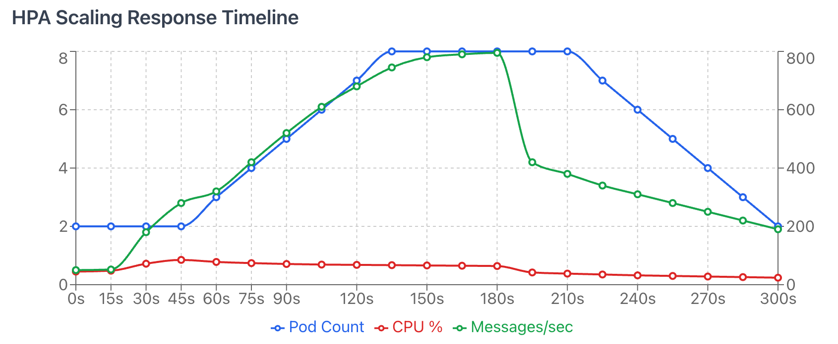
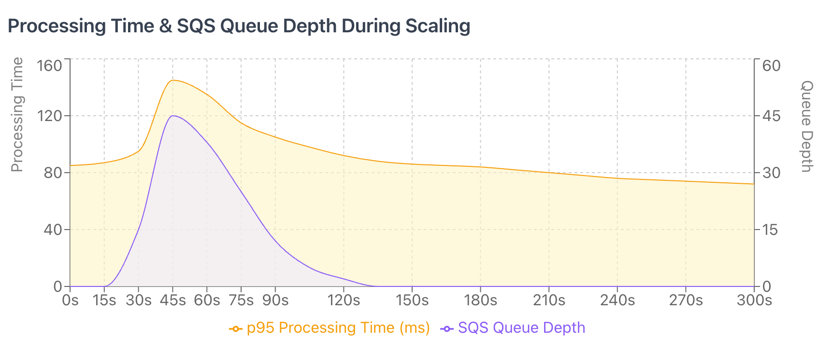
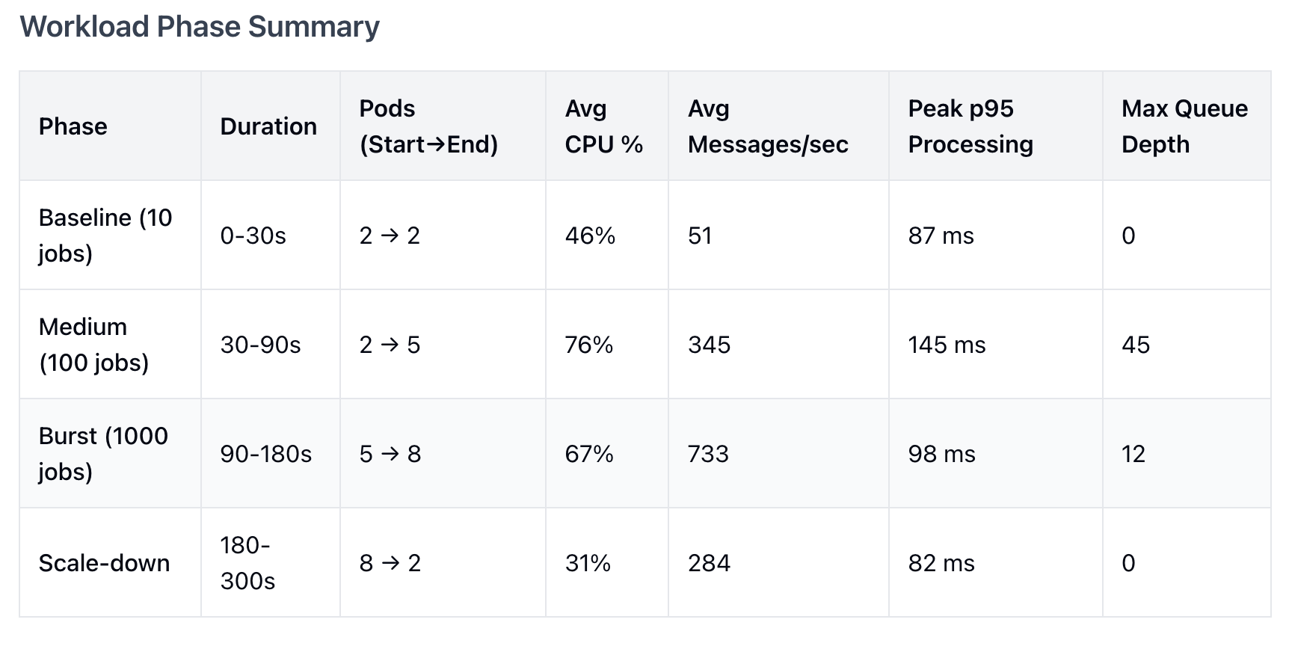
Exp 2 Results: Scaling Response
Rapid Scale-Up:
Pods increased 2 → 8 during burst.
Queue Mgmt:
Peaked at 45 msgs, cleared by 135s.
Stable Latency:
p95 stabilized at ≈85ms after initial spike.
Notes:
From the first chart, we see that When the burst starts, CPU goes above the target and the system scales from 2 to 8 pods. The queue briefly grows to around 45 messages but is cleared quickly, and p95 latency returns to normal.
The second chart shows that both queue depth and processing time increase at the start of the burst but return to normal as new pods come online, confirming that HPA handles the burst well.
Across all phases, pods scale from 2→5 under medium load and 2→8 during the burst, then smoothly scale down with no oscillation.
From the first chart we can see how the system reacts during the burst.
At the start, only two pods are running. When the load increases, CPU rises above the HPA target, and the system scales up to eight pods.
The queue briefly spikes to around 45 messages, but the workers clear it by about 135 seconds.
We also see that p95 processing time spikes once during the burst, and then stabilizes around 85 milliseconds.
From the second chart we see the relationship between processing time and queue depth.
When the burst begins, both curves rise quickly, which is expected.
But as new pods come online, queue depth drops and processing time returns to normal.
This confirms that HPA prevents long-term congestion in the system.
This table summarizes all phases.
In medium load, pods grow from 2 to 5, and during the burst, they reach 8.
After the burst ends, the system scales down smoothly with no oscillation.

Slide 4


Exp 2 Analysis
Successes
Limitations
HPA prevented long-term backlog.
CPU is an indirect load signal.
Balanced throughput vs. resource cost.
Recommendation: Use KEDA for queue-depth based autoscaling for faster reaction.
Smooth scale-down (no oscillation).
Notes:
HPA successfully prevented backlog buildup and kept latency stable, and scale-down was smooth. However, relying on CPU as a signal is slower than using queue depth, so a queue-based autoscaler like KEDA would respond more quickly to bursts.
In terms of successes, HPA prevented a long backlog and kept latency under control.
Scale-down was smooth, and the system stayed stable throughout the test.
However, CPU is an indirect signal — it reacts slower than queue depth.
A better approach would be queue-based autoscaling, for example using KEDA, which could react even faster to sudden bursts.In terms of successes, HPA prevented a long backlog and kept latency under control.

Slide 5


Exp 3: Fault Tolerance
Scenario 1: Malformed XML
Scenario 2: S3 Outage
Scenario 3: 7/8 Pods Dropped
Notes:
The goal of Experiment 3 is to understand how the system behaves when failures happen.
We test three scenarios: malformed XML input, an S3 outage, and losing most of our worker pods.
For each scenario, we want to see whether the system isolates the error, continues running, and recovers properly.

Slide 6
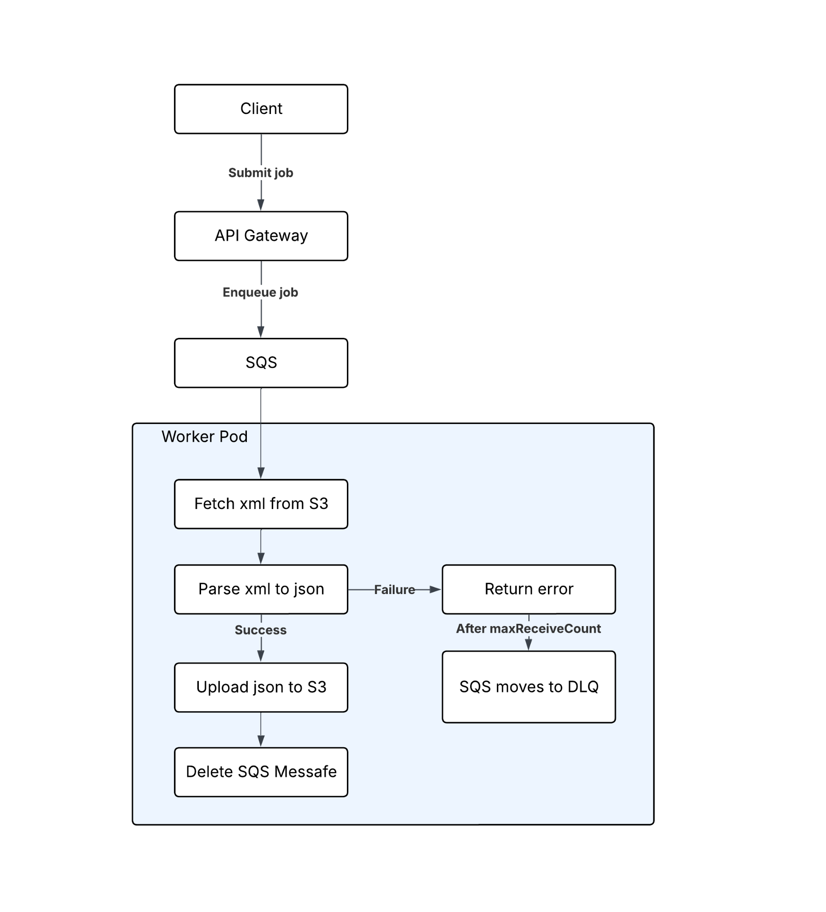
Exp 3 Results: Malformed XML Input
Scenario 1: Malformed XML
987 (98.7%) bad messages detected & moved to DLQ.
0 Pod crashes.
Clean Isolation: Parsing failures did not cascade.
Notes:
This scenario shows how the system handles invalid XML. When a malformed file is encountered, the worker fails fast without crashing or retrying indefinitely. After reaching the configured maxReceiveCount, SQS automatically sends the message to the DLQ.
This scenario tests what happens when workers receive invalid XML.
The risk here is that one bad message might crash the worker or block other jobs.
The diagram on the right shows the full flow.
Workers pull a message from SQS, fetch the XML from S3, and try to parse it.
When the XML is malformed, the worker immediately returns an error.
It does not retry endlessly or crash.
After the message hits the maxReceiveCount configured in SQS, the queue automatically moves it to the DLQ.

Slide 7
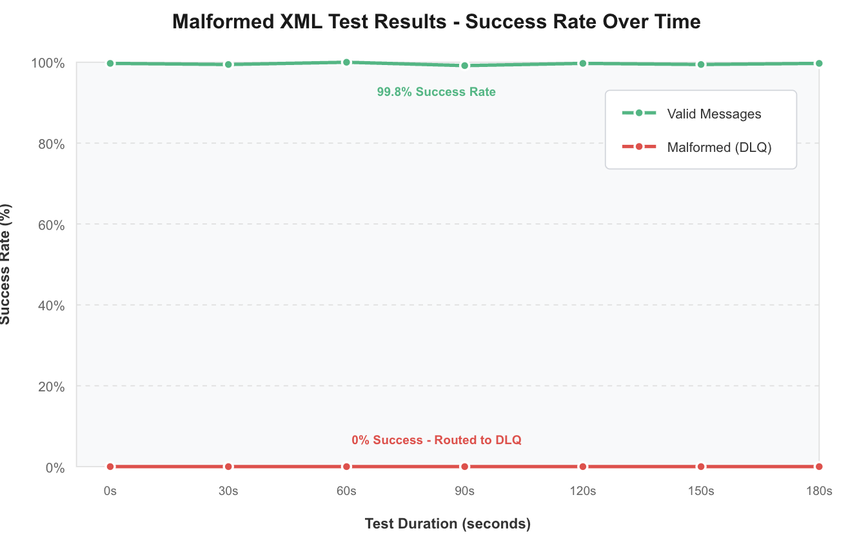
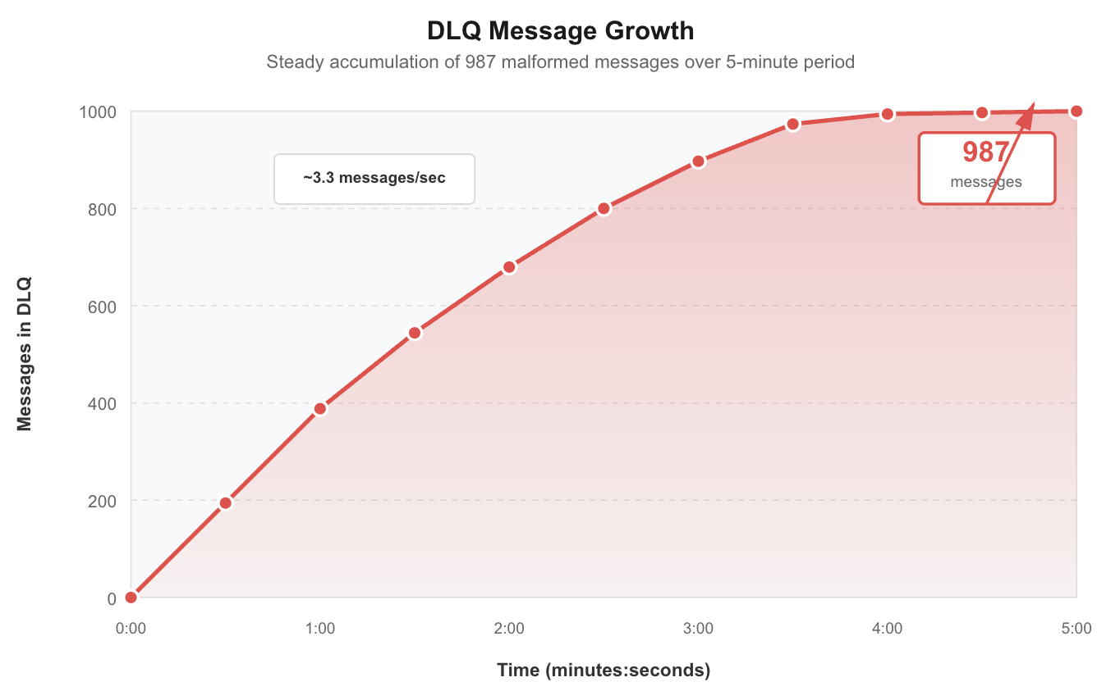
Exp 3 Results: Malformed XML Input
Notes:
Workers immediately detected the malformed XML and failed fast without crashing. SQS moved 987 invalid messages to the DLQ after retries were exhausted, while valid messages continued processing normally, showing that parsing errors were fully isolated. A possible improvement is adding richer DLQ metadata to surface specific parsing errors.
During this test, workers pulled messages from SQS as usual, attempted to parse them, and immediately detected that the XML structure was invalid.
Instead of retrying endlessly or crashing, each worker returned an error once, and SQS automatically moved the message to the DLQ after exceeding the retry limit.
In total, 987 malformed messages were routed to the DLQ, and no pods crashed or restarted.
Valid messages continued to be processed normally, confirming that parsing failures are fully isolated.
One improvement we could add is richer DLQ metadata — for example, tagging each failed message with the exact parsing error — so operators can quickly identify bad input sources.

