Slide 1
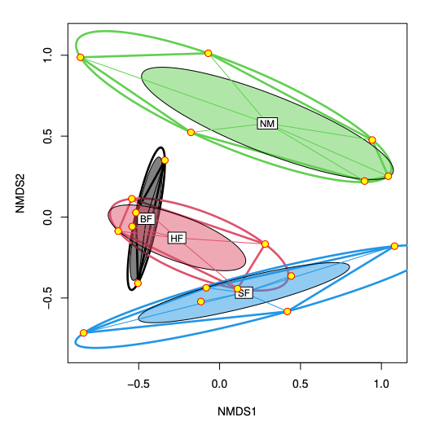
Sources of multivariate data
Dr John Dwyer CONS7008

Slide 2
Multivariate data
More than one response variable!
Multiple correlated variables

Slide 3
Common types
Climate / soil data
Multiple variables measured at each site
Trait data
Multiple measurements taken on each species or individual
Genetic data
Expression of multiple genes measured in each individual
Composition matrices
Presence / absence
Abundance

Slide 4
Some applications
Multivariate hypothesis testing
MANOVA (multivariate ANOVA)
Redundancy analysis (RDA; like a multivariate regression)
Correlation analysis / Dimension reduction
PCA
Clustering
E.g. K-Means
Classification
Linear discriminant analysis

Slide 5
Let’s have a look in R

