Slide 1
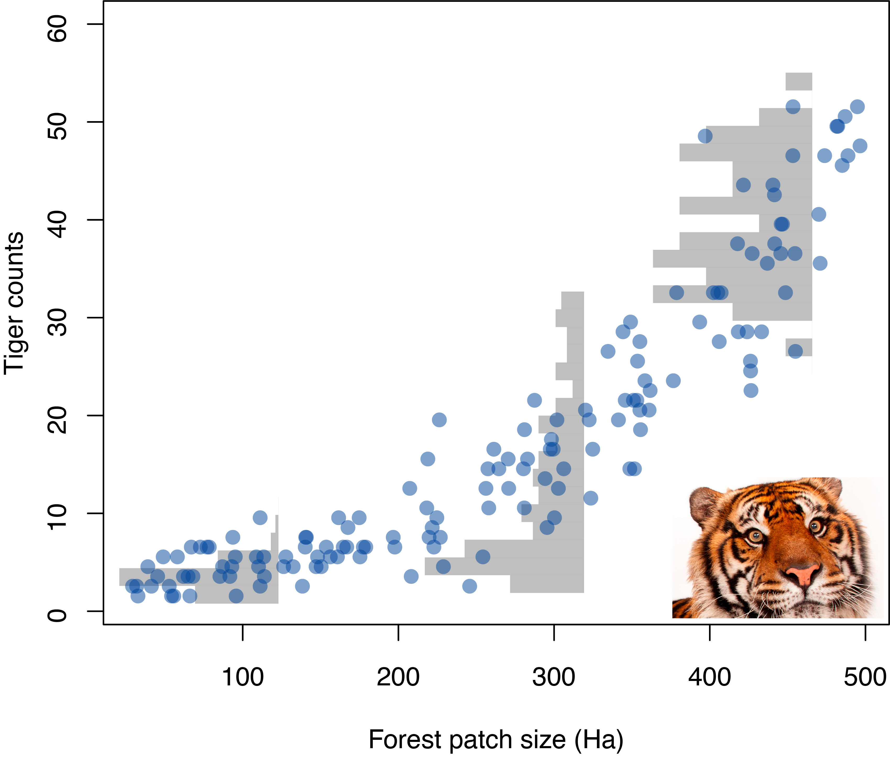
Generalised linear models
Dr John Dwyer CONS7008
Notes:
1

Slide 2
Where are we up to?
W1: Tidy Data
W2: Sampling from populations
W3: Hypothesis testing
W4: Linear models (Regression)
W5: Linear models (ANOVA)
W6: Linear models (Multiple regression)
W7: Mixed-effects models
W8: Generalised linear models
W9: Datavis
W10: Multivariate statistics and PCA
W11: Research proposal presentations

Slide 3
Statistical models in general
The thing we are trying to explain
Left over stuff that we can’t explain
=
The part that we can explain
+

Slide 4
Linear models (LMs)
The thing we are trying to explain
Left over stuff that we can’t explain
=
The part that we can explain
+
y_{i} ~ Normal(μ_{i}, σ)
μ_{i} = α + βx_{i}

Slide 5
Generalised linear models (GLMs)
The thing we are trying to explain
Left over stuff that we can’t explain
=
The part that we can explain
+
y_{i} ~ Normal(μ_{i}, σ)
μ_{i} = α + βx_{i}
y_{i} ~ Some distribution(Par1_{i}, Par2)
Link function(Par1_{i}) = α + βx_{i}

Slide 6
Generalised linear models (GLMs)
y_{i} ~ Some distribution(Par1_{i}, Par2)
Link function(Par1_{i}) = α + βx_{i}

Slide 7
Generalised linear models (GLMs)
y_{i} ~ Some distribution(Par1_{i}, Par2)
Link function(Par1_{i}) = α + βx_{i}
“Linear predictor”

Slide 8
Generalised linear models (GLMs)
y_{i} ~ Some distribution(Par1_{i}, Par2)
Link function(Par1_{i}) = α + βx_{i}
y_{i} ~ Binomial(n = 1, p_{i})
Binary response
logit(p_{i})= α + βx_{i}

Slide 9
Generalised linear models (GLMs)
y_{i} ~ Some distribution(Par1_{i}, Par2)
Link function(Par1_{i}) = α + βx_{i}
y_{i} ~ Binomial(n = 1, p_{i})
Binary response
logit(p_{i})= α + βx_{i}
# successes,
# failures
y_{i} ~ Binomial(n, p_{i})
logit(p_{i})= α + βx_{i}

Slide 10
Generalised linear models (GLMs)
y_{i} ~ Some distribution(Par1_{i}, Par2)
Link function(Par1_{i}) = α + βx_{i}
y_{i} ~ Binomial(n = 1, p_{i})
Binary response
logit(p_{i})= α + βx_{i}
# successes,
# failures
y_{i} ~ Binomial(n, p_{i})
logit(p_{i})= α + βx_{i}
y_{i} ~ Poisson(λ_{i})
Count response
log(λ_{i})= α + βx_{i}

Slide 11
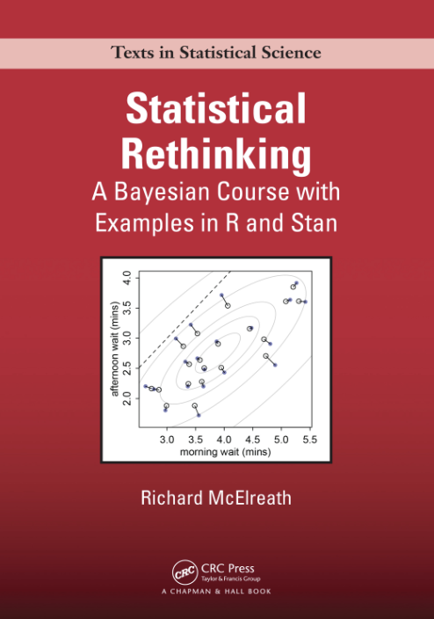
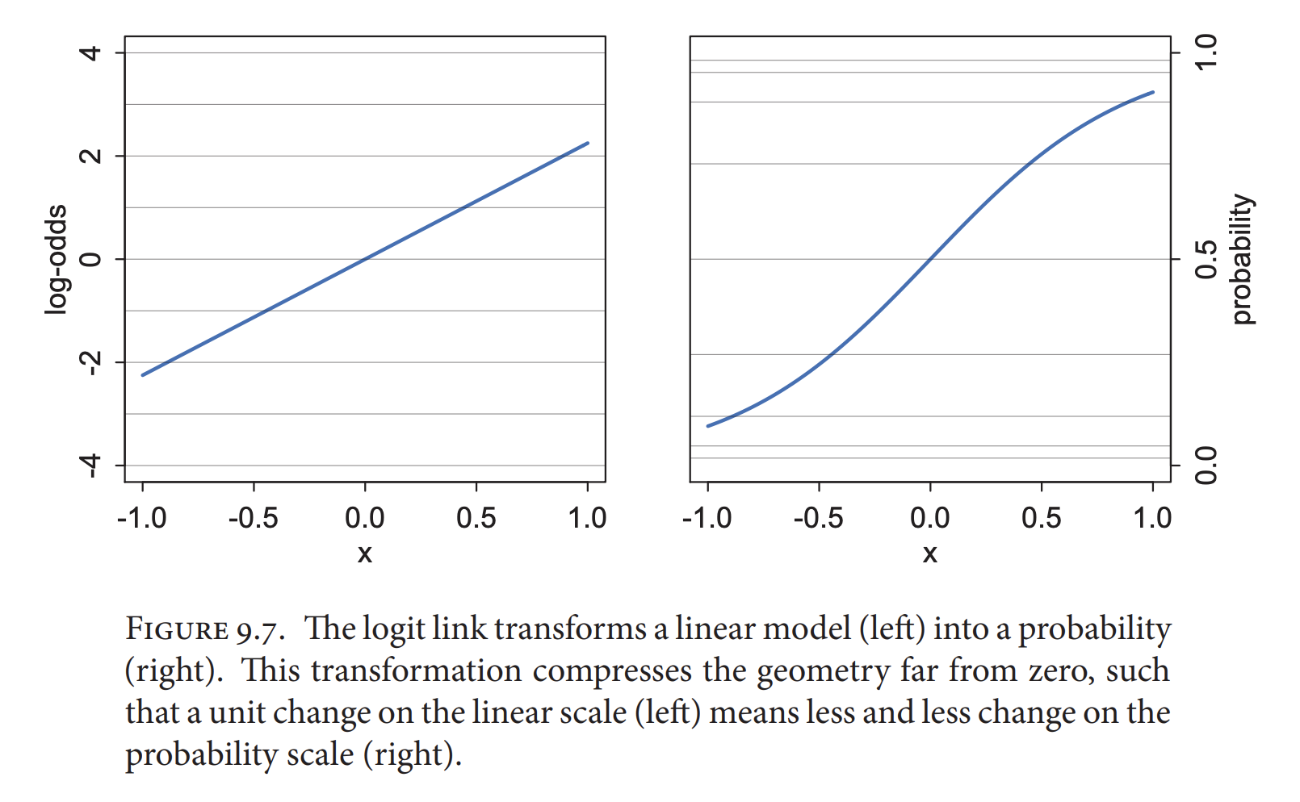
y_{i} ~ Binomial(n, p_{i})
logit(p_{i})= α + βx_{i}
Logits (AKA “log-odds”)

Slide 12
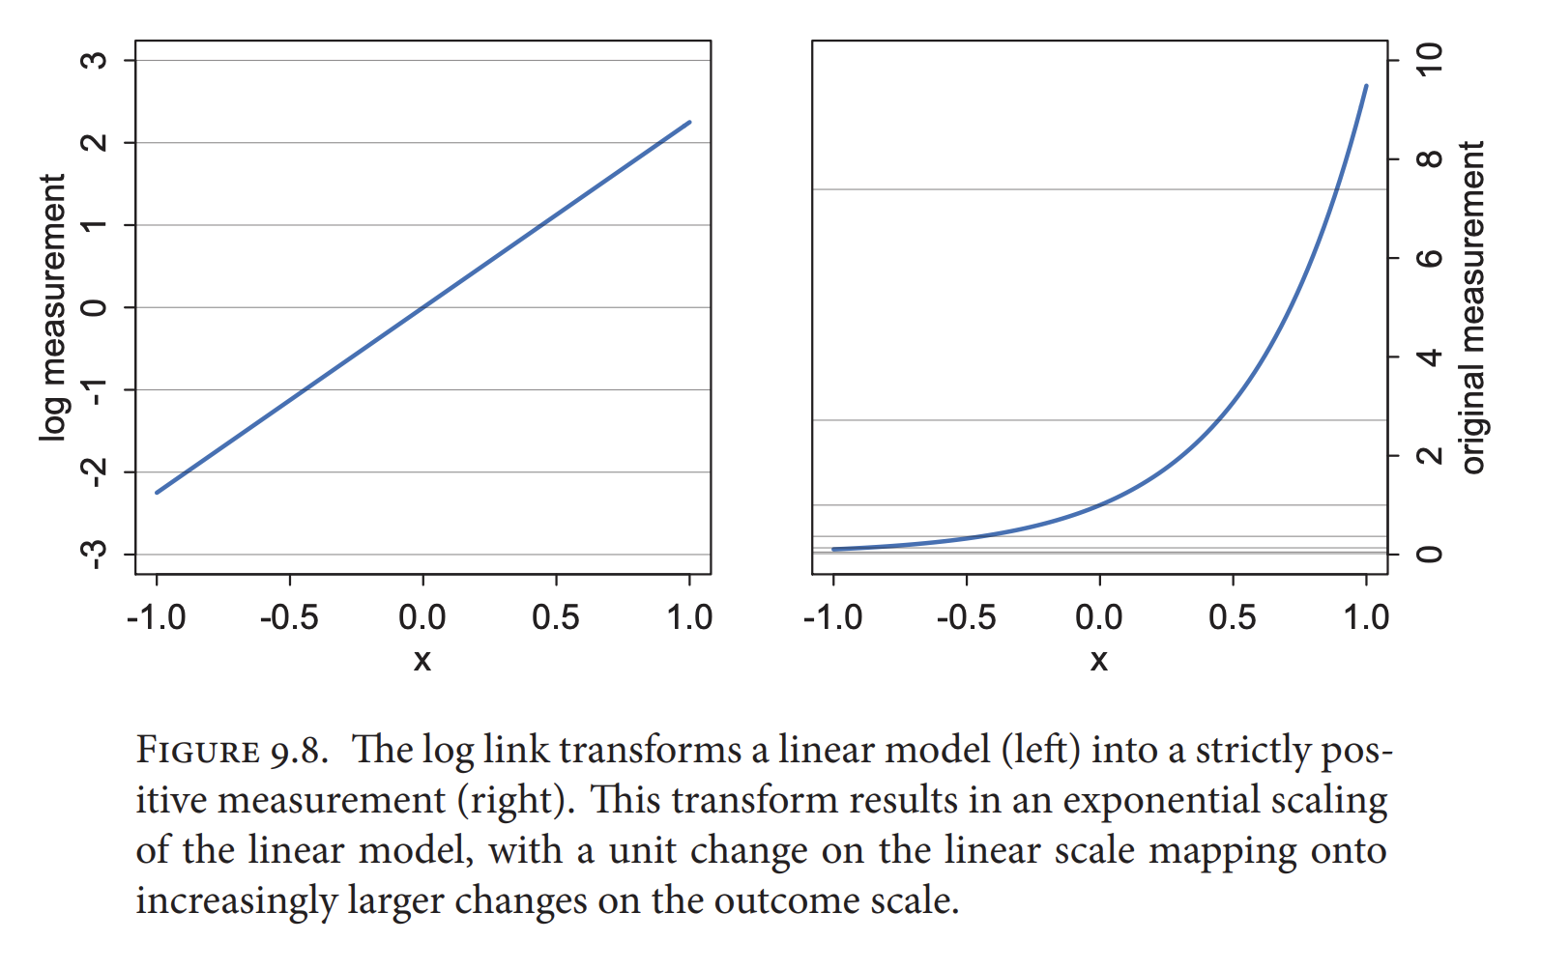
y_{i} ~ Poisson(λ_{i})
log(λ_{i})= α + βx_{i}

Slide 13
Why GLMs? (1) Respecting the bounds!
1
Fish Survival
0
Maximum temperature (deg C)

Slide 14
Why GLMs? (1) Respecting the bounds!
1
Fish Survival
0
Maximum temperature (deg C)

Slide 15
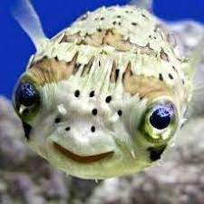

Why GLMs? (1) Respecting the bounds!
Fish can’t be more alive than alive
1
Fish Survival
0
Fish can’t be more dead than dead
Maximum temperature (deg C)

Slide 16
Why GLMs? (1) Respecting the bounds!
Fish can’t be more alive than alive
1
Fish Survival
0
Fish can’t be more dead than dead
Maximum temperature (deg C)

Slide 17
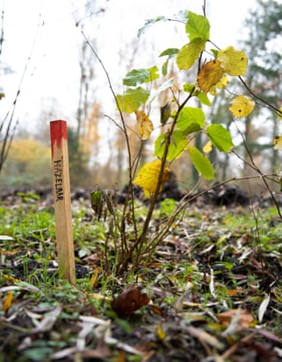
Why GLMs? (1) Respecting the bounds!
600
Seedling count
0
Recent rainfall (mm in last 3 months)

Slide 18
Why GLMs? (1) Respecting the bounds!
600
Seedling count
0
Recent rainfall (mm in last 3 months)
Can’t count fewer than zero seedlings!

Slide 19
Why GLMs? (1) Respecting the bounds!
600
Seedling count
0
Recent rainfall (mm in last 3 months)
Can’t count fewer than zero seedlings!

Slide 20
Why GLMs? (2) Appropriate error distributions

Slide 21
Why GLMs? (2) Appropriate error distributions
In this case the residuals spread more as the average count increases!
600
Seedling count
And counts are “discrete”, not continuous! So we should use a discrete error distribution
0
Recent rainfall (mm in last 3 months)

Slide 22

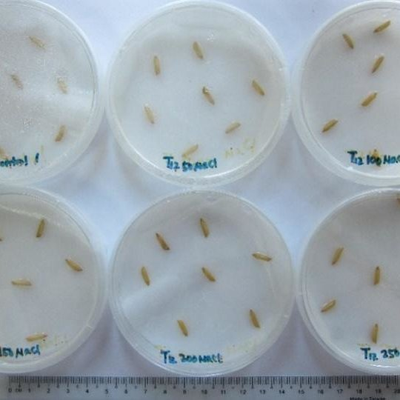
Three treatments:
Control (wet filter paper)
Warm after-ripening
Smoke chemical
Rhodanthe manglesii (hubba hubba!)

Slide 23
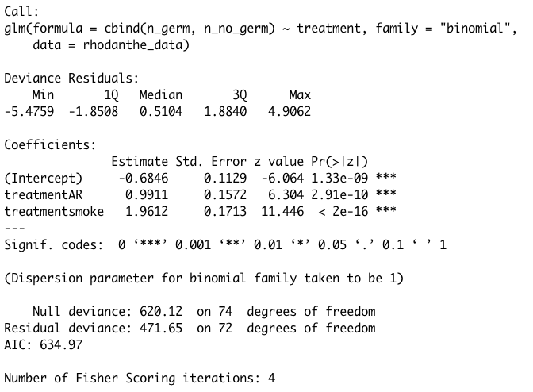
Rhodanthe germination data
> rhodanthe_glm<-glm(cbind(n_germ, n_no_germ) ~ treatment, family="binomial", data = rhodanthe_data)
> summary(rhodanthe_glm)

Slide 24
GLM summary tables
Same format as LMs!

Slide 25
GLM summary tables
Same format as LMs!
For this binomial model the parameter estimates are in logits (AKA log-odds)

Slide 26
GLM summary tables
Same format as LMs!
For this binomial model the parameter estimates are in logits (AKA log-odds)
Simple back-transformation to get probabilities!
> plogis(-0.6846) ## average control prob of germination = 0.335
> plogis(-0.6846 + 0.9911) ## average AR prob of germination = 0.576
> plogis(-0.6846 + 1.9612) ## average smoke prob of germination = 0.782

Slide 27
The thing we are trying to explain
Left over stuff that we can’t explain
=
The part that we can explain
+
What if our chosen distribution doesn’t “mop up” all the unexplained variation???

Slide 28
Overdispersion!!!
The thing we are trying to explain
Left over stuff that we can’t explain
=
The part that we can explain
+
What if our chosen distribution doesn’t “mop up” all the unexplained variation???
y_{i} ~ Poisson(λ_{i})
y_{i} ~ Binomial(n, p_{i})
log(λ_{i})= α + βx_{i}
logit(p_{i})= α + βx_{i}

Slide 29
Overdispersion
The residual deviance should be roughly the same as the residual degrees of freedom

Slide 30
Overdispersion
In this case the residual deviance is about 6 times larger than the residual DF…this is OVERDISPERSION!!!

Slide 31
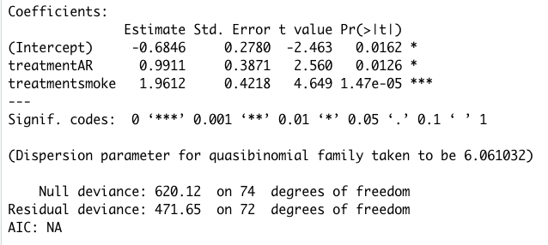
Dealing with overdispersion
> rhodanthe_glm2<-glm(cbind(n_germ, n_no_germ) ~ treatment, family=”quasibinomial", data = rhodanthe_data)
> summary(rhodanthe_glm2)

Slide 32
Dealing with overdispersion
> rhodanthe_glm2<-glm(cbind(n_germ, n_no_germ) ~ treatment, family=”quasibinomial", data = rhodanthe_data)
> summary(rhodanthe_glm2)
Notice that the estimates are the same!!!

Slide 33
Dealing with overdispersion
> rhodanthe_glm2<-glm(cbind(n_germ, n_no_germ) ~ treatment, family=”quasibinomial", data = rhodanthe_data)
> summary(rhodanthe_glm2)
But the standard errors have increased and P vals decreased

Slide 34
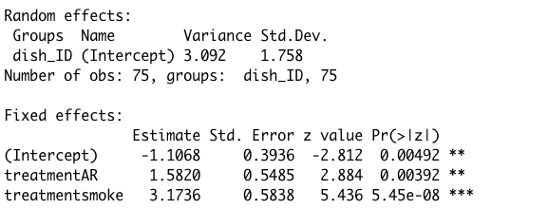
Dealing with overdispersion
> rhodanthe_glmer<-glmer(cbind(n_germ, n_no_germ) ~ treatment
+ (1 | dish_ID), family=”binomial", data = rhodanthe_data)
> summary(rhodanthe_glmer)

Slide 35
Dealing with overdispersion
> rhodanthe_glmer<-glmer(cbind(n_germ, n_no_germ) ~ treatment
+ (1 | dish_ID), family=”binomial", data = rhodanthe_data)
> summary(rhodanthe_glmer)

Slide 36
Dealing with overdispersion
> rhodanthe_glmer<-glmer(cbind(n_germ, n_no_germ) ~ treatment
+ (1 | dish_ID), family=”binomial", data = rhodanthe_data)
> summary(rhodanthe_glmer)
Estimates, SEs and P-vals have all changed

Slide 37
Dealing with overdispersion
> rhodanthe_glmer<-glmer(cbind(n_germ, n_no_germ) ~ treatment
+ (1 | dish_ID), family=”binomial", data = rhodanthe_data)
> summary(rhodanthe_glmer)
Compare back-transformed probabilities
> plogis(-1.1068) ## average control prob of germination = 0.248 (was 0.335)
> plogis(-1.1068 + 1.5820) ## average AR prob of germination = 0.617 (was 0.576)
> plogis(-1.1068 + 3.1737) ## average smoke prob of germination = 0.888 (was 0.782)

Slide 38
Key points
Generalised linear models (GLMs) allow us to model non-normal response variables. They use two tricks:
A link function that links the “linear predictor” to the response variable
An error distribution that describes the scatter in the data more appropriately than a normal distribution
The most common types of GLMs are Poisson, binomial and negative binomial
Poisson and some binomial GLMs are prone to overdispersion
Where the chosen error distribution doesn’t describe all of the scatter in the residuals
We can “mop up” the remaining scatter using a normal distribution via “observation- level” random effects

