Slide 1
Project Update: rrs gene
Le Na Ngo

Slide 2
Step 5: Processing and filtering of raw output
Selected_sequence: 510-920
 | raw_output | filtered_output | filtered_output (align_2000) | filtered_output (dist_190) | filtered_output (dist_190 + align_2000)
min_seq_length |  | 1200 | 1200 | 1200 | 1200
min_align_score |  | -Inf | -2000 | -Inf | -2000
max_core_dist |  | 220 | 220 | 190 | 190
Total number of rows | 697748 | 145477 | 126834 | 121472 | 113787
Number of rows (contain NA values) | 52611 (Nt_target)
Number of distinct species | 17508 | 16691 | 14898 | 13979 | 13116
Number of genomes with more than one rrs sequence | 6821 | 6553 | 5730 | 5494 | 5115

Slide 4
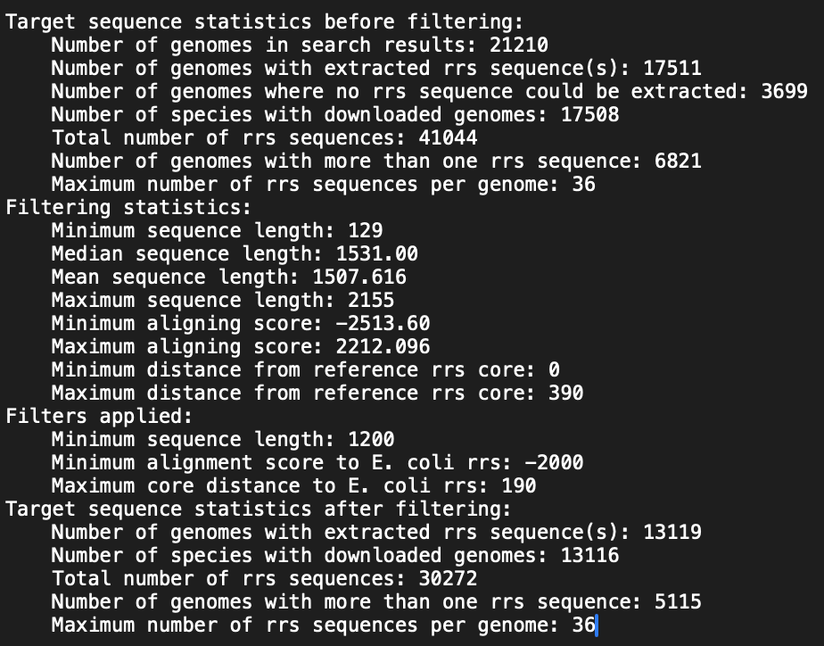
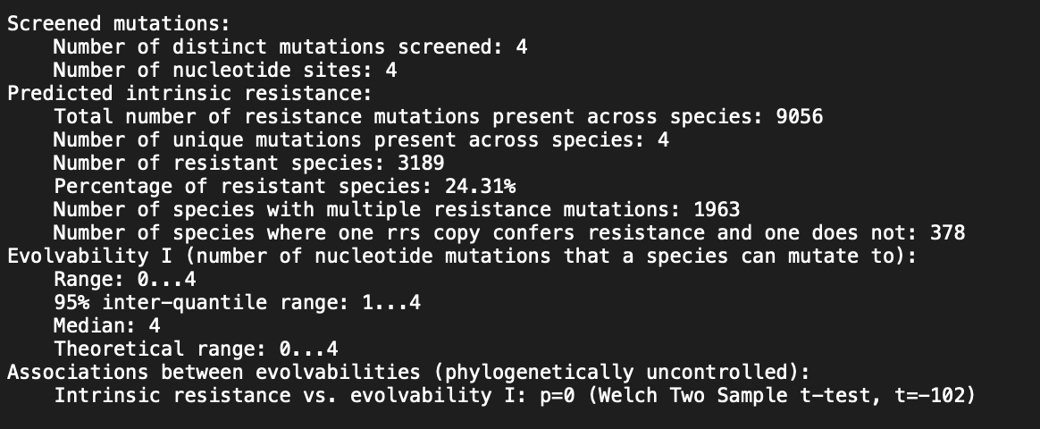
Summary

Slide 7
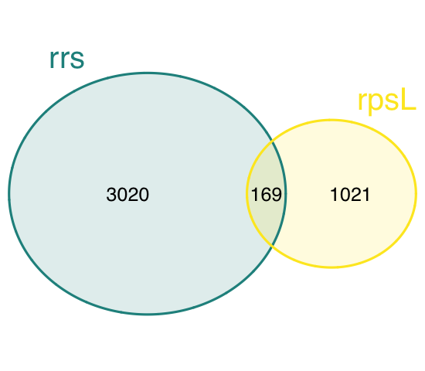

Slide 8
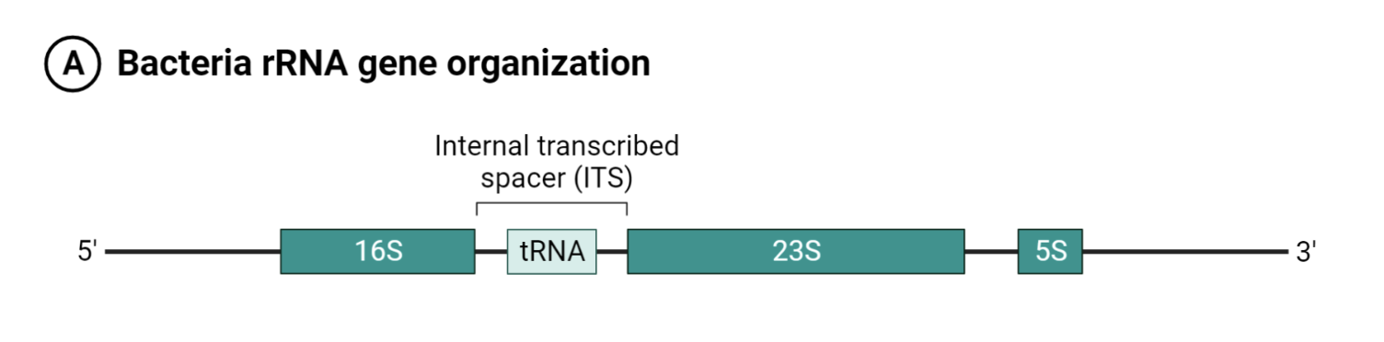
16S rRNA (rrs)

Slide 9
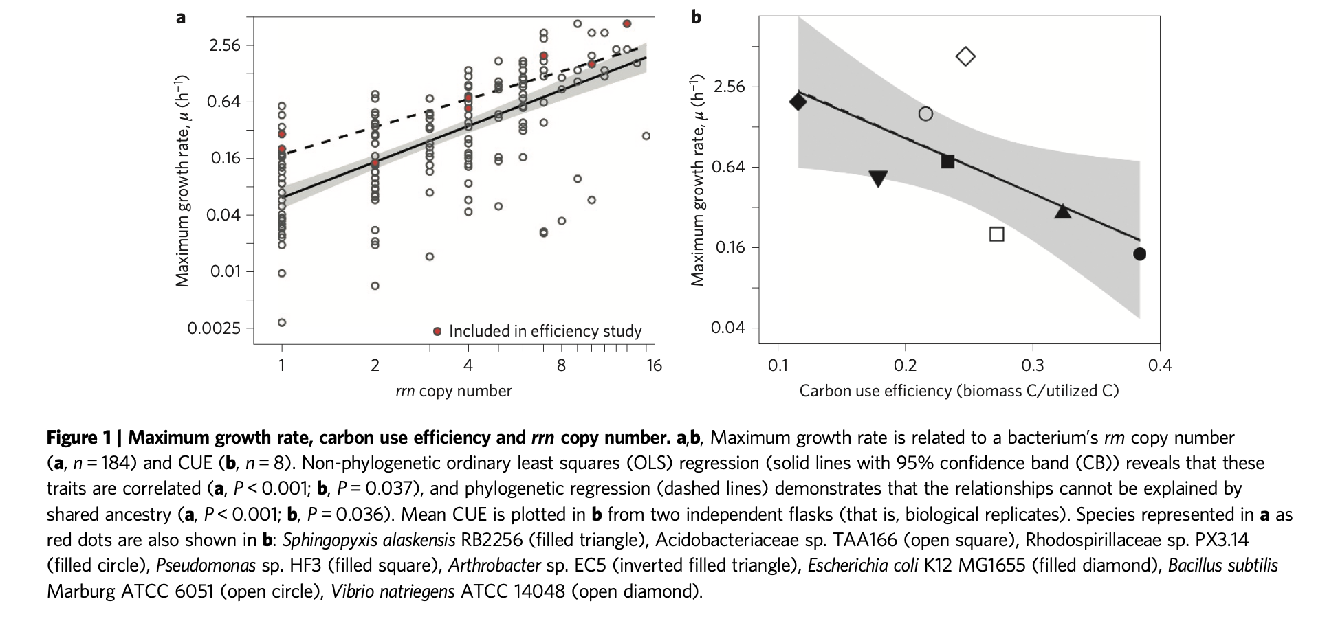
16S rRNA (rrs)
Number of ribosomal RNA genes reflects the bacterium’s life history strategy:
Resource abundance – copiotroph => rapid bacterial growth => Increase ribosome content = multiple rrn copies
Resource scarcity – oligotroph => fewer rrn copies
Exploiting rRNA operon copy number to investigate bacterial reproductive strategies

Slide 10
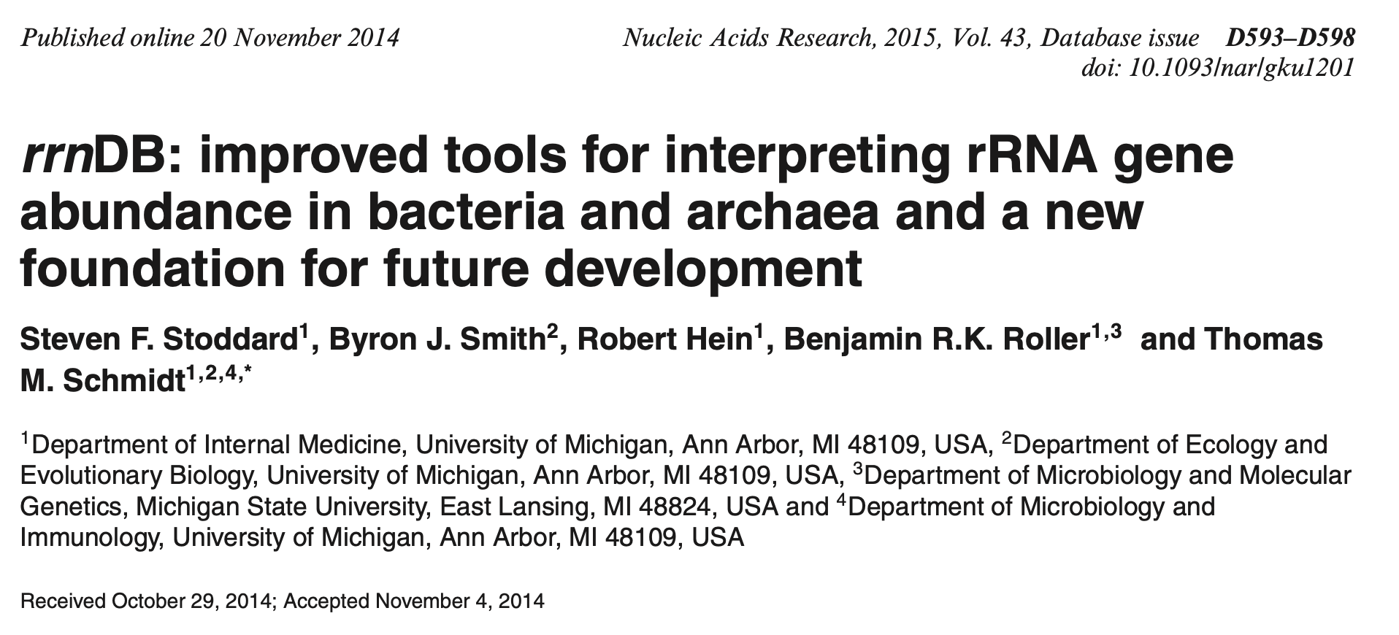
rrnDB: The Ribosomal RNA Database

Slide 11
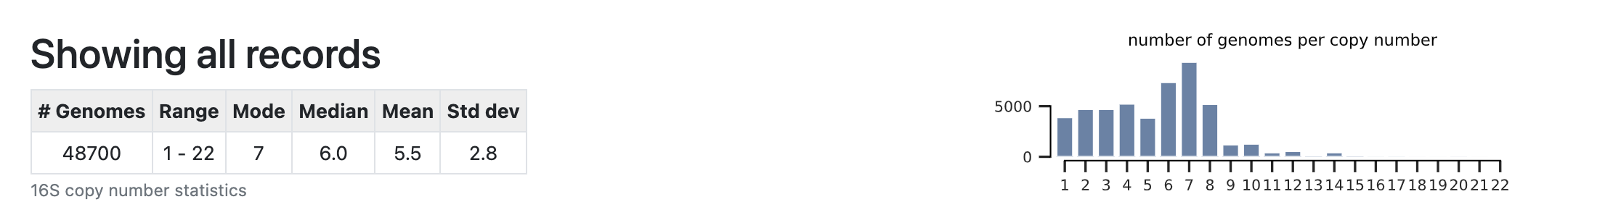
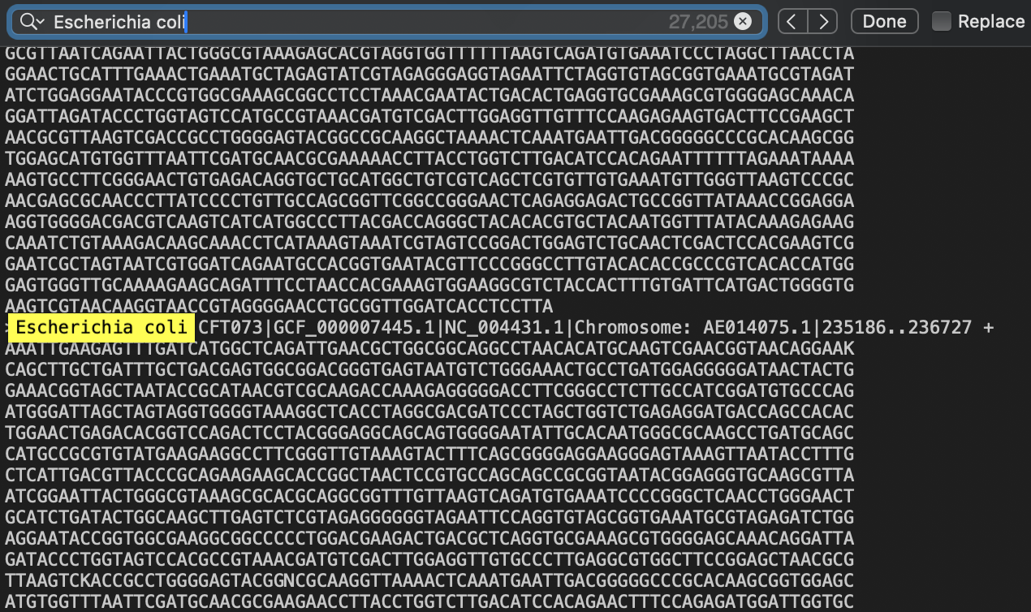
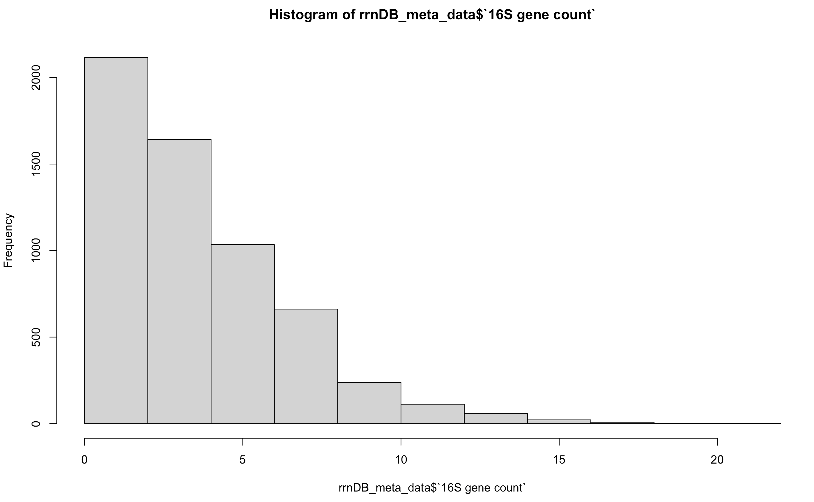
rrnDB: Records Curation
48077 Bacteria records representing 12138 species

