Slide 1
Project Update: rrs gene
Le Na Ngo

Slide 2
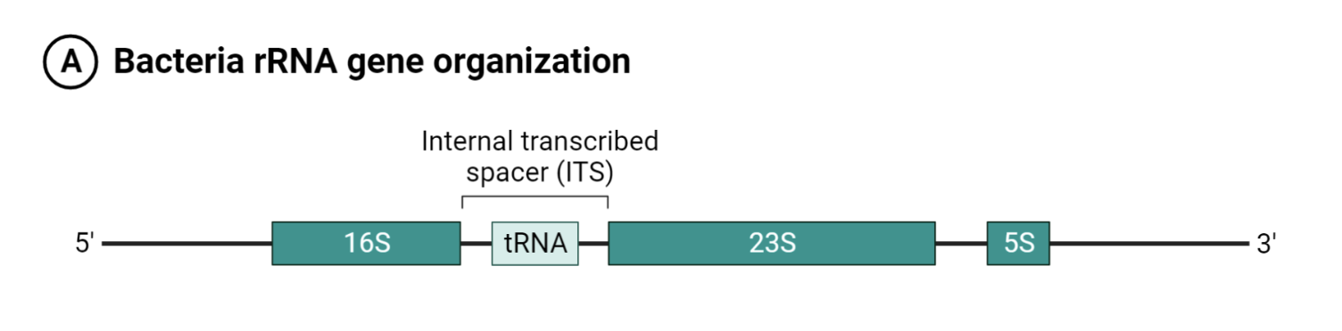
16S rRNA (rrs)

Slide 3
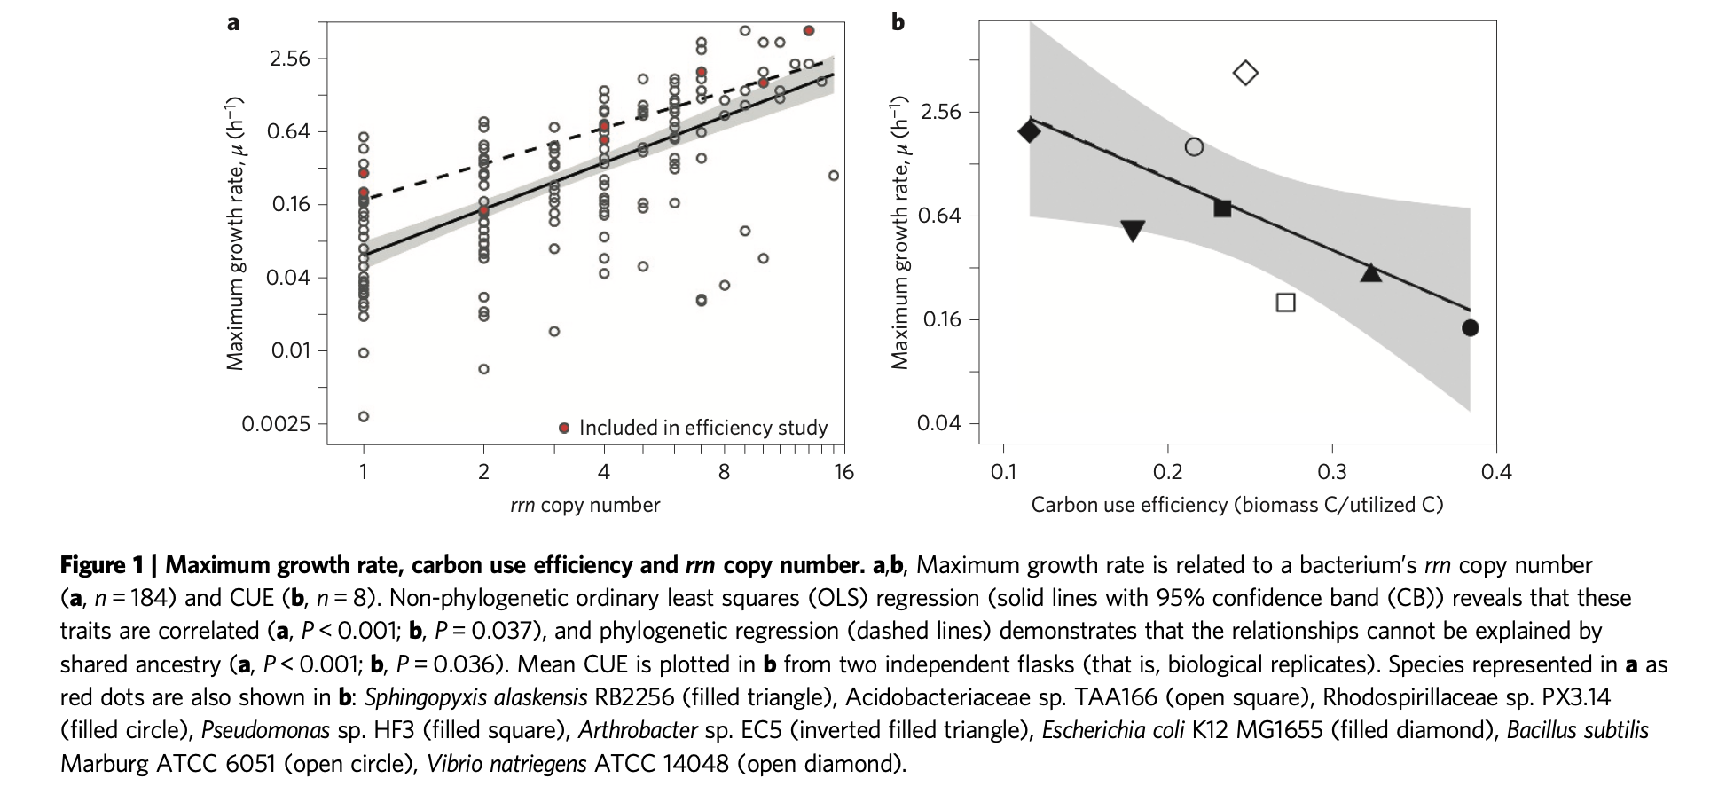
16S rRNA (rrs)
Copiotroph - Microbes that thrive in an environment rich in organic matter and nutrients. Tend to have higher number of rrn.
Oligotrophs - Microbes that thrive in an environment that offers very low levels of nutrients. Tend to have fewer number of rrn.
=> The number of rrn - the capacity for rapid growth and reproduction when resources are abundance
Exploiting rRNA operon copy number to investigate bacterial reproductive strategies

Slide 4
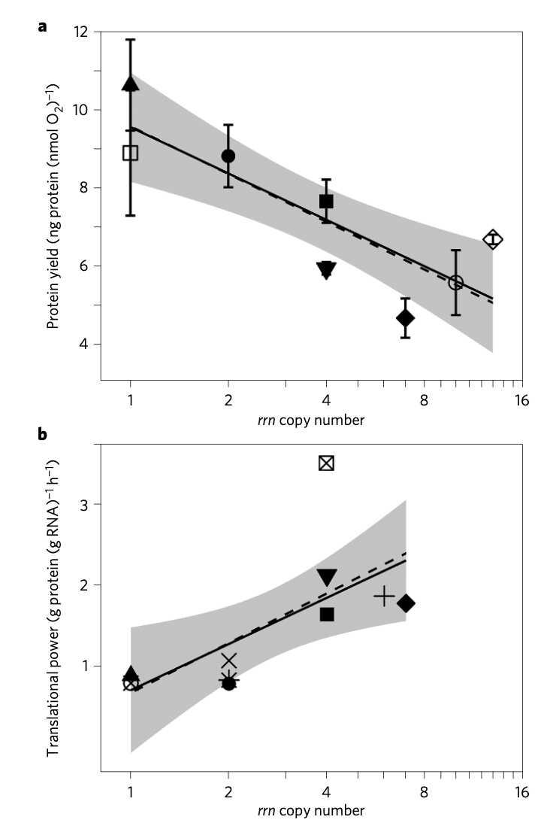
16S rRNA (rrs)
Protein yield (protein produced per O2 consumed) and Translational power (the translation rate per ribosome).
=> Bacteria with fewer rrn exhibit slower growth but greater efficiency

Slide 5
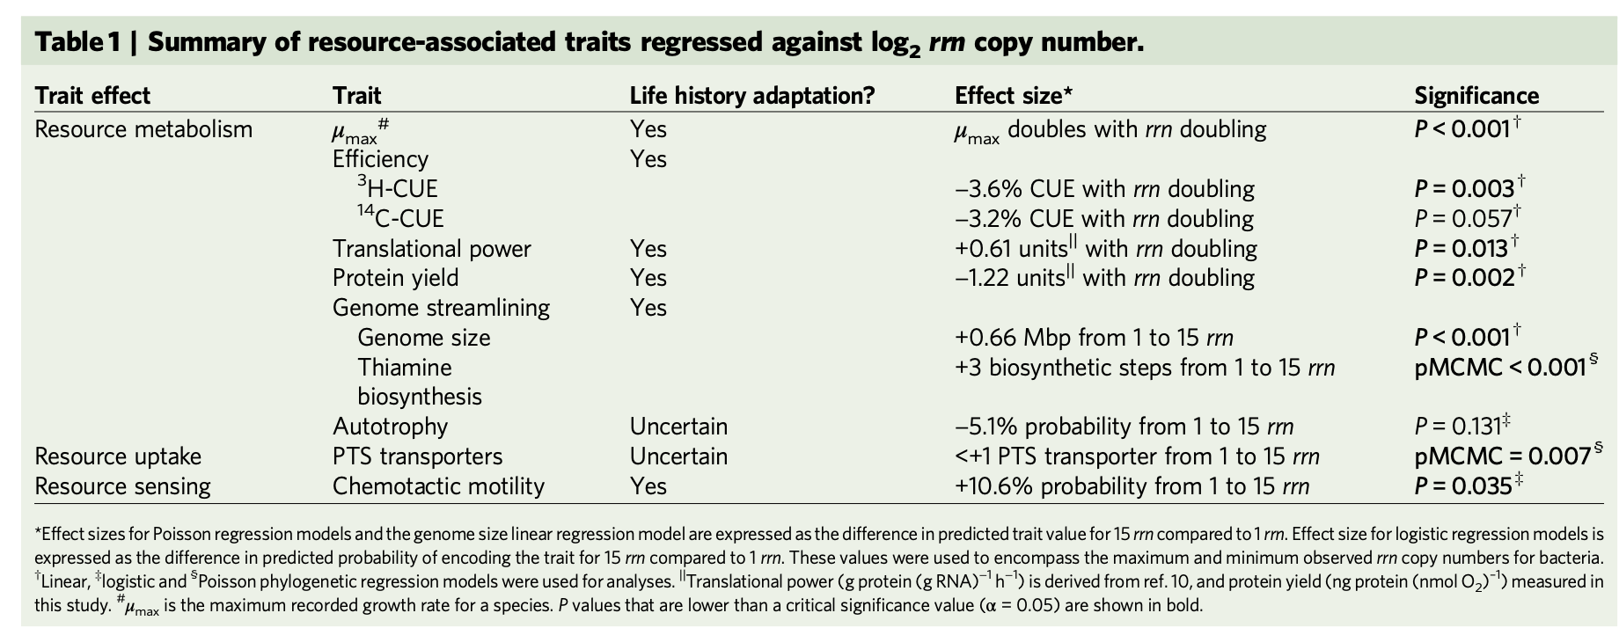
16S rRNA (rrs)
Exploiting rRNA operon copy number to investigate bacterial reproductive strategies

Slide 6
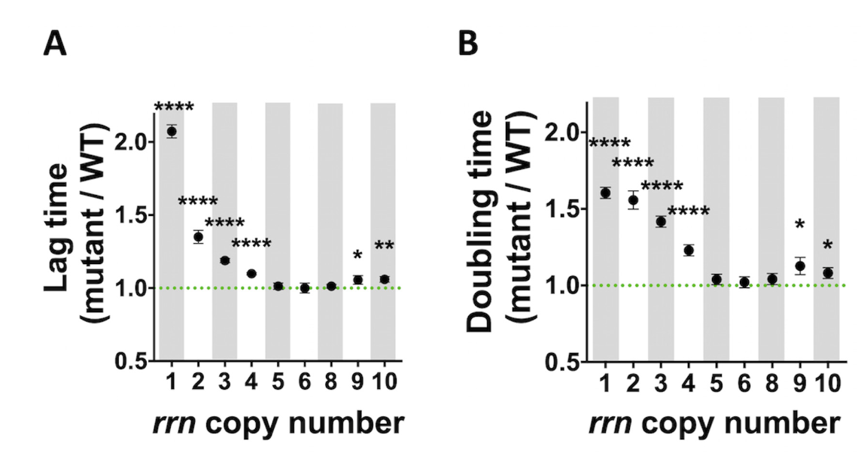
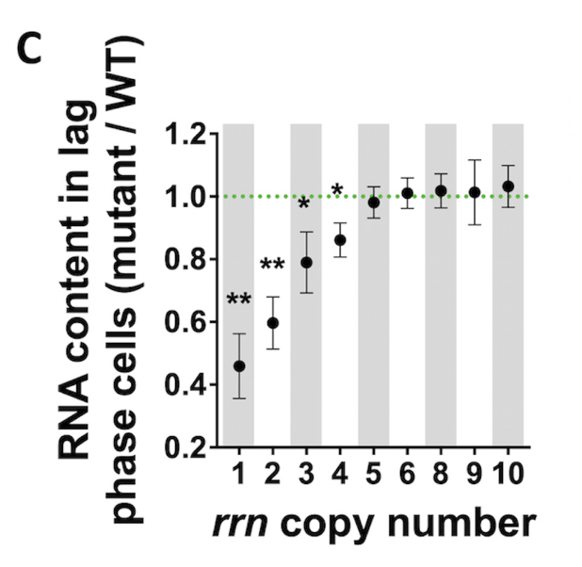

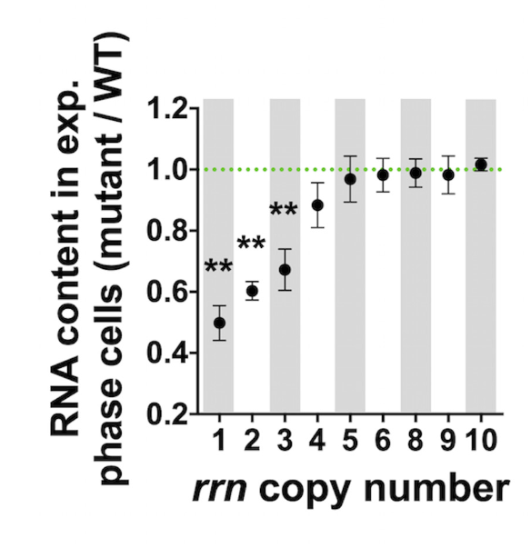
16S rRNA (rrs)
Growth, RNA content of cells having different rrn operon copy numbers growing in LB medium. (A) Lag time and (B) doubling time, calculated from the growth curves (see Supplementary Figures S1A1, S3). Total RNA content in (C) lag phase and (D) exponential phase cells.
rRNA operon multiplicity as a bacterial genome stability insurance policy

