Slide 1
Project Update: rrs gene
Le Na Ngo

Slide 2
Step 5: Processing and filtering of raw output
Selected_sequence: 510-920
 | raw_output | filtered_output | filtered_output (align_2000) | filtered_output (dist_190) | filtered_output (dist_190 + align_2000)
min_seq_length |  | 1200 | 1200 | 1200 | 1200
min_align_score |  | -Inf | -2000 | -Inf | -2000
max_core_dist |  | 220 | 220 | 190 | 190
Total number of rows | 697748 | 145477 | 126834 | 121472 | 113787
Number of rows (contain NA values) | 52611 (Nt_target)
Number of distinct species | 17508 | 16691 | 14898 | 13979 | 13116
Number of genomes with more than one rrs sequence | 6821 | 6553 | 5730 | 5494 | 5115

Slide 3
Case 1

Slide 4
Case 2

Slide 5
Case 3

Slide 6
Case 4

Slide 7
Only include one copy genome!
Case 1
Case 2
Case 3
Case 4

Slide 8
Step 6: Analysis of results
Predicted intrinsic resistance:
Total number of resistance mutations present across species: 14661
Number of unique mutations present across species: 4
Number of resistant species: 5023
Percentage of resistant species: 30.09%
Number of species with multiple resistance mutations: 3061
Number of species where one rrs copy confers resistance and one does not: 608

Slide 9
Step 6: Analysis of results
Predicted intrinsic resistance:
Total number of resistance mutations present across species: 11709
Number of unique mutations present across species: 4
Number of resistant species: 4125
Percentage of resistant species: 27.69%
Number of species with multiple resistance mutations: 2515
Number of species where one rrs copy confers resistance and one does not: 474

Slide 10
Step 6: Analysis of results
Predicted intrinsic resistance:
Total number of resistance mutations present across species: 10343
Number of unique mutations present across species: 4
Number of resistant species: 3581
Percentage of resistant species: 25.62%
Number of species with multiple resistance mutations: 2204
Number of species where one rrs copy confers resistance and one does not: 436

Slide 11
Step 6: Analysis of results
Predicted intrinsic resistance:
Total number of resistance mutations present across species: 9056
Number of unique mutations present across species: 4
Number of resistant species: 3189
Percentage of resistant species: 24.31%
Number of species with multiple resistance mutations: 1963
Number of species where one rrs copy confers resistance and one does not: 378

Slide 12
Multiple copies - Mutation screen for each site (Case 1)

Slide 13
How similarity these copies at mutation sites?
N>1 copies:
All copies have the mutation.
All copies don’t have the mutation.
Some copies have; some don’t.

Slide 15
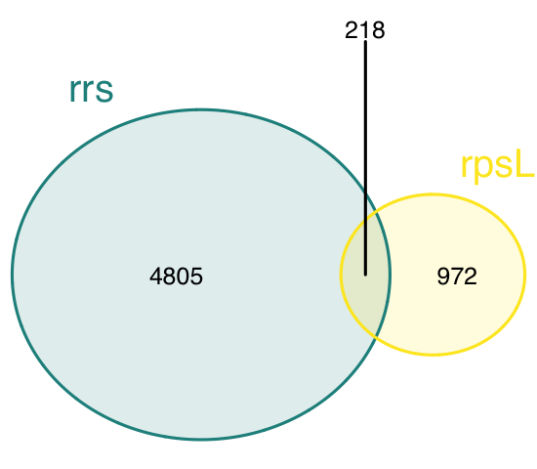
rrs vs rpsL

Slide 16
Problem: EvolvabilityI
get_species_output_nt <- function(output) {
species_output <- output |>
# step 1: merge multiple gene copies into one:
group_by(species, genus, accession_numbers, mutation_name) |>
summarise(mutation_category = ifelse(any(mutation_category == "present"),
"present",
ifelse(any(mutation_category == "possible"), "possible", "impossible")),
n_possible = sum(n_possible),
.groups = "drop") |>
# step 2: summarise across all screened mutations:
group_by(species, genus, accession_numbers) |>
summarise(resistance = any(mutation_category == "present"),
evolvabilityI = sum(mutation_category == "possible"),
# evolvabilityII = sum(n_possible),
.groups = "drop") |>
# step 3: discard sequences in cases where there are >1 genome per species:
group_by(species, genus) |>
summarise(resistance = dplyr::first(resistance),
evolvabilityI = dplyr::first(evolvabilityI),
# evolvabilityII = dplyr::first(evolvabilityII),
.groups = "drop") |>
# step 4: turn resistance column into categorical:
mutate(resistance = ifelse(resistance, "resistant", "susceptible"))
return(species_output)
}
rrs genomes has multiple copies
one copy contains a present mutation while
another copy has a possible mutation.

