Slide 1
QBIO7008 - Project Update
Le Na Ngo

Slide 2
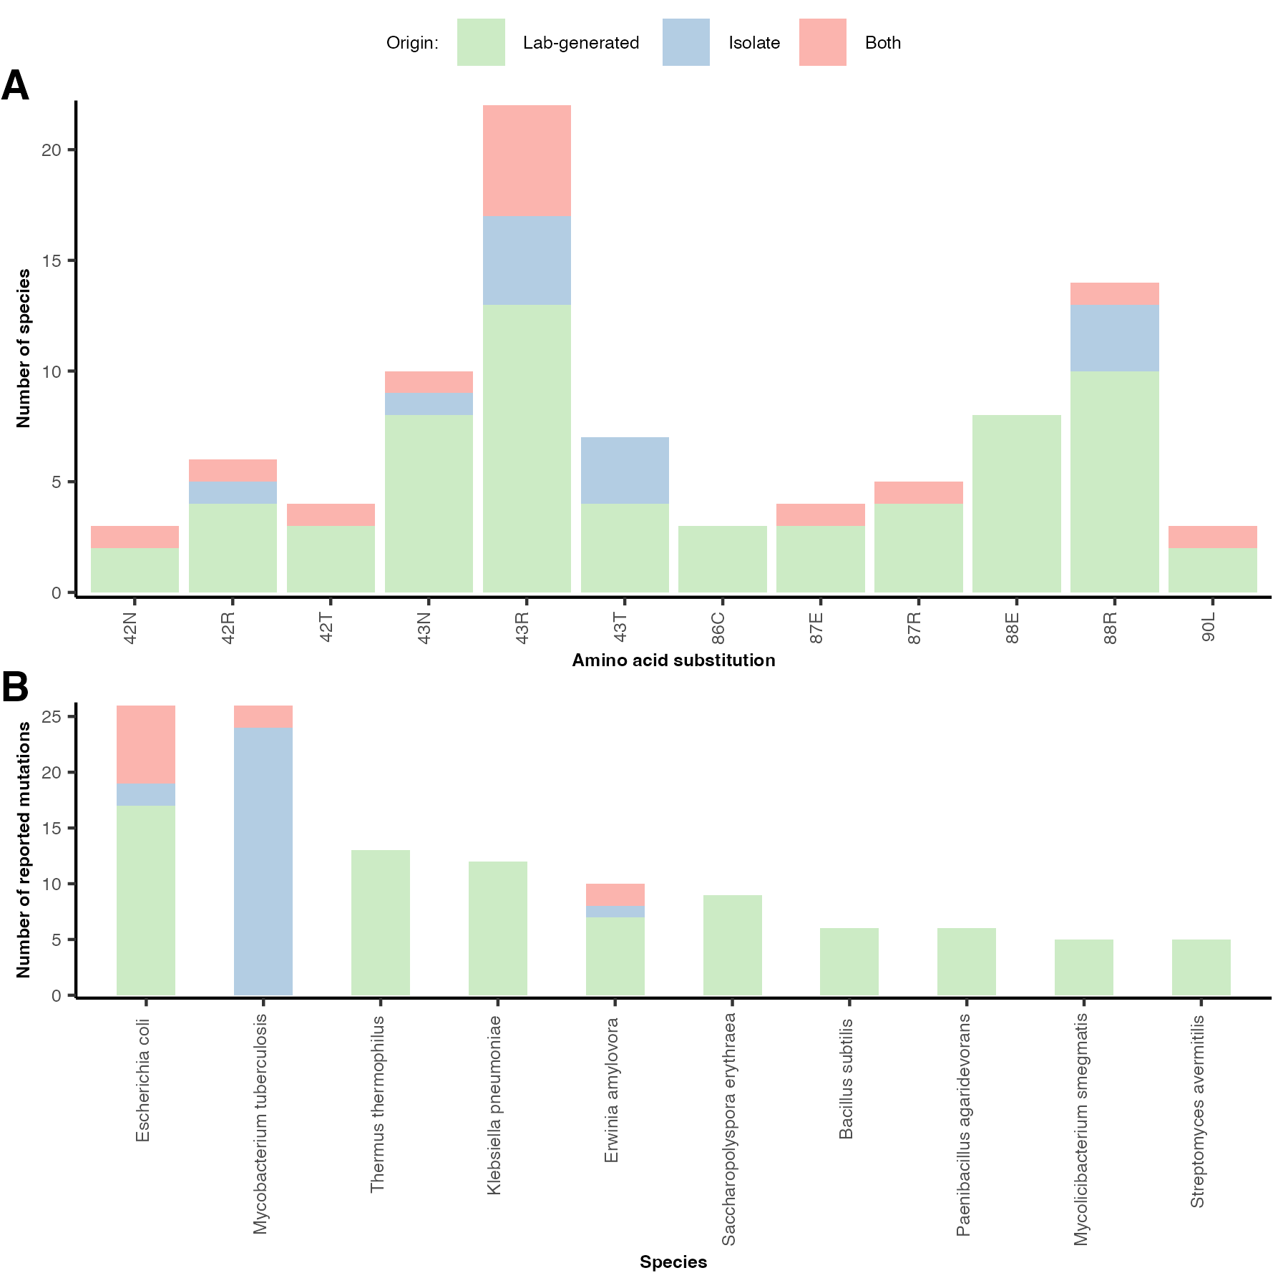
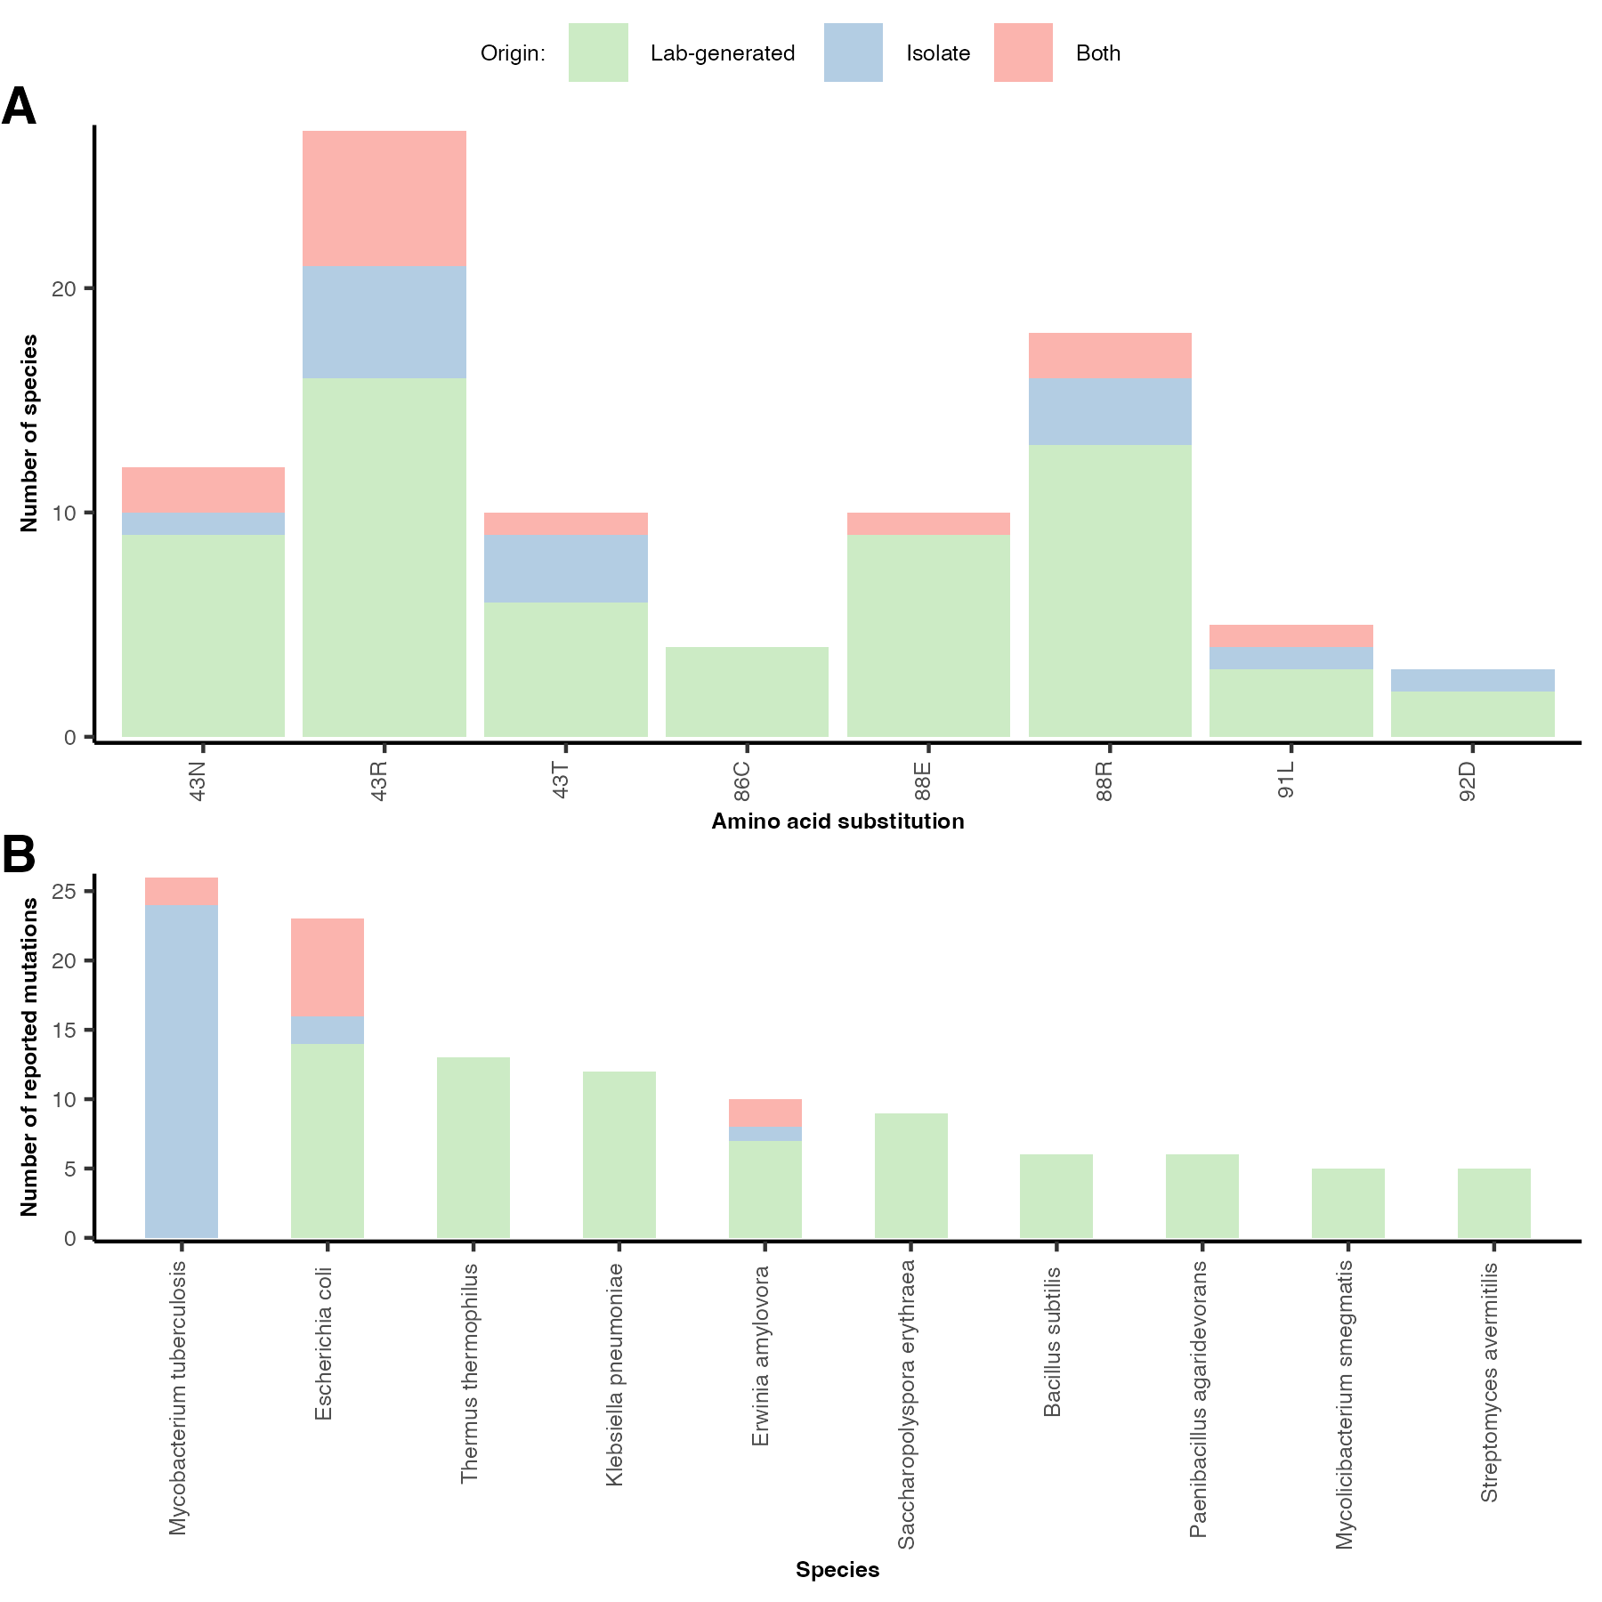
Step 2: Processing table of mutations
Original
Manually Processed

Slide 3
Step 5: Processing and filtering of raw output
globsets <- list(
min_n_studies = 3, # minimum number of studies that a mutation needs to be reported in for inclusion
min_n_species = 3, # minimum number of species that a mutation needs to be reported in for inclusion
min_seq_length = 300, # minimum length of included gene target sequences
min_alig_score = -Inf, # minimum alignment score (with E. coli) of included gene target sequences
max_core_dist = 50, # maximum Levenshtein distance between E. coli core gene region to corresponding target region
phylo_stats_sample_n = 5000, # number of species to sample for phylogenetics statistics
random_seed = 22)
 | raw_output | filtered_output | filtered_output | filtered_output
min_seq_length |  | 300 | 300 | 300
max_core_dist |  | 35 | 40 | 50
Number of rows | 146104 | 87647 | 110180 | 142439
Number of distinct species | 20804 | 12506 | 15721 | 20323

Slide 4
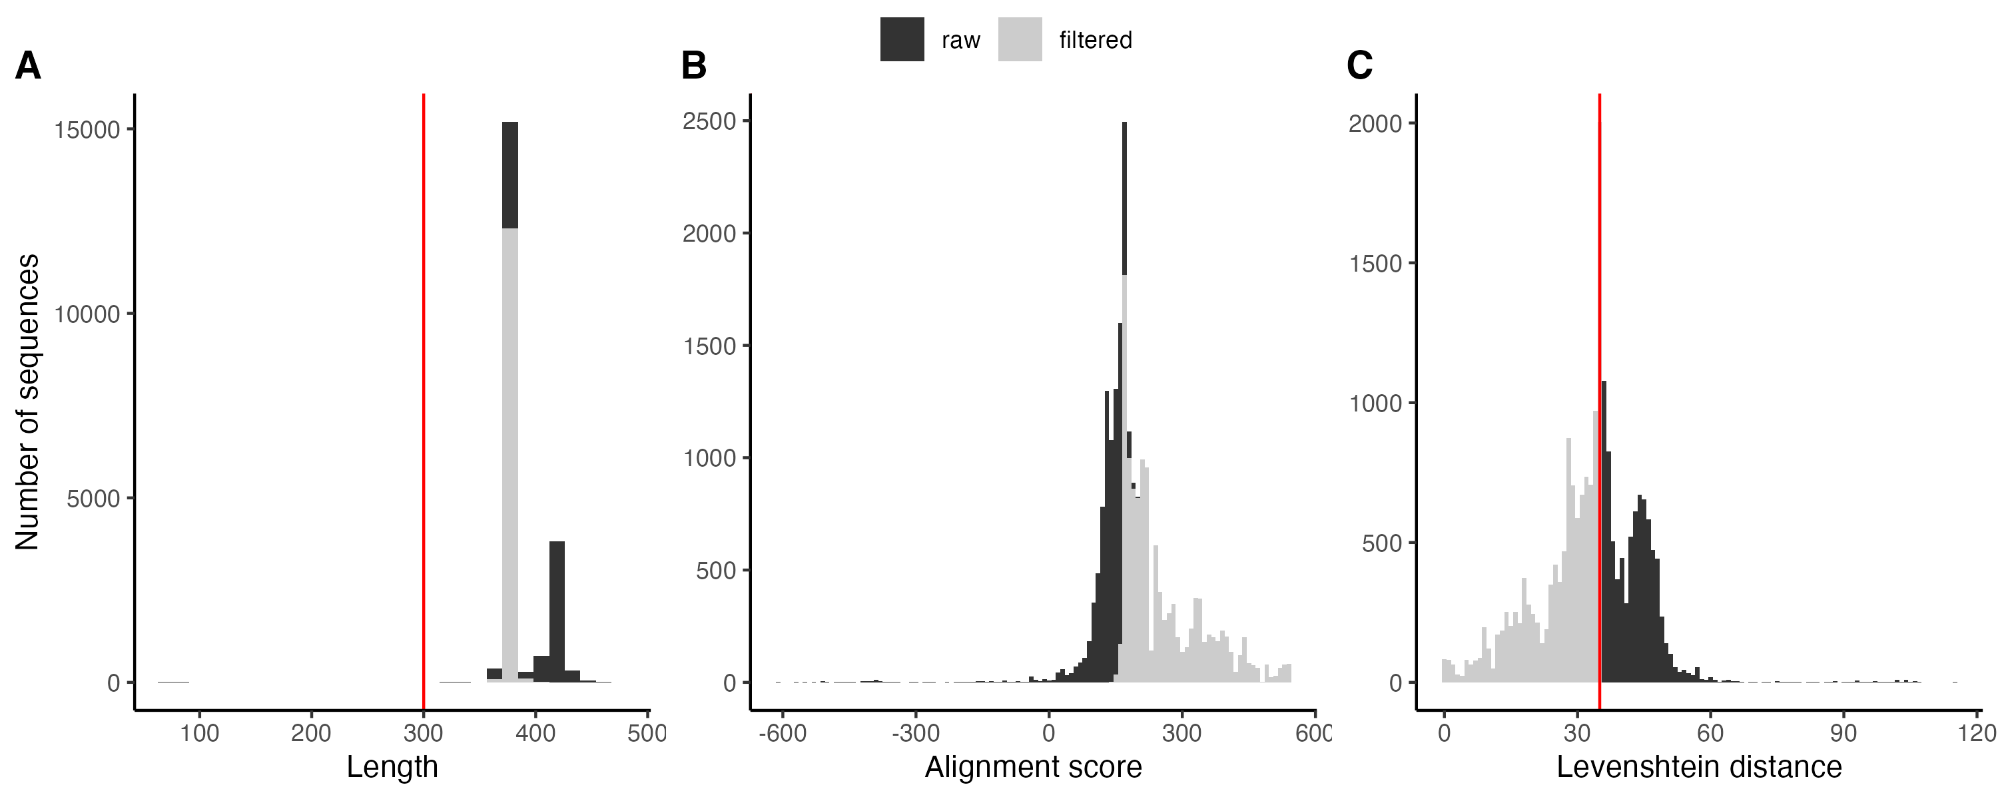
Step 5: Processing and filtering of raw output
max_core_dist = 35

Slide 5
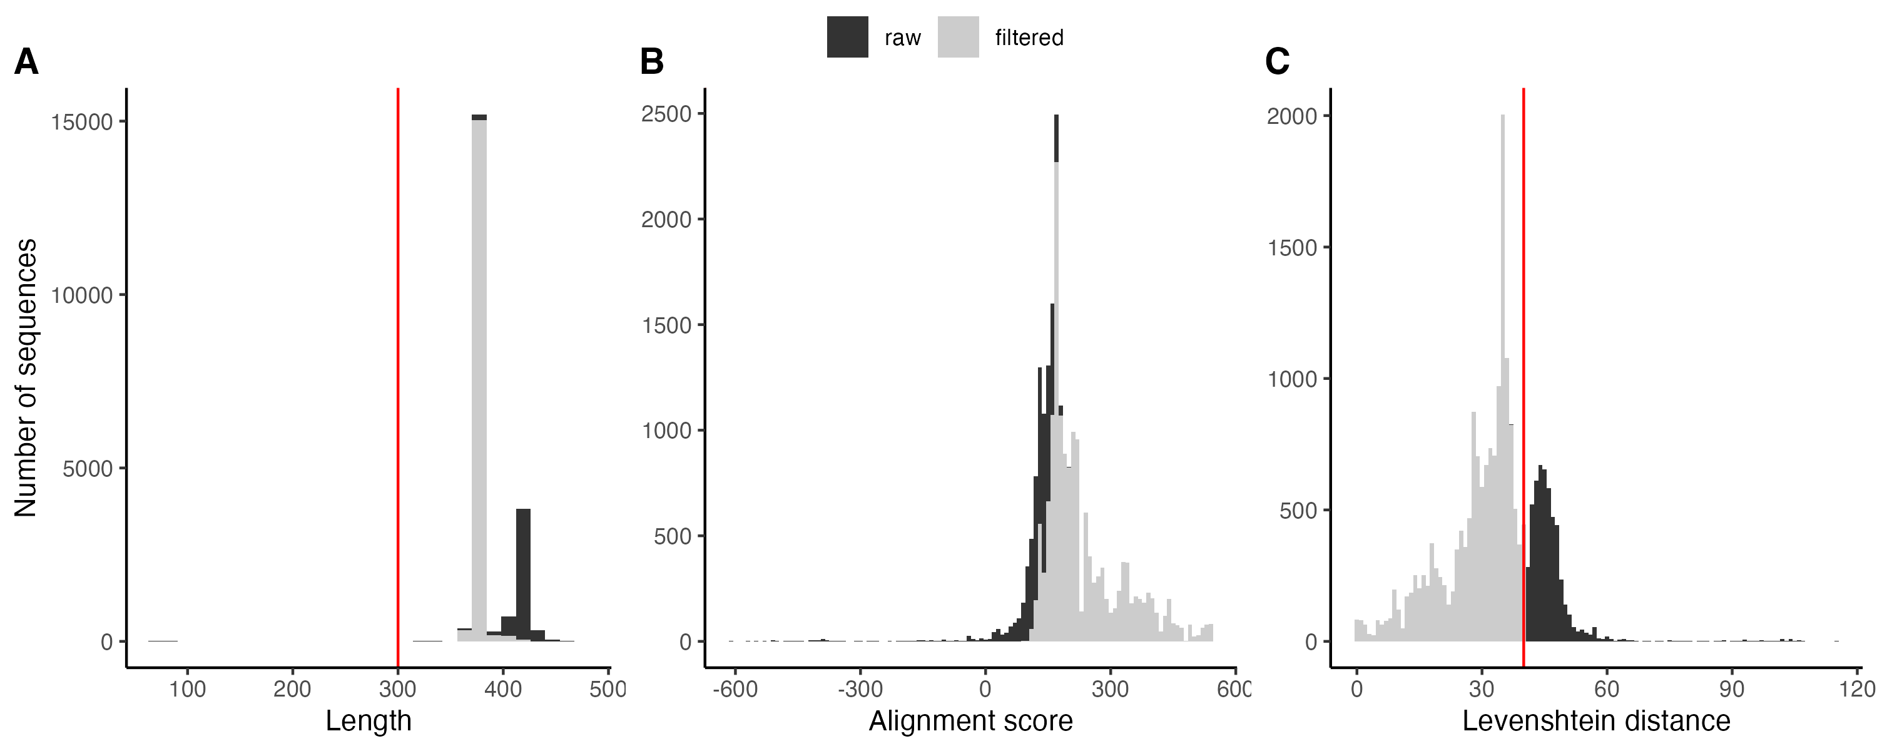
Step 5: Processing and filtering of raw output
max_core_dist = 40

Slide 6
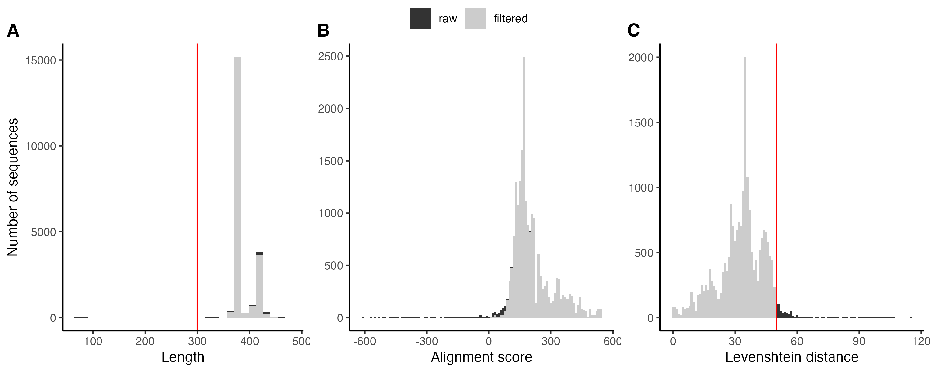
Step 5: Processing and filtering of raw output
max_core_dist = 50

Slide 7
Step 6: Analysis of result

Slide 8
Step 6: Analysis of result

Slide 9
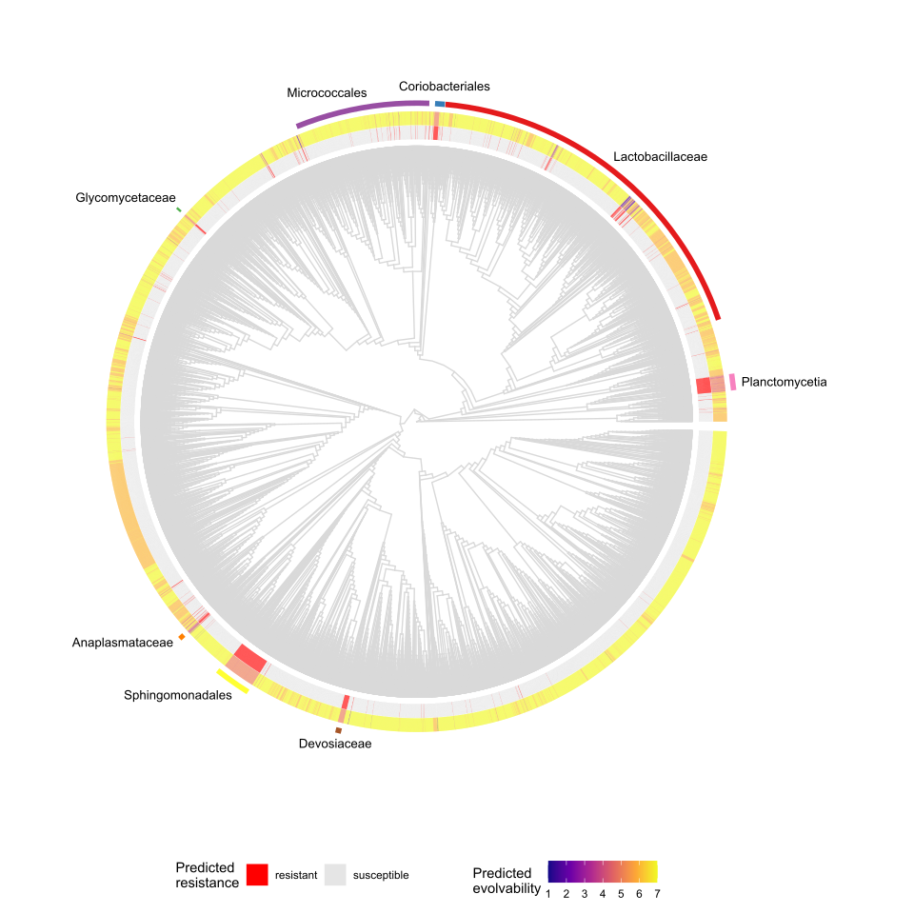
Step 7: Phylogenetic distribution of resistance and evolvability

