Slide 1
QBIO7008 - Project Update
Le Na Ngo

Slide 2
Step 2: Processing table of mutations
Thermus thermophilus
All mutations from Thermus thermophilus species come from 2 papers with the same author (Gregory2001 and Gregory2009).
Klebsiella pneumoniae
All mutations from Klebsiella pneumoniae species come from the same paper (Tsai2014).
Klebsiella pneumoniae is a frequent cause of community-acquired infections, typically presenting as pneumonia or urinary tract infections (UTIs). The isolates in this study were obtained from a patient with a liver abscess.
Erwinia amylovora
Erwinia amylovora, the causal agent of fire blight, poses a serious threat to several rosaceous plants, particularly apples and pears.

Slide 3
Step 5: Processing and filtering of raw output
max_core_dist = 40

Slide 4
Step 6: Analysis of result

Slide 5
Step 6: Analysis of result

Slide 6
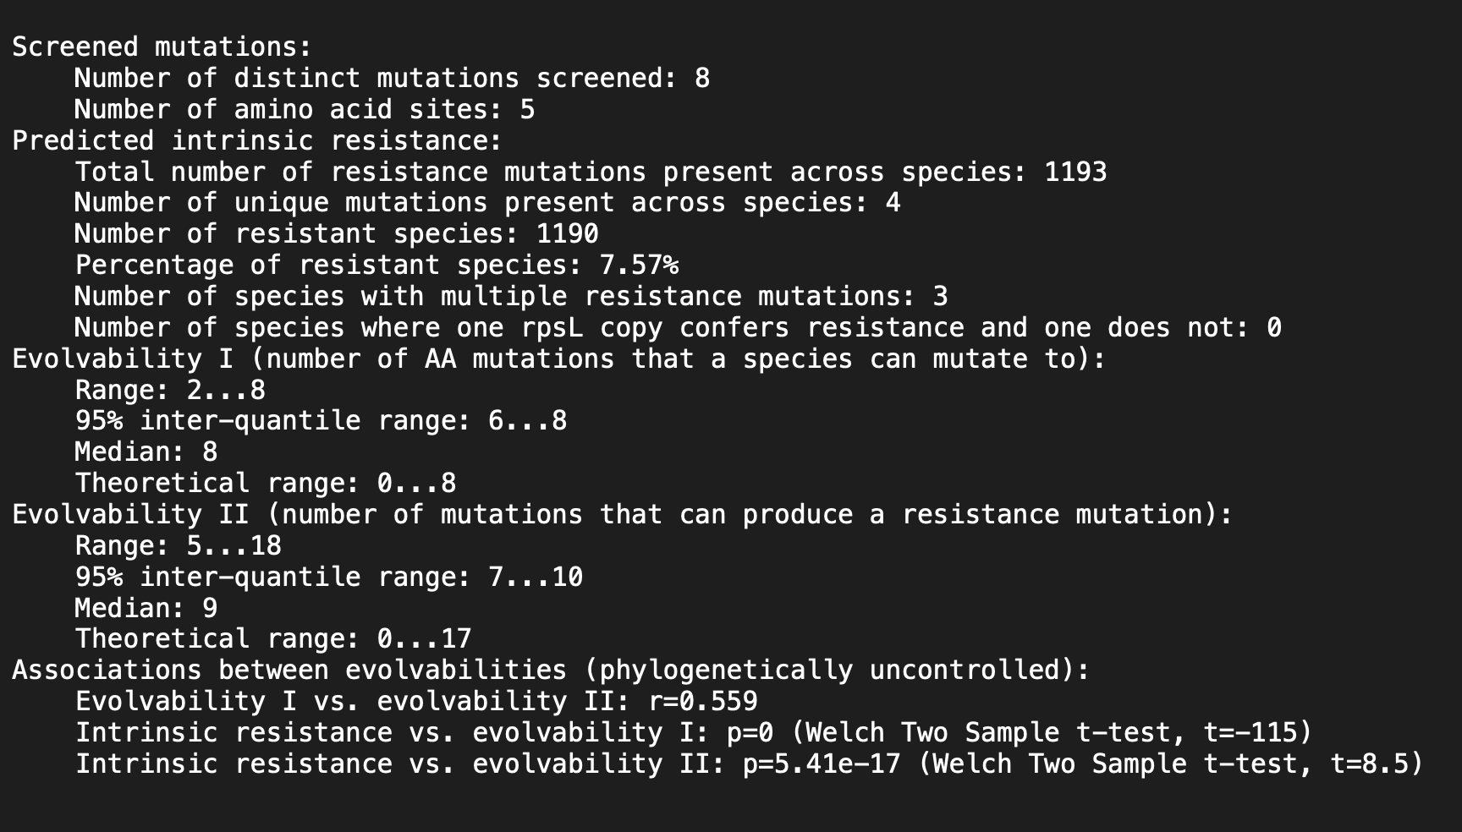
Summary of the mutation screen

Slide 7
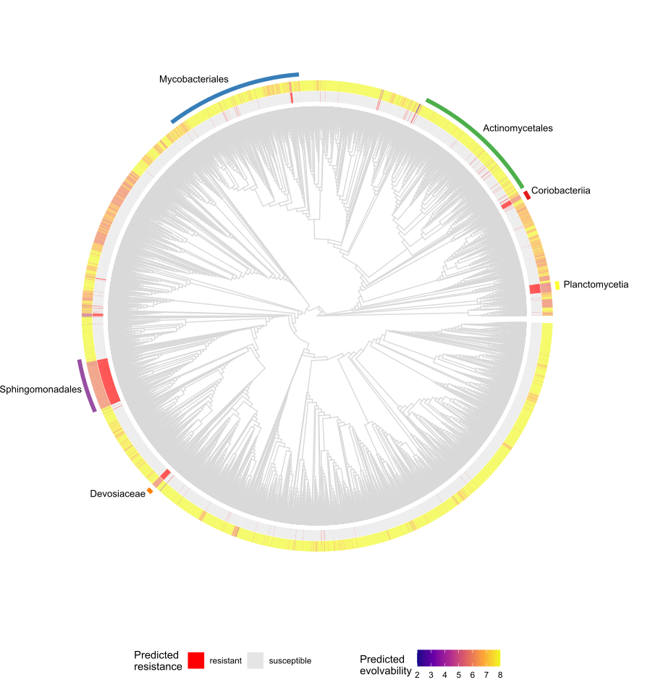
Step 7: Phylogenetic distribution of resistance and evolvability

Slide 8
Step 8: Codon Networks
Total of 15721 species have a 236.3 mean align_score.
Position 43:
19 species have a CGT codon at position 43 with a 152.2 mean align_score.

Slide 9
Step 8: Codon Networks
Position 88:
69 species have a CGT codon at position 88 with a mean 163.5 align_score.
687 species have a CGC codon at position 88 with a mean 213.1 align_score.

Slide 10
Step 9: Plotting rpsL structure and sequence conservation

