Slide 1
QBIO7008 - Project Update
Le Na Ngo

Slide 2
Step 2: Processing table of mutations
Thermus thermophilus
All mutations from Thermus thermophilus species come from 2 papers with the same author (Gregory2001 and Gregory2009).
Klebsiella pneumoniae
All mutations from Klebsiella pneumoniae species come from the same paper (Tsai2014).
Klebsiella pneumoniae is a frequent cause of community-acquired infections, typically presenting as pneumonia or urinary tract infections (UTIs). The isolates in this study were obtained from a patient with a liver abscess.
Erwinia amylovora
Erwinia amylovora, the causal agent of fire blight, poses a serious threat to several rosaceous plants, particularly apples and pears.

Slide 3
Step 5: Processing and filtering of raw output
max_core_dist = 40

Slide 4
GTDB taxonomy
genus | family | order | class | phylum | genus_origin
Actinomadura_C | Streptosporangiaceae | Streptosporangiales | Actinomycetes | Actinomycetota | Actinomadura
Actinomadura_D | Streptosporangiaceae | Streptosporangiales | Actinomycetes | Actinomycetota | Actinomadura
Thalassotalea_A | Alteromonadaceae | Enterobacterales | Gammaproteobacteria | Pseudomonadota | Thalassotalea
Thalassotalea_C | Alteromonadaceae | Enterobacterales | Gammaproteobacteria | Pseudomonadota | Thalassotalea
Thalassotalea_B | Alteromonadaceae | Enterobacterales | Gammaproteobacteria | Pseudomonadota | Thalassotalea
Thalassotalea_G | Alteromonadaceae | Enterobacterales | Gammaproteobacteria | Pseudomonadota | Thalassotalea
Thalassotalea_H | Alteromonadaceae | Enterobacterales | Gammaproteobacteria | Pseudomonadota | Thalassotalea
Thalassotalea_F | Alteromonadaceae | Enterobacterales | Gammaproteobacteria | Pseudomonadota | Thalassotalea
Thalassotalea_E | Alteromonadaceae | Enterobacterales | Gammaproteobacteria | Pseudomonadota | Thalassotalea
Thalassotalea_D | Alteromonadaceae | Enterobacterales | Gammaproteobacteria | Pseudomonadota | Thalassotalea
Aphanothece_B | Microcystaceae | Cyanobacteriales | Cyanobacteriia | Cyanobacteriota | Aphanothece
Tolypothrix_B | Nostocaceae | Cyanobacteriales | Cyanobacteriia | Cyanobacteriota | Tolypothrix
Sphingorhabdus_C | Sphingomonadaceae | Sphingomonadales | Alphaproteobacteria | Pseudomonadota | Sphingorhabdus
Sphingorhabdus_B | Sphingomonadaceae | Sphingomonadales | Alphaproteobacteria | Pseudomonadota | Sphingorhabdus
Aquamicrobium_A | Rhizobiaceae | Rhizobiales | Alphaproteobacteria | Pseudomonadota | Aquamicrobium
Altererythrobacter_H | Sphingomonadaceae | Sphingomonadales | Alphaproteobacteria | Pseudomonadota | Altererythrobacter
Nitrospira_D | Nitrospiraceae | Nitrospirales | Nitrospiria | Nitrospirota | Nitrospira
Nitrospira_G | Nitrospiraceae | Nitrospirales | Nitrospiria | Nitrospirota | Nitrospira
Nitrospira_E | UBA8639 | Nitrospirales | Nitrospiria | Nitrospirota | Nitrospira
Nitrospira_G | Nitrospiraceae | Nitrospirales | Nitrospiria | Nitrospirota | Nitrospira
Nitrospira_A | Nitrospiraceae | Nitrospirales | Nitrospiria | Nitrospirota | Nitrospira
Phormidium_B | Aerosakkonemataceae | Cyanobacteriales | Cyanobacteriia | Cyanobacteriota | Phormidium
Polymorphobacter_A | Sphingomonadaceae | Sphingomonadales | Alphaproteobacteria | Pseudomonadota | Polymorphobacter
Polymorphobacter_B | Sphingomonadaceae | Sphingomonadales | Alphaproteobacteria | Pseudomonadota | Polymorphobacter
Calothrix_A | Nostocaceae | Cyanobacteriales | Cyanobacteriia | Cyanobacteriota | Calothrix
Spirochaeta_B | DSM-8902 | DSM-27196 | Spirochaetia | Spirochaetota | Spirochaeta
Spirochaeta_E | DSM-17781 | DSM-17781 | Spirochaetia | Spirochaetota | Spirochaeta
Spirochaeta_F | DSM-2461 | Spirochaetales_E | Spirochaetia | Spirochaetota | Spirochaeta
Spirochaeta_D | Salinispiraceae | DSM-27196 | Spirochaetia | Spirochaetota | Spirochaeta
Hyphomicrobium_C | Hyphomicrobiaceae | Rhizobiales | Alphaproteobacteria | Pseudomonadota | Hyphomicrobium
Hyphomicrobium_A | Hyphomicrobiaceae | Rhizobiales | Alphaproteobacteria | Pseudomonadota | Hyphomicrobium
Hyphomicrobium_B | Hyphomicrobiaceae | Rhizobiales | Alphaproteobacteria | Pseudomonadota | Hyphomicrobium
Macromonas_A | Burkholderiaceae | Burkholderiales | Gammaproteobacteria | Pseudomonadota | Macromonas
Macromonas_B | Burkholderiaceae | Burkholderiales | Gammaproteobacteria | Pseudomonadota | Macromonas

Slide 5
Step 6: Analysis of result

Slide 7
Analyse species with multiple gene copies

Slide 8
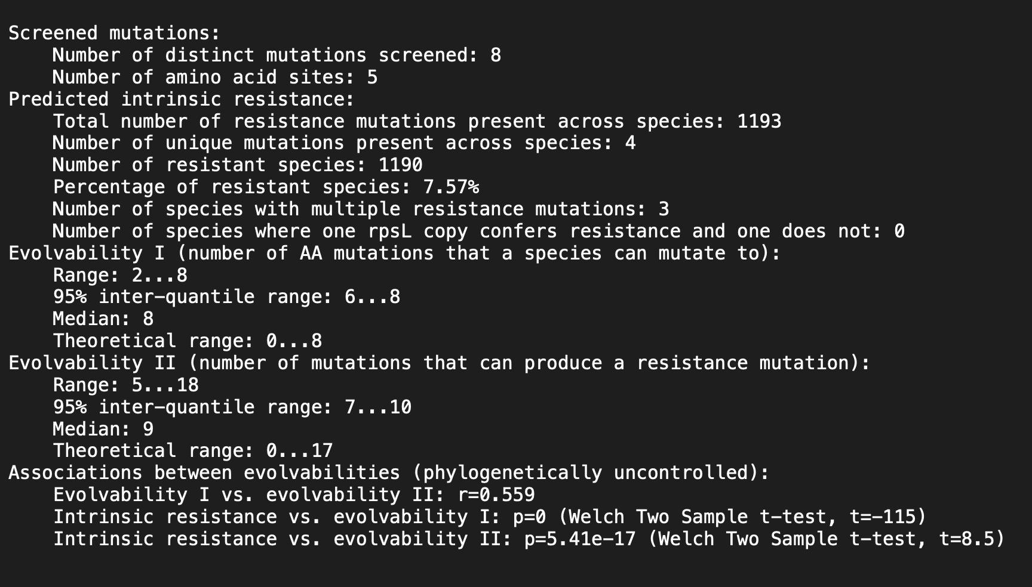
Summary of the mutation screen

Slide 9
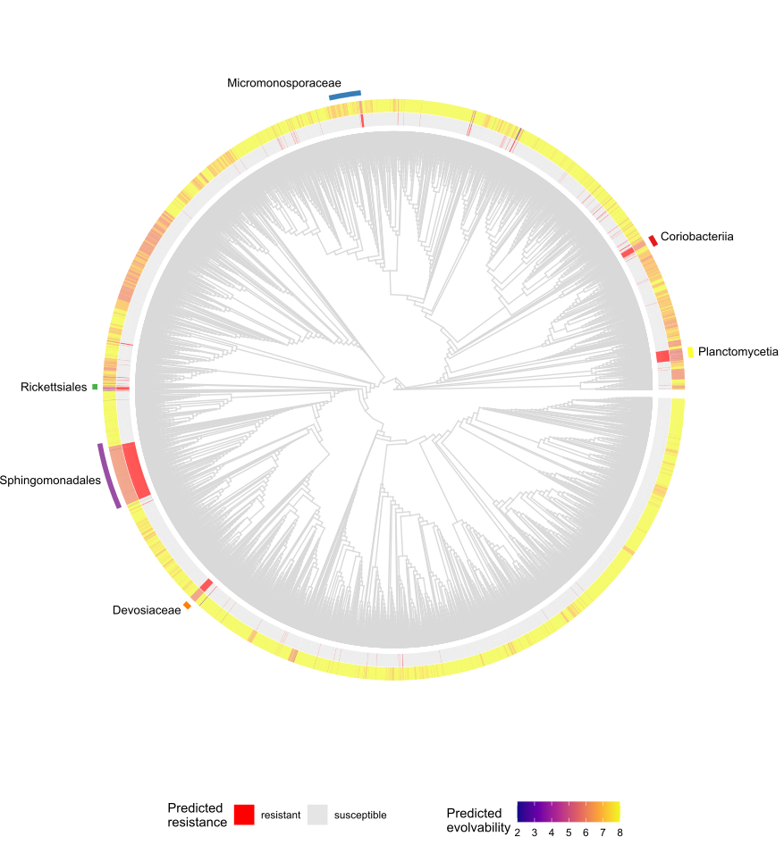
Step 7: Phylogenetic distribution of resistance and evolvability

Slide 10
Step 8: Codon Networks
Total of 15721 species have a 236.3 mean align_score.
Position 43:
19 species have a CGT codon at position 43 with a 152.2 mean align_score.

Slide 11
Step 8: Codon Networks
Position 88:
69 species have a CGT codon at position 88 with a mean 163.5 align_score.
687 species have a CGC codon at position 88 with a mean 213.1 align_score.

Slide 12
Step 9: Plotting rpsL structure and sequence conservation
Hamming
Grantham

Slide 13
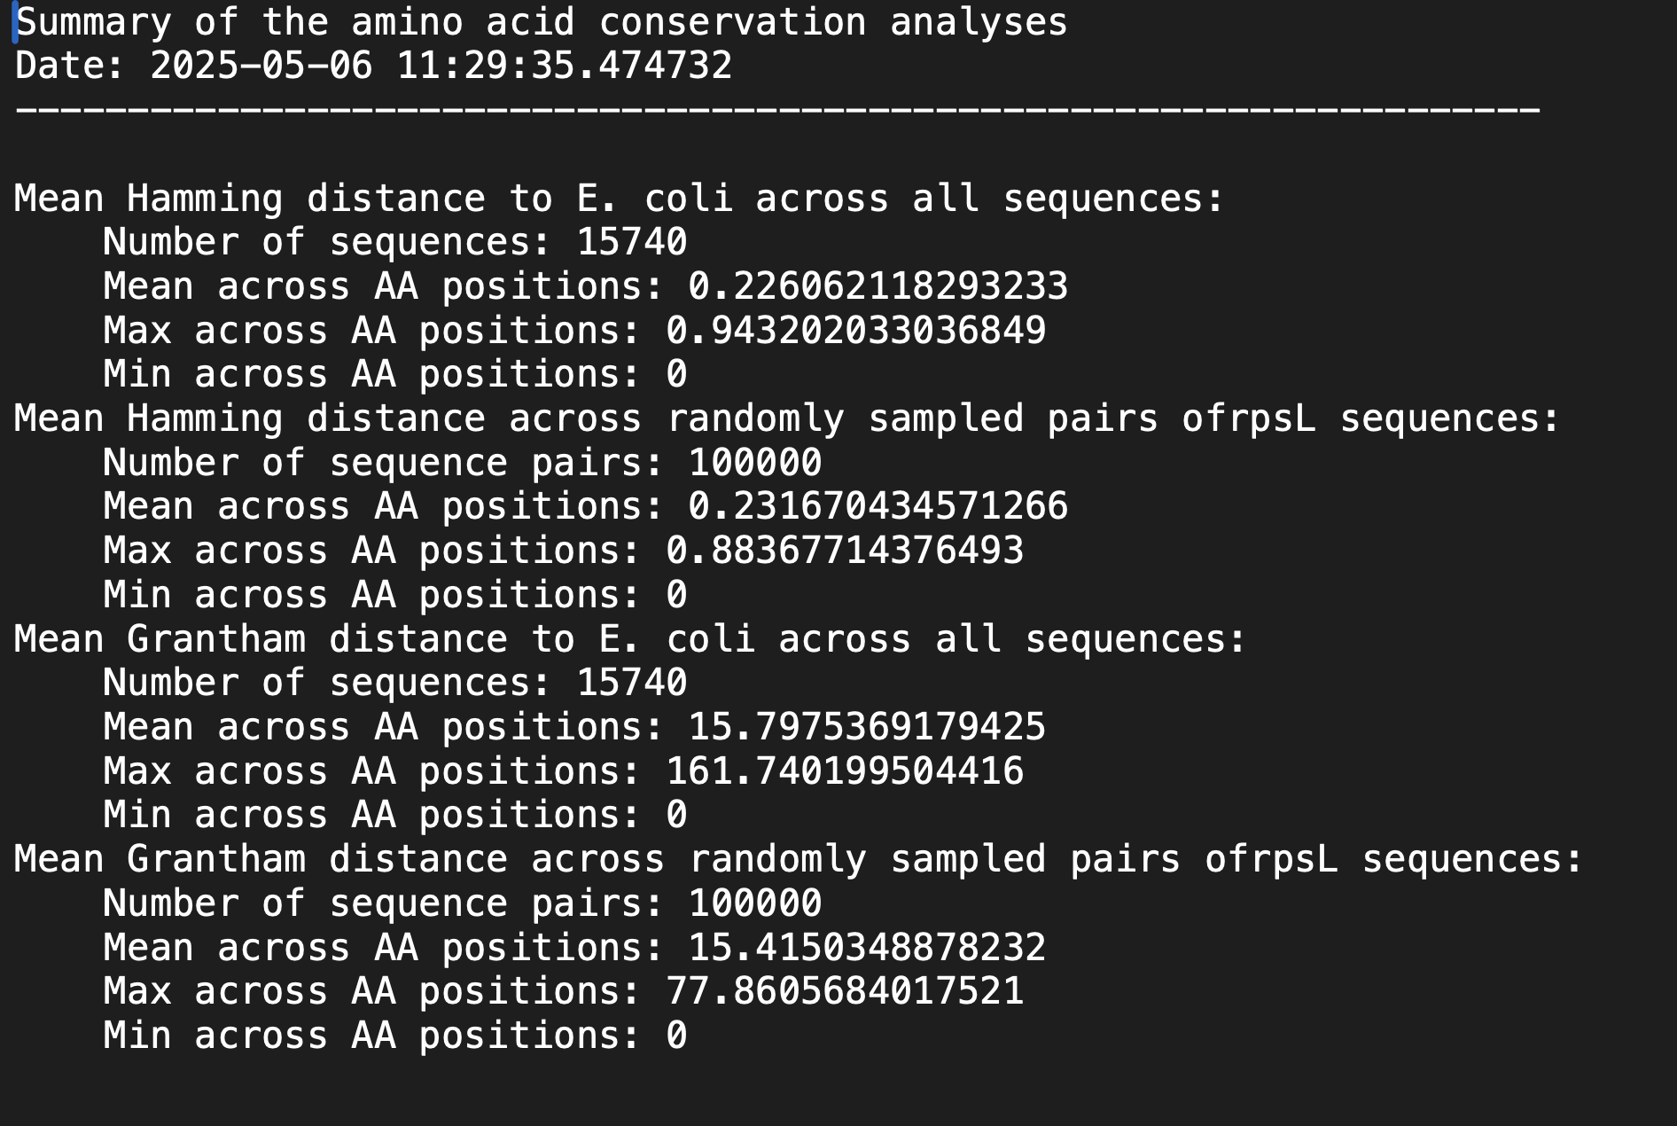
Step 9: Plotting rpsL structure and sequence conservation

Slide 14
Step 9: Plotting rpsL structure and sequence conservation
- Download PDB file for E. coli rpsL chain L: https://www.rcsb.org/structure/8CGJ

Slide 15
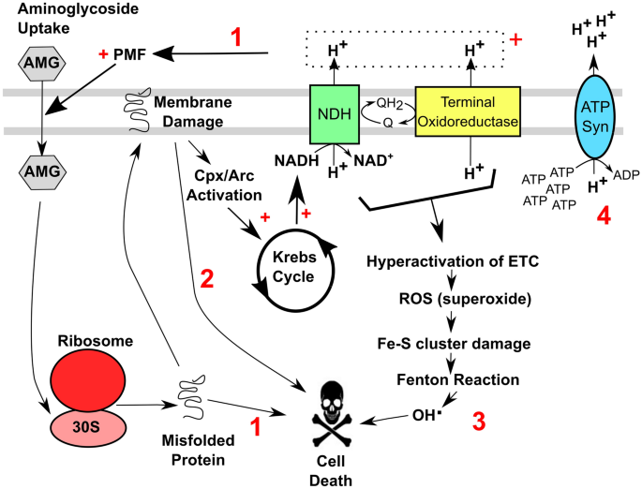
Proposal Feedbacks
Examiner 1: Weakness
(Introduction) Perhaps state the “selection of specific resistance mechanisms” rather than development. As it is highly likely that they were already present in the environment. Is the function of a particular allele independent of its context? If not, how helpful is location of a particular allele within the genome of an organism of undefined phenotype? Is streptomycin sensitivity impacted by cell wall permeability and/or efflux pumps and other bacterial stress responses? Maybe need to be a little more tentative in the introduction. The systems of AMR or complex, not merely complicated.
Suggestions: While I understand that the role of a model is to simplify a complex system, it is important not to lose sight of the complexity of the system under investigation. This will help to identify potential confounding issues (that may or may not be able to be addressed) and will qualify and identify the caveats under which the results can be interpreted.
Aminoglycoside entry into bacterial cells: 3 stages
The first stage: aminoglycosides bind to negatively charged sites on the bacterial outer membrane
Increase membrane permeability => Enhance aminoglycoside uptake
Reduce efflux => Enhance aminoglycoside uptake
The second and third stage are energy-dependent.
Require an electrochemical gradient, particular a proton motive force (PMF) which is generated by the electron transport chain during aerobic respiration.
A large number of metabolites, non-metabolites and physical treatments – sensitize bacterial pathogens to aminoglycosides via PMF-dependent or PMF-independent routes.
Current dogma on cell death pathways for aminoglycosides.

Slide 16
Proposal Feedbacks
2. In the collation and filtering of the literature search, will sequences derived from organisms where phenotype (wild type or resistant) has been determined by scored separately from those where no phenotype has been determined? How do you set a threshold in Levenshtein distance for discarding sequences that are “too distant”: from the E. coli sequence? What is the evidentiary basis? Might be worth doing some work on the metadata to find some connection between wild type and sensitive phenotype for more distantly related taxa.

Slide 17
Proposal Feedbacks
Examiner 2:
The following is more about questions, so may not necessarily be weaknesses:
Literature search: how comprehensive is searching only in Web of Science? It is well known that different platforms (eg WoS vs Scopus) index different papers. Is there any process to refine the search string? What are the criteria for a paper to be eligible? How robust is the use of ASReview in terms of identifying relevant papers? I am particularly concerned about the use of only abstracts, as the main text screening is almost always needed in systematic literature reviews.

