Slide 1
Project Update: rrs gene
Le Na Ngo

Slide 2
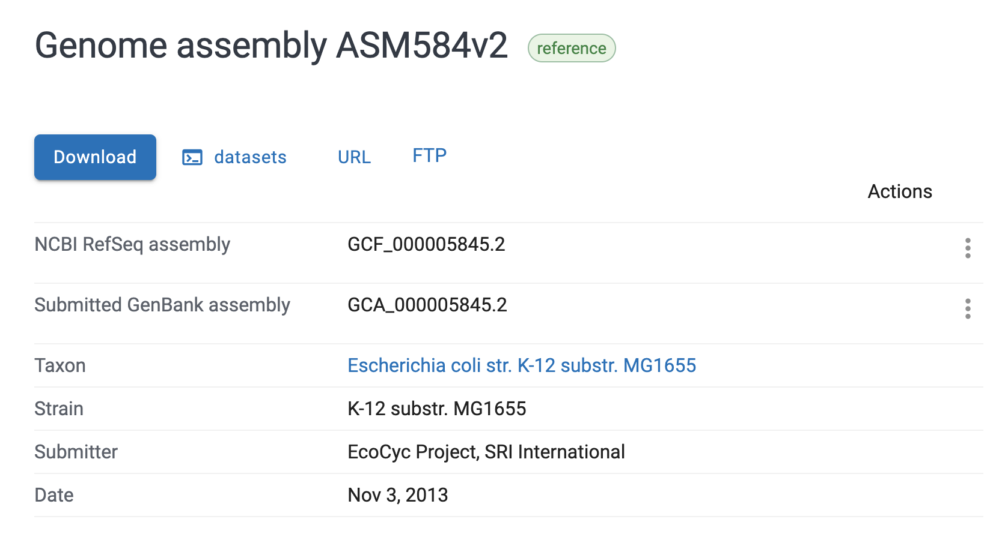
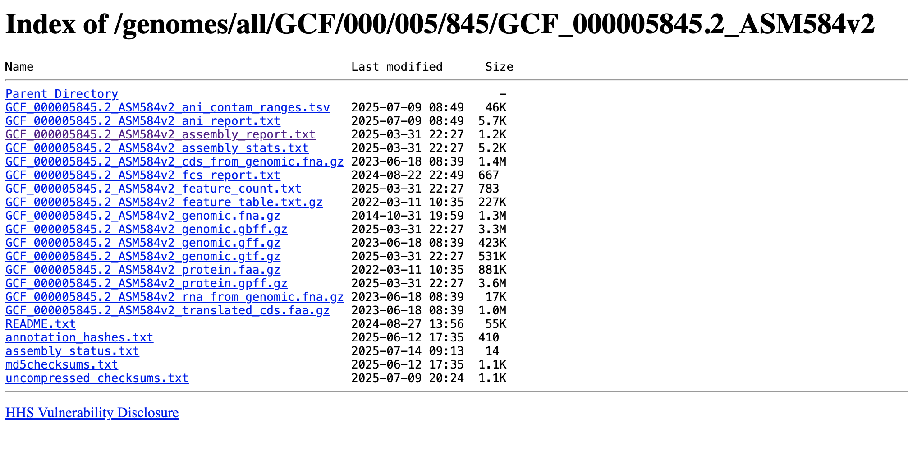
Step 1: NCBI rrs sequencing
https://www.ncbi.nlm.nih.gov/datasets/genome/GCF_000005845.2/
download_files <- function(summaries, suffix = "_cds_from_genomic.fna.gz", dir = "output/genomes", max_tries = 10) {
file_paths <- list()
for(i in 1:length(summaries)) {
cat(paste0("Downloading genome for species #", i, "/", length(summaries), "\n..."))
try( # continue to download the genomes if any download fails
file_path <- download_file(summaries[[i]], suffix = suffix, dir = dir, max_tries = max_tries)
)
file_paths[[i]] <- file_path
}
return(file_paths)
}
download_files(summaries, dir = "output/rrs_genomes", suffix = "_rna_from_genomic.fna.gz")

Slide 3
Step 1: rrs references gene
A total of 6 species were used to build the reference rrs sequence dataset.
Only Escherichia coli contains 7 distinct rrs (16S rRNA) gene copies.
Two species—Thermus thermophilus and Mycolicibacterium smegmatis—each have 2 identical rrs copies.
Only 3 published articles were found that link E. coli rrs genes to streptomycin resistance, most MB uses H37Rv as reference.
All of them are older studies, and each identifies rrsB as the relevant copy.
rrsB has the lowest average levenshtein distance to all other rrs copies.

Slide 4

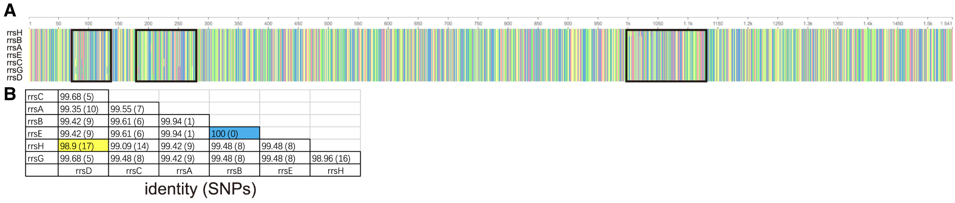
Step 1: rrs references gene

Slide 5
Step 1: Mutations Panel
https://scholar.dlu.edu.vn/thuvienso/bitstream/DLU123456789/213563/1/CVv262V16S42018737.pdf

