Slide 1

AI-Powered Returns & Refund Automation
AI AUTOMATION • 2026
DIGITEK
REFUND FLOW
AI Implementation & Automation Intern Assessment
Digitek Camera Accessories
By LEISHA NAMPALLY
Faster triage. Safer decisions. Human control where it matters.

Slide 2
DIGITEK AI SUPPORT
AI AUTOMATION • 2026
Customer sends refund request
Today:
Refund Journey Is Manual
Support reads the email
Order & issue details are checked
WHY THIS NEEDS AUTOMATION:
6 manual steps
↓
Repetitive support work
↓
Slower response times
Refund/replacement is verified
Refund decisions still require human judgement.

Slide 3
DIGITEK AI SUPPORT
AI AUTOMATION • 2026
AI HANDLES
✓ Read & classify emails
✓ Extract customer details
✓ Detect urgency
✓ Summarize requests
✓ Log & route cases
Automate the Repetitive.
Escalate the Risky.
AI handles repetitive triage, extraction and routing. Humans handle decisions that require live systems, judgement or exceptions.
HUMAN HANDLES
✓ Refund decisions
✓ Live order verification
✓ Replacement approval
✓ Exceptions & complaints

Slide 4
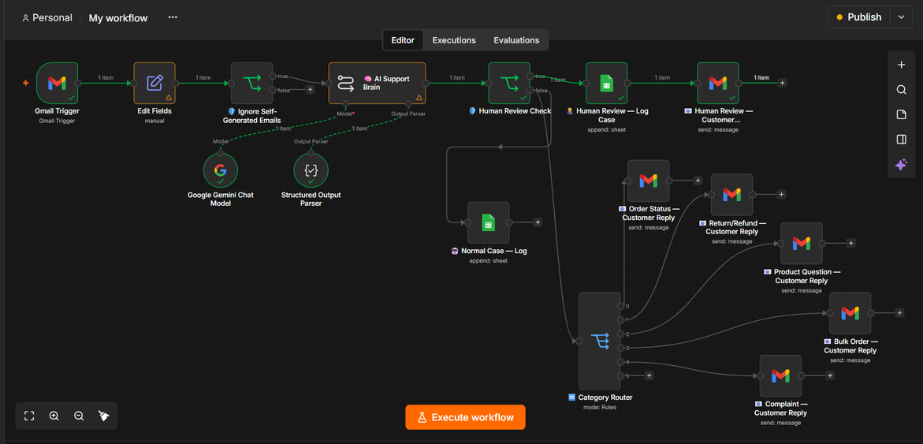
Cloudlet Tech
WORKING AUTOMATION — n8n
AI AUTOMATION • 2026
The Digitek
AI Support Flow
RECEIVE
Gmail Trigger
UNDERSTAND
Gemini AI
DECIDE
Human Review
ROUTE
n8n + Google Sheets
Customer emails enter the support workflow automatically.
Classifies requests and extracts customer and order details.
Unclear or high-risk cases are escalated for human judgement.
Logs the case and routes it to the correct response path.
Gmail → AI Triage → Human Review → Category Routing → Customer Response

Slide 5
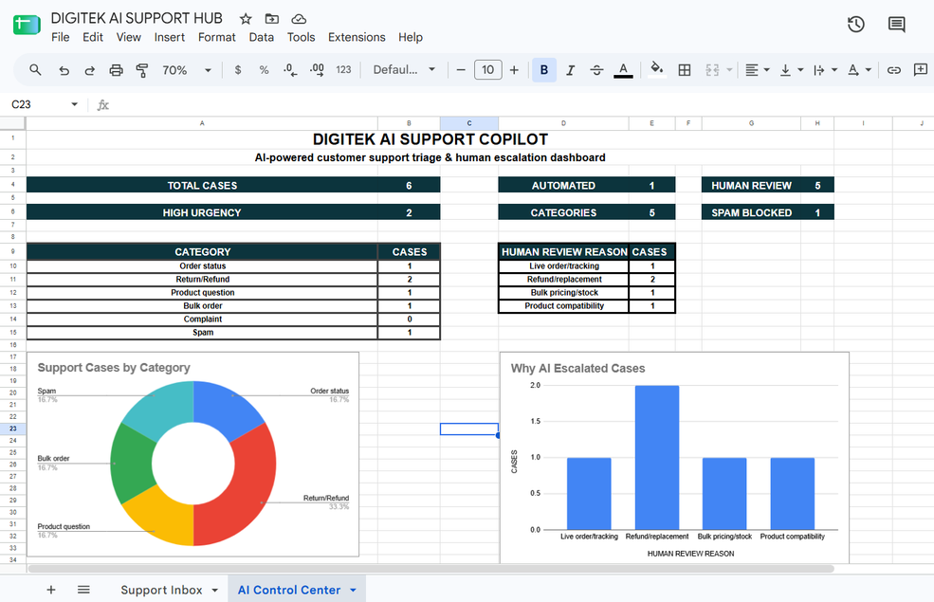
DIGITEK AI SUPPORT
02.05.2030
Tested on 6 Customer
Scenarios
01 — ORDER STATUS
02 — RETURN / REFUND
03 — BULK ORDER
Ankit
Order DGT25412
Human Review
Priya
Order DGT25877
Human Review
Rakesh
40 wireless mics + 40 tripods
Human Review
04 — PRODUCT QUESTION
05 — SPAM
06 — COMPLAINT
Sameer
Refund pending 15 days
Human Review
Gimbal compatibility
iPhone 15 Pro Max
Human Review
Ranking promotion
Classified as Spam
No Reply

Slide 6
DIGITEK AI SUPPORT
AI AUTOMATION • 2026
From Manual Work
BEFORE
Manual Support
~5 min / case
to Intelligent Support
Read → Classify → Log → Acknowledge
≈80%
LESS REPETITIVE HANDLING TIME
At 100 cases/day
8.3 hrs manual → 1.7 hrs AI-assisted
≈6.7 hrs/day potential saving
AFTER
AI-Assisted Support
~1 min / case
AI reduces repetitive triage, logging and acknowledgement work — allowing support teams to focus on decisions that require human judgement.
Triage → Extract → Log → Escalate
Illustrative estimate based on assumed handling times; not a measured production result.

Slide 7
DIGITEK AI SUPPORT
AI AUTOMATION • 2026
AI prepares the case.
Humans make the decisions.
Faster. Safer. More consistent.
Human-in-the-loop by design
Automation With
Guardrails
LIVE DATA
Escalate when tracking or refund status is unavailable.
AI UNCERTAINTY
Low confidence or missing information → human review.
AUTOMATION CONTROL
No invented pricing, stock or compatibility claims.

