Slide 1

Evaluating Performance in Cloud-Based Application Architectures
Team: Lokesh
Team Members:
Ben Gideon Dokiburra (2283917)
Lokeshwar Reddy Nandanapalli (2299460)
Nithin Kumar Balisetty (2299352)

Slide 2
Introduction
Performance evaluation by deploying the same application built using different architectures in the cloud.
Comparing the performance, advantages and drawbacks of different architectures in the cloud.
Full-stack application (E-commerce)
Monolithic
EC2
Microservices-based,
Cloud Services
AWS MQ
Amazon ECS and ECR

Slide 3
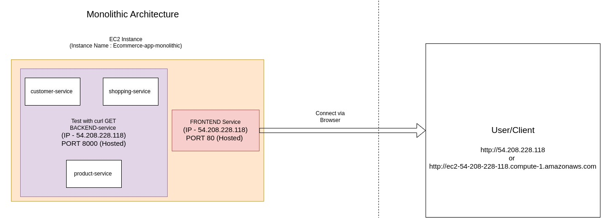
Design - Monolithic Architecture

Slide 4
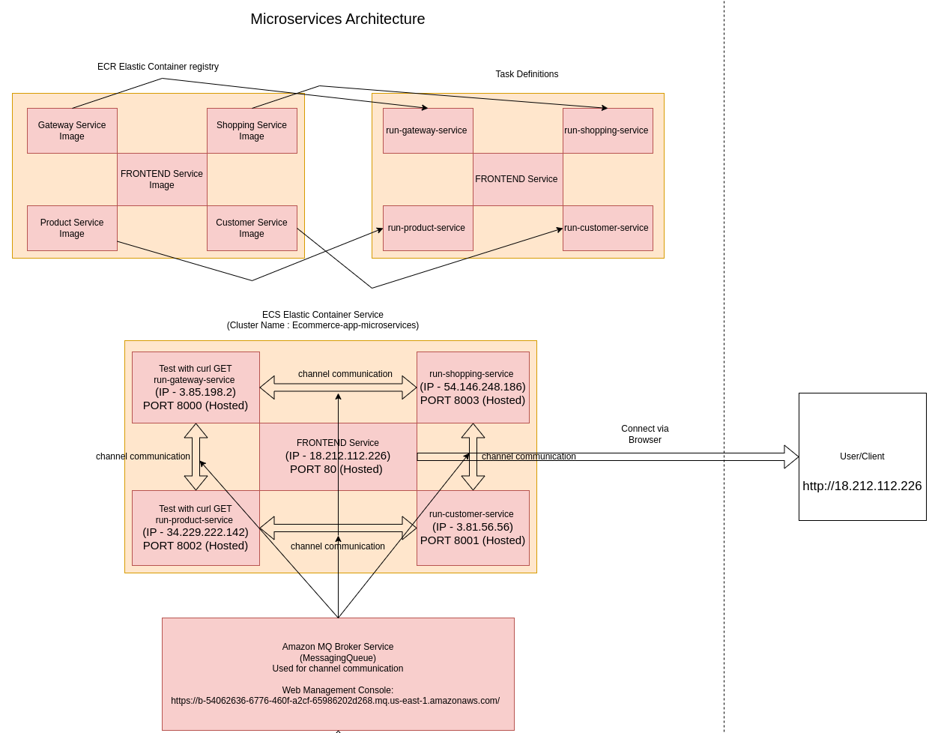
Design - Microservices Architecture

Slide 5
Implementation - Monolithic Architecture
Components
Single Codebase: Product, shopping, and customer services were combined into a single codebase.
Separate Front-End Service: Similar to the microservices version.
Deployment Process:
EC2 Instance: The monolithic application was hosted on an Amazon EC2 instance.
Public IP: The instance's public IP was used for accessing the app via the website.
Notes:
I

Slide 6
Implementation - Microservices Architecture
Services:
Product Service: Handles product data (get, insert, delete).
Shopping Service: Manages cart, wishlist, and order functions.
Customer Service: Handles user login, signup, and session management.
Front-End Service: User interface for accessing the app.
Gateway Service: Bridges requests between services.

Slide 7
Implementation - Microservices Architecture
Deployment Process:
Docker Images: Each service was containerized using Docker images and pushed to Amazon ECR (Elastic Container Registry).
Communication and Information Exchange: Amazon MQ was used to facilitate communication and information exchange between the microservices.
ECS Cluster: An ECS (Elastic Container Service) cluster was created.
Task Definitions: Task definitions were created for each service.
Tasks: Task definitions were added as tasks to run within the ECS cluster.
Public IPs: Each running task received a public IP.
Access: The front-end service's public IP was provided to users for app access.

Slide 8
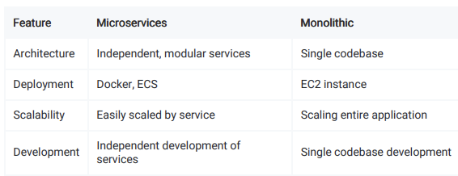
Comparison
Monolithic vs Microservices

Slide 9
Performance Evaluation
Load Testing:
Comprehensive load testing analysis is performed, plotting the performance metrics and response time distributions of our e-commerce shopping app under varying user loads.
Product Service Testing:
Testing product url to observe the latency and performance of different architectures.

Slide 10
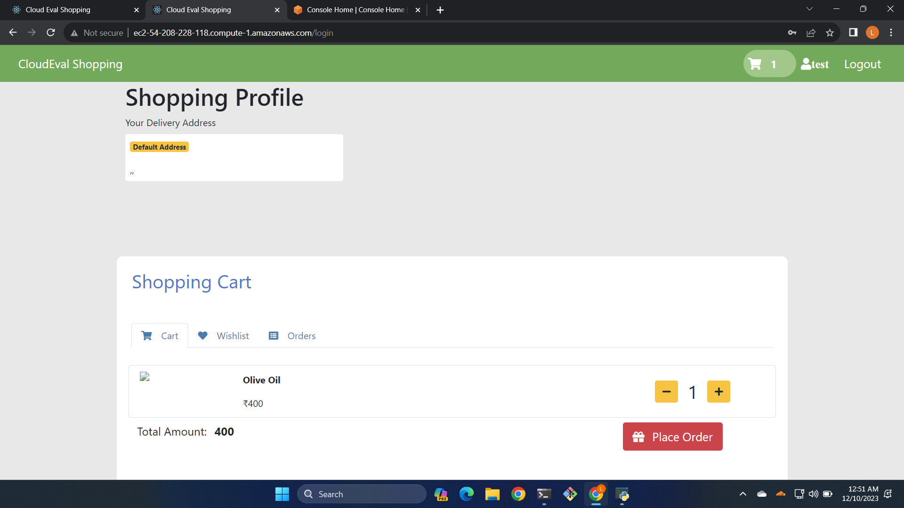
Demo - Website - Monolithic

Slide 11
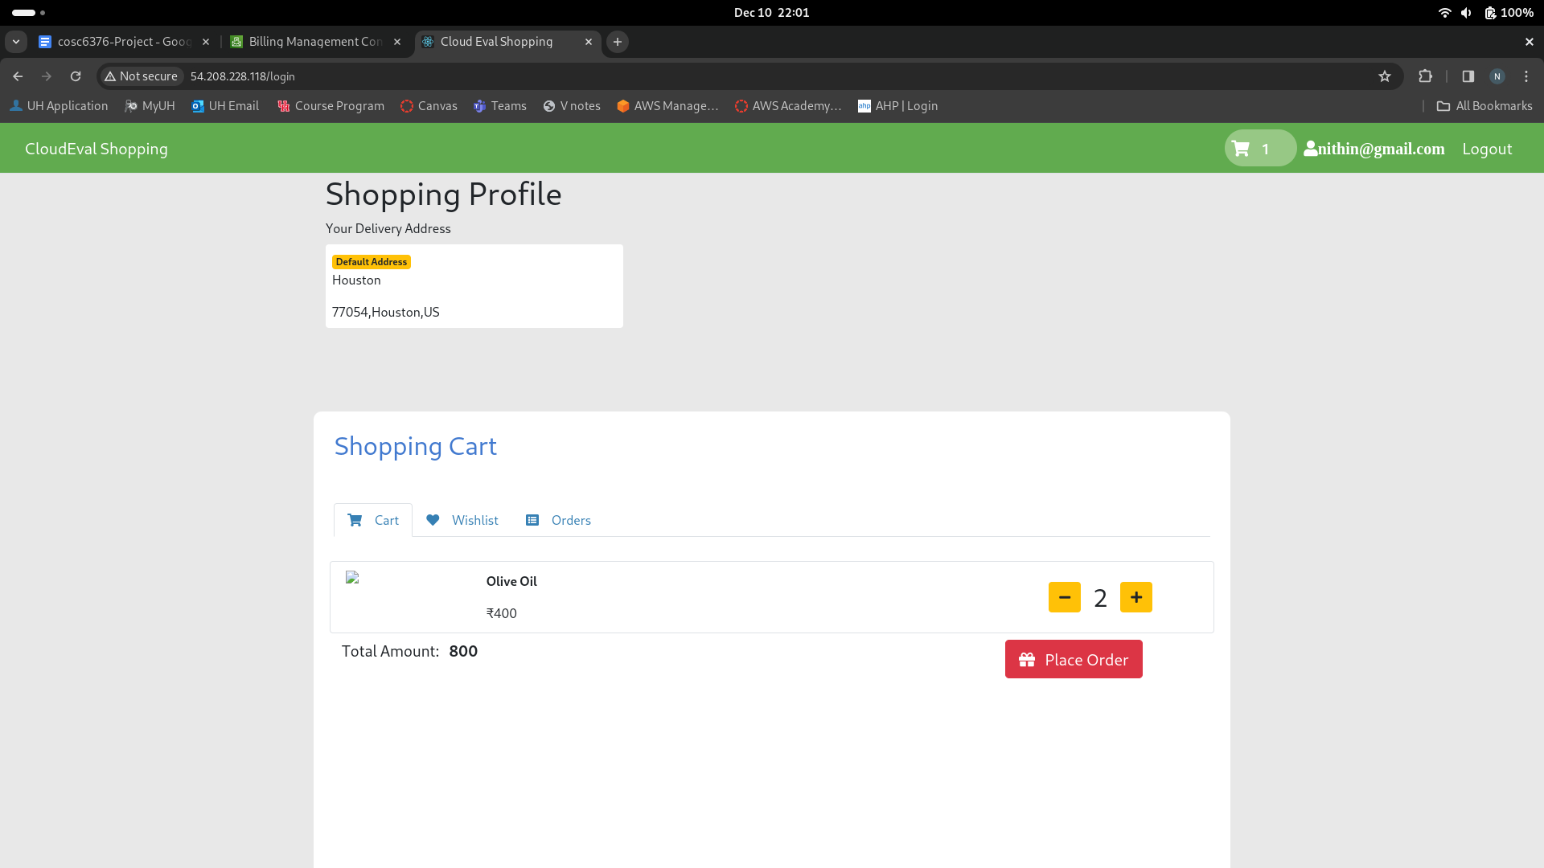
Demo - Website - Microservices

Slide 12
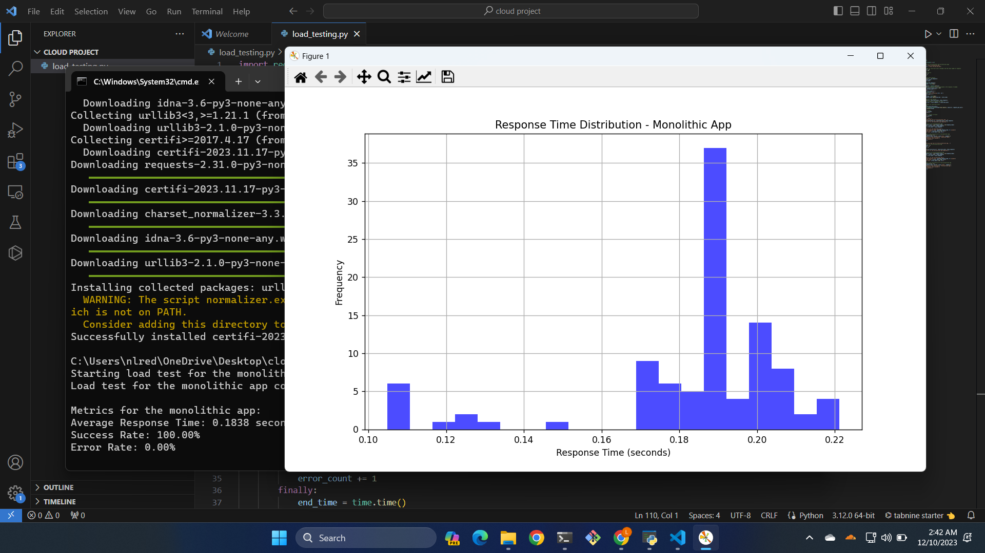
Demo - Load Testing - Monolithic

Slide 13
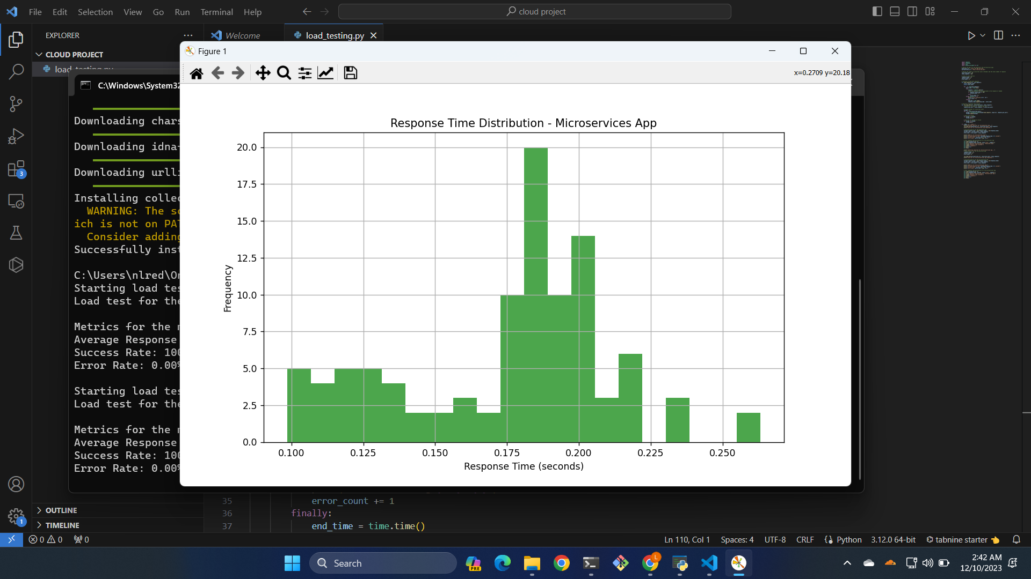
Demo - Load Testing - Microservices

Slide 14
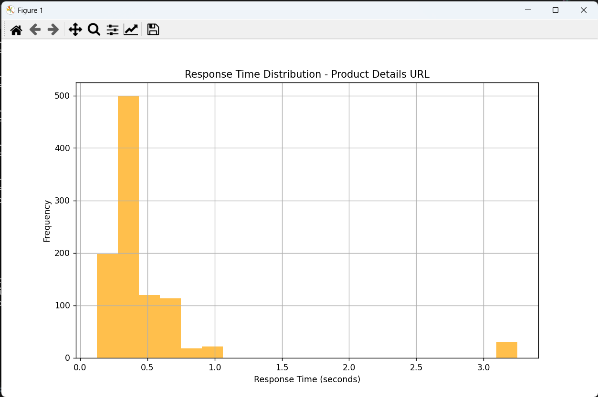
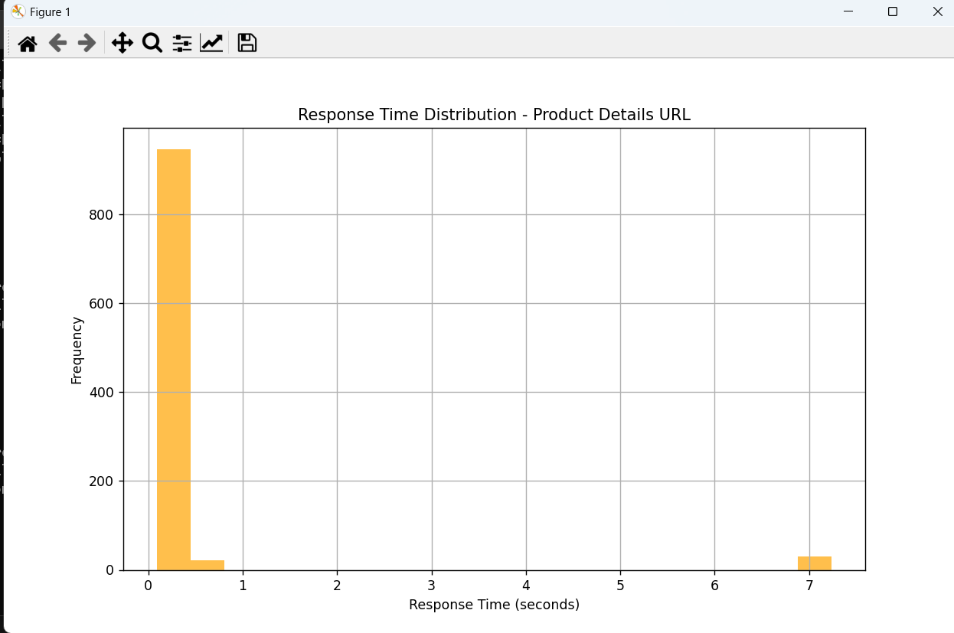
Demo - Product Service Testing

Slide 15
Conclusion
Performance of different architecture is evaluated successfully in terms of latency, throughput, resource utilization.
Microservices architecture appears more promising for applications with high unpredictable load.
Monolithic architecture appears best for applications with low load

Slide 16
References
• https://ieeexplore.ieee.org/document/9717259
• https://docs.aws.amazon.com
• https://en.wikipedia.org/wiki/Monolithic_application
• https://en.wikipedia.org/wiki/Microservices
• https://docs.python.org/3/
• https://requests.readthedocs.io/en/latest/
• https://www.mongodb.com/docs/
• https://docs.aws.amazon.com/amazon-mq/

