Slide 1
MO FARAH !!!
BY ALEXANDER J.M.F. DOWN

Slide 2
WHY HE INSPIRRES ME
MO INSPIRES ME BECAUSE HE NEVER GIVES UP.
HE RUNS LONG DISTANCES FAST WITHOUT STOPING !
HE IS A STRONG INSPERATION.
He is a world record bracker.

Slide 3
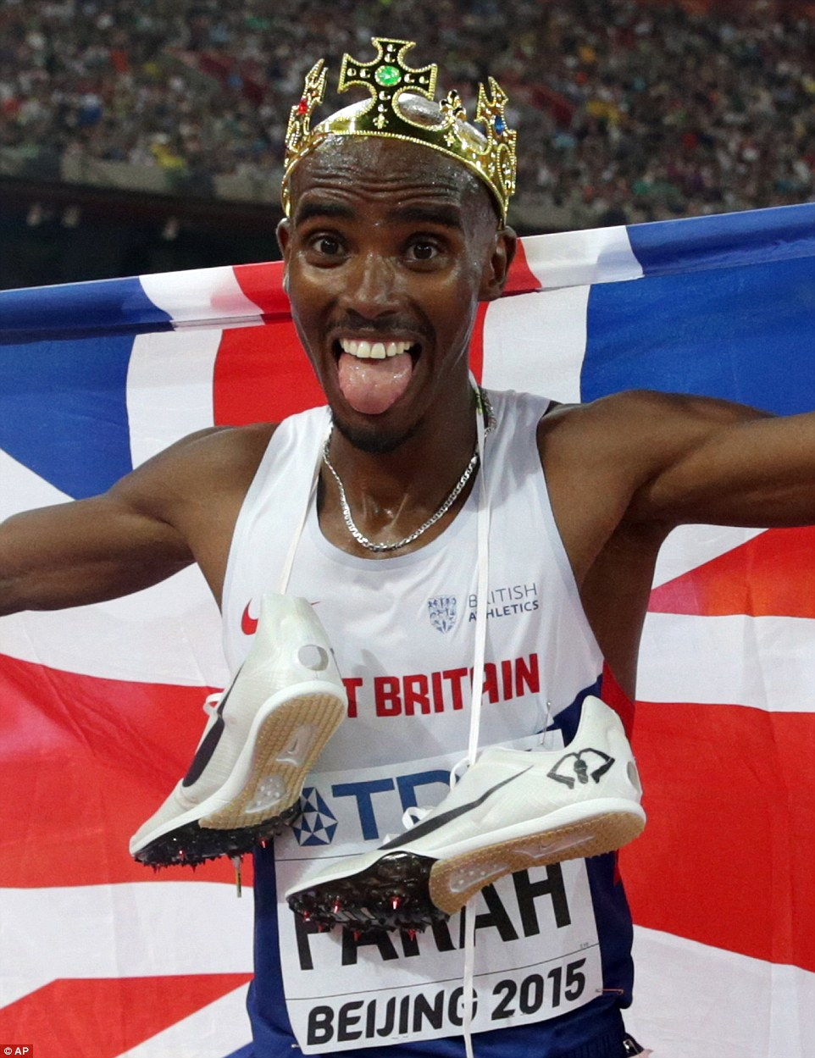
VIDEO!
https://www.youtube.com/watch?v=Kzee0gPqcwE

Slide 4
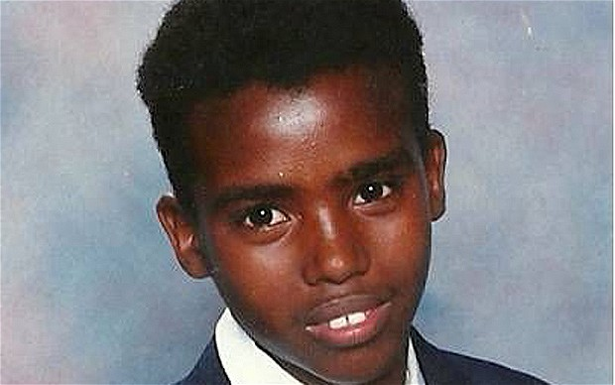
Life story
. Born in Somalia
. Born in 1983
. Left home contry because of war.
. Refuge in England.
. Left when he was 8.

Slide 5
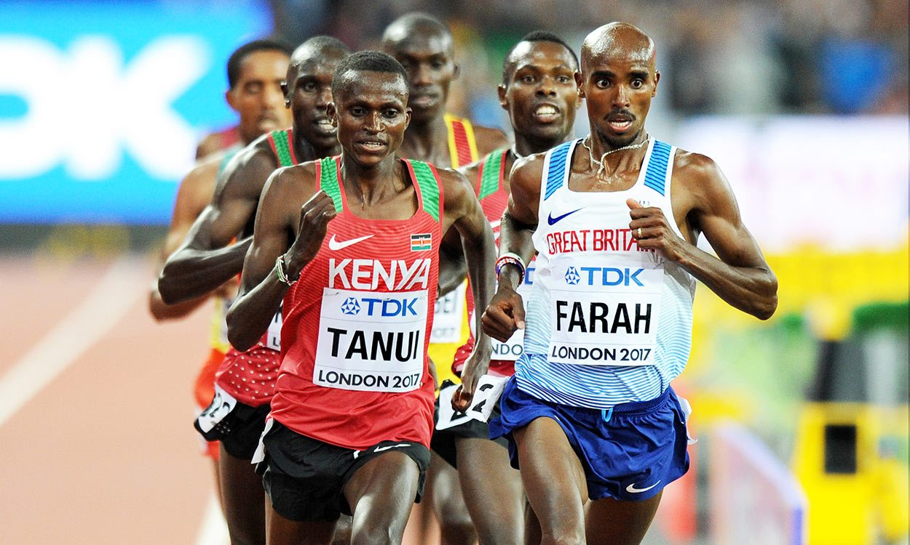
Track run
Fastes t.r.5000 meters

Slide 6
Fastest run record
1500!!!!!!!!!!!!

Slide 7

THANK YOU
ANY QUESTIONS?

