Slide 1
SHAP = SHapley Additive Explanations for model explanation and feature importance

Slide 2
References
Slides are adapted from Lectures by Adi Watzman
slundberg/shap: A game theoretic approach to explain the output of any machine learning model. (github.com)

Slide 3
Model: Bank Loan “approve” or “not approve”
Features
Annual Salary
Credit Score
Inconsistent past payments
Previously used credit cards
Model
Probability(approve)

Slide 4
Explainable/Interpretable Model
Features
Annual Salary
Credit Score
Inconsistent past payments
Previously used credit cards
Model
P(approve) = 0.2
Why was the person not approved ?
How much contribution from each feature to the probability value ?
Which contribution was negative and positive to the model prediction ?
Additive nature: The addition of the contribution should yield p(approve).
Local: Explainable model for individual samples.

Slide 5
Explainable/Interpretable Model
Provides Data insights
People want to know why the model give a specific score for a particular data set.
Model Debugging
If feature contribution doesn’t match or doesn’t make sense, the model may be incorrect.
People do not usually like “black box” models.

Slide 6
SHAP = SHapley Additive Explanations
Single instance (x)
Annual Salary
Credit Score
Inconsistent past payments
Previously used credit cards
Explanation
Trained Model (f)
Contribution of each
Input feature to the model
score f(x) for a single instance
x
Additive contributions from
the features sum to f(x)
Aggregated Contribution
of each Input feature to the
Model score for a test set
SHAP
analysis

Slide 7
SHapley values in Game Theory
First defined by Economics Nobel Laureate Lloyd Shapley in 1953 paper “A value of n-persons games”
A cooperative game played by n players and at the end of the game there is some money left.
How to divide money in a fair way ? Definition of a “fair way”
Additive: money got by different players should sum up to the total money.
Consistency: player who contributed more should get more money.

Slide 8
SHapley values in Game Theory
Shapley value of player i in game f = amount of money player i should get.
Take a subset (S) of players without player i and play the game to obtain the game money result : f(S)
Include player i to the same subset (S) , play the game to obtain the game money result : f( S U {i} )
Compute marginal contribution f( S U {i} ) – f (S)
Do steps 1 to 3 for all possible Subsets S and take the average of
f( S U {i} ) – f (S) obtained from all possibilities. This is Shapley value
of player i in game f

Slide 9
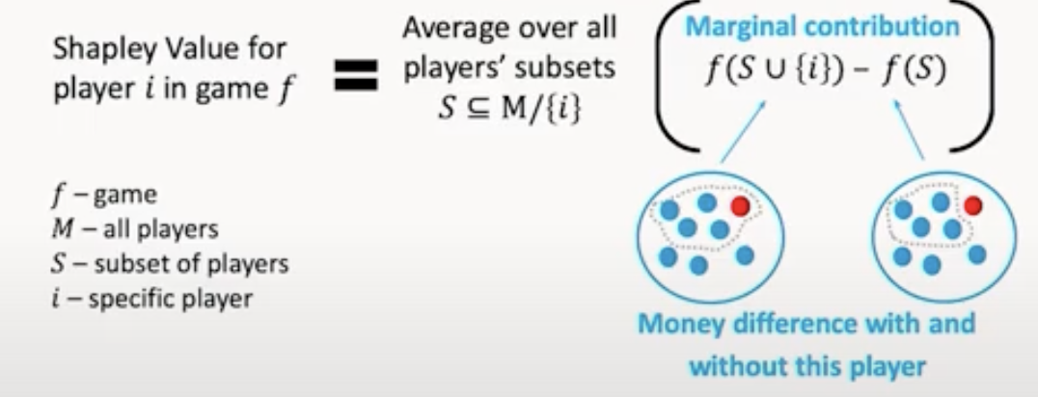
SHapley values in Game Theory
Shapley value of player i in game f = amount of money player i should get in the game.
It was proven that Shapley value is the only unique way to distribute the money among the players in a fair way.

Slide 10
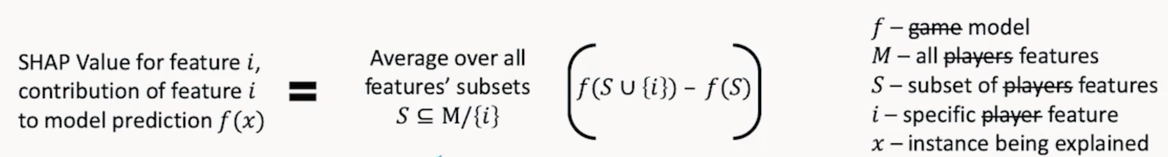
SHapley values for feature contributions
Exponential Time
Too many possibilities
For any subset S, model f should
incorporate all n features
(n = total number of features)
How to run a model with missing features ?
Different algorithms have been proposed to solve the above two issues.
Lundberg, Scott M., and Su-In Lee. “A unified approach to interpreting model predictions.” Advances in Neural Information Processing Systems (2017)

Slide 11
SHAP kernel explainer method:
Generally, can be used with any ML model.
Provides approximation of SHAP values.
Only considers a portion of all possible subsets of features.
Fill missing features using a background data set [ no concrete method to go about this]
Training set
K-means representations
Median of the data set

Slide 12
SHAP Tree-based explainer method:
Only for Tree-based model.
Decision Trees, Random Forest, Boosting etc.
Provides exact SHAP values.
Considers all possible subsets of features
Able to do so because of tree traversal (navigating) algorithms.
Fill missing features using a background data set [ no concrete method to go about this]
Training set
K-means representations
Median of the data set

Slide 13
SHAP Deep explainer method:
Generally, for Neural Networks.
Provides approximation of SHAP values.
Fill missing features using a background data set [ no concrete method to go about this]
Training set
K-means representations
Median of the data set
Uses other methods such as DeepLift Algorithm, and analytical solutions.

Slide 14
SHapley values (pros)
Based on theoretical foundations. It has been proven that shapley value is the only unique way to be fair to the features based on their importance.
Local nature: can explain model behavior for a single instance
Additive nature: shapley values of each feature add up to the model score.
Other methods exist for feature importance, but they lack the additive nature.

Slide 15
SHapley values (cons)
Kernel Explainer may take a longer time depending on the size of subset size the use chooses.
Kernel Explainer may give approximate solutions.

