Slide 1
IBM University Engagement Project Submission
“Exploring the Power of Agentic AI with IBM Granite and IBM Bob”

Slide 2

Project Title – AI-Powered Travel Planner Agent using IBM Bob and IBM Granite
Domain of Project – Travel & Tourism
Student Name | Recent Passport Photo | Email ID | Mobile number [WhatsApp]
Divyansh Agarwal |  | Lnct.divyanshgoyan@gmail.com | +91-8318898449

Slide 3
Problem Statement
Problem Statement : AI-Powered Travel Planner Agent
The Challenge
Challenges faced while planning trips include budget management, hotel selection, route planning, generating personalized itineraries, and dealing with travel information scattered across multiple websites.
The Objective
Develop an intelligent Agentic AI solution capable of generating personalized travel plans, recommending hotels, transportation, attractions, restaurants, estimated budgets, and travel tips.

Slide 4
Proposed Solution
Proposed Solution: AI-Powered Travel Planner Agent
IBM Bob coordinates multiple AI agents to deliver a seamless travel planning experience. The system addresses challenges in trip planning through an intelligent, modular architecture.
Key Agents:
• Destination Recommendation Agent: Suggests optimal destinations based on preferences.
• Budget Planning Agent: Optimizes budget for the trip.
• Hotel Recommendation Agent: Finds the best accommodations.
• Itinerary Generator: Creates dynamic, personalized day-by-day plans.
• Travel Advisory Agent: Provides tips and essential travel information.

Slide 5
Technology Used
• IBM Bob - For designing and orchestrating multi-agent workflows visually
• IBM Granite 3.x Model - For natural language understanding, reasoning, and personalization
• IBM Cloud Lite - Provides reliable, secure infrastructure
• IBM watsonx.ai - For model deployment, embeddings, and AI governance
• Retrieval-Augmented Generation (RAG) - To fetch real data first, then generate intelligent answers
• Vector Database (FAISS/Chroma) - For RAG-based data retrieval
• GitHub - For version control and repository hosting

Slide 6
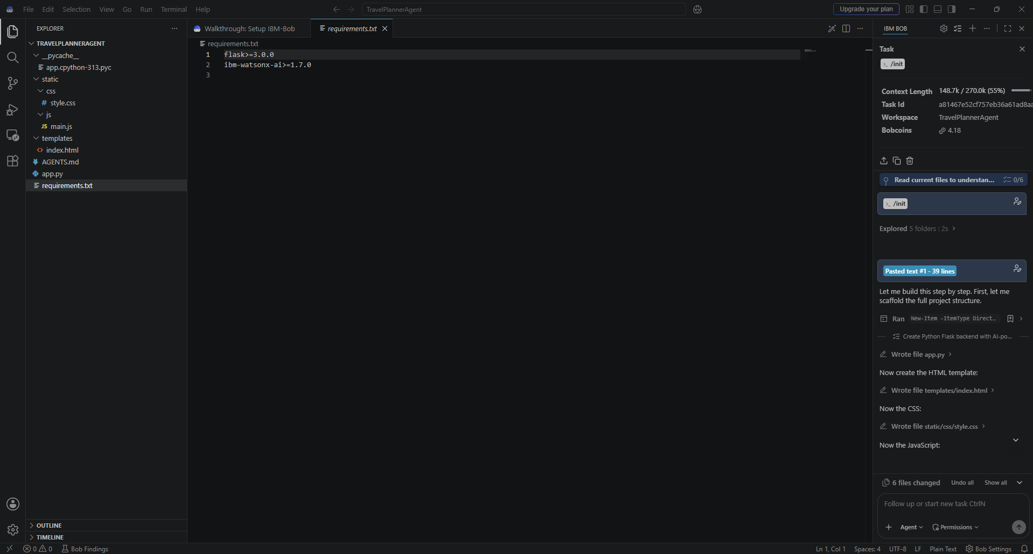
Required Files created using IBM Bob

Slide 7
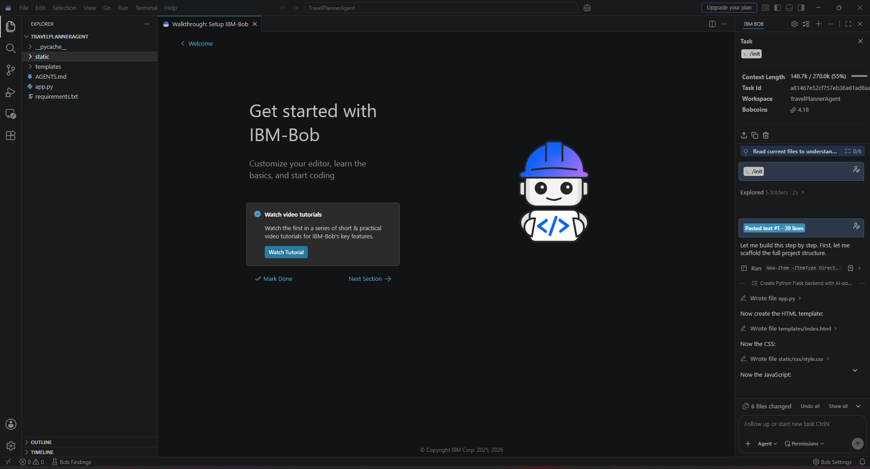
IBM Bob Screenshots:

Slide 8
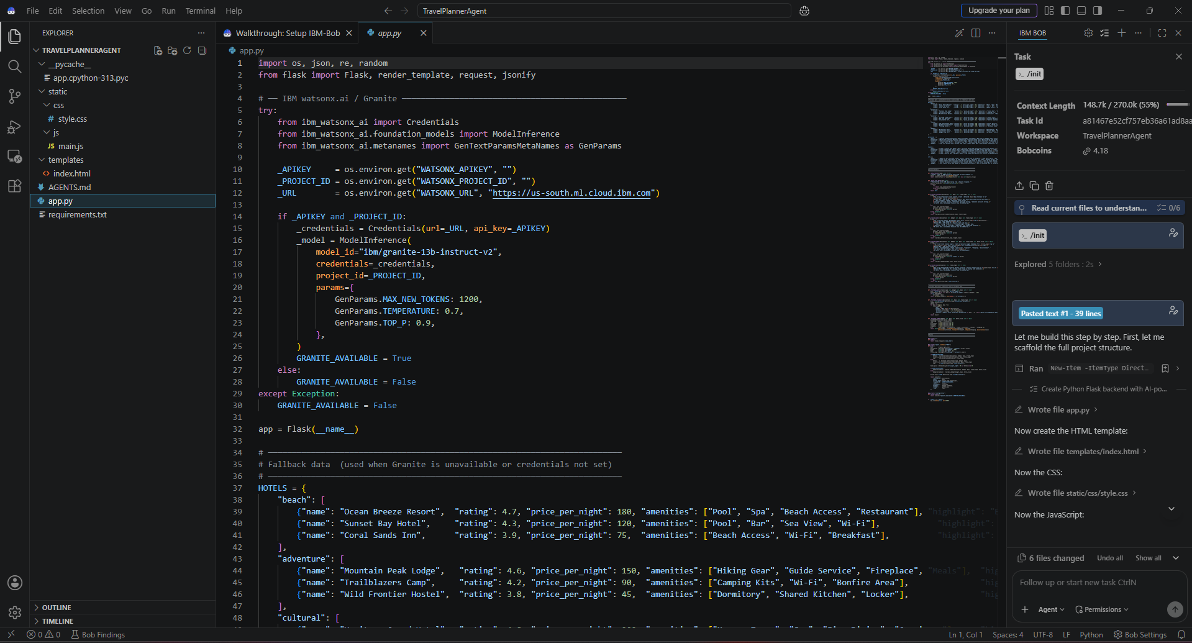

Slide 9
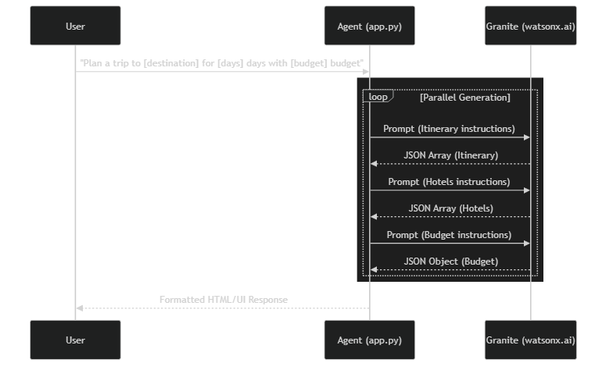
Architecture Blueprint

Slide 10

Role of Agentic AI
Role of Agentic AI in Travel Planner Agent
• Autonomous reasoning: The agent independently analyzes requirements to make optimal travel decisions.
• Multi-agent collaboration: Specialized agents work together to handle destinations, budgets, and itineraries.
• Personalized recommendations: Tailors travel plans based on user-specific preferences and constraints.
• Dynamic itinerary generation: Adjusts plans in real-time based on new inputs or constraints.
• Context awareness: Understands the broader context of the trip, including weather, location, and user intent.

Slide 11
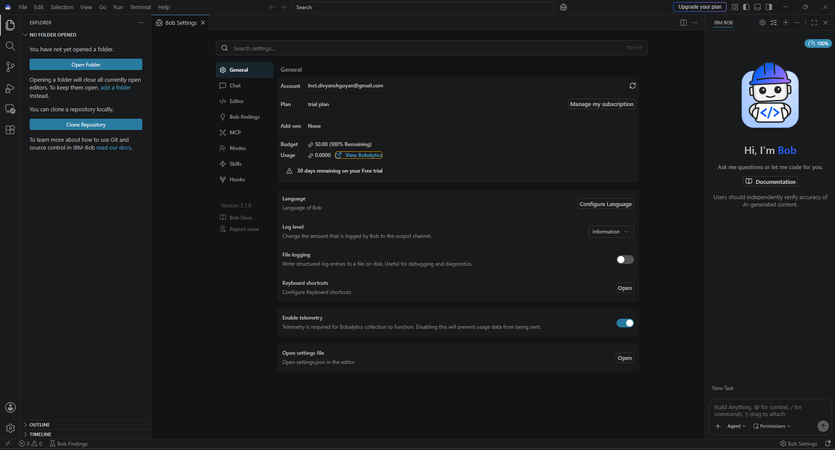
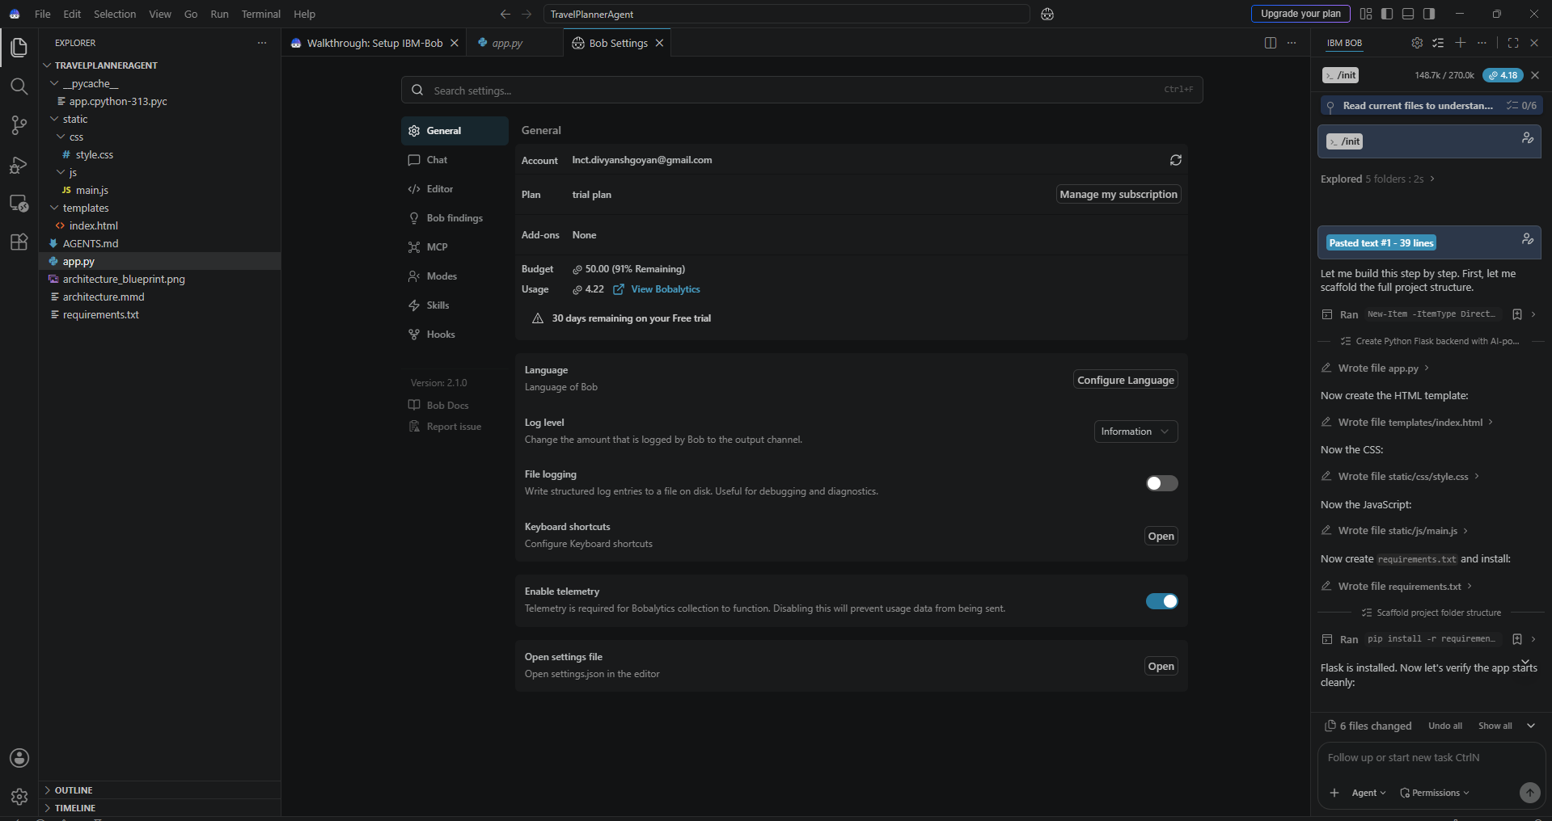
Token Usage
Total Tokens Used: 148.7k
[Before Prompt]
[After Prompt]
·
·
·

Slide 12
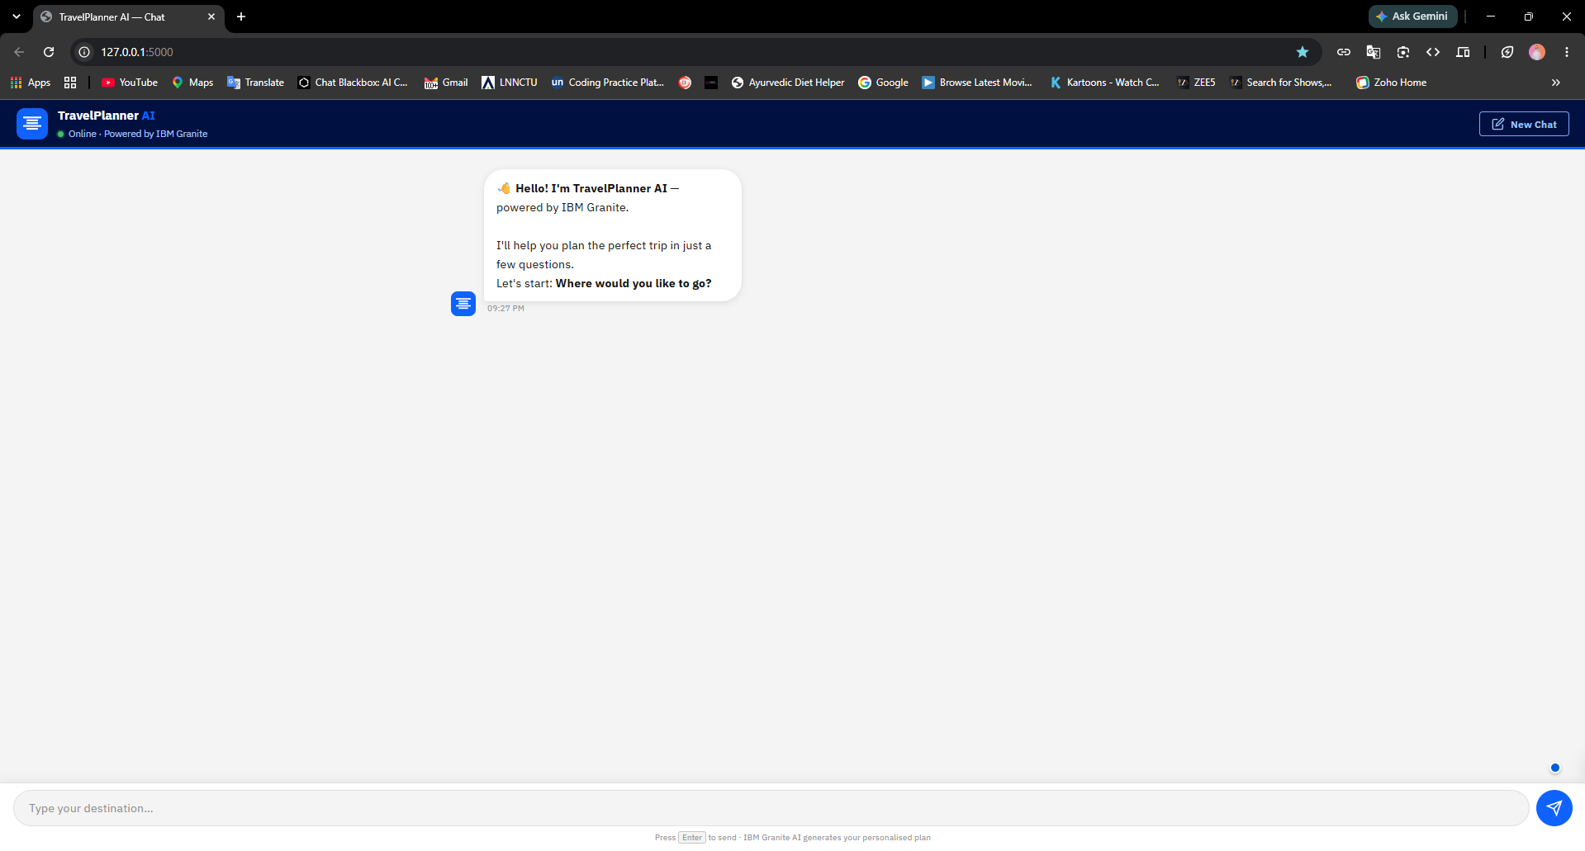
Project Output
Prompt: "Plan a 3-day Goa trip under ₹15,000."
[Large Screenshot Placeholder]
·
·
·

Slide 13
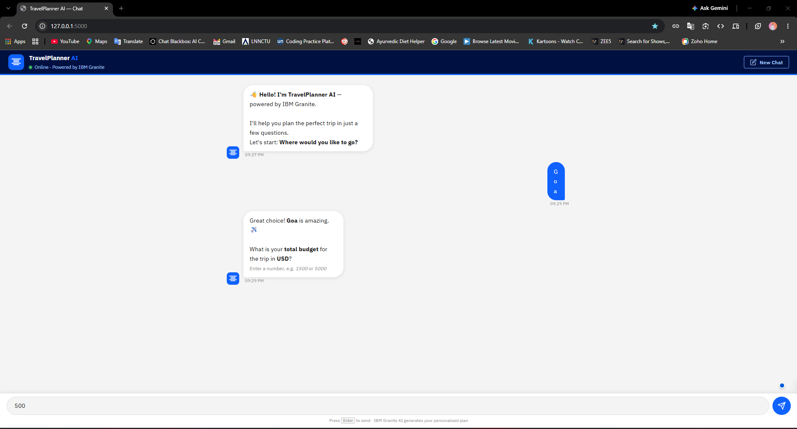
Project Output
Prompt: "Plan a 5-day family trip to Jaipur."
[Large Screenshot Placeholder]
·
·
·

Slide 14
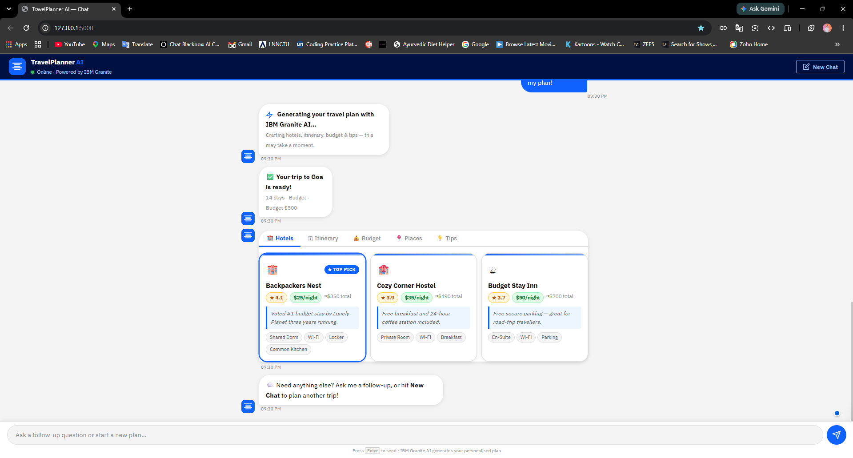
Project Output
Prompt: "Plan a honeymoon trip to Manali."
[Large Screenshot Placeholder]
·
·
·

Slide 15
Novelty and Uniqueness
• Multi-Agent AI – Collaborative agents for a seamless travel planning experience.
• Personalized itineraries – Tailored to user preferences, budget, and duration.
• Budget optimization – Real-time cost analysis and adjustments.
• Real-time recommendations – Dynamic suggestions for hotels and attractions.
• Agentic workflow – Autonomous execution of complex planning tasks.
• IBM Granite reasoning – Advanced natural language understanding for accurate plans.
• Scalable cloud architecture – Built on IBM Cloud for reliability and performance.

Slide 16
GitHub Link
[Placeholder: Public GitHub Repository URL]
https://github.com/lnct-dag/travel-planner-agent
Required files uploaded:
• IBM Bob files
• Problem Statement PDF
• Presentation
• README
• Other project files
·
·
·

Slide 17
Future Scope
• Voice Assistant
• Google Maps Integration
• Weather API
• Flight Booking
• Hotel Booking
• Multilingual Support
• Mobile App
·
·
·

Slide 18
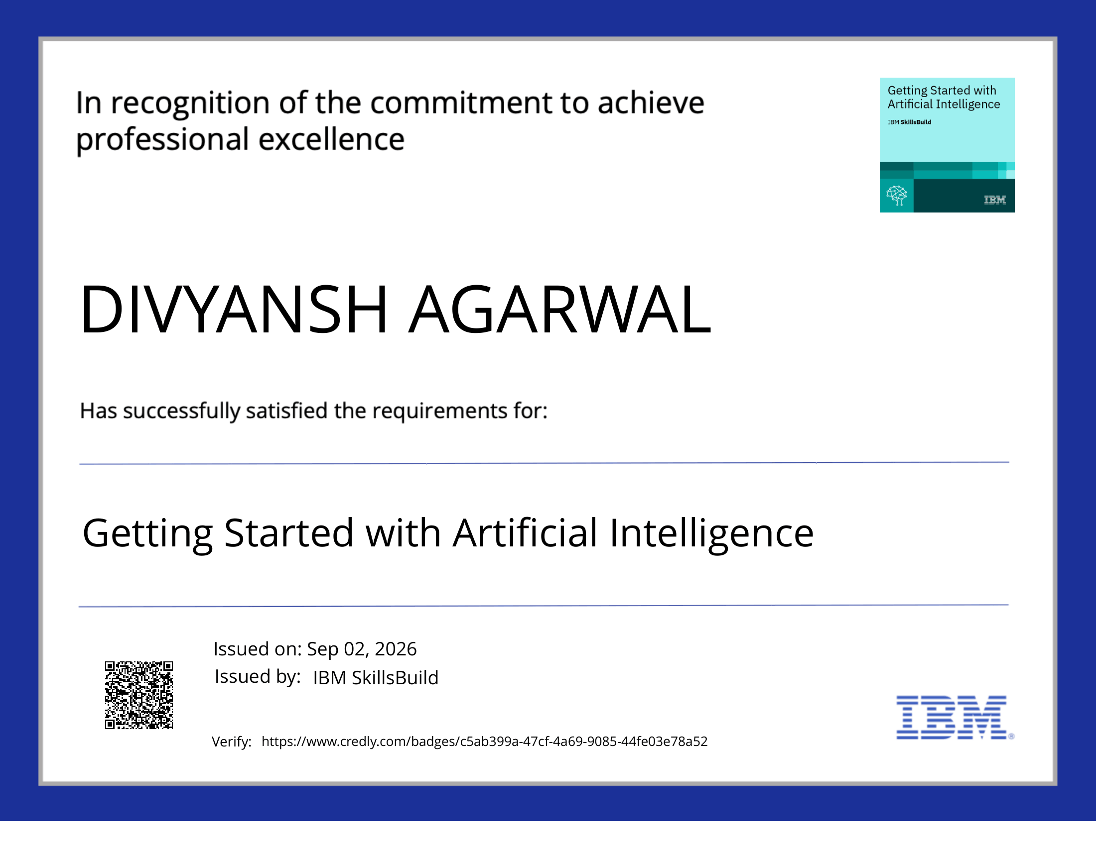
Certificates Earned:
Getting Started with Artificial Intelligence

Slide 19
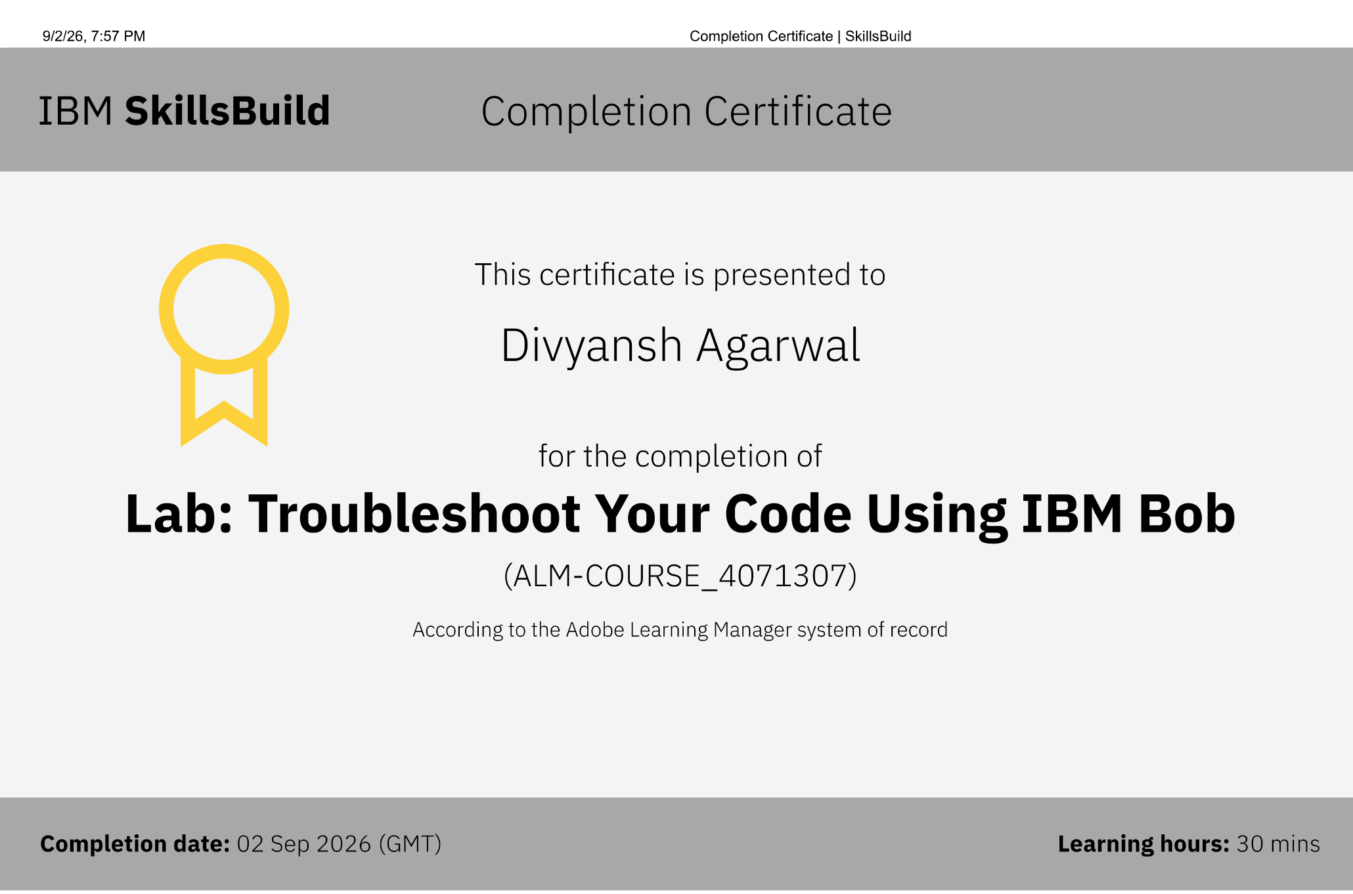
Certificates Earned:​
[Placeholder: IBM Bob Certificate]

Slide 20


