Slide 1
Introduction to
Artificial Intelligence
Lecture: Constraint Satisfaction Problems

Slide 2
Outline
Constraint Satisfaction Problems (CSPs)
Constraint Propagation: Inference in CSPs
Backtracking Search for CSPs
Local Search for CSPs

Slide 3
Constraint Satisfaction Problems (CSPs)
A constraint satisfaction problem (CSP) uses a factored representation for each state.
State = a set of variables and each of which has a value
Solution = each variable has a value that satisfies all constraints on that variable
Take advantage of the structure of states
General-purpose rather than problem-specific heuristics
Identify combinations of variable-value that violate the constraints → eliminate large portions of the search space all at once
Solutions to complex problems

Slide 4
Constraint Satisfaction Problems (CSPs)
A CSP consists of the following three components
𝑿 = {𝑋₁,.., 𝑋_{n}}: a set of variables
𝑫 = {𝐷₁,.., 𝐷_{n}}: a set of domains, one for each variable.
𝑪: a set of constraints that state allowable combinations of values.
Each 𝐶 consists of a pair <𝑠𝑐𝑜𝑝𝑒, 𝑟𝑒𝑙>
𝑠𝑐𝑜𝑝𝑒: a tuple of variables that participate in the constraint
A relation 𝑟𝑒𝑙 defines the values that participated variables can take

Slide 5
Constraints in CSPs
Assume that both 𝑋₁ and 𝑋₂ have the domain {𝐴,𝐵}
“Two variables must have different values”
A relation can be an explicit list of all tuples of values that satisfy the constraint.
<(𝑋₁, 𝑋₂), {(𝐴, 𝐵), (𝐵, 𝐴)}>
It can be an abstract relation that supports two operations
Test whether a tuple is a member of the relation
Enumerate the members of the relation
<(𝑋₁, 𝑋₂), 𝑋₁ ≠ 𝑋₂>

Slide 6
Solutions for CSPs
Each state is defined by an assignment of values to some or all the variables.
A solution to a CSP is a consistent – complete assignment.
A consistent assignment does not violate any constraints.
A complete assignment has every variable assigned, while a partial assignment assigns values to only some variables.

Slide 7
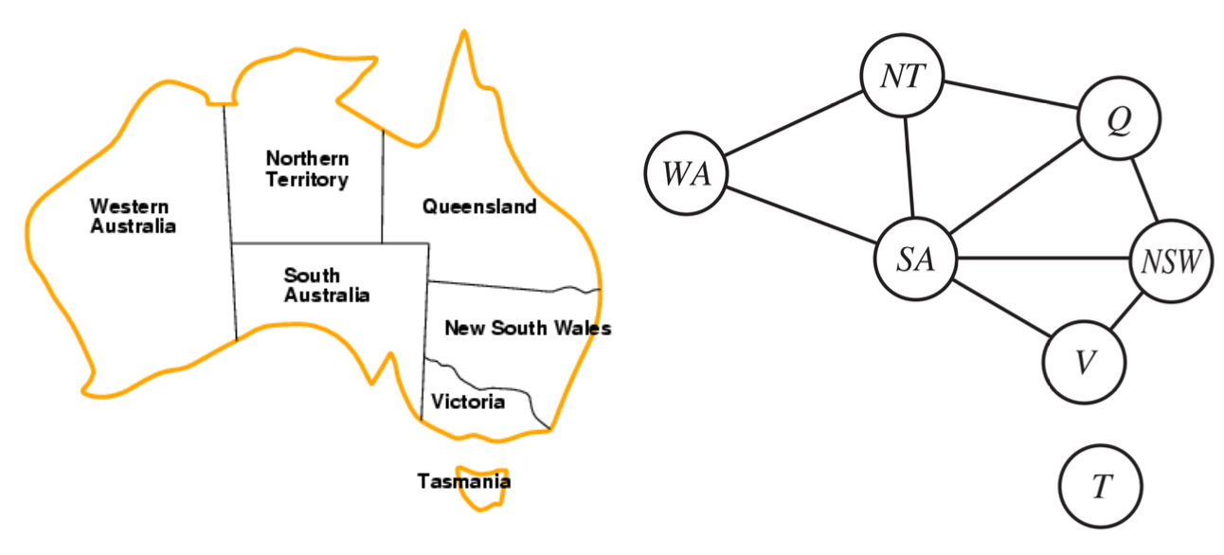
Example: Map Coloring
Each state is assigned a color in {red, green, blue}.
Adjacent states have different colors.
Constraint graph:
Nodes ⇔ Variables
Arcs ⇔ Constraints

Slide 8
Example: Map Coloring
Variables: 𝑋 = {𝑊𝐴, 𝑁𝑇, 𝑄, 𝑁𝑆𝑊, 𝑉, 𝑆𝐴, 𝑇}
Domains: 𝐷_{i} = {𝑟𝑒𝑑, 𝑔𝑟𝑒𝑒𝑛, 𝑏𝑙𝑢𝑒}
Constraints: Adjacent regions must have different colors
{𝑆𝐴 ≠ 𝑊𝐴, 𝑆𝐴 ≠ 𝑁𝑇, 𝑆𝐴 ≠ 𝑄, 𝑆𝐴 ≠ 𝑁𝑆𝑊,
𝑆𝐴 ≠ 𝑉, 𝑊𝐴 ≠ 𝑁𝑇, 𝑁𝑇 ≠ 𝑄, 𝑄 ≠ 𝑁𝑆𝑊 , 𝑁𝑆𝑊 ≠ 𝑉}
𝑆𝐴 ≠ 𝑊𝐴 is a shortcut of <(𝑆𝐴,𝑊𝐴), 𝑆𝐴 ≠ 𝑊𝐴>
𝑆𝐴 ≠ 𝑊𝐴 can be fully enumerated as
{(red,green), (red,blue), (green,red),
(green,blue), (blue,red), (blue,green)}

Slide 9
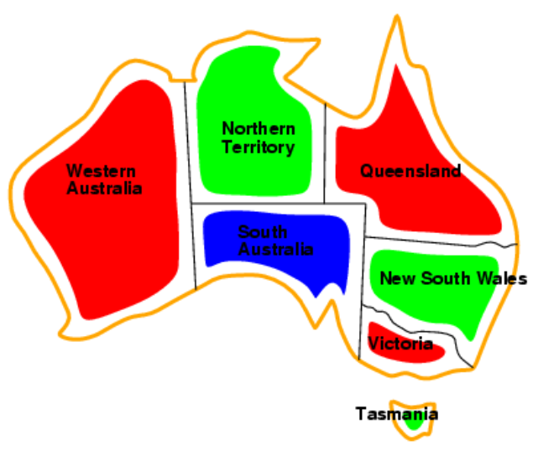
Example: Map Coloring
There are many possible solutions to this problem.
{𝑊𝐴 = 𝑟𝑒𝑑, 𝑁𝑇 = 𝑔𝑟𝑒𝑒𝑛, 𝑄 = 𝑟𝑒𝑑, 𝑁𝑆𝑊 = 𝑔𝑟𝑒𝑒𝑛,
𝑉 = 𝑟𝑒𝑑, 𝑆𝐴 = 𝑏𝑙𝑢𝑒, 𝑇 = 𝑟𝑒𝑑}

Slide 10
Benefits of CSPs
Provide natural representation for a wide variety of problems
Many problems intractable in regular state-space search can be solved quickly with CSP formulation.
Better insights to the problem and its solution.

Slide 11
Variations on the CSP formalism
Discrete and finite variables
𝑛 variables, domain size 𝑑 → 𝑂(𝑑^{𝑛}) complete assignments
E.g., map coloring, scheduling with time limits, 8-queens etc.
Discrete, infinite domains
Sets of Integers, strings, etc.
E.g., job scheduling without deadlines
Constraint language: understand constraints without enumeration
Continuous domains
Real-world problems often involve continuous domains and even real-valued variables.

Slide 12
CPSs in practise
Operations Research (scheduling, timetabling)
Scheduling the time of observations on the Hubble Space Telescope
Airline schedules
Linear programming
Constraints must be linear equalities or inequalities
→ solved in time polynomial in the number of variables.
Bioinformatics (DNA sequencing)
Electrical engineering (circuit layout-ing)
Cryptography
Computer vision: image interpretation

Slide 13
Types of constraints
Unary constraint: restrict the value of a single variable
𝑆𝐴 ≠ 𝑔𝑟𝑒𝑒𝑛
Binary constraint: relate two variables
𝑆𝐴 ≠ 𝑊𝐴
Higher-order constraints: involve three or more variables
E.g., Professors A, B, and C cannot be on a committee together
Always possible to be represented by multiple binary constraints
Global constraints: involving an arbitrary number of variables
𝐴𝑙𝑙𝑑𝑖𝑓𝑓 = all variables involved must have different values

Slide 14
Preference constraints
Which solutions are preferred → soft constraints
E.g., 𝑟𝑒𝑑 is better than 𝑔𝑟𝑒𝑒𝑛
→ this often can be represented by a cost for each variable assignment
Constraint optimization problem (COP): a combination of optimization with CSPs → linear programming

Slide 15
Constraint propagation
Constraints help to reduce the number of legal values for a variable
→ legal values for another variable are also reduced.
Intertwined with search, or done as a preprocessing step.
Enforcing local consistency in each part of a graph causes inconsistent values to be eliminated throughout the graph.

Slide 16
Node consistency
A single variable is node-consistent if all the values in the variable’s domain satisfy the variable’s unary constraints.
Eliminate all the unary constraints in a CSP by running node consistency.
E.g., The South Australians dislike green, the domain of {𝑆𝐴} will be {𝑟𝑒𝑑, 𝑔𝑟𝑒𝑒𝑛, 𝑏𝑙𝑢𝑒}

Slide 17
Arc consistency
A variable in a CSP is arc-consistent if every value in its domain satisfies the variable’s binary constraints.
Arc consistency may have no effect in several cases.
E.g., the Australia map, no matter what value chosen for 𝑆𝐴 (or for 𝑊𝐴), there is a valid value for the other variable.

Slide 18
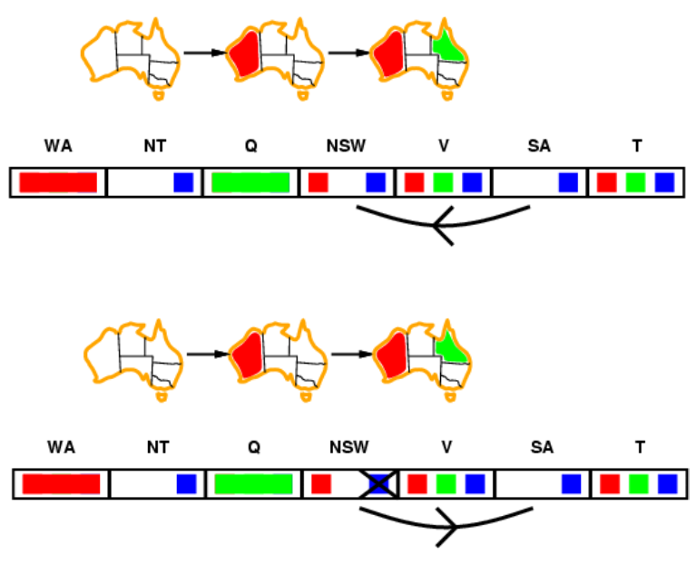
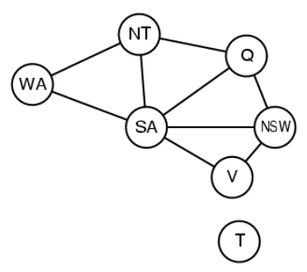
Arc consistency

Slide 19
Arc consistency
Run as a preprocessor before the search starts or after each assignment
AC must be run repeatedly until no inconsistency remains
Need a systematic method for arc-checking
If 𝑋 loses a value, neighbors of 𝑋 need to be rechecked
→ incoming arcs can become inconsistent again while outgoing arcs stay still

Slide 20
AC-3 algorithm
function AC-3(csp)
returns false if an inconsistency is found and true otherwise
inputs: csp, a binary CSP with components (X, D, C)
local variables: queue, a queue of arcs, initially all the arcs in csp
while queue is not empty do
(X_{i} , X_{j}) ← REMOVE-FIRST(queue)
if REVISE(csp, Xi , Xj) then
if size of D_{i} = 0 then return false
for each X_{k} in X_{i}.NEIGHBORS - {X_{j}} do
add (X_{k} , X_{i}) to queue
return true

Slide 21
AC-3 algorithm
function REVISE(csp, X_{i} , X_{j})
returns true iff we revise the domain of Xi
revised ← false
for each x in D_{i} do
if no value y in D_{j} allows (x ,y) to satisfy the constraint between X_{i} and X_{j} then
delete x from D_{i}
revised ← true
return revised
The worst-case complexity is 𝑂(𝑐𝑑³)
𝑛: number of variables, each has domain size 𝑑, 𝑐 binary constraints (arc)

Slide 22
Backtracking Search
States are defined by the values assigned so far
Initial state: empty assignment { }
Successor function: assign a value to an unassigned variable that agrees with the current assignment
→ fail if no legal assignments
Goal test: the current assignment is complete
Depth-first search: choose values for one variable at a time and backtrack when a variable has no legal values left

Slide 23
Backtracking Search
function BACKTRACKING-SEARCH(csp) returns a solution, or failure
return BACKTRACK({ }, csp)
function BACKTRACK(assignment, csp) returns a solution, or failure
if assignment is complete then return assignment
var ← SELECT-UNASSIGNED-VARIABLE(csp)
for each value in ORDER-DOMAIN-VALUES(var, assignment, csp) do
if value is consistent with assignment then
add {var = value} to assignment
inferences ← INFERENCE(csp, var, value)
if inferences != failure then
add inferences to assignment
result ← BACKTRACK(assignment, csp)
if result != failure then
return result
remove {var = value} and inferences from assignment
return failure

Slide 24
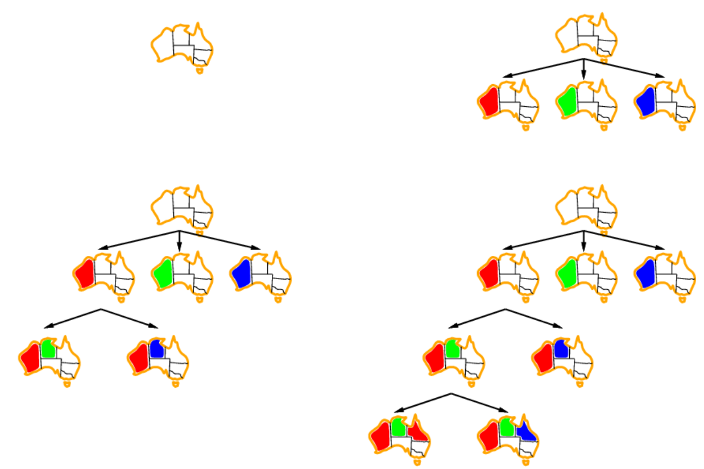
Backtracking Search

Slide 25

Variable and value ordering
Minimum-remainfewest legal values
ing-values (MRV) heuristic: choose the variable with the E.g., after [𝑊𝐴 = 𝑟𝑒𝑑, 𝑁𝑇 = 𝑔𝑟𝑒𝑒𝑛] only one possible value for 𝑆𝐴

Slide 26

Variable and value ordering
Degree heuristic (DH): choose the variable that involves in the largest number of constraints on other unassigned variables.
E.g., 𝑆𝐴 has a highest degree of 5

Slide 27
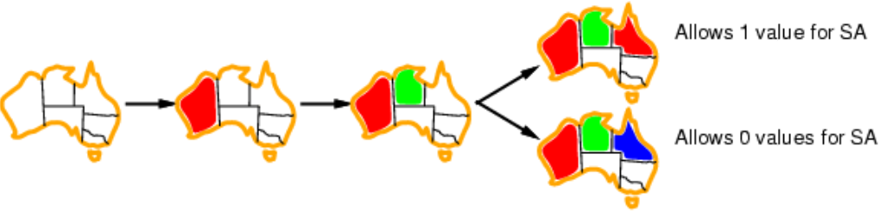
Variable and value ordering
Least constraining value (LCV) heuristic: given a variable, choose the value that leaves the maximum flexibility for subsequent variable assignments

Slide 28
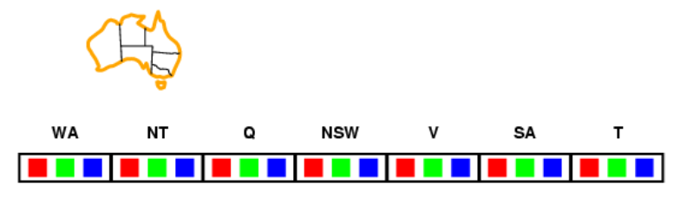
Inference: Forward checking
Keep track of remaining legal values for unassigned variables
Terminate search when any variable has no legal values

Slide 29
Local search for CSPs
Complete-state formulation
The initial state assigns a value to every variable → violation
The search changes the value of one variable at a time → eliminate the violated constraints
Min-conflicts heuristic: the minimum number of conflicts with other variables
Min-conflicts is surprisingly effective for many CSPs.

Slide 30
MIN-CONFLICTS algorithm
function MIN-CONFLICTS(csp, max steps) returns a solution or failure
inputs: csp, a constraint satisfaction problem
max steps, the number of steps allowed before giving up
current ← an initial complete assignment for csp
for i = 1 to max steps do
if current is a solution for csp then return current
var ← a randomly chosen conflicted variable from csp.VARIABLES
value ← the value v for var that minimizes CONFLICTS(var, v, current, csp)
set var = value in current
return failure

Slide 31
Local search for CSPs
The landscape of a CSP under the min-conflicts heuristic usually has a series of plateaux.
Plateau search: allow sideways moves to another state with the same score.
Tabu search: keep a small list of recently visited states and forbid the algorithm to return to those states
Simulated annealing can also be used.

Slide 32
Constraint weighting
Concentrate the search on the important constraints
Each constraint is given a numeric weight, 𝑊 , initially all 1.
At each step, choose a variable/value pair to change that has the lowest total weight of all violated constraints
Increase the weight of each constraint that is violated by the current assignment.

Slide 33
Homework
Conduct homework in the given notebook

Slide 34
References
Stuart Russell and Peter Norvig. 2009. Artificial Intelligence: A Modern Approach (3rd ed.). Prentice Hall Press, Upper Saddle River, NJ, USA.
Lê Hoài Bắc, Tô Hoài Việt. 2014. Giáo trình Cơ sở Trí tuệ nhân tạo. Khoa Công nghệ Thông tin. Trường ĐH Khoa học Tự nhiên, ĐHQG-HCM.
Nguyễn Ngọc Thảo, Nguyễn Hải Minh. 2020. Bài giảng Cơ sở Trí tuệ Nhân tạo. Khoa Công nghệ Thông tin. Trường ĐH Khoa học Tự nhiên, ĐHQG-HCM.

