Slide 1
Introduction
HKTT Store
Instructor: Mr. Ngo Phuoc Nguyen
Class: T1.1807.M0
Group: 1
Team Members: Le Ngoc Dang Khoa
Pham Huynh
Ha Minh Tan
Hoang Thanh Tai

Slide 2
Content
Introduction
Actual requirements
Requirements of the project
Deployment diagram
Test result
Conclusion and development
Task list

Slide 3
Introduction - Actual requirements
Existing scenario
With the development of mobile phone, now you can do a lot more in a mobile phone as in a computer and the amount of mobile apps are increasing by days, expecially e-commerce apps. With an e-commerce app you can do everything like using a web browser but more simpler.
You can access an online shop using a web browser on your phone but it will depend a lot on what type of browser you are using. Maybe the browser can access to the website but it can not display correctly all the information the seller wanted, and because there are lot of web browser on mobile phone the sellers can not control all.

Slide 4
Introduction - Actual requirements
For customers:
Allow customers who enter the application to browse and search for products using search terms or filtering products’ categories.
Customers need to register an account in order to add product to cart, place order… because every thing is stored in the database so if they use an other phone, they still can see their cart items.
Can create order, payment information and change their information with a registered account.

Slide 5
Introduction - Actual requirements
For admin:
View, update (when requirements are met) existing products, categories and product’s details, customers who have registered, orders which have been placed.
Aside from managing products, categories, orders, etc. an admin can also view reports on products, orders and customers.

Slide 6
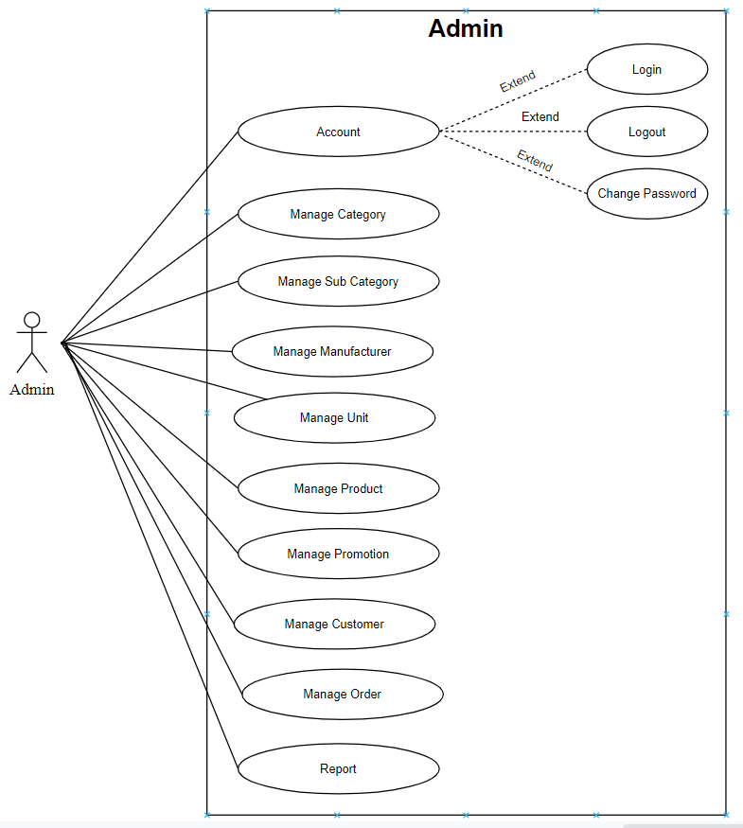
Introduction - Requirements of the project
Admin functional:
Notes:
Non-functional (how the system works)
Functional (what the system should do)

Slide 7
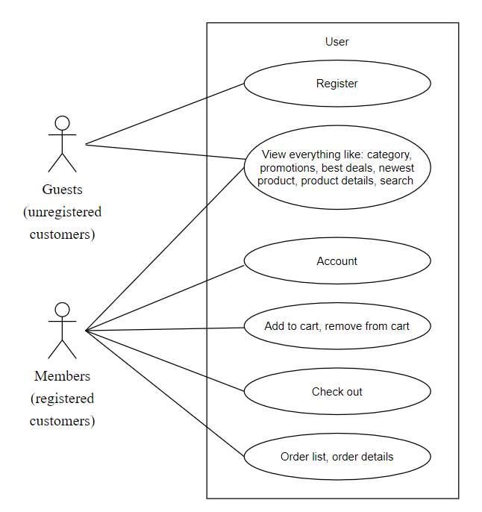
Introduction - Requirements of the project
Customer functional:
Notes:
Non-functional (how the system works)
Functional (what the system should do)

Slide 8
Introduction - Requirements of the project
Non-functional
User-friendly
Compatible
High-performance
Secure
Notes:
Non-functional (how the system works)
Functional (what the system should do)

Slide 9
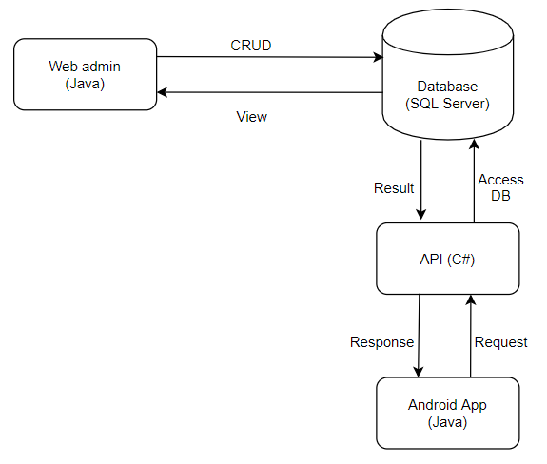
Introduction - Deployment diagram

Slide 10
Test Result for Admin website
TEST CASE DESCRIPTION | EXPECTED RESULT | ACTUAL RESULT (SUCCESS/PASS/FAIL)
Functionalities | Input should be inserted, removed, or updated in the database successfully | SUCCESS
Validation | Input validity should be checked before being submitted | SUCCESS
Compatibility | The web application should function properly in web browsers | SUCCESS (Some of web components using JS frameworks are not working in IE)
Speed | The web application should run fast and smoothly | SUCCESS (Some of web components using JS frameworks are taking a while to process)
GUI Design | The GUI should be user-friendly, clear and simple | SUCCESS

Slide 11
Test Result for Android application
TEST CASE DESCRIPTION | EXPECTED RESULT | ACTUAL RESULT (SUCCESS/PASS/FAIL)
Functionalities | All function shoud be excuted exaclly as expected. | SUCCESS
Validation | Input validity should be checked before being submitted | SUCCESS
Compatibility | Android application should work on all android version after Android 4.4 | SUCCESS in Android 9.0 (Not tested in other android version)
Speed | The application should run fast and smoothly. | SUCCESS (The speed depend a lot on where the server is located cause the API will handle request)
GUI Design | The GUI should be user-friendly, clear and simple | SUCCESS

Slide 12
Conclusion
Upside:
The HKTT storesatisfies all of the indicated requirement for both admin management and customer.
Downside:
Report take a lot of time to generate PDF file.
Future update:
The performance of all the webpages and components will be optimized.
The internationalization will be added to be readable to foreign visitors.
Review product after ordered is done.

Slide 13
Development
Technologies used in development:
Admin website:
- Boostrap
- Jquery
- JSP Servlet
- Maven
- Cloudinary
- Jasper report
API
- ASP.NET Core API
Android application
- Android Studio
+ Retrofit
+ Recycler view
+ Picasso
+ Gson

Slide 14
Task List
Project Ref. No: |  | Project Title: HKTT Store | Date of Preparation of Activity Plan
No. | Task | Description | Start Date | Complete Date | Team Member Names | Status
01 | Review 3 | I. Database Relationship Diagram II. Table Definiton IV. Customer GUI design - Home screen - Cart screen - Check out screen - Search by product name - Filtered by sub category - Product details V. Admin GUI design - Report top 10 sold product from A to B * All APIs required for android application | 10/06/2020 | 24/06/2020 | Le Ngoc Dang Khoa | Completed
02 |  | IV. Customer GUI design - Splash screen - Login screen - Sign up - Profile - Change password - Update information - Orders list - Order details V. Admin GUI design - Report total product by sub category |  |  | Hoang Thanh Tai | Completed

Slide 15
Task List
Project Ref. No: |  | Project Title: HKTT Store | Date of Preparation of Activity Plan
No. | Task | Description | Start Date | Complete Date | Team Member Names | Status
03 | Review 3 | IV. Customer GUI design - About us V. Admin GUI design - Change password - Category - SubCategory - Manufacturer - Promotion - Report: Total product sold in year | 10/06/2020 | 24/06/2020 | Ha Minh Tan | Completed
04 |  | III. Site map V. Admin GUI design - Login - Dashboard - Unit - Product - Customer - Order - Report: Top 10 buyers report |  |  | Pham Huynh | Completed

Slide 16

Thank You

Slide 17
Reference

