Slide 1
PSE Molekulardynamik
Sheet 1
First steps towards a molecular dynamics simulation

Slide 2
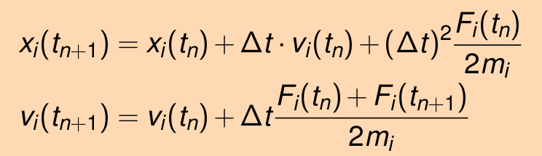
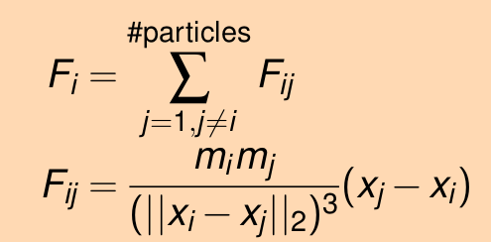
Task 2: Completion of the program frame
Implementation of basic algorithms
Implementation of the formulas for force, position and velocities according to the script
Particles updated with setter functions
  setter for force also updates old_f
Equality checking via == operation of Particle
Value for each dimension is calculated separately

Slide 3
Task 2: Completion of the program frame
Implementation of VTKWriter
InitializeOutput() for four particles to be plotted
For each of the four particles call plotParticle()
To write the particles to a file call writeFile()
For each iteration, this procedure has to be repeated

Slide 4
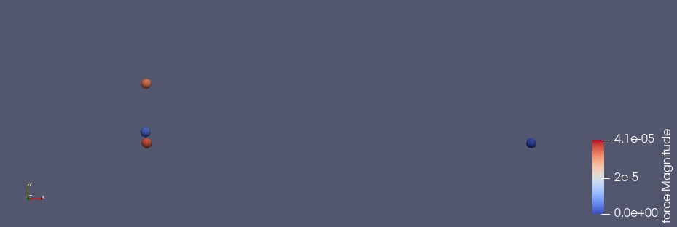
Task 3: Simulation of Halley’s Comet
Overview celestial bodies
Setup: endtime: 250, delta_t: 0.01

Slide 5
Task 3: Simulation of Halley’s Comet
Simulation in action

Slide 6
Task 3: Simulation of Halley’s Comet
Simulation with default_time problem

Slide 7
Task 4: Refactoring and Documentation
Implementation of the ParticleContainer
Software pattern we used: iterator pattern
→ enables usage of range-based for-loop
→ easy iteration over particles and pairs of particles
Implementation as innerclass of ParticleContainer
→ begin(), end(), !=, ++, ==, *
std::vector is used internally

Slide 8
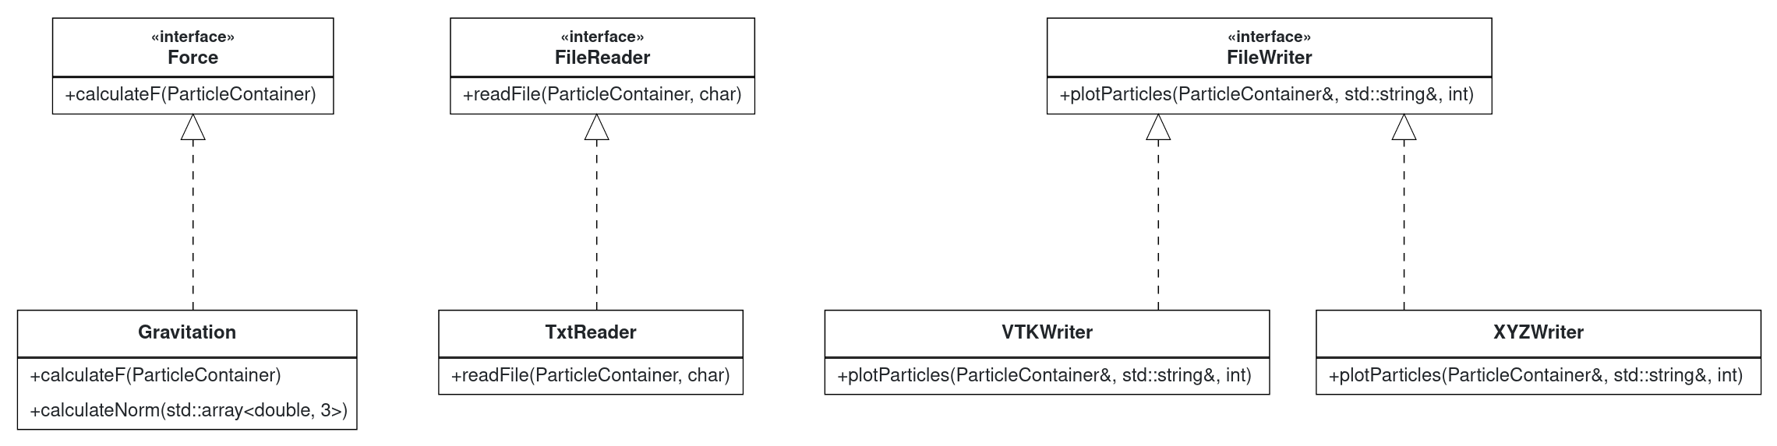
Task 4: Refactoring and Documentation
Template pattern for I/O and calculation methods
→ usage of std::unique_ptr with interfaces as static type and realization as dynamic type
→ usage of virtual destructor to prevent memory leaks

Slide 9
Task 4: Refactoring and Documentation
Datastructure for storing particles
ParticleContainer uses std::vector internally
Mainly iteration over stored particles
→ vector uses a continous memory space
→ lower memory overhead when using vector

Slide 10
Task 4: Refactoring and Documentation
Doxygen and CMake
Doxygen is useful for documenting the API, but not the implementation
Example:
Integration in CMake:
  option DISABLE_DOXYGEN (OFF per default)
  Can be alter using -D DISABLE_DOXYGEN=ON

