Slide 1
Machine-Level Programming I: Basics CSCI 2400: Introduction to Computer Systems 5th Lecture, Jan 30th , 2019
Spring 2019
Instructor: SANDESH DHAWASKAR SATHYANARAYANA
Email ID: sadh0344@Colorado.edu
Slides are adopted from CMU text book slides

Slide 2
Announcement
All the questions or doubts should be posted in Discussion forum even including the logistics. Emails will not be responded.
If you don’t see slots send email to TA’s they will fix it. This should be again done before the deadline
Bomb lab is out, start working on it ,it’s the most difficult and interesting lab you will get!!!!

Slide 3
Today: Machine Programming I: Basics
History of Intel processors and architectures
Assembly Basics: Registers, operands, move
Arithmetic & logical operations
C, assembly, machine code

Slide 4
Intel x86 Processors
Dominate laptop/desktop/server market
Evolutionary design
Backwards compatible up until 8086, introduced in 1978
Added more features as time goes on
Complex instruction set computer (CISC)
Many different instructions with many different formats
But, only small subset encountered with Linux programs
Hard to match performance of Reduced Instruction Set Computers (RISC)
But, Intel has done just that!
In terms of speed. Less so for low power.

Slide 5
Intel x86 Evolution: Milestones
Name Date Transistors MHz
8086 1978 29K 5-10
First 16-bit Intel processor. Basis for IBM PC & DOS
1MB address space
386 1985 275K 16-33
First 32 bit Intel processor , referred to as IA32
Added “flat addressing”, capable of running Unix
Pentium 4E 2004 125M 2800-3800
First 64-bit Intel x86 processor, referred to as x86-64
Core 2 2006 291M 1060-3333
First multi-core Intel processor
Core i7 2008 731M 1600-4400
Four cores (our shark machines)

Slide 6
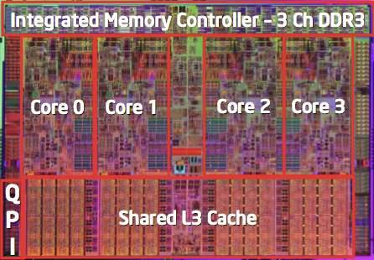
Intel x86 Processors, cont.
Machine Evolution
386 1985 0.3M
Pentium 1993 3.1M
Pentium/MMX 1997 4.5M
PentiumPro 1995 6.5M
Pentium III 1999 8.2M
Pentium 4 2000 42M
Core 2 Duo 2006 291M
Core i7 2008 731M
Added Features
Instructions to support multimedia operations
Instructions to enable more efficient conditional operations
Transition from 32 bits to 64 bits
More cores

Slide 7
Intel x86 Processors, cont.
Past Generations
1st Pentium Pro 1995 600 nm
1st Pentium III 1999 250 nm
1st Pentium 4 2000 180 nm
1st Core 2 Duo 2006 65 nm
Recent & Upcoming Generations
Nehalem 2008 45 nm
Sandy Bridge 2011 32 nm
Ivy Bridge 2012 22 nm
Haswell 2013 22 nm
Broadwell 2014 14 nm
Skylake 2015 14 nm
Kaby Lake 2016 14 nm
Coffee Lake 2017? 14 nm
Cannonlake 2018? 10 nm
Process technology
Process technology dimension = width of narrowest wires
(10 nm ≈ 100 atoms wide)

Slide 8
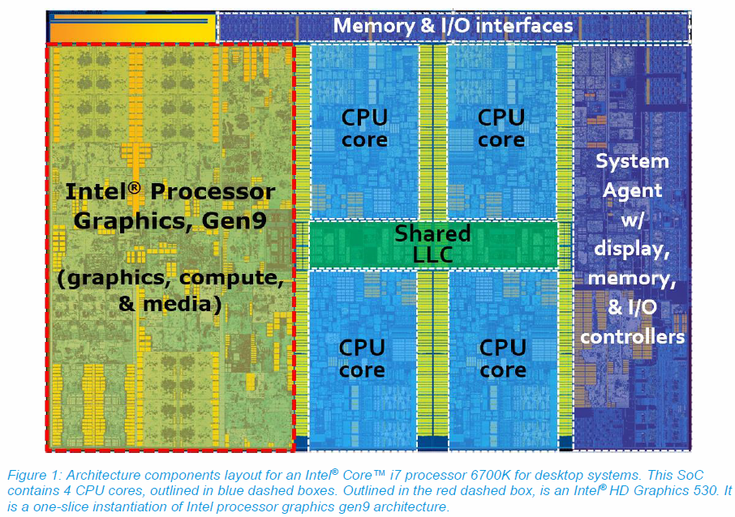
2017 State of the Art: Skylake
Mobile Model: Core i7
2.6-2.9 GHz
45 W
Desktop Model: Core i7
Integrated graphics
2.8-4.0 GHz
35-91 W
Server Model: Xeon
Integrated graphics
Multi-socket enabled
2-3.7 GHz
25-80 W

Slide 9
x86 Clones: Advanced Micro Devices (AMD)
Historically
AMD has followed just behind Intel
A little bit slower, a lot cheaper
Then
Recruited top circuit designers from Digital Equipment Corp. and other downward trending companies
Built Opteron: tough competitor to Pentium 4
Developed x86-64, their own extension to 64 bits
Recent Years
Intel got its act together
Leads the world in semiconductor technology
AMD has fallen behind
Relies on external semiconductor manufacturer

Slide 10
Intel’s 64-Bit History
2001: Intel Attempts Radical Shift from IA32 to IA64
Totally different architecture (Itanium)
Executes IA32 code only as legacy
Performance disappointing
2003: AMD Steps in with Evolutionary Solution
x86-64 (now called “AMD64”)
Intel Felt Obligated to Focus on IA64
Hard to admit mistake or that AMD is better
2004: Intel Announces EM64T extension to IA32
Extended Memory 64-bit Technology
Almost identical to x86-64!
All but low-end x86 processors support x86-64
But, lots of code still runs in 32-bit mode

Slide 11
Today: Machine Programming I: Basics
History of Intel processors and architectures
Assembly Basics: Registers, operands, move
Arithmetic & logical operations
C, assembly, machine code

Slide 12
Definitions
Architecture: (also ISA: instruction set architecture) The parts of a processor design that one needs to understand for writing correct machine/assembly code
Examples: instruction set specification, registers
Machine Code: The byte-level programs that a processor executes
Assembly Code: A text representation of machine code
Microarchitecture: Implementation of the architecture
Examples: cache sizes and core frequency
Example ISAs:
Intel: x86, IA32, Itanium, x86-64
ARM: Used in almost all mobile phones
RISC V: New open-source ISA

Slide 13
Assembly/Machine Code View
CPU
Memory
Registers
Addresses
Data
Code
Data
Stack
PC
Condition
Codes
Instructions
Programmer-Visible State
PC: Program counter
Address of next instruction
Called “RIP” (x86-64)
Register file
Heavily used program data
Condition codes
Store status information about most recent arithmetic or logical operation
Used for conditional branching
Memory
Byte addressable array
Code and user data
Stack to support procedures

Slide 14
Assembly Characteristics: Data Types
“Integer” data of 1, 2, 4, or 8 bytes
Data values
Addresses (untyped pointers)
Floating point data of 4, 8, or 10 bytes
(SIMD vector data types of 8, 16, 32 or 64 bytes)
Code: Byte sequences encoding series of instructions
No aggregate types such as arrays or structures
Just contiguously allocated bytes in memory

Slide 15
Assembler
Three different way to get into object code
Disassembler using objdump
gdb debugger
Gcc –Og –S sumc. Using gcc compiler to tell it to generate assembly code
Demo

Slide 16
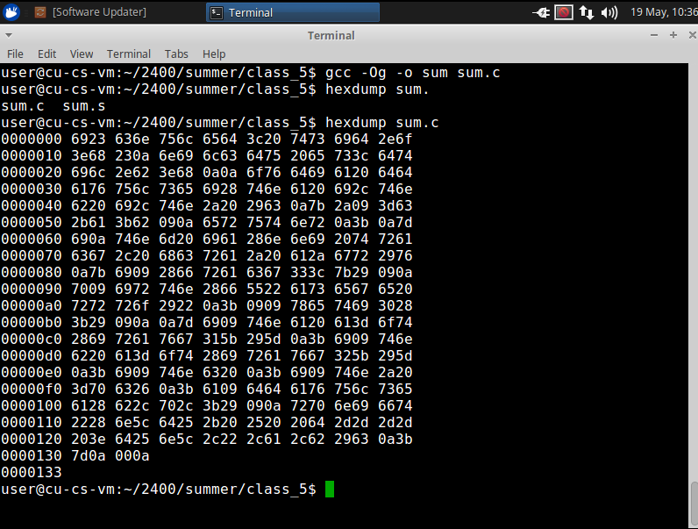
gcc compiled machine code is in binary do hexdump to see its contents.

Slide 17
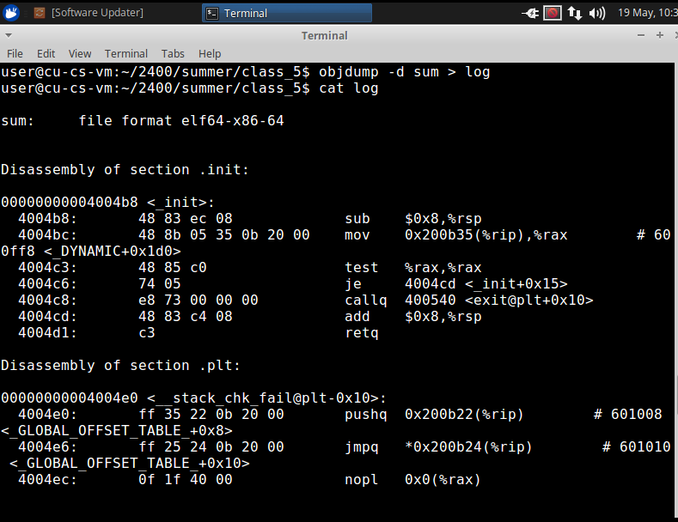
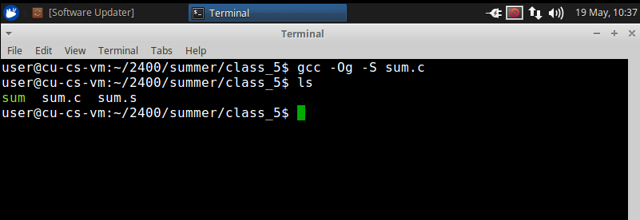
Use objdump to see the assembled text code

Slide 18
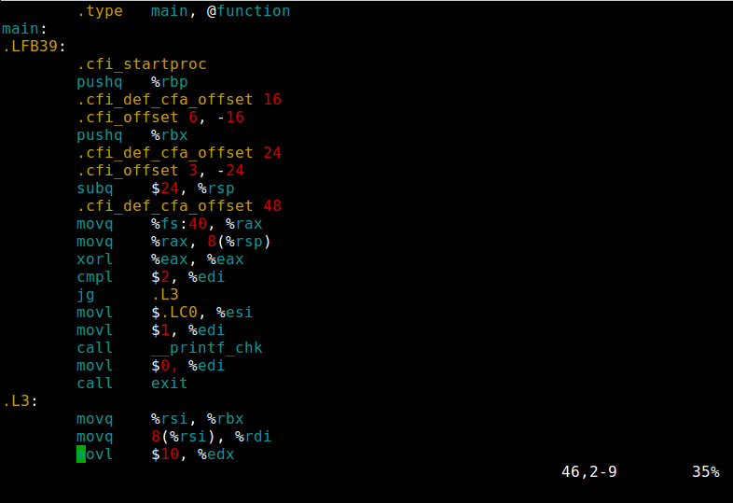
Use gcc –Og –S sum.c which creates sum.s file

Slide 19
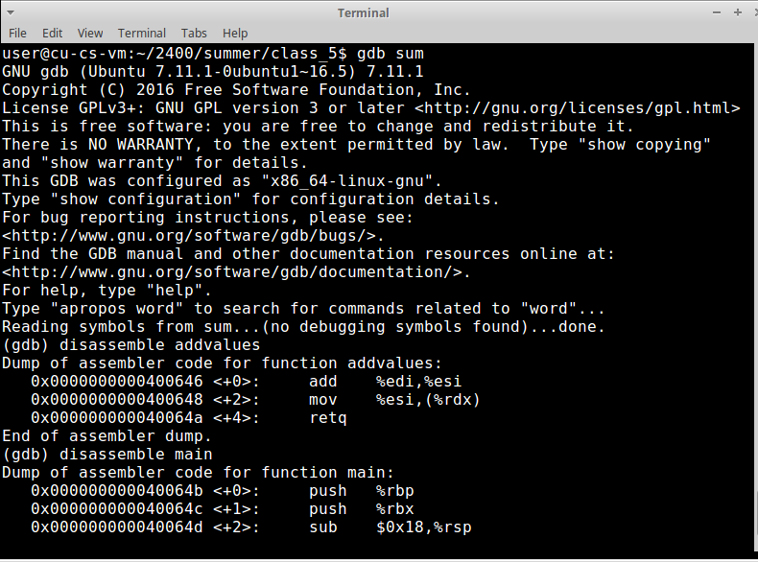
Use gdb to see dissembled code

Slide 20
x86-64 Integer Registers
%rax
%r8
%eax
%r8d
%rbx
%r9
%ebx
%r9d
%rcx
%r10
%ecx
%r10d
%rdx
%r11
%edx
%r11d
%rsi
%r12
%esi
%r12d
%rdi
%r13
%edi
%r13d
%rsp
%r14
%esp
%r14d
%rbp
%r15
%ebp
%r15d
Can reference low-order 4 bytes (also low-order 1 & 2 bytes)
Not part of memory (or cache)

Slide 21
Some History: IA32 Registers
Origin
(mostly obsolete)
%eax
%ax
%ah
%al
accumulate
%ecx
%cx
%ch
%cl
counter
%edx
%dx
%dh
%dl
data
general purpose
%ebx
%bx
%bh
%bl
base
%esi
source
index
%si
%edi
destination
index
%di
%esp
stack
pointer
%sp
%ebp
base
pointer
%bp
16-bit virtual registers
(backwards compatibility)

Slide 22
Assembly Characteristics: Operations
Transfer data between memory and register
Load data from memory into register
Store register data into memory
Perform arithmetic function on register or memory data
Transfer control
Unconditional jumps to/from procedures
Conditional branches
Indirect branches

Slide 23
Moving Data
%rax
%rcx
Moving Data
movq Source, Dest
Operand Types
Immediate: Constant integer data
Example: $0x400, $-533
Like C constant, but prefixed with ‘$’
Encoded with 1, 2, or 4 bytes
Register: One of 16 integer registers
Example: %rax, %r13
But %rsp reserved for special use
Others have special uses for particular instructions
Memory: 8 consecutive bytes of memory at address given by register
Simplest example: (%rax)
Various other “addressing modes”
%rdx
%rbx
%rsi
%rdi
%rsp
%rbp
%rN
Warning: Intel docs use mov Dest, Source

Slide 24
movq Operand Combinations
Source
Dest
Src,Dest
C Analog
Reg
movq $0x4,%rax
temp = 0x4;
Imm
Mem
movq $-147,(%rax)
*p = -147;
Reg
movq %rax,%rdx
temp2 = temp1;
movq
Reg
Mem
movq %rax,(%rdx)
*p = temp;
Mem
Reg
movq (%rax),%rdx
temp = *p;
Cannot do memory-memory transfer with a single instruction

Slide 25
Simple Memory Addressing Modes
Normal (R) Mem[Reg[R]]
Register R specifies memory address
Aha! Pointer dereferencing in C movq (%rcx),%rax
Displacement D(R) Mem[Reg[R]+D]
Register R specifies start of memory region
Constant displacement D specifies offset movq 8(%rbp),%rdx

Slide 26
Example of Simple Addressing Modes
void
whatAmI(<type> a, <type> b)
{
????
}
whatAmI:
movq (%rdi), %rax
movq (%rsi), %rdx
movq %rdx, (%rdi)
movq %rax, (%rsi)
ret
%rsi
%rdi

Slide 27
Example of Simple Addressing Modes
void swap
(long *xp, long *yp)
{
long t0 = *xp;
long t1 = *yp;
*xp = t1;
*yp = t0;
}
swap:
movq (%rdi), %rax
movq (%rsi), %rdx
movq %rdx, (%rdi)
movq %rax, (%rsi)
ret

Slide 28
Understanding Swap()
Memory
void swap
(long *xp, long *yp)
{
long t0 = *xp;
long t1 = *yp;
*xp = t1;
*yp = t0;
}
Registers
%rdi
%rsi
%rax
%rdx
Register Value
%rdi xp
%rsi yp
%rax t0
%rdx t1
swap:
movq (%rdi), %rax # t0 = *xp
movq (%rsi), %rdx # t1 = *yp
movq %rdx, (%rdi) # *xp = t1
movq %rax, (%rsi) # *yp = t0
ret

Slide 29
Understanding Swap()
Memory
Registers
Address
123
0x120
%rdi
0x120
0x118
%rsi
0x100
0x110
%rax
0x108
%rdx
456
0x100
swap:
movq (%rdi), %rax # t0 = *xp
movq (%rsi), %rdx # t1 = *yp
movq %rdx, (%rdi) # *xp = t1
movq %rax, (%rsi) # *yp = t0
ret

Slide 30
Understanding Swap()
Memory
Registers
Address
123
0x120
%rdi
0x120
0x118
%rsi
0x100
0x110
%rax
123
0x108
%rdx
456
0x100
swap:
movq (%rdi), %rax # t0 = *xp
movq (%rsi), %rdx # t1 = *yp
movq %rdx, (%rdi) # *xp = t1
movq %rax, (%rsi) # *yp = t0
ret

Slide 31
Understanding Swap()
Memory
Registers
Address
123
0x120
%rdi
0x120
0x118
%rsi
0x100
0x110
%rax
123
0x108
%rdx
456
456
0x100
swap:
movq (%rdi), %rax # t0 = *xp
movq (%rsi), %rdx # t1 = *yp
movq %rdx, (%rdi) # *xp = t1
movq %rax, (%rsi) # *yp = t0
ret

Slide 32
Understanding Swap()
Memory
Registers
Address
456
0x120
%rdi
0x120
0x118
%rsi
0x100
0x110
%rax
123
0x108
%rdx
456
456
0x100
swap:
movq (%rdi), %rax # t0 = *xp
movq (%rsi), %rdx # t1 = *yp
movq %rdx, (%rdi) # *xp = t1
movq %rax, (%rsi) # *yp = t0
ret

Slide 33
Understanding Swap()
Memory
Registers
Address
456
0x120
%rdi
0x120
0x118
%rsi
0x100
0x110
%rax
123
0x108
%rdx
456
123
0x100
swap:
movq (%rdi), %rax # t0 = *xp
movq (%rsi), %rdx # t1 = *yp
movq %rdx, (%rdi) # *xp = t1
movq %rax, (%rsi) # *yp = t0
ret

Slide 34
Simple Memory Addressing Modes
Normal (R) Mem[Reg[R]]
Register R specifies memory address
Aha! Pointer dereferencing in C movq (%rcx),%rax
Displacement D(R) Mem[Reg[R]+D]
Register R specifies start of memory region
Constant displacement D specifies offset movq 8(%rbp),%rdx

Slide 35
Complete Memory Addressing Modes
Most General Form
D(Rb,Ri,S) Mem[Reg[Rb]+S*Reg[Ri]+ D]
D: Constant “displacement” 1, 2, or 4 bytes
Rb: Base register: Any of 16 integer registers
Ri: Index register: Any, except for %rsp
S: Scale: 1, 2, 4, or 8 (why these numbers?)
Special Cases
(Rb,Ri) Mem[Reg[Rb]+Reg[Ri]]
D(Rb,Ri) Mem[Reg[Rb]+Reg[Ri]+D]
(Rb,Ri,S) Mem[Reg[Rb]+S*Reg[Ri]]

Slide 36
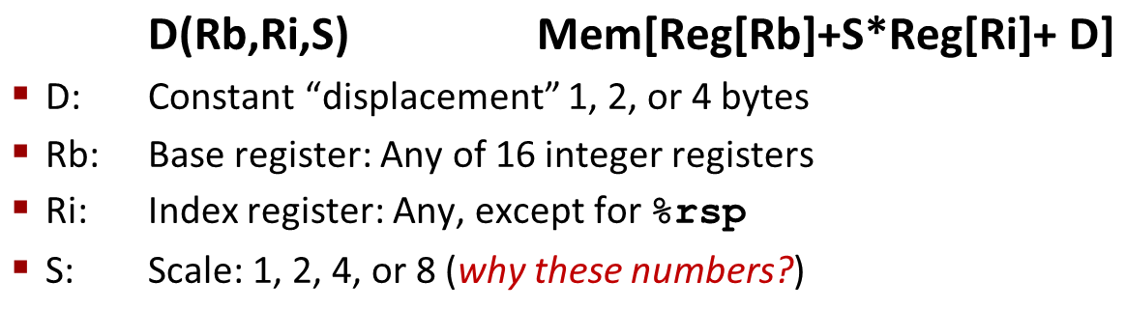
Address Computation Examples
%rdx | 0xf000
%rcx | 0x0100
Expression | Address Computation | Address
0x8(%rdx)
(%rdx,%rcx)
(%rdx,%rcx,4)
0x80(,%rdx,2)
Expression | Address Computation | Address
0x8(%rdx) | 0xf000 + 0x8 | 0xf008
(%rdx,%rcx) | 0xf000 + 0x100 | 0xf100
(%rdx,%rcx,4) | 0xf000 + 4*0x100 | 0xf400
0x80(,%rdx,2) | 2*0xf000 + 0x80 | 0x1e080
Notes:
0xf000 + 0x8 = 0xf008
0xf000 + 0x0100 = 0xf100
0xf000 + 4*0x0100 = 0xf400
2*0xf000 + 0x80 = 0x1d080

Slide 37
Address Computation Examples
%rdx | 0xf000
%rcx | 0x0100
Expression | Address Computation | Address
0x8(%rdx)
(%rdx,%rcx)
(%rdx,%rcx,4)
0x80(,%rdx,2)
Expression | Address Computation | Address
0x8(%rdx) | 0xf000 + 0x8 | 0xf008
(%rdx,%rcx) | 0xf000 + 0x100 | 0xf100
(%rdx,%rcx,4) | 0xf000 + 4*0x100 | 0xf400
0x80(,%rdx,2) | 2*0xf000 + 0x80 | 0x1e080
Notes:
0xf000 + 0x8 = 0xf008
0xf000 + 0x0100 = 0xf100
0xf000 + 4*0x0100 = 0xf400
2*0xf000 + 0x80 = 0x1d080

Slide 38
Today: Machine Programming I: Basics
History of Intel processors and architectures
Assembly Basics: Registers, operands, move
Arithmetic & logical operations
C, assembly, machine code

Slide 39
Address Computation Instruction
leaq Src, Dst
Src is address mode expression
Set Dst to address denoted by expression
Uses
Computing addresses without a memory reference
E.g., translation of p = &x[i];
Computing arithmetic expressions of the form x + k*y
k = 1, 2, 4, or 8
Example
long m12(long x)
{
return x*12;
}
Converted to ASM by compiler:
leaq (%rdi,%rdi,2), %rax # t = x+2*x
salq $2, %rax # return t<<2

Slide 40
Some Arithmetic Operations
Two Operand Instructions:
Format Computation
addq Src,Dest Dest = Dest + Src
subq Src,Dest Dest = Dest − Src
imulq Src,Dest Dest = Dest * Src
salq Src,Dest Dest = Dest << Src Also called shlq
sarq Src,Dest Dest = Dest >> Src Arithmetic
shrq Src,Dest Dest = Dest >> Src Logical
xorq Src,Dest Dest = Dest ^ Src
andq Src,Dest Dest = Dest & Src
orq Src,Dest Dest = Dest | Src
Watch out for argument order! Src,Dest (Warning: Intel docs use “op Dest,Src”)
No distinction between signed and unsigned int (why?)

Slide 41
Some Arithmetic Operations
One Operand Instructions
incq Dest Dest = Dest + 1
decq Dest Dest = Dest − 1
negq Dest Dest = − Dest
notq Dest Dest = ~Dest
See book for more instructions

Slide 42
Arithmetic Expression Example
arith:
leaq (%rdi,%rsi), %rax
addq %rdx, %rax
leaq (%rsi,%rsi,2), %rdx
salq $4, %rdx
leaq 4(%rdi,%rdx), %rcx
imulq %rcx, %rax
ret
long arith
(long x, long y, long z)
{
long t1 = x+y;
long t2 = z+t1;
long t3 = x+4;
long t4 = y * 48;
long t5 = t3 + t4;
long rval = t2 * t5;
return rval;
}
Interesting Instructions
leaq: address computation
salq: shift
imulq: multiplication
But, only used once

Slide 43
Understanding Arithmetic Expression Example
arith:
leaq (%rdi,%rsi), %rax # t1
addq %rdx, %rax # t2
leaq (%rsi,%rsi,2), %rdx
salq $4, %rdx # t4
leaq 4(%rdi,%rdx), %rcx # t5
imulq %rcx, %rax # rval
ret
long arith
(long x, long y, long z)
{
long t1 = x+y;
long t2 = z+t1;
long t3 = x+4;
long t4 = y * 48;
long t5 = t3 + t4;
long rval = t2 * t5;
return rval;
}
Register | Use(s)
%rdi | Argument x
%rsi | Argument y
%rdx | Argument z, t4
%rax | t1, t2, rval
%rcx | t5

Slide 44
Today: Machine Programming I: Basics
History of Intel processors and architectures
Assembly Basics: Registers, operands, move
Arithmetic & logical operations
C, assembly, machine code

Slide 45
Turning C into Object Code
Code in files p1.c p2.c
Compile with command: gcc –Og p1.c p2.c -o p
Use basic optimizations (-Og) [New to recent versions of GCC]
Put resulting binary in file p
text
C program (p1.c p2.c)
Compiler (gcc –Og -S)
text
Asm program (p1.s p2.s)
Assembler (gcc or as)
binary
Object program (p1.o p2.o)
Static libraries (.a)
Linker (gcc or ld)
binary
Executable program (p)

Slide 46
Compiling Into Assembly
C Code (sum.c)
Generated x86-64 Assembly
long plus(long x, long y);
void sumstore(long x, long y,
long *dest)
{
long t = plus(x, y);
*dest = t;
}
sumstore:
pushq %rbx
movq %rdx, %rbx
call plus
movq %rax, (%rbx)
popq %rbx
ret
Obtain (on shark machine) with command
gcc –Og –S sum.c
Produces file sum.s
Warning: Will get very different results on non-Shark machines (Andrew Linux, Mac OS-X, …) due to different versions of gcc and different compiler settings.

Slide 47
What it really looks like
.globl sumstore
.type sumstore, @function
sumstore:
.LFB35:
.cfi_startproc
pushq %rbx
.cfi_def_cfa_offset 16
.cfi_offset 3, -16
movq %rdx, %rbx
call plus
movq %rax, (%rbx)
popq %rbx
.cfi_def_cfa_offset 8
ret
.cfi_endproc
.LFE35:
.size sumstore, .-sumstore

Slide 48
What it really looks like
Things that look weird and are preceded by a ‘.’ are generally directives.
.globl sumstore
.type sumstore, @function
sumstore:
.LFB35:
.cfi_startproc
pushq %rbx
.cfi_def_cfa_offset 16
.cfi_offset 3, -16
movq %rdx, %rbx
call plus
movq %rax, (%rbx)
popq %rbx
.cfi_def_cfa_offset 8
ret
.cfi_endproc
.LFE35:
.size sumstore, .-sumstore
sumstore:
pushq %rbx
movq %rdx, %rbx
call plus
movq %rax, (%rbx)
popq %rbx
ret

Slide 49
Assembly Characteristics: Data Types
“Integer” data of 1, 2, 4, or 8 bytes
Data values
Addresses (untyped pointers)
Floating point data of 4, 8, or 10 bytes
(SIMD vector data types of 8, 16, 32 or 64 bytes)
Code: Byte sequences encoding series of instructions
No aggregate types such as arrays or structures
Just contiguously allocated bytes in memory

Slide 50
Assembly Characteristics: Operations
Transfer data between memory and register
Load data from memory into register
Store register data into memory
Perform arithmetic function on register or memory data
Transfer control
Unconditional jumps to/from procedures
Conditional branches

Slide 51
Object Code
Code for sumstore
Assembler
Translates .s into .o
Binary encoding of each instruction
Nearly-complete image of executable code
Missing linkages between code in different files
Linker
Resolves references between files
Combines with static run-time libraries
E.g., code for malloc, printf
Some libraries are dynamically linked
Linking occurs when program begins execution
0x0400595:
0x53
0x48
0x89
0xd3
0xe8
0xf2
0xff
0xff
0xff
0x48
0x89
0x03
0x5b
0xc3
Total of 14 bytes
Each instruction 1, 3, or 5 bytes
Starts at address 0x0400595

Slide 52
Machine Instruction Example
C Code
Store value t where designated by dest
Assembly
Move 8-byte value to memory
Quad words in x86-64 parlance
Operands:
t: Register %rax
dest: Register %rbx
*dest: Memory M[%rbx]
Object Code
3-byte instruction
Stored at address 0x40059e
*dest = t;
movq %rax, (%rbx)
0x40059e: 48 89 03

Slide 53
Disassembling Object Code
Disassembled
0000000000400595 <sumstore>:
400595: 53 push %rbx
400596: 48 89 d3 mov %rdx,%rbx
400599: e8 f2 ff ff ff callq 400590 <plus>
40059e: 48 89 03 mov %rax,(%rbx)
4005a1: 5b pop %rbx
4005a2: c3 retq
Disassembler
objdump –d sum
Useful tool for examining object code
Analyzes bit pattern of series of instructions
Produces approximate rendition of assembly code
Can be run on either a.out (complete executable) or .o file

Slide 54
Alternate Disassembly
Disassembled
Dump of assembler code for function sumstore:
0x0000000000400595 <+0>: push %rbx
0x0000000000400596 <+1>: mov %rdx,%rbx
0x0000000000400599 <+4>: callq 0x400590 <plus>
0x000000000040059e <+9>: mov %rax,(%rbx)
0x00000000004005a1 <+12>:pop %rbx
0x00000000004005a2 <+13>:retq
Within gdb Debugger
Disassemble procedure
gdb sum
disassemble sumstore

Slide 55
Alternate Disassembly
Disassembled
Object Code
Dump of assembler code for function sumstore:
0x0000000000400595 <+0>: push %rbx
0x0000000000400596 <+1>: mov %rdx,%rbx
0x0000000000400599 <+4>: callq 0x400590 <plus>
0x000000000040059e <+9>: mov %rax,(%rbx)
0x00000000004005a1 <+12>:pop %rbx
0x00000000004005a2 <+13>:retq
0x0400595:
0x53
0x48
0x89
0xd3
0xe8
0xf2
0xff
0xff
0xff
0x48
0x89
0x03
0x5b
0xc3
Within gdb Debugger
Disassemble procedure
gdb sum
disassemble sumstore
Examine the 14 bytes starting at sumstore
x/14xb sumstore

Slide 56
What Can be Disassembled?
% objdump -d WINWORD.EXE
WINWORD.EXE: file format pei-i386
No symbols in "WINWORD.EXE".
Disassembly of section .text:
30001000 <.text>:
30001000: 55 push %ebp
30001001: 8b ec mov %esp,%ebp
30001003: 6a ff push $0xffffffff
30001005: 68 90 10 00 30 push $0x30001090
3000100a: 68 91 dc 4c 30 push $0x304cdc91
Reverse engineering forbidden by
Microsoft End User License Agreement
Anything that can be interpreted as executable code
Disassembler examines bytes and reconstructs assembly source

Slide 57
Machine Programming I: Summary
History of Intel processors and architectures
Evolutionary design leads to many quirks and artifacts
C, assembly, machine code
New forms of visible state: program counter, registers, ...
Compiler must transform statements, expressions, procedures into low-level instruction sequences
Assembly Basics: Registers, operands, move
The x86-64 move instructions cover wide range of data movement forms
Arithmetic
C compiler will figure out different instruction combinations to carry out computation

