Slide 1
Lab 3: Attack Lab
By Liam Nestelroad

Slide 2
Subject for interview grading
Subject Attack Lab: Target 44
Liam Nestelroad

Slide 3
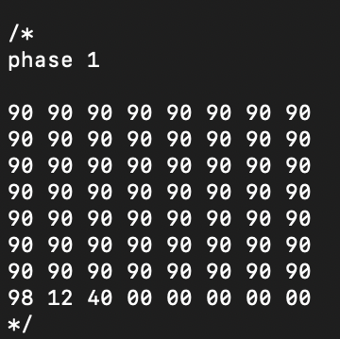
Phase one
This phase was done by filling the buffer with no ops. Then I overflew it with the return
Address of the touch 1 function. The address was found using gdb as seen below.
(gdb) print touch1
$1 = {void ()} 0x401298 <touch1>
(gdb)

Slide 4
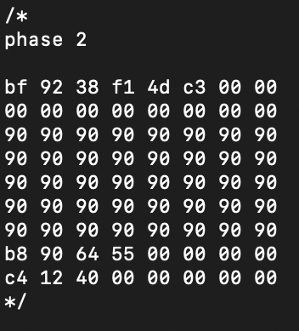
Phase 2
The hex command for mov $cookie to %edi with a ret was found using an assembly
compiler. This command was then placed at the beginning of the buffer. The return
Address was then overflown with the address of the beginning of the stack which was
Found using gdb (see below). Then the address of touch 2 was found and placed after
The address of the buffer.
(gdb) run
Starting program: /home/vagrant/Computer_Systems/target44/ctarget
Cookie: 0x4df13892
Type string:AAAABBBBCCCCDDDD
Breakpoint 1, getbuf () at buf.c:16
16 buf.c: No such file or directory.
(gdb) x/50x %sp-20
A syntax error in expression, near `%sp-20'.
(gdb) x/50x $sp-20
0x556490a4: 0x00000000 0x00000001 0x00000000 0x0040128e
0x556490b4: 0x00000000 0x41414141 0x42424242 0x43434343
0x556490c4: 0x44444444 0x00000000 0x00000000 0x00000000

Slide 5
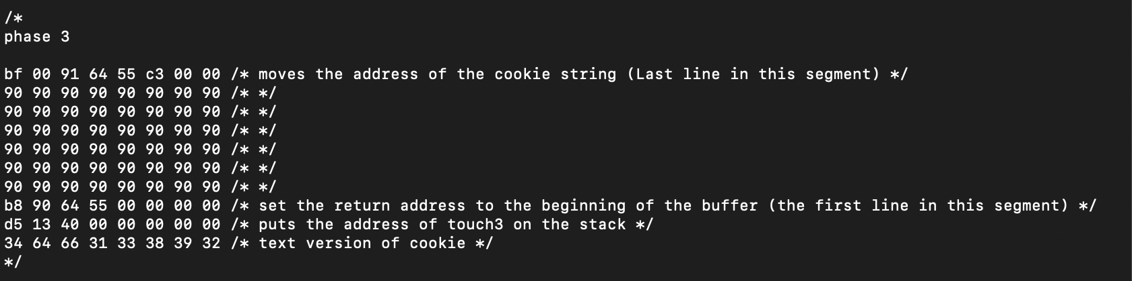
Phase 3
Address of cookie string was found by adding 0x8 + 0x8 + 0x556490b4. Two 8 bytes are added to skip over
The return address of the beginning of the buffer and the address of touch 3.

Slide 6
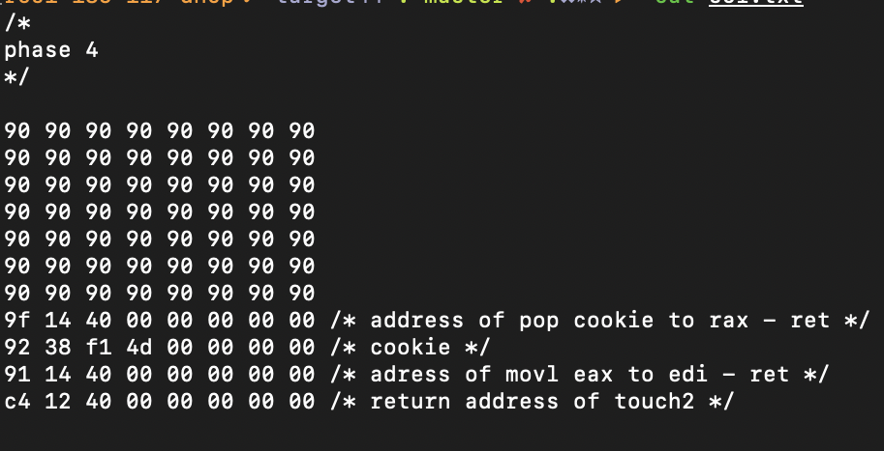
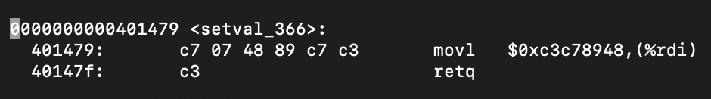
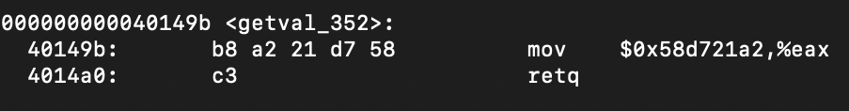
Phase 4
The address after the buffer were found by finding a
Combination of hex values in the gadget farm that
Encode a move and pop instruction as seen below
respectively.

