Slide 1
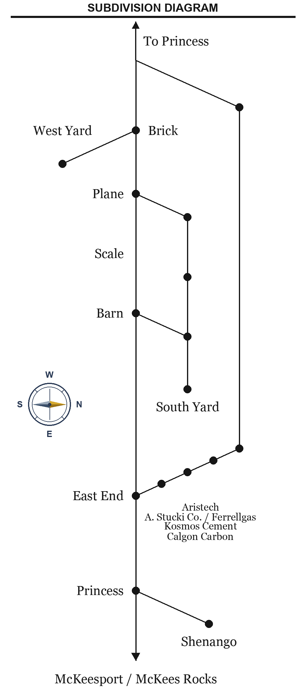
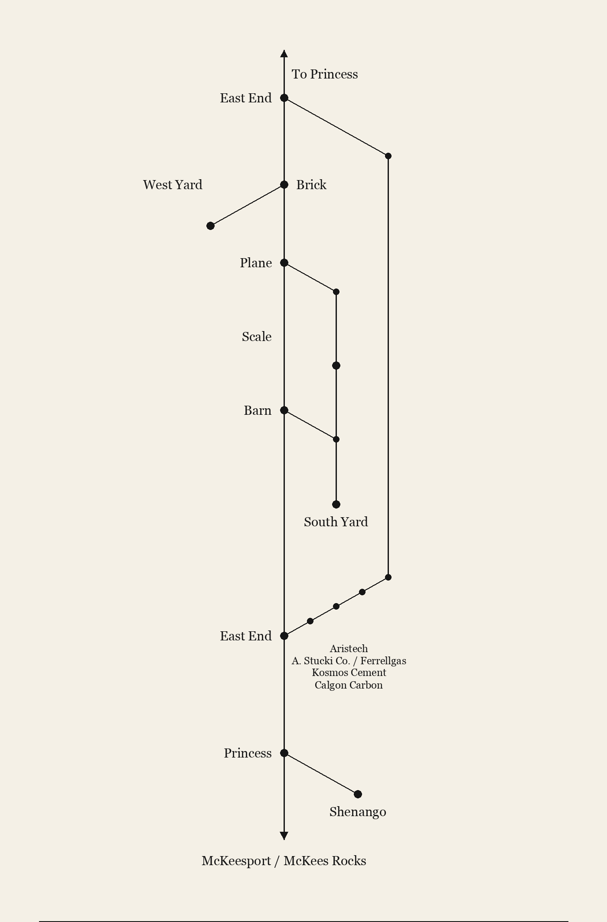
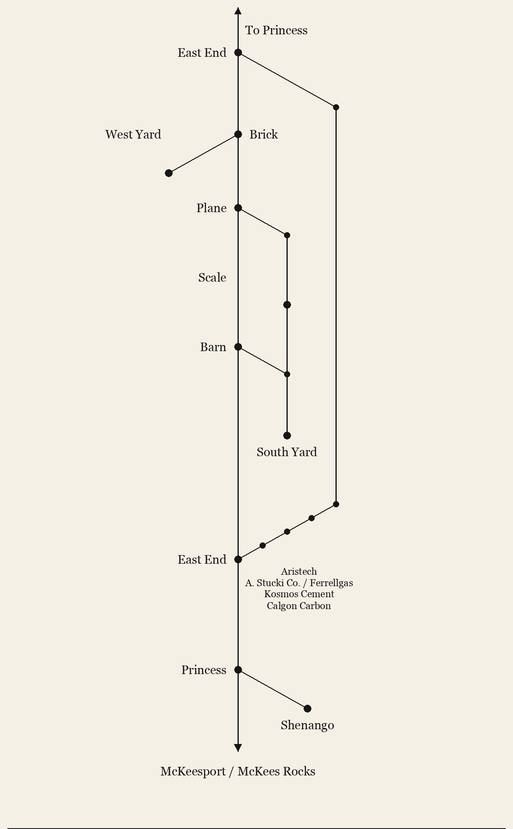
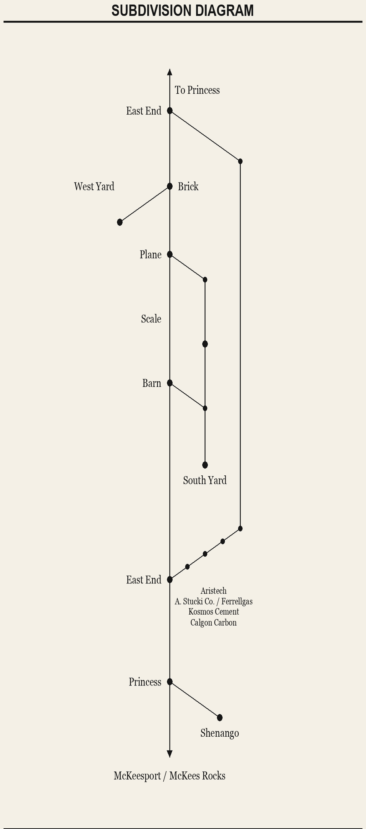
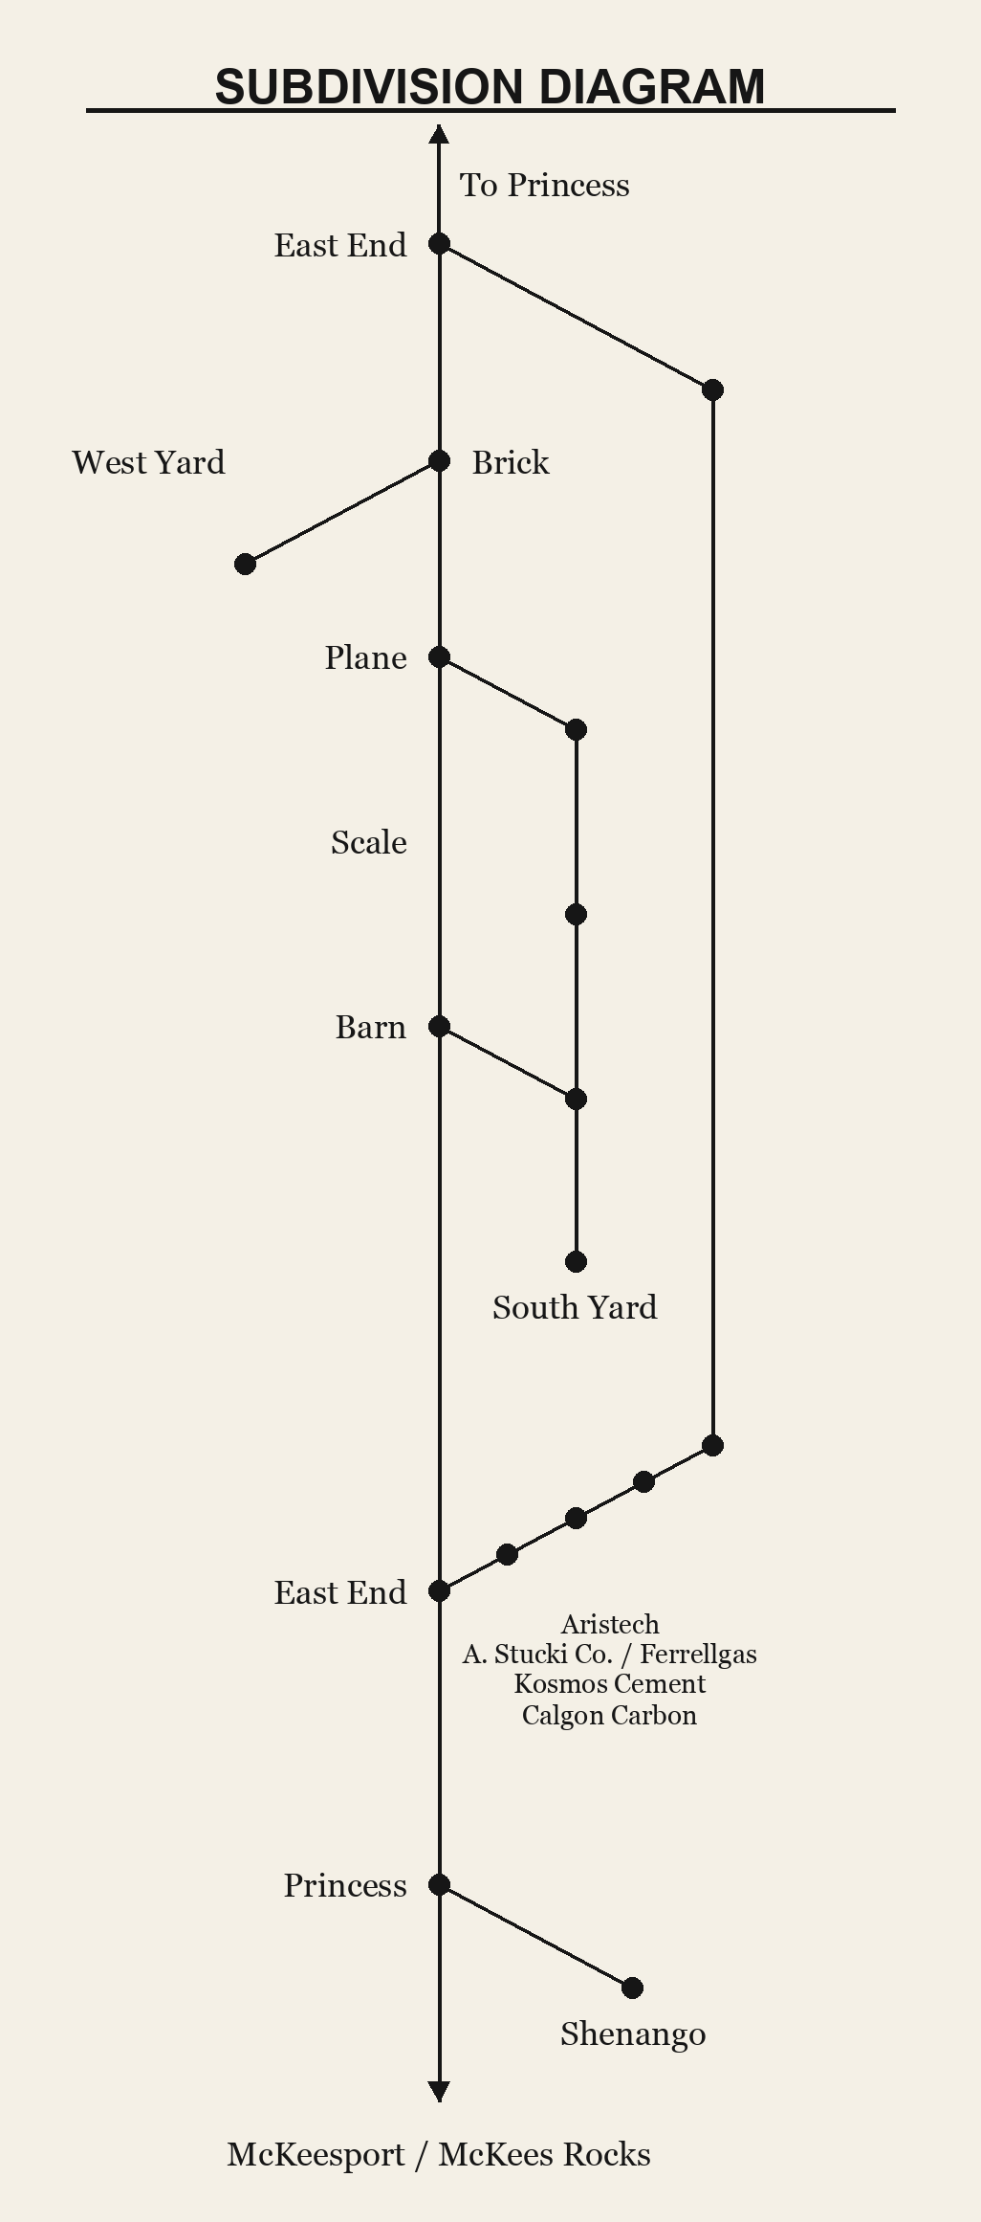
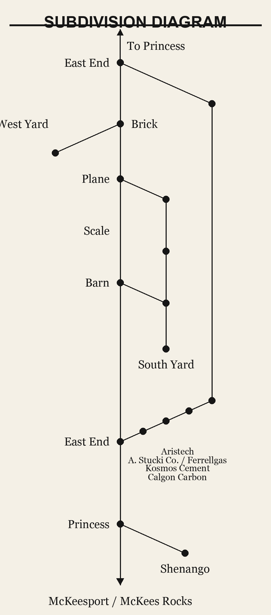
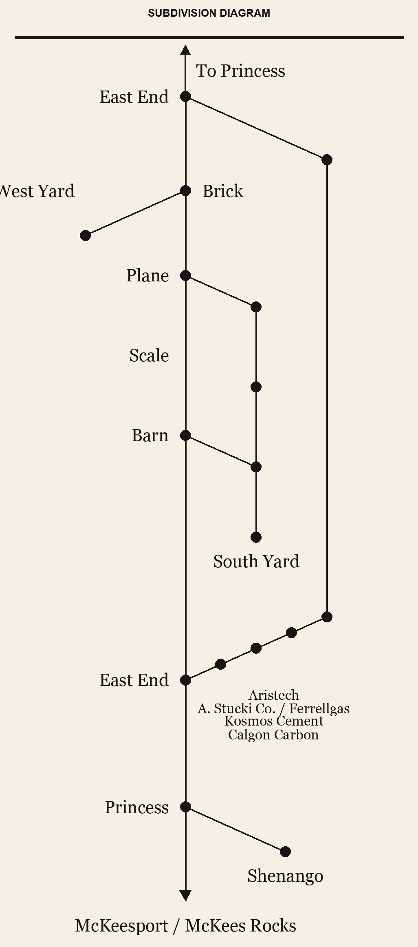
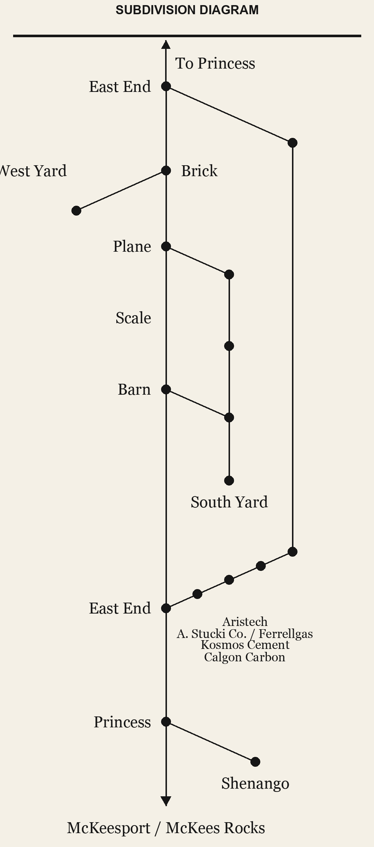
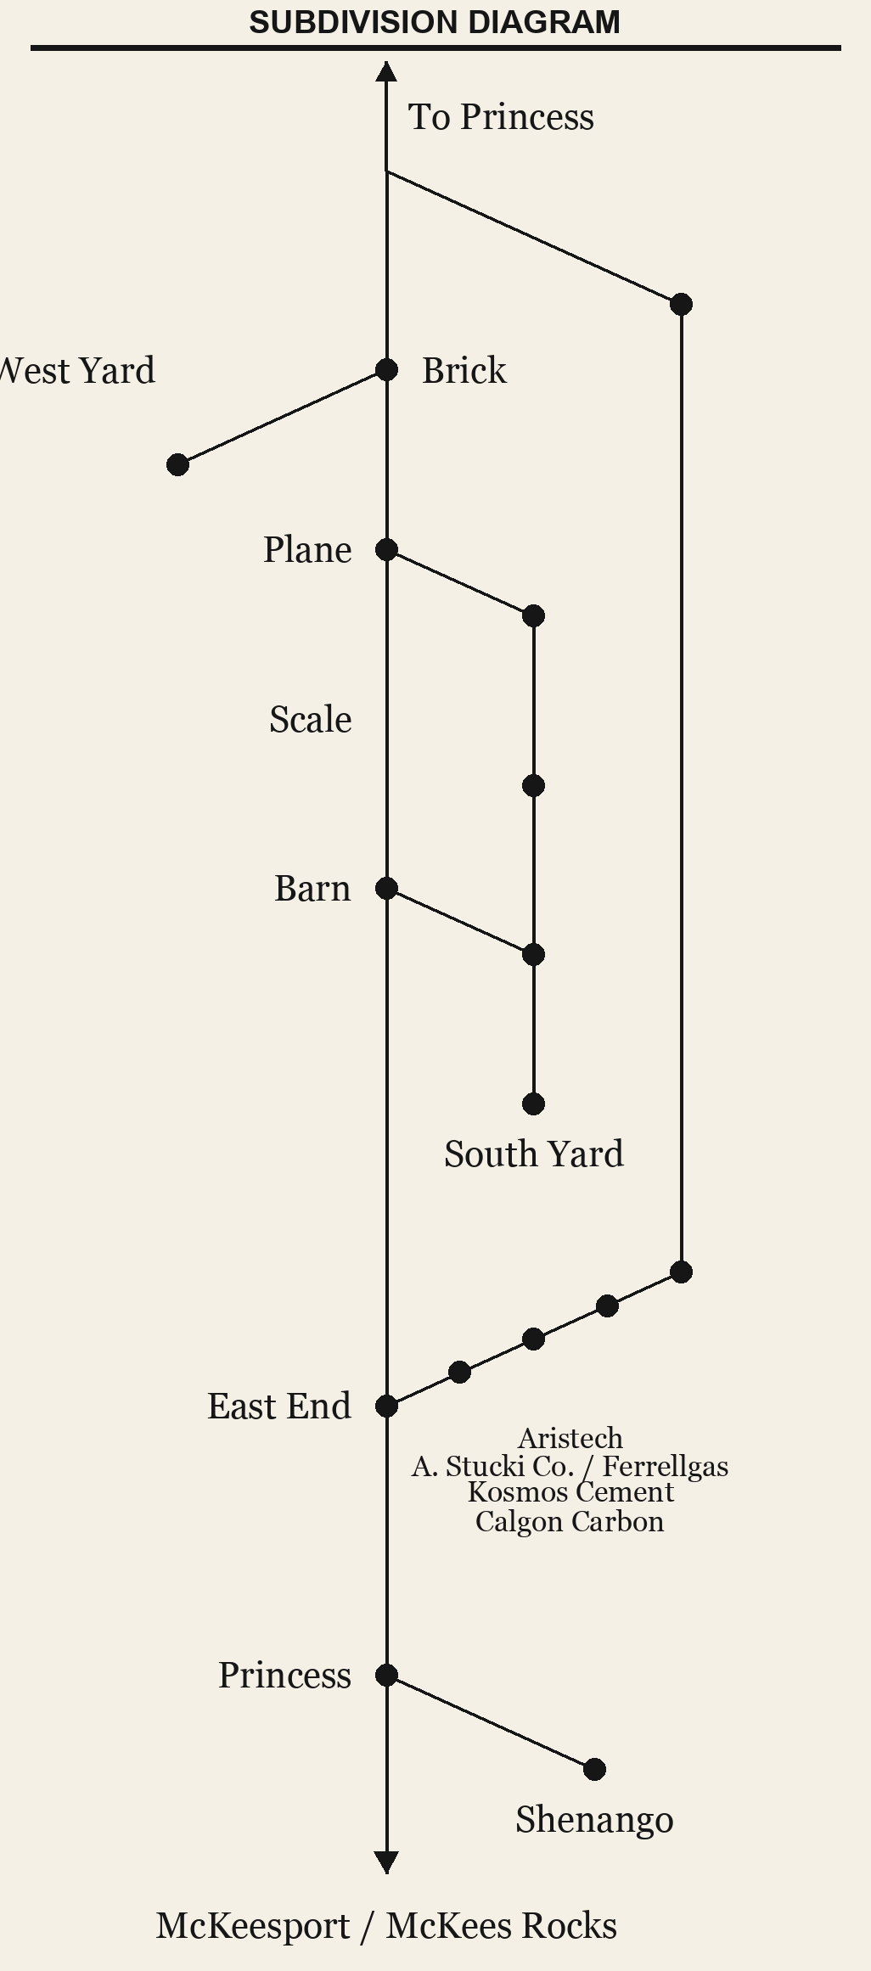
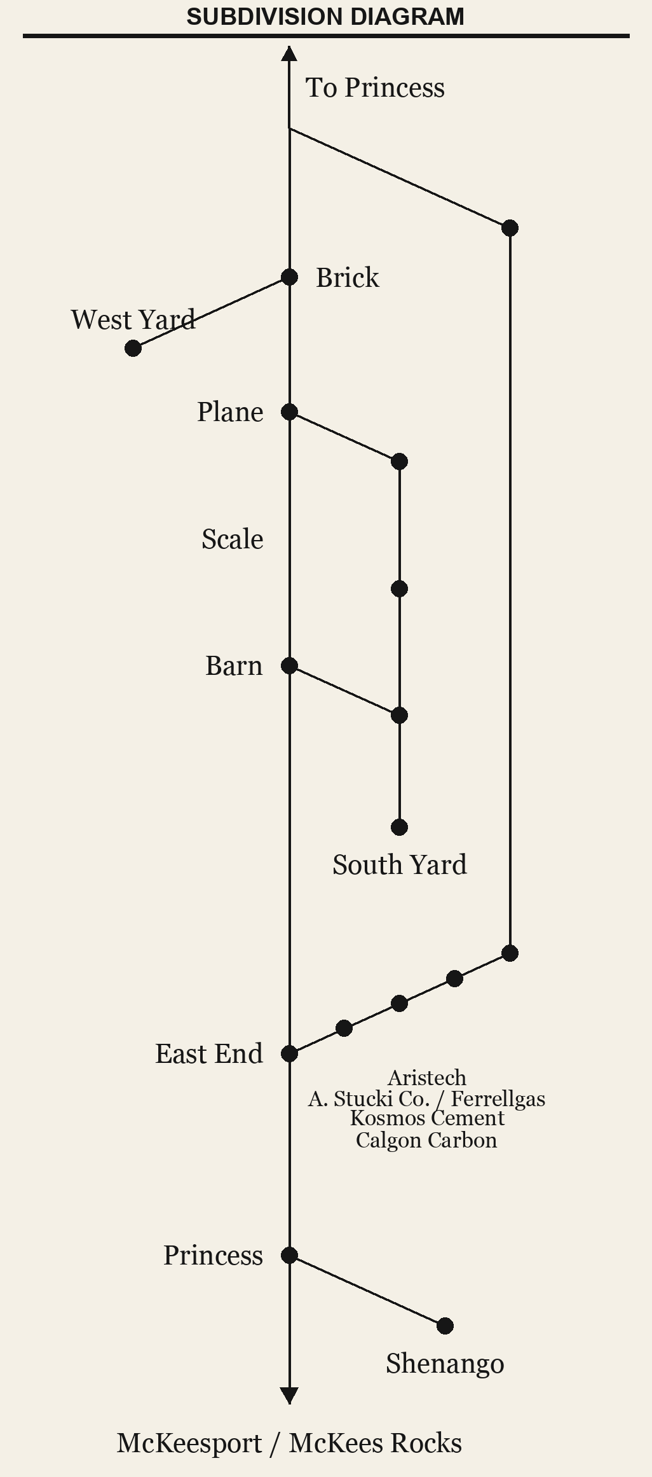
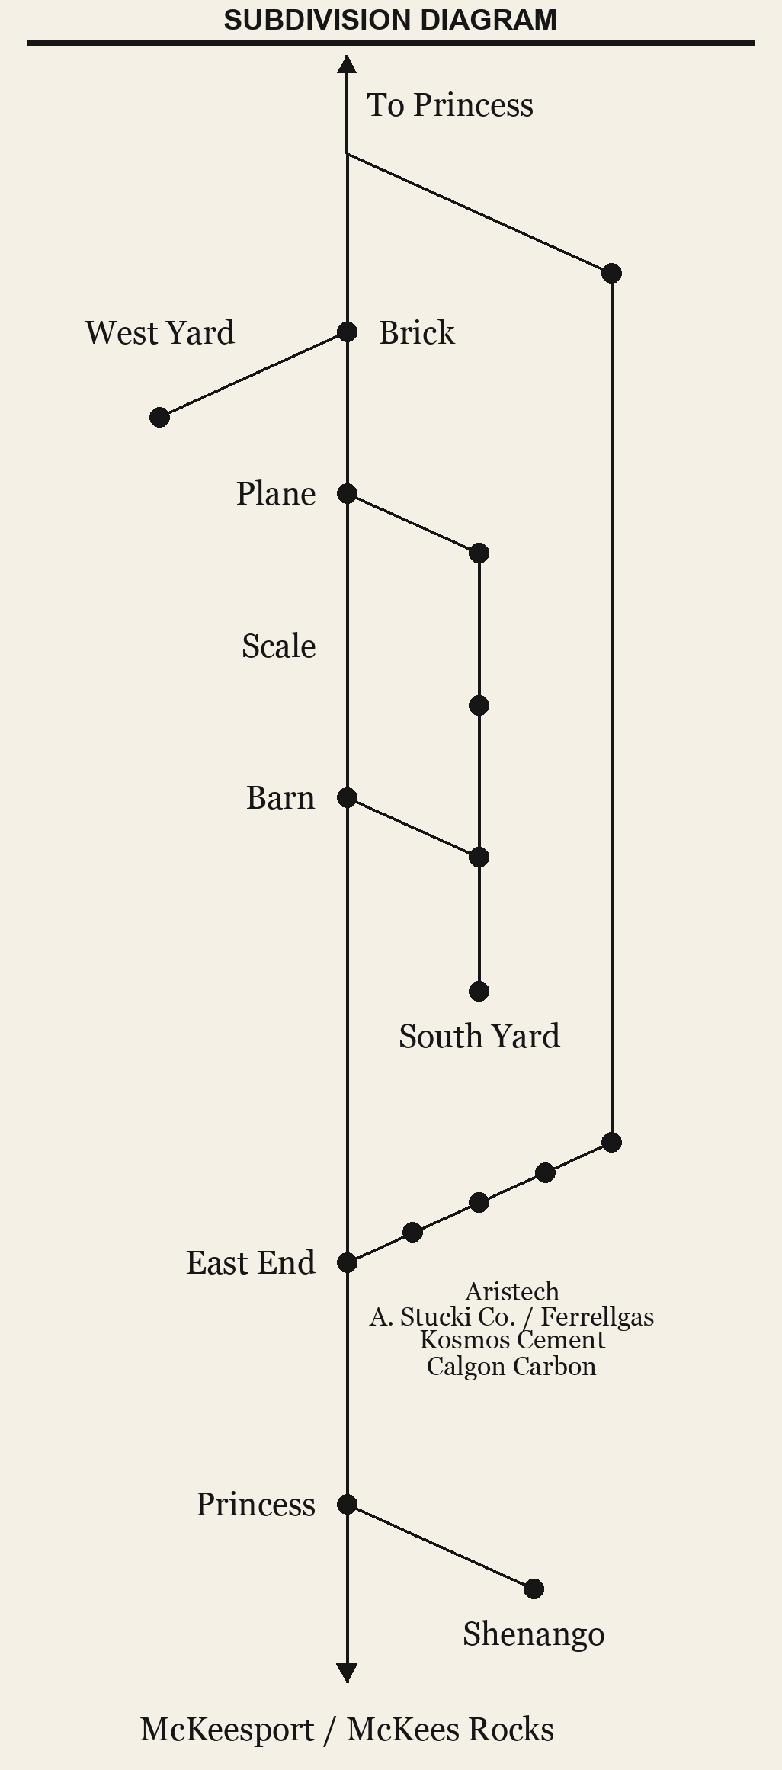
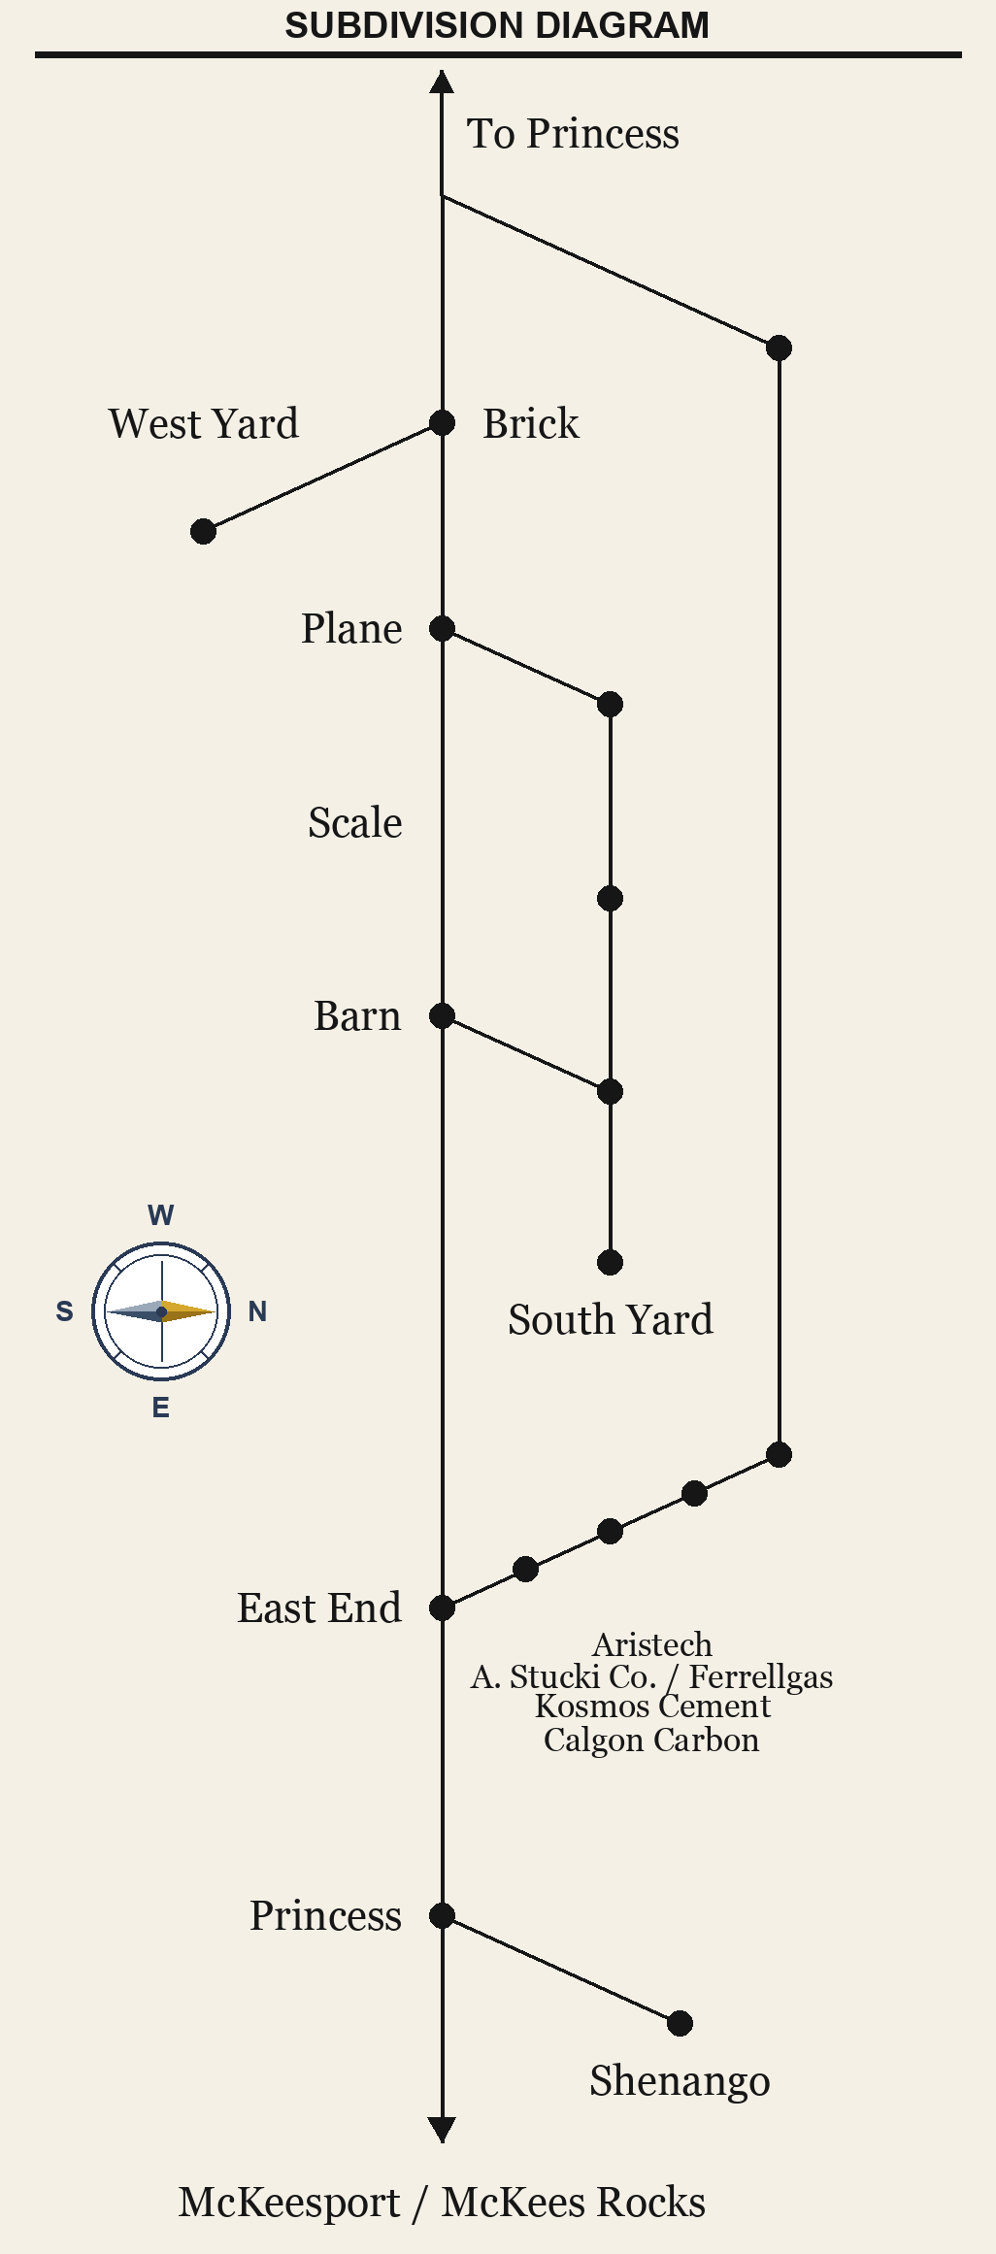
SPECIAL INSTRUCTIONS
HART RAILROAD
Pittsburgh & Chartiers Valley Division
1. Passenger trains will stop at all scheduled stations unless otherwise directed.
Neville Island Operations
2. Time shown is station time.
ROUTE 23
3. Employees must compare watches before commencing duty.
"NEVILLE QUEEN"
4. Trains may operate ahead of schedule only by dispatcher authority.
5. Maximum authorized speed is _____ MPH.
Employee Timetable No. 23
Effective __________________
Supersedes Timetable No. ___
Bulletin notices affecting this timetable must be observed until superseded.
Conductor ____________________
Engineer _____________________
Session ______________________
Office of the Superintendent
Neville Island Operations
Official Publication
Publication TT-23 · Revision A
Official Publication

Slide 2
ROUTE 23 — NEVILLE QUEEN
Employee Timetable No. 23
EAST
STATION
WEST
9:00
Barn
5:00 PM
9:06
Scale
4:54 PM
9:12
Brick
4:48 PM
9:18
East End
4:42 PM
9:24
Aristech
4:36 PM
9:30
Calgon Carbon
4:30 PM
9:36
Kosmos Cement
4:24 PM
9:42
Ferrel Gas
4:18 PM
9:48
A. Stucki Co.
4:12 PM
9:54
Princess
4:06 PM
10:00
McKees Rocks
4:00 PM
Eastbound service operates Barn to McKees Rocks. Westbound service operates McKees Rocks to Barn.
Time shown is station time. Employees must compare watches before commencing duty.
Office of the Superintendent • Neville Island Operations • Publication TT-23 • Revision A

