Slide 1
CS580
(Computer Graphics Rendering)
Rasterization
HW2
Flat-shaded z-buffer triangle teapot
Ulrich Neumann

Slide 2
Rendering HWs in steps
first build a display (HW1)
then rasterize a screen space triangle (HW2)
  Input tris (pre-transformed)
  Output pixels to display created in HW1
then add transforms (HW 3)
then add shading (HW 4)
…..

Slide 3
Rasterization
The center points (marked by x’s) are the integer coordinates of the pixels, eg., (3,2)
The colors at those points are stored in the frame buffer
The circles represent the area (region) of color that is created around the pixel point by the display
0
1
Pixel Array
and coordinates (X,Y)
2
3
Y
0
1
2
3
4
X

Slide 4
Rasterizing Lines
Given two endpoints, P= (x₀, y₀), R = (x₁, y₁)
find the pixels that make up the line
R
P
Lines are infinitely thin so they
rarely fall on pixel sample points

Slide 5
Rasterizing Lines
Render lines as “closest” pixels to actual lines
No gaps
Minimize error (distance to true line)

Slide 6
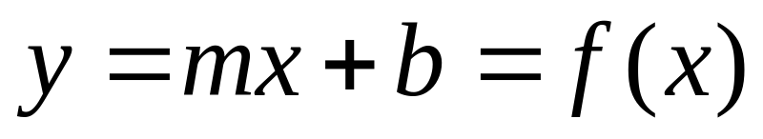
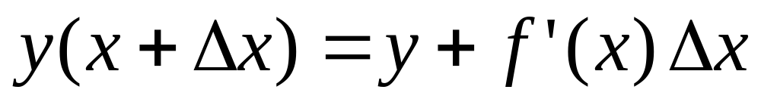
Rasterizing Lines
Equation of a Line:
Taylor Expansion:
So if we know an x,y position on the line,
we can find the next point incrementally
This is the basis of many line rendering algorithms

Slide 7
Rasterizing Lines
Assume –1 < m < 1, x0 < x1 so lines are +/- 45 degrees
Line (int x0, int y0, int x1, int y1)
float dx = x1 – x0;
float dy = y1 – y0;
float m = dy/dx;
float x = x0, y= y0;
for(x = x0; x <= x1; x++)
setPixel(x, round(y));
y = y+m;
The mid-point algorithm is a faster version of this idea
that eliminates floats and rounding http://www.mat.univie.ac.at/~kriegl/Skripten/CG/node25.html
0
1
X1
2
X0
3
0
1
2
3
4

Slide 8
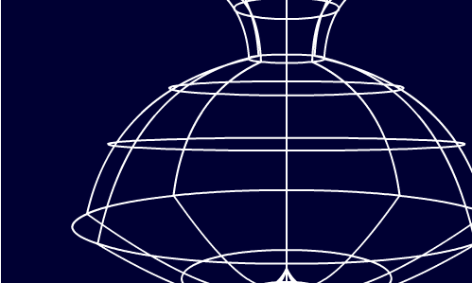
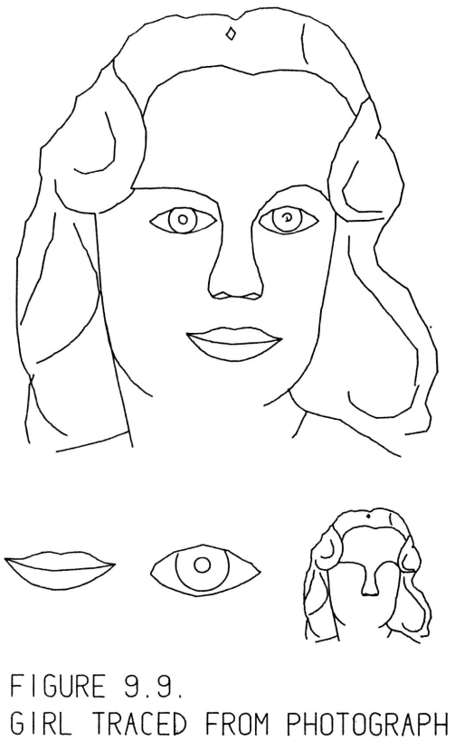
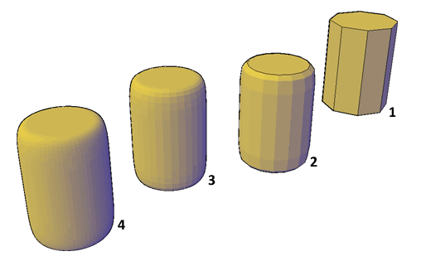
Line and Surface Renderings
3D line drawing is sufficient for conveying or manipulating objects.
More realistic 3D graphics requires an ability to draw surfaces.
Visualizations including both lines and surfaces are possible and useful.
“SketchPad” submitted January
1963 by the author for the degree of Doctor of Philosophy to the
Massachusetts Institute of Technology

Slide 9
Triangles as a 3D Surface Model
Triangles (tris) are a simple explicit 3D surface representation
Convex and concave polygons (polys) can be decomposed into triangles (usually offline)
Tris are planar and unambiguously defined by three vertex coordinates (coords)
There are several common options for structuring triangle data
We define triangles with a vertex-coordinate list per triangle - used in HWs
Tri 1 = XYZ_{A}, XYZ_{B}, XYZ_{D} and Tri 2 = XYZ_{C}, XYZ_{B}, XYZ_{D}
The order of vertices (verts) does not matter and the three edges are unambiguous
Note that verts B and D (or edge BD) are repeated. We say they are shared by both tris
Another common encoding is a triangle strip (or T-strip or winged-edge)
List each vertex once, taking care to sequence the verts
so that any contiguous three vertices form a complete triangle
XYZ_{A} Tri 1
XYZ_{B}
XYZ_{D}
XYZ_{C} Tri 2
Note that the next triangle in the strip would have to share verts C and D
A
B
Tri 1
Tri 2
C
D

Slide 10
Triangles in .obj Format
outward
1
inward
1
Vertices are stored in a counter-clockwise order (by default )
  A face orientation or normal is therefore encoded
  by the sequence of vertices
A list of vertices, with (x, y, z [,w]) coordinates, (w is optional and defaults to 1.0)
v 0.123 0.234 0.345
v 2.34 1.23 0.88
v -3.324 -2.26 1.88
v ...
A list of texture coords, with (u, v, [w]) coords (w is optional and defaults to 1.0)
vt 0.2 0.33
vt …
A list of vertex normals, with (x,y,z) coords (might not be unit vectors)
vn 0.707 0.000 -0.707
vn ...
A list of faces, with indices to vertices/texture coords/normals
f 1 2 3
f 3/1 4/2 5/3
f 6/4/1 3/5/3 7/6/5
2
2
3
3
https://en.wikipedia.org/wiki/Wavefront_.obj_file

Slide 11
Vertices
Verts have X,Y,Z coords and other attributes like color, normal, texture coords, etc.
Verts are where we “know something” about the model.
Verts are model "sample points".
Tris are planar approximation of “true” object geometry.
Coords are relative to some origin and axes (e.g., Model Space).
Example of tri from pot4.asc input file: {X, Y, Z, Nx, Ny, Nz, U, V}
triangle
1.400000 2.250000 0.000000 -0.902861 -0.429934 0.000000 0.000000 0.000000
1.273482 2.323828 0.541834 -0.918898 0.095044 -0.382874 0.250000 0.250000
1.380469 2.323828 0.000000 -0.995495 0.094810 -0.000000 0.000000 0.250000

Slide 12
Rasterization
Rasterizer fills pixel samples inside tri edges and interpolates parameters known at verts
3 verts are given (V1, V2, V3)
  coordinates and parameters at each vert
3 verts imply 3 edges
Pixels inside edges are
affected by the triangle
  colored based on
  vert parameters
  parameter values
  are interpolated to
  pixel locations and then
  used to compute pixel color
0
V1
1
V2
2
3
V3
0
1
2
3
4

Slide 13
Rasterization and Hidden Surface Removal
Two algorithm “classes” have evolved over many years
Image order rasterization -- ray tracing / ray casting
  traverse pixels (image), process each in world space
  transform rays from image space to world space
  Turner Whitted's paper (sig 79), Glassner, web, etc
Object order rasterization -- scan-line / LEE
  traverse primitives (tris), process each in image space
  transform objects from model space to image space
  Reyes (PIXAR) paper (sig87) - classic reference
  We’ll examine two object order rasterization algorithms. Pick one of them for HW2.
    LEE or Scan Line - both produce the same result

Slide 14
Linear Expression Evaluation
Use E3 as an example (1st quadrant vector, positive slope dy/dx
  All edges are clockwise (CW) about tri (need to sort verts)
  Tail of vector is (X,Y)
  Head is (X + dX, Y + dY)
Edge Equation: E(x,y) = dY (x-X) - dX (y-Y) [1]
  = 0 for points (x,y) on line (use E3 for this example)
  = + for points in half-plane to right/below line
  = - for points in half-plane to left/above line
Note: these relations hold for all multiples of dY and dX: KdY, KdX (all E vectors within the same line)
The in/out tri regions have same sign relative to all 3 edges.
Use [1] definition and cast into general form of
2D line equation : Ax + By + C = 0
dYx - dYX - dXy + dXY = 0 (multiply terms in [1])
dYx + (-dXy) + (dXY - dYX) = 0 (collect terms)
  A = dY
  B = -dX
  C = dXY – dYX (Compute A,B,C from edge verts)
E3
+
+
_
E2
+
E1

Slide 15
LEE for Rasterization
Given 3 tri verts defining 3 edges,
  Compute consistent CW or CCW edge orientation by sorting verts
  (see next slide)
  Compute A, B, C for each edge
For each pixel in the bounding box of the verts
  Compute LEE result for all three edges
  Pixels with consistent sign for all three edges are inside the tri and therefore colored (green)
  Note circled pixel falls exactly on line
    Include edge pixels on left or right edges (also determined by sort) to avoid missed pixels (or pinholes) between tris
E3
+
+
_
E2
+
E1

Slide 16
Vertex Sorting
Given 3 tri verts we need to sort them
  Find CW edge cycle
  Determine L/R and Top/Bot edges for edge-pixel ownership
Start by sorting vert Y-coords
  V2, V1, V3 is low-to-high Y ordering (for case shown)
  So, CW edges are either 2-1, 1-3, 3-2 or 2-3, 3-1, 1-2
  depending on which are L/R edges
To find L/R relationship, use mid-Y vert V1 (X₁, Y₁) and find point P (circled) along non-V1 edge (V2-V3) with same y value (y = Y₁)
  Formulate line eq for V2-V3 to get
  Ax + By + C = 0
  Plug in y = Y₁ and solve for x
  Compare x to X₁ and greatest value
  establishes R-edge(s)
  In case shown, x < X₁, so edges with
  V1 (mid-Y vertex) must be R edges
If two verts have exact same Y-values, treat as
special case (horizontal top or bottom edge)
V2
P
V1
-
V3

Slide 17
Interpolate Z
In addition to X,Y coords, verts also have a Z coord
  Need to determine the Z value at each pixel in a triangle
  Compute Z during rasterization
A general 3D plane equation has four terms:
  Ax + By + Cz + D = 0 [1]
  where vector (A,B,C) is normal to the plane
The cross-product of two tri edges produces the (A,B,C) vector
Create edge vectors (X,Y,Z)₀ and (X,Y,Z)₁ from any two pairs of verts
(X,Y,Z)₀ × (X,Y,Z)₁ = (A,B,C) = norm to plane of edges (and tri)
Use (A,B,C) and plug any vertex coord into [1] and solve for D
Given (A,B,C,D) for a given tri, evaluate [1] at any pixel (x,y) and solve for z at that pixel (interpolated Z value)
We can substitute other parameters (e.g., u,v) for Z, and compute (A,B,C,D) plane coefficients to interpolate these parameters to pixels
  need this later for interpolations of texture or color or normals

Slide 18
Z-buffer to remove hidden surfaces
For each pixel inside triangle:
  Interpolate vertex Z values to get Zpix
  Compare computed Z-pix value against current
  Z-value in Frame Buffer (Zfb)
  If Zpix < Zfb, write new pixel color and Zpix into FB (overwrite current FB values)
  Otherwise, do nothing, skip pixel – it’s an occluded surface point
This assumes a coord system such that Z increases with distance from the viewer
Pixel color is known - given by application in HW2

Slide 19
Hardware for LEE Rasterization
Parallel evaluation is possible for all pixels in NxM footprint given 3 edge coef-sets (A,B,C)
  this is the basis of Pixel-Planes and Pixel-Flow systems from UNC (1980s and 1990s) and many graphics accelerators today
First rasterize - find the pixel coverage and do hidden surface removal for a triangle
Then interpolate other vertex parameters needed for color, and store them at visible pixels in a deep frame buffer
After all tris are rasterized, compute (deferred) shading of all FB pixels using the values stored at each FB pixel
  Shading is parrallel (SIMD) and only for visible surfaces

Slide 20
Rasterization Papers to Read
Siggraph 1985 - "Fast Spheres, Shadows, Textures, Transparencies, and Image Enhancements in Pixel-Planes," Henry Fuchs,et. al.
2000 Sig/Euro Workshop on Graphics Hardware - "Tiled Polygon Traversal Using Half-Plane Edge Functions," Joel McCormack, Robert McNamara
Siggraph 1988 - "A Parallel Algorithm for Polygon Rasterization," Juan Pineda
Siggraph 2005 - “Resolution-Independent Curve Rendering Using Programmable Graphics Hardware,” Charles Loop, Jim Blinn

Slide 21
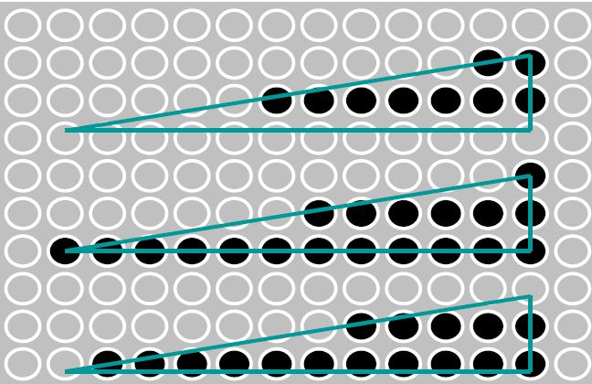
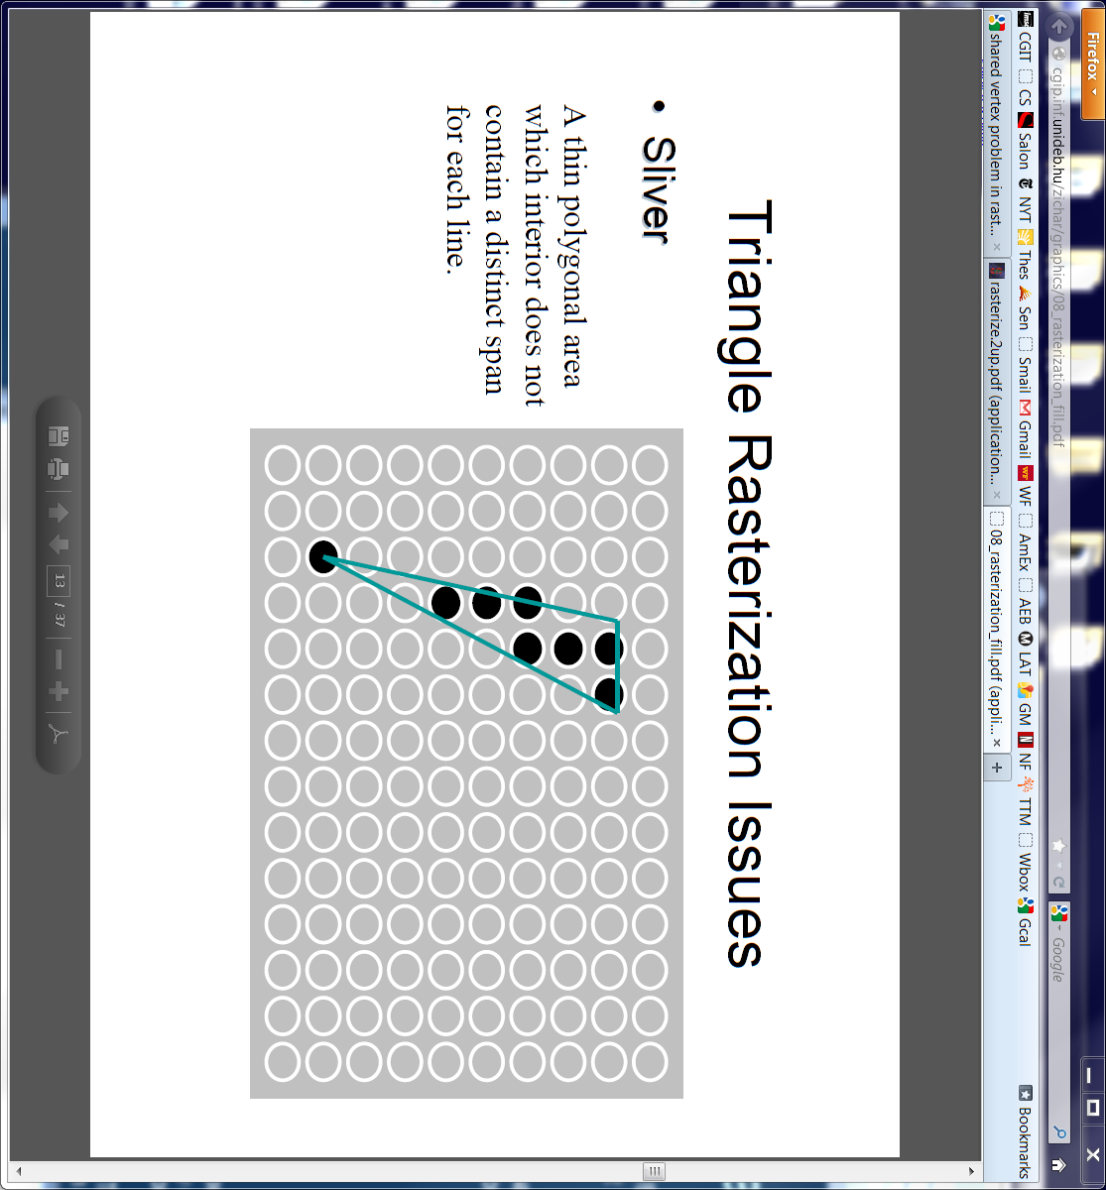
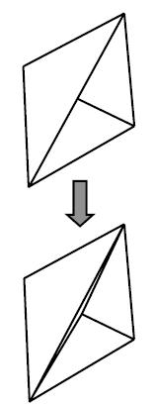
Rasterization Special Cases
Simple x-sort
does not robustly identify
L/R edges
*** Watch/detect for special cases for
  Define a convention for pixels on exact L/R T/B edges
    one edge covers pixel, the other does not
  Horizontal edges – watch sort and traversals
    Use slope or y-intercept methods to sort left/right edges
  Thin tris can have zero pixels covered in a row/column
    Ensure loop controls manage zero-iteration cases
Test yourself (these need not be addressed in your HW)
  What if a vertex falls exactly on a pixel? How can you ensure that one and only one triangle will color that pixel?
  Why is it a bad idea to create a model with a T-junction?
  A T-junction is created when a vertex lies
  on another triangle’s edge

