Slide 1
Scan Line Rasterizer
HW2
Hidden Surfaces & Culling Algorithms
CS580
(Computer Graphics Rendering)
Ulrich Neumann

Slide 2
Scan Line Rasterizer
DDA uses slope dx/dy to compute tri edges at each scan line
Generic DDA has position start, end, current, and slope data
  Add additional parameter value (Z) start, end, current, and slope data for interpolation
Assume conventions:
  Screen origin is UL corner of screen
  Screen coords (RH) -> X = right, Y = down, and Z into screen
X
1
1
2
2
3
3
Y

Slide 3
Scan Line Algorithm
1
1
2
2
3
3
Sort verts by Y into (1-2, 2-3), and (1-3) (sort for sequence of use)
Setup edge DDAs for (1-2), (2-3), (1-3)
Sort edges by L or R (2 possible configurations - above figure)
Ex: Assign edge DDA s as L (1-2-3), and R (1-3) (for right-most tri in figure)
Recall: Comparing X-coords of vert 2 and 3 is not valid L/R test
    Use dx/dy slopes (1-2) < or > (1-3) as test OR use y-intercept method
Advance (1-2) and (1-3) DDA current positions to top y-scan line (ceiling)
Setup span DDA on successive lines based on edge DDA position values
Set span DDA current and end positions to right and left edge values
Advance span current position to left-most covered pixel (ceiling)
Interpolate span position and parameters (Z) until current position > end
Test interpolated-Z against FB-Z for each pixel - low Z wins
Write color value into FB pixel (default or computed color)
Switch from 1-2 edge to 2-3 edge when current 1-2 edge position > Y(2)
Continue spans until vert 3 is passed: current 1-3 edge position > Y(3)

Slide 4
interpolators – init edges
Setup edge DDAs for E(1-2), E(2-3), E(1-3)
E(1-2) {
  start = V1 (X,Y,Z)
  end = V2 (X,Y,Z)
  current = V1 (X,Y,Z)
  slope_{x} = dx/dy (X2-X1)/(Y2-Y1)
  slope_{z} = dz/dy (Z2-Z1)/(Y2-Y1)
  }
V1
V2
V3

Slide 5
interpolators – advance edges
Advance (1-2) and (1-3) DDA current positions to top y-scan line (orange points)
Move down edges to first line
ΔY = ceil(V1(Y)) – V1(Y)
E(1-2) {
  start = V1 (X,Y,Z)
  end = V2 (X,Y,Z)
  current =
  V1 (X + slope_{x} ΔY),
  V1 (Y + ΔY),
  V1 (Z + slope_{z} ΔY)
  slope_{x} = dx/dy (X2-X1)/(Y2-Y1)
  slope_{z} = dz/dy (Z2-Z1)/(Y2-Y1)
  }
V1
V2
V3

Slide 6
interpolators - span setup and advance
Setup span DDA on successive lines based on edge DDA values
Set span DDA current and end positions to right and left edge values
SPAN {
  start = L (X, Z)
  end = R (X, Z)
  current = L (X, Z)
  slope_{z} = dz/dx (RZ-LZ)/(RX-LX)
  }
Advance span current position to left-most covered pixel (red point) ΔX = ceil(LX) - LX
SPAN {
  start = L (X, Z)
  end = R (X, Z)
  current = LX + ΔX, LZ + ΔX slope_{z}
  slope_{z} = dz/dx (RZ-LZ)/(RX-LX)
  }
V1
L
R
V2
V3

Slide 7
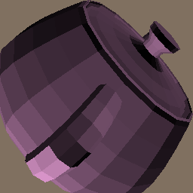
HW2
Tris are pre-transformed into screen coordinates for HW2
Input file has tris with X,Y,Z ready for rasterization
Color is assigned for each tri
The renderer must do z-buffering
so you need to initialize z in
the frame buffer, in addition
to setting the background color
Initial z-value is MAXINT,
the maximum positive integer
value

Slide 8
HW2.txt
Your assignment is to produce a working scan converter based on the files you're given below.
The API calls in rend.cpp *must* be provided just as they are outlined.
Remember to interpolate Z and do Z-buffer testing on each pixel write to the Display.
*** Changes in the API are not allowed ***
The standard application you are given must work without modification.
The renderer will be added to your display code from HW1.
If your display code is not yet correct, you'll have to complete it since you need it now.
There are several other files there that will be useful.
- Gz.h : Global definitions
- Application2.cpp : new application that calls for your rend.cpp functions
- rend.cpp : new skeleton file with API definition and comments
- pot4.screen.asc : the Utah teapot triangle data transformed for scan conversion
- pot4.ppm : the result of running with input file pot4.screen.asc to create pot4.ppm"
The result images are made into a 256x256 window.
Do not change the resolution/size of your display image since the transformation
is precomputed for that image size.
NOTE – You mush initialize Z in your frame buffer in addition to the background color

Slide 9
Application API
View Application2.cpp
Use API calls to GzRender() to create the renderer
Use GzDefault() to initialize at the start of a new frame
Color is sent to renderer via the generic GzPutAttribute() call that also uses pointers to a token list and value list
A Triangle is sent to renderer via the GzPutTriangle() call that passes a pointer to a vertex structure defined in Gz.h
Note: *nameList points to a list of “type” tokens
and *valueList points to a list of parameters of those types
Note: a simple shading function is within the application and it computes a color for each triangle

Slide 10
Tokens and Values
int GzPutAttribute (int numAttributes,
GzToken *nameList, GzPointer *valueList)
List of Tokens (ints) List of values
  GZ_RGB_COLOR Float Color [3]
  ….. …..
Increment through tokens (ints) and use (sizeof) token type to increment the pointer through the value list
Only use GZ_RGB_COLOR for HW2, but other data will be passed in later HWs
int GzPutTriangle (int numParts,
GzToken *nameList, GzPointer *valueList)
Same with PutTriangle function – only use GZ_POSITION token for HW2 – that token means valueList is a pointer to 3 vertex positions XYZ, XYZ, XYZ

Slide 11
Renderer API
Look at Rend.cpp
Note separate GzPutAttribute() and GzPutTriangle() calls
Tokens for “types” in PutTriangle call only use GZ_POSITION right now – no other triangle data for HW2
Color is passed to Renderer as RGB array of floats defined over the range [0.0, 1.0]
Ctoi( ) function converts float color range of [0.0, 1.0] to GzIntensity 12-bit range for PutPixel calls to the display
  Bound the float range to ensure conversion doesn’t overflow 12-bit range (0-4095)

Slide 12
The “Original” Scan Line Algorithm
The “classic” scan line algorithm was a variation of what is described in the prior slides.
Walk the screen scan lines (top to bottom) and deal with all triangles that intersect the current line. This requires only one scan-line of Z-buffer for hidden surface calculations.
Y-sort all triangles based on their lowest-Y vertex. Put all of them into the unrendered list
For all scan lines {
Test the pool of unrendered tri’s to see if any start on the current line. If so, move them to the current tri list.
Render the current list tris for by incrementing their DDAs to the current line – do the same edge stepping and span stepping we discussed. Keep all the DDA parameters for a triangle in each tri data structure since we’ll need them on subsequent lines. Use Z-buffering for all pixel writes.
Increment the scan line and test all current list tris for completion.
Remove any completed tris from the current list.
}

Slide 13
Hidden Surface Removal Algorithms
  Finding the visible surface at each pixel during rasterization
  Required to produce a correct image
Culling Algorithms
  Finding surfaces that will not be visible and removing them before rasterization
  Optional to improve performance

Slide 14
Hidden Line Removal (HLR)
Edge or line drawing also requires visibility methods
wireframe lines are hard to deal with
  simple z-buffer does not work when the renderer only draws lines (outlines of polygons)
  edge-crossing and object sorting methods
no line hiding means no depth sense
hidden line drawing provides depth sense

Slide 15
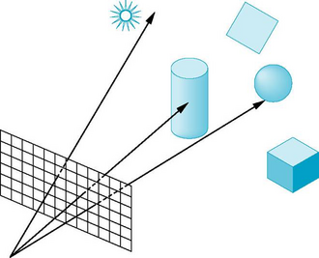
Raycasting
For every ray through a pixel,
  Perform a ray-intersection with every object
  Keep the closest intersection
Image plane
View point
or focal point

Slide 16
Painter’s Algorithm (1)
Just render in order -- front to back or back to front
  view-dependent ordering needs to be computed very frame
Simple cases allow sorting by a simple “per polygon” test : (not pixel test)
  Z of all verts of one poly are < or > than all verts of another
View (Z) direction
top
view
All B vertex Z-values are less than
all R vertex Z-values
front
view

Slide 17
Painter’s Algorithm (2)
Failure cases:
Vertex Z-sort is ambiguous when all vert test fails
  Can’t tell if B in front of R or not (in examples below)
  Vert sort of B-R and G-R produce same order
- Cannot resolve cycles or overlapping surfaces
View (Z) direction
top
view
front
view

Slide 18
Warnock algorithm
Overcomes problem of view dependent ordering and intersecting geometry by divide and conquer strategy
  Subdivide screen until a leaf region has a simple front/back relationship
  Leaf regions have one or zero surfaces visible, and smallest region is usually a pixel
  Usually use quad tree subdivision
Useful for curved surfaces and antialiasing where the subdivision is done to sub-pixel levels
Efficient and focuses work where needed adaptively
  a common theme in graphics
Think of z-buffer as a fixed subdivision to pixel regions

Slide 19
Area Subdivision (Warnock)
Initialize the area to be the image plane
Four cases:
  No polygons in area: done
  One polygon in area: draw it
  Pixel sized area: draw closest polygon
  Front polygon covers area: draw it
Otherwise, subdivide and recurse

Slide 20
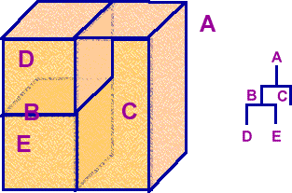
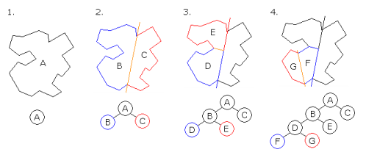
BSP-Tree
A view-independent binary tree structure that allows a view-dependent front-to-back or back-to-front traversal of surfaces
  use Painter’s Algorithm with back-to-front traversal
  useful for transparency – full depth-sort of all surfaces
  fast – no Z-calculation or testing per pixel
  more detail in later class

Slide 21
Z-buffer
Compare each new surface pixel’s depth to current frame-buffer pixel value
Compare FB-Z with new triangle pixel-Z
Lowest Z-value (front-most) wins and becomes the new FB pixel
Most common today due to cheap/fast memory
Advantages
simple
reasonably efficient
Disadvantages
increased memory & bandwidth
z-quantization/accuracy limits
over-rendering
no support for transparency

Slide 22
Culling: Eliminating Triangles
Culling methods reduce the number of triangles
that need to be rasterized for a scene image
  Portals – precompute visible (or invisible) sets
  of triangles for view-point regions (precompute once)
  Frustum cull – skip triangles that fall completely
  off screen (check every triangle every frame)
  Backface cull – skip triangles for closed objects that are facing away from the camera
  (check every triangle every frame)

Slide 23
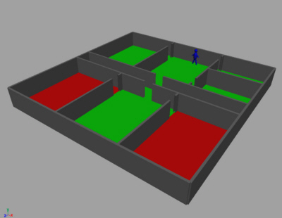
Culling With Portals
Useful concept for buildings and other static scenes
Represent the environment as a graph of Nodes which are bounded areas of visible triangles
Graphs are precomputed for view positions (optionally also directions)
Edges are portals through which Nodes are visible
All potentially-visible triangles are included in a graph
Each room triangle set is a Node
Construct a graph of all visible Nodes from any view point in each room
When rendering: use the graph to determine all Nodes visible from current position and render only those Node triangle sets

Slide 24
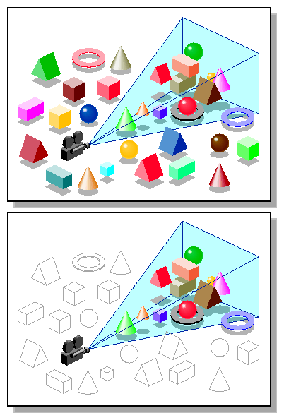
Culling by View Frustum
Check if entire object lies outside the frustum created by extending the four screen edges into the viewing volume
Simplest test is to skip a triangle
iff all its vertices are beyond
the same screen edge
(e.g., to the right of the screen)
image
image
verts are all
off-screen, but
not off same
edge, so don’t skip
skip, this
meets the
cull test
criteria

Slide 25
Backface Culling (1)
For closed (water-tight) objects, surfaces with oriented-normals facing away from the camera (called back-facing) are never visible
  The inner surfaces of closed objects are never seen
  Oriented-normals (N) face outward from the outer surface side
  Below, the red surfaces have normals that face the viewpoint P so they are rendered. The blue surface normals face away so they can be skipped since the front (red) surfaces will always occlude the rear (blue) ones.
If triangle models include an oriented surface-normal vector N, then we can find and skip backfacing triangles:
If (View • N) > 0, then skip the triangle
  View is a vector from the view-point P
  to any point (or vertex) on the surface
Note: our teapot model does not have
oriented-normal vectors – it is not “closed” or “water-tight”
N
View
P

Slide 26
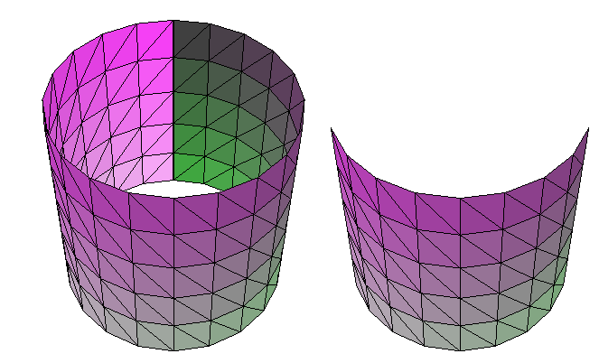
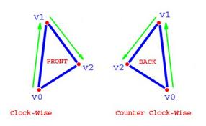
Backface Culling (2)
Alternatively, rather than adding a surface-normal to a triangle data structure, the triangle vertex sequence can encode face orientation
  When viewed from front face, the vertex sequence V0,V1,V2 appears in clock-wise order
  When viewed from the back face, the same vertex sequence appears counter clock-wise
  Example (right image) shows RGB dots to illustrate vertex sequence for front and back facing triangles
With BF-culling, all the back-face triangles are skipped

Slide 27
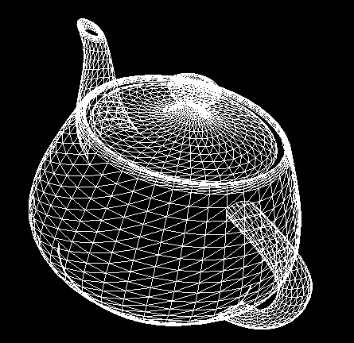
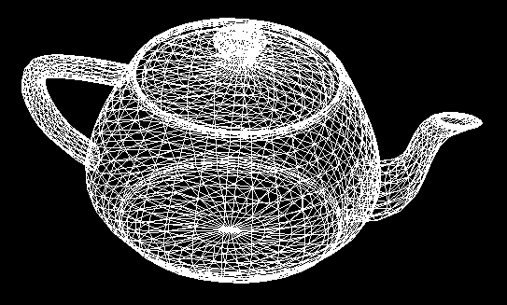
Backface Cull
Wireframe rendering with BF-cull shows missing surfaces at top of spout and crack around lid (left image)
  Such problems occur when models are not “closed” or “watertight”
No BF-cull
BF-cull

Slide 28
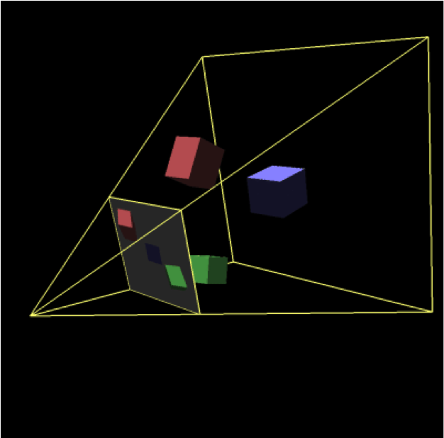
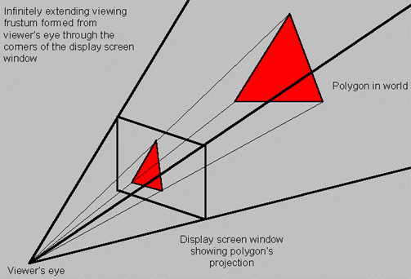
Frustums
The view frustum is formed by a view point, a view direction, and a view plane
  The field of view (FOV) is the angle that fits the view plane (or image plane) into the frustum (horizontal and vertical FOV)
  The image is created by projecting objects in the frustum to the focal point – the projections pass through the image plane (more about this later)
  Frame buffer pixels are sample points on the view (or image) plane
Horizontal FOV
Vertical FOV

Slide 29
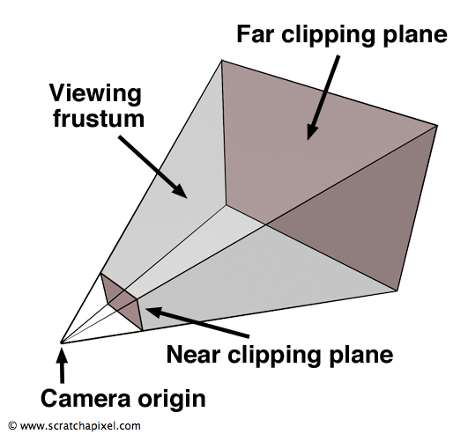
Frustums and Clipping
Clipping to the view frustum ensures that only visible triangles (or fragments) are drawn into the frame buffer
  Trivial clipping to frustum sides is done in the HW1 display by checking for valid pixel addresses
  A far clip plane can be useful, but we
  don’t need or use one in our HWs
  A near clip plane is needed to eliminate
  objects behind the image plane
  in HW3 (details
  coming later)
  Our near clip plane
  is the image
  plane at Z = 0
  (screen space)

