Slide 1
Screen-Space Parameter Interpolation with
Perspective Correction
CS580
(Computer Graphics Rendering)
Ulrich Neumann

Slide 2
Problem
We employ simple linear interpolation of vertex shading parameters for HW4
  accurate interpolation of RGB color or Normal vectors should take perspective into account
  we need the equivalent of “perspective-z” for accurate parameter interpolation

Slide 3
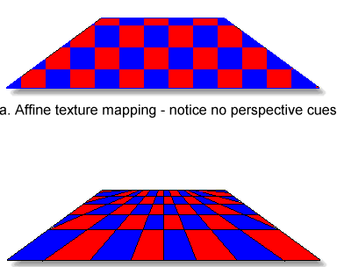
Checkerboard Example
Checkerboard defined as integer grid derived from vertex parameters
  red over odd/odd (o, o) and even/even (e, e) intervals
  black over odd/even intervals (e, o), (o, e)
Image midpoint is not actual midpoint of checkerboard
  Straight line along diagonal remains straight under perspective
0,2
1,2
2,2
0,1
2,1
0,0
2,0
1,0
Linear Interpolation
Perspective Interpolation
Mid-image checkerboard
interpolation
point is not mid-object
Correct mid-checkerboard
interpolation to mid-object

Slide 4
Parameter Interpolation
Similarly, linear interpolation of affine (image space) parameters like Z give wrong results at pixels
Interpolation of perspective-z is correct (all HW so far)
  we can recover image space result if we transform perspective-z back to image (affine) space after interpolation
Effect is modest for scene like teapot where Z range is small, or with narrow FOV cameras
  Roads to horizon, grazing angles on curved surface like a car hood, and wide FOV cameras produce a more dramatic impact
Perspective-correct interpolation of u,v texture coords is needed in HW5 – e.g., checkerboard texture
Z= 0
a
bc
Z= -d
Z=1 Z = 11 Z = 21

Slide 5
Color and Normal Interpolation
Color or Normal interpolation (Gouraud/Phong) is actually wrong (in HW 4) since parameters are interpolated as affine-space values
  Colors and Norms are not transformed to perspective-space where depth is taken into account
Ignore error in color interpolation – it’s an approximation
  Visual system is sensitive to intensity and color discontinuities
  Interpolation errors impact the rate of changes
  Human visual perception is not sensitive to rate of color change
  Often triangle vertices only differ by a small color change
Ignore error in normal interpolation – it’s an approximation
  Diffuse variations are not important for reasons already stated above
  Specular errors are minor and only shift the highlights slightly
  Much larger highlight errors can result from approximations of L and E as constant over the scene – and these are not noticeable either

Slide 6
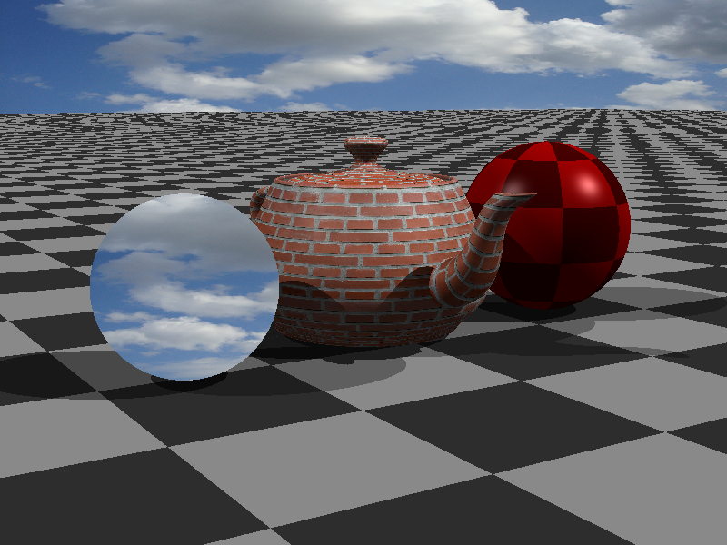
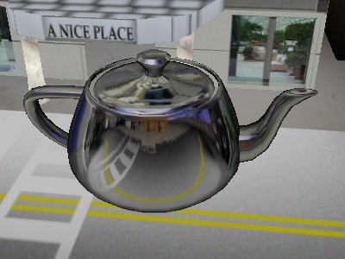
Perspective-Correct Parameters
Perspective-correct interpolation is needed when interpolated parameters produce edges or discontinuities in shading or geometry
  E.g., texture edges (in checkerboard) or use of normals for reflective or mirror surfaces

Slide 7
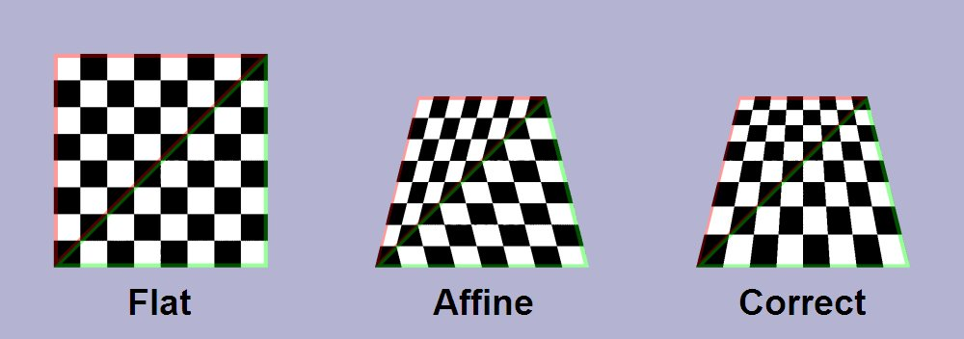
Perspective-Correct Parameters
Our z-interpolation is perspective-correct
Screen-space and NDC space only differ by scale (MAXINT)
  Perspective-correction is not impacted by scaling
We need a similar perspective transformation to allow interpolation of other shading parameters (e.g., texture u,v coordinates)

Slide 8
Any parameter P can be properly interpolated by…
Transform (warp) vertex parameter P to perspective space P^{s} vertex value
Interpolate perspective P^{s} vertex values to new sample points (P^{s} values at pixels)
Transform (unwarp) interpolated P^{s} pixel values back to original space to produce interpolated P values for use in shading (or other processes)

Slide 9
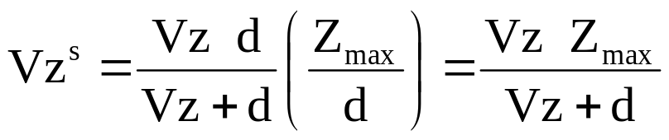
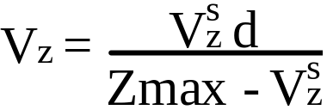
What happens to Z ? study Z as an example of perspective interpolation
V = [Vx,Vy,Vz] an image-space point, V^{s} is its perspective coordinate
Writing the transformation as an equation:
(1)
= V^{s} (2)
We scaled Xpi to scale Vz^{s} ∈ [0, Zmax] to bound it for Z-buffer range
Scaling by Zmax/d doesn’t alter perspective characteristic that arise from divide by (Vz+d)
Z-buffer doesn’t require inverting the transformation of z to get Vz at each pixel – but we could do it
(3)
Invert the relation to find Vz (image space)
(4)

Slide 10
Interpolating Parameter P
Use the unscaled Xpi matrix (Eq 2) for any parameter P
(in image-space) that we wish to transform to P^{s} for correct interpolation in screen space
(5)
After interpolation of P^{s} parameter values to a pixel, the pixel-value can be transformed back to image space
(6)
Note that d plays a role in the transformations and that we need V_{z} values at each vertex (for Eq5) and pixel (for Eq 6)
We don’t have V_{z}, but we do have V_{z}^{s} the screen space z-values at the vertices and at each pixel (for z-buffer)
P^{s} = P d / (V_{z} + d)
P = P^{s} (V_{z} + d) / d

Slide 11
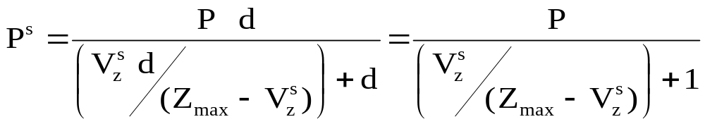
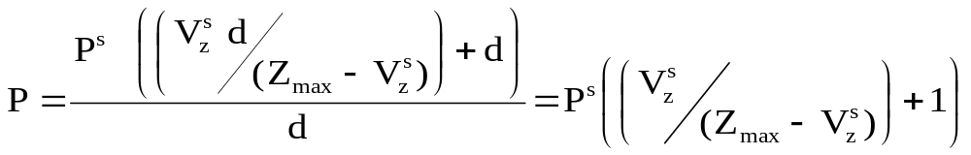
Interpolation Using Screen Z
If we plug in Eq. 4 for Vz in equation 5, we get
(7)
and (6) becomes
(8)
In both cases the d’s cancel so in fact, d is not needed
Note that Zmax is needed, but it is constant and known
We use (7) and (8) as transformations between image and screen space to interpolate any parameter P to any pixel using screen-space z-values, which we know everywhere

Slide 12
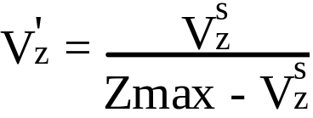
P Interpolation Simplified
Create a new term V′z based on screen space Z interpolated during rendering for z-buffer use
(9)
Then we use (9) in (7) to transform parameter into perspective space before interpolation
(10)
and in (8) to transform interpolated parameters back to affine space after interpolation
(11)
P^{s} = P / (V'_{z} + 1)
P = P^{s} (V'_{z} + 1)

Slide 13
Summary
By using (9), (10), and (11) we perform perspective-corrected interpolation for any affine-space parameter
  without dealing with d and only using screen-z values already computed for z-buffer use
Note that V_{z}^{s} , (screen space Z) is needed (in 9) at each point where transformations are done in or out of perspective space
  We know it at vertices and we compute
  interpolated V_{z}^{s} (screen-space z values)
  at each pixel for z-buffer tests

Slide 14

HW5 texture procedure
The procedure for texture u,v coordinate interpolation needed for HW5 is :
  1. Use (9) and (10) for each vertex u,v to transform them to perspective space U,V (use V_{z}^{s} at each vertex)
  2. Interpolate transformed U,V components (like Z)
  3. At each visible pixel in triangle (after Z-buffer test) use interpolated V_{z}^{s} in (9) and (11) to transform interpolated U,V back to affine space u,v values
  4. Compute texture color = f(u,v) and evaluate shading equation
1
u,v → U,V
3
U,V → u,v
Texture and shading
4
2
U,V
1
u,v → U,V
1
u,v → U,V

Slide 15
Image Textures

Slide 16
How can we model a cloth-covered chair next to a wood bowl with oranges?
Geometry, color, lighting model
  Operate over wide range of scales
Geometry defined by triangle faces
  Coarse facets approximate true shape
  Material properties are defined per triangle (K's)
  Lighting parameters are defined at vertices (normals)
Vertex or facet parameters can not convey interior triangle details or variations in color, smoothness, or opacity
Geometry, color, and smoothness variations occur at different scales
  For example a printed picture has a flat simple geometry, but complex color
  An orange peel (or plastic chair) has simple color, and although wrinkled surface is a minor change in overall geometry, the wrinkles have large impact on shading due to complex small scale variation of surface normals

Slide 17
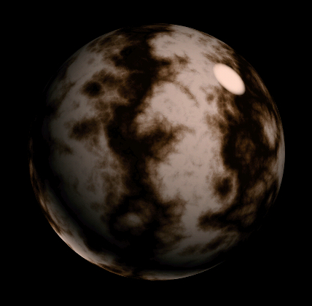
Texture Example
Simple model and complex color
  Could be a sphere equation x² + y² + z² = K
How do we control color everywhere?
  Not just constant K-terms for entire object
  Not just shading at vertices
Need a mechanism for color control at each pixel

Slide 18
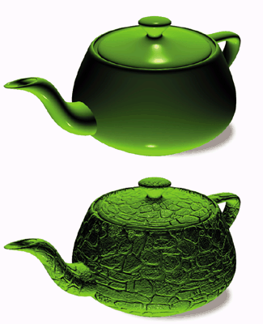
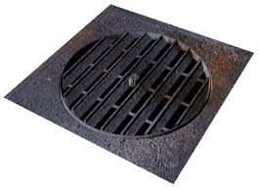
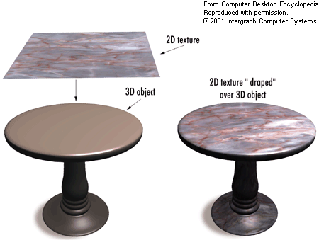
Textures
Textures are techniques for creating
small-scale complexity beyond vertex
geometry and parameters
Any part of the graphics process can
be textured
  use any mapping from the object surface to
  some set of parameters involved in rendering
A texture could affect, for example:
  Geometry (displacement, cut/stencil)
  Material properties (color, opacity)
  Shading equation parameters
  (normals, light visibility/shadows)

Slide 19
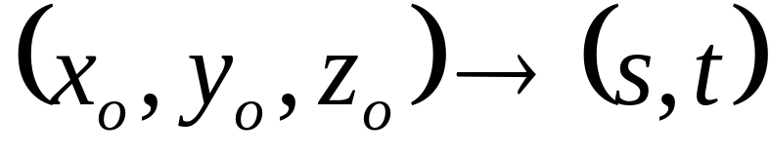

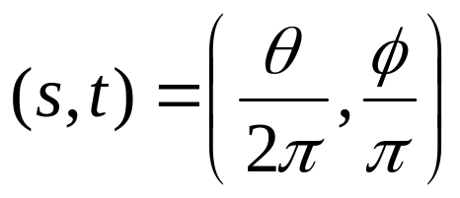
Mapping Function
Many possible mapping functions - in general:
        map 3D points on a surface to 2D parameters
Example - sphere mapping: a computed mapping
Convert sphere coords (x, y, z) to angles
Normalize angles to produce
texture coords (2D) (s, t) spanning [0,1]
over entire surface

Slide 20
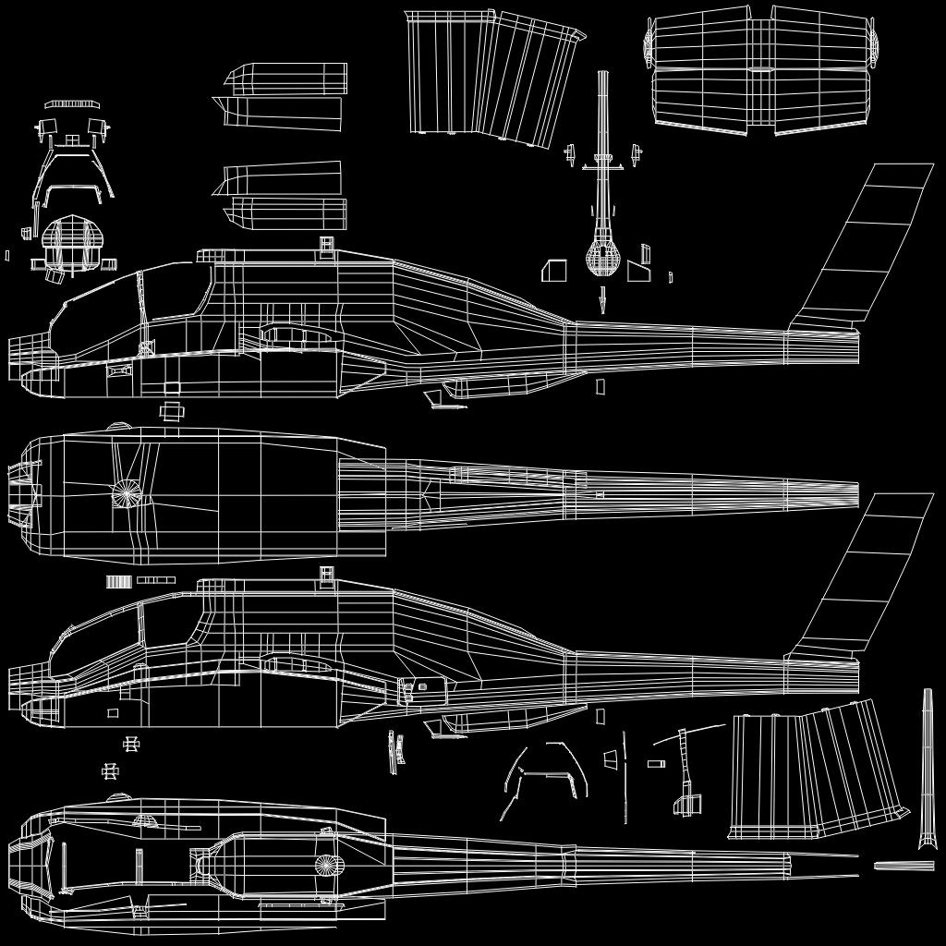
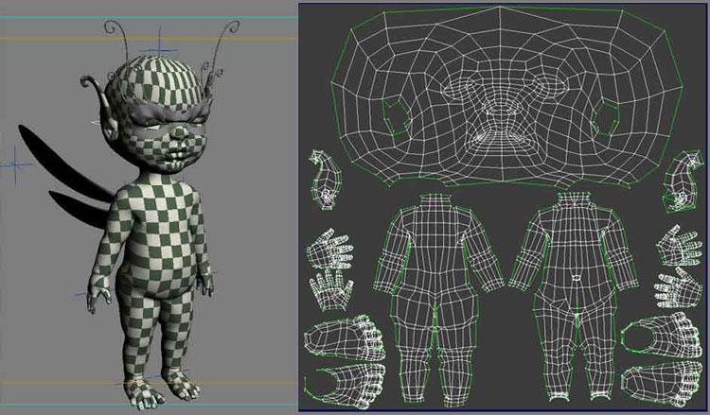
Mappings for Arbitrary Models
Computed mappings don’t exist for most objects
  The modeling process
  includes a surface map
  with u,v coordinates
  defined at each vertex
  Often an interactive process
  of “flattening”

Slide 21
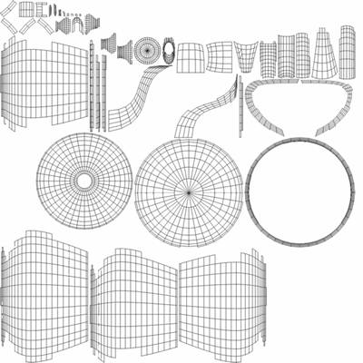
Mappings for Arbitrary Models
Teapot model includes (u,v) coords at each vertex
  Defined domain of [0,1] for u,v coords
  Each point on the model surface has a surface coordinate (u,v) distinct from
  its 3D coordinate (x,y,z)

Slide 22
Scale u,v to Texture Image Size
Surface parameters (u,v) define (2D:2D) mapping from a triangle surface location to a texture-image location
(u,v) coords range over [0, 1]
  convention observed during model construction and mapping
Scale the 2D coords to index into a 2D texture image
  pixel array of xs-1, ys-1 (e.g., 255, 255 for 256x256 texture image)
u and v are fixed parameters at verts, no transformations impact these values
  latitude, longitude coords on earth’s surface don’t change as it spins
u
x
Image texture resolution
([0, xs-1], [0, ys-1])
u,v coordinates range
([0,1], [0,1])
scale
v
y

Slide 23
2D Image Texture Process
Interpolate texture coords to texture pixels (texels)
Warp u,v to perspective space (U,V) at verts
Interpolate U,V to pixel coords
Unwarp U,V to get u,v at each pixel
Do texture look up at a screen pixel : u,v → Color = f(u,v)
Scale u,v range to x,y texture image size (x-size, y-size)
  Scaling is done with multiply of pixel u,v by the size of the texture image (x-size -1) and (y-size -1) to get a float coord (x,y), which is a sample point in the texture image
Interpolate nearest-neighbor texel colors to scaled (x,y) sample point
  Reconstruct texture-image color at sample point

Slide 24
Texture-Image Lookup Example
U,V → u,v
u • (xs-1) = 2.4 (x-texel sample coord)
v • (ys-1) = 3.7 (y-texel sample coord)
u,v → U,V
x
0,0
U,V
u,v → U,V
u,v → U,V
Rasterized Triangle
Compute texture at image pixels
7,6
y
Image Texture Map
xs = 8 ys = 7
Color for the triangle pixel is found in the texture map image
…but the sample point lies between texels (pixels in the texture map)
Interpolate Color (2.4, 3.7) as a function of the surrounding texel colors (colored locations 2,3 2,4 3,3 3,4)

Slide 25
Bilinear Interpolation
Apply a reconstruction (interpolation) filter
  Bilinear interpolation, cubic, etc. are all possible filters
We will use simple bilinear interpolation filter
  a.k.a: triangle or pyramid reconstruction filter
Color(p) = s t C + (1-s) t D + s (1-t) B + (1-s) (1-t) A
  s, t are fractional distances [0,1]
  A, B, C, D are pixel RGB colors at neighboring
  integer-coord texels
A
B
t
E.g., Find Color (2.4, 3.7)
where: s = .4 t = .7
Color(2.4, 3.7) =
.4•.7•Color(3,4) + .6•.7•Color(2,4) +
.4•.3•Color(3,3) + .6•.3•Color(2,3)
s
p
D
C

Slide 26
Texture Color for Phong Shading
Compute Phong shading as in HW4 – but now set Kd and Ka at each pixel to color computed by texture lookup process
  First, do u,v interpolation to a pixel
  Then, texture color lookup with bilinear interpolation
  Then shading calculation with texture color used as Kd and Ka (Normal interpolation is same as HW4)
    Keep Ks and s as set by application in the renderer state
    Material specular color is often independent of diffuse color

Slide 27
Texture Color for Gouraud Shading
Normally, Gouraud shading computes shading Eq at verticies – but we can’t do that if we want to use a texture
So…delay the color (K’s) multiplies until we do pixel rasterization
  Do the texture K_{T} lookup after z-buffer test determines a visible pixel
Set K_{T} = Kd = Ks = Ka for Gouraud textures so it can be factored out of shading equation
  K_{T} is the texture color (RGB triple), used for all K-terms in shading eq
Gouraud or color interpolation is done as “light-intensity” interpolation from modified vertex shading calculation (terms known at vertices)
  Delay the multiplication of cumulative light intensities by K_{T} =Ka=Kd=Ks
  Multiply interpolated term by texture color K_{T} during pixel rasterization
C = (Ks Σ_{L} [Ie (R•E)^{s}] ) + (Kd Σ_{L} [Ie (N•L)]) + (Ka Ia)
C = (K_{T}) (Σ_{L} [Ie (R•E)^{s}] + Σ_{L} [Ie (N•L)] + Ia)
pixel-by-pixel compute at vertices and interpolate to pixels
texture lookup

Slide 28
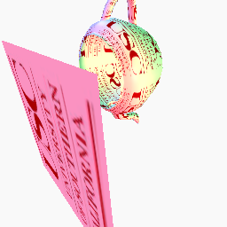
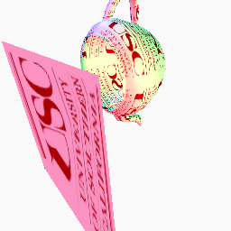

HW5 Results
Perspective correction No perspective correction
texture image

