Slide 1
Image Textures
HW5
CS580
(Computer Graphics Rendering)
Ulrich Neumann

Slide 2
Summary of Image Color Textures
Compute perspective-correct interpolation of u,v at each pixel
Scale u,v for image texture size and do bilinear interpolation of 4-corner texel colors to produce the u,v sample point color
Use texture color as K terms in Phong or modified-Gouraud shading equation

Slide 3
HW5 – Image Texture
Add image texturing capabilities to your renderer.
Load a specific ppm-format texture file ("texture") that is applied to every triangle.
A new input file “ppot.asc” contains a teapot sitting on a plane.
When rendered without perspective correction, it produces ppot.np.ppm.
When rendered with perspective correction, it produces ppot.p.ppm. Note the difference.
Your renderer should make the equivalent of ppot.p.ppm. ppot.np.ppm is only for reference.
Try some other texture images too. Any ppm image should work (e.g., photos or results from prior HWs)
The texture parameter that is passed to the renderer is a pointer to a function.
  tex_fun.cpp helps you build your own texture function for image textures
  complete the texture function by adding bilinear interpolation and bounds checking as described in the class slides.
You need to support textures with Phong and Gouraud shading (not Flat)
  Gouraud shading uses the texture color as Ka, Kd, and Ks.
  Phong shading uses the texture color as Ka and Kd.
    Ks and s, the specular parameters, remains as defined for the triangle.
  The ppm result images (prior slide) were created with Phong shading.

Slide 4
tex_fun.cpp code fragments (1)
GzColor *image;
int xs, ys, reset = 1;
int tex_fun(float u, float v, GzColor color) /* accept u,v and write color */
{ unsigned char pixel[3]; unsigned char dummy;
char foo[8]; int i, j; FILE *fd;
if (reset) { /* open and load texture file */
fd = fopen ("texture", "rb");
if (fd == NULL) {
fprintf (stderr, "texture file not found\n");
exit(-1);
}
fscanf (fd, "%s %d %d %c", foo, &xs, &ys, &dummy);
image = (GzColor*)malloc(sizeof(GzColor)*(xs+1)*(ys+1));
if (image == NULL) {
fprintf (stderr, "malloc for texture image failed\n");
exit(-1);
}

Slide 5
tex_fun.cpp code fragments (2)
for (i = 0; i < xs*ys; i++) { /* create array of GzColor values */
fread(pixel, sizeof(pixel), 1, fd);
image[i][RED] = (float)((int)pixel[RED]) * (1.0 / 255.0);
image[i][GREEN] = (float)((int)pixel[GREEN]) * (1.0 / 255.0);
image[i][BLUE] = (float)((int)pixel[BLUE]) * (1.0 / 255.0);
}
reset = 0; /* init is done */
fclose(fd);
}
/* bounds-test u,v to make sure nothing will overflow image array bounds */
/* determine texel sample 4-corner values and perform bilinear interpolation */
/* set color to interpolated GzColor value and return */
}
/* Procedural texture function - add any procedural texture you can think of */
int ptex_fun(float u, float v, GzColor color)
{
}

Slide 6
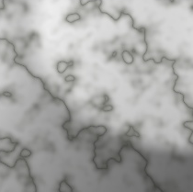
Procedural Textures
Textures compute general functions: f(u,v)
Lookup table images are only one f(u,v) evaluation method
Mathematical or procedural functions are another

Slide 7
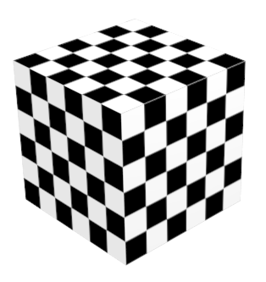
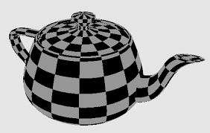
Simple Procedural Texture
The checkerboard
Two colors are determined by odd/even intervals in u,v range [0,1]
Split u,v range in N intervals (e.g.: N=6 in cube)
1 2 3 4 5 6
u or v
0
1
v
u

Slide 8
Simple Checkerboard Texture
Split u,v range in N intervals (e.g.: N=6 in cube)
  Intervals are labeled as odd/even (e.g., odd are shown as red)
Compute u,v coord per pixel and do f(u,v) evaluation
Texture f(u,v) = Black if u and v fall in same (odd/odd or even/even) intervals
Texture f(u,v) = White if u and v fall in different (odd/even) intervals
1 2 3 4 5 6
u
0
1/6
2/6
3/6
4/6
5/6
1
1 2 3 4 5 6
v
0
1/6
2/6
3/6
4/6
5/6
1

Slide 9


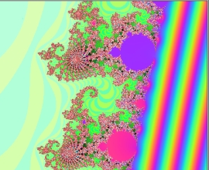




Fractal texture(1)
A fractal texture function is evaluated as an iterative function in the plane
  This is perfect for 2D (u,v) texture coords
A Mandlebrot set X = X² + C where X and C are complex numbers
  X = (Xr + Xi) i=sqrt(-1)
  C = texture coords u+vi,
  X = 0+0i initially
  Complex multiply XY = (Xr Yr - XiYi) r + (Xr Yi + XiYr) i

Slide 10
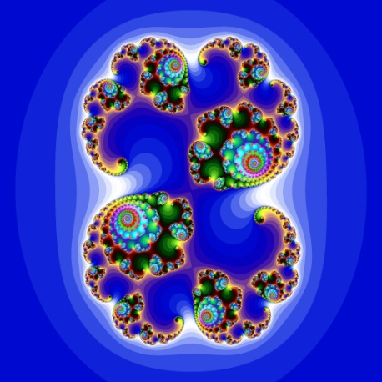
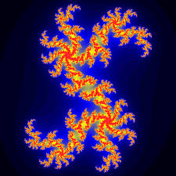
Fractal texture(2)
The Julia set is also X = X² + C
  X = u+vi
  C = constant
    C = (-0.12375+0.56805i) or (-0.012+0.74i) : possible start values
For either function, do N-iterations and evaluate the result X
  N = 100 – 500, for example (higher N produces more visual detail)
  Length (X) = sqrt(Xr² + |Xi²|) measured after iterations
Map a clamped range (e.g., [0,2]) of Length(X) values to pseudo-colors using a color look up table (LUT) and interpolation
  Color LUT maps scalar S : vector C (R,G,B) returned as texture color
Fractal procedural textures require two functions
  F(u,v) -> scalar length (fractal function)
  G(scalar length) -> color (color function)

Slide 11
Color LUT
(Look-Up Table)
Map Scalar to Color (a.k.a. pseudocolor)
  At discrete values of S (S1, …, Sn) define colors (C1, …, Cn) to create LUT
  Given a new S, interpolate (reconstruct) its color value from nearest color values
    C = a C_{i} + b C_{i+1} a, b = [0, 1] fractional distances between LUT entries
    i, i+1 are LUT indices for closest (bracketing) scalar values to S S_{i} ≤ S < S_{i+1}
    a = (S_{i+1} - S) / (S_{i+1} - S_{i}) b = (S - S_{i}) / (S_{i+1} - S_{i})
S = 0.47
b = . 07/.2
a = . 13/.2
C_{i}
C_{i+1}
0 0.2 0.4 0.6 0.8 1.0 1.2 1.4 1.6 1.8 2
11 discrete color values span the range of input [0,2]
Continuous input values (S) result in smoothly interpolated color output

Slide 12
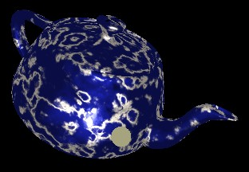
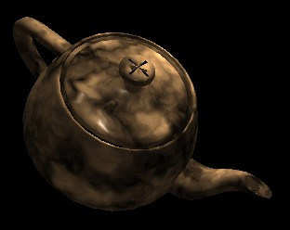

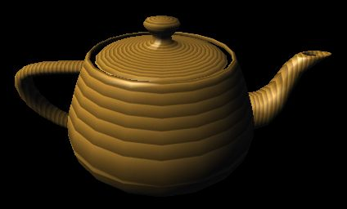
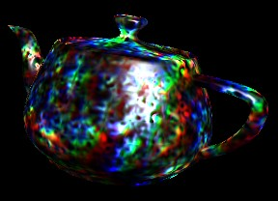
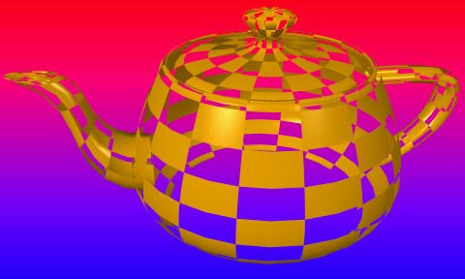
HW5 : Procedural Texture
Extend HW5
As the second part of HW5, you need to write "ptex_fun()" a procedural texture
You're free to implement a simple noise function, or Julia set, or whatever function of u,v you want as long the as a texture pattern is clearly evident.
Use your imagination....

Slide 13
Bump Maps, Noise Textures, and Environment Maps
CS580
(Computer Graphics Rendering)
Ulrich Neumann

Slide 14
Texture ANY Parameters
Textures can be used to modify or set any parameters of the rendering process
  Geometry, surface characteristics, lighting and shading model,
  Displacement, normal perturbation, shadow maps, reflection, etc...
  Find and read a survey of textures
    Heckbert http://www.cs.cmu.edu/~ph/texsurv.pdf (1986 – basics)

Slide 15
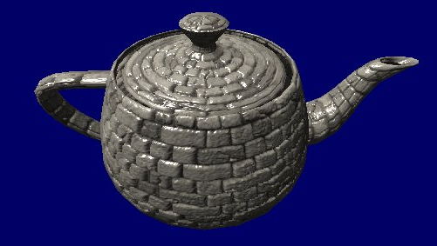
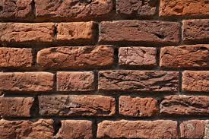
Texture Orientation
Texture parameters are often 2D (u,v) values at vertices
  created during modeling and stored as part of a model
u and v orientations on a model are manually assigned principle directions for orienting a texture map (teapot below)
  smooth and consistent directions over each part of a complex model’s surfaces
Texture maps are often oriented along u and v axes (bricks below) to facilitate alignment on the 3D model
u
v

Slide 16
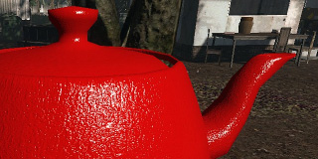
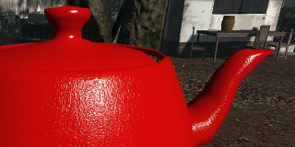
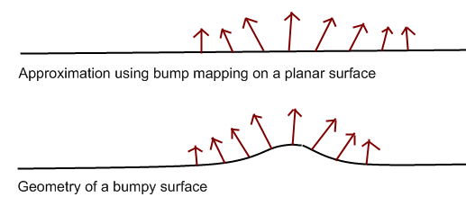
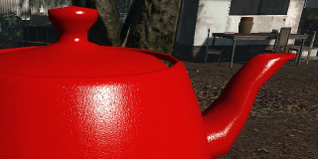

Bump Textures
Bump textures alter normals at each pixel to create bump shading effects – many methods
NOTE:
Bump textures do not alter the actual geometry
They only affect the shading process
… so there may be visual inconsistency at silhouette edges

Slide 17
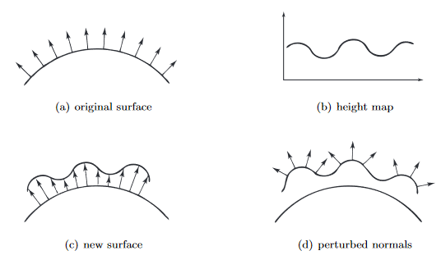
Bump Mapping
Bump Maps use a texture to perturb a model’s normal
  BLINN, NEWELL. Texture and reflection in computer generated images. ACM Communications 19 (1976)
  Blinn. Simulation of wrinkled surfaces. Proceedings of the 5th annual conference on Computer Graphics and Interactive Techniques, pp. 286–292, 1978
Method stores a surface displacement (or height map) texture which is used to
compute a pixel’s
perturbed normal
  - Basic ideas have been
  modified/adapted for
  triangle meshes
From: http://image.diku.dk/projects/media/morten.mikkelsen.08.pdf

Slide 18
Normal Perturbation
Perturbation is a vector (P)
  What direction? What coord system?
  P chould be in same space as N so N+P=N′
  Bump texture of P vectors in model space is impractical since P vectors would have to follow object geometry
    Define P vectors in terms of
    local-surface coords
    or tangent-space
P
N
N′

Slide 19
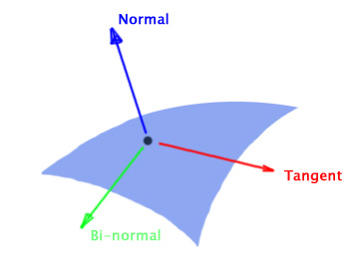
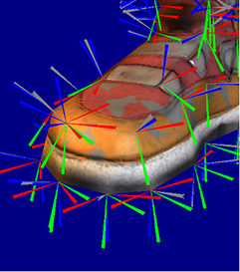
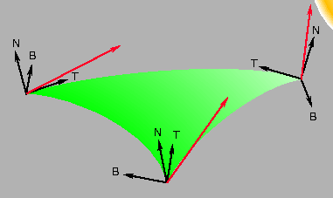
Surface Coordinates
Normal and u,v surface axes define a 3D coord system
  Tangent (t), normal (n), binormal (s) at each vertex
    Interpolated to each pixel
  f(u,v) produces a Normal perturbation as texture output
    f(u,v) = (dn/dt, dn/ds) = P vector in tangent plane of any model triangle
  A 2D parameter (u,v) maps to a tilt-modification of the 3D Normal vector at each pixel => classic bump mapping
Surface orientation over a complex object can be difficult to describe
dn/dt
dn/ds

Slide 20
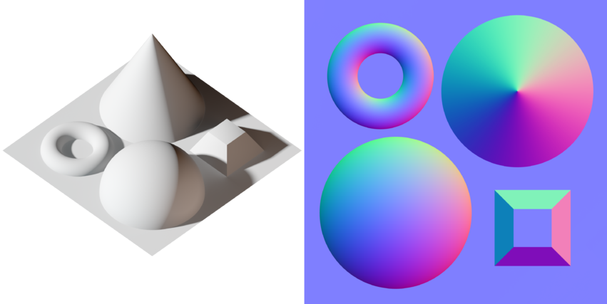
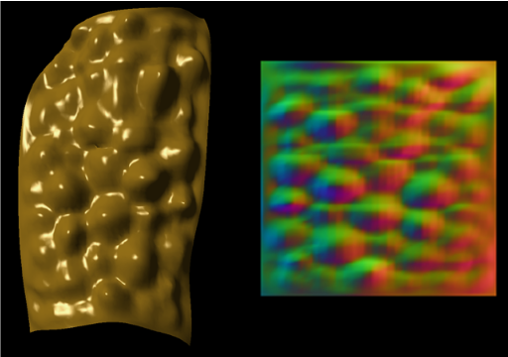
Normal Mapping
Normal mapping encodes the surface normal itself rather than a perturbation
  A. Fournier, “Normal distribution functions and multiple surfaces,” Graphics Interface '92 Workshop on Local Illumination, pp. 45--52, 1992
  J. Cohen, M.Olano, D. Manocha Appearance-Preserving Simplification, SIGGRAPH 1998
Commonly, the texture encodes normal vectors as an RGB image with RGB colors corresponding to the XYZ components of the normal vector
  A limited-precision representation: 8-bits per axis or 24-bits per normal
https://en.wikipedia.org/wiki/Normal_mapping
http://gamma.cs.unc.edu/APS/APS.pdf

Slide 21
Tangent Space
A Normal Map encodes the surface normal in Tangent Space
  The surface normal and two co-tangent vectors form a basis at each vertex (interpolated to pixels) in a triangle with u,v coords
    Z is the surface normal – orthogonal to underlying surface curvature
    X is tangent aligned with the surface texture “u” direction
    Y is tangent aligned with the surface texture “v” direction
u,v lookup -> normal in tangent space
  L and E must be transformed into tangent space
    Approx constant for a triangle with small normal curvature
    Reflection (R) and N•L and R•E for shading Eq can be computed per pixel
For more details:
Lengyel, Eric. “Computing Tangent Space Basis Vectors for an Arbitrary Mesh”.
Terathon Software, 2001. http://terathon.com/code/tangent.html
http://www.opengl-tutorial.org/intermediate-tutorials/tutorial-13-normal-mapping/

Slide 22
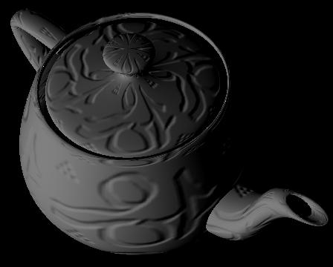
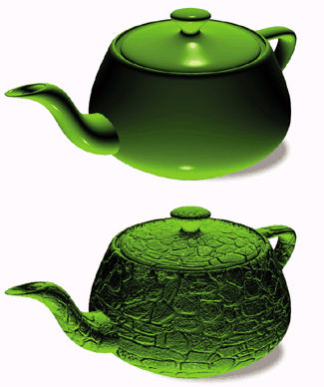
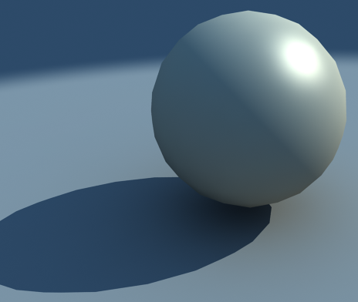
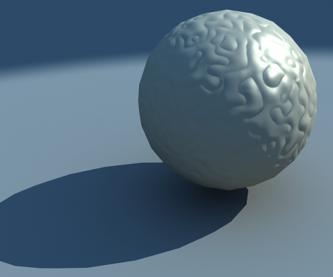

Bump Map Examples
BUMP MAP only affects the shading of a surface
The geometry of this surface has actual bumps

Slide 23
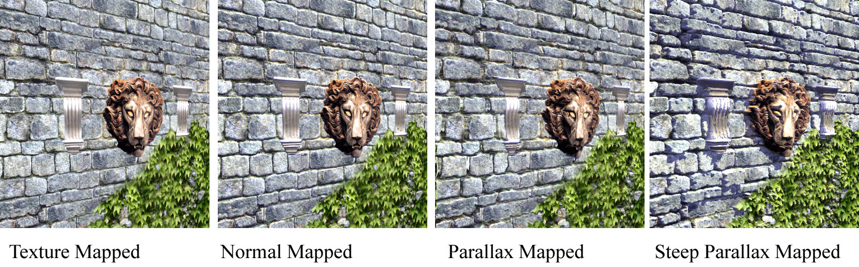
Enhanced 3D Bump Fidelity
Steep Parallax Mapping
  Morgan McGuire and Max McGuire, Steep Parallax Mapping, I3D 2005 Poster
Use a ray tracer on displacement texture for 3D approximations inside a pixel process
  Compute view-dependent occlusion and self-shadowing
    Similar to semi-local methods used for ambient occlusion
  http://graphics.cs.brown.edu/games/SteepParallax/index.html

